Slide 1





CADRE
Lesson 4
First Aid and Basic Life Support
Presented By:- Pavan Dev Gaur,2IC

Slide 2



OBJECTIVES
Define first aid.
List the steps in Initial Assessment.
Demonstrate CPR and BLS in Adults.
Demonstrate Heimlich maneuver in choking victims.
List and Demonstrate steps in controlling bleeding.
1
Upon completing of this lesson, you will be able to :-
2
3
4
5

Slide 3
OBJECTIVES
Demonstrate the application of splints in treating fractures, dislocation, sprains and strains.
Demonstrate a complete Physical Exam as defined in this lesson.
Demonstrate emergency and non-emergency moves.
6
Upon completion of this lesson, you will be able to :-
7
8

Slide 4


First Aid - is the provision of initial care for an ill or injured person and usually performed by a lay person (not limited to) until professional care arrives or definitive medical treatment can be accessed. It is generally consists of a series of simple and in some cases, potentially life-saving techniques that an individual can be trained to perform with minimal equipment.
DEFINITION

Slide 5
Compression - Push hard and fast
Airway – Open Airway and check for any obstructions.
Breathing – give mouth to mouth rescue breath
NEW guidelines suggest

Slide 6
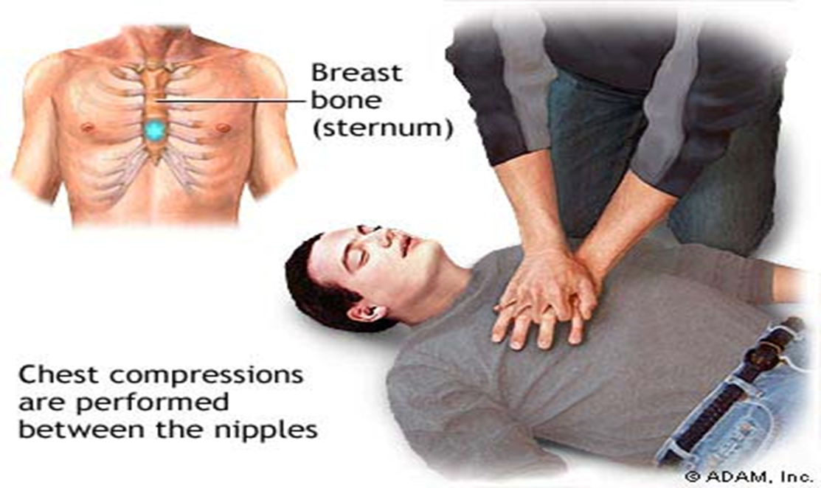
C- A -B

Slide 7


Give 30 compressions and 2 breaths for 5 cycles
Compression depth 1 ½ - 2 inches
100 compression per minute

Slide 8
Give one breath every 5 seconds. 24 cycles is equivalent to 2mins of Rescue Breathing.
Re-assess after 24th cycle.
Note:
This is if you are trained to do so, otherwise deliver Compression only CPR

Slide 9
 | Compression ventilation ratio | Artificial Respiration | Compression rate | Depth of Compression
Infant
Child
Adult
30:2
1 breath every 3 sec. (40 breaths for 2
minutes)
100 compression per minute
½ to 1 inch
30:2
1 breath every 3 sec. (40 breaths for 2 minutes)
100 compression per minute
At least 1 ½ inches
30:2
1 breath every 5 sec. (24 breaths for 2 minutes
80-100 compression per minute
At least 2 inches

Slide 10
SIGNS OF COMPLETE OBSTRUCTION
Pale to Bluish discoloration of the face
Unusual sounds; shrill
Unable to cough
May clutch neck with thumb and finger known as the universal sign of choking.

Slide 11
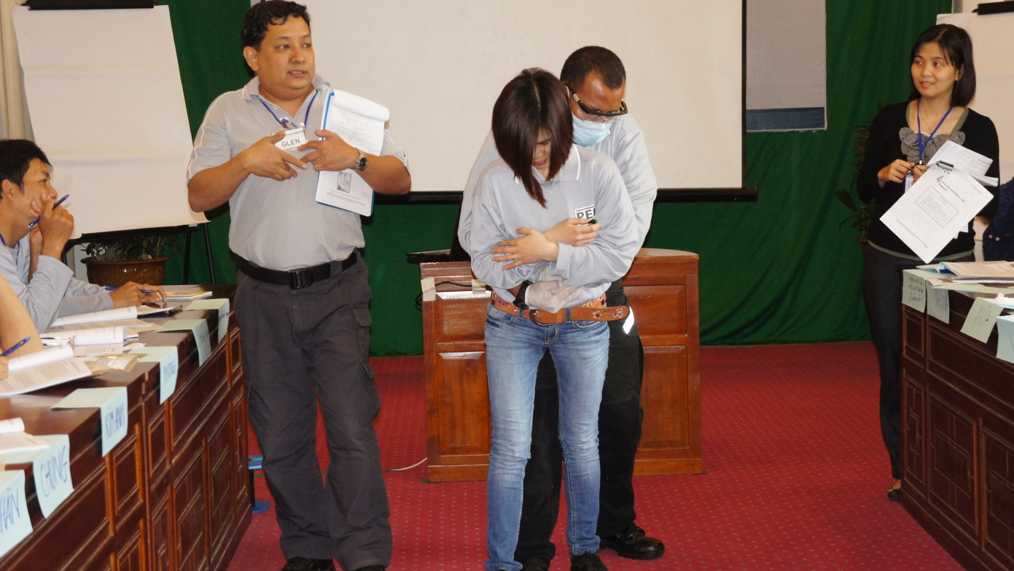
HEMLECHE MANEUVER

Slide 12
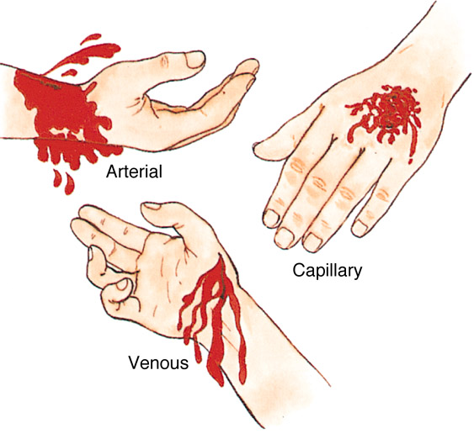

Slide 13
Procedure to Control Bleeding
Direct Pressure
Elévation
Pressure Point.

Slide 14
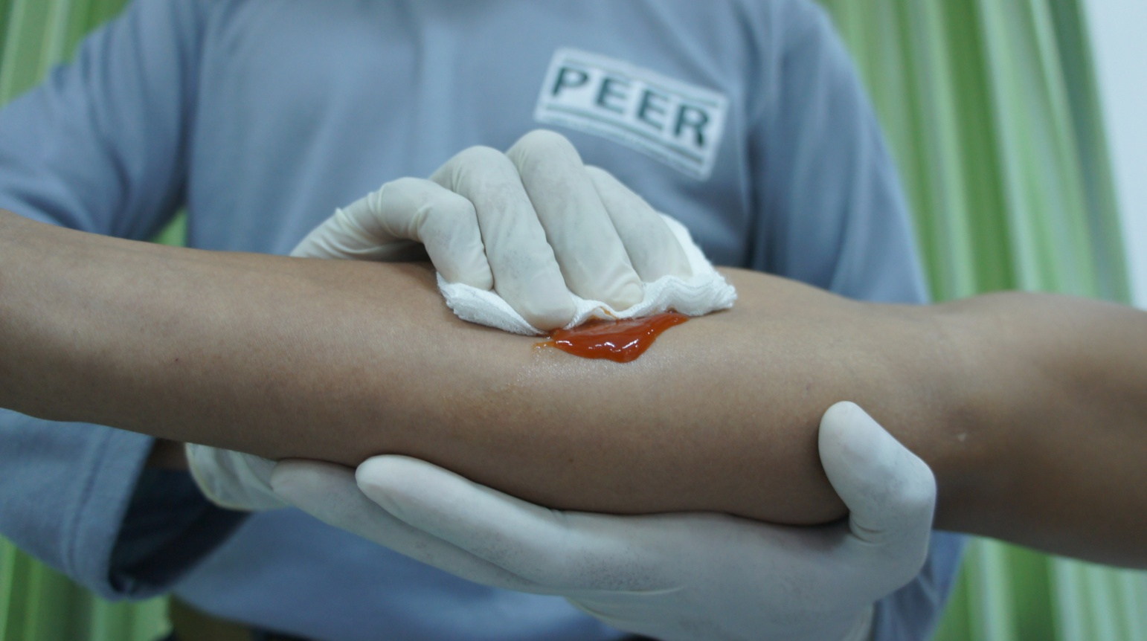
Direct Pressure

Slide 15
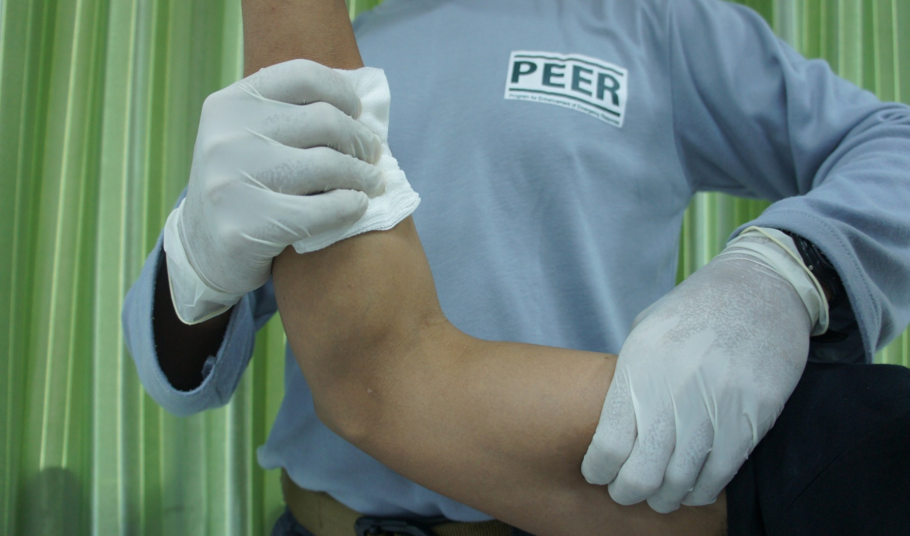
Direct Pressure, Elevation and Pressure Point

Slide 16
Pressure points most often used are:
Brachial point in the arm.
Femoral point in the leg.

Slide 17
Rapid and shallow breathing.
Capillary refill of greater than 2 seconds.
Failure to follow simple commands, such as, “Squeeze my hand.”
Changes in skin color.
Signs of Shock:

Slide 18
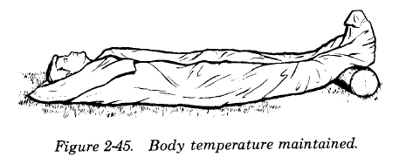
Treatment for Shock

Slide 19
Control bleeding
Prevent secondary infection
Objectives of treatment for wounds is to:

Slide 20
Difference a dressing and a bandage:
A dressing is applied directly to the wound.
A bandage holds the dressing in place.

Slide 21
Treatment for amputation
Control bleeding
Treat shock

Slide 22
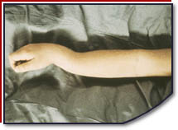
Closed Fractures

Slide 23
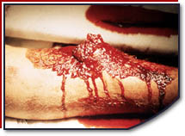
Open Fracture

Slide 24
Tenderness at the site of the injury.
Swelling and/or bruising.
Restricted use, or loss of use.
Sprains and Strains

Slide 25
Soft materials: Towels, blankets, or pillows, tied with bandaging materials of soft cloths.
Rigid materials: a board, metal strip, folded magazine or newspaper, or another rigid item.
Splinting

Slide 26
D – deformity
O – Open Wounds
T – Tenderness; pain upon touching
S – Swelling

Slide 27
Conducted on all victims, even those who seem alright. Everyone gets a tag.
Verbal (if the injured person is able to speak).
Hands-on.
Head to toe assessment should be:

Slide 28
Victims has the right to refuse treatment. Then:
Pay careful attention.
Look, listen, and feel for anything unusual.

Slide 29
Sudden change in consciousness.
Inability to move one or more body parts.
Severe pain or pressure in the head, neck, or back.
Tingling or numbness in extremities.
Difficulty breathing or seeing.
Signs of a spinal injury

Slide 30
Looking for materials that can be used as a backboard – a door, iron board, building materials – anything that might be available.

Slide 31
REVIEW
Define first aid.
List the steps in Initial Assessment.
Demonstrate CPR and BLS in Adults.
Demonstrate Heimlich maneuver in choking victims.
List and Demonstrate steps in controlling bleeding.
1
Now you will be able to :-
2
3
4
5

Slide 32
REVIEW
Demonstrate the application of splints in treating fractures, dislocation, sprains and strains.
Demonstrate a complete Physical Exam as defined in this lesson.
Demonstrate emergency and non-emergency moves.
6
Now you will be able to :-
7
8

Slide 33



THANK YOU

