Slide 1




MEDICAL FIRST RESPONDER
LESSON 4
The Incident
CAPF | MFR | INDIA
-

Slide 2
OBJECTIVES
Upon completion of this lesson, you will be able to:
1
  List the five items of information to obtain when receiving a call for assistance.
  List five factors to consider when responding to a call.
  List the three steps for scene size-up,
  in proper order.
2
3

Slide 3
OBJECTIVES
Upon completion of this lesson, you will be able to:
4
  List the six items of information that should be included in the initial report when arriving at the scene.
  List three priorities when securing the scene.
5

Slide 4
OBJECTIVES
Upon completion of this lesson, you will be able to:
6
  List five basic tools used to gain access to a patient trapped in a vehicle.
  List two ways to gain access to a patient trapped in a vehicle.
7

Slide 5
Incident
An event caused by a natural phenomenon or human activity that requires the intervention of emergency service personnel to prevent or mitigate loss of life and damage to property and the environment.

Slide 6
Steps to Assess
the Scene
What is the current situation ?
Where is it going ?
How do I control it ?
(operations and resources needed)
PPT 4 -

Slide 7
The following are the information to be obtain while receiving a call-
Location/address of the incident
Identify the origin of the call
Incident type(what is happening)
Victims(number and condition)
Actions taken
INFORMATION TO OBTAIN

Slide 8

When responding to a call, you should consider, among others, the following factors:
• Day of the week (traffic etc.)
• Time of day (school, business hours, people at home etc)
• Weather (rain, wind, storms etc.)
RESPONSE

Slide 9
Social disturbances, riots etc
• Topography (winding roads etc.)
• Hazardous materials (fuel leaks, radiation etc.)
• Access routes (freeways, crossings, bridges, height, width, road maintenance, land mines etc.)
• Power lines
• Proper vehicle placement
RESPONSE

Slide 10

Address/location
Incident type
Environmental condition
Current situation
Number of victims
Resources needed
REPORTING
(initial)

Slide 11
SCENE SIZE-UP
The evaluation of factors that are used in the decision-making process to establish the strategy and tactics to be used in a particular incident.
Ongoing evaluation of the incident begins when the call is received and continues until the incident is successfully mitigated.

Slide 12
Securing
the Scene
Place vehicle properly
Isolate and mark the scene
Mitigate risks
PPT 4 -

Slide 13
GAINING ACCESS
The MFR should always analyze the need for personal protection such as helmet, eye protection, mask, self-contained breathing apparatus, gloves, etc. before attempting to gain access to a patient.
In case the incident occurs in water, cliffs, etc., the MFR should request assistance from specially trained personnel.

Slide 14
GAINING ACCESS TO BUILDINGS
Always look for alternate means of entry. Consider the easiest route for entry and exit based on the situation and the patient’s needs.

Slide 15
DOORS
With padlock: Insert the tip of the Kelly tool in the eye of the padlock bolt and use it as a lever to open the padlock.
• Solid door: Before using force, notice whether the door opens in or out. If it opens out, it may be possible to remove the hinges.

Slide 16
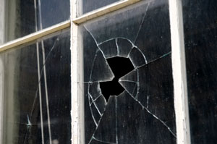
WINDOWS
A glass window should only be forced as a last resort.
• If you need to break a window, protect yourself properly and use a pointed tool.

Slide 17
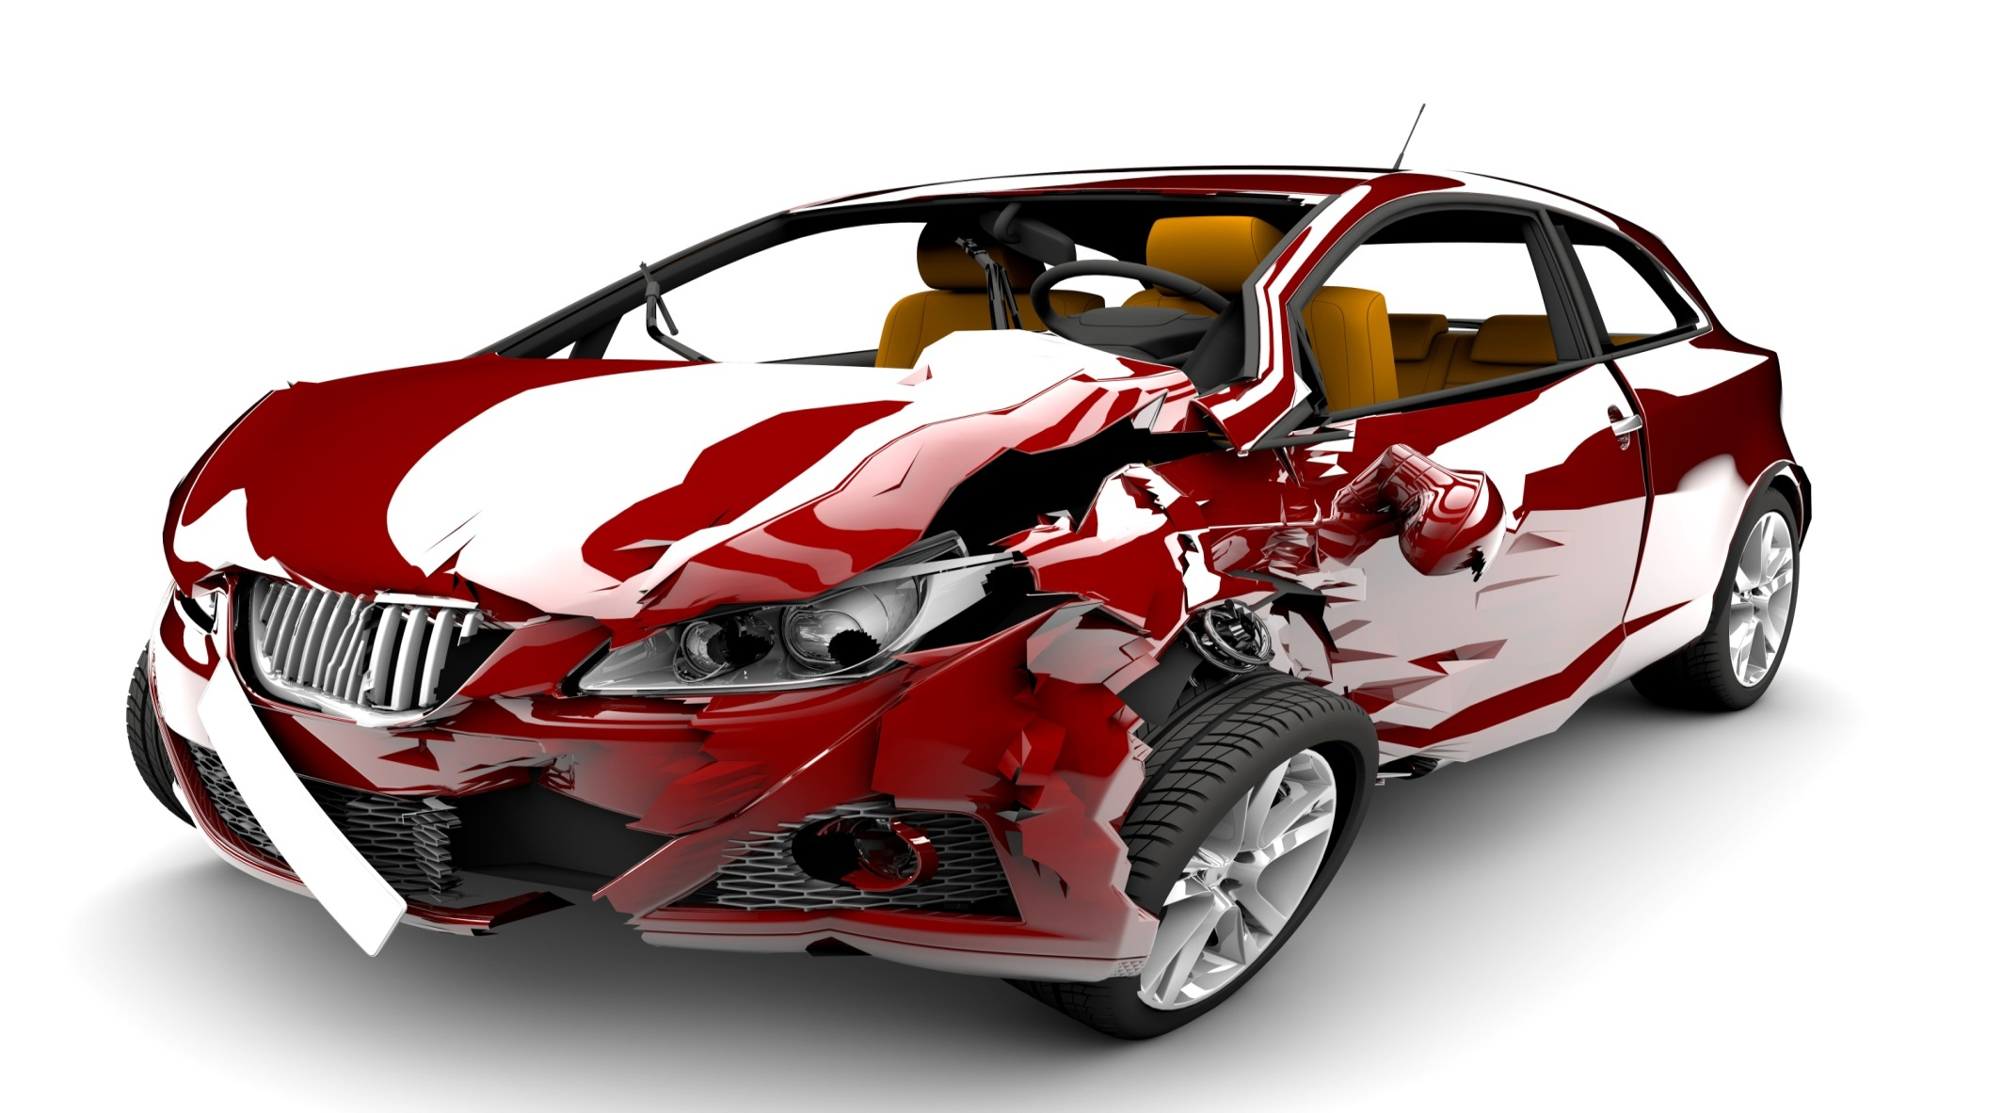

GAINING ACCESS TO VEHICLE USING BASIC TOOLS

Slide 18
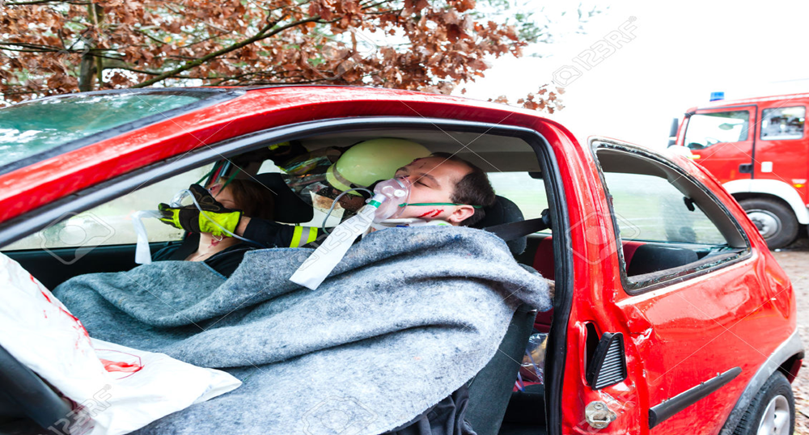
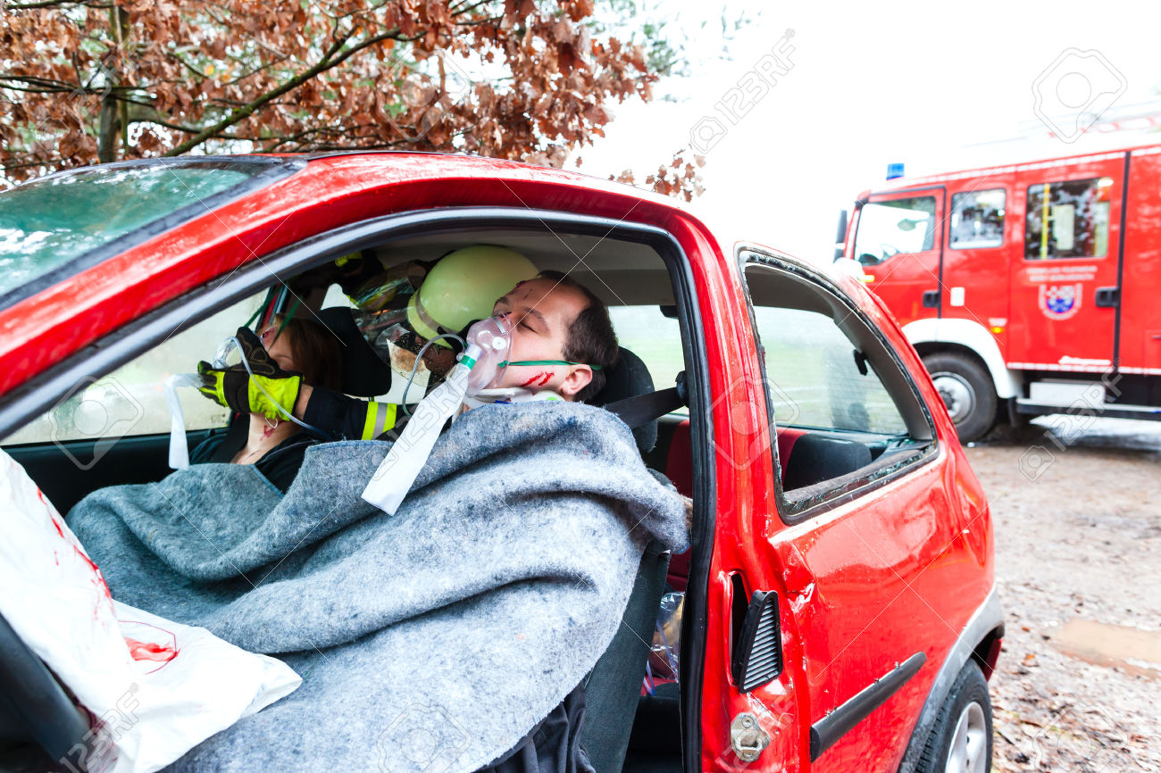
Generally , if possible medical treatment should be given to the patient before extricating. Patient should be remove in such a way as to minimize further injury.

Slide 19
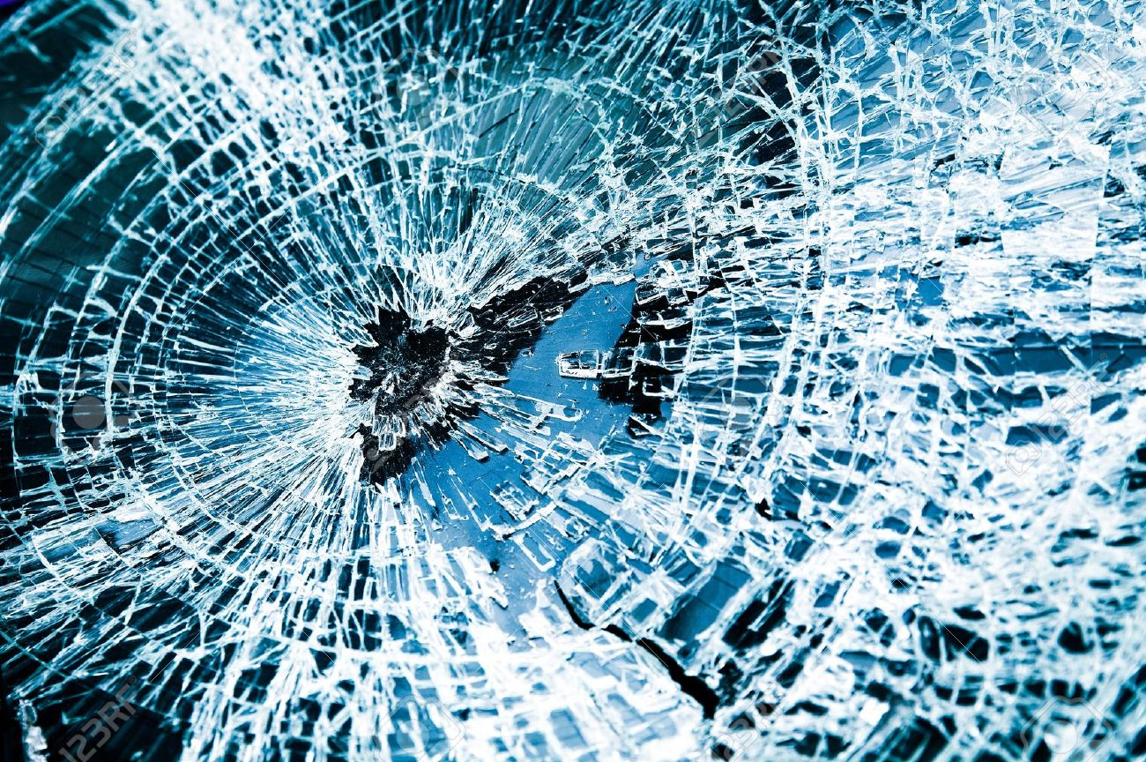
WINDOWS
Make sure patients is protected from glass particles.

Slide 20
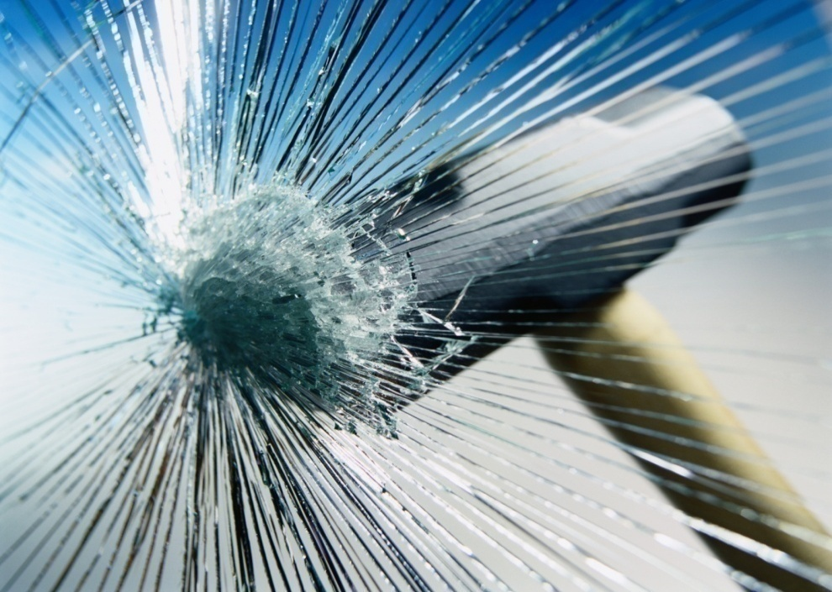
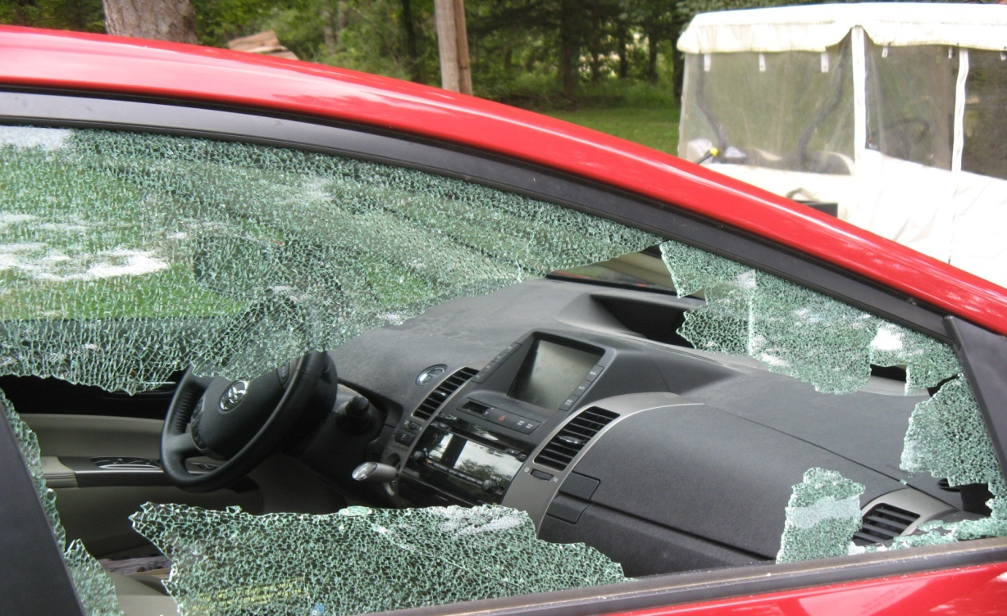
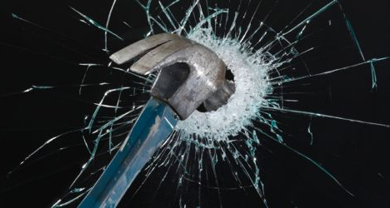
Use a screw driver or other pointed tools.
Strike tool against lower corner of the window and continues to strike in the same spot until the window shatters.

Slide 21
Basic Tools
Pliers
Screwdriver
Tin snips
Hammer
Knife
Rope
Kelly tool
Padlock remover
Pry bar
Vise grip
Axe
Hacksaw
Rubber mallet
Automatic center punch
Personal protective equipment

Slide 22
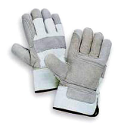

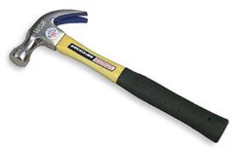
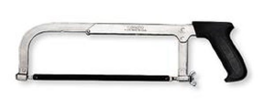

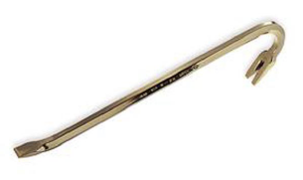
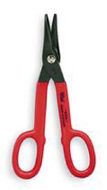
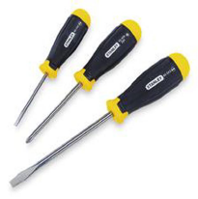
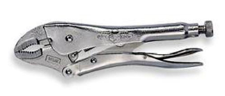

Slide 23

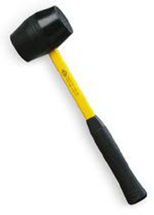

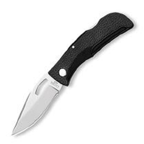
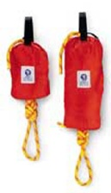
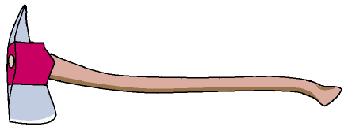

Slide 24
REVIEW
Now you are able to:
1
  List the five items of information to obtain when receiving a call for assistance.
  List five factors to consider when responding to a call.
  List the three steps for scene size-up,
  in proper order.
2
3

Slide 25
REVIEW
Now you are able to:
4
  List the six items of information that should be included in the initial report when arriving at the scene.
  List three priorities when securing the scene.
5

Slide 26
REVIEW
Now you are able to:
6
  List five basic tools used to gain access to a patient trapped in a vehicle.
  List two ways to gain access to a patient trapped in a vehicle.
7

Slide 27


THANK YOU

