Slide 1


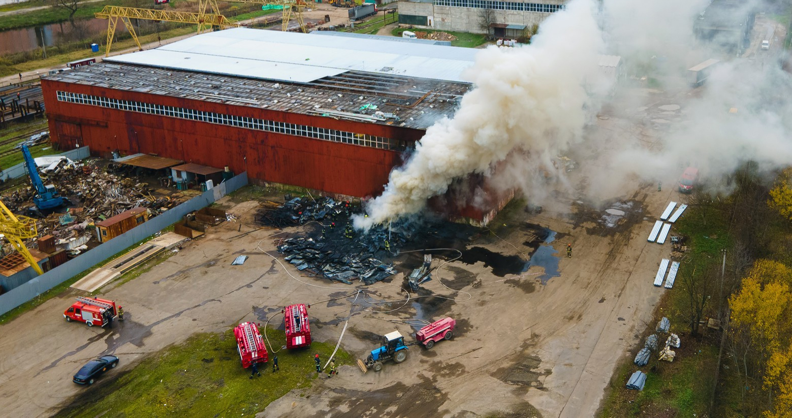


COLLAPSED STRUCTURE SEARCH AND RESCUE
LESSON 1
COURSE INTRODUCTION
LESSON 3
Construction Materials,
Structures and
Damage Types
LESSON 3
Construction Materials,
Structures and
Damage Types
Presented By:- Kamlesh Dhoundiyal,2IC
NDRF | CSSR | INDIA
PPT 3-1

Slide 2
1
Define construction materials and classify them by their composition types and uses.
List and describe three forces that can affect construction materials.
List three properties of each material: concrete, steel and wood.
Describe two methods of construction.
OBJECTIVES
Upon completing this lesson, you will be able to:
2
3
4
NDRF | CSSR | INDIA
PPT 3 -

Slide 3
OBJECTIVES
5
List four types of structures.
List at least three characteristics of
a building in each of the following
four categories:
general
architecture
structural elements
non-structural elements
Upon completing this lesson, you will be able to:
6
NDRF | CSSR | INDIA
PPT 3 -

Slide 4
OBJECTIVES
7
List and describe two types of damage in a structure and their potential resulting failures.
Name and describe the four basic collapse patterns.
Upon completing this lesson, you will be able to:
8
NDRF | CSSR | INDIA
PPT 3 -

Slide 5
Construction
Materials
Classified by composition
Organic materials
Stone
Metal
Conglomerates
Ceramics
Glass
Plastics
NDRF | CSSR | INDIA
PPT 3 -

Slide 6
Construction
Materials
Classified by Use
Structural/load-bearing elements
Decorative elements
Non-structural walls and partitions
Covering elements (roofing)
NDRF | CSSR | INDIA
PPT 3 -

Slide 7
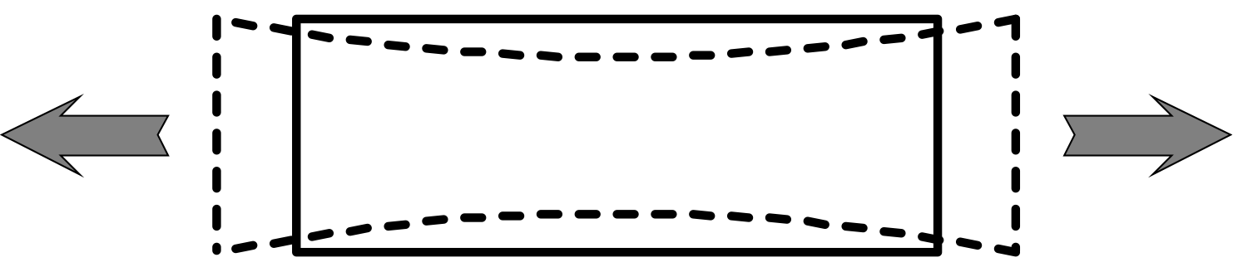
Tension
NDRF | CSSR | INDIA
PPT 3 -

Slide 8
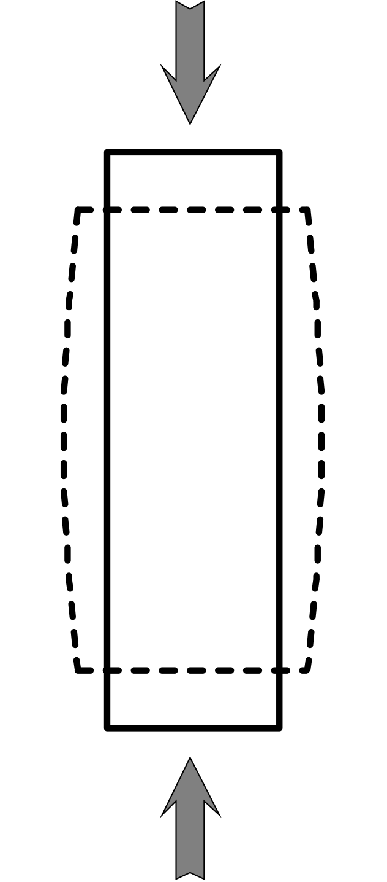
Compression
NDRF | CSSR | INDIA
PPT 3 -

Slide 9
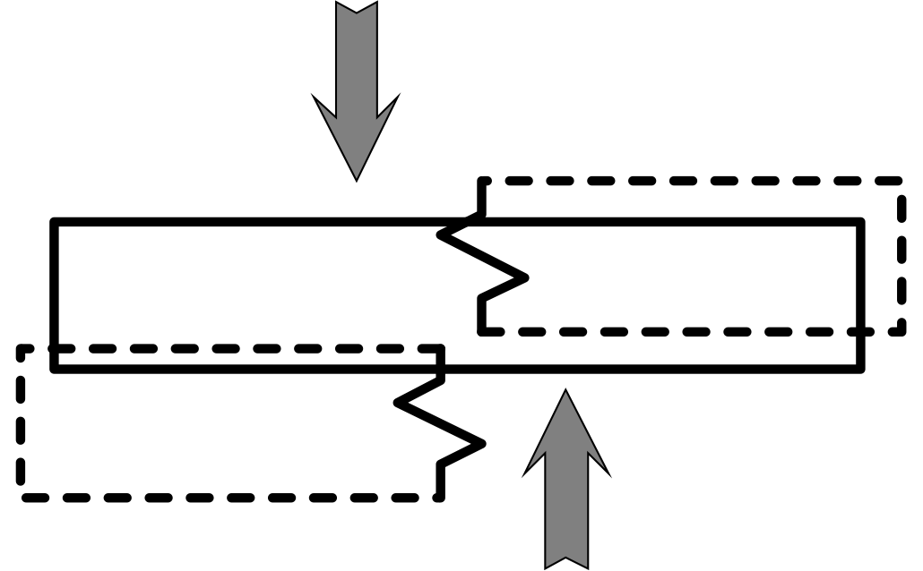
Shear
NDRF | CSSR | INDIA
PPT 3 -

Slide 10
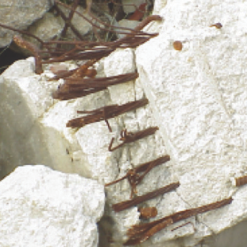
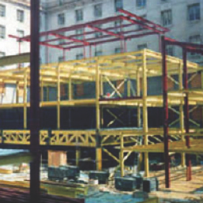
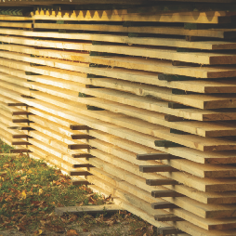
Properties of Construction Materials
Concrete
Steel
Wood
NDRF | CSSR | INDIA
PPT 3 -

Slide 11
Methods of Construction
UNFRAMED STRUCTURES: those in which the weight of the floors and roof are supported by the bearing walls.
NDRF | CSSR | INDIA
PPT 3 -

Slide 12
Methods of Construction
FRAMED STRUCTURES: consist of a structural steel or reinforced concrete skeleton made of horizontal beams and vertical columns.
NDRF | CSSR | INDIA
PPT 3 -

Slide 13
Structural Types
Light frame
Heavy wall
Heavy floor
Pre-cast concrete
NDRF | CSSR | INDIA
PPT 3 -

Slide 14
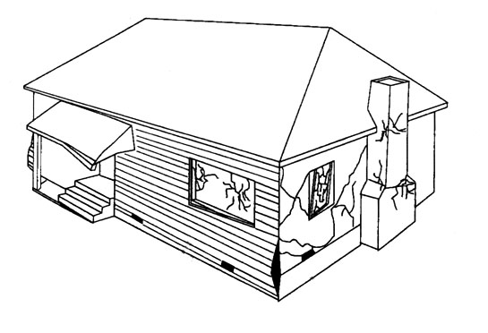
Light Frame Structure
NDRF | CSSR | INDIA
PPT 3 -

Slide 15
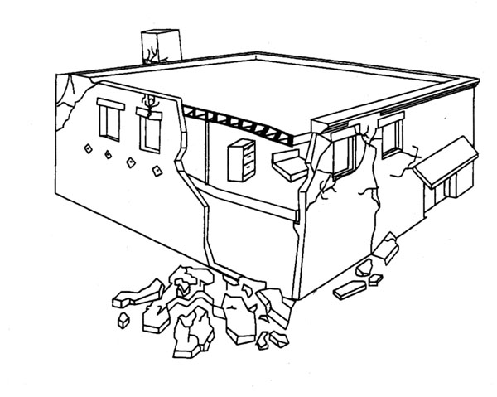
Heavy Wall Structure
NDRF | CSSR | INDIA
PPT 3 -

Slide 16
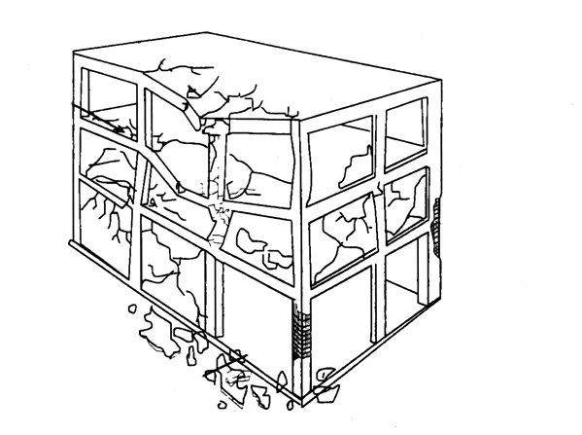
Heavy Floor Structure
NDRF | CSSR | INDIA
PPT 3 -

Slide 17
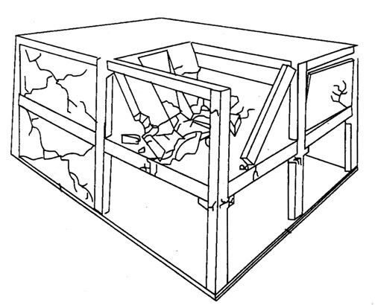
Pre-Cast Concrete Structure
NDRF | CSSR | INDIA
PPT 3 -

Slide 18
Characteristics of a Structure
General
Architecture
Structural elements
Non-structural elements
NDRF | CSSR | INDIA
PPT 3 -

Slide 19
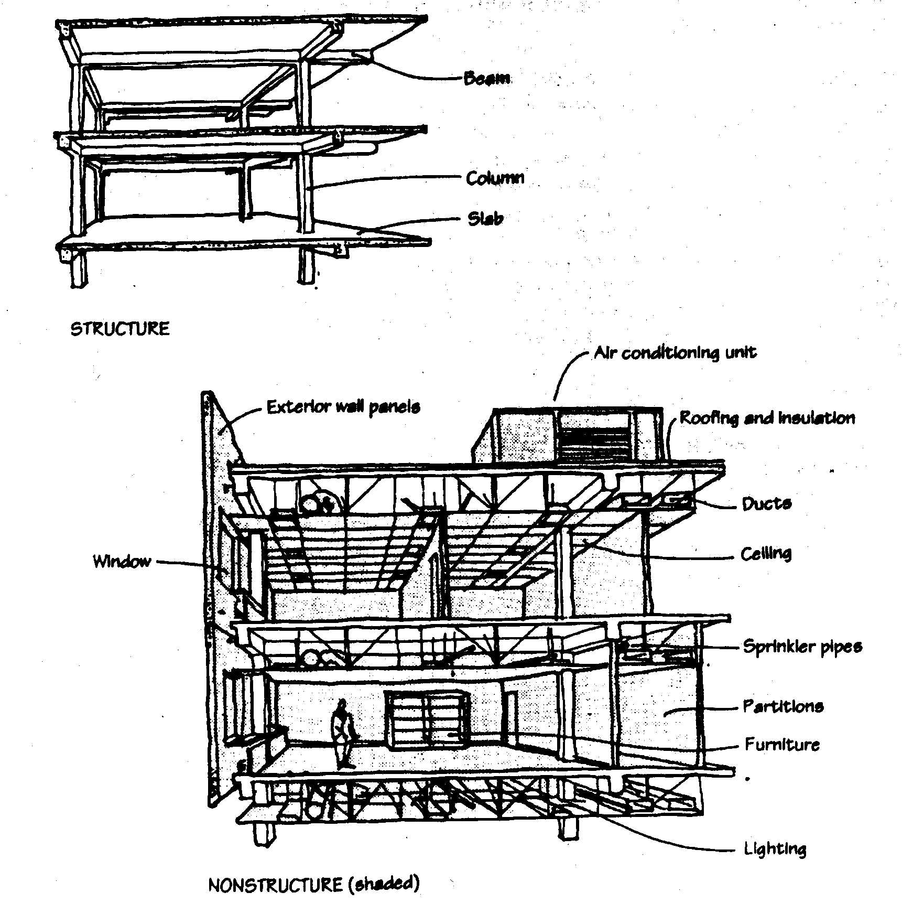
Structural Elements
Beam
Cantilever
Foundation
NDRF | CSSR | INDIA
PPT 3 -

Slide 20
Non-Structural Elements
NDRF | CSSR | INDIA
PPT 3 -

Slide 21
Damage Types
Damage to a building can be classified as two types:
STRUCTURAL: affecting structural (load-bearing) elements
NON-STRUCTURAL: affecting
non-structural and decorative elements
NDRF | CSSR | INDIA
PPT 3 -

Slide 22
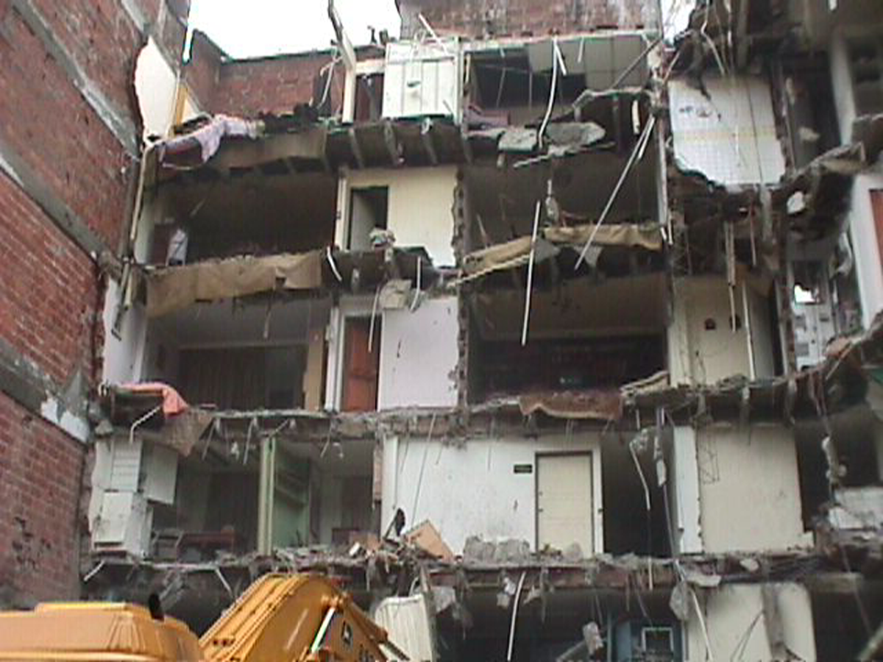
Bhuj (Gujarat) earthquake:
structural and non-structural damage
NDRF | CSSR | INDIA
PPT 3 -

Slide 23
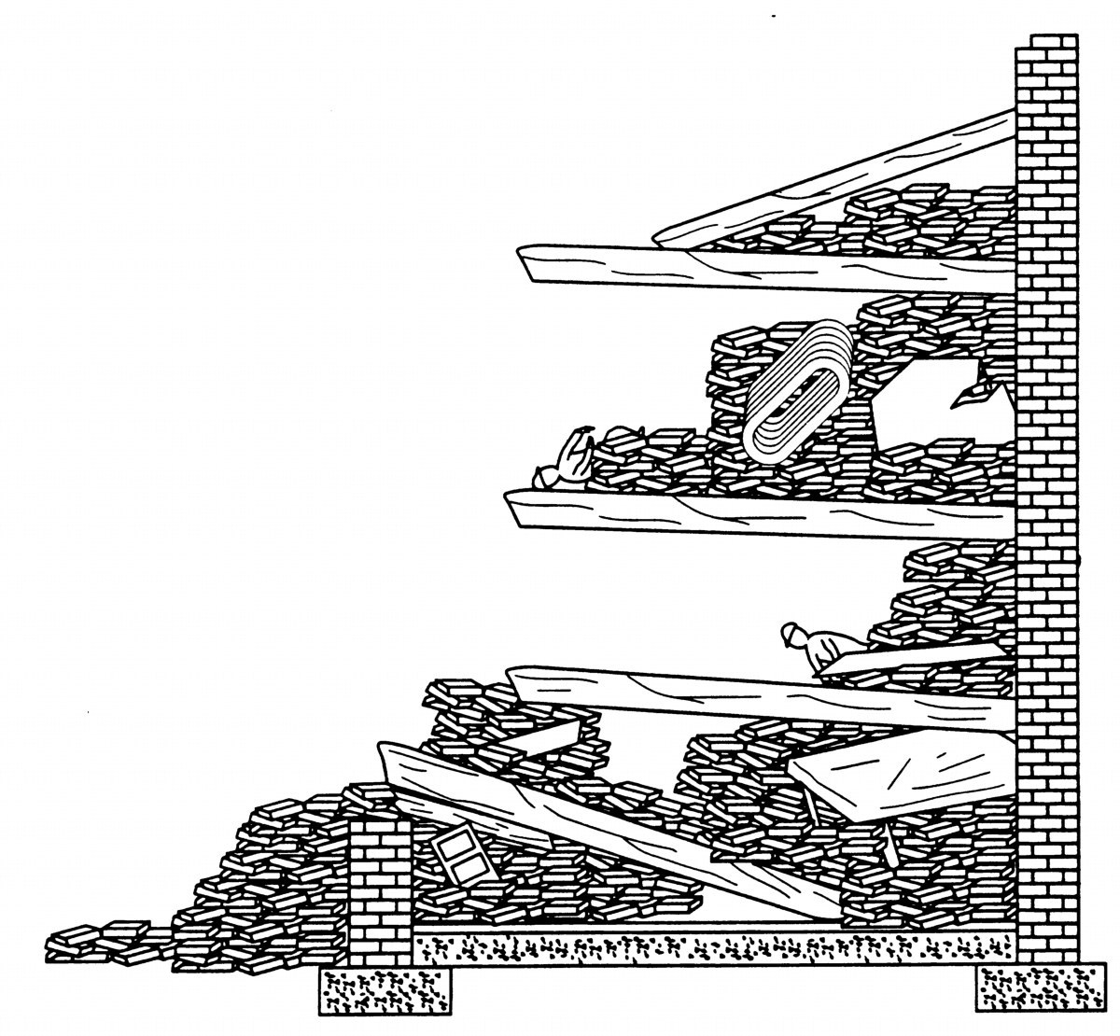
Basic Collapse Patterns
Cantilever
NDRF | CSSR | INDIA
PPT 3 -

Slide 24
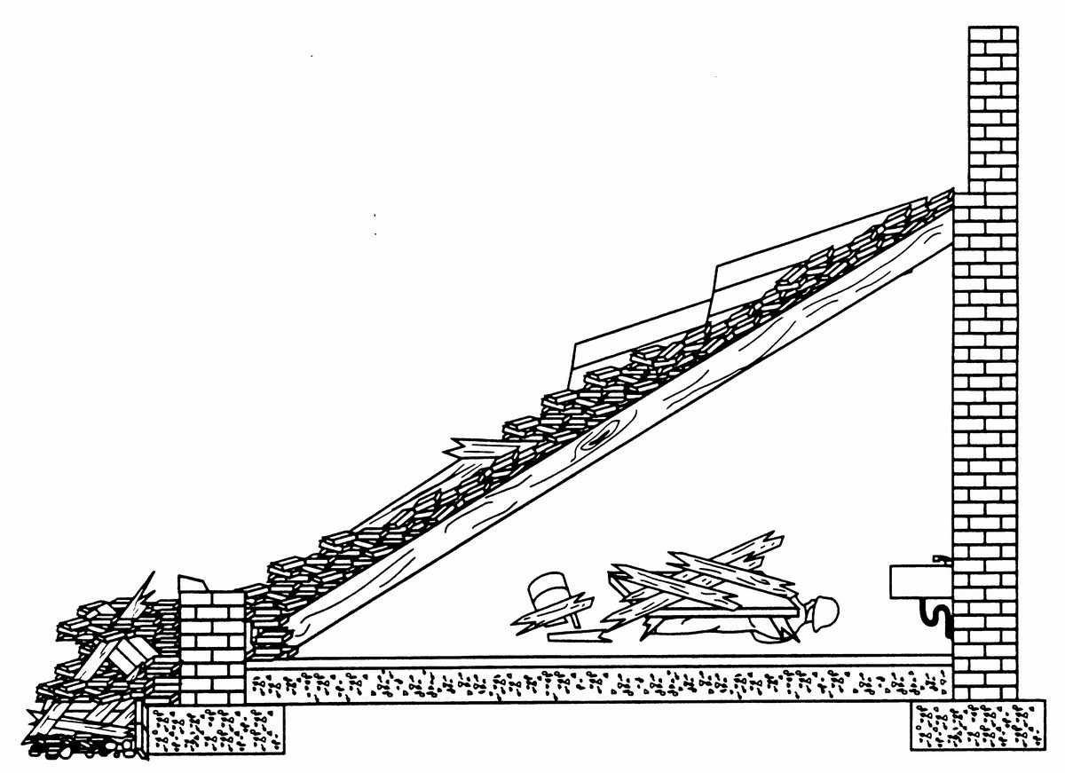
Basic Collapse Patterns
Lean-to
NDRF | CSSR | INDIA
PPT 3 -

Slide 25
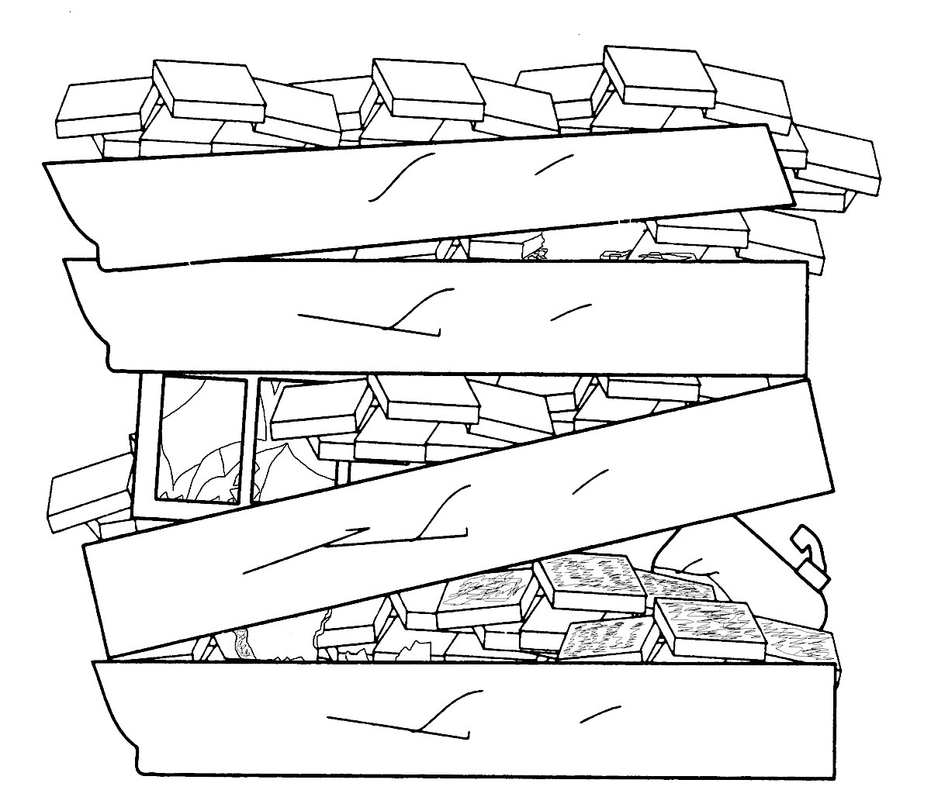
Basic Collapse Patterns
Pancake
NDRF | CSSR | INDIA
PPT 3 -

Slide 26
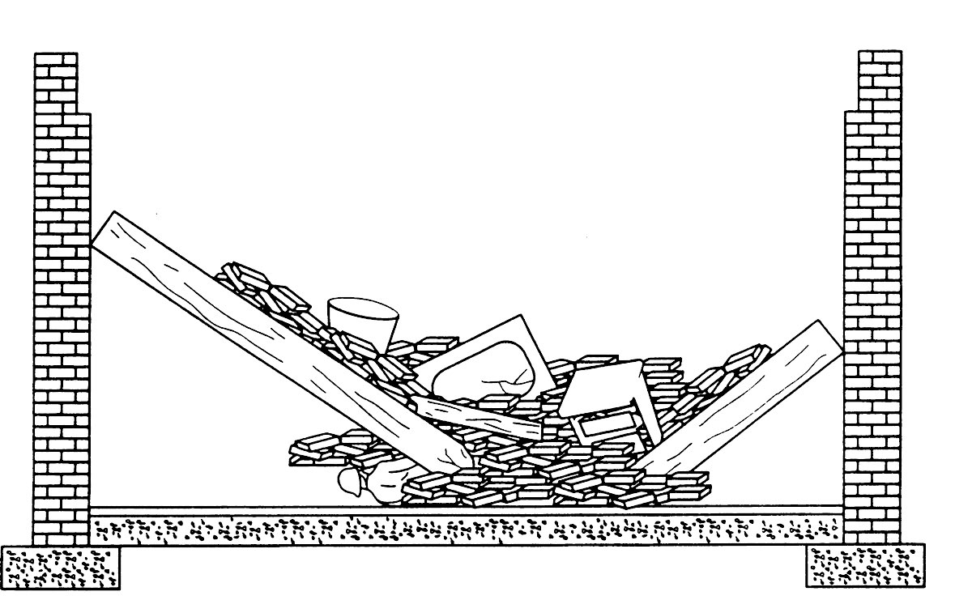
Basic Collapse Patterns
V-Shape
NDRF | CSSR | INDIA
PPT 3 -

Slide 27
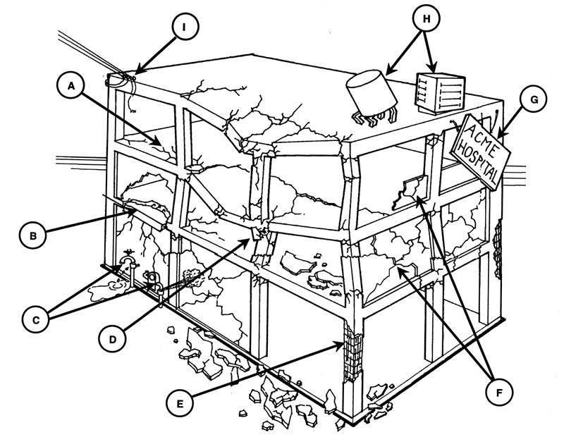
Identify Structural Damage
NDRF | CSSR | INDIA
PPT 3 -

Slide 28



THANK YOU

