Slide 1





CADRE
Lesson 3
Securing Family and Preparing for Response
Presented By:- Pavan Dev Gaur,2IC

Slide 2



OBJECTIVES
Describe the importance of Family Preparedness.
List the steps in creating a Family Disaster Plan.
List the important items in assembling and storing a disaster kit.
Identify the Phases of Operation.
List the steps to follow in Operation Phase.
1
Upon completion of this lesson, you will be able to :-
2
3
4
5

Slide 3


Talk and discuss strategies to your family.
First things first
Talk and discuss strategies to your family.
Plan how your family will stay in contact if separated by disaster.
Post emergency telephone numbers by phone.
Important steps in creating a family disaster plan

Slide 4
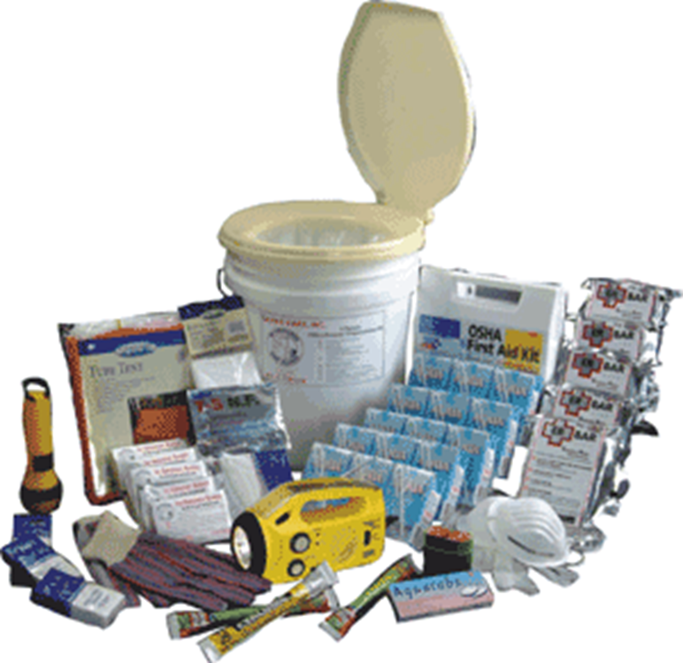
Talk and discuss strategies to your family.
The important items in assembling and storing a disaster kit

Slide 5
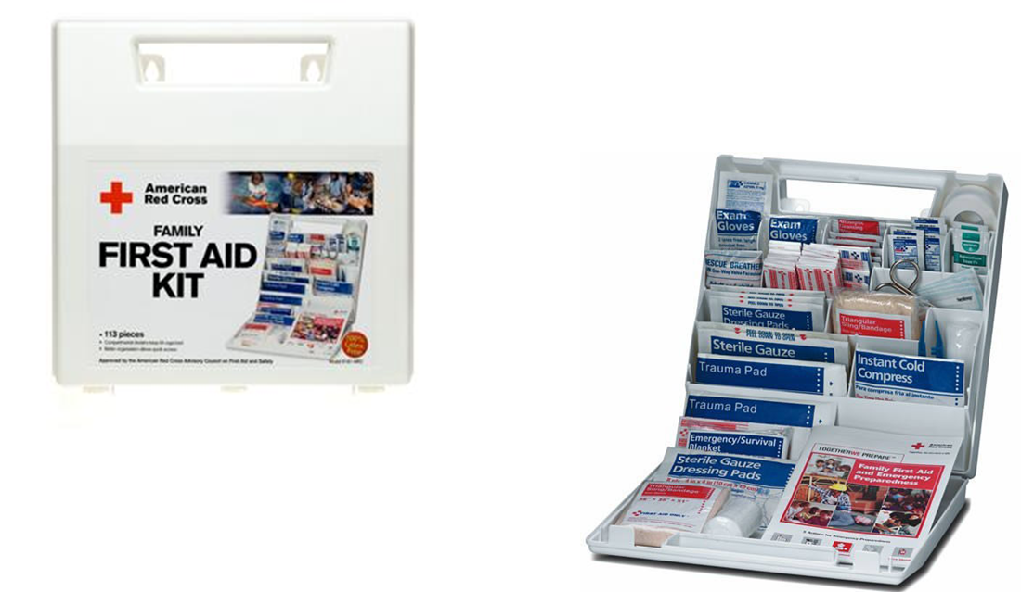
Talk and discuss strategies to your family.
The important items in assembling and storing a disaster kit

Slide 6
Talk and discuss strategies to your family.
Preparation Phase :
Training
Selection of Team members and Squad Leaders.
PPE.
Knowledge of Community Disaster Plan.
Transportation arrangements.
PHASES OF OPERATION

Slide 7
Talk and discuss strategies to your family.
2. Activation and Mobilization Phase :
Request for transportation if necessary.
Notify team members.
Load team jump kits.
Obtain information of disaster or emergency
Brief team members
PHASES OF OPERATION

Slide 8
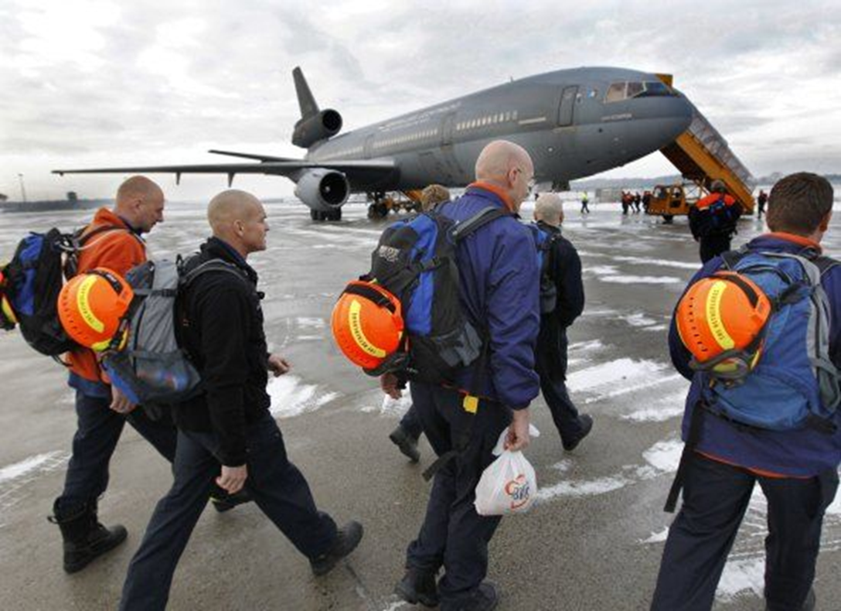
Talk and discuss strategies to your family.
Activation and Mobilization Phase

Slide 9
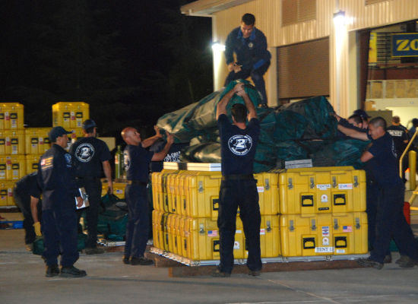
Talk and discuss strategies to your family.
Activation and Mobilization Phase

Slide 10
Talk and discuss strategies to your family.
3. Operation Phase :
Secure the scene
Initial assessment.
Conduct search.
Gain access to victims.
Stabilize the victim.
Extricate and transfer to treatment area.
PHASES OF OPERATION

Slide 11
Talk and discuss strategies to your family.
4. Deactivation and Demobilization Phase :
Confirm no operation is further needed.
Account for personnel and basic tools.
Arrange transportation if necessary.
PHASES OF OPERATION

Slide 12
Talk and discuss strategies to your family.
5. Post Operation Phase :
Keep all logs and records.
Team de-briefing.
PHASES OF OPERATION

Slide 13
REVIEW
Describe the importance of Family Preparedness.
List the steps in creating a Family Disaster Plan.
List the important items in assembling and storing a disaster kit.
Identify the Phases of Operation.
List the steps to follow in Operation Phase.
1
Upon completion of this lesson, now you are able to :-
2
3
4
5

Slide 14

THANK YOU

