Slide 1



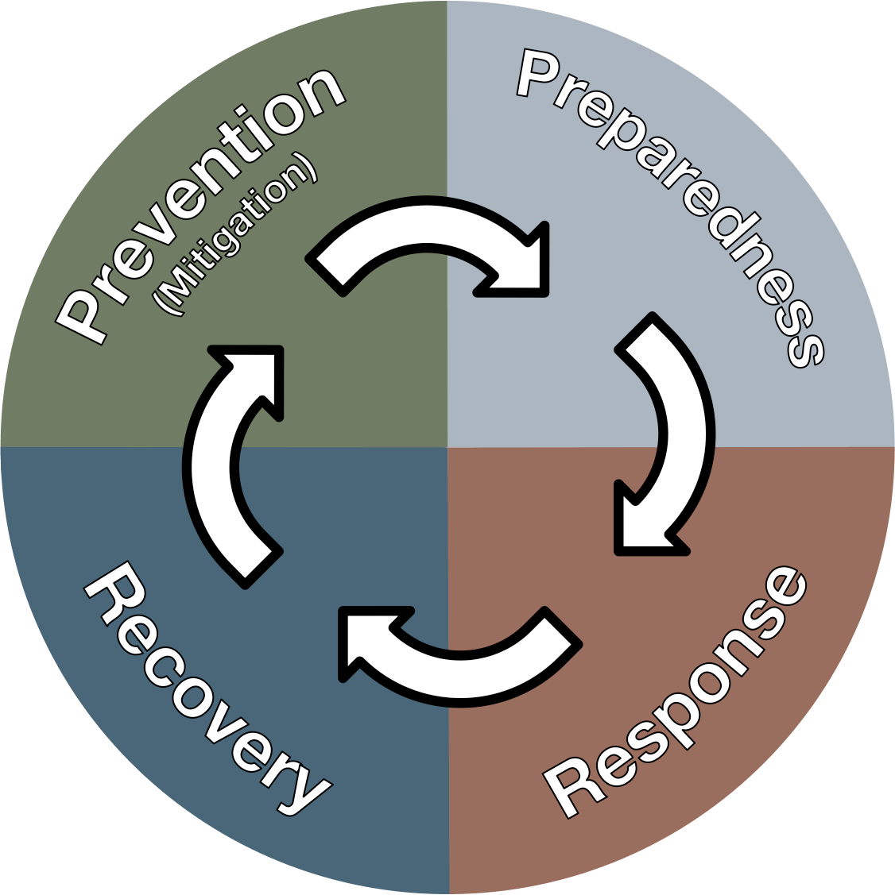
DISASTER MANAGEMENT ORIENTATION
Psycho-Social Issues Related to Disaster
Presented by:- Pavan Dev Gaur, 2IC
NDRF | DMO | INDIA
PPT 8- 1

Slide 2
OBJECTIVES
Upon completing this lesson, you will be able to:
1
  Understand Psycho-social care requirement during disaster response
  Identify 02 types of psychological reaction of victims including Medium & Long-Term Psychosocial Issues
  Understand psychological requirement of various types of victims
2
3

Slide 3
OBJECTIVES
Upon completing this lesson, you will be able to:
4
  Aquent with mental health and psychosocial support (MHPSS) framework
  Provide psychological first aid at field
  Prepare Operational Checklist for NDRF Rescuers to address psychosocial issues
5
6

Slide 4
Why Psychosocial Care Matters during Disaster Response?
To address traumatic reaction of victims
To Promote Community Resilience
To Supports Emotional and Mental Health
To Fosters a Holistic Recovery
To Minimize negative consequences of Disaster
To realize specific needs of vulnerable groups
PPT 8 -

Slide 5
Indian Context: Hazards & Mental Health
Multi-hazard setting: floods, cyclones, earthquakes, landslides, industrial, biological
Disasters amplify pre-existing vulnerabilities and service gaps
High population density → crowded shelters; language and cultural diversity

Slide 6
Reactions: Normal vs Concerning
Normal: Fear, Sadness, Anger, Numbness, Sleep Disturbance
Concerning: Persistent Disorientation, Panic Attacks, Dissociation, Suicidal Talk

Slide 7
Medium & Long-Term Psychosocial Issues
Depression, anxiety, PTSD, complicated grief
Substance misuse; domestic violence; livelihood stress
School dropouts; family separation; social conflict

Slide 8
Children & Adolescents: Psychological requirements
Safe spaces, routine, play/learning activities reduce distress
Screen for unaccompanied/separated children; rapid family tracing
Avoid graphic details in front of children; prepare caregivers for common reactions

Slide 9
Women, Pregnant & Lactating Persons: Psychological requirements
Privacy, lighting, and safe WASH reduce anxiety
Link to MISP services: obstetric emergencies, clinical management of rape
Watch for intimate partner violence; provide discreet reporting pathways

Slide 10
Elderly & Persons with Disabilities: Psychological requirements
Accessibility: seating, ramps, proximity to WASH and medical desk
Buddy system; medication continuity and assistive devices
Watch for confusion, delirium, neglect

Slide 11
First Responders: Stress & Burnout
Operational stress, moral injury, sleep deprivation
Peer support, rest cycles, nutrition/hydration plans
Post-mission defusing/debrief; referral pathways for responders
PPT 8 -

Slide 12
Culture, Stigma & Communication
Respect rituals and mourning practices
Use clear, compassionate, non-judgmental language
Counter rumours; avoid sensationalism or blame
PPT 8 -

Slide 13
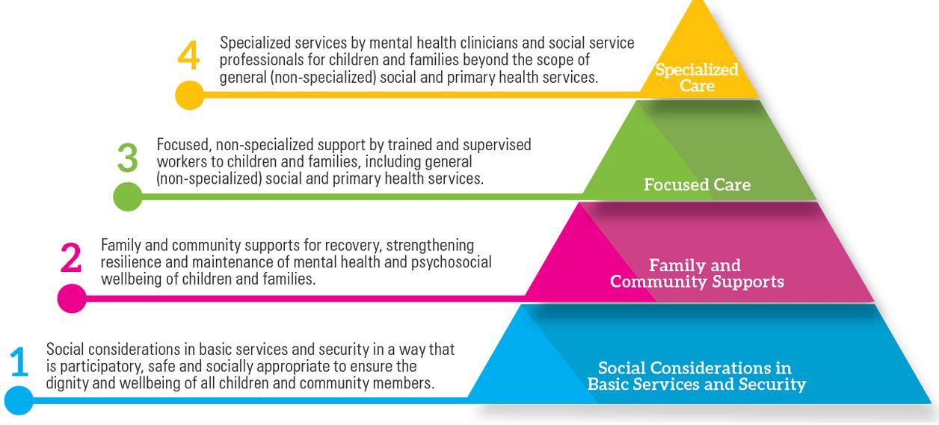
MHPSS Framework

Slide 14
NDMA MHPSS Guidelines (2023)
Integrate MHPSS across preparedness, response, recovery
Train responders in PFA and referral pathways
Set up safe spaces; ensure confidentiality and data protection
Coordinate with DMHP, NIMHANS, NGOs; collect SADD where appropriate
PPT 8 -

Slide 15
Psychological First Aid (PFA)
LOOK: assess safety, basic needs, urgent risks
LISTEN: attend, accept, and comfort; no forced debriefing
LINK: to information, services, social supports

Slide 16
Psychological Triage & Referral
Green: mild distress → basic/communal support
Yellow: significant impairment → focused support, follow-up
Red: severe risk (suicidality, psychosis, extreme agitation) → urgent specialist referral

Slide 17
Camp Design to Reduce Distress
Zoning for families, women/children; quiet corners
Lighting, locks; predictable schedules (meals, announcements)
Complaint/help desk with female presence; suggestion box
PPT 8 -

Slide 18
Managing Grief, Loss & Missing Persons
Provide private space for bad news; allow rituals where possible
Respect diverse mourning practices; avoid rushed disposal
Support documentation for death/missing certificates; link to compensation desks
PPT 8 -

Slide 19
Suicide Risk: Identify & Act
Warning signs: hopelessness, withdrawal, giving away belongings, explicit talk
Do not leave the person alone; remove means; engage family/peer support
Activate emergency referral (ambulance/psychiatry); maintain confidentiality

Slide 20
GBV & Protection Linkages
Map pathways: 112 (ERSS), 1091 (Women), 1098 (Childline)
Confidential reporting; same-sex interviewer on request
Coordinate with One-Stop Centres, Police, DWCD, Health
PPT 8 -

Slide 21
Case Study:
Kerala Floods 2018 – Community PSS
Community volunteers ran child-friendly spaces and PFA corners
Integration with Health Dept. improved follow-up and referrals

Slide 22
Case Study:
Cyclone Fani 2019 – Odisha
Women’s SHGs supported shelter management and information desks
Night lighting and routine announcements reduced anxiety and conflict

Slide 23
Case Study:
COVID - 19 – Migrant Workers’ Distress
Helplines, community kitchens, and transit camp PFA reduced panic
Integration with transport and documentation desks supported dignity

Slide 24
Operational Checklist for NDRF Rescuers
Designate MHPSS focal; brief team on PFA & confidentiality
Set up safe/quiet spaces; ensure lighting/locks
Map and display referral numbers; coordinate with DMHP/NIMHANS links
Establish daily feedback huddle; track follow-ups discreetly
PPT 8 -

Slide 25
References – Government Guidelines
NDMA: Mental Health & Psychosocial Support (MHPSS) Guidelines, 2023
NDMA: National Disaster Management Plan (NDMP), 2019 – mainstreaming MHPSS
NDMA: Minimum Standards of Relief – camp norms impacting psychosocial wellbeing
MoHFW/NIMHANS/DMHP resources; IASC PSS in emergencies (adapted)
PPT 8 -

Slide 26
Contacts & Helplines
112 (ERSS), 1098 (Childline), 1091 (Women)
District Mental Health Programme (DMHP) nodal contacts
NIMHANS & State Mental Health Institutes for training/referral
KIRAN National Mental Health Helpline: 1800-599-0019
PPT 8 -

Slide 27
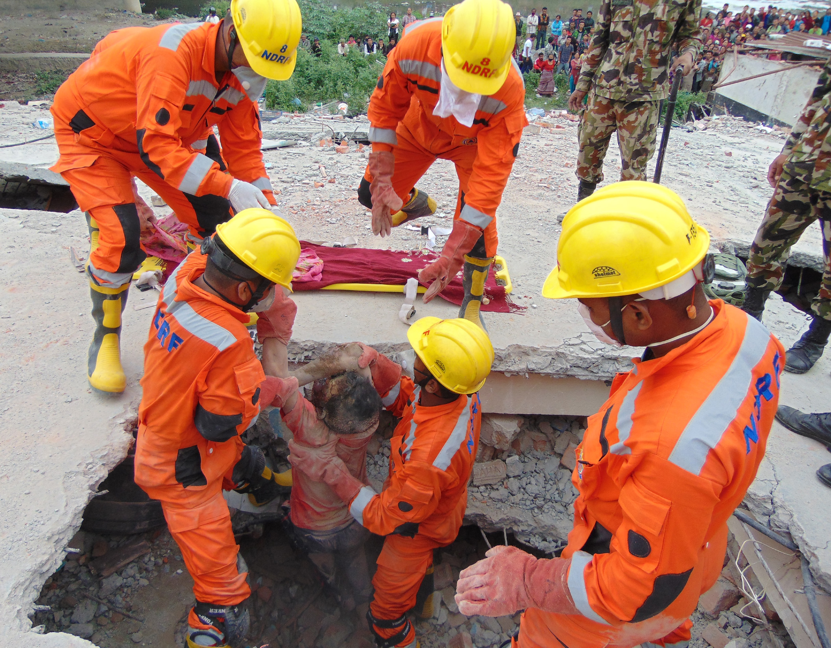

THANK YOU

