Slide 1


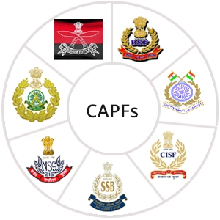

MEDICAL FIRST RESPONDER
LESSON 3
Infectious Disease and Precautions
Presented by:- Pavan Dev Gaur, 2IC
CAPF | MFR | INDIA
-

Slide 2
OBJECTIVES
Upon completion of this lesson, you will be able to:
1
Define infectious disease.
Describe the two means of transmission of infectious disease.
List eight signs and symptoms
of infectious disease.
2
3

Slide 3
OBJECTIVES
Upon completion of this lesson, you will be able to:
4
Define body substance isolation and list three categories of body substance isolation precautions.
List five components of the personal protective equipment (PPE) used for patient assessment and during
pre-hospital treatment.
5

Slide 4
Infectious Diseases
Illnesses caused by pathogens, microorganisms such as bacteria or viruses, that can be transmitted.

Slide 5
Methods of Transmission
Direct contact:
Which occurs through contact with bodily fluids, contact through open wounds or exposed tissues, or contact with mucous membranes of the mouth, eyes or nose.
PPT 3 -

Slide 6
Methods of Transmission
Indirect contact:
Through airborne pathogens spread by tiny droplets sprayed during breathing, coughing or sneezing, or by way of contaminated objects, such as needles.
PPT 3 -

Slide 7
Infectious Disease
Signs and Symptoms
Fever
Nausea, vomiting, dizziness
Yellowish coloration of the skin and whites of the eyes
Headache, chest or abdominal pain

Slide 8
Infectious Disease
Signs and Symptoms
Coughing, shortness of breath
Diarrhea
Fatigue
Weight loss

Slide 9
Body Substance Isolation
A strict form of infection control, based on the premise, that blood and bodily fluids are infectious.
PPT 3 -

Slide 10

DANGER
All bodily fluids are considered infectious and you must take appropriate precautions for all patients at all times!

Slide 11
Always discard contaminated items properly so YOU don’t get infected!

Slide 12
REVIEW
Now you are able to:
1
Define infectious disease.
Describe the two means of transmission of infectious disease.
List eight signs and symptoms
of infectious disease.
2
3

Slide 13
REVIEW
Now you are able to:
4
Define body substance isolation and list three categories of body substance isolation precautions.
List five components of the personal protective equipment (PPE) used for patient assessment and during
pre-hospital treatment.
5

Slide 14



THANK YOU

