Slide 1


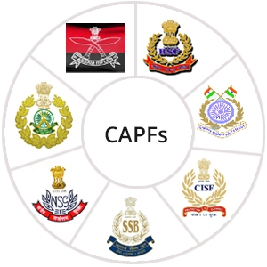

Aquatic Disaster Response Course
LESSON 03
IMPROVISED FLOATING DEVICES (IFDs)
Presented by:- Pavan Dev Gaur, 2IC
CAPF | ADRC | INDIA
-

Slide 2
OBJECTIVES
Upon completion of this lesson, you will be able to:
  Introduction of IFDs
  Preparation
  Its Uses
1
2
3

Slide 3

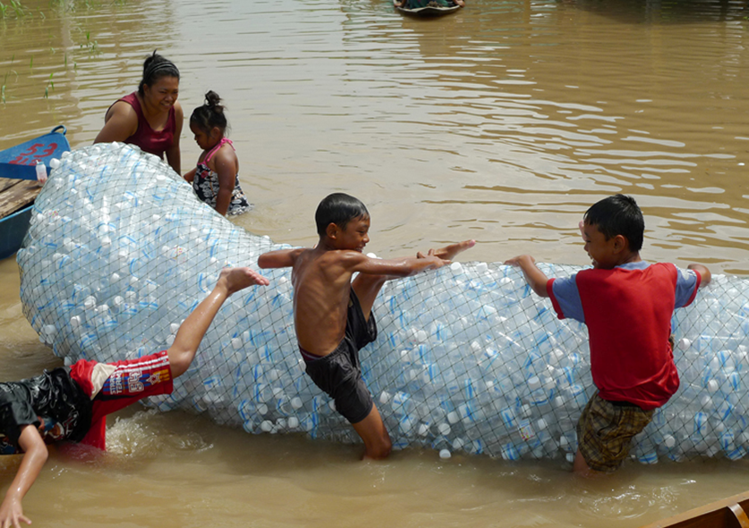
INTRODUCTION
Improvised life saving devices (improvised rafts) are one of the best tools which can help the community people to come out of flood affected area and save many precious lives without much effort.
Rafts can easily be made with the help of local/household materials.
PPT 2 -

Slide 4
IMPROVISED FLOATING DEVICES (IFDs)
Water Bottle Raft
Ball Raft
Jerrycan Raft
Dry Coconut Raft
Drum/Barrel Raft
Bamboo Raft
PPT 2 -

Slide 5
WATER BOTTLE RAFT
Water Bottle Raft can be prepared from empty plastic water bottles (cold drink or water bottles) generally available in our houses.
Materials required
04 Meter coconut fiber rope (approx.)
05-06 Empty plastic bottles (cold drink or mineral water bottles) of 1.5/2 liters.
PPT 2 -

Slide 6
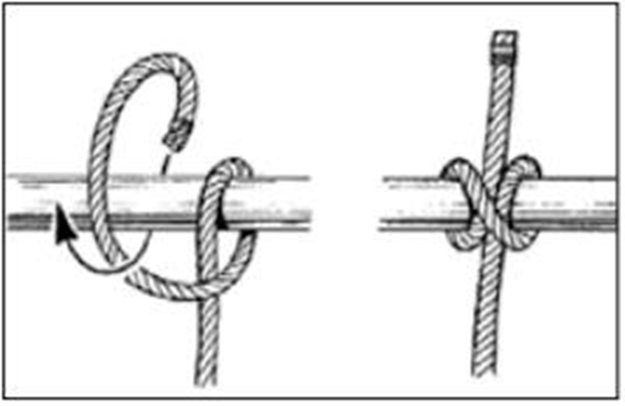
METHOD OF PREPARATION
Seal Bottles: Ensure all empty plastic bottles are unbroken and tightly sealed with caps.
Bottom Knot: Tie a clove hitch knot slightly above the bottom of each bottle, followed by a safety knot to prevent slipping.
PPT 2 -

Slide 7
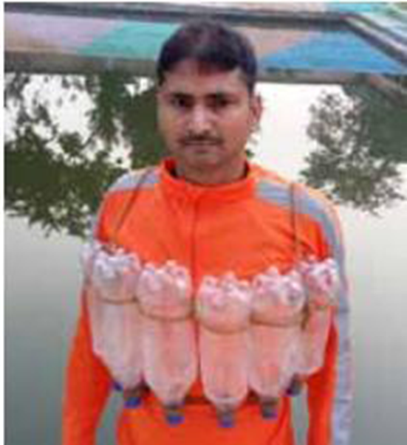
METHOD OF PREPARATION
Side-by-Side Arrangement: Repeat the knotting for all bottles and tie them side by side securely.
Leave Rope Ends: Keep ½ meter of rope free at the start and end for tying around the chest.
Top Knot (Bottle Neck): Repeat the knotting process at the neck of each bottle, again keeping ½ meter rope free on both ends.
Final Setup: You’ll have 4 free rope ends to secure the raft to the individual’s chest—your water bottle raft is now ready to use.
PPT 2 -

Slide 8
METHOD TO USE
Tie the bottle raft on the chest of an individual properly
Bottles should be placed on the chest (below the shoulder joint) by putting cross knots at the back.
Bottle neck part of the bottle should be downward.
Ensure the bottles are properly tied with the person’s body.
PPT 2 -

Slide 9
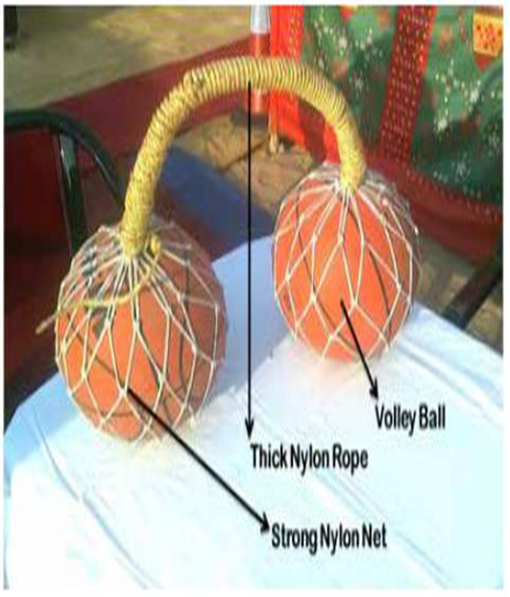
BALL RAFT
This raft is made by fully air filled playing football volleyball (which is not punctured).
Material Required
Two footballs or basketballs (fully air-filled, not punctured)
Two nylon nets (preferably thick, good-quality nylon rope) — one for each ball
10 meters of rope (thick nylon or coconut fiber, approx. 5–8 mm diameter)
PPT 2 -

Slide 10
BALL RAFT
Method of making :-
Place each ball securely inside a nylon net for easy tying.
Keep balls ~2 feet apart and tow rope 10–12 times from one ball to the other.
This creates a thick rope strand strong enough to support body weight.
Strengthen the central rope by rolling another rope around it side by side, forming a cylindrical roll.
Tie both ends tightly to prevent loosening.
Your ball-based raft is now ready for use!
PPT 2 -

Slide 11
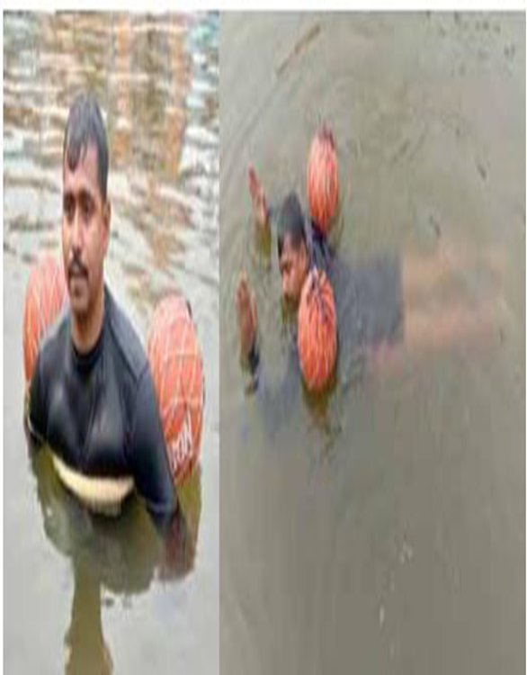
Method to use
Place the rope over the chest, passing both balls under each armpit toward the back.
Lay face-down on the water surface in a relaxed position.
Keep the balls secured under the arms, ensuring they stay above water.
For added safety, tie the two balls together at the back with a rope to prevent separation.
This setup helps the body stay afloat and prevents drowning.
PPT 2 -

Slide 12
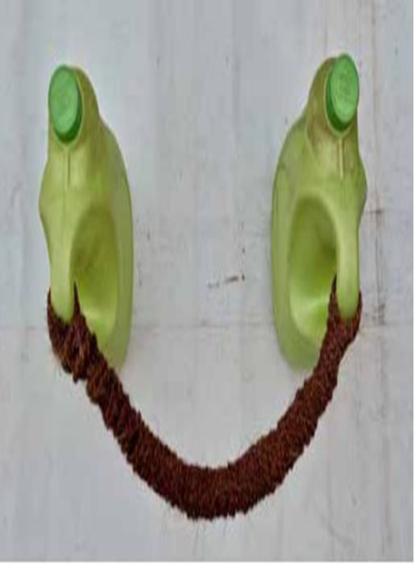
JERRYCAN RAFT
This raft is made with the help of plastic jerrycan available in the house.
This raft can easily withstand the load of 01 person.
Material Required
Two Empty Plastic Jerrycan of 05 Ltr capacity.
10 m coconut fiber rope (thickness of rope 05 – 08 mm)
PPT 2 -

Slide 13
Method of making
Take two 5-liter jerrycans with caps tightly closed.
Tie rope to the handles of each jerrycan, keeping them about 2 feet apart.
Tow the rope 7–8 times between the handles to create a strong central strand.
Reinforce by wrapping another rope around the strand side by side, forming a cylindrical roll.
Secure both ends tightly to prevent loosening.
The jerrycan raft is now ready for emergency floating.
PPT 2 -

Slide 14
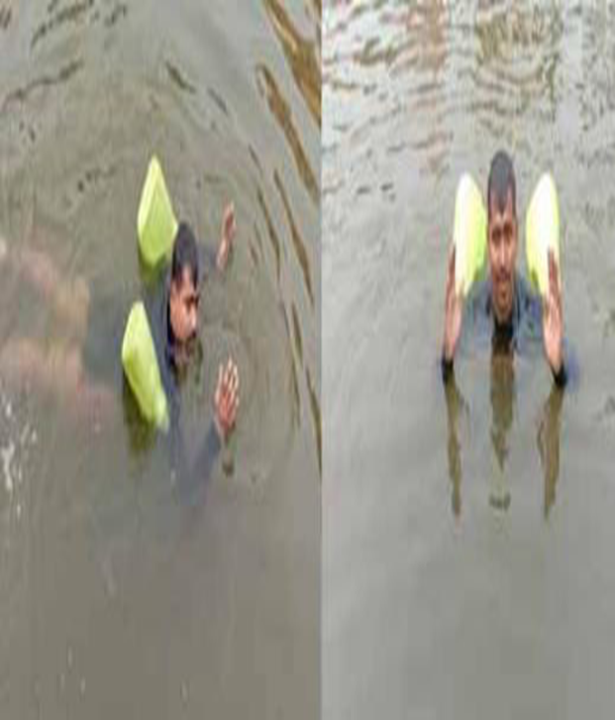
Method to use
Place the rope over the chest and pass the jerrycans through both armpits to the back.
Lay face-down on the water surface in a stable position.
Keep the jerrycans secured under the arms, floating outside the water surface.
For extra safety, tie both jerrycans together behind the back with a simple rope.
This prevents the jerrycans from slipping away and keeps them close to the body.
The raft will keep one person afloat and prevent drowning.
PPT 2 -

Slide 15
DRY COCONUT RAFT
This raft is prepared with the help of the dry coconuts available in the houses / local markets. It is made by attaching 06 - 08 dry coconuts with the help of rope.
Materials required
06 dry coconuts
03 mtr coconut fiber rope
PPT 2 -

Slide 16
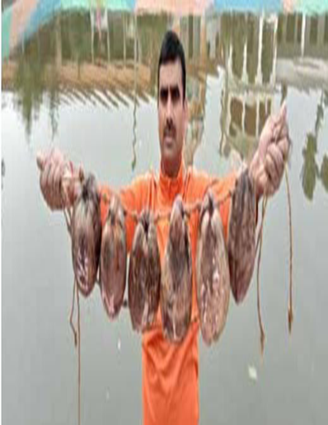
Method of making
Pierce two holes (top and bottom) in each dry coconut using a big needle or 8–10 inch nail.
Insert rope through the upper hole of the first coconut, leaving ½ meter of rope free.
Tie knots on both sides of the coconut (near the hole) to keep it fixed in place.
Repeat for each coconut, tying them side-by-side to form a belt-like structure.
Repeat the same process through the lower holes to strengthen the raft.
After the last coconut, tie a final knot and leave ½ meter of rope free at the end.
A belt of coconuts with free rope ends on both sides is now ready — your coconut raft is complete.
PPT 2 -

Slide 17
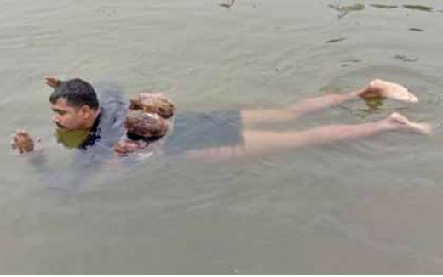
Method to use
Tie the coconut raft to the chest using the rope ends attached to the coconut belt.
Position coconuts below the shoulder joints, securing with cross knots at the back.
For extra safety, add another cross knot from front to back.
Ensure the upper part of the coconuts face upward when tying to the chest.
If tied on the back, the person can float or swim face-down on the water.
If tied on the front, the person can float on the back or stand floating in deep water.
PPT 2 -

Slide 18
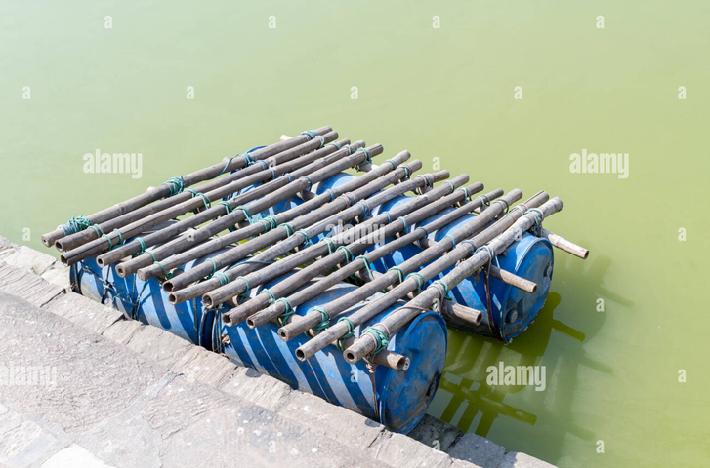
DRUM/BARREL RAFT
It is prepared by tying two or more empty PVC barrels with the bamboo/ wooden planks with the help of rope.
This raft can carry 2 to 4 persons during flood situations.
Materials Required
2 plastic drums/barrels (220-liter capacity each)
Approx. 50 meters of coconut fiber rope (5–8 mm thickness)
4 dry bamboo logs or wooden planks
Each ~2 feet longer than the total diameter of the barrels
12–15 bamboo or wooden planks
Each about 4 feet in length
Used for making the raft platform
PPT 2 -

Slide 19
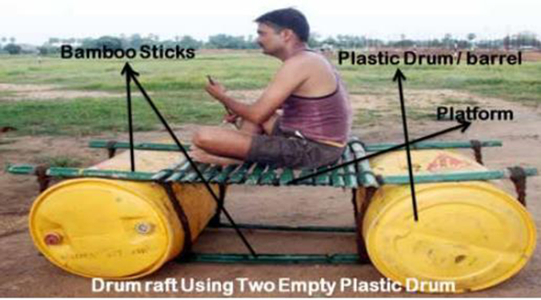
Method of making
Place two bamboo logs/planks parallel on the ground, about 1 foot less than the length of the drum apart.
Lay the drums side by side horizontally across the bamboo, with 6” of the drum extending beyond the bamboo edges.
Ensure drum caps are sealed tightly to maintain buoyancy.
PPT 2 -

Slide 20
Method of making
Place another set of bamboo/planks on top of the drums, directly opposite the lower set.
Tie the upper and lower bamboo together tightly, securing the drum in between.
Build a small platform on top using bamboo or wooden pieces (approx. 4 ft long).
Drum raft is ready and can carry 2–4 people. Balance must be maintained while using it.
PPT 2 -

Slide 21
Method to use
Place the raft on the water's surface and sit on it comfortably or build a platform for carrying loads.
Use a long bamboo log for balancing and steering the raft.
Wooden planks can be used to create a platform over the drums/barrels and securely tie them to the bamboo sticks.
The raft can be used to carry household goods, children, or livestock (e.g., goats, sheep, dogs) across flooded or waterlogged areas.
PPT 2 -

Slide 22
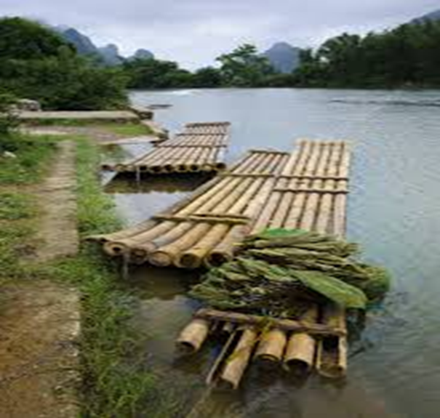
BAMBOO RAFT
Bamboo raft is made with the help of bamboos & rope as per the need.
Material Required
10 to 12 Nos. of dry bamboos of at least 4” diameter and 05 mtr long.
05 mtr strong coconut fiber rope to tie the bamboo.
PPT 2 -

Slide 23
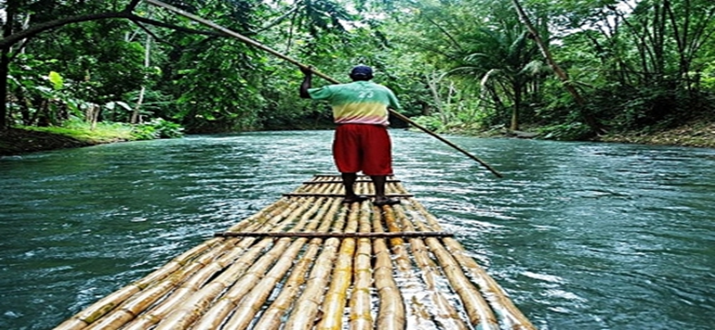
Method of making
Split a bamboo into two pieces along its longer axis and place them 4 feet apart on a flat surface.
Place the remaining bamboo pieces side by side, perpendicular to the first two bamboos.
Tie the bamboos together using coconut fiber rope, securing them with half parts of bamboo for added support.
PPT 2 -

Slide 24
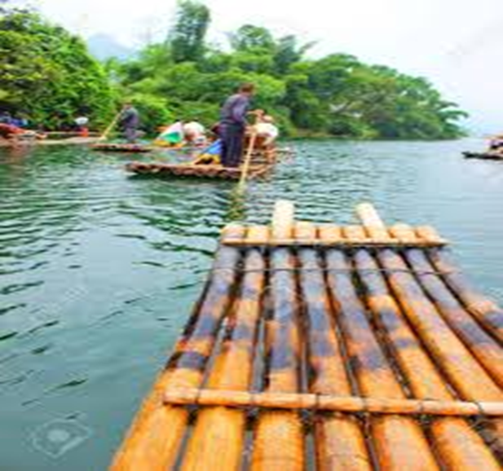
Method to use
Place the raft on the water and lay face-down with the raft under the chest.
Hold the edge of the raft strongly with your hands, keeping the body floating in the water.
The raft can be used for rowing in swift water while sitting on it.
This raft is also useful for transporting household goods, grain, children, or small animals (e.g., goats, sheep) through waterlogged areas.
PPT 2 -

Slide 25
Review
Now you are able to define:
  Introduction of IFDs
  Preparation
  Its Uses
1
2
3

Slide 26


THANK YOU

