Slide 1


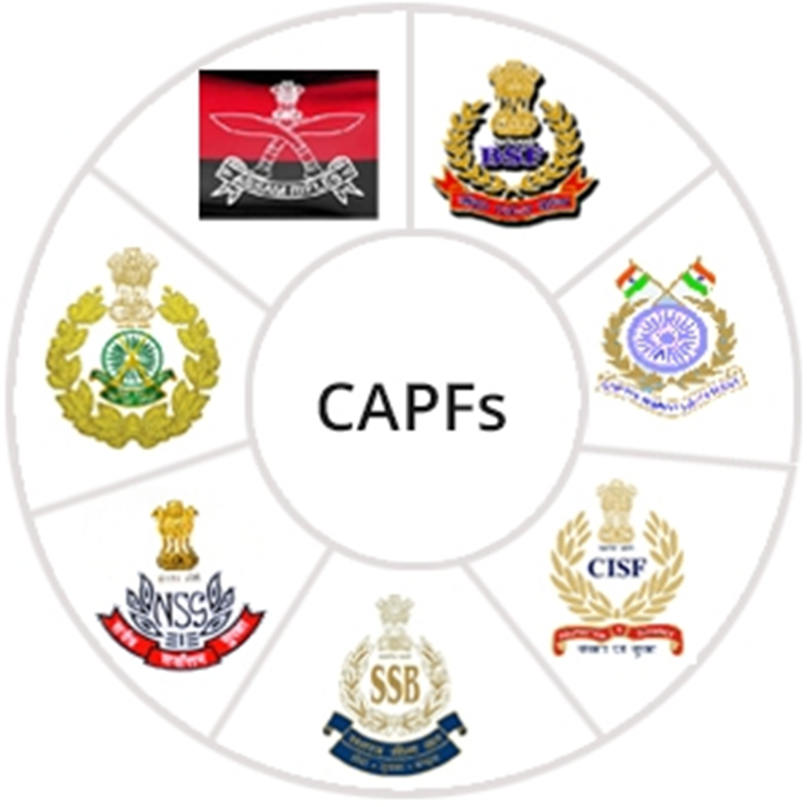

CBRN Module: CAPF
LESSON 03
HISTORY & OVERVIEW OF CWA
Presented by:- Pavan Dev Gaur, 2IC

Slide 2
OBJECTIVES
History of CWA
Classification
Characteristics and physical properties of CWA
Sign and Symptoms
Review
Upon completing of this lesson, you will be able to :-

Slide 3
INTRODUCTION
Triage and casualty management in CBRN (Chemical, Biological, Radiological, and Nuclear) emergencies refer to the systematic approach of assessing, prioritizing, and providing medical care to individuals affected by CBRN incidents.
These incidents involve the release or exposure to hazardous substances or agents that can cause severe harm to human health.

Slide 4
Ancient History
428 - 424 B.C. - Spartans ignited pitch and sulfur to create toxic fumes in the Peloponnesian Wars.
187 B.C. - Choking smoke and caustic ash were used by Roman cavalry at the siege of Ambracia.\
960-1279 A.D. - Smoke containing Arsenic was used during battles in China during the Sung Dynasty.

Slide 5
19th Century
Various plans to use chemical weapons were not carried out because such weapons were felt to be dishonorable in the field of battle.
1863 - The development of shells filled with chlorine against the Southern forces during the USA War of Secession, 1861-1865 was was rejected.

Slide 6
World War I
1914 - French begin using tear gas in grenades and Germans retaliate with tear gas in artillery shells.
1915 - Germans attack the French with chlorine gas at Ypres, France. The first significant use of chemical warfare in WWI.
1915 - First British chemical weapons attack; chlorine gas is used against Germans at the Battle of Loos.

Slide 7
World War I
During the period of 1918, massive use of gas-filled shells are used by both sides. During these attacks, approximately 25% of projectiles were chemical shells.
It has been estimated that if the conflict had continued, it would have turned into a true chemical war.

Slide 8
Between the World Wars
1920 - Chemical weapons were used during the Russian Civil War.
1922-1927 - The Spanish used chemical weapons against the rebels in Spanish Morocco.
1936 - Italy uses mustard gas against Ethiopians during its invasion of Abyssinia.

Slide 9
World War II
The Nazis SS used chemical agents to kill millions of Jews and other prisoners in concentration camps.
The US developed Chemicals designed to harm crops, and would harm those dependent upon it. However, they were never used.

Slide 10
Yellow Rain
1975 -1983
Documented testimony indicated that the countries of Laos, Kampuchea and Afghanistan were sprayed with Chemical Agents to clear foliage.

Slide 11
Iranian and Iraqi War
1983 - Iraq begins using chemical weapons (mustard gas), in Iran-Iraq War
1984 - First ever use of nerve agent tabun on the battlefield, by Iraq during Iran-Iraq War
1987-1988 - Iraq uses chemical weapons (hydrogen cyanide, mustard gas) against the Kurds, most notably in the Halabja Massacre of 1988.

Slide 12
Terrorist’s Attack
1995: A terrorist attack by the Aum Shinri Kyo Cult, using chemical Nerve agent Sarin resulted in 7 dead and 270 injured in Matsumoto, and 12 dead and 5,500 injured in Tokyo.

Slide 13
Current Status
Iran - Research & Possible Production
Iraq - Research & Possible Production
Libya - Research & Possible Production
N. Korea - Research & Possible Production
Syria - Research & Possible Production
Russia - Defensive Research Program
United States - Defensive Research Program

Slide 14
Iran
Chemical -
Possible possession of:
Mustard Gas
Sarin

Slide 15
Iraq
Chemical
Known possession of:
Mustard Gas
Sarin
Tabun
VX

Slide 16
Iran
Chemical
Possible possession of:
Mustard Gas
Sarin
Tabun
Lewsite
Phosgene

Slide 17
North Korea
Chemical
Possible possession of:
Mustard Gas
Hydrogen Cyanide
Sarin
Soman
Tabun
VX

Slide 18
Syria
Chemical
Possible Possession of:
Mustard Gas
Sarin
VX

Slide 19
CW AGENTS: CLASSIFICATION
Chemical agents are classified according to following criteria:
Military use.
Duration of effectiveness.
Effects on the body.

Slide 20
(a) MILITARY USE:
Killer Agents: Prim motive of killing max no of men. E.g. Vx, GB.
Incapacitating Agents: Prim motive is to avoid death but make men temporarily unable to perform their duties. E.g. CS and BZ.
Riot control Agents: Used while giving aid to civil authorities. E.g. CS.
CW AGENTS: CLASSIFICATION

Slide 21
(b) DURATION OF EFFECTIVENESS:
Non-Persistent: these agents disperse rapidly after release and present an immediate short duration hazard. E.g. G (nerve) agents, Hydrogen Cyanide(blood agent).
Persistent: These agents continue to present a hazard of consedirable period after delivery by remaining a liquid contact hazard and by continuing to produce vapour by the evaporation of the liquid. E.g V (Nerve) agents, Suplhur Mustard (Blister agents).
CW AGENTS: CLASSIFICATION

Slide 22
Cw Agents: Classification
(c) EFFECTS ON THE BODY:
BLISTERING AGENTS
BLOOD AGENTS
CHOKING AGENTS
INCAPACITATING AGENTS OR PSYCHO-CHEMICALS
RIOT CONTROL /TEAR AGENTS

Slide 23
CWA CHARACTERISTICS AND BEHAVIOR
Generally Liquid (When Containerized)
Normally Disseminated As Aerosol or Gas
Present Both a Respiratory and Skin Contact Hazard
May Be Detectable by the Senses (Especially Smell)
Influenced by Weather Conditions

Slide 24
PHYSICAL PROPERTIES
Freezing/Melting Point
Boiling Point
Vapor Density
Vapor Pressure
Volatility
Persistency

Slide 25
CHEMICAL PROPERTIES
Stability
Hydrolysis Rate and Products
Reactivity

Slide 26
PHYSIOLOGICAL PROPERTIESE
Odor
Onset Time of Effects
Rate of Detoxification

Slide 27
SEVEN TYPES OF CWA
Nerve agents.
Blistering agents (vesicants).
Blood agents.
Choking agents (lung injurient).
Psycho- chemical agents.
Irritants.
Defoliants.

Slide 28
NERVE AGENTS
Belong chemically to the group of organophosphorus compounds.
These are the most toxic of the known chemicals agents.
They are hazard in their liquid and vapour state.
Nerve agent can cause death within minutes after exposure. Nerve agents are normally in liquid state on temperate condition.
On dispersal the more volatile ones constitute a vapour and liquid hazard.

Slide 29
Common Name/ Military Symbol | Tabun GA | Sarin GB | Soman GD
Volatility/Persistency | Semi-persistent Persistent
Route of Entry | skin • respiratory
Rate of Action | Extremely Rapid
Odor | Fruit | Camphor | Sulphar
Symptoms | Pin-pointing of pupils, Salivation, Vomiting/Diarrhea, twitching, difficulty in Breathing, Loss of consciousness
Protection | • Respiratory and Skin
First Aid | • Atropine • 2-Pam Chloride
Decontamination | • Remove agent • Flush with water or Dilute bleach

Slide 30
Sarin – Chemical Properties
Military designation: GB
Chemical name: Isopropyl methyl phosphono fluoridate
Rate of hydrolysis: Hours to days, acid dependent
Hydrolysis products: Acidic = organophosphorus acids
Alkaline = Isopropyl alcohol and polymers

Slide 31
Sarin – Physical Properties…
Odour: None when pure (fruity if impure)
Vapour density, 4.86
Boiling point, 158ºC
This agent is a non-persistent vapor at room temperature.
Both respiratory and skin protection are required.

Slide 32
Chemical Agent– Relative Toxicity
Agent LD₅₀
Phosgene 3.2 g/m³
Sarin (GB) 70 mg/m³
VX 10 mg on skin
A232 <0.1 mg on skin

Slide 33
PHYSIO-CHEMICAL PROPERTIES OF NERVE AGENTS
The group of organophosphorus compounds
Hazard in their liquid and vapour state
Normally in liquid state on temperate condition.

Slide 34
V Agents
(Persistence agent) The persistent nerve agents are practically colorless and relatively in volatile liquids, which slowly omit an odorless toxic vapor.
Their consistency is much the same as that of light lubricating oil and their persistency is such as to make them extremely hazardous as a liquid or as an aerosol, which can be inhaled, absorbed through the skin or swallowed with contaminated food or water.
The standard US persistent agent is VX. Since they do not readily evaporate, they stay in terrain/ equipment/ material for a day or years depending on the weather conditions.

Slide 35
G Agents
(Non persistence) the non-persistent G agents which are practically colorless and odorless, are in general in contrast to V agents, highly volatile and they vaporize rapidly to a highly toxic cloud.
Their consistency is somewhat analogues to that of petrol. They normally present a vapor hazard, which attack through the eyes and respiratory tract, but may also penetrate normal clothing to attack through the skin. Although vapor is the more likely hazard, liquid G agents coming directly in contact with the skin area also lethal. Tabun (GA) and Soman (GD) are comparatively less volatile than Sarin (GB) and may persist for longer duration over the target.

Slide 36
G Agents
It is pertinent to note that the toxic effects of Soman (GD) are more difficult to cure since the normal treatment for nerve agents is less effective against it. The standard US non-persistent nerve agent is Sarin (GB).

Slide 37
Properties | GA (Tabun) | GB (Sarin) | GD (Soman) | GF | VX
Molecular Weight g/mole | 162 | 140 | 182 | 180 | 267
Vapour Density | 5.63 | 4.86 | 6.33 | 6.2 | 9.2
Liquid density | 1.07 at 25 C | 1.09 at 25C | 1.02 at 25 C | 1.17at 25C | 1.01 at 25 C
Melting points ( C) | -5 | -56 | -42 | -30 | -51
Boiling point ( C) | 240 | 158 | 198 | 239 | 298
Volatility | 610 | 22000 | 3900 | 438 | 10.5

Slide 38
NERVE AGENT COMPARISON
Property Significance
Treatment GD more resistant to treatment than GB
Persistency VX > > GA > GD > GB
Dissemination VX more difficult to aerosolize
Difficulty of production GD > VX > other G agents
Toxicity VX > GD > GB > GA

Slide 39
HOW MUCH SARIN (GB) DOES IT TAKE?
STRUCTURE VOLUME LETHAL RESPIRATORY LETHAL AMOUNT
DOSE
Domed Stadium 1.07 x 10⁶m³ 100 mg-min/m³ 107 kg, about 26 gals
Movie Theater 12,000 m³ 100 mg-min/m³ 1.2 kg, about 5 cups
Conference Room 400 m³ 100 mg-min/m³ 33 g, about 1 shot glass
(50-100 seating)

Slide 40
BLISTER AGENTS
Blister agents affect the eyes and lungs and blister the skin. Some types are painless while others sting and still others cause the formation of wheals.
They may appear as colourless to dark brown, oily liquid droplets but are normally invisible in the vapour form.
The principal blister agent is persistent liquid known as mustard, which gives off a vapour with slight but characteristic odour of garlic
Mustard causes little pain upon exposure.
Lewisite and phosgene oxime cause intense pain.

Slide 41
Common Name/ Military Symbol | Mustard (H) | Lewisite (L) | Phosgene Oxime (CX)
Volatility/Persistency | Persistent
Route of Entry | skin • Inhalation . Eyes
Rate of Action | Delayed Rapid
Odor | Garlic | Geraniums | Irritating
Symptoms | Eyes: burning, Inhalation: coughing Skin: blistering after 4-24 hours, pain
Protection | • Respiratory and Skin
First Aid | • Decontaminate • Ensure air passages
Decontamination | • Immediate removal • Flush with water or bleach

Slide 42
Mustard - Chemical Properties
Military designation: H, HD
Chemical name: Bi chloroethyl sulfide
Rate of hydrolysis: Extremely slow
Hydrolysis products: HCl and thiodiglycol

Slide 43
Mustard - Physical Properties
Vapor density: 5.5
Boiling point: 217°C
This agent is a very persistent liquid at room temperature
Respiratory and skin protection are required.

Slide 44
BLISTER AGENT POINTS OF EMPHASIS
Sulfur Mustard Agent Freezes at 57° F
Mustard Agent Symptoms Delayed - NOT Onset Time of Effects
Lewisite/phosgene Oxime Cause Immediate, Severe Pain
Persistency of Hours (Desert) to Days or Even Weeks (Temperate)
Suspected Carcinogens
Vapor Is Skin Hazard
Blisters on Over 50% of Body Can Prove Fatal

Slide 45
BLOOD AGENTS
These agents are colourless and are usually disseminated as vapours or gases and are taken into the body by breathing.
They prevent the utilization of oxygen carried by the blood, at the cellular level thus causing the cells to die.
They cause symptoms ranging from convulsions to coma. After inhaling a high concentration of blood agent, a man may become unconscious and die within a few minutes.
They may more often be employed in conjunction with some other agent because of the difficulty in creating lethal concentration in the field, and to circumvent the protection provided by the respirator.

Slide 46
Blood agent
Common Name | Hydrogen Cyanide (CA) HCN | Cyanogens Chloride (CK) CNCL
Volatility/ Persistency | Non-Persistent
Rate of Action | Rapid
Route of Entry | Respiratory
Rate of hydrolysis | Very Slow
Hydrolysis products: | HCl
Odour | Bitter Almonds or peach Kernels
Symptoms | Coughing, gasping for air, reddish skin & lips (purple lips for dark complexioned), unconsciousness, death
Protection | Respiratory, Skin
First Aid | Mask, antidote available to medical
Decontamination | Remove from area
.

Slide 47
Cyanogens Chloride - Physical Properties
Odor: bitter almonds and extremely irritating
Vapour density: 2.1 (compared to air)
Boiling point 12.8ºC
This agent is a non-persistent gas at room temperature.
Respiratory protection is required.

Slide 48
Choking agents
These agents are colourless and are usually disseminated as gases and are taken into the body by inhalation.
They affect the respiratory system by damaging the lungs and in extreme cases, causing them to fill with fluid.
They produce symptoms such as coughing, choking, tightness in the chest, nausea headache and watering of eyes.
This is followed by a latent period of two to four hours during which the individual appears to have recovered. The delayed affects include rapid and shallow breathing, painful cough, discomfort and fatigue, shock and frequently death.

Slide 49
Choking agents
Common Name Military Symbol | Phosgene (CG) COCL2 | Chlorine (Cl)
Volatility / Persistency | Non-Persistent
Rate of Action | Rapid
Route of Entry | Respiratory
Odour | Mew-Mown hay | Bleach
Symptoms | *Coughing*Choking* Tightness of Chest
Protection | Respiratory, Skin
First Aid | Carry from area
Decontamination | Aeration

Slide 50
CHOKING AGENTS
Properties | COCl2 (Phosgene) | CCl₃ O COCl (Diphosgene)
Physical state | Gas | Gas
Molecular Weight | 98.92 | 197.85
Liquid Density at 25 C | 1.37 | 1.65
Volatility | Short | Short

Slide 51
Phosgene
Chemical Properties
Physical Properties
Military designation: CG
Chemical name: Carbonyl chloride
: Rapid, destroyed by rain
Hydrolysis products: HCl + CO₂
Boiling point, 7.6°C
Vapour density, 3.4 (very heavy compared to air)
This agent is a non-persistent gas at room temperature.
Respiratory protection is required

Slide 52
PSYCHOCHEMICALS
The non-lethal incapacitates or psychochemical produce physical or mental effects of sufficient severity to prevent men from carrying out their normal tasks.
The duration of effect could be as brief as several minutes although it could last for several days in certain cases recovery is complete and there are normally no after effects.
Many drugs are known which can act incapacitate producing temporary paralysis, persistent lachrymator, diarrhea, vomiting, convulsive spells of mental confusion, but no military means of exploiting most of these substances have so far been developed.

Slide 53
BZ AGENTS
Chemical name :3 quinuclidiny benzilate (BZ)
Physical state :white solid
Melting point :160 C
Volatility :negligible

Slide 54
IRRITANTS (TEAR GAS)
CS (2-chlorobenzal malanonitrile) would be considered an example of a physical incapacitates.
White crystalline solid
Disseminated as an aerosol in a non-persistent cloud
A truly non-lethal agent
CN- chloroacetophenone): solid agent is disseminated at an aerosol; volatility is low and has lachrymatory effects.

Slide 55
IRRITANTS (TEAR GAS)
Properties | CN | CS | CR
Physical state | Solid | Solid | Pale yellow solid
Melting point C | 54 | 93-95 | 72
Boiling point C | 248 | 310-315 | 315
Density G/ML | 1.187 | 1.04 | -
Volatility mg/m3 | 34.3 | 0.71-

Slide 56
PROTECTION
The respirator affords full protection against the inhalation of both CS and BZ, but with the latter agent, contaminated food or drink must also be avoided.

Slide 57
Defoliants (Herbicides)
Herbicides or anti plant agent may be used in a military Conflict for the destruction of crops or for defoliation of natural vegetation to reduce the possible cover.
The agent can be divided into three types:
• Defoliation
• Poisoning
• Prevention of growth

Slide 58
Defoliation is induced by defoliants interfere with mechanism that normally brings about seasonal leaf falls. The toxin action are caused by plant growth regulators which promote, inhibit or modify physiological process in plants
Employment of soil sterilant prevents the growth of plants. Herbicides were used on a large scale in the Vietnam War.
2,4- Dichlorophenoxyacetic acid (2, 4-D): - It is a herbicide used for the control of broad leaf plants and a general plant growth regulator in 1942, later it was used by Americans in Vietnam war
2 4 5-Trichlorophenoxyacetic acid: -
It is also a general plant growth regulator. Its military uses from the Second World War to present. Britishers first used it, in 1955-57 and thereafter by Americans during Vietnam War.
Cacodylic acid: It is effective herbicides in grasses than broad leaf plants it kills the plants through absorption of water from leaves. Agent can produce rapid defoliation; re-growth may occur in one month.

Slide 59
Defoliants (Herbicides)
Employment of soil sterilant prevents the growth of plants. Herbicides were used on a large scale in the Vietnam War.
Dichlorophenoxyacetic acid (2,4-D)
2 4 5-Trichlorophenoxyacetic acid
Cacodylic acid.

Slide 60
Routes of Entry
Ingestion
Eyes
Respiratory Tract
Injection
Skin

Slide 61
Indicators of possible CW use
Yellowing of leaves
Dead or dying animals and insects.
Multiple victims, serious illness, nausea, disorientation (Hkzfer djus okyk), suffocation, convulsions, and definite(Li"V) casualty pattern.
Low flying clouds/fog unrelated to weather.

Slide 62
Nerve Agents
Signs and Symptoms:
Difficulty breathing, drooling (ykj cguk), nausea, vomiting, cramps,. Involuntary defecation and urination, twitching (QMduk), jerking (>Vdk), staggering (pkSadk nsus okyk), headache, confusion, drowsiness, coma, convulsions, and death.

Slide 63
Blister Agents
Sulfur Mustard (H) & Distilled Mustard (HD)
Signs & Symptoms:
Inflammation of the eyes and nose, throat, trachea, bronchi (’o’kuh) and lung tissue; redness of the skin, blister or ulceration; more "at ease“ (fuf’Upr) attitude, vomiting; and fever, beginning about same time as skin reddening

Slide 64
HN-1 (Nitrogen Mustard)
Signs & Symptoms:
Redness of the skin, causing irritation and itching, blisters in red area, irritation of the nose and throat, hoarseness progressing to loss of voice, persistent cough , fever, labored breathing, bronchial pneumonia after 24 hours; severe diarrhea ; nausea; vomiting.

Slide 65
Lewisite (L)
Signs & Symptoms:
Immediate burning sensation in the eyes; permanent loss of sight if not decontaminated with 3 minutes with large amounts of water; immediate and strong stingingsensation to the skin; reddening of the skin starts with in 30 minutes; blistering does not appear until after about 13 hours; skins burns are mush deeper than those caused by HD

Slide 66
Mustard-Lewisite Mixture
Signs & Symptoms:
Immediate stinging (pqHku) sensation in the skin; reddening of the skin starts with in 30 minutes; blistering does not appear until after about 13 hours; skins burns are mush deeper than those caused by HD; fluid in chest cavity and lungs; increase papillary (nkusnkj) permeability which causes shock and death because of loss of fluid from the bloodstream

Slide 67
CHOKING AGENTS
Phosgene (CG)
Signs & Symptoms:
Initially only minor irritation to the eyes and throat; after latent period of 4-8 hours, discoloration of the lips, break out in a cold, sticky, sweat, long lasting lesions(?kko) on lung, quantities of fluid escape from bloodstream into lungs, literally drowning the victim who dies from a lack of oxygen.

Slide 68
Diphosgene (DP)
Signs & Symptoms:
Initially only minor irritation to eyes and throat; after latent period of 4-8 hours, discoloration of the lips, breaking out in a cold, sticky sweat, systemic damage, especially to liver and kidneys, long lasting lesions on lungs develop, quantities of fluid escape from bloodstream into lungs, literally drowning the victim who dies from a lack of oxygen.

Slide 69
BLOOD AGENTS
HCN (Hydrogen Cyanide)
Signs & Symptoms:
Flushed(yky@mrsftr) skin, weakness, headaches, nausea, confusion, dizziness, unconsciousness, convulsions, violent contraction(fldqMuk) of blood vessels, severe shock, end to breathing.
CK (Cyanogen Chloride)
Signs & Symptoms:
Eye and respiratory irritation, weakness, headache, disorientation, nausea, vomiting, pinkness of skin, loss of consciousness, coma, end of respiration, and death in 15 minutes

Slide 70
INCAPACITATING AGENTS
BZ: -
Sign & Symptoms:
Fast heartbeat, dry skin and lips, blurred near vision, flushed (iwjh yky) skin, urinary retention (jksd), constipation (dCt), sedation(‘kkfUr) progression to stupor (lnek) and interference with ordinary activity, extreme excitement, delusions (Hkze@ /kks[kk), hallucinations (efr Hkze), high doses completely destroy the ability to perform any military task, untreated casualty requires from three to four days to reach full recovery.

Slide 71
TEAR AGENTS
Chloroactophenone (CN)
Signs & Symptoms:
Burning sensation of the eyes and upper respiratory passages, tearing, tingling sensation, irritation, burning, and pain of the nose and throat, burning on tender areas of skin especially areas wet by perspiration (ilhuk).

Slide 72
TEAR AGENTS
O-Chlorobenzylidene Malononitrile (CS)
Signs & Symptoms:
Extreme burning of the eyes accompanied by copious flow of tears, coughing, difficulty in breathing, tightness of the chest, involuntary closing of the eyes, stinging (pqHku) or burning on moist skin, heavy mucous formation in the nose with sinus (f’kjkuky) and nasal drip, dizziness, nausea, vomiting, severe skin irritation and blistering.

Slide 73
Dibenz-(b,f)-1,4-oxazepine(CR)
Signs& Symptoms:
Immediate and sever stinging of the skin, eyes, nose, and throat, eye pain, discomfort, and excessive tearing, painful sensitivity, to strong light or temporary blindness, nasal irritation , coughing, sneezing, nasal drip, sting or burning sensation with increased irritation on moist skin, nausea and vomiting

Slide 74
VOMITING AGENTS
Di phenylchloroarsine (DA)
Sign & Symptoms:
Irritation of eyes and the mucous membranes; viscous(xk<k) discharge from the nose similar to that caused by a cold, sneezing and coughing; severe headache, acute pain and tightness in the chest; nausea and vomiting

Slide 75
Do not crowd near the victim to avoid further contamination
Do not go in down wind direction
Do not get back in the cordoned off area till final clearance
Those in rescue crew should not remove the protective gear until they are declared safe
Don’ts
(During emergency operations)

Slide 76
Do not use protective clothing's more than one time
Do not allow decontamination team to work more than 60 minutes
Do not forget to replace canister after every 30 - 60 minutes depending on the conc. of CW agents
Do not handle contaminated clothing and protective gear with bare hands
Don’ts
(During emergency operations)

Slide 77
The Basic Do’s
Safe distance/move upwind/wear PPE
Avoid contact
Focus on avoiding the hazard.
Emergency Decon

Slide 78
PRECAUTIONS
All personnel must wear NBC Suit and display detector paper
Non essential personnel to remain under cover
Chemical sentries posted upwind
Food and water under cover
When ordered NAPS tablets are taken
Knowledge of alarm system
Practice immediate action drill

Slide 79
Review
History of CWA
Classification
Characteristics and physical properties of CWA
Sign and Symptoms
Upon completing of this lesson, you are able to :-

Slide 80

Any question ?

Slide 81
Evaluation
Q. What are the types of CWA?

Slide 82


THANK YOU

