Slide 1

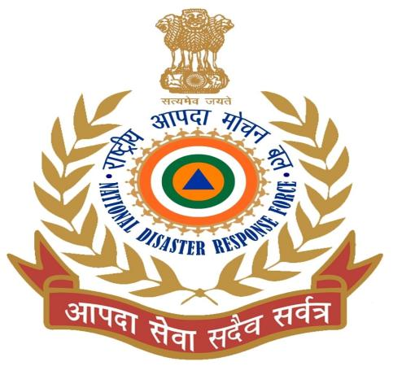
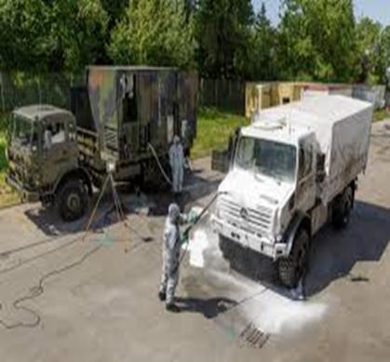
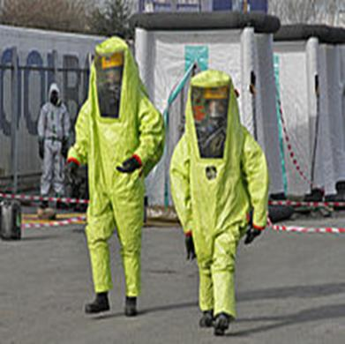
CONTAMINATION & DECONTAMINATION PROCEDURE
Presented by:- Kamlesh Dhoundiyal, 2IC

Slide 2
INTRODUCTION
Occupational workers as well as general population may be exposed to radiation by various routes following an accidental release of radioactivity from nuclear facilities.
Minor sine contamination may occur from time to time in nuclear facilities, hospital or industrial, laboratories where unsealed radioisotopes are handled.

Slide 3
OBJECTIVES
Upon completion of this lesson you will be able to :-
Contamination
Types of contamination
Concept of decontamination
Types of decontamination
Steps of decontamination
Decontamination of personnel, Vehicle & Equipment.

Slide 4
CONTAMINATION
Contamination may be defined as undesired presence of material in amounts that may be harmful to health and safety of personnel.
Types of contamination-:
1. External Contamination
2. Internal Contamination
Occur due to-
1. Inhalation (Nose)
2. Ingestion (Food & Water)
3. Injection (through wounds)

Slide 5
REQUIREMENTS OF DECONTAMINATION
  Rapid in action.
  Efficiency.
  Harmless to humans.
  Non-corrosive and washable with water.
  Stable during storage.
  Easy to handle.

Slide 6
AIM
OF DECON.
  To reduce the number of casualties.
  To decrease the clinical effect of the CW agent.
  To make the area safe for resuming normal activity.
  Site selection for decontamination:
  Security
  Sufficient space for personal & vehicle
  Availability of water
  Drainage system
  Wind direction

Slide 7
TYPES OF
DECON.
PROCEDURE
  Depending on methods-
  Physical
  Chemical (most suited and favored method)
  Depending on subjects-
  Individual
  Area & material (equipment , vehicles)

Slide 8
PHYSICAL
METHODS
  Scooping/Scraping (with wooden stick, knife, brush etc.)
  Evaporation (with hot air steam)
  Dilution and washing (with water, soap water)
  Adsorption (with fuller earth, sand, active charcoal)
Advantages of Physical decontamination
Cheapest.
Used for all type CW agent.
Easily available.

Slide 9
PERSONAL DECONTAMINATION KIT (PDK)
PDK-1- This is personnel Decon. Kit .
This handy sachet Contains 20g.activated adsorbent powder
Use for decon. of skin against CW agents .
It is effective for all type of CW Agents .
PDK-2 - This is also personnel decontamination kit similar to PDK-I
The adsorbent powder(80g)
Used to decontamination of clothing and equipment.

Slide 10
CHEMICAL
METHOD
Decontamination through chemical method is more reliable and effective as compared to physical methods.
Convert toxic CW agent into innocent ( harmless) product.
This method however needs special chemicals and trained personnel.
Most widely accepted reaction for detoxification of CW agents by chemical modification are
  Oxidation
  Hydrolysis

Slide 11
OXIDATION
In this type of reaction substance gains oxygen or loses hydrogen. V agents & Sulphur Mustard are highly vulnerable to oxidation. Chloramines are effective against mustard and V agents but ineffective against G agent.
Commonly used oxidants are:-
Sodium hypo chloride(NaClO)
Bleaching powder(STB)
Calcium hypo chloride

Slide 12
HYDROLYSIS
It is the reaction of water with an organic compound it is facilitated by the presence of bases, acids. G type nerve agents can be rapidly decomposed by hydrolysis.
Such decontaminants are:-
Caustic soda (NaOH)
Baking powder (NaHCO3)
Washing powder (Na2CO3)

Slide 13
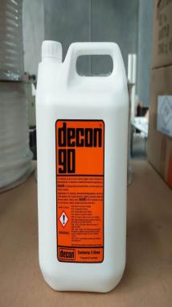
DS-2
(DECON. SOLUTION)
Composition:
1)NaOH - 2%,
2)Ethylene glycol monomethyl
ether - 28%,
3)Diethylene triamine - 70%.

Slide 14
CHARACTERISTICS OF
DS-2 SOLUTION
  Widely used in contamination with blister & nerve agents
  Used for equipment/vehicle & area decontamination
  Non-corrosive to metals but damages paints and rubber leather and plastic materials.
  Within 30 min contact time neutralize all known toxic chemical agents

Slide 15

DS-2 (DECON. SOLUTION)
  Merits of DS-2
  DS-2 Ready to use solution.
Long term storage stability.
Long operative temperature.
Demerits of DS-2
  Damages paints and plastics.

Slide 16
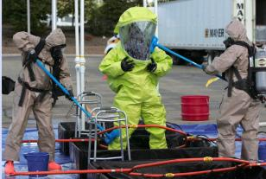
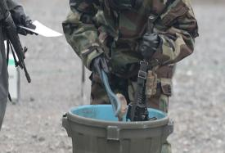
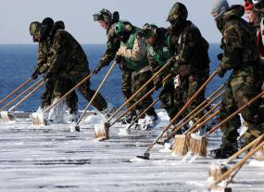
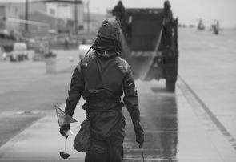
WHERE DECON HAS TO BE CARRIED OUT?
PERSONAL
EQUIPMENT
VEHICLES
TERRAIN

Slide 17
4 STEPS OF DECON.
FOR VICTIMS
Garments off
Showering
Monitoring
Re issue clothing /registration .

Slide 18
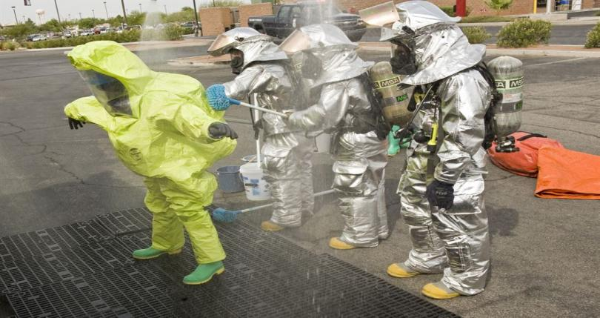
PERSONNEL DECONTAMINATION

Slide 19
STEPS OF PERSONNEL DECON.
Individual gear drop.
Shuffle Pit.
Over garment off ( CBRN suit removal).
Over boots and gloves off.
Monitor.
Mask removal.
Showering.
Re-monitoring.
Re issue clothing / Registration.

Slide 20
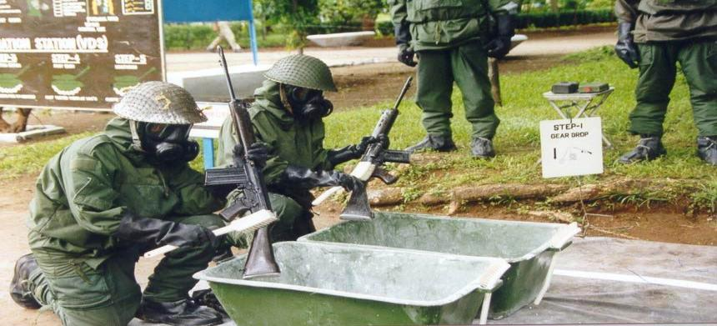
STEP 1 – INDIVIDUAL GEAR DROP

Slide 21
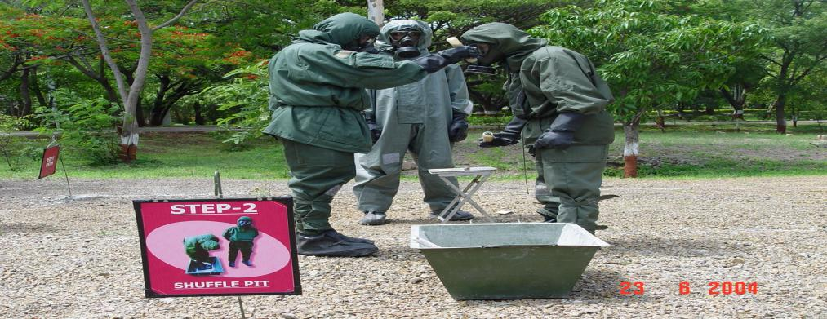
STEP-2 SHUFFLE PIT

Slide 22
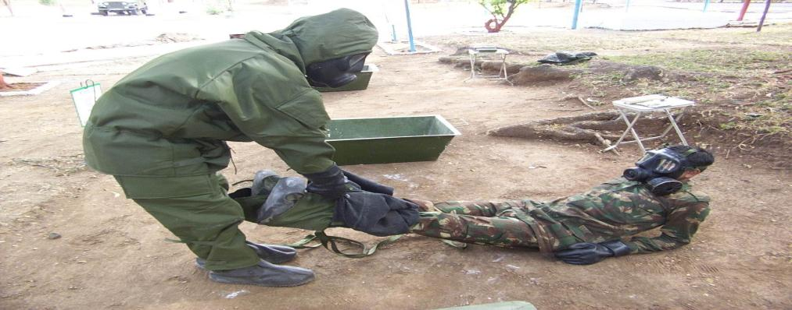
STEP-3 OVER GARMENT OFF

Slide 23
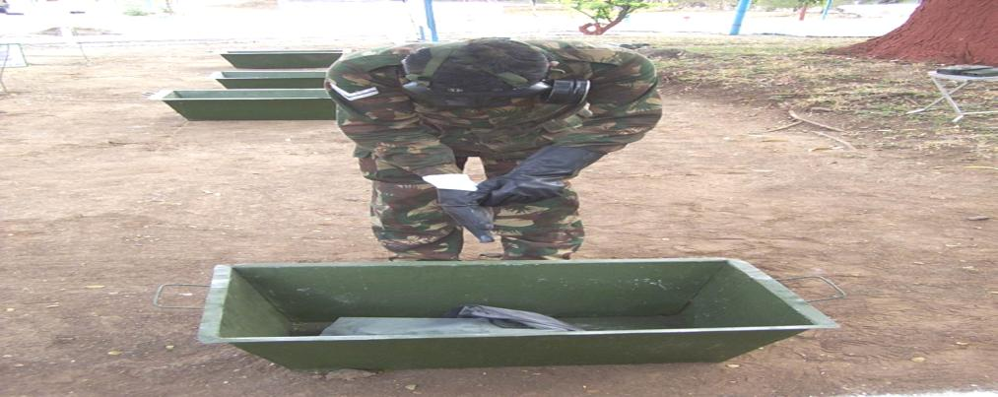
STEP-4 OVER BOOTS AND GLOVES OFF

Slide 24
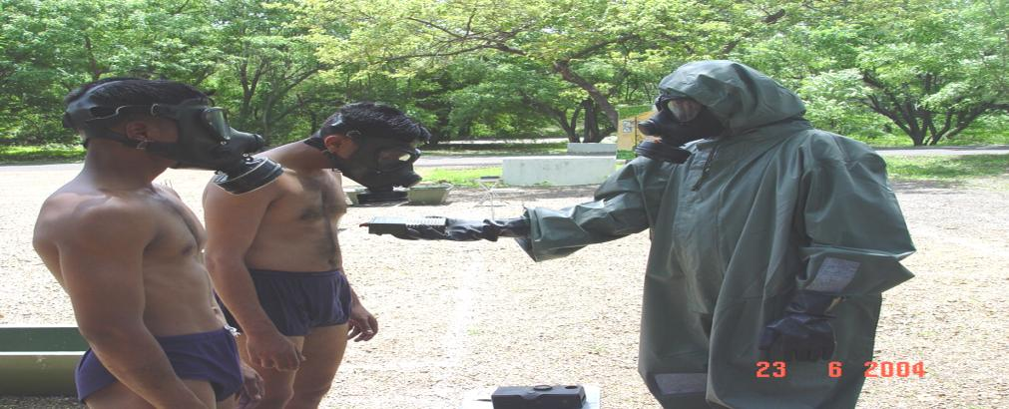
STEP- 5 MONITOR

Slide 25
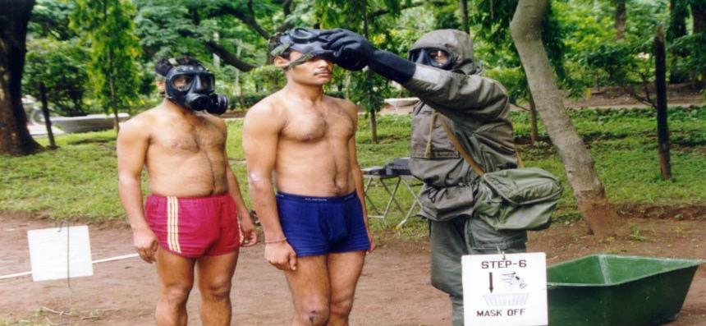
STEP- 6 MASK REMOVAL

Slide 26
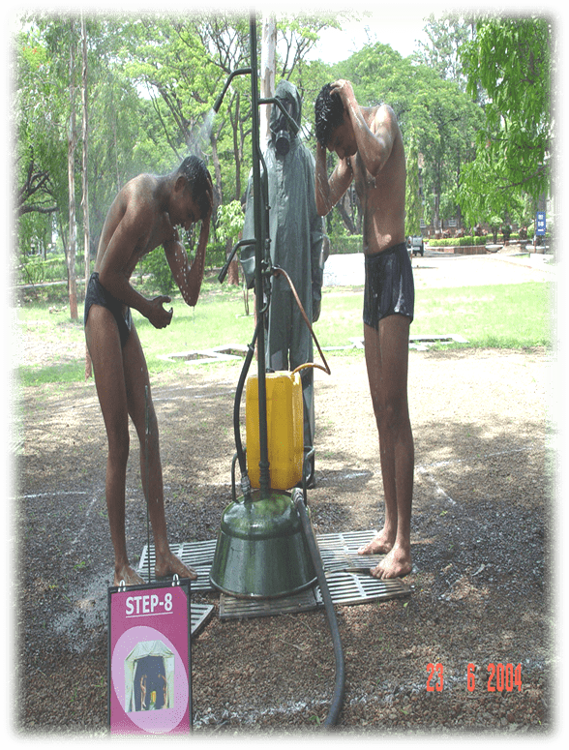
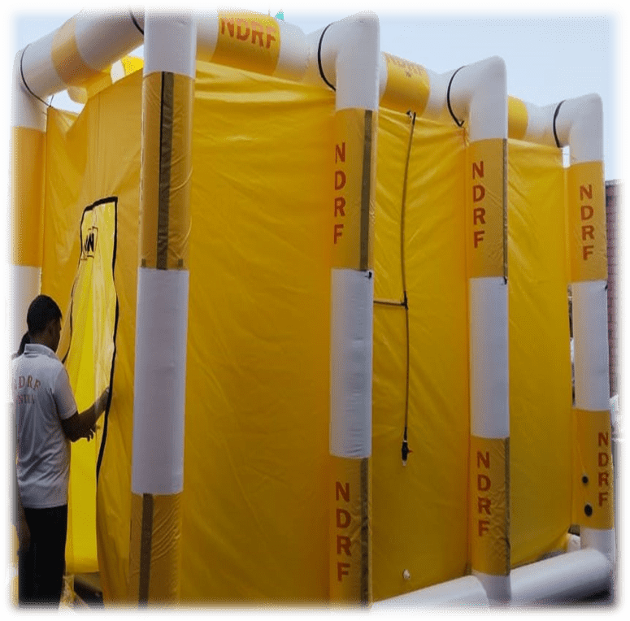
STEP -7 SHOWRING

Slide 27
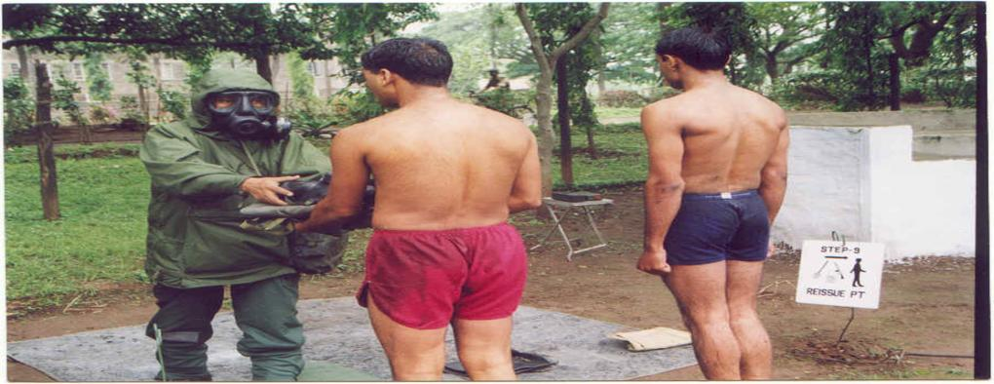
STEP- 8 RE-MONITORING.

Slide 28
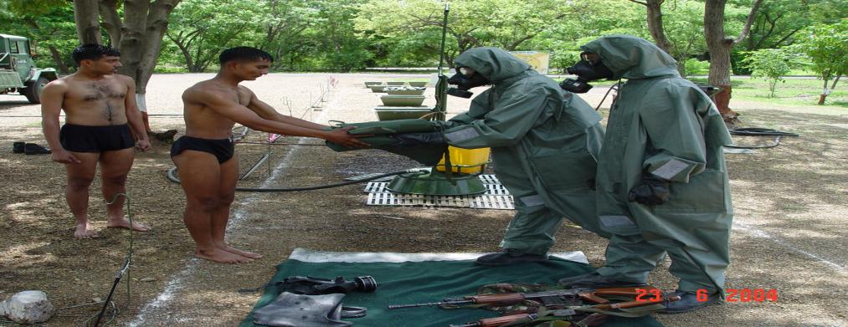
STEP-9 RE ISSUE CLOTHING/REGISTRATION

Slide 29
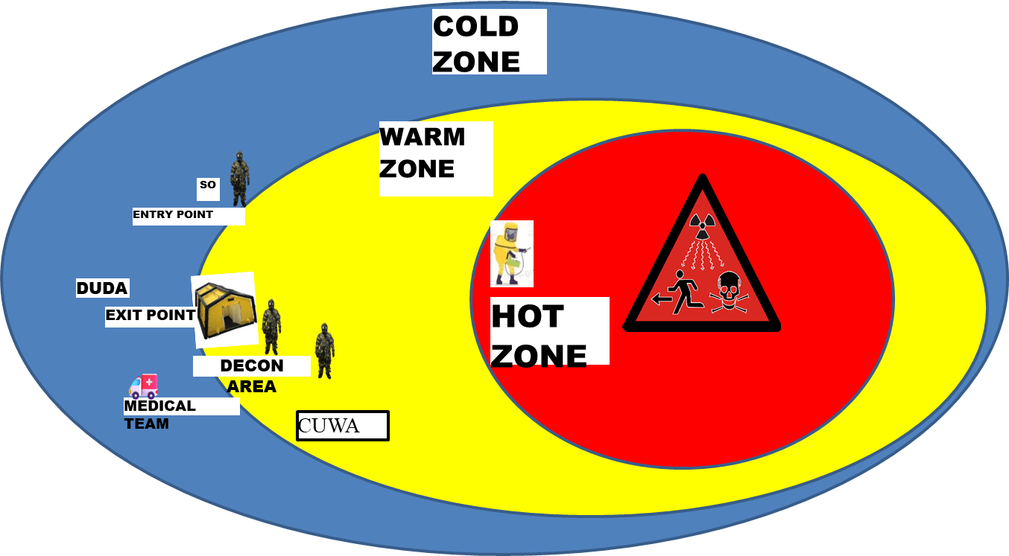
STEPS OF DECON AT SITE

Slide 30
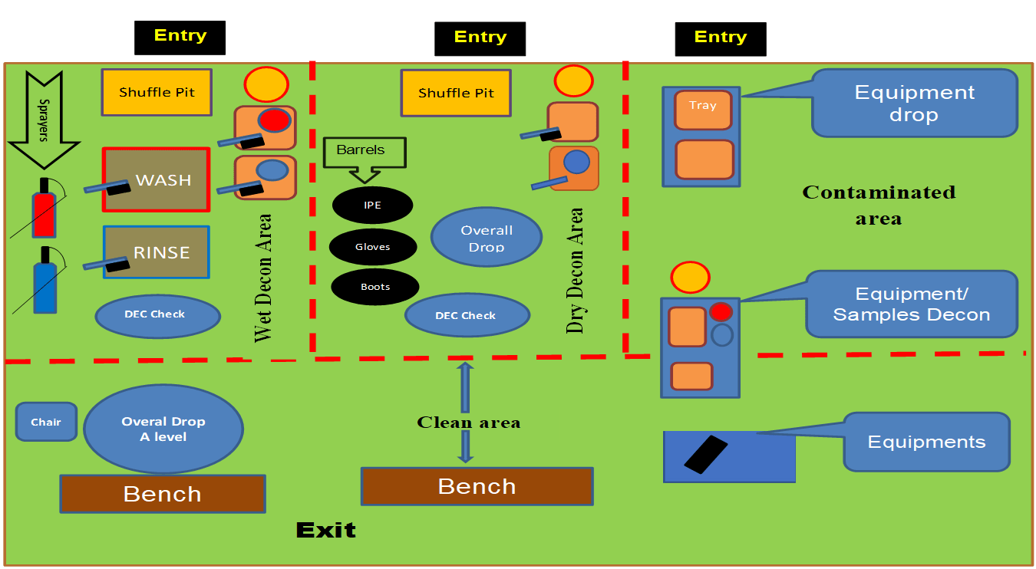
LAYOUT OF DECON STATION

Slide 31
STEPS FOR
EQUIPMENT DECON.
Isolation and Segregation
Initial Survey
Removal of Loose Contamination
Decontamination
Monitoring and Survey
Repeat Decontamination, In cases of persistent or high levels of contamination
Equipment Inspection
Documentation
Release for Use

Slide 32
EQUIPMENT
DECON.
  Immediate decontamination of personal equipment and certain other kinds of smaller equipment is generally done with individual decontaminants.
  The decontamination of equipment is done by PDK-2.
  Equipment / material can be painted with chemical resistant paint system e.g. polyurethane paint.
  Other methods are utilizing heat, steam or hot air.

Slide 33
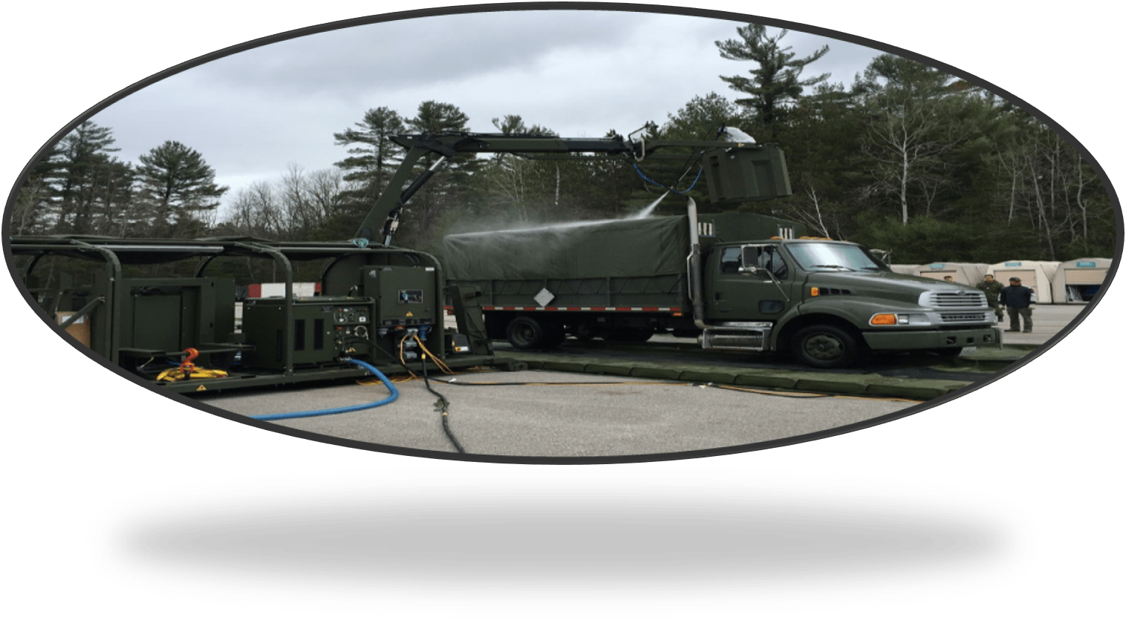
VEHICLE DECONTAMINATION
Requires large water supplies.
Set up decontamination station close to water source.
Rescuers involved should wear non-permeable rubber suits.

Slide 34
PHASES OF
VEHICLE DECON.
Pre treatment.
Main treatment (Tetrachloride Ethylene)
Reaction station (30 Min.)
Post treatment
Interior decontamination .
Monitoring.

Slide 35
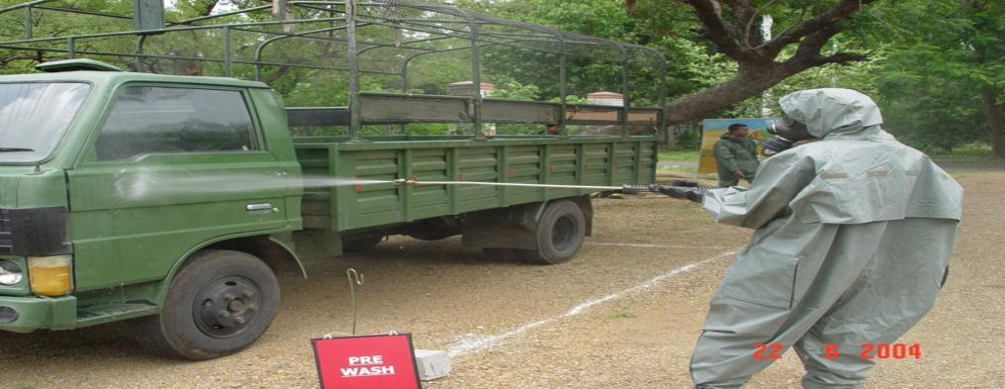
PRE TREATMENT

Slide 36
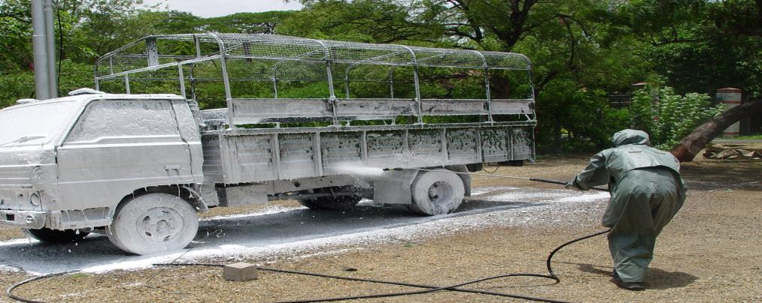
MAIN TREATMENT

Slide 37
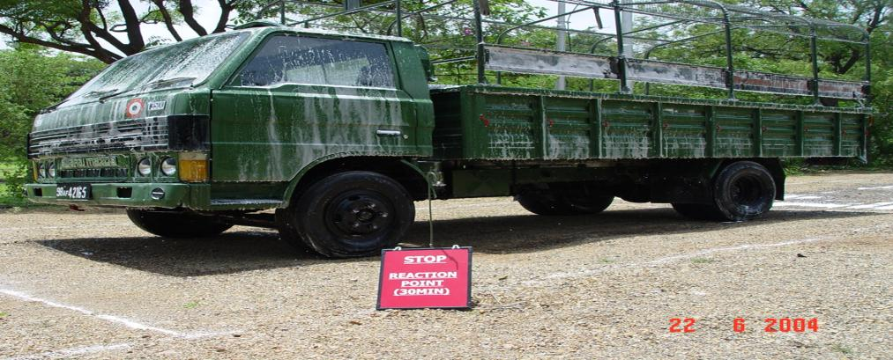
REACTION STATION

Slide 38
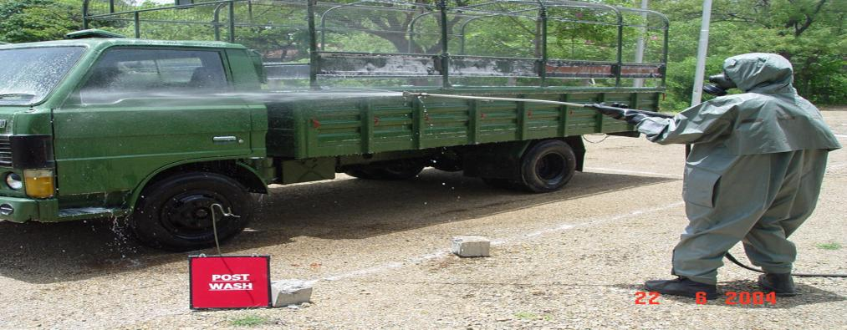
POST TREATMENT

Slide 39
INTERIOR
DECON.
Purpose: Decon Of Crew Compartment And Dvr Exch Point.
Procedure: Dvr Opens All Hatches, Pers From Decn Team Enters And Wipes Surfaces With Hot Water. Decon Can Be Carried Out With PDA, Decon.fog Etc
Reqmts:
  Pers : One
  Mtrl : Hot Water/Steam
.

Slide 40
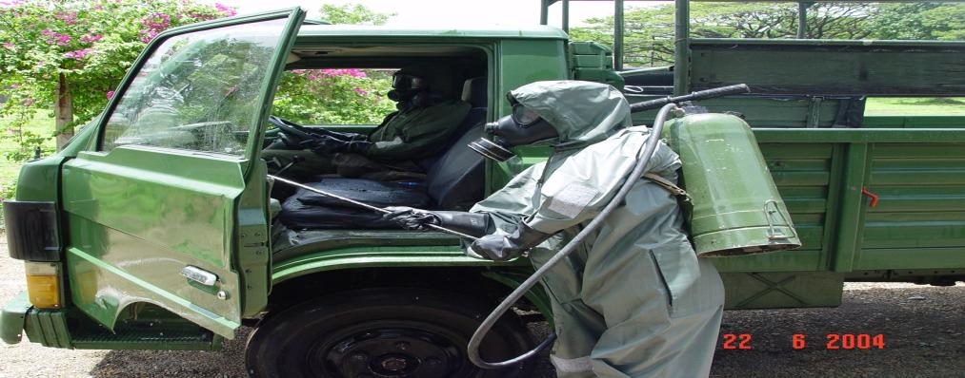
INTERIOR DECON.

Slide 41
MONITORING
Purpose: Tells Whether Significant Contamination Is Present Or Not.
Procedure: Chem Detector Papers To Blot Various Dry Surfaces On Veh/Or Use Of RVD Kit/Cam.
Reqmts
  Pers: Two,: One With Chem Detection Other With Radio Meter. (Both From Contaminated Unit)
  Mtrls
    Chem Detector Paper.
    RVD
    Radio Meter.

Slide 42
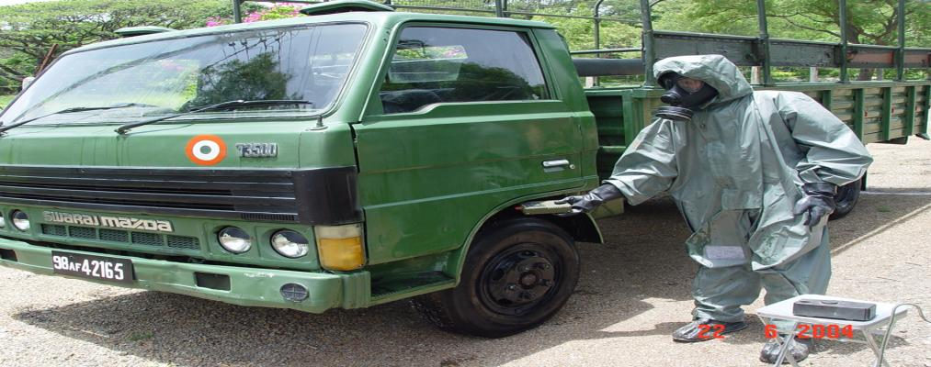
MONITORING

Slide 43
AREA
DECON.
Mop the area with soap solution – dry mop
the area
Check for any loose contamination
Mop with soap solution mixed with citric acid
If contamination remains - Chipping and re-plastering (Concrete)
-Acid cleaning
-Painting of surface ( low contamination)

Slide 44
DECON.
ARRANGEMENTS
Trained decontamination team
Setup site for decontamination
Dressing and undressing team
Full protection gear
Hand held detection devices
Decontamination solution and devices
Communication devices
Transport

Slide 45
REVIEW
Now you are able to know :-
Contamination
Types of contamination
Concept of decontamination
Types of decontamination
Steps of decontamination
Decontamination of personnel, Vehicle & Equipment.

Slide 46

ANY QUESTION ?

Slide 47
EVALUATION
Q. 1. Weight of PDK-II
a) 80 mg
b) 20 gm
c) 80 gm
d) 20 mg
Q. 2. ------- % of Diethylene triamine in DS-2
a) 2 %
b) 28 %
c) 70 %
d) 72 %

Slide 48
THANK YOU

