Slide 1




MAPS ON DISASTER MANAGEMENT IN SCHOOL
Presented by:- Amit Kumar, AC
PEER | CSSR | INDIA
PPT 2 -

Slide 2




Objective
What is a map in context of SDMP
Importance of maps
Types of map

Slide 3

MAPS FOR SDMP:
While preparing disaster management planning of a school, map is an important document to depict various locations, resources, vulnerable zones, safe zones, escape route, etc.

Slide 4
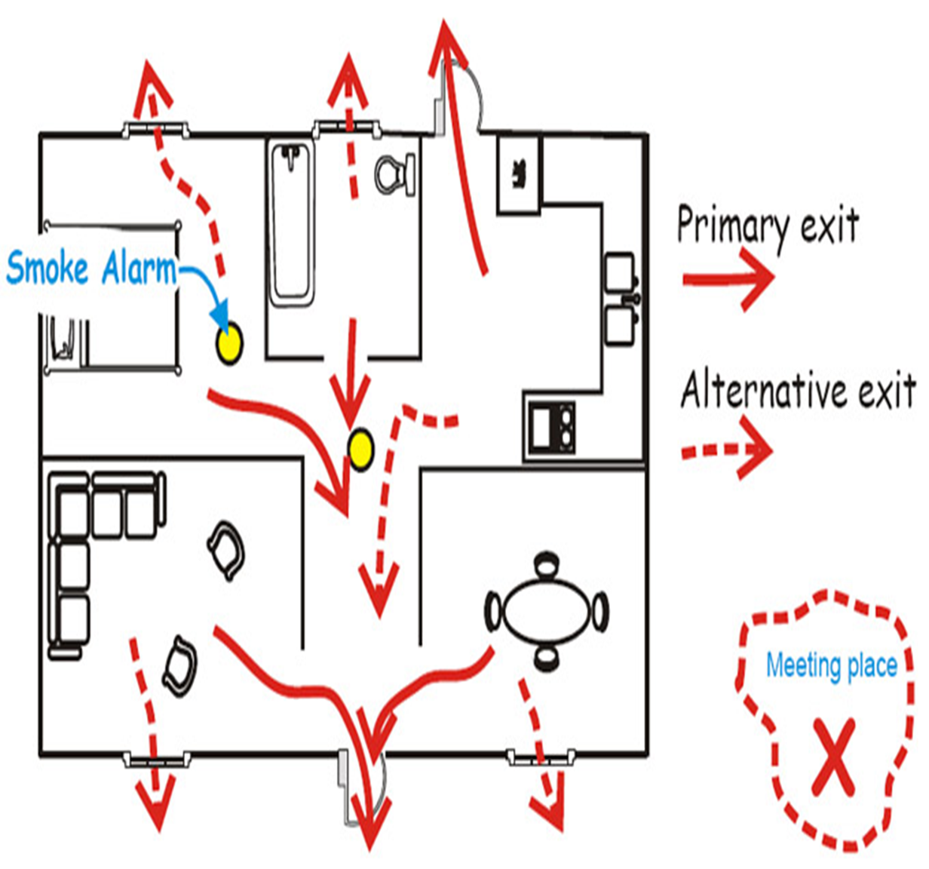

Slide 5
Map for SDMP
Exit routes & the location of the resources available.
Hazards map
        Electric circuit panel
        Inflammable fuel/ chemical store
        Etc.

Slide 6
Social Map/SDMP map :
Physical Location of the school.
Number of classrooms in the school.
Laboratories in the school.
The school canteen and any prominent land mark in the school.
The play grounds and open spaces within the school premises.

Slide 7


Slide 8
MAP
A diagrammatic representation of an area of land showing physical features, cities, roads, etc.

Slide 9
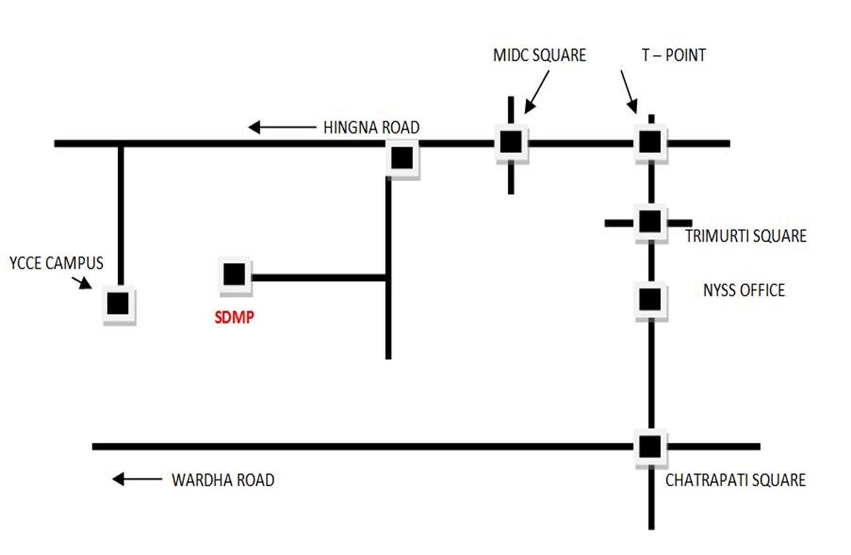
LOCATION MAP
The physical location of the school building and its surrounding.
School

Slide 10
D.M. Kit
Stretchers
Fire Extinguishers
Ladders
Thick Ropes
Torch
Communication System
First Aid Box
Temporary Shelters (Tents/Tarpaulins)
Lab Safety Equipment (PPE)
RESOURCES

Slide 11
Create Inventory of Resources available in school
List of skilled human resources
Inventory of nearest available critical resources along with details: Name, address and contact number.
List of material resources available in the school.

Slide 12
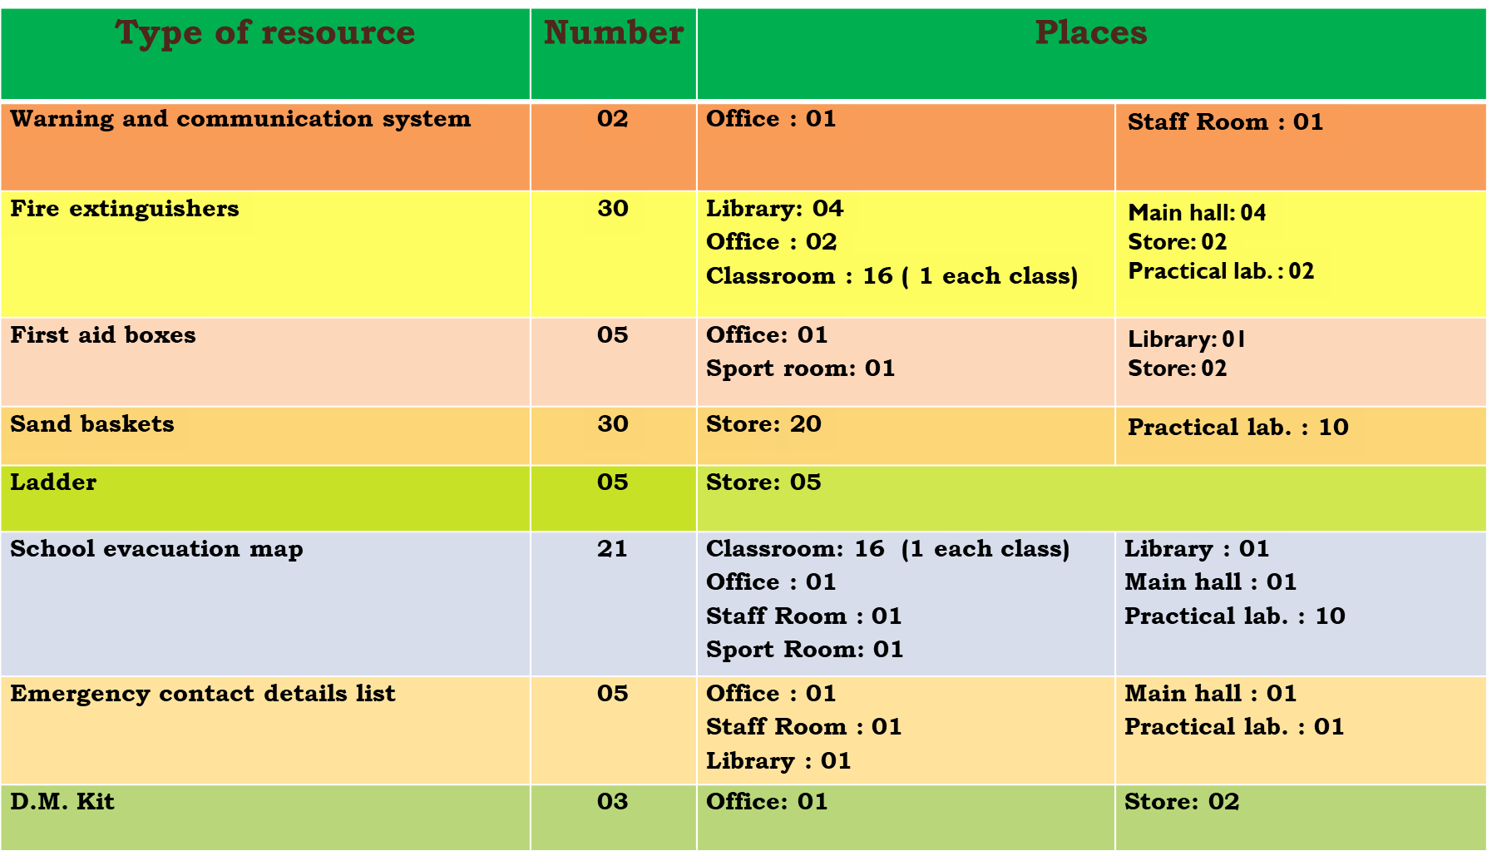
Inventory of Resources available in the school

Slide 13
Chart of Potential Hazards in and around the school
Type of hazards | Possible places | Possible solution identified
Fire in electric cables | In the Main hall In the Library In the Physics/chemistry labs In the Office In the classroom | Rewiring the electric system Trip switches Using Display instructions Use fire braking mechanisms (fire extinguisher/ and baskets)
Chemical spill | in the chemistry lab | Use proper storing mechanisms Use proper instructions Keep chemical protective equipment
Damages from older buildings (Breaking the Ceiling/Tiles) | In class rooms In office and all ceiling room | Reconstruct the ceiling

Slide 14
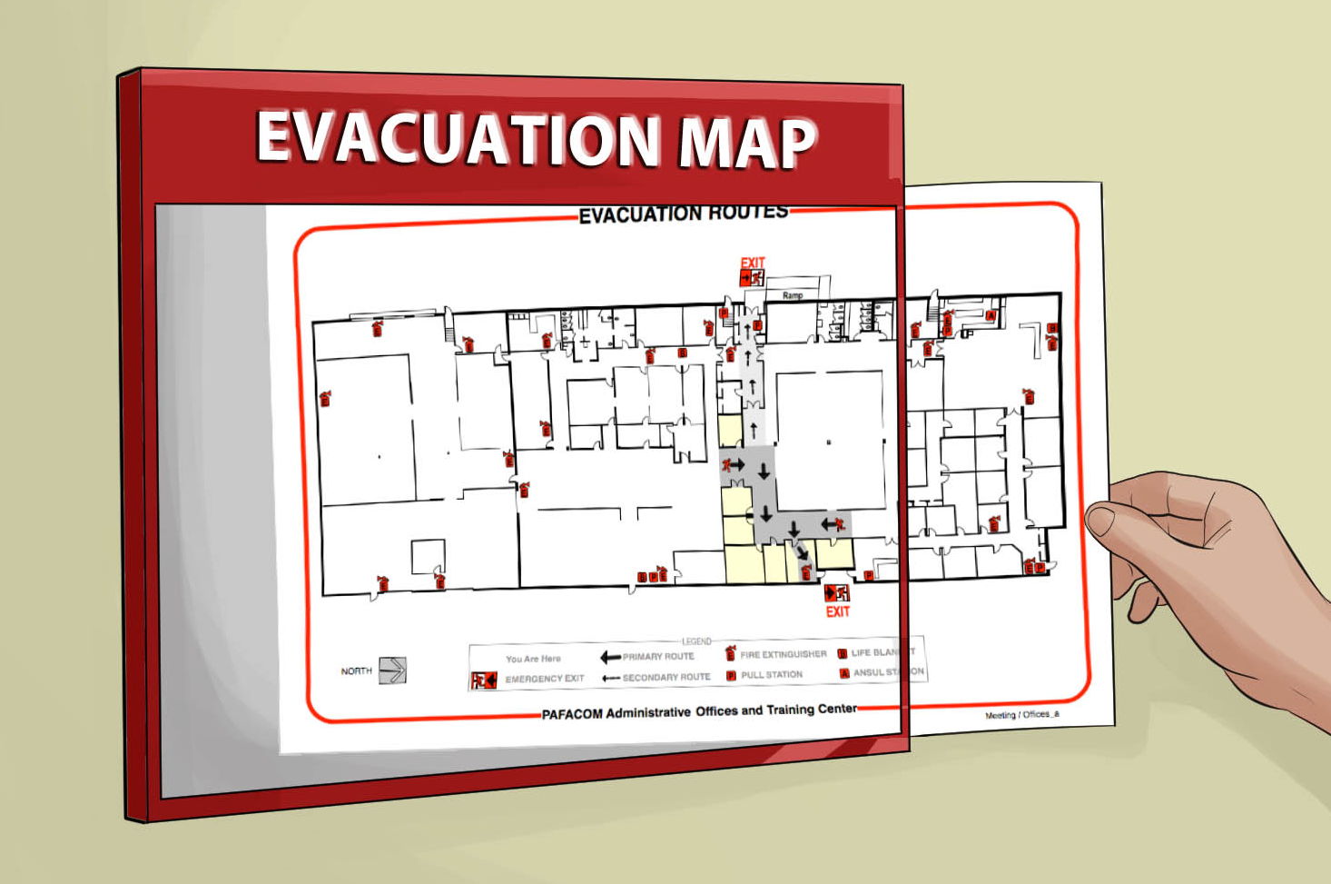
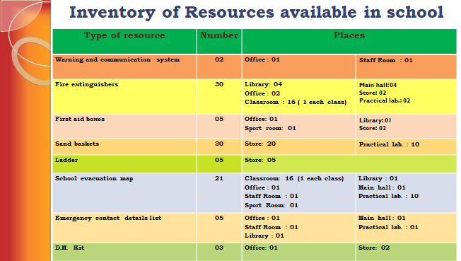
Inventory of emergency Resources

Slide 15
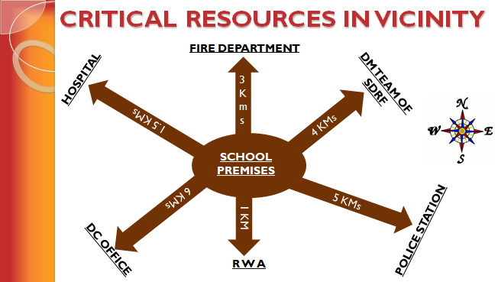

Slide 16

DC OFF.
RWA
DM TEAM

Slide 17
VULNERABILITY MAP/CHART
Library | Unclamped book shelves Uncovered Power cables & AC
Practical lab. | Chemicals, inflammable liquids Power cable, spark plaque & AC Unclamped shelves
Stairs | Ensure no any luggage in stairs.
Classroom | Power cable, spark plaque & AC Tables, chairs, benches, etc.
Play ground

Slide 18
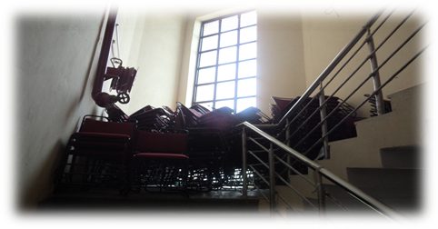
Exit route should be clear no any obstruction

Slide 19
Safe places map:
Safe place marking in school.
Playground
Verandas
Other open space area.

Slide 20
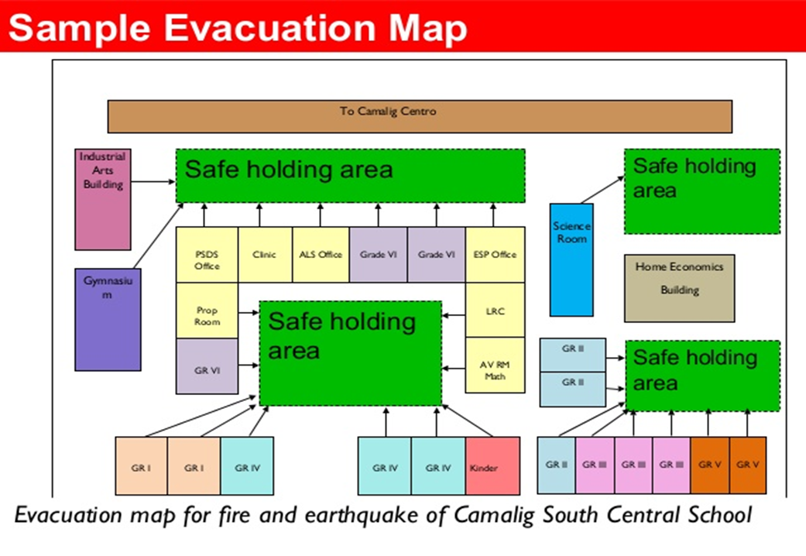

Slide 21
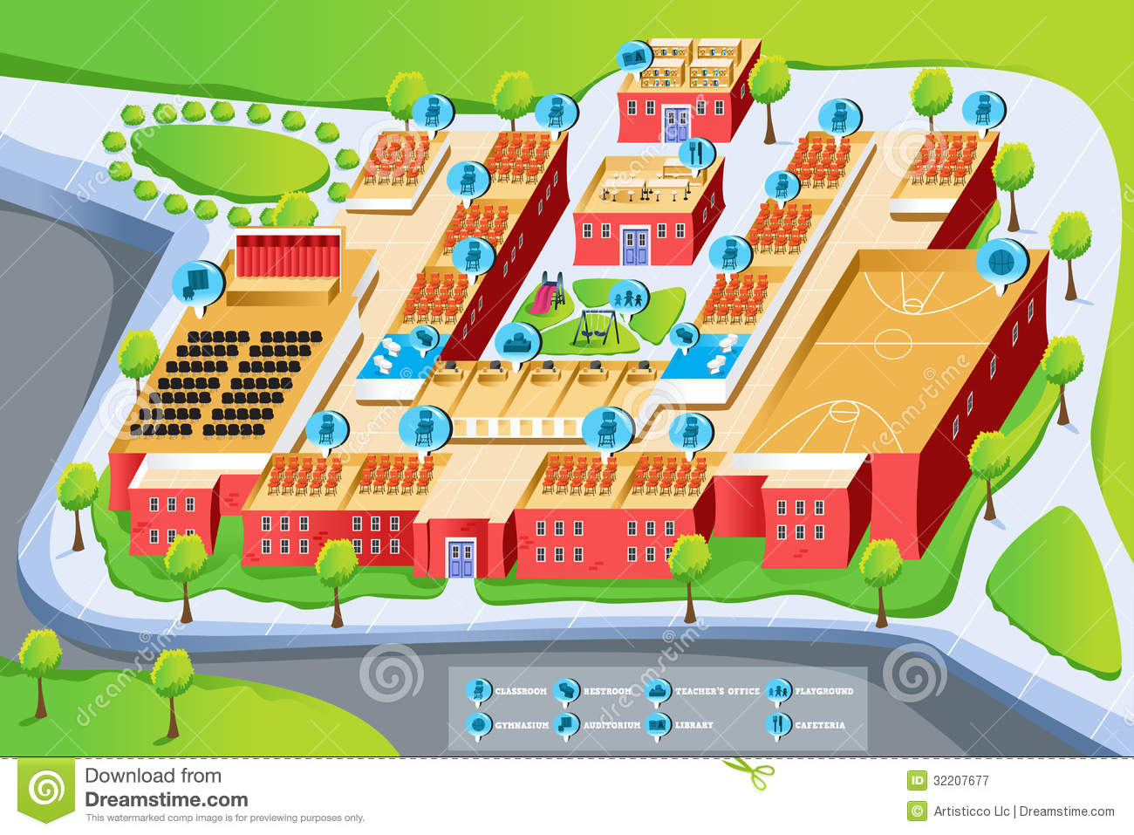




Slide 22
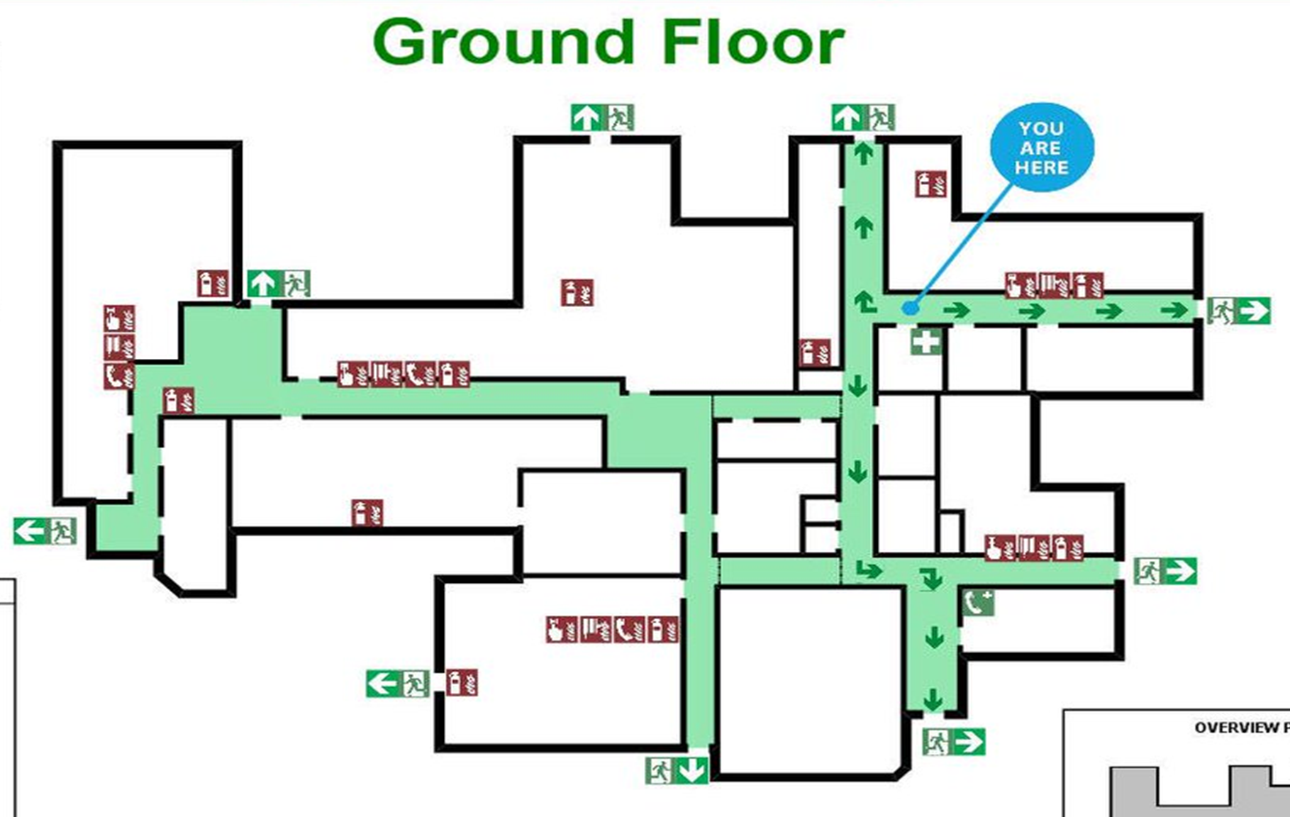
SCHOOL EVACUATION PLAN MAP

Slide 23
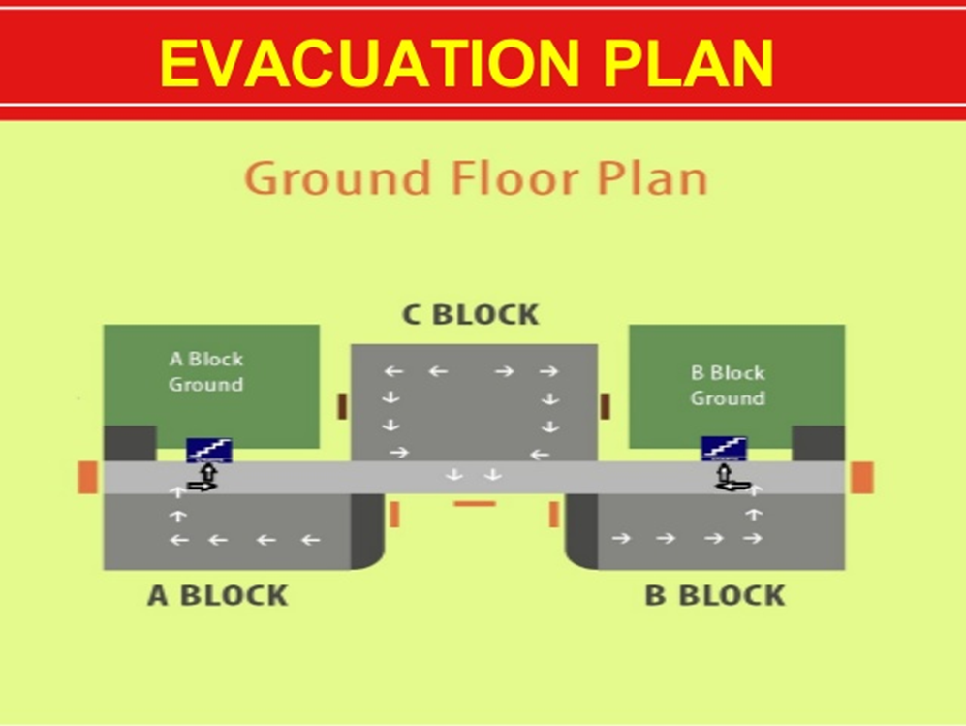

Slide 24

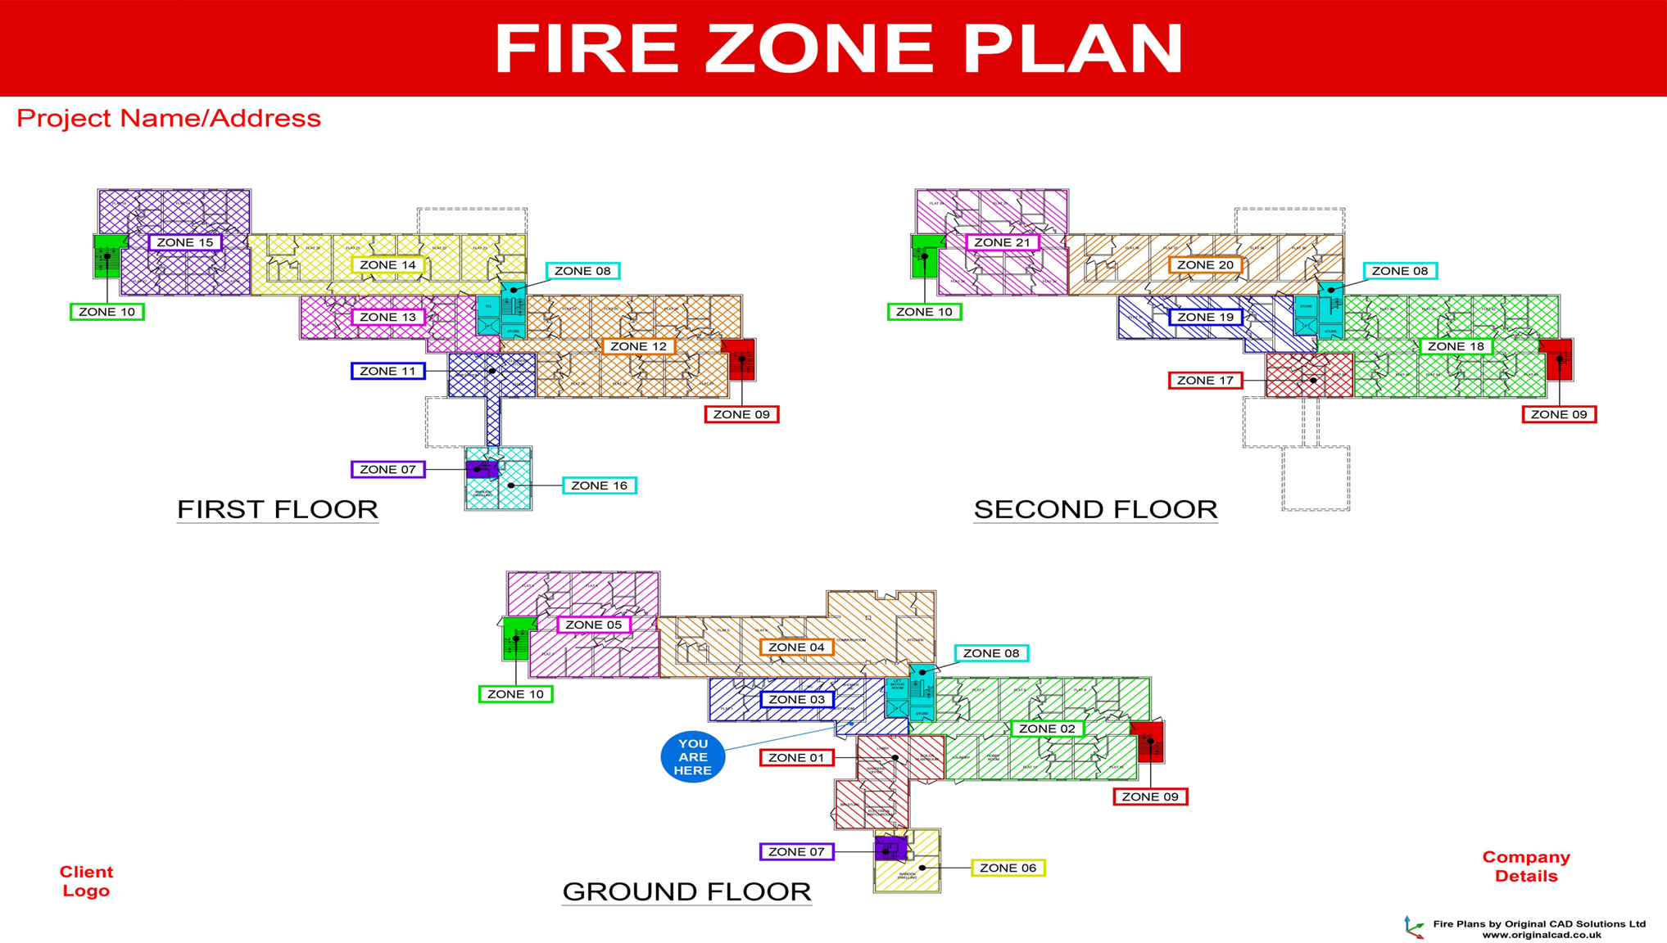

Slide 26

Area Evacuation Plan
Police station
School
Alternative route

Slide 27


ANY QUESTION?

Slide 28
Review
What is a map in context of SDMP
Importance of maps
Types of map

Slide 29
Evaluation
1. SDMP means?
Ans ;- School disaster management planning

Slide 30



THANK YOU

