Slide 1


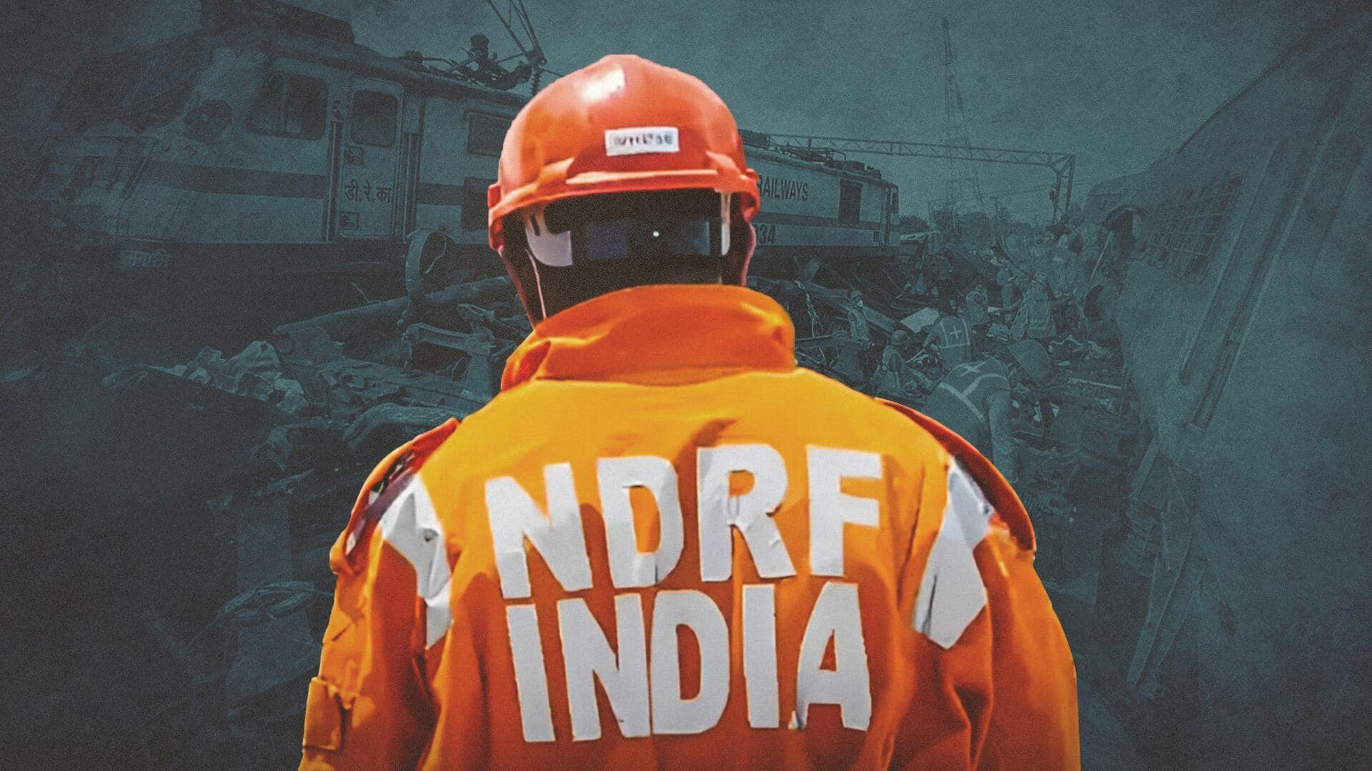

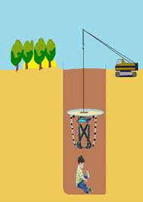
BOREWELL RESCUE
LESSON 02
LEGAL ASPECT OF BOREWELL RESCUE & MEDIA MANAGEMENT
Presented By:- Pavan Dev Gaur,2IC

Slide 2


OBJECTIVES
What is Borewell.
Guidelines regarding bore well safety measures by Supreme Court.
Media Management
Upon completion of this lesson, you will be able to :-
1
2
3
4

Slide 3
A bore well is a well of 4 " to 12" in diameter drilled into the earth for retrieving water. High grade PVC pipes are used for Casing in bore wells. The depth of a bore well can vary from 50 feet to 1500 feet.
What is bore well
or
A deep, narrow well for water that is drilled into the ground and has a pipe fitted as a casing in the upper part of the borehole, typically equipped with a pump to draw the water to the surface

Slide 4
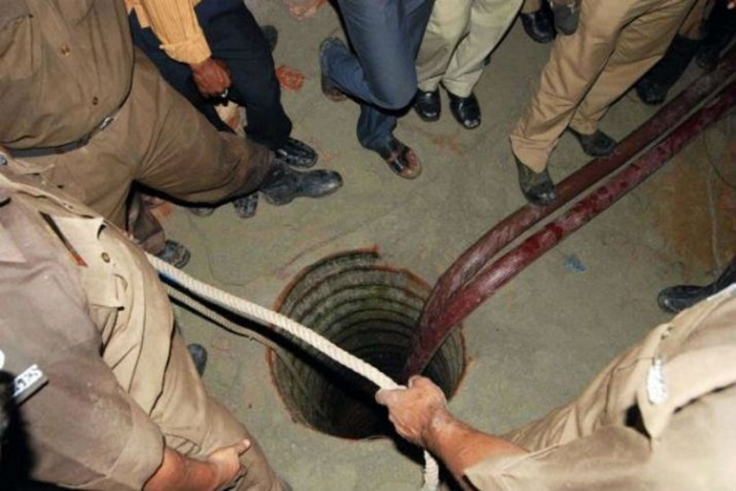
What is bore well

Slide 5
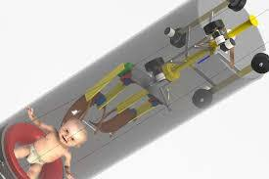
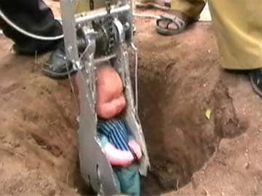
What is bore well

Slide 6
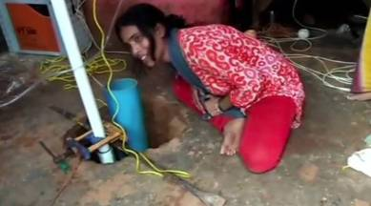
What is bore well

Slide 7
GUIDELINES REGARDING BORE WELL SAFETY MEASURES BY SUPREME COURT
Safety measures/guidelines as given in the Order dated 11.02.2010 of Hon’ble Supreme Court is to be observed by all the States: -
“ The owner of the land/premises, before taking any steps for construction bore well/tube well must inform in writing at least 15 days in advance to the concerned authorities in the area, i.e., District Collector/District Magistrate/Sarpanch of the Gram Panchayat/ Concerned officers of the Department of Ground Water/ Public Health/Municipal Corporation, as the case may be, about the construction of bore well/tube well”

Slide 8
ii) Registration of all the drilling agencies, viz., Govt./Semi Govt./Private etc. should be mandatory with the district administration.
iii) Construction of cement/concrete platform measuring 0.50x0.50x0.60 meter (0.30 meter above ground level and 0.30 meter below ground level) around the well casing.
iv) Capping of well assembly by welding steel plate or by providing a strong cap to be fixed to the casing pipe with bolts and nuts.
GUIDELINES REGARDING BORE WELL SAFETY MEASURES BY SUPREME COURT

Slide 9
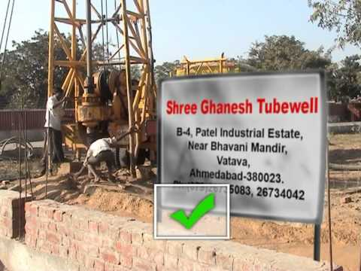
v) Erection of signboard at the time of construction near the well with the following details:-
(a) Complete address of the drilling agency at the time of construction/rehabilitation of well.
(b) Complete address of the user agency/owner of the well.
GUIDELINES REGARDING BORE WELL SAFETY MEASURES BY SUPREME COURT

Slide 10
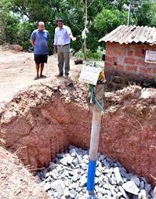
vi) Erection of barbed wire fencing or any other suitable barrier around the well during construction.
vii) In case of pump repair, the tube well should not be left uncovered.
viii) Filling of mud pits and channels after completion of works.
ix) Filling up abandoned Bore wells by clay/sand/boulders/pebbles /drill cuttings etc. from bottom to ground level
GUIDELINES REGARDING BORE WELL SAFETY MEASURES BY SUPREME COURT

Slide 11
x) On completion of the drilling operations at a particular location, the ground conditions are to be restored as before the start of drilling.
xi) District Collector should be empowered to verify that the above guidelines are being followed and proper monitoring check about the status of boreholes/tube-wells are being taken care through the concerned State/Central Government agencies.
GUIDELINES REGARDING BORE WELL SAFETY MEASURES BY SUPREME COURT

Slide 12
GUIDELINES REGARDING BORE WELL SAFETY MEASURES BY SUPREME COURT
xii) District/Block/Village wise status of bore wells/tube-wells drilled viz. No. of wells in use, No. of abandoned bore wells/tube wells found open, No. of abandoned Bore wells/tube wells properly filled up to ground level and balance number of abandoned Bore wells/tube-wells to be filled up to ground level is to be maintained at District Level. In rural areas, the monitoring of the above is to be done through village Sarpanch and the Executive from the Agriculture Department.

Slide 13
GUIDELINES REGARDING BORE WELL SAFETY MEASURES BY SUPREME COURT
(xiii) If a Bore well/tube-well is ‘Abandoned’ at any stage, a certificate from the concerned department of Ground Water/Public health/Municipal Corporation/Private contractor etc. must be obtained by the aforesaid agencies that the ‘Abandoned’ Bore well/tube-well is properly filled up-to the ground level. Random inspection of the abandoned wells is also to be done by the Executive of the concern agency/department.
Information on all such data on the above are to be maintained in the District Collector/Block Development Office of the State.

Slide 14
Secure the scene by cordoning the bore well to avoid any unwanted objects falling into the bore well and causing harm to the child and thus hamper the rescuing efforts.
• Cordon the affected area and control unnecessary movements/crowd gathering near the bore well.
• Try to stabilize the victim, if possible, with the help of rope.
• Arrangement of sufficient lights in the area for the night operation.
• Make arrangements for supplying of oxygen to the child with the help of pipe.
MEASURES AFTER BORE WELL INCIDENT

Slide 15
Immediately contact the nearby NDRF Unit.
Keep motivating the victim by regular talking of parents or relatives.
District medical officer should be made aware about the compartment compression syndrome and action to be taken in such cases.
MEASURES AFTER BORE WELL INCIDENT

Slide 16
Don’t leave the tube well/bore well uncovered after repair/daily work done.
Do not throw any food article or pour water in the Bore well.
Do not allow underground water seepage in bore well.
Do not allow heavy machines to work at full power to avoid heavy vibration which may result in loosening of surrounding soils and collapse of the bore well.
Do not allow crowd to gather around the incident site.
Don’ts

Slide 17
Media and other people who do not have a direct role in the rescue work should be kept at a safe distance.
Periodical briefing by the incident commander/team commander can be done to maintain the flow of information.
However, it should be ensured that such information is restricted strictly to ongoing/concluded rescue efforts only.
Media Management

Slide 18
Now you are able to:-
What is Borewell.
Guidelines regarding bore well safety measures by Supreme Court.
Media Management
REVIEW

Slide 19
ANY QUESTION ?

Slide 20



THANK YOU

