Slide 1





COLLAPSED STRUCTURE SEARCH AND RESCUE
LESSON 1
COURSE INTRODUCTION
LESSON 2
ORGANIZING AND STARTING
A CSSR OPERATION
Presented By:- Kamlesh Dhoundiyal,2IC
NDRF | CSSR | INDIA
PPT 2-1

Slide 2
OBJECTIVES
Upon completing this lesson, you will be able to:
1
Define a collapsed structure search and rescue operation.
Describe the structure of a CSSR squad and the positions within it.
List five phases of a CSSR operation.
2
3
NDRF | CSSR | INDIA
PPT 2 -

Slide 3
OBJECTIVES
4
List the six stages of
the Operations Phase.
List the five steps of
the initial assessment.
Describe how a CSSR squad fits into the Incident Response System.
Name the four levels in the scope of operations as they pertain to CSSR.
Upon completing this lesson, you will be able to:
5
6
7
NDRF | CSSR | INDIA
PPT 2 -

Slide 4
COLLAPSED STRUCTURE SEARCH AND RESCUE
According to the National Disaster Management Act (NDMA 2005) CSSR is an operation to conduct safe and effective search and rescue operations at collapsed structure incidents involving the collapse or failure of reinforced and unreinforced masonry, concrete, tilt-up and heavy timber construction.
NDRF | CSSR | INDIA
PPT 2 -

Slide 5
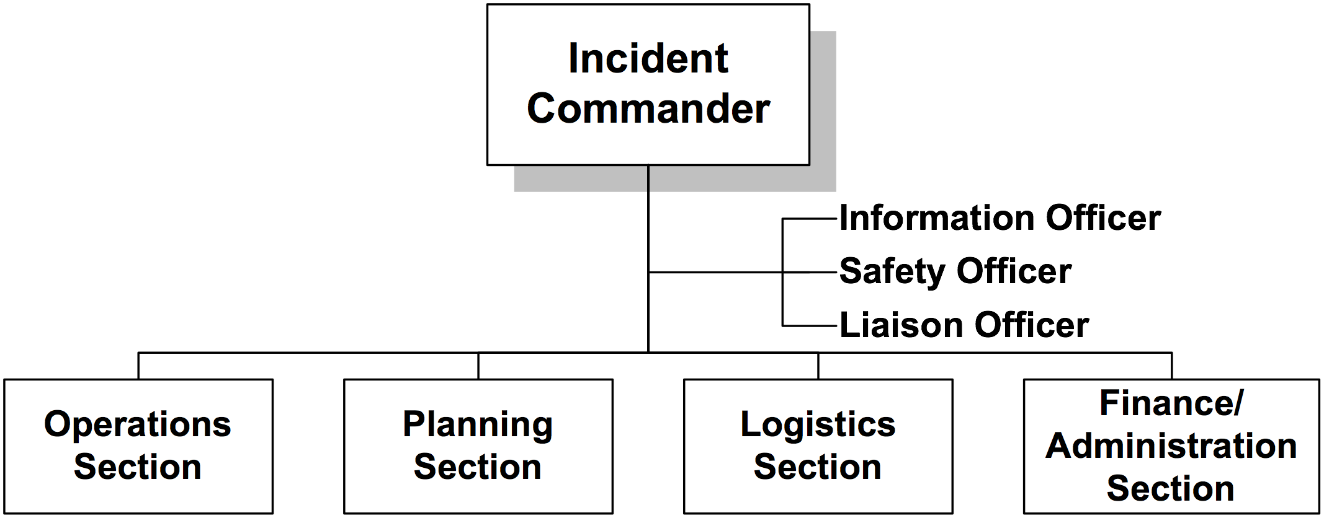
INCIDENT COMMAND SYSTEM
A flexible system for managing people and resources.
NDRF | CSSR | INDIA
PPT 2 -

Slide 6
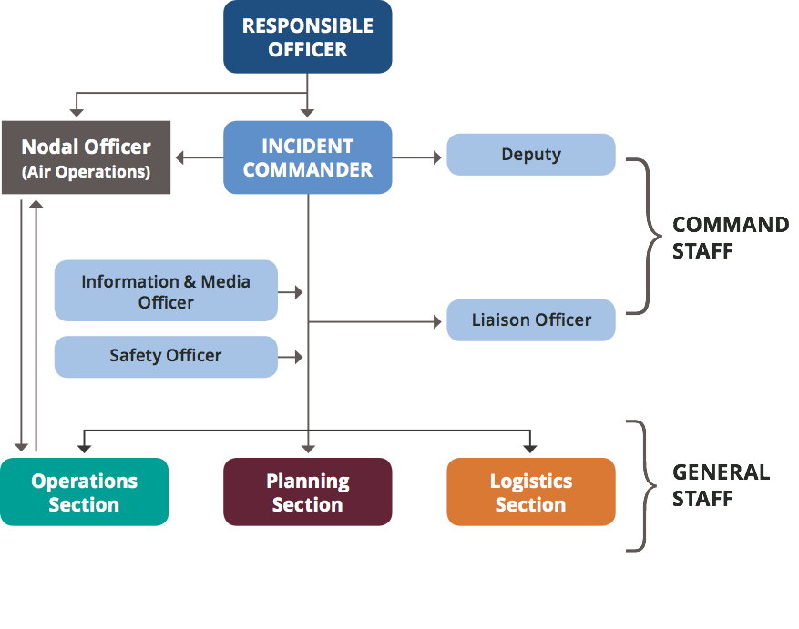
INCIDENT RESPONSE SYSTEM
NDRF | CSSR | INDIA
PPT 2 -

Slide 7
CSSR SQUAD
An active component of an emergency response system whose purpose is to search for, locate, gain access to, stabilise and extricate trapped victims from a collapsed structure.
NDRF | CSSR | INDIA
PPT 2 -

Slide 8
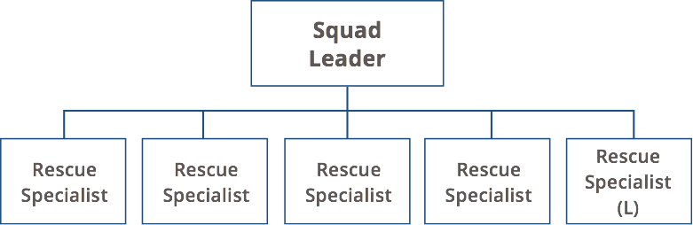
CSSR SQUAD ORGANISATION
(L) – Squad members rotate positions as Logistics Person
NDRF | CSSR | INDIA
PPT 2 -

Slide 9
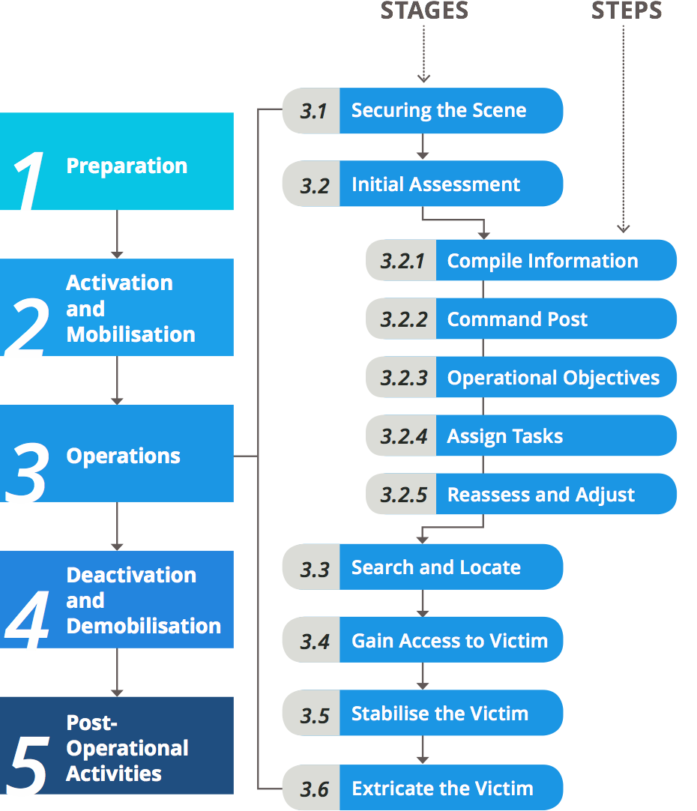
PHASES
OF A CSSR OPERATION
NDRF | CSSR | INDIA
PPT 2 -

Slide 10
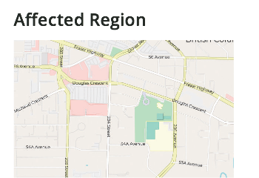


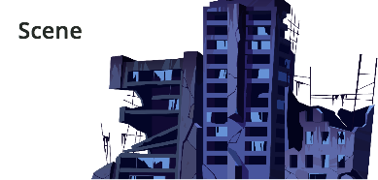
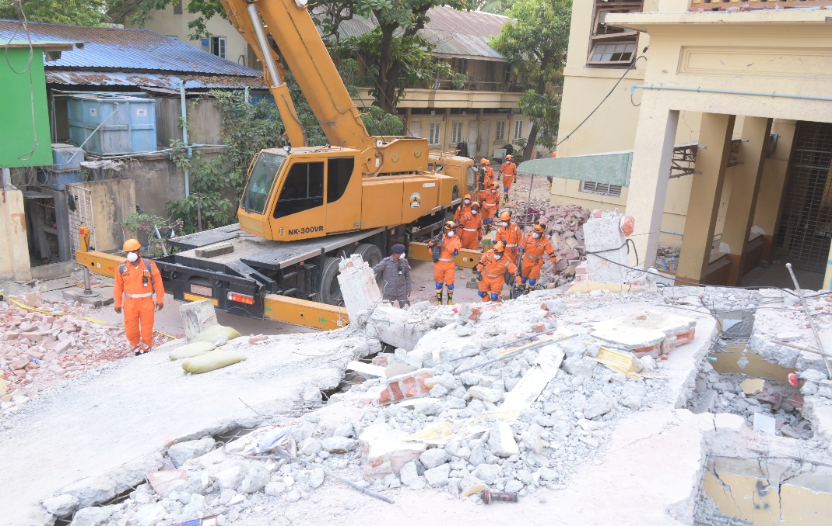
SCOPE OF OPERATION
Work Site
NDRF | CSSR | INDIA
PPT 2 -

Slide 11



THANK YOU

