Slide 1


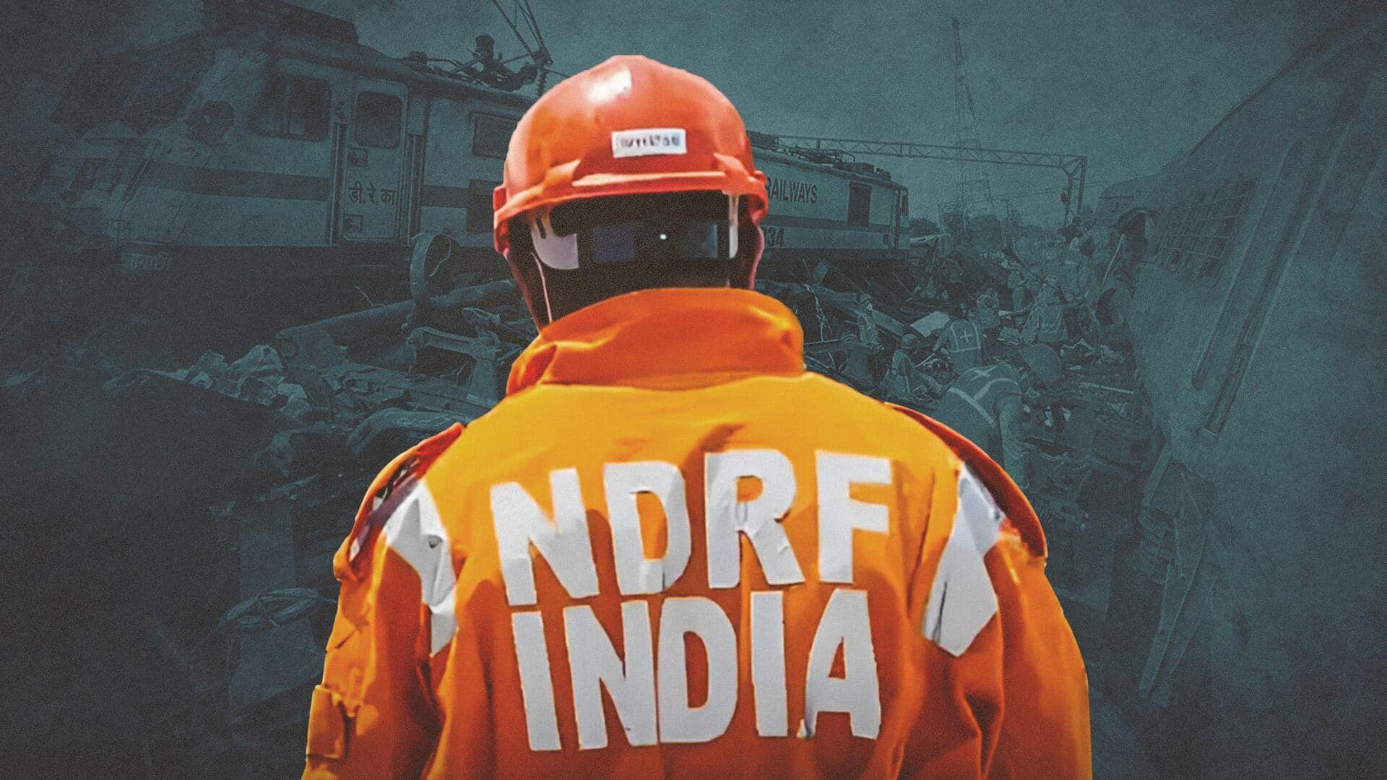


CADRE
Lesson 2
Common Hazards and the Community Response Group
Presented By:- Pavan Dev Gaur,2IC

Slide 2



OBJECTIVES
Define Hazards.
List the different classification of hazards and its possible consequences.
Define what a Community Responder is.
List the roles, responsibilities and limitations of a community responder.
List the Composition of CADRE squad.
List items in Personal Protective Equipment.
1
2
Upon completion of this lesson, you will be able to :-
3
4
5
6

Slide 3


A natural or man-made process, phenomenon, or activity that poses a potential threat of causing harm, including loss of life, injury, property damage, social and economic disruption, or environmental degradation.
HAZARDS

Slide 4
Natural Hazard
Biological Hazard
Technological Hazard
Civil-Political Hazard
COMMON HAZARDS

Slide 5
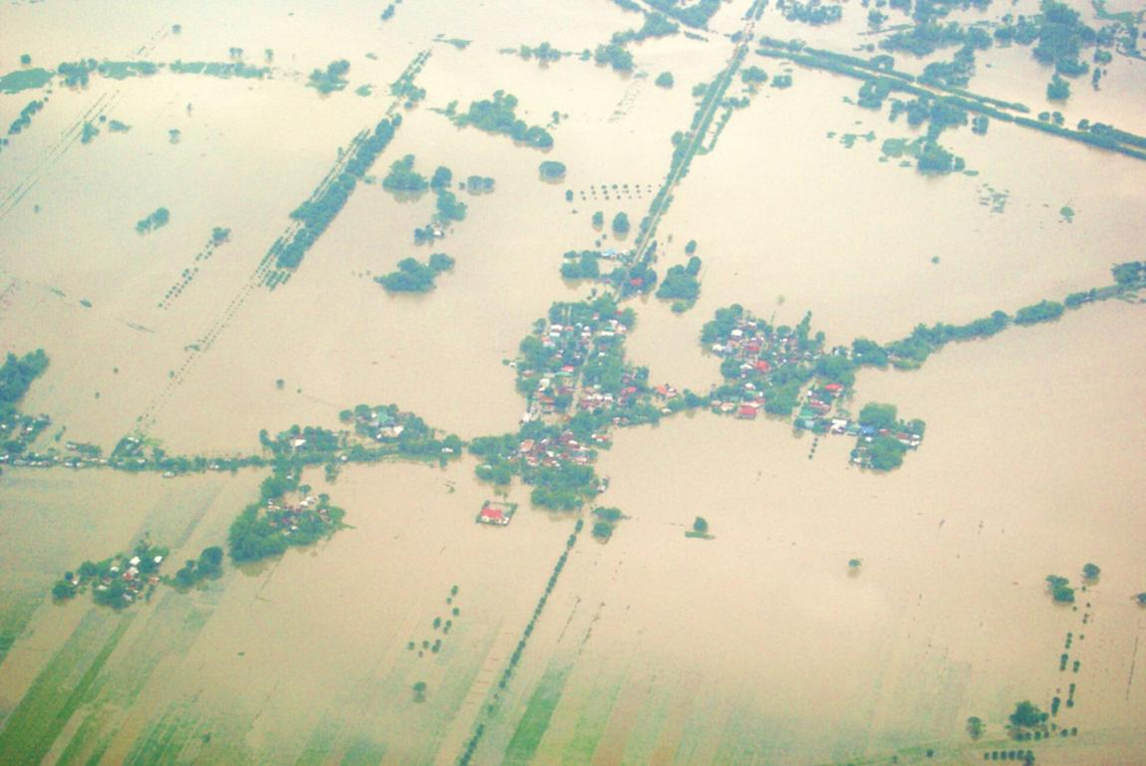
COMMON HAZARDS

Slide 6
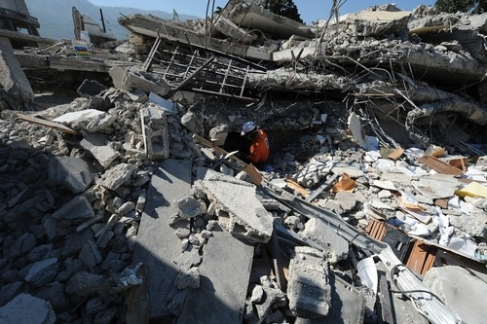
COMMON HAZARDS

Slide 7
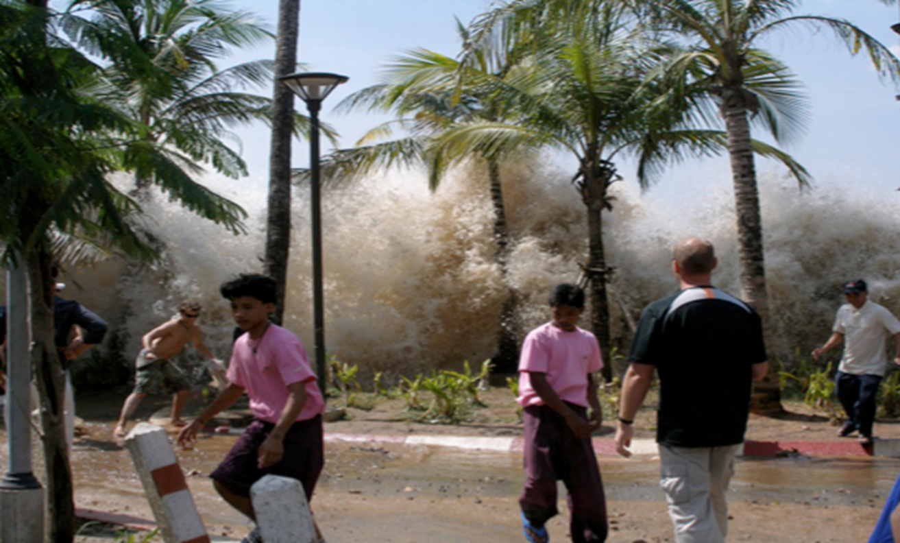
COMMON HAZARDS

Slide 8
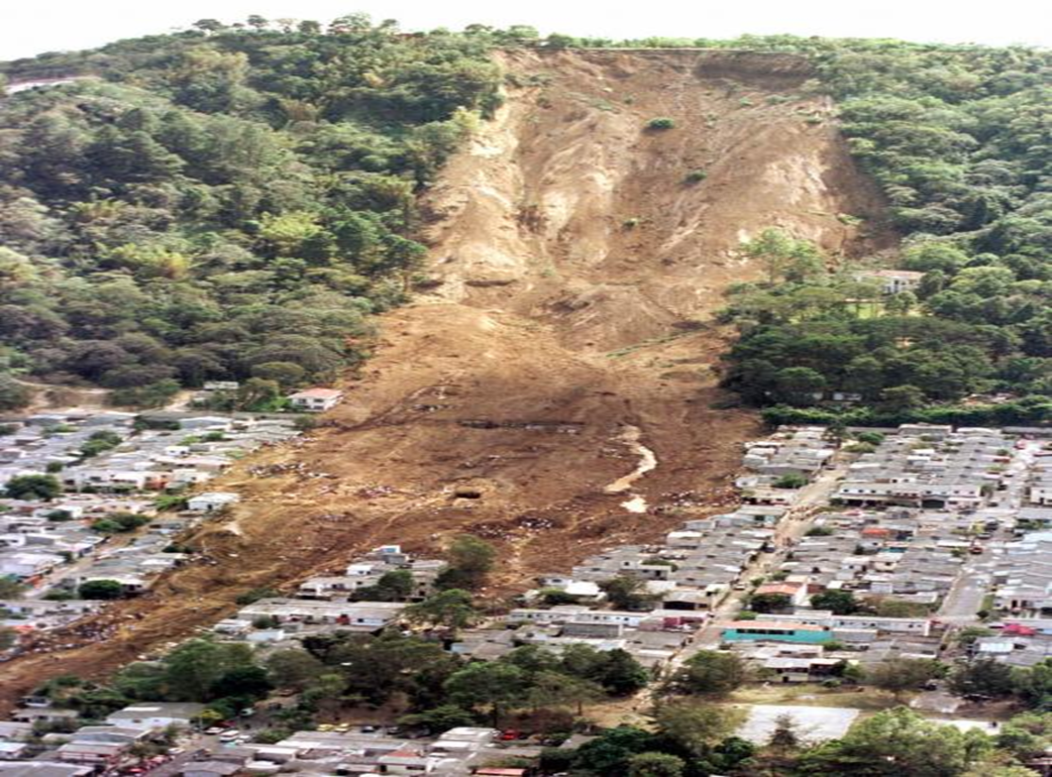
COMMON HAZARDS

Slide 9
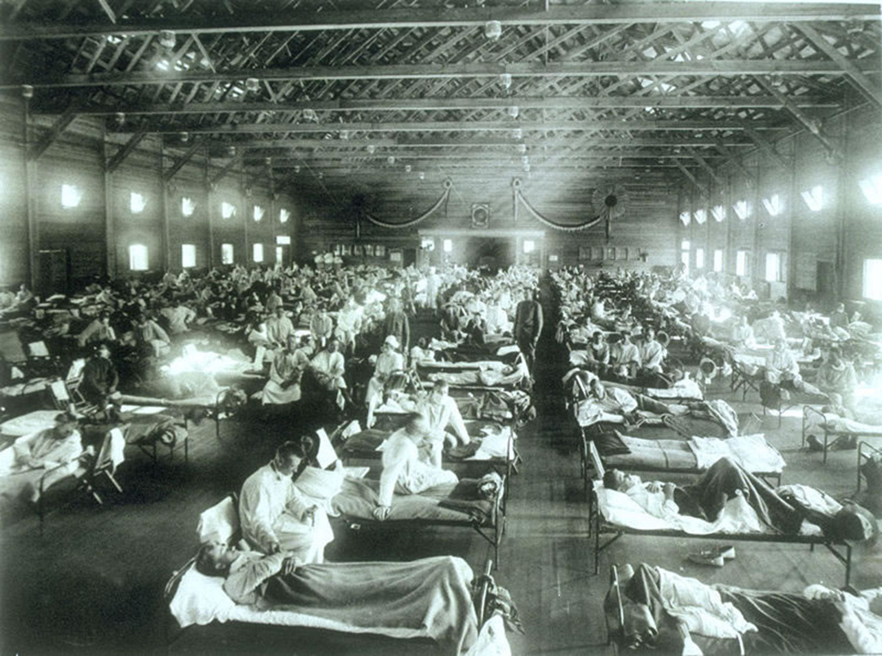
COMMON HAZARDS

Slide 10
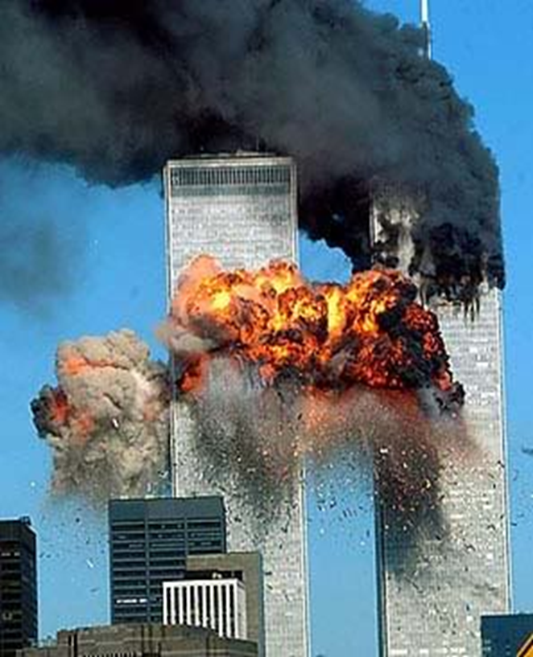
COMMON HAZARDS

Slide 11
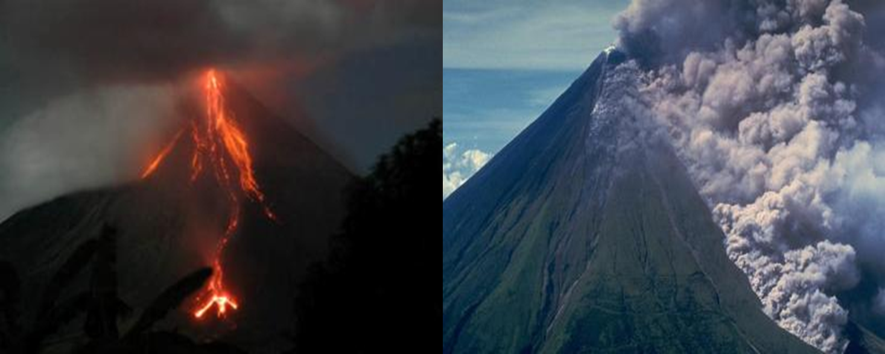
COMMON HAZARDS

Slide 12
A first responder, usually (but not exclusively) a lay person who has been trained to act in this capacity who can safely respond after a disaster or an emergency.
COMMUNITY RESPONDER

Slide 13
Helmet or hard hat
Goggles
Leather work gloves/medical gloves
Dust mask
Safety identification vest
Flashlight
Extra clothing and a hat
Sturdy & comfortable shoes or boots
Personal Protective Equipment

Slide 14
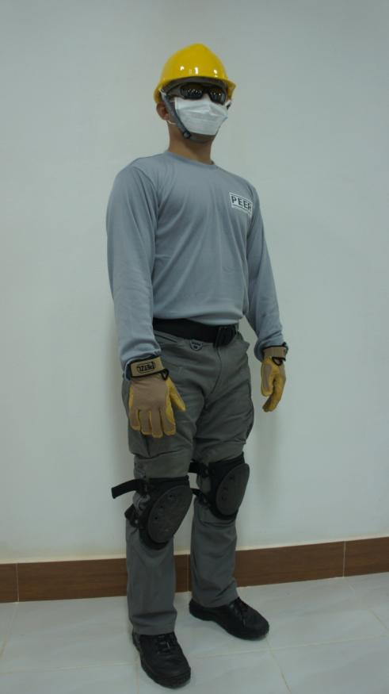
Personal Protective Equipment

Slide 15
REVIEW
Define Hazards.
List the different classification of hazards and its possible consequences.
Define what a Community Responder is.
List the roles, responsibilities and limitations of a community responder.
List the Composition of CADRE squad.
List items in Personal Protective Equipment.
1
2
Upon completion of this lesson, now you are able to :-
3
4
5
6

Slide 16



THANK YOU

