Slide 1




Aquatic Disaster Response Course
LESSON 02
UNDERWATER PHYSIOLOGY AND FIRST AID
Presented by:- Pavan Dev Gaur, 2IC
CAPF | ADRC | INDIA
-

Slide 2
OBJECTIVES
Upon completion of this lesson, you will be able to:
What is underwater diving ?
Common illness in underwater.
Describe of nitrogen narcosis, oxygen toxicity, Ear barotrauma, Pulmonary Over Inflation Syndrome & Pneumothorax.
First aid of drowning victim.
1
2
3
4

Slide 3

Under water diving
When human beings descend beneath the water, the pressure around them increases greatly.
To keep the lungs from collapsing, air must be supplied at very high pressure to keep them inflated.
The exposes the blood in the lungs also to extremely high alveolar gas pressure, a condition called Hyperbarism.
Beyond certain limits, these high pressures can cause great alterations in body physiology and can be lethal.
PPT 2 -

Slide 4
PRESSURE AT DEPTH
Depth (feet) | Atmosphere pressure
Sea level | 01
33 | 02
66 | 03
100 | 04
133 | 05
166 | 06
200 | 07
300 | 10
400 | 13
500 | 16
PPT 2 -

Slide 5
COMMON ILLNESS IN UNDERWATER
Nitrogen narcosis
Oxygen toxicity
Ear barotrauma
Pneumothorax
Hypothermia
Decompression
sickness
Hypoxia
Pulmonary Over Inflation Syndrome(POIS)
PPT 2 -

Slide 6
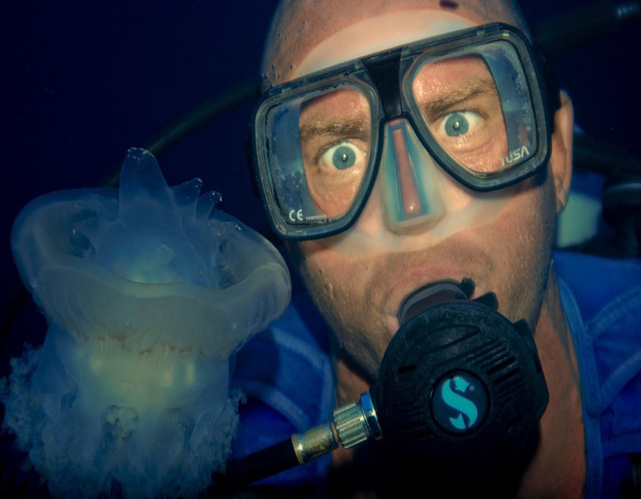
NITROGEN NARCOSIS
Nitrogen narcosis is a condition that affect deep sea divers. It goes by many other name, including:-
Narks
Rapture of the deep
The martini effect
Inert gas narcosis
PPT 2 -

Slide 7
NITROGEN NARCOSIS
Cont….
Deep-sea divers use oxygen tanks to help them breath underwater. These tanks usually contain a mix of oxygen, nitrogen and other gasses.
Once divers swim deeper than about 100 feet, the increased pressure can alter these gases.
When inhaled, the gasses can produce unusual symptoms that often make a person appear to be drunk.
PPT 2 -

Slide 8
SYMPTOMS OF NITROGEN NARCOSIS
30m (100 feet) – Mild impairment of performance. Mildly impaired reasoning. Mildly euphoria.
30-50m (100-165 feet) - Delayed response to visual/auditory stimuli, Calculation errors, Anxiety.
50-70m (165-230 feet) - Poor concentration, confusion, Loss of memory.
90m (300 feet) - Hallucination, depressive state, Unconsciousness, death.
PPT 2 -

Slide 9
PRE HOSPITAL TREATMENT
Nitrogen narcosis is immediate controlled ascent to the surface.
Administration of Oxygen.
Temporary cessation of diving
Breathe a gas mixture that contains Helium instead of nitrogen
PPT 2 -

Slide 10

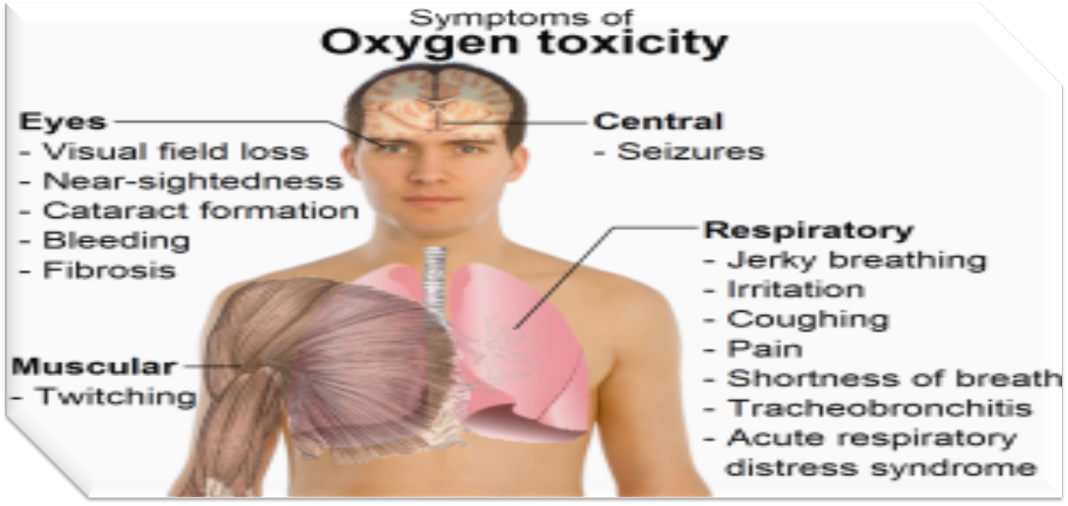
OXYGEN TOXICITY
It can be defined as high concentration of oxygen in a body when a body’s protective systems are affected by increase in oxygen partial pressure.
The most common cause of lung oxygen toxicity is prolonged use of pressurized oxygen cylinders in diving
Oxygen toxicity of the brain, commonly referred to as CNS oxygen toxicity, is more serious.
PPT 2 -

Slide 11
SIGN & SYMPTOMS
Nausea.
Muscle twitching.
Dizziness.
Disturbances of vision.
Irritability.
Disorientation.
PPT 2 -

Slide 12
Ear Barotraumas
Ear Barotraumas is physical damage to body tissues caused by a difference in pressure between a gas spaces inside or contact with, the body and the surrounding gas or liquid.
The initial damage is usually due to over-stretching the tissues in tension or shear, either directly by an expansion of the gas in the closed space or by pressure difference hydrostatically transmitted through the tissue.
Barotraumas can occur during both compression and decompression events
PPT 2 -

Slide 13
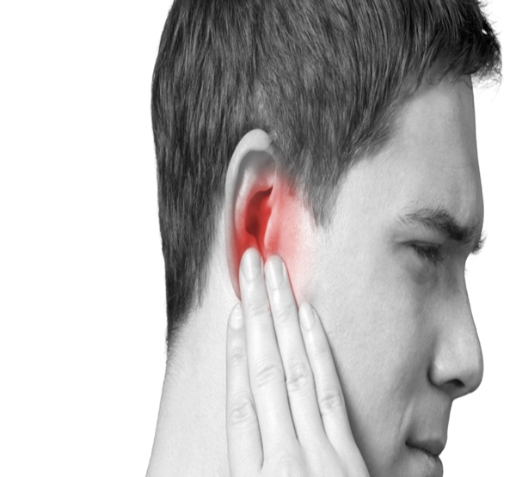
Ear Barotraumas
Dizziness
General ear discomfort
Slight hearing loss or difficulty hearing
Stuffiness or fullness in the ear
PPT 2 -

Slide 14
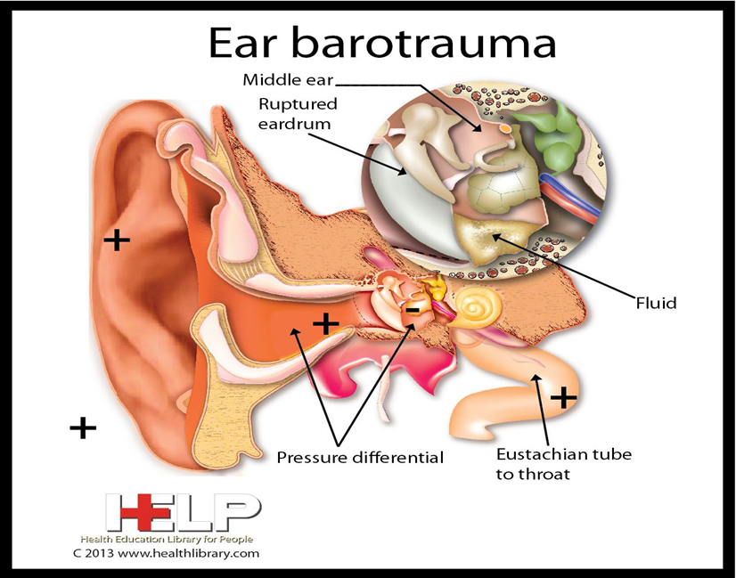
CAUSE OF EAR BAROTRAUMA
Eustachian tube blockage is one of the cause of ear barotrauma.
Scuba diving
Hiking
Pressure underwater (first 14 feet)
PPT 2 -

Slide 15

EAR BAROTRAUMA TREATMENT
Most cases of ear barotrauma generally heal without medical intervention. There are some self-care step you can take for immediate relief.
Yawning
Chewing gum
Practicing breathing exercises.
PPT 2 -

Slide 16
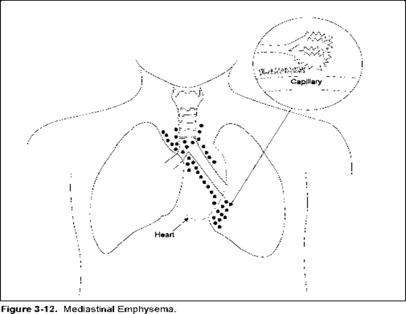
PULMONARY OVER INFLATION SYNDROME
Pulmonary over inflation syndrome (POIS) is a group of barotrauma related diseases caused by the expansion of gas trapped in the lungs, or over pressurization of the lungs with subsequent over expansion and rupture of the alveolar air sacs.
PPT 2 -

Slide 17
Causes
Breath holding during ascent.
Rapid uncontrolled ascent (blow-up)
Air trapped in lung.
PPT 2 -

Slide 18
SIGNS & SYMPTOMS
Shortness of breath
Chest pain or discomfort
Wheezing
Chronic cough
Reduced exercise tolerance
Barrel chest
Cyanosis
PPT 2 -

Slide 19
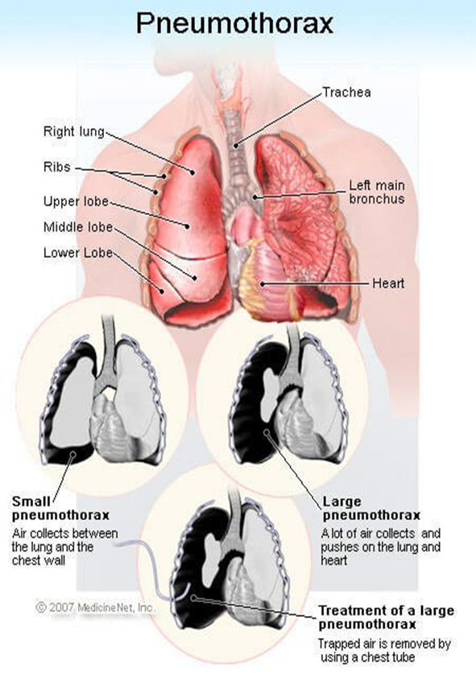
PNEUMOTHORAX
Pneumothorax is the medical term for a collapsed lung.
Pneumothorax occurs when air enters the space around your lungs.
Pneumothorax can be a complete lung collapse or a collapse of only a portion of lung.
PPT 2 -

Slide 20
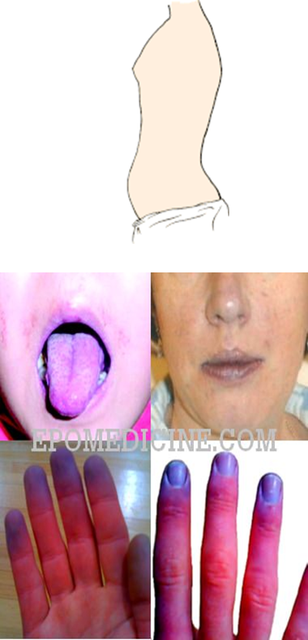
SYMPTOMS
A sudden attack of chest pain is often the first symptoms.
Shortness of breath
Cyanosis
Tightness in the chest
PPT 2 -

Slide 21
HYPOTHERMIA
Hypothermia, or low body temperature, is a condition that occurs when your body’s temperature drops below 95 degrees Fahrenheit (35 degrees Celsius).
Left untreated, hypothermia can lead to cardiac arrest (When your heart stops beating) and death.
PPT 2 -

Slide 22
SIGNS & SYMPTOMS
Hypothermia symptoms vary based on the severity of the condition.
The stages of hypothermia include mild, moderate and severe.
PPT 2 -

Slide 23
PRE HOSPITAL TREATMENT
Hypothermia treatment includes the prevention of further heat loss and the process of rewarming.
Move the person to a warm, dry location.
Remove wet clothing and replace with dry clothing.
Cover them up with a jacket, hat and blanket.
Apply external heat to their skin, such as with a heat lamp or hot pack.
PPT 2 -

Slide 24

DROWNING
Drowning is the condition when the victim inhales or ingests water through his/her respiratory tract or alimentary tract.
Death occurs within 24 hrs due to suffocation.
PPT 2 -

Slide 25
CAUSES
Seizure, unconscious near water.
Suicide
Drowning in swimming pool.
Small children have drowning in bath tubs.
Fall during boating.
PPT 2 -

Slide 26
SIGN & SYMPTOMS
Body is wet, cold hands and legs.
Bluish discoloration of body especially lips.
Frothy discharge from mouth, vomiting.
Increased/decreased rate of breathing/ absent breathing.
Abnormal sound.
Decreased heart rate.
No breathing and no pulse.
PPT 2 -

Slide 27
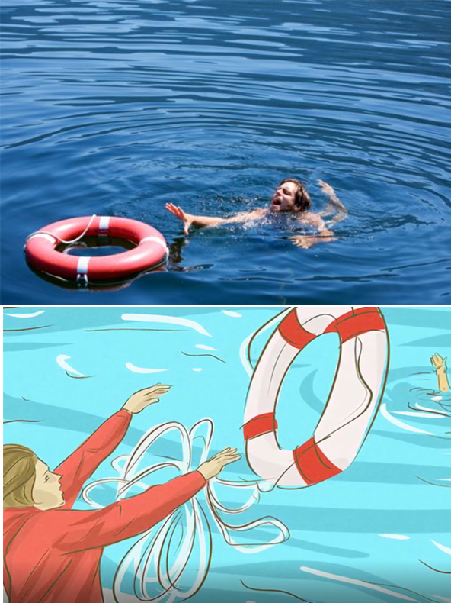
FIRST AID MANAGEMENT
During drowning
Your safety first: don’t just jump in the water.
Throw a light object(life jacket, wooden piece,rope) for the patient to catch.
PPT 2 -

Slide 28
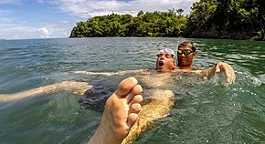


FIRST AID MANAGEMENT
Rescue the patient from under water.
Lie the patient in flat surface.
Remove all the wet clothes and make the patient warm.
PPT 2 -

Slide 29
ASSESS THE PATIENT
Check responsiveness :–
Look :- Alertness (AVPU) chest movement.
Listen :- Heart sound and Respiration sound.
Feel :- Air passage through nostrils.
PPT 2 -

Slide 30
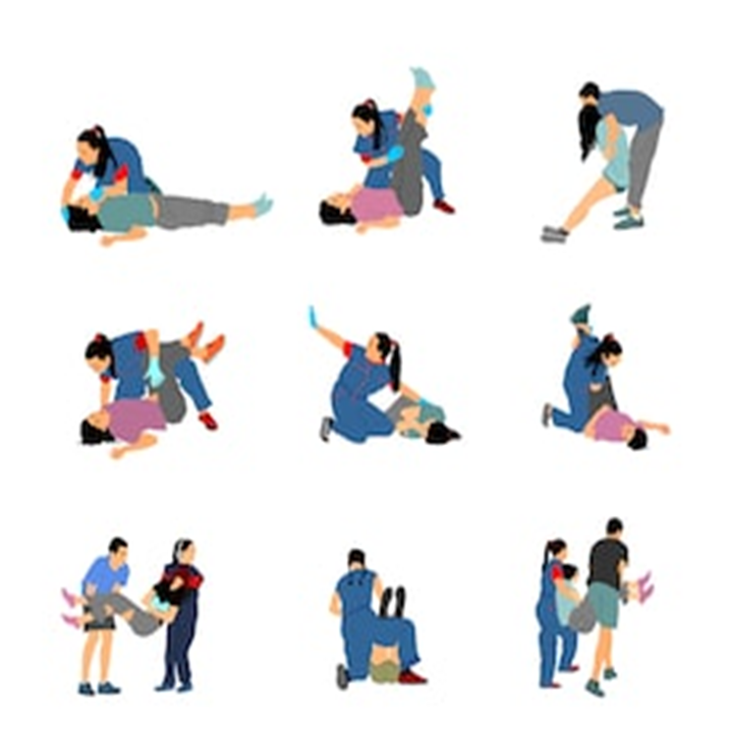
ASSESS THE PATIENT
No pulse no respiration:- Start CPR.
Patient breathing but has difficulty.
Maintain ABC.
Manage if injuries.
PPT 2 -

Slide 31
Maintain Airway
Left lateral position.
Clear foreign body.
Don’t insert anything in mouth (e.g. Spoon)
Air way open through head tilt chin lift or jaw thrust.
Loosen tie, clothing around the neck.
Remove artificial dentures if possible
PPT 2 -

Slide 32
Maintain Airway
Remove excess water from lungs and abdomen:
1. By turning upside down
2. Or pressing over the abdomen
Reassure the patient shows sign of become responsive such as coughing, opening eyes, speaking and start to breathe normally put them it the recovery position.
You may also need to treat them for hypothermia covering them with warm clothes and blankets.
Immediately transfer to hospital.
PPT 2 -

Slide 33


THANK YOU

