Slide 1


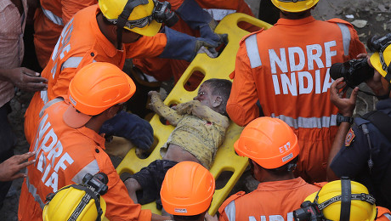
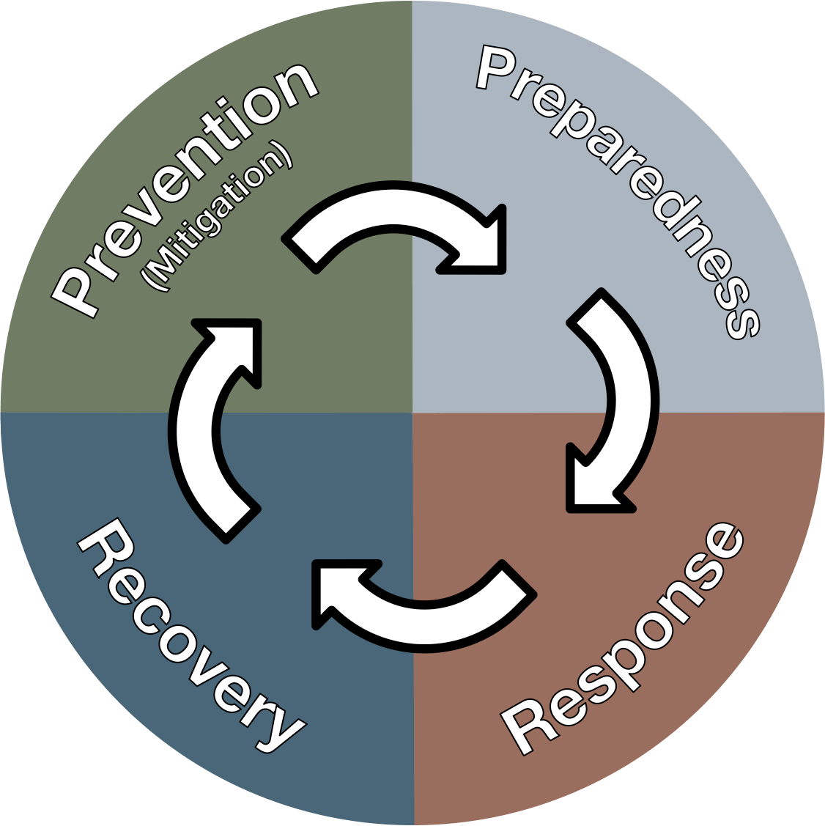
DISASTER MANAGEMENT ORIENTATION
DISASTER MANAGEMENT IN GENERAL
Presented by:- Pavan Dev Gaur, 2IC
NDRF | DMO | INDIA
PPT 5 - 1

Slide 2
OBJECTIVES
Upon completing this lesson, you will be able to:
1
  Acquaint with Disaster profile of India
  Understand disaster and its effects
  Know about the features of National Disaster Management Plan
2
3

Slide 3
OBJECTIVES
Upon completing this lesson, you will be able to:
4
  Know the Level of Disaster as per NDMP
  Get the overview DM Cycle and DRR
  Get the overview about Incident Response System
5
6

Slide 4
Disaster
Disaster Management Act, 2005
A catastrophe, mishap, calamity, or grave occurrence in any area, arising from natural or man-made causes (including by accident or negligence), which results in substantial loss of life or human suffering, damage to property, or degradation of the environment, and is of such a nature or magnitude as to be beyond the coping capacity of the affected community.

Slide 5
Disaster profile of India
India has a diverse and complex disaster profile, shaped by its unique geo-climatic conditions and high population density. The country is highly vulnerable to a wide array of natural hazards, which are compounded by socio-economic factors and climate change.

Slide 6
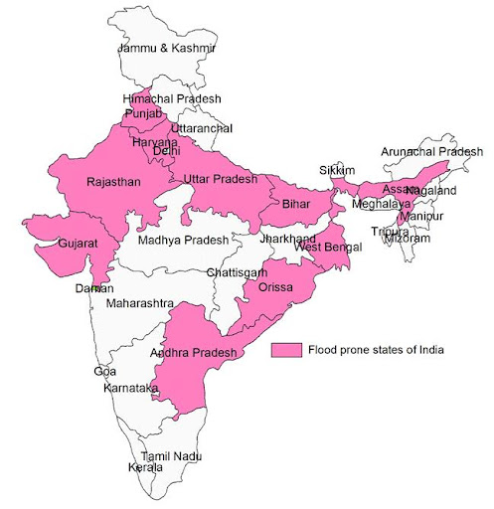
Disaster profile of India
Floods and River Erosion
Over 40 million hectares
12 per cent of land

Slide 7
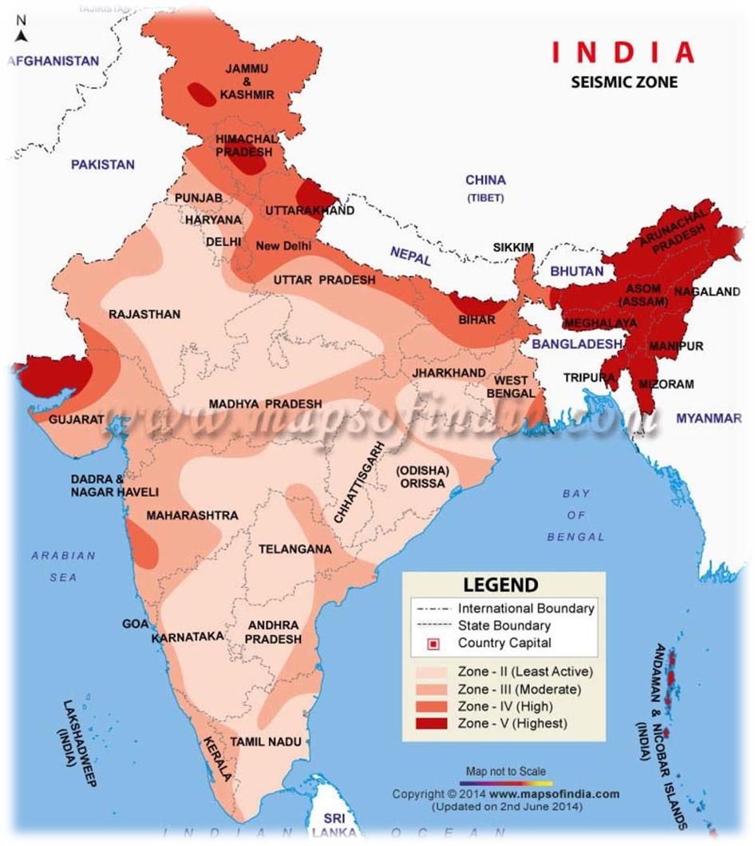
Disaster profile of India
Earthquake
58.6 per cent of the landmass
Moderate to very high intensity

Slide 8
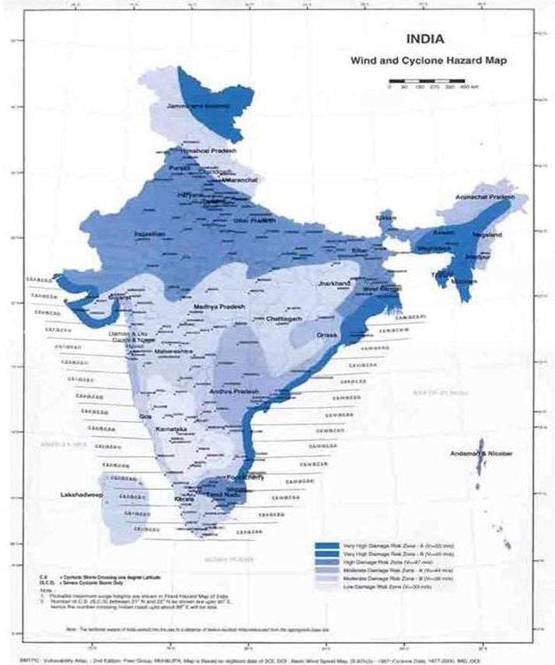
Disaster profile of India
Cyclones and Tsunamis
Total Coastline – 7,516 kms
10% of the World's tropical cyclones
Highly Vulnerable to Cyclones & Tsunamis – 5,700 kms

Slide 9
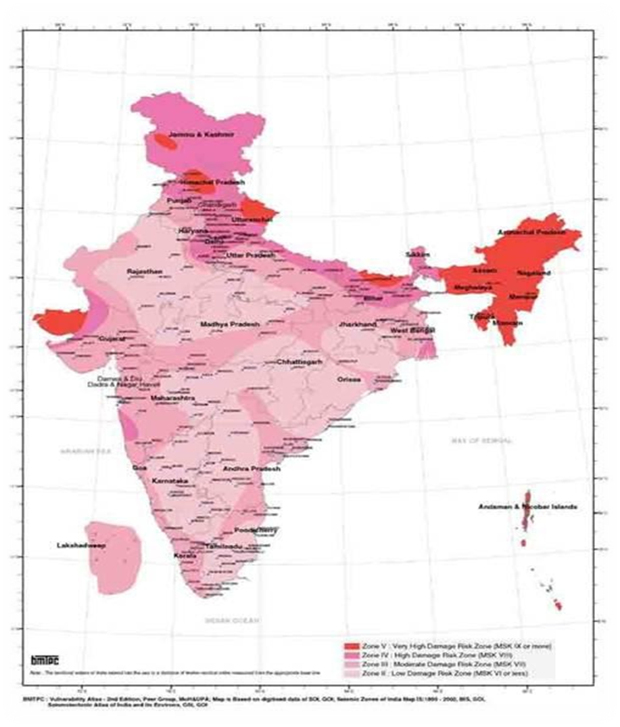
Disaster profile of India
Drought
68 per cent of the cultivable area is vulnerable to drought
Major cause of famine

Slide 10
Disaster profile of India
Drought
68 per cent of the cultivable area is vulnerable to drought
Major cause of famine

Slide 11
IMPACT OF DISASTER
Direct Impact
Human Lives
Livestock and Animals
Indirect Impact
Export/Import
Agricultural Output
Tertiary Impact
Health hazard
Overall Development of Nation
Private Property
Infrastructure
Connectivity
Health
Industry/Service Output
Falling PPP
Unemployment
Migration

Slide 12
DISASTER MANAGEMENT
A continuous and integrated process of planning, organizing, coordinating and implementing measures which are necessary or expedient for-
Prevention and Mitigation
Preparedness
Assessing the severity or magnitude of effects of any disaster
Prompt response
Evacuation, rescue and relief
Rehabilitation and reconstruction
Capacity-building
PPT 5 -

Slide 13
disaster management cycle
A continuous process involving four phases: Mitigation, Preparedness, Response, and Recovery, each with distinct activities to reduce the impact of hazards and promote a return to normalcy after a disaster.
It's a cyclical model because disasters are recurrent, requiring ongoing efforts to improve and adapt strategies for future events, aiming to reduce losses and enhance societal resilience.

Slide 14
disaster management cycle
This involves developing plans and preparing resources to respond effectively when a disaster strikes.
Activities: Creating emergency response plans, training personnel, conducting drills, and maintaining strategic reserves of food, water, and medical supplies.
Preparedness

Slide 15
disaster management cycle
This is the action taken during and immediately after a disaster to save lives, meet basic needs, and limit further damage.
Activities: Search and rescue operations, providing emergency aid, setting up temporary shelters, and coordinating emergency services.
Response

Slide 16
disaster management cycle
This phase involves activities to restore or improve a community after a disaster, moving from immediate emergency to long-term rebuilding and resilience.
Activities: Restoring infrastructure, providing temporary and permanent housing, supporting economic recovery etc.
Recovery

Slide 17
disaster management cycle
This phase focuses on long-term actions to prevent or reduce the severity of a disaster and its impacts.
Activities: Structural measures like building flood defenses, non-structural measures like land-use planning, and public awareness campaigns.
Mitigation

Slide 18
National Disaster Response Framework
Institutional mechanisms
Disaster prevention strategy
Early warning system
Disaster mitigation
Preparedness and response
PPT 5 -

Slide 19
National Disaster Response Framework
Human resource development and Community-based disaster management
Capacity development in all related areas
Cooperation with agencies at national, regional and international levels
CONT.
PPT 5 -

Slide 20
PMs Ten -Point Agenda
All development sectors must imbibe the principles of DRM
Risk coverage must include all
Women’s leadership and greater involvement
Invest in risk mapping
Leverage technology to enhance the efficiency

Slide 21
PMs Ten -Point Agenda
CONT.
Develop a network of universities to work on disaster-related issues
Use social media and mobile technologies
Build on local capacity
Studies on the lessons after every disaster
Bring about greater cohesion in international response

Slide 22
Main pillars of NATONAL DISASTER MANAGEMENT PLAN
Conforming to the national legal mandates
Participatory proactively to realizing the global goals
Prime Minister’s Ten Point Agenda
Social inclusion as a ubiquitous and cross-cutting principle
Mainstreaming DRR as an integral feature
PPT 5 -

Slide 23
Vision : NDMP
Make India disaster resilient across all sectors, achieve substantial and inclusive disaster risk reduction by building local capacities starting with the poor and decreasing significantly, the loss of lives, livelihoods, and assets in different forms including economic, physical, social, cultural, and environmental while enhancing the ability to cope with disasters at all levels.

Slide 24
OBJECTIVES : NDMP
Improve the understanding of disaster risk, hazards, and vulnerabilities
Strengthen disaster risk governance at all levels from local to Centre
Invest in disaster risk reduction for resilience
Enhance disaster preparedness for effective response
Promote “Build Back Better” in recovery, rehabilitation and reconstruction

Slide 25
OBJECTIVES : NDMP
CONT.
Prevent disasters and achieve substantial reduction of disaster risk
Increase resilience and prevent the emergence of new disaster risk
Prevent and reduce hazard exposure and vulnerabilities to disaster
Empower both local authorities and communities as partners

Slide 26
OBJECTIVES : NDMP
CONT.
Strengthen scientific and technical capabilities in all aspects of disaster management
Capacity development at all levels
Provide clarity on roles and responsibilities
Facilitate the mainstreaming of disaster management

Slide 27
Three Tier Mechanism
National Level
State Level
District Level
PPT 5 -

Slide 28
SOCIAL INCLUSION IN DRR
Gender Perspective
Guidelines regarding weaker section
Guidelines regarding children, elderly and Persons with Disability
Making DRM inclusive
Responsibility Framework
PPT 5 -

Slide 29
BUILDING DISASTER RELIGELIENCE
Understanding Risk
Inter-Agency Coordination
Disaster
Structural Measures
Non-Structural Measures
Capacity Development
Climate Change Risk Management

Slide 30
Recovery and Building Back Better
Physical aspects of recovery
Economic aspects of recovery
Social recovery
PPT 5 -

Slide 31
Disaster recovery process
Damage and needs assessments
Safe removal of damaged structures
Recovery framework
Restoration and even upgradation
PPT 5 -

Slide 32
Disaster recovery process
Re-establishment of major transport linkages
Measures to ensure socially inclusive recovery
Environmental assessments
Financial management
CONT.
PPT 5 -

Slide 33
FINANCIAL ARRANGEMENTS
National Disaster Response Fund
State Disaster Response Fund
National Disaster Mitigation Fund
Allocation by Ministries and Departments

Slide 34
MONITORING AND UPDATING DM PLAN
Major review and revisions after each major incident
After significant change in operational resources
After every case of plan activation in anticipation of an emergency
PPT 5 -

Slide 35
MONITORING AND UPDATING DM PLAN
After the completion of major exercises
A change in the district’s demographics or hazard or threat profile
Enactment of new or amended laws
CONT.
PPT 5 -

Slide 36
INCIDENT RESPONSE SYSTEM
A standardized, flexible organizational framework and set of procedures used to manage disasters and emergencies, whether natural or man-made, by coordinating resources, personnel, and communication across different agencies to reduce chaos and improve overall response effectiveness.

Slide 37
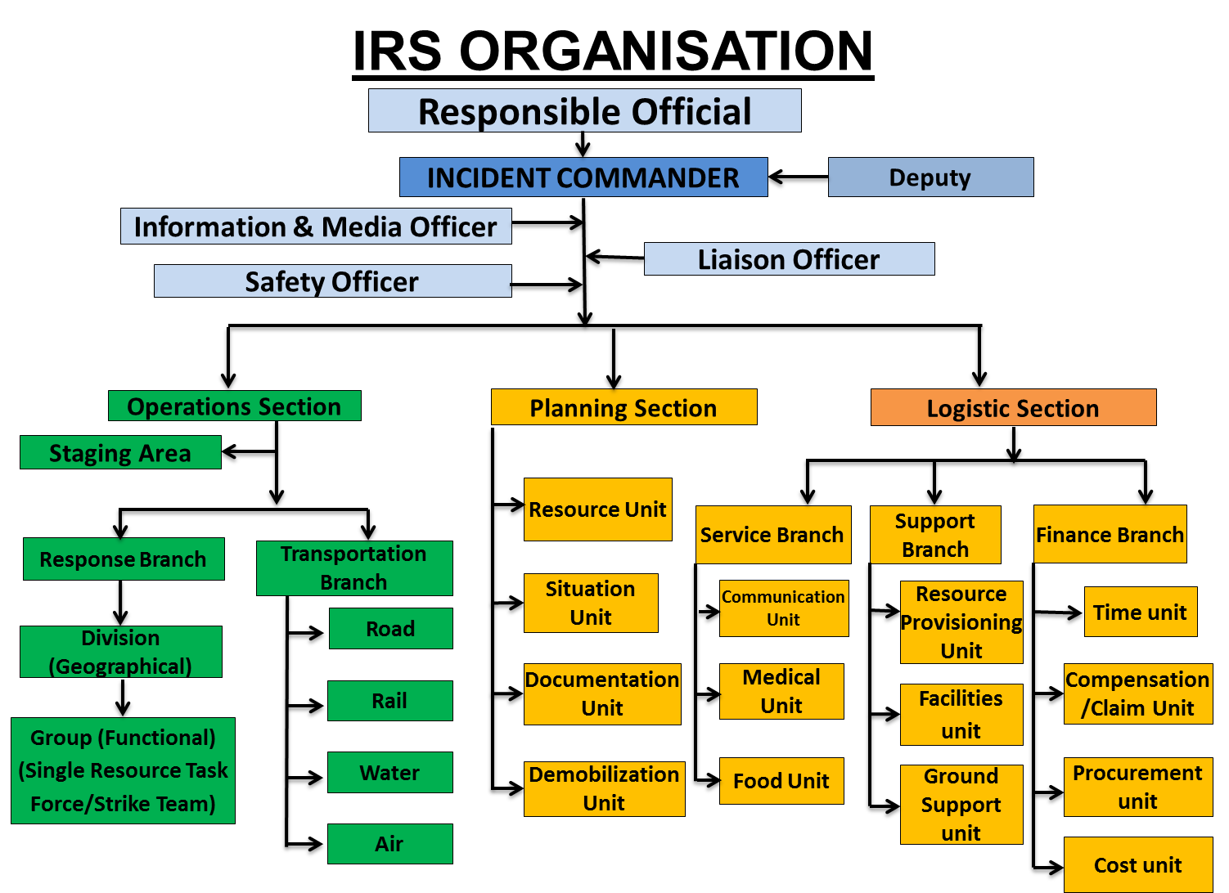
INCIDENT RESPONSE SYSTEM

Slide 38
Key Aspects of Incident Response System
Management by Objectives
Unity of Command and Chain of Command
Transfer of Command
Organisational Flexibility
Span of Control
Common Terminology
Accountability
Integrated Communications
Resource Management
Incident Action Plan
PPT 5 -

Slide 39
National Disaster Response Force (NDRF)
A specialized Indian force under the Ministry of Home Affairs tasked with responding to natural and man-made disasters, including floods, earthquakes, and Chemical, Biological, Radiological, and Nuclear (CBRN) emergencies. Constituted by the Disaster Management Act, 2005.

Slide 40
National Disaster Response Force (NDRF)
Chapter VIII, DM Act -2005 -Sec 44 (i) NDRF: a ‘Specialist Force’ to respond to disasters/threatening disaster
Order of MHA dated 19th Jan 2006, approving conversion of 8 Bns of CAPFs into NDRF
NDRF has now expanded to 16 Battalions, each comprising 18 specialized response teams
CONT.

Slide 41
NDRF Expertise
CSSR
Aquatic Disaster
CBRN
Confined space SAR
Air/Rail/Road Accident
High Rise and Rope Rescue
MFR
PPT 5 -

Slide 42
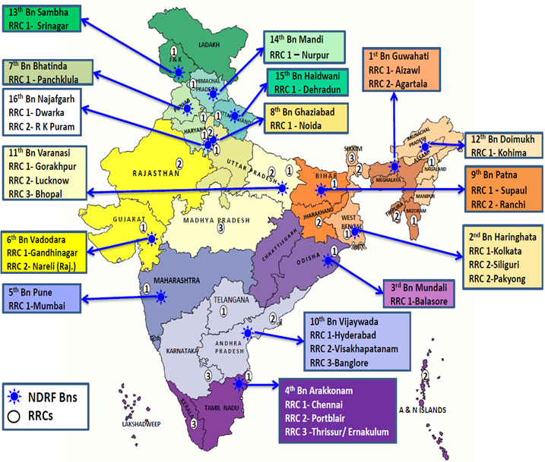
42

Slide 43








NDRF: Response Mechanism
INFORMATION RECEIVED
ACTIVATION/
MOBILIZATION
ESTABLISHMENT
Of ICP
ARRIVAL
AT INCIDENT
SITE
& BRIEFING
CONDUCT
SAR
DEMOBILIZATION

Slide 44
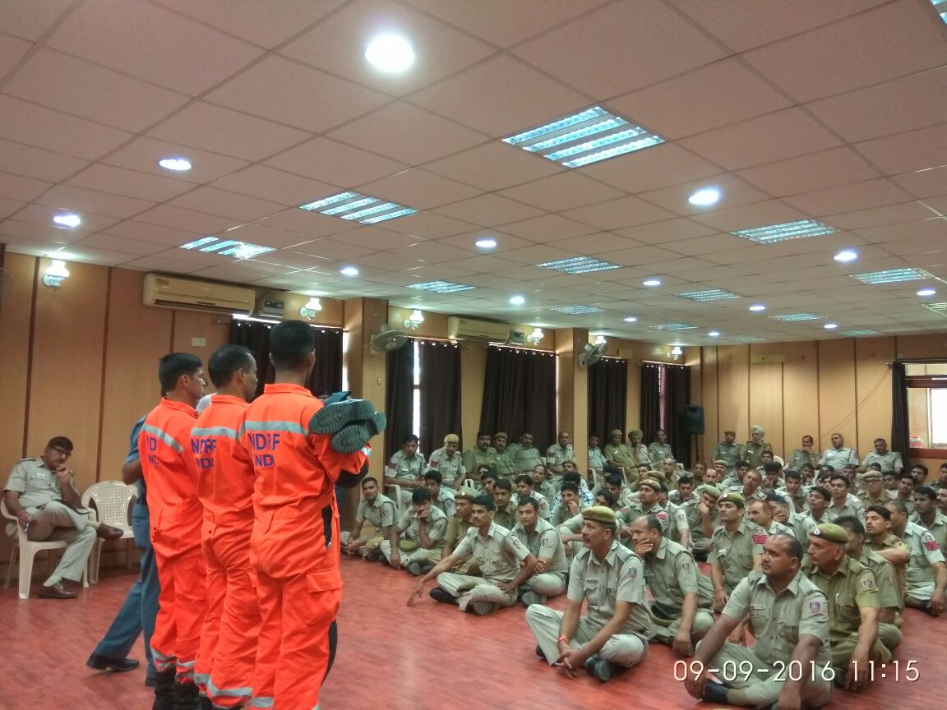
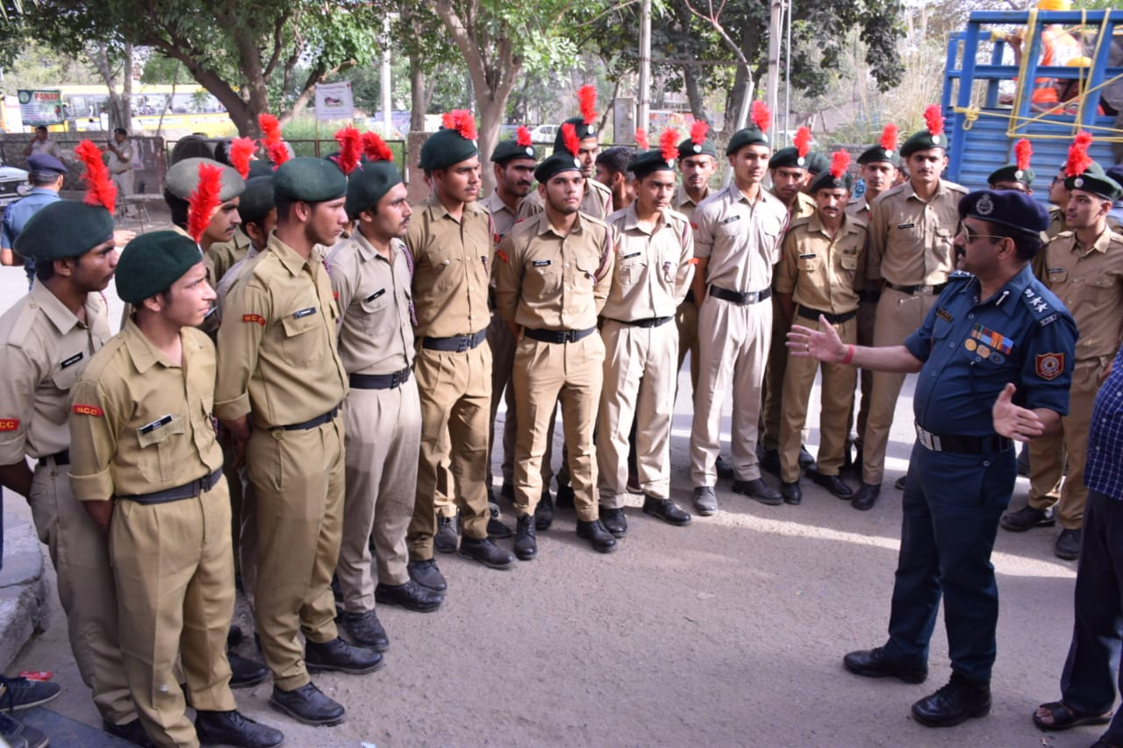
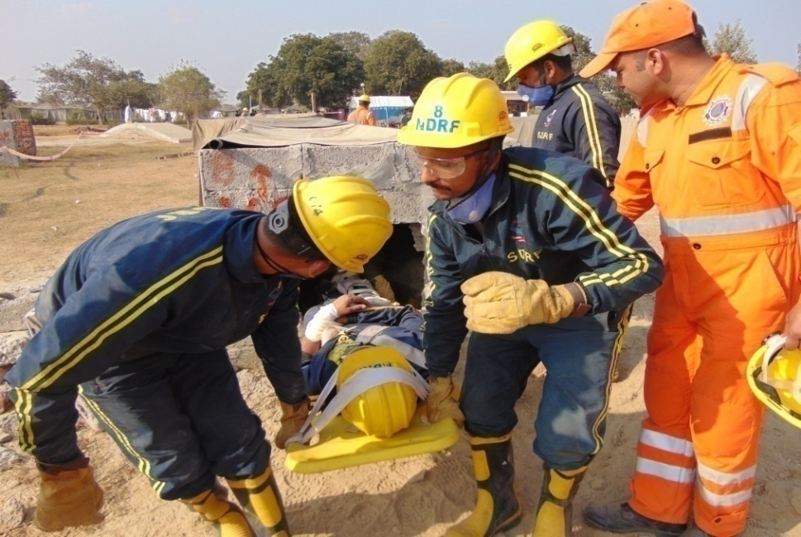
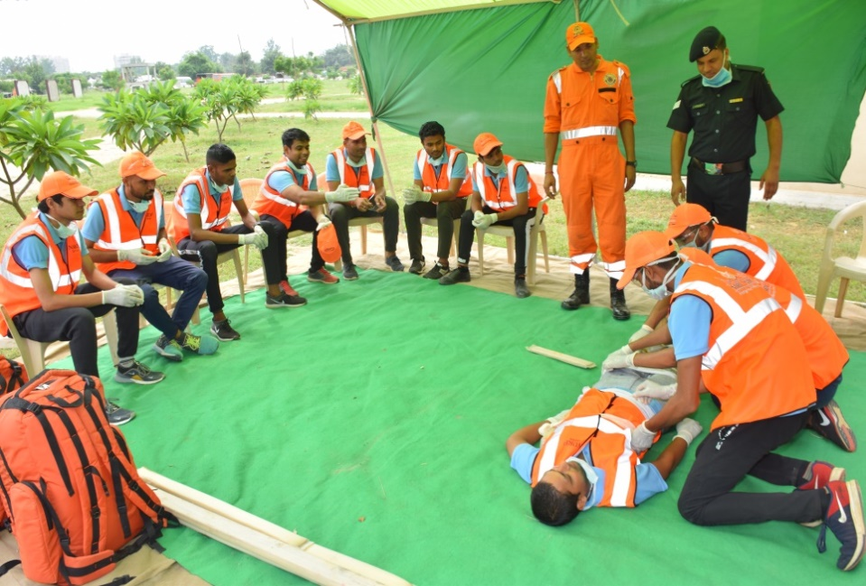
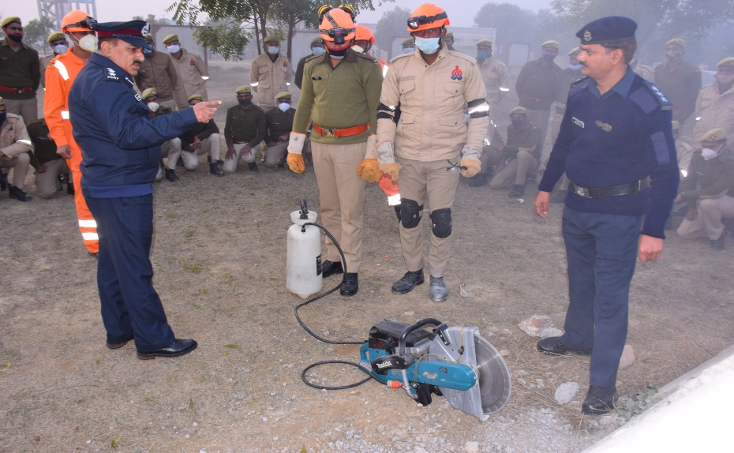
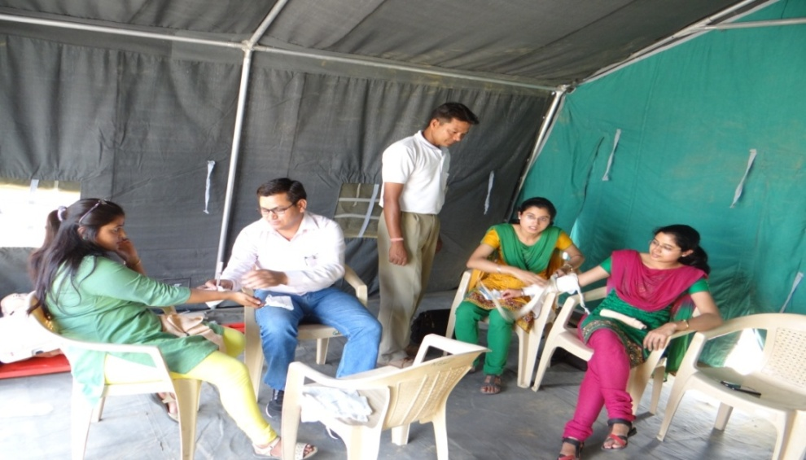
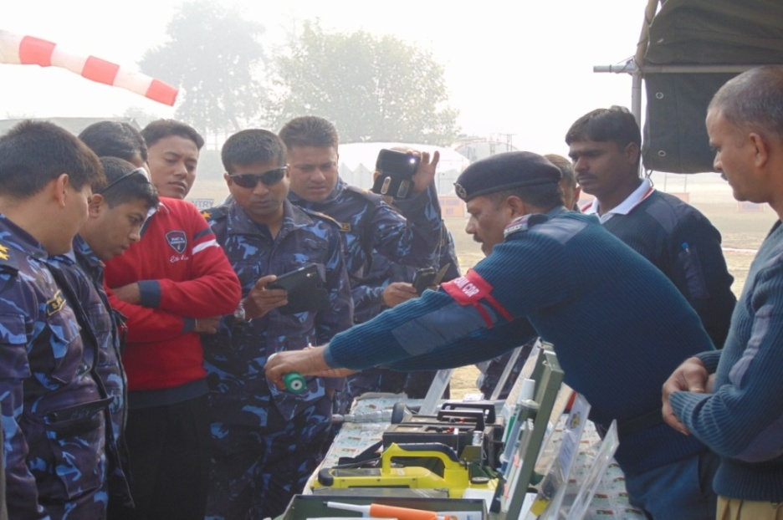
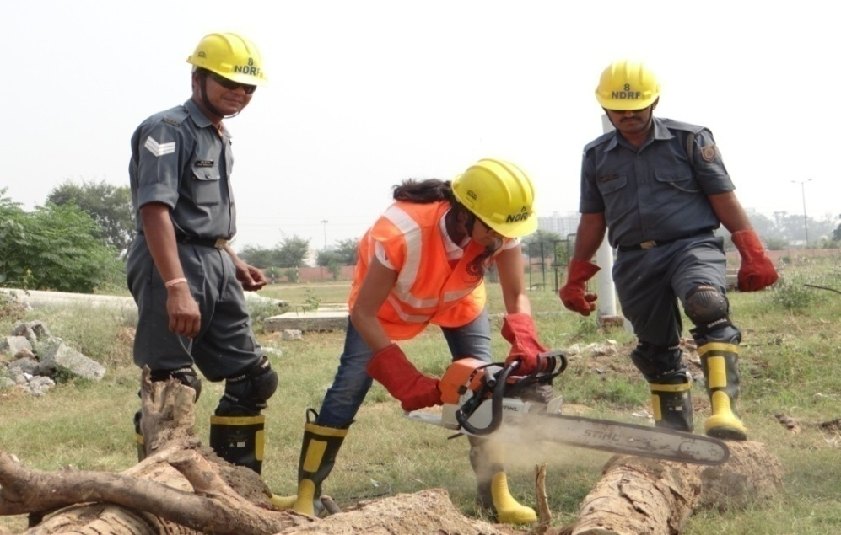
TRAINING TO STAKEHOLDERS
Railways
NCC
SDRF
NYKS
Armed Forces and Police
Civil Dept.
Friendly Nations
Civil Defense

Slide 45
Empowering local communities through training and awareness
Development of local disaster management plans
Example: Community involvement in flood and cyclone preparedness
Community-Based Initiatives

Slide 46
Emergency Numbers
NATIONAL EMERGENCY NUMBER | 112
Disaster Management Services | 108
Disaster Management NDMA Control Room | 1078
Road Accident Emergency Service | 1073
Railway Accident Emergency Service | 1072
LPG Leak Helpline | 1906

Slide 47
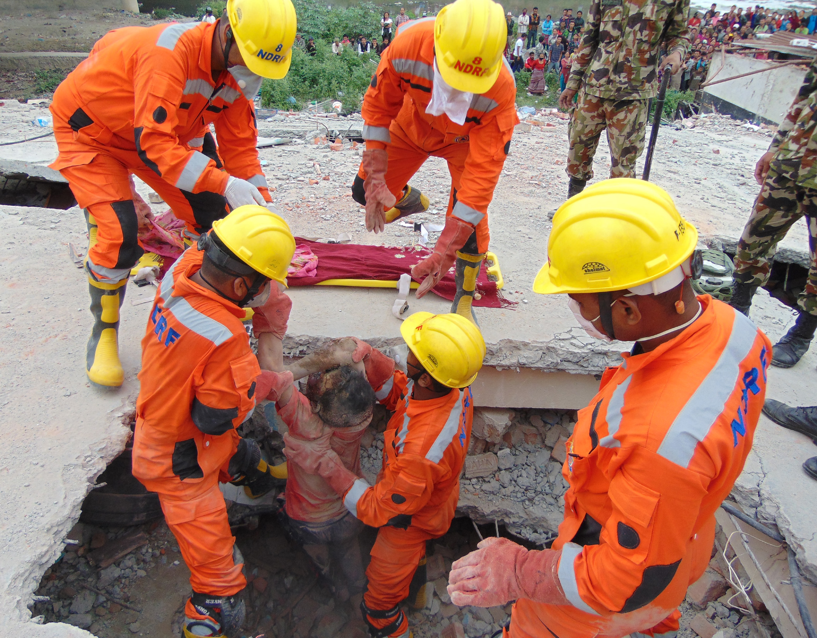

THANK YOU

