Slide 1



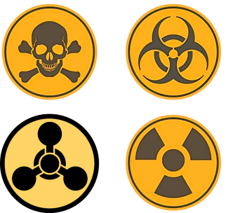
CBRN Module: CAPF
LESSON 02
DOs AND DON’TS DURING CBRN EMERGENCIES
Presented by:- Pavan Dev Gaur, 2IC

Slide 2
OBJECTIVES
Upon completing this lesson, you will be able to:
1
  What is CBRN Emergency?
  Understand key DO's and DON'Ts during a CBRN event
  Enhance personal and community safety
  Learn practical response measures
2
3
4

Slide 3

What is CBRN emergency
Chemical, biological, radiological, nuclear and explosive (CBRN) events refer to the uncontrolled release of chemicals, biological agents or radioactive contamination into the environment or explosions that cause widespread damage. CBRN events can be caused by accidents or by terrorist acts.
PPT 2 -

Slide 4
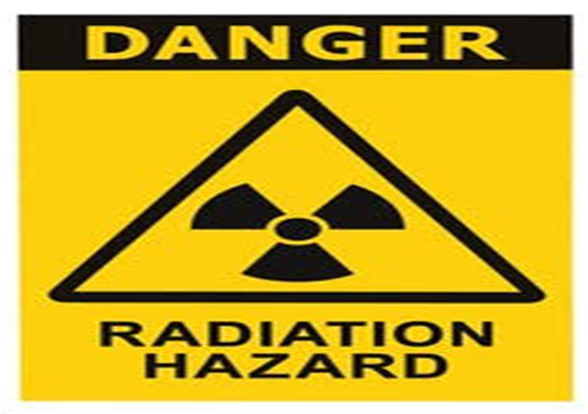
Signs Of A Cbrn Incident
Unusual smells, clouds, or vapor
People collapsing or showing symptoms
Unusual containers or spraying devices
Panic in surroundings
PPT 2 -

Slide 5
Stay calm and alert
Follow official instructions (radio, emergency services)
Evacuate or shelter-in-place as advised
Use protective gear (masks, gloves) if available
Assist vulnerable individuals
General DO'S in a CBRN Emergency
PPT 2 -

Slide 6
Don’t touch unknown substances or materials
Don’t panic or spread misinformation
Don’t use mobile phones near suspicious materials (possible detonation risk).
Don’t evacuate unless instructed.
General DON’T’S in a CBRN Emergency
PPT 2 -

Slide 7
Chemical Emergency DO'S & DON'TS
DO’S
DON'TS
  Cover nose and mouth with cloth.
  Move upwind and uphill if outdoors.
  Remove contaminated clothing.
  Don’t smell or touch unknown liquids or gases.
  Don’t use water on chemical spills unless advised.
PPT 2 -

Slide 8
Biological Emergency DO'S & DON'TS
DO’S
DON'TS
Practice hygiene: wash hands, wear masks.
Stay indoors and isolate if exposed
Don’t come in close contact with sick individuals
Don’t consume exposed food or water
PPT 2 -

Slide 9
Radiological Emergency DO'S & DON'TS
DO’S
DON'TS
Don’t go outdoors during fallout
Don’t eat contaminated food or water
Seek shelter in solid buildings (preferably underground).
Wash exposed skin with soap and water
PPT 2 -

Slide 10
Nuclear Emergency DO'S & DON'TS
DO’S
DON'TS
Drop, cover, and remain covered during a blast
Shelter for 24+ hours or as instructed
Don’t go outdoors during fallout
Don’t eat contaminated food or water
PPT 2 -

Slide 11
List of basic PPE items (masks, gloves, emergency kits)
Importance of personal hygiene
Creating a home emergency plan
Protective Measures You Can Take
PPT 2 -

Slide 12
As a responder, the first and foremost duty is to rescue / safe life in any emergency considering self safety precaution. Therefore the only precautionary steps to protect and prevents ourself and victim from any hazard(CBRN) is Personal Protective Equipment.
It is a specialized clothing or equipment which can create a barrier between a potential hazard and the user.
CBRN PPE
PPT 2 -

Slide 13
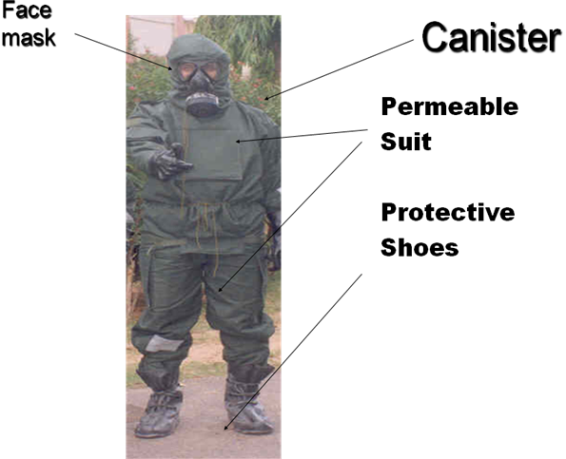
Protective equipment which is used for respiratory and body protection by
an individual to achieve physical protection is termed as PPE
Gas Mask
Trousers
Jacket with hood
Over boots/gumboots
Gloves
PARTS OF PPE PPE
PPT 2 -

Slide 14
Emergency Kit Checklist
Checklist Style:
N95 masks
Water and non-perishable food
Flashlight, batteries, radio
First aid kit, iodine tablets (if advised)
PPT 2 -

Slide 15
Community and Govt Support
Role of Community & Authorities :-
How local authorities respond.
How to stay informed (radio, apps, sirens).
Importance of community drills and awareness
PPT 2 -

Slide 16
Review
Now You are able to define:
1
  What is CBRN Emergency?
  Understand key DO's and DON'Ts during a CBRN event
  Enhance personal and community safety
  Learn practical response measures
2
3
4

Slide 17


THANK YOU

