Slide 1
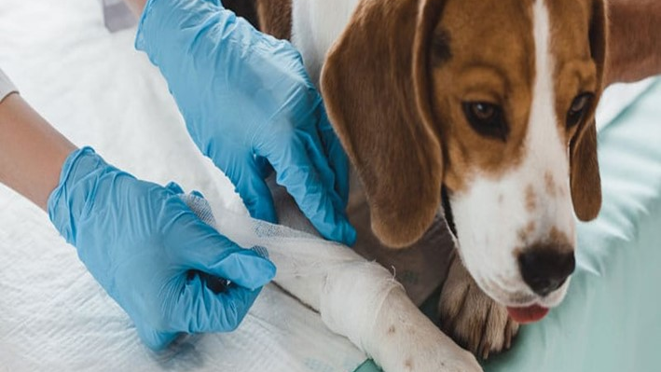



Dead Body Management and Caracas Management
LESSON 02
ANIMAL FIRST AID & EMERGENCY CARE
Presented By:- Kamlesh Dhoundiyal,2IC
NDRF | DBM-CM | INDIA
PPT 2 - 1

Slide 2
OBJECTIVES
Upon completing this lesson, you will be able to:
1
  Acquaint with Animal first aid and its importance.
  Know about 03 classification of Animal emergencies
  Know about Responders safety and animal restraint during first aid
2
3

Slide 3
OBJECTIVES
Upon completing this lesson, you will be able to:
4
  Know about procedure of examination of injured animal
  Know About first aid procedure during various emergencies
  Aquent with procedure for handling of snake bite and poisoning
5
6

Slide 4
Objectives of Animal Rescue
Save animal lives
Prevent suffering
Minimize economic loss
Maintain public health

Slide 5
Animal First Aid
First aid is the immediate treatment prior to hospitalization of injured animals or those suffering From sudden illness

Slide 6
Why is first aid important?
To preserve life
To reduce pain and suffering
To prevent the situation deteriorating
To promote recovery

Slide 7
Animal First Aid – Preliminary Steps
Before administering first aid, assess the situation.
For danger to yourself or others.
Injured animals are usually in pain and may bite.
Make sure that the animal is correctly restrained .
NEVER put yourself or others at risk.
PPT 2 -

Slide 8
Limitations of First Aid
Under the Veterinary Surgeons’ Act 1966.
  No-one is allowed to practice veterinary surgery.
  Unless they are registered in the veterinary surgeons’ register.

Slide 9
What is classed as Veterinary Surgery?
The diagnosis of diseases and injuries including diagnostic tests
Giving advice based on such diagnosis .
The medical and surgical treatment of animals .
Surgical operations

Slide 10
Classification of Animal Emergency
Life-threatening emergencies.
Emergencies requiring prompt attention .
Minor

Slide 11
Animal Life-Threatening Emergency
Unconsciousness
Conscious collapse with dyspnea or cyanosis
Severe haemorrhage
Severe burns
Poisoning
Snake bites
PPT 2 -

Slide 12
Animal Emergency requiring Prompt Attention
Conscious collapse
Dyspnoea
Fractures / dislocations
Haemorrhage
Gaping wounds
Severe dysuria
Dystopia
PPT 2 -

Slide 13
Animal Minor Emergency
Insect stings
Minor wounds
(where the haemorrhage is easily controlled by bandaging)
Minor burns
Abscesses
Slight lameness
Hematuria
PPT 2 -

Slide 14
Responder Safety & PPE (Zoonoses)
Size up hazards (electric lines, water, traffic, snakes/chemicals)
PPE: helmet, eye protection, leather + disposable gloves, mask/N95, boots, coveralls
Hand hygiene, wound protection, sharps/biowaste protocol
Rabies exposure & leptospirosis risks—report and seek medical advice
Notes:
All suspected rabies exposures require immediate PEP via medical officer. If anthrax suspected (sudden death, bleeding from orifices), do not necropsy; coordinate with vets for safe disposal.

Slide 15
Handling & Restraint (Species Basics)
Cattle/buffalo: Halters, flank/shoulder ropes; never drag by horns/tail
Equines: Blindfold to calm; lead from left; stand near shoulder
Small ruminants: Hold under jaw/chest; avoid lifting by wool/skin
Dogs/cats: Slip leads, muzzles if not in respiratory distress; covered carriers
Notes:
Practice knots and low‑stress handling. Avoid overcrowding and loud noises.

Slide 16
Triage & Tags
Immediate (red): airway compromise, severe bleeding, snakebite with collapse
Delayed (yellow): stable fractures, moderate dehydration
Minimal (green): minor wounds; owner can assist care
Expectant (black): non‑survivable—veterinary decision only
Notes:
Use simple tags/paint. Align with IRS (Form 214 activity log).

Slide 17
Primary Examination of an Injured Animal
A: Airway—Clear obstructions; avoid hand-in-mouth in dogs/cats
B: Breathing—Observe chest movement; recovery position for small animals
C: Circulation—Capillary refill, pulse; control external bleeding
D: Disability—Consciousness, seizures; spinal precautions
E: Exposure—Check for wounds, heat/cold stress, tags/ID
ABCDE
PPT 2 -

Slide 18
Examination of an injured animal
Any examination should be done methodically
To ensure that no areas are missed.
Examinations usually start at the head. All areas of the body should be checked .
Abnormal swelling, haemorrhage, discharge, deformity, fracture, wound or sign of pain should be noted.
Notes:
Carry species-appropriate kits: halters, ropes, webbing, slings, blankets, muzzles, carriers. Train on knots (bowline, figure-8, prusik) and low-angle haul systems for large animals.

Slide 19
Examination of an injured animal
Cont…
Nose - Haemorrhage (epistaxis) and whether is present from one or both nostrils
Mouth - Colour of mucous membranes – should be pink
- Fractured teeth
- Ulcerated tongue or strange odours
which could indicate poisoning
Notes:
Carry species-appropriate kits: halters, ropes, webbing, slings, blankets, muzzles, carriers. Train on knots (bowline, figure-8, prusik) and low-angle haul systems for large animals.

Slide 20
Examination of an injured animal
Cont…
Eyes - Colour of conjunctival membranes (pink – normal; yellow – jaundice; blue – cyanosis; pale – shock or blood loss; red – toxins, heatstroke)
Ears – Haemorrhage
Skull - Fractures
Limbs - Fractures, deformities, wounds, paralysis, loss of function.
Notes:
Carry species-appropriate kits: halters, ropes, webbing, slings, blankets, muzzles, carriers. Train on knots (bowline, figure-8, prusik) and low-angle haul systems for large animals.

Slide 21
Examination of an injured animal
Cont…
Rib cage - Fractured ribs or wounds penetrating chest.
Abdomen - Bruising or swelling (could indicate internal bleeding).
Spine - Deformities indicating fractures or dislocations.
Pelvis - Fractures, deformities.
Notes:
Carry species-appropriate kits: halters, ropes, webbing, slings, blankets, muzzles, carriers. Train on knots (bowline, figure-8, prusik) and low-angle haul systems for large animals.

Slide 22
Examination of an injured animal
Cont…
Perineal region - Haemorrhage from prepuce vulva or anus which may indicate internal bleeding.
Tail - Voluntary movement.
General body surface - Matting of the fur which could indicate an underlying wound.
Notes:
Carry species-appropriate kits: halters, ropes, webbing, slings, blankets, muzzles, carriers. Train on knots (bowline, figure-8, prusik) and low-angle haul systems for large animals.

Slide 23
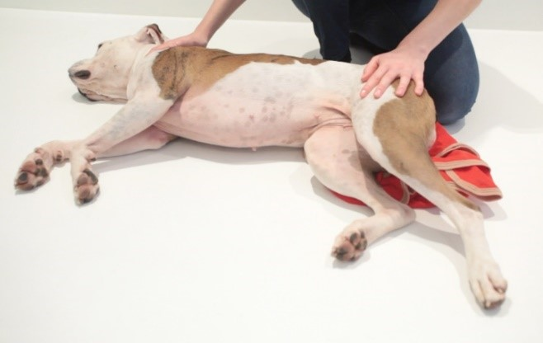
Recovery Position for Animal
Put any injured animals into the recovery position
Contact the veterinary surgery for advice.
Lay animal on its right side.
To access left side so that the heartbeat can be palpated.
Cardiac massage to be performed if necessary.
Straighten the head and neck to opens the airways.
PPT 2 -

Slide 24
Animal first aid
Direct pressure with clean cloth/gauze; pressure bandage if needed
Avoid limb tourniquets unless vet-directed in catastrophic bleeding
Irrigate wounds with clean water/saline; cover; avoid powders on deep wounds
Bite wounds: high infection risk—protect and refer
Haemorrhage Control & Wounds
PPT 2 -
Notes:
Pack large bleeding with clean dressings. Do not remove stuck clots—layer more dressings.

Slide 25
Wound Cleaning & Bandaging
Flush with clean water/saline; clip hair if trained
Apply non‑adherent dressing; pad; secure with conforming bandage
Check circulation distal to bandage; recheck every 2–4 hrs
Avoid tight elastic directly on skin/fur
Notes:
Photograph before/after. Note time of dressing. Escalate deep/contaminated wounds to vets.

Slide 26
Animal first aid
Suspect with deformity, crepitus, non‑weight bearing
Immobilize joints above/below; use padded splints/boards
Large animals: use slings/forward assist; never lift by limbs
Suspected spinal injury: minimize movement; spine board if feasible
Fractures, Dislocations & Spinal Precautions
PPT 2 -
Notes:
Pain control only by veterinarian. Document time of splinting and neuro status if possible.

Slide 27
Animal first aid
Heat stress: shade, airflow, misting; cool water to groin/neck
Hypothermia: dry, blanket, warm (not hot) packs to core
Dehydration: skin tenting, sunken eyes; small frequent water if conscious
Heat Stress, Hypothermia & Dehydration
PPT 2 -
Notes:
Monitor rectal temperature when possible. Heat stroke = emergency—urgent vet referral.

Slide 28
First Aid Supplies
Gloves, gauze/rolls, pressure bandages, saline, antiseptic, shears
Splints, triangular bandages, slings, blankets, muzzles, leads/halters
Thermometer, flashlight, tags/markers, forms, camera
Water, bowls, ORS, tarps; biohazard bags, disinfectant
Notes:
Never attach slings to limbs or neck. Keep animal’s head above water/mud. Pre-plan with Fire Services and SDRF for rigging support.

Slide 29
First Aid Supplies
Cont…
Dog muzzle (or length of non-stretch bandage)
Swabs Nail clippers to cut overlong or broken nails
Antiseptic wash e.g. Hibiscrub
Round-ended scissors
Salt – to clean wounds mix 1 teaspoon of salt to 1 pint of water
Sticky tape
Notes:
Never attach slings to limbs or neck. Keep animal’s head above water/mud. Pre-plan with Fire Services and SDRF for rigging support.

Slide 30
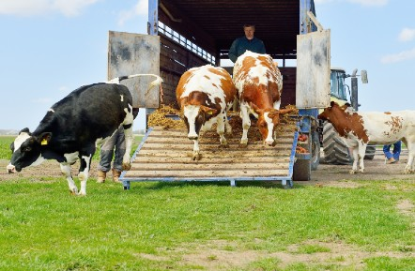
Evacuation & Transport Planning
Pre-identify high-ground holding areas & routes
Load order: calm leaders first; avoid overloading; partitions for species/sex
Ventilation & rest stops; water at least every 4–6 hours
Manifesting & tagging animals to owners; security at offloading
PPT 1 -
Notes:
Use temporary permits if inter-district movement controls are active. Clean/disinfect vehicles after each trip.

Slide 31
SNAKEBITE: Risk & Identification
High‑risk zones: Flood debris, waterlogged fields, woodpiles, barns
Medically important snakes (India): Russell’s viper, Echis, cobras, kraits, saw‑scaled viper
Symptoms in animals: Yelp/collapse, bleeding/swelling (viper), paralysis (neurotoxic)
PPT 1 -
Notes:
Follow local bylaws and AWBI welfare requirements. Provide complaint mechanism for owners. Maintain feeding logs and vet records.

Slide 32
Venom classification
Neurotoxic
Hemotoxic
Myotoxic
Notes:
Key lesson: pre-identified high ground and community animal volunteers accelerated rescue; fodder logistics were critical.

Slide 33
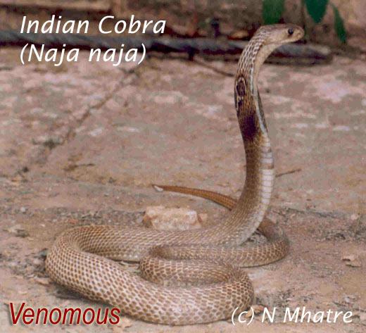
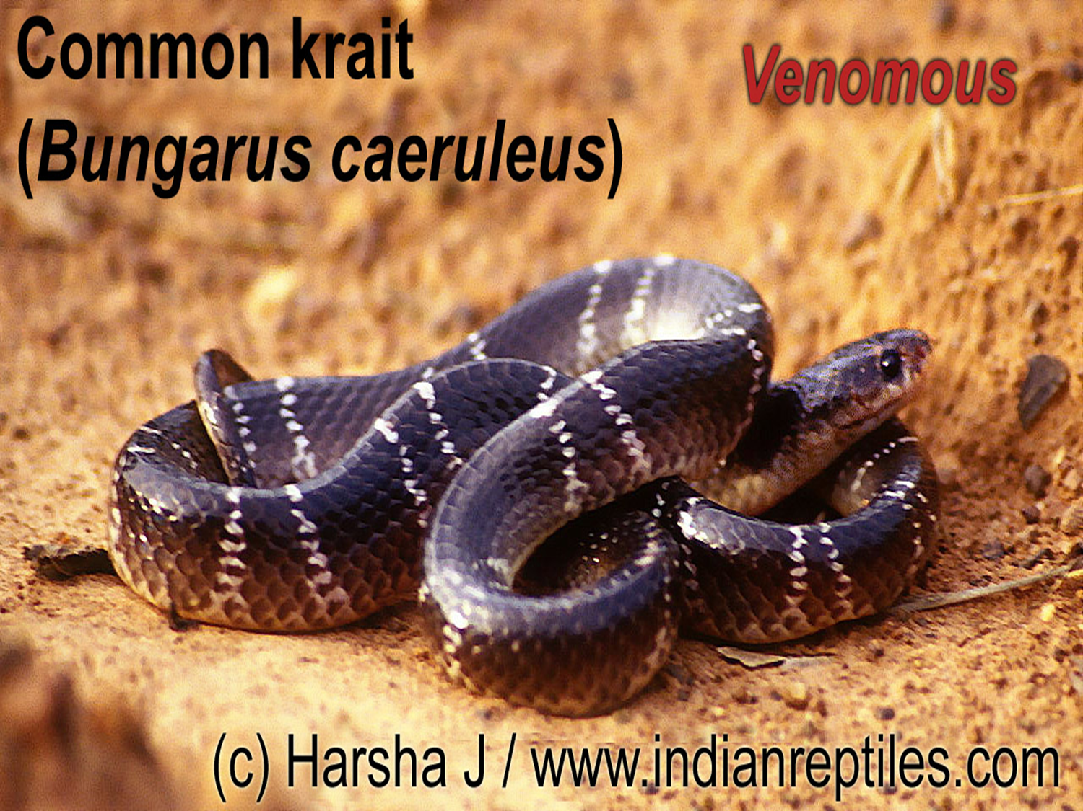
Snakes of concern in India

Slide 34
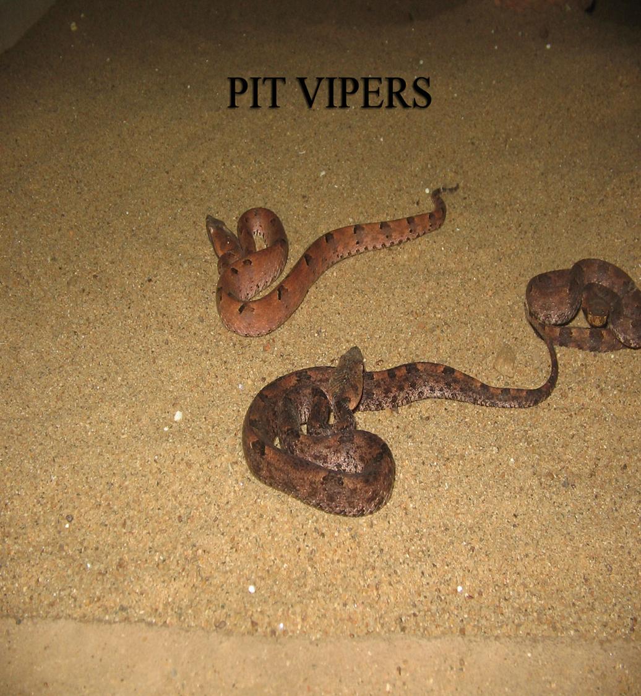
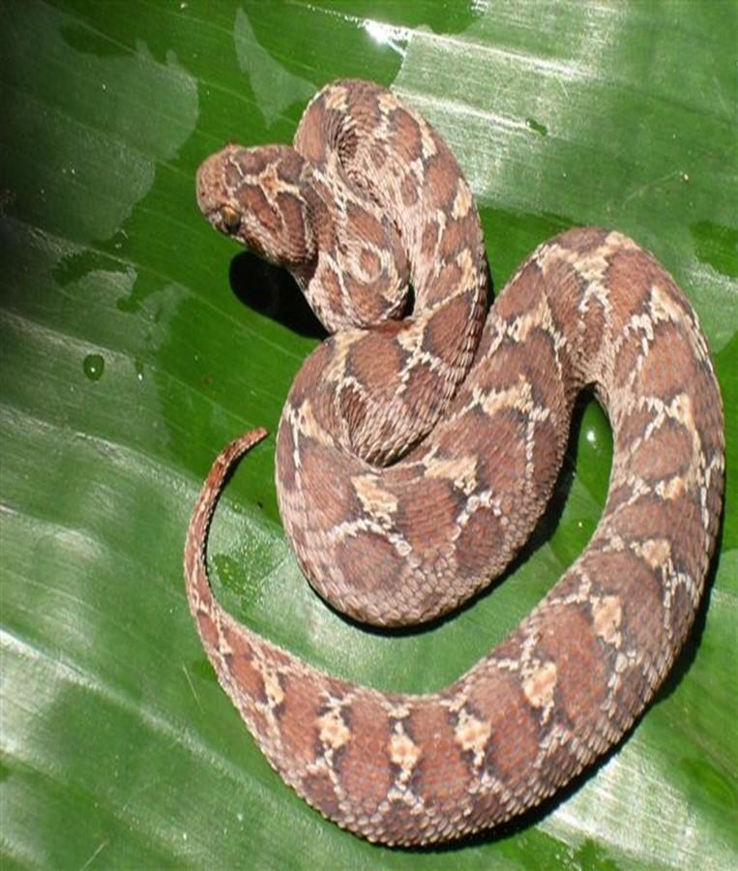
Snakes of concern in India
Saw Scaled Viper

Slide 35
Clinical signs of snake bite
Trembling
Vomiting
Salivation, drooling, frothing
Diarrhea
Weakness in back legs and unsteadiness
Dilated pupils
Respiratory distress
Blood in urine
Swelling at or around bite wound area
Continuous bleeding from bite wound

Slide 36
SNAKEBITE: DOs (First Aid for Animals)
Move away; reassure; minimize movement—carry if possible
Immobilize limb with a splint; remove collars/halters/jewelry
Keep bite at heart level; mark swelling edge; record time
Monitor breathing and consciousness en route
Providing oxygen if the animal is having trouble in breathing.
Nutritional support

Slide 37
SNAKEBITE: DON’Ts (Evidence‑Based)
No cutting/sucking/ice/electric shocks/herbal remedies
No tight tourniquets—worsen ischemia/tissue damage
Do not wash/milk wound; avoid alcohol/coffee
Pressure immobilization bandage not routinely recommended for viper bites—follow vet/medical guidance

Slide 38
SNAKEBITE: Veterinary Care & Transport
Antivenom selection/dosing—veterinary decision
Support: airway/oxygen, IV fluids, analgesia; monitor for anaphylaxis
Neurotoxic signs may need ventilation support
Pre‑alert clinic; minimal‑movement transport
PPT 1 -
Notes:
Follow local bylaws and AWBI welfare requirements. Provide complaint mechanism for owners. Maintain feeding logs and vet records.

Slide 39
POISONING: Common Exposures in Disasters
Pesticides (organophosphates/carbamates), rodenticides
Fuel/oil/chemical spills; smoke inhalation
Feed: Urea/ammonia, nitrate/nitrite, cyanogenic plants, mycotoxins
Household toxins: Human medicines, disinfectants, batteries
PPT 1 -
Notes:
Set up clean feed/water lines and secure chemical stores in shelters.

Slide 40
POISONING: First Aid
Remove from source; fresh air for inhalation
Decontaminate skin/fur with water; PPE for rescuer
Do NOT induce vomiting unless vet advises
Collect sample/label of suspected toxin for vet
Notes:
Activated charcoal only under vet direction. Prioritize airway and circulation.

Slide 41
POISONING: Red Flags & Veterinary Treatments
Organophosphate: Salivation, tremors, pinpoint pupils—vet may use atropine/oximes
Nitrate/nitrite: Brown mucous membranes—vet may use methylene blue
Cyanide: Rapid breathing, bright red blood—vet may use nitrite/thiosulfate
Rodenticide (anticoagulant): Bleeding—vitamin K1 by vet
Notes:
Rescuers must not administer prescription antidotes; focus on rapid referral and safe handling.

Slide 42
First Aid Stations & Records
Triage desk with clean water, lighting, supplies
Census board: intake, treatments, outcomes
Isolation area for sick animals; footbaths and biosecurity
Notes:
Daily vet rounds; referral/ambulance roster. Waste segregation and sharps containers mandatory.

Slide 43
Case Study– Flood Response
Dogs with lacerations—cleaning & bandaging; vet antibiotics
Cattle with snakebite—immobilization, vet antivenom; recovery
Goats with pesticide exposure—wash, ventilate, vet therapy
Notes:
Key lesson: pre-identified high ground and community animal volunteers accelerated rescue; fodder logistics were critical.

Slide 44
Coordination & Referrals
Activate AHD Veterinary Support Unit via EOC
AWBI‑Registered NGOs for ambulances and sheltering
Contact list: Nearest clinics, antivenom availability
Daily SITREP at 1700 hrs; track first aid metrics
Notes:
Key lesson: pre-identified high ground and community animal volunteers accelerated rescue; fodder logistics were critical.

Slide 45
Key references
DAHD (2024): Crisis Management Plan for Livestock Diseases
NIDM (2022): Handbook for Management of Animals in Disasters & Emergencies
AWBI: Scheme for Relief to Animals during Natural Calamities & Unforeseen Circumstances
MoHFW / NCDC (2024): National Action Plan for Prevention & Control of Snakebite

Slide 46



THANK YOU

