Slide 1






CBRN COURSE INTRODUCTION
Presented By:- Amit Kumar, AC

Slide 2
Overview of Course
Introduction of course coordinator, instructors, assistants, support staff and the other participants.
Duration of Course & Methodology
Evaluation/Curriculum & Schedule
What is CBRN…?
Role of first responder
Composition of CBRN Team & SOP
OBJECTIVES
Upon completion of this lesson you will be able to:

Slide 3
OVERVIEW OF COURSE
01 | Duration of course | 04 weeks
02 | Total working days in a week | 06 days
03 | Total working days during course | 24 working days (4x6)
04 | No. of periods in a day | 09 periods
05 | Total periods during course | 216 periods(24x9)
06 | Duration of period | 40 minutes

Slide 4
DAILY SCHEDULE
1 | 0630-0715 | PT/YOGA
2 | 0930 – 1010 | I Period
3 | 1015– 1055 | II Period
4 | 1100 -1140 | III Period
5 | 1140 – 1155 | Tea Break
6 | 1155-1235 | IV Period
7 | 1240– 1320 | V Period
8 | 1320– 1445 | Lunch Break
9 | 1445– 1525 | VI Period
10 | 1530– 1610 | VII Period
11 | 1610 – 1620 | Tea Break
12 | 1620– 1700 | VIII Period
13 | 1705-1745 | IX Period
14 | 1745-1755 | DCE

Slide 5
INTRODUCTION
Course coordinator
Instructors
Assistants instructor
Field Instructors
Support staffs
All Instructors are well qualified in various advance CBRN Courses and having a good knowledge of this field.

Slide 6
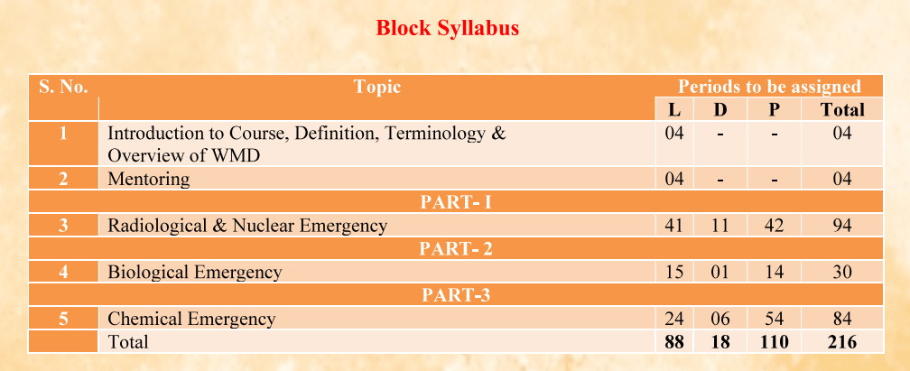
BLOCK SYLLABUS

Slide 7
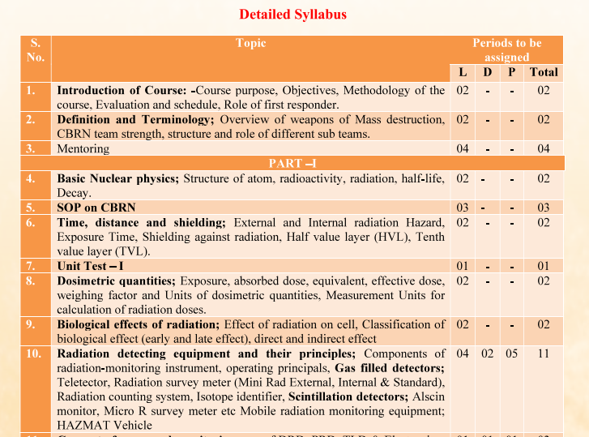
DETAILED SYLLABUS

Slide 8
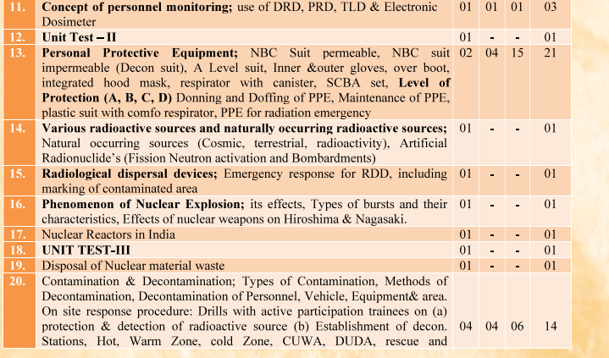
DETAILED SYLLABUS

Slide 9
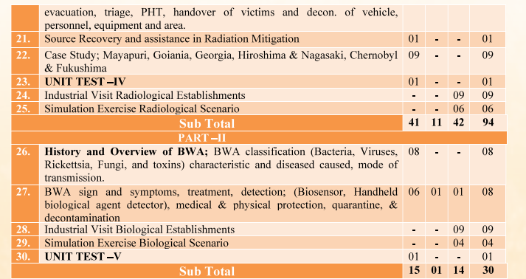
DETAILED SYLLABUS

Slide 10
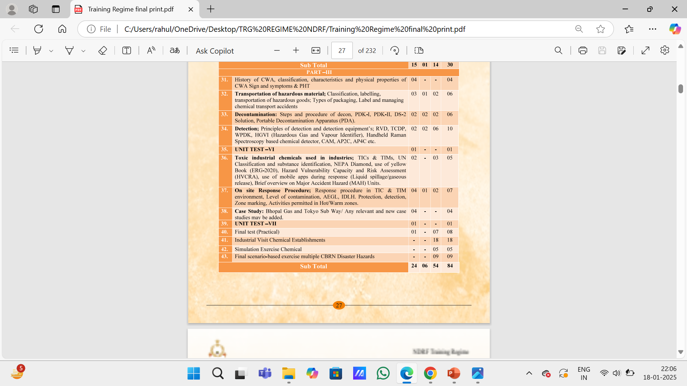
DETAILED SYLLABUS

Slide 11
METHOD OF INSTRUCTION
Lectures
Demonstration
Practical
Group Activities/Exercise
Audio-Visual Training videos

Slide 12
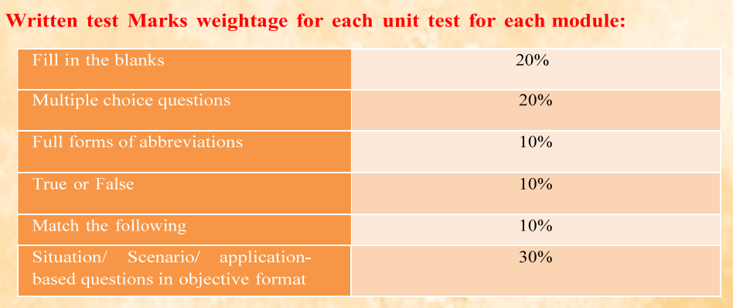
UNIT TEST

Slide 13
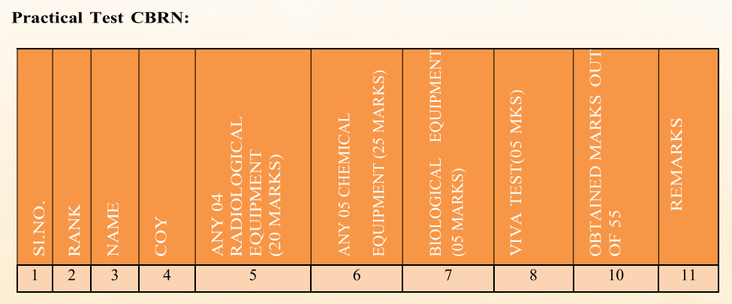
FINAL TEST PRACTICAL

Slide 14
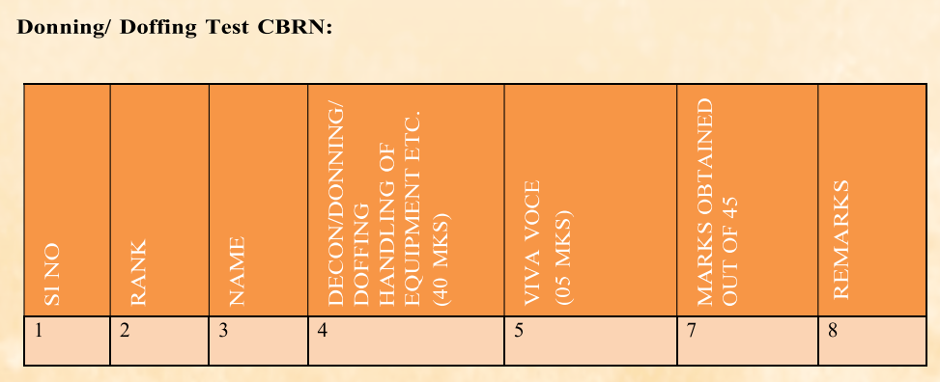
FINAL TEST PRACTICAL

Slide 15
EVALUATION
Total Unit Test 7
Written Marks 175 (Each 25 Mks)
Practical Marks 100 Inc Viva Voice
Everyone has to pass in each unit test to pass in CBRN min 70 % marks
Grading System
Written A,B,C
Practical X,Y,Z

Slide 16
EVALUATION METHOD
You will be evaluated in this course using three methods:
Lesson Post-Tests: You will take a written post-test (self-test) every evening on the lesson(s) that you took that day. Questions may be in the form of short answer, multiple choice, true/false, fill-in-the-blank or matching. You may also be asked to draw or complete a graphic or sign. These post-tests will be reviewed the next

Slide 17
EVALUATION METHOD
Practical Evaluations, which will be given in lessons with a performance component. Duration will depend on complexity and number of tasks
Final Written Evaluation: There will be a final written evaluation covering all lessons with a minimum passing score of 70 percent in order to complete the course.

Slide 18
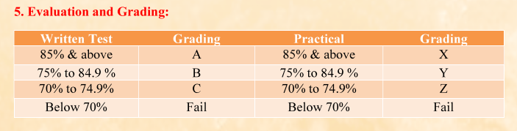
EVALUATION

Slide 19
SCORING SYSTEM
Practical Evaluations:
Lessons with a performance component will have a practical evaluation afterwards. Practical evaluations are scored as Pass or No-Pass, based on your performance of tasks and attention to safety. If you receive a No-Pass score on a Practical Evaluation, you will be allowed to take one make-up per Practical Evaluation.

Slide 20
WHAT IS CBRN?
CBRN are weaponized or non-weaponized Chemical, Biological, Radiological and Nuclear materials that can cause great harm and pose significant threats in the hands of terrorists.
Weaponized materials can be delivered using conventional bombs, improved explosive materials and enhanced blast weapons (e.g., dirty bombs).
Non-weaponized materials are traditionally referred to as Dangerous Goods (DG) or Hazardous Materials (HAZMAT) and can include contaminated food, livestock and crops.
CBRN Emergencies can be either Accidental or Intentional.

Slide 21
TYPES OF CBRN HAZARDS
CHEMICAL HAZARDS
Chemical Warfare Agents
Hazardous Industrial chemicals causing leakage, explosion, Corrosion, fire, contamination, poisoning
BIOLOGICAL HAZARDS
Biological Warfare Agents
Bacteria, Viruses, Rickettsia and parasites
Endemic diseases and Epidemics

Slide 22
TYPES OF CBRN HAZARDS
NUCLEAR AND RADIOLOGICAL HAZARDS
- Nuclear Weapons and Improvised Nuclear device (Dirty Bomb)
- Radiological dispersal device (RDD)
- Radiological exposure device (RED)
- Industrial Accidents
- Transportation Accidents

Slide 23
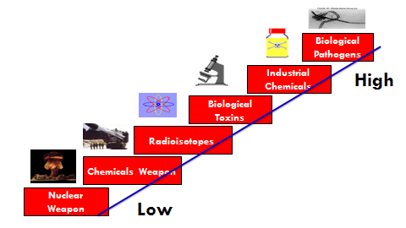
CBRN RISKS
Nuclear disasters are the high risk but low probability disasters whereas chemical and biological disasters in civil domain may take more casualties in comparison to an anticipated Radiological & Nuclear Emergencies.

Slide 24
NODAL MINISTRIES FOR CBRN DISASTER RESPONSE COORDINATION AT NATIONAL LEVEL
SL. NO. | TYPE OF DISASTER | NODAL MINISTRY
1. | Biological Disasters | Min. of Health and Family Welfare
2. | Chemical Disasters and Industrial Accidents | Min. of Environment, Forests and Climate Change
3. | Nuclear and Radiological Emergencies | Dept. of Atomic Energy, Min. of Home Affairs

Slide 25
CBRN: ROLE OF NDRF
The CBRN response planning is based on the following pillars :
Detection, Assessment and Protection.
Rescue and Evacuation of victims.
Decontamination.
Triage and Pre-hospital management of injured victims.

Slide 26
CBRN: EMERGENCY RESPONSE PHILOSOPHY
The CBRN emergency response philosophy is based on following three principles:
DETECTION : Detection of hazards with state-of-the-art equipment.
PROTECTION & EVACUATION : Protection of responders and victims from harmful effects of hazardous material. It includes rescue and evacuation.
DECONTAMINATION : Decontamination of personnel, victims, vehicles, area etc.

Slide 27
STRUCTURE OF CBRN TEAM
Strength 47
Sub Teams
Technical Support Team
Detection & Assessment Cum Evacuation Team
Rescue & Evacuation Team 1
Rescue & Evacuation Team 2
Decontamination Team
Medical Unit
Adm Support Team

Slide 28
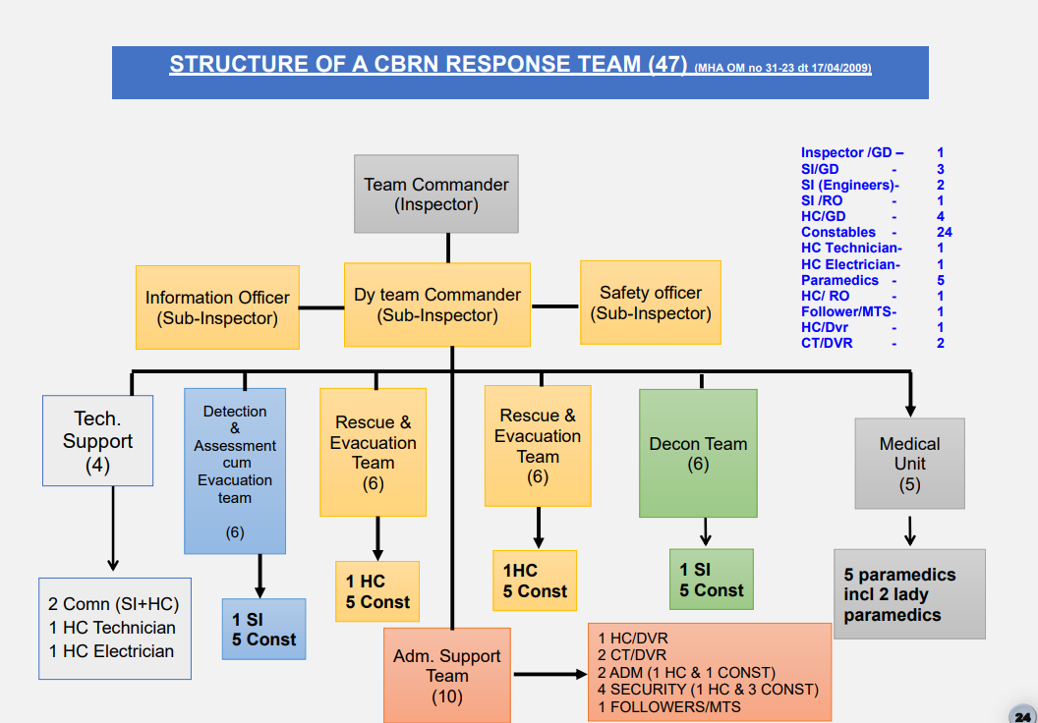
STRUCTURE OF CBRN TEAM

Slide 29


Overview of Course
Introduction of course coordinator, instructors, assistants, support staff and the other participants.
Duration of Course & Methodology
Evaluation/Curriculum & Schedule
What is CBRN…?
Role of first responder
Composition of CBRN Team
REVIEW

Slide 30

ANY QUESTION?

Slide 31


1. What is the minimum passing score in CBRN written examination?
Ans- 70% (70 percent).
2. What is strength of the CBRN response team?
Ans- 47
EVALUATION

Slide 32

THANK YOU

