Slide 1
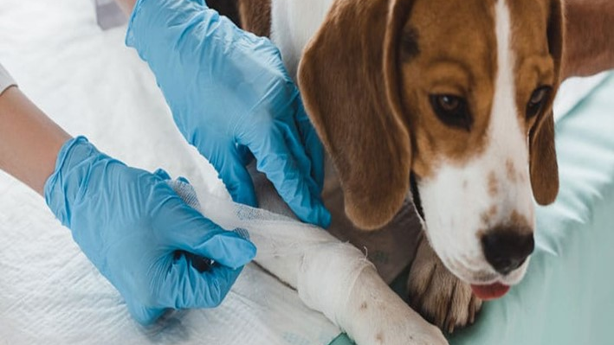


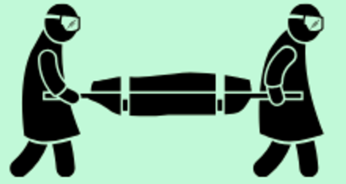
Dead Body Management and Caracas Management
LESSON 01
Introduction, Anatomy & Physiology of Animals
Presented By:- Kamlesh Dhoundiyal,2IC
NDRF | DBM-CM | INDIA
PPT 1 - 1

Slide 2
OBJECTIVES
Upon completing this lesson, you will be able to:
1
  Acquaint with Veterinary Science and Key Roles of Veterinarians
  Acquaint with Animal Husbandry and Key Aspects of Animal Husbandry
  Know 04 key classification of Animals
2
3

Slide 3
OBJECTIVES
Upon completing this lesson, you will be able to:
4
  Get overview of basic anatomy of Animals
  Aquent with animal behavior during Distress
  Aquent with key physiological parameters of Animals
5
6

Slide 4
Veterinary Science
Veterinary Science is the branch of science concerned with the prevention, diagnosis, and treatment of diseases, disorders, and injuries in animals.
Scope: Encompasses care for domestic animals, livestock, and wildlife. Also plays a vital role in public health and food safety.

Slide 5
Key Roles of Veterinarians
Animal healthcare and surgery
Disease control and epidemiology
Livestock management
Animal welfare and conservation
Research in zoonotic diseases.

Slide 6
Animal Husbandry
Animal husbandry is a branch of agriculture focused on the care, management, and breeding of domesticated animals for various purposes, including food production, fiber, and other products

Slide 7
Key Aspects of Animal Husbandry
Care and Management
Breeding
Livestock Raising
Health Management
Production

Slide 8
Classification of Animals
Livestock: Cattle, Buffalo, Goats
Companion: Dogs, Cats
Equines: Horses, Donkeys
Poultry, fisheries & others
PPT 1 -

Slide 9
Basic Anatomy Overview
Skeletal system
Muscular system
Cardiovascular & respiratory systems
PPT 1 -

Slide 10
Body Parts of Cattle
Head, ears, eyes, nose
Neck, back, tail
Limbs and hooves
PPT 1 -

Slide 11
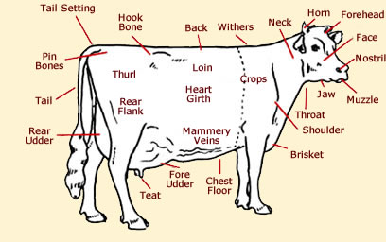
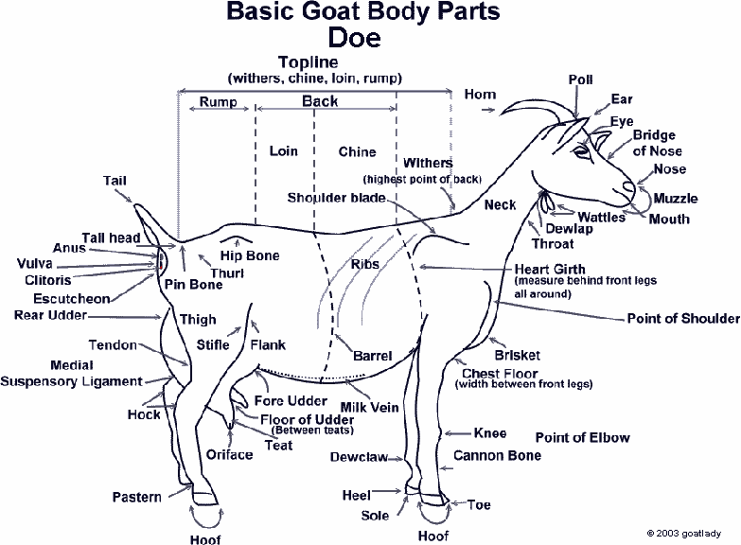
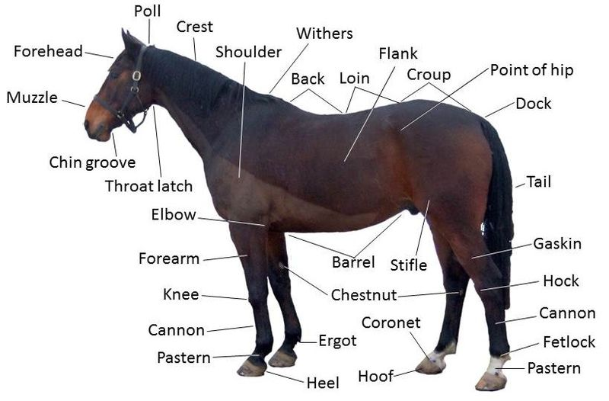
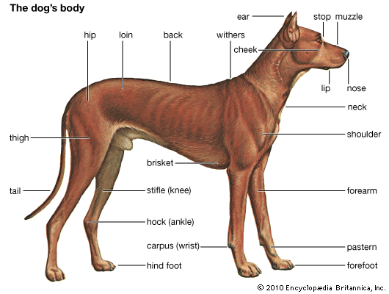
External Body Parts of Cattle
PPT 1 -

Slide 12
Body Parts of Poultry
Beak, comb, wattles
Wings, feathers, legs, claws
Cloaca and tail
PPT 1 -

Slide 13
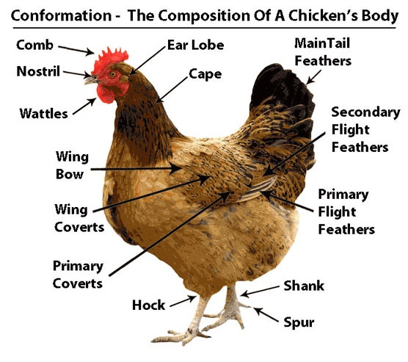
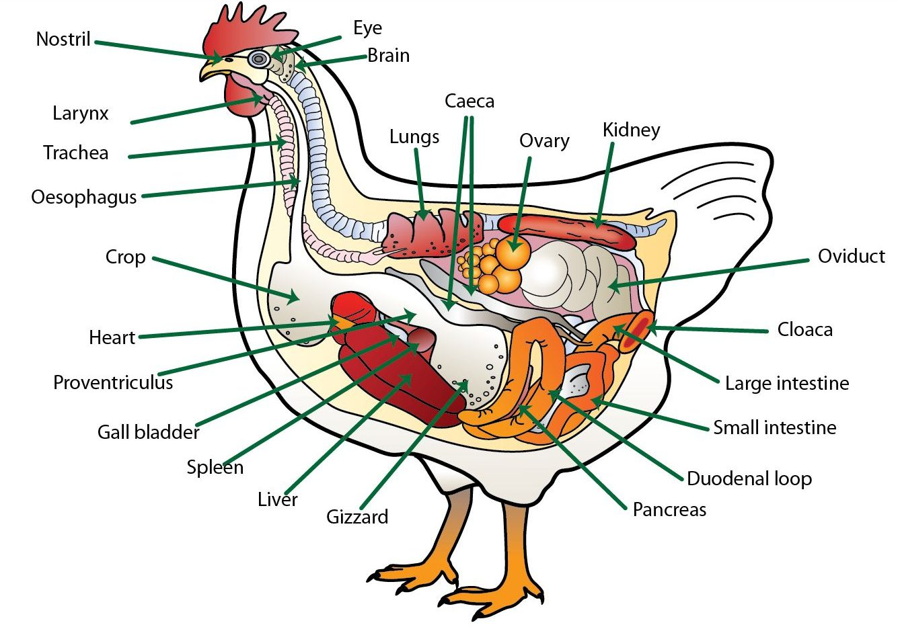
Body Parts of Poultry
PPT 1 -

Slide 14
Skeletal System
Function: support and movement
Major bones in animals
Differences in species
PPT 1 -

Slide 15
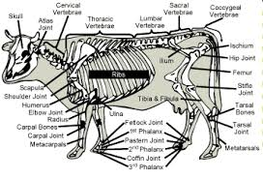
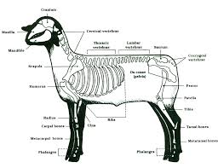
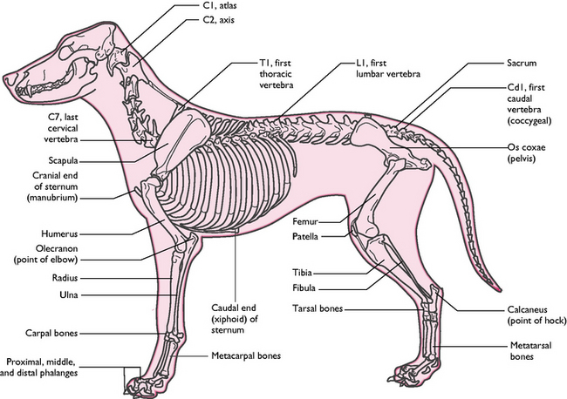
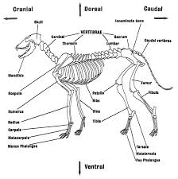
Skeletal System
PPT 1 -

Slide 16
Muscular System
Function: movement and posture
Types of muscles: skeletal, smooth, cardiac
Muscles in locomotion
PPT 1 -

Slide 17
Cardiovascular System
Heart and blood vessels
Pulse points for rescue: femoral, facial arteries
PPT 1 -

Slide 18
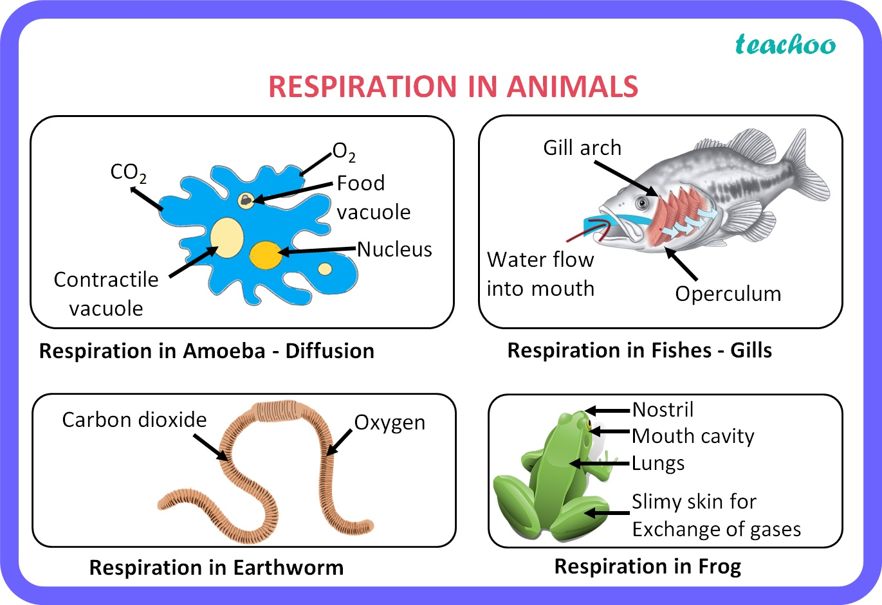
Respiratory System
Nasal passages, trachea, lungs
Signs of distress: rapid breathing, nasal flaring
PPT 1 -

Slide 19
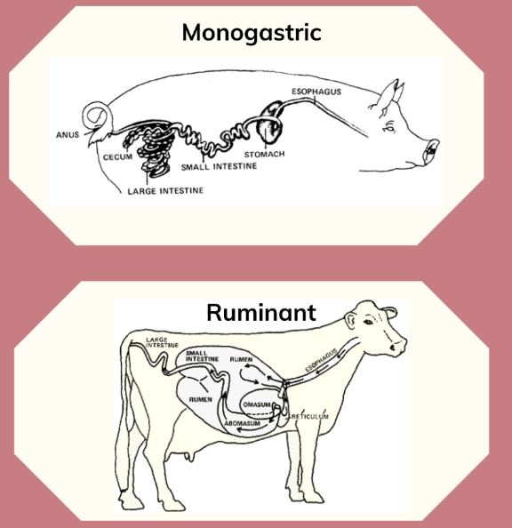
Digestive System
Ruminants vs monogastric
Risk of bloat in stressed animals
PPT 1 -

Slide 20
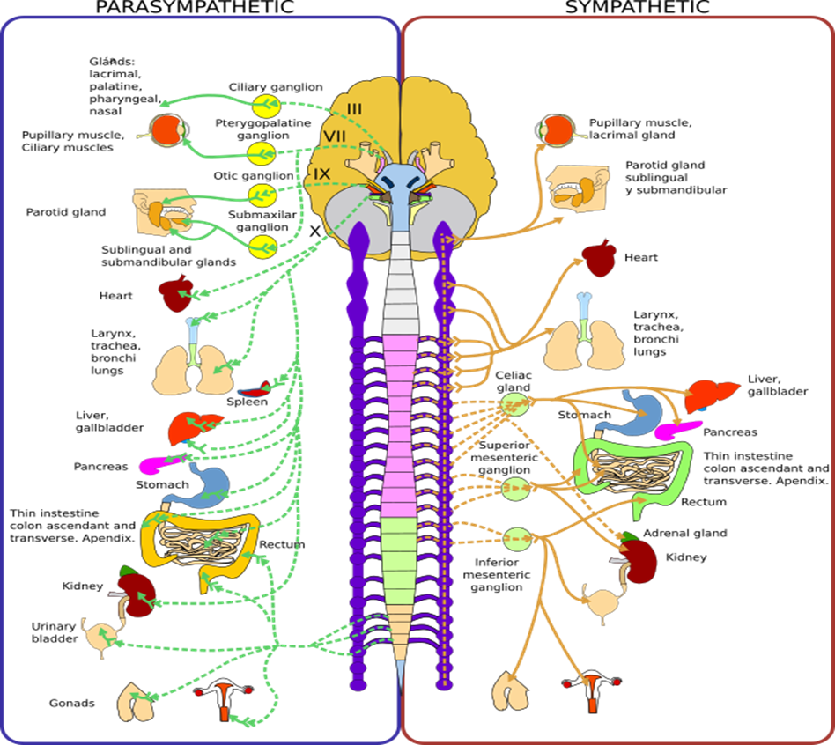
Nervous System
Brain, spinal cord, nerves
Fight-or-flight response
PPT 1 -

Slide 21
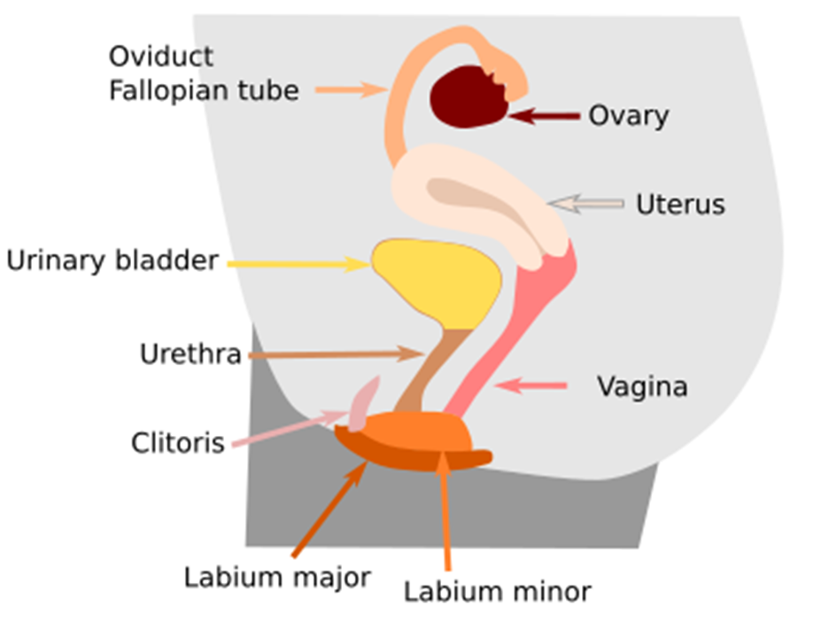
Reproductive & Urinary Systems
Special care for pregnant/lactating animals
Monitor urination for hydration status
PPT 1 -

Slide 22
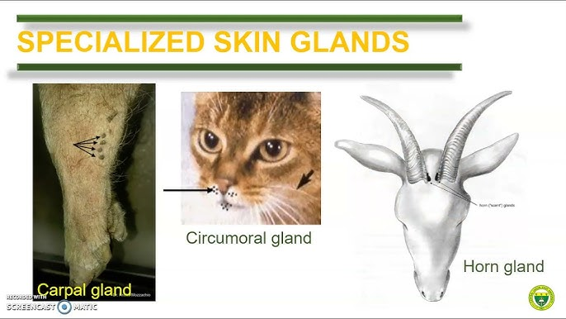
Skin & Integumentary System
Barrier: skin, hair, hooves
Inspect for wounds, infections
PPT 1 -

Slide 23
Animal Behavior in Disasters
Panic, aggression, separation anxiety
Species-Specific Handling
  Cattle: slow, heavy; need ramps
  Horses: blindfold to calm
  Dogs/cats: crates and muzzles

Slide 24
Physiological Parameters
Temperature: Cattle 38–39°C
Heart rate: Dog 70–120 bpm
Respiratory rate: species-dependent
Stress & Shock Signs
  Rapid pulse, pale gums
  Restlessness or collapse

Slide 25
Importance of Anatomy & Physiology in Animal Care
Basis for diagnosis and treatment
Understanding animal behavior and health
Application in breeding and nutrition

Slide 26
Role of NDRF Rescuers
Coordinate with Animal Husbandry Dept
Assist in evacuation and sheltering
Support carcass disposal if required
PPT 1 -

Slide 27
Key references
DAHD (2024): Crisis Management Plan for Livestock Diseases
NIDM (2022): Handbook for Management of Animals in Disasters & Emergencies
AWBI: Scheme for Relief to Animals during Natural Calamities & Unforeseen Circumstances
MoHFW / NCDC (2024): National Action Plan for Prevention & Control of Snakebite

Slide 28



THANK YOU

