Slide 1


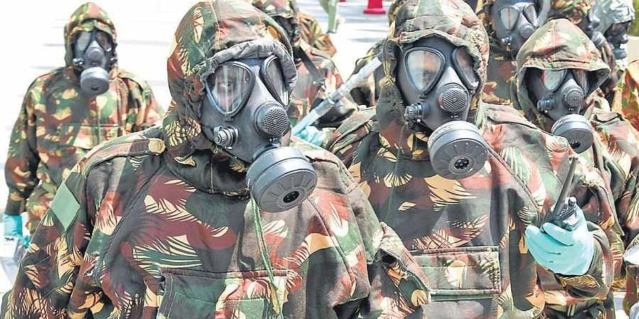
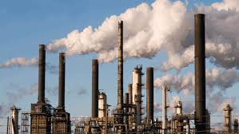
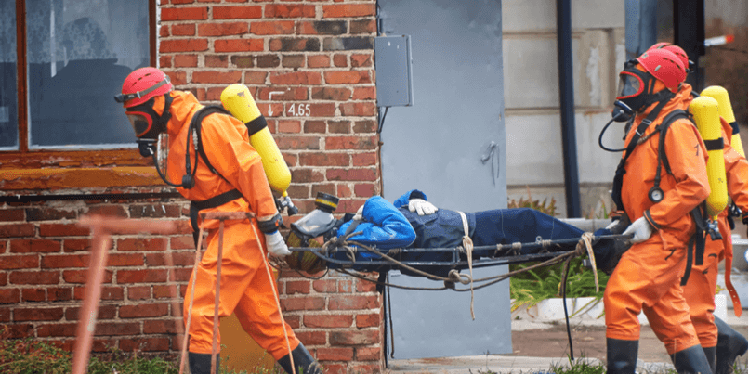
OVERVIEW OF CBRN EMERGENCY
Presented by:- Kamlesh Dhoundiyal, 2IC

Slide 2
Upon completion of this lesson you will be able to know:
What is CBRN Emergency?
Info about TIC & TIM
Management of HAZMAT Transportation accident
Role and Procedure during offsite Emergency
Info about CBRN Eqpts, Wiser/ERG apps
Monitoring of threats in cities/towns with MAH Units
Conclusion
OBJECTIVE

Slide 3

Chemical, biological, radiological, nuclear and explosive (CBRN) events refer to the uncontrolled release of chemicals, biological agents or radioactive contamination into the environment or explosions that cause widespread damage. CBRN events can be caused by accidents or by terrorist acts.
WHAT IS CBRN
EMERGENCY

Slide 4
Chemical Hazards.
Biological Hazards.
Nuclear and Radiological Hazards.
TYPES OF CBRN EMERGENCY

Slide 5
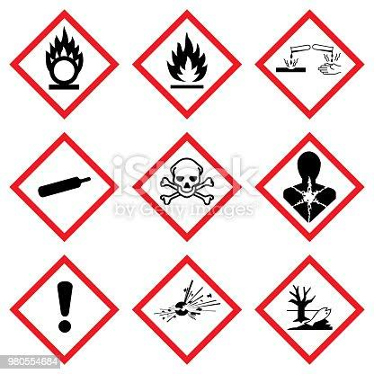
Chemical Warfare Agents
Hazardous Industrial chemicals causing
leakage,
explosion,
fire,
contamination,
poisoning
CHEMICAL
HAZARDS

Slide 6

Biological Warfare Agents
Bacteria, Viruses, parasites
Endemic diseases and Epidemics
BIOLOGICAL
HAZARDS

Slide 7
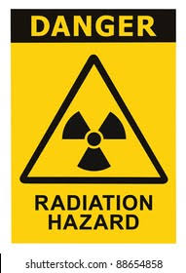
Radiological dispersal device(RDD)
Radiological exposure device(RED)
Industrial Accidents
Transportation Accidents
Nuclear Weapons and Improvised Nuclear device
NUCLEAR AND
RADIOLOGICAL
HAZARDS

Slide 8
TOXIC INDUSTRIAL CHEMICALS
TIC Are any substances that produced and used by industries for various purpose and that, because of their chemical and physical properties pose a potential risk of life, health and environment when not properly contained.
Toxic industrial chemical can be in Solid, Liquid, or Gaseous state.

Slide 9
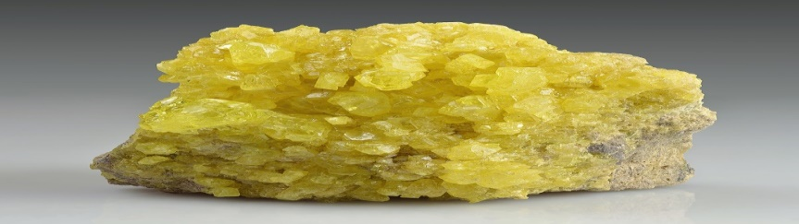
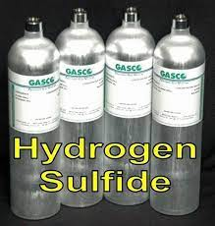
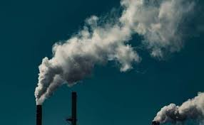
TOXIC INDUSTRIAL CHEMICALS
Toxic industrial chemical can be three states.
Solid
Liquid
Gas

Slide 10
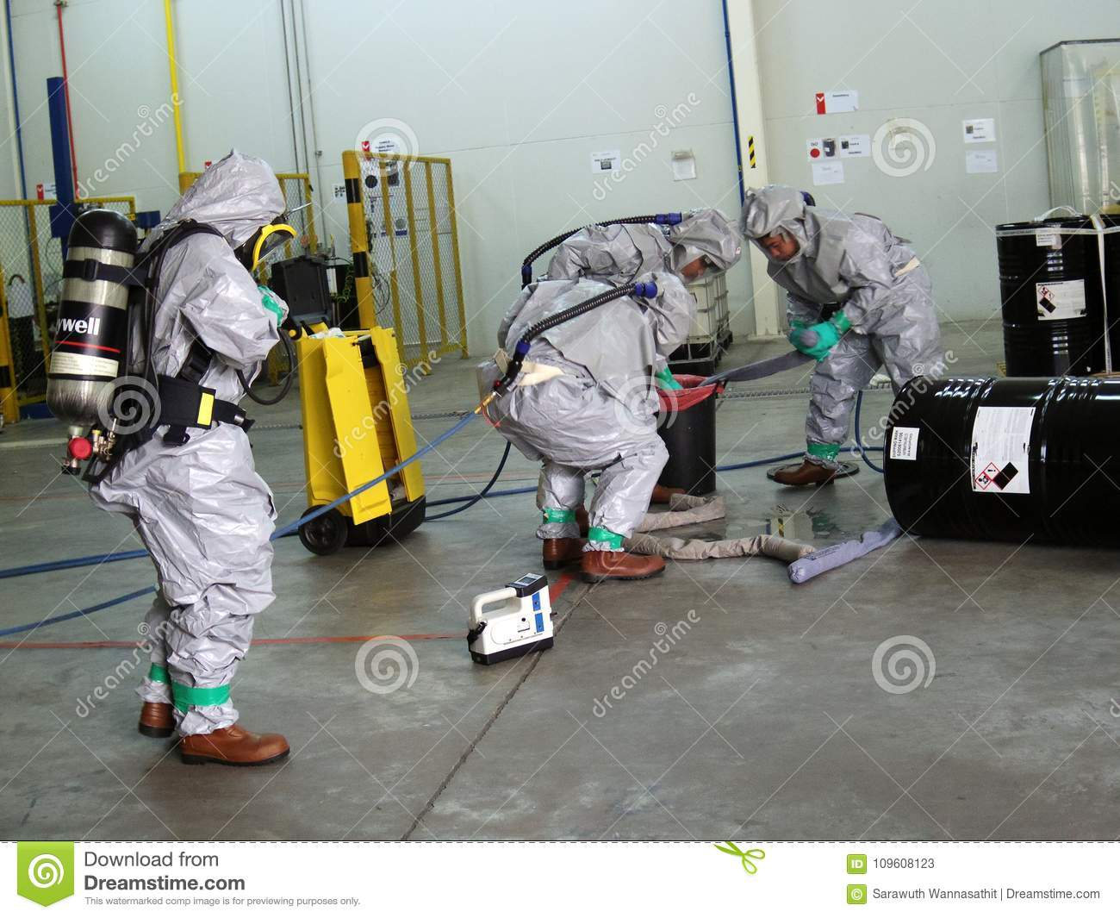

Slide 11
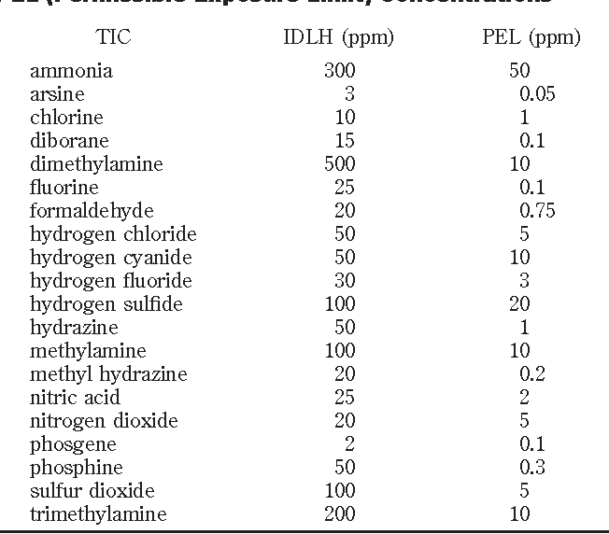
TOXIC INDUSTRIAL CHEMICALS

Slide 12
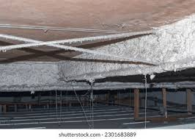
TIM (TOXIC INDUSTRIAL MATERIAL)
TIC’s are refer to substances used in various industries that pose significant risks to human health and the environment due to their toxic properties.
asbestos,
Lead ,
Mercury,
Chromium and etc.

Slide 13

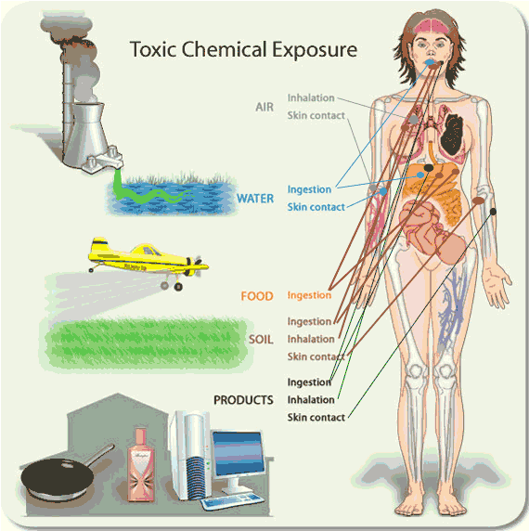



HEALTH EFFECTS OF TICS AND TIMS
Absorption …..
Inhalation……
Ingestion………
Injection………

Slide 14
Class 1 Explosives
Class 2 Gases
Class 3 Flammable Liquids
Class 4 Solids
Class 5 Oxidizing Substances
Class 6 Toxic and Infectious Substances
Class 7 Radioactive Substances
Class 8 Corrosives
Class 9 Miscellaneous Substances
CLASSES
OF
CHEMICALS

Slide 15

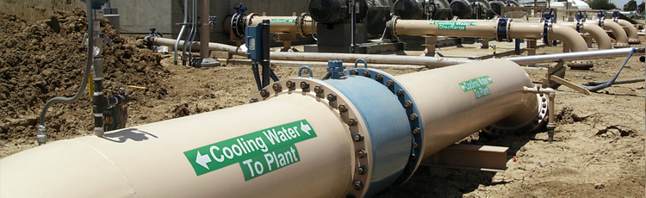
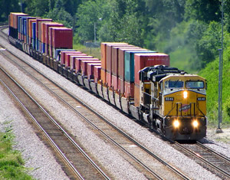
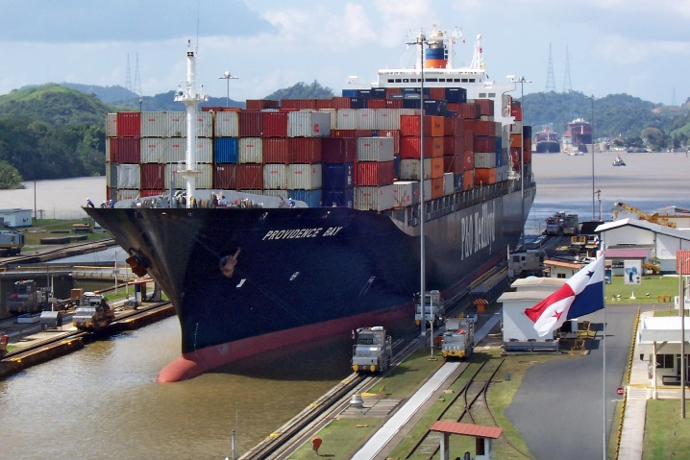
MODE OF TRANSPORTATION OF HAZMAT
Taps ( pipe line )
Plane (air ways )
Ship (water transport )
Train (rail transport )
Motor vehicle (road transport)
15

Slide 16
Preparation and Planning
Immediate Response
Containment and Control
Evacuation and Shelter-in-Place
Medical Response
Environmental Protection
Communication
Investigation and Documentation
Recovery and Cleanup
MANAGING
HAZMAT
TRANSPORTATION
ACCIDENTS

Slide 17
OFF-SITE EMERGENCY PLAN
Is an integral part of any major hard control system.
Base on those accidents, which could affect people and the environment outside the workers.
Based on those events which are most likely to occur.
A good off-site emergency plan has the flexibility in its application to emergencies other than those specifically included in the formation of the plan.

Slide 18
OFF-SITE EMERGENCY PLAN- PART-1 ( INDIVIDUAL INDUSTRIES)
Site location – road/ railway stations
Brief details of manufacturing processes and materials handled.
Hazard potential.
Basic control system and communications.
Material safety data sheets of important hazardous chemicals handled.
Responsibilities and duties of key personnel.

Slide 19
OFF-SITE EMERGENCY – PLAN-2 (COMMON OFF-SITE EMERGENCY PLAN)
Sectorial division of emergency planning zone
( Direction/distance/Sectors giving details of villages and approximate population)
Emergency committees.
Notification of off-site emergency.
Responsibilities and duties of Govt. and other agencies.
Annexures containing details of telephone numbers. Contact address safety professionals of the area, Medical facilities etc.

Slide 20
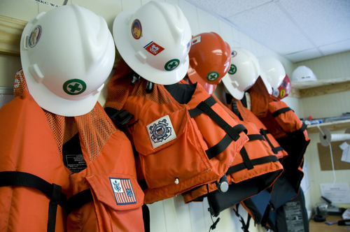
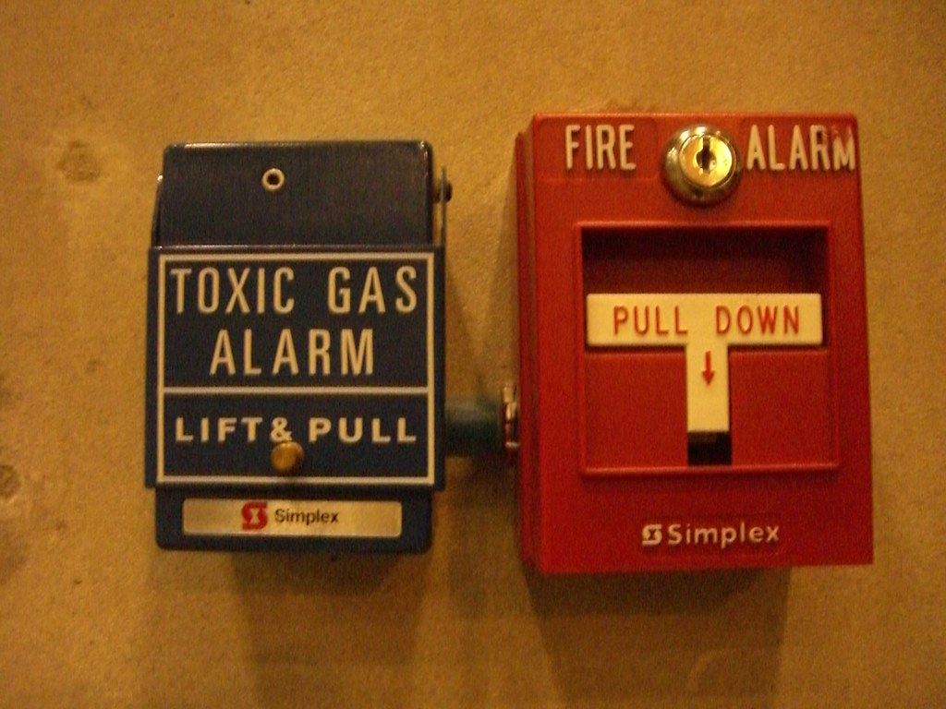
SAFETY EQUIPMENT
Respirators.
Gum boot.
Safety helmets.
Asbestos Rubber hand gloves
Google and face shield.
Toxic gas measuring instrument.
Explosive meter.
Oxygen measuring instrument.
Wind direction indicator
This Photo by Unknown Author is licensed under CC BY

Slide 21
INFO ABOUT CBRN EQPTS, WISER/ERG APPS

Slide 22
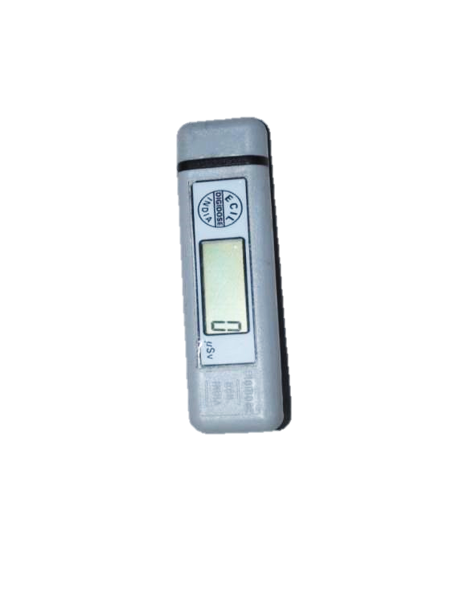
ELECTRONIC DOSIMETER
DETECTOR :- Gamma & x-ray (Dose)
PRINCIPLE :- Semi-conductor
RANGE :- 1uSv to 999999 uSv
DISPLAY :- 6 digit LCD
ACCURACY:- (±)15%
BATTERY:- Lithium Ion Cell (03 volts)
Used for 1000 hrs
It records instantaneous dose
It is temporary record

Slide 23
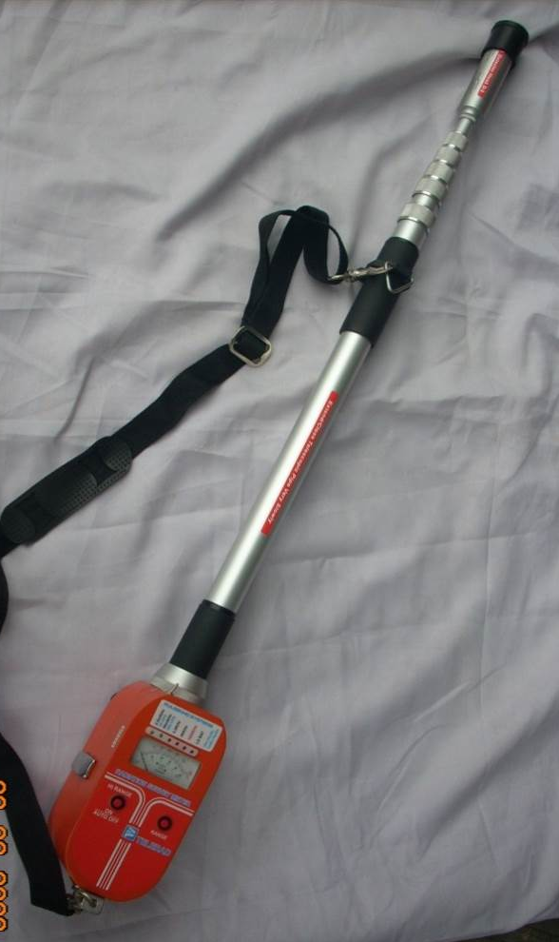
TELETECTOR (TELERAD)
PURPOSE : Beta/ Gama / X-Ray detection
ADVANTAGE : 4 Mtr long Telescopic Probe
WORKS ON : GMT (D1&D2)
RANGE : (X-Ray & Gamma Ray) 0 to1000 R/hr
Beta : 0 to 900 CPS
BATTERY : (1.5 V) 5 Pencil Cells
PRINCIPLE : Gas Filled Detector
ACCURACY : (+/-) 15%
NO | RANGES | SCALE | LED | RADIATION | DETECTOR
01 | 0-1000R | RED | RED | X &Gamma | D-2
02 | 0-50R | BLACK | RED | X &Gamma | D-2
03 | 0-2.5R | BLACK | RED | X &Gamma | D-2
04 | 0-50mR/ 900CPS | BLACK | GREEN | X, Gamma&Beta | D-1
05 | 0-2.5mR/ 45cps | BLACK | GREEN | X, Gamma & Beta | D-1
23

Slide 24
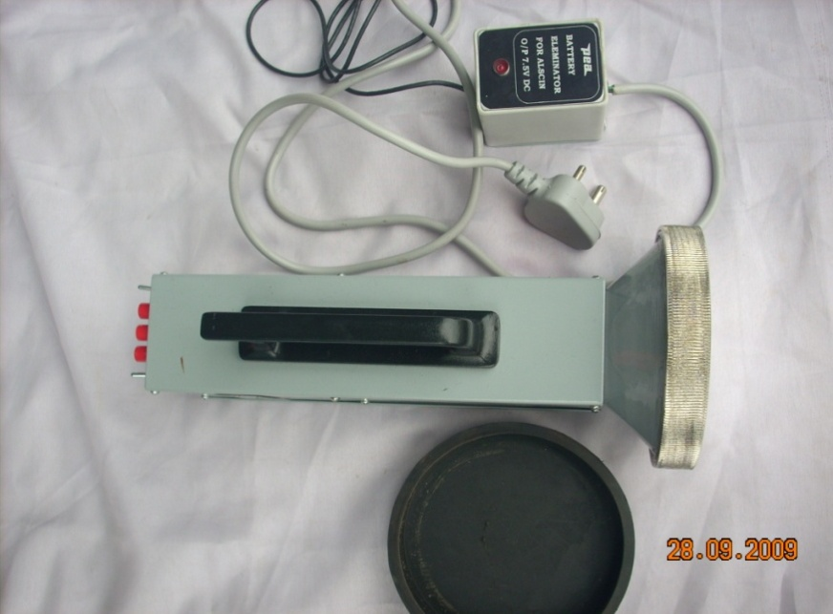
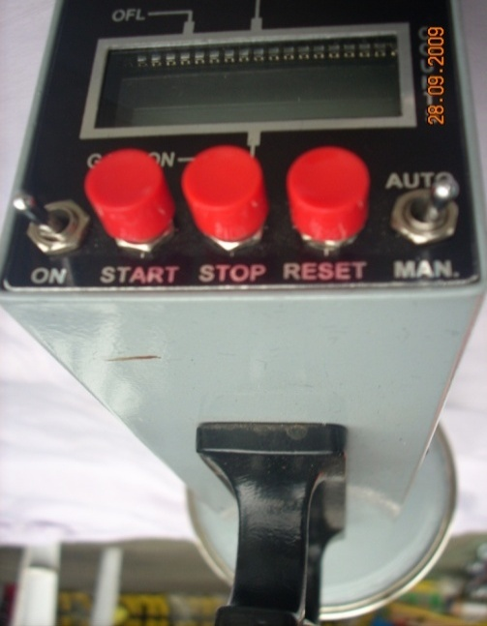
ALSCIN MONITOR
PORTABLE DEVICE TO MEASURE ALPHA CONTAMINATION LEVEL
PURPOSE : Detects Alpha particle
ADVANTAGE : Portable & Accurate Device
READING : In PPS (Particles per Second)
PRINCIPLE : Scintillator detector(PMT)
RANGE : 4-5cms
DISPLAY : 4 digit LCD
MODES : Auto & Manual
WORKING TIME : 1 Min (in Auto Mode)
: Continuous (in Manual Mode)
BATTERY : (1.5V) DC-R14 size 05 cells (medium battery)

Slide 25
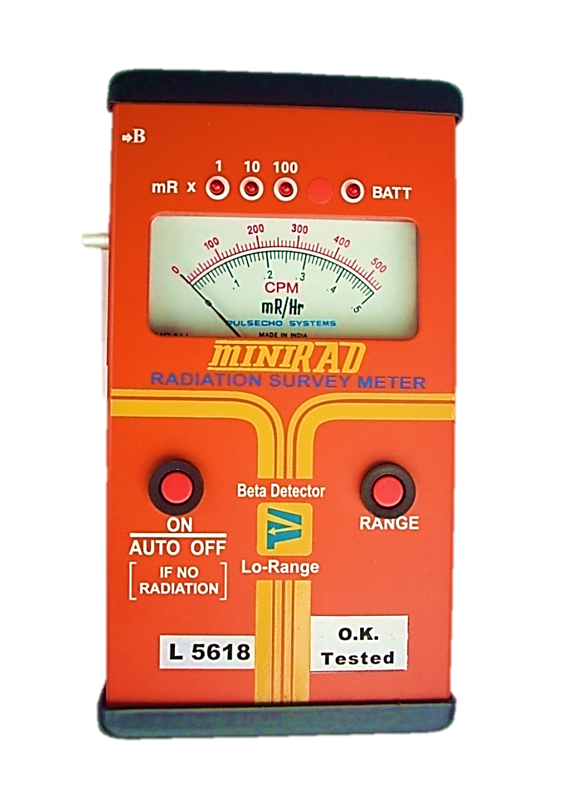
RADIATION SURVEY METER
(MINIRAD BETA INTERNAL)
PORTABLE DEVICE TO MEASURE LOW RANGE X-RAY, BETA & GAMMA RADIATION
PURPOSE : Beta/ Gama / X-Ray detection
ADVANTAGE : Light, Portable, gives Fast &
Accurate measurement.
READING : 4 LED Display to indicate
* Range
* Incident RADIATION
* Low Battery
PRINCIPLE : (Gas Filled Detector) GM Tube
LOW RANGE : 0 – 50 mR/Hr, 0 – 54000cpm
BATTERY : 05 Pencil Cells (1.5V)
ACCURACY : (+/-) 15%
WORKING TIME : 60 hrs Continuous
OPERATING TEMP. :0-50 Deg.C
25

Slide 26
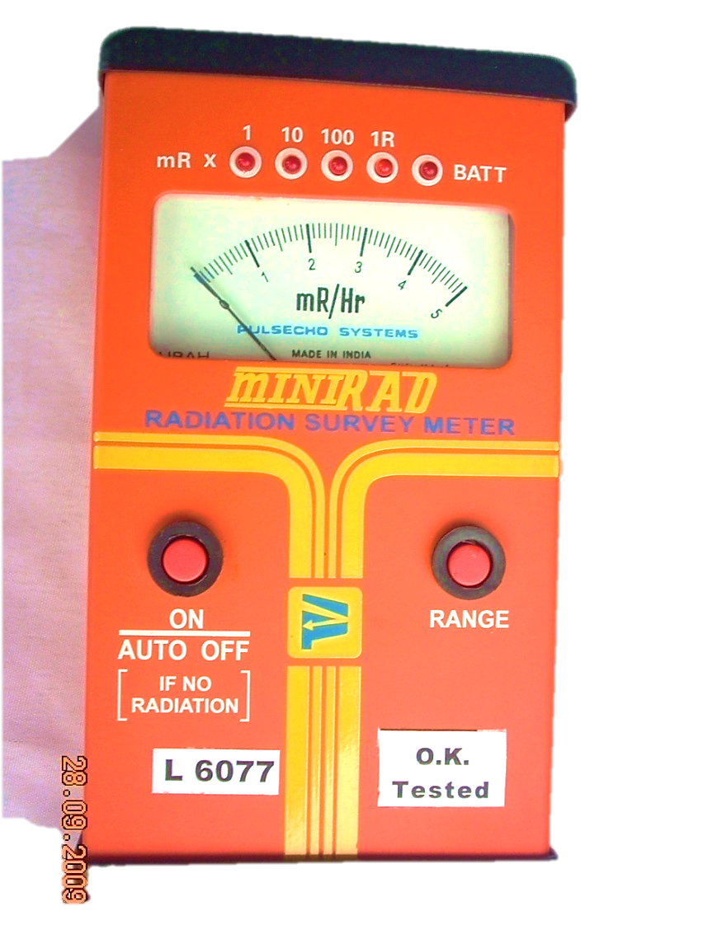
RADIATION SURVEY METER
(MINIRAD )
PORTABLE DEVICE TO MEASURE X-RAY & GAMMA RADIATION
PURPOSE : Gama / X-Ray detection
ADVANTAGE : Light, Portable, gives Fast & accurate measurement.
READING : 5 LED Display to indicate
* Range
*Instant Reading
PRINCIPLE : Gas Filled Detector (GMT)
WEIGHT : 450 Gm
HIGH RANGE : 0 – 5 R/Hr
ACCURACY : (+/-) 15 % with Cesium (Cs) 137 source
WORKING TIME : 02 min (otherwise switched off)
OPERATING TEMP. : 0 TO 50 Degree C
BATTERY : 05 Pencil Cell (1.5V)
WORKING TIME : 60 hrs Continuous
26

Slide 27
RADIATION SURVEY METER
(MINIRAD )
PORTABLE DEVICE TO MEASURE X-RAY & GAMMA RADIATION
PURPOSE : Gama / X-Ray detection
ADVANTAGE : Light, Portable, gives Fast & accurate measurement.
READING : 5 LED Display to indicate
* Range
*Instant Reading
PRINCIPLE : Gas Filled Detector (GMT)
WEIGHT : 450 Gm
HIGH RANGE : 0 – 5 R/Hr
ACCURACY : (+/-) 15 % with Cesium (Cs) 137 source
WORKING TIME : 02 min (otherwise switched off)
OPERATING TEMP. : 0 TO 50 Degree C
BATTERY : 05 Pencil Cell (1.5V)
WORKING TIME : 60 hrs Continuous
27

Slide 28
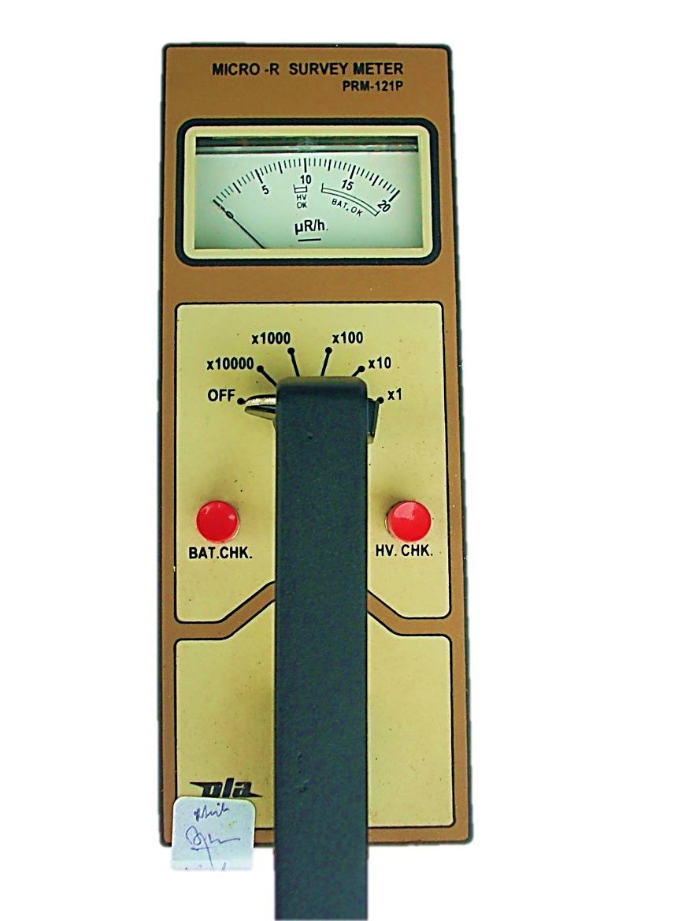
MICRO “R” SURVEY METER
VERY EFFECTIVE, PORTABLE DEVICE TO MEASURE GAMMA RADIATION
PRINCIPLE:- Scintillation
ADVANTAGE: Hand held, portable , light weight and analog dose rate meter.
DETECTOR : Gamma & x-ray (PMT)
RANGE : 0 to 2,00,000 μR/h
ACCURACY : (+/-) 20 %
BATTERY : (1.5 V) 6 pencil battery
Before use always checkup the battery and its high voltage
If least range is selected & display show 2 to 10 µR/h, It is natural back ground. If reading exceeds more than 15 µR/h then some artificial Gamma radiation is present

Slide 29
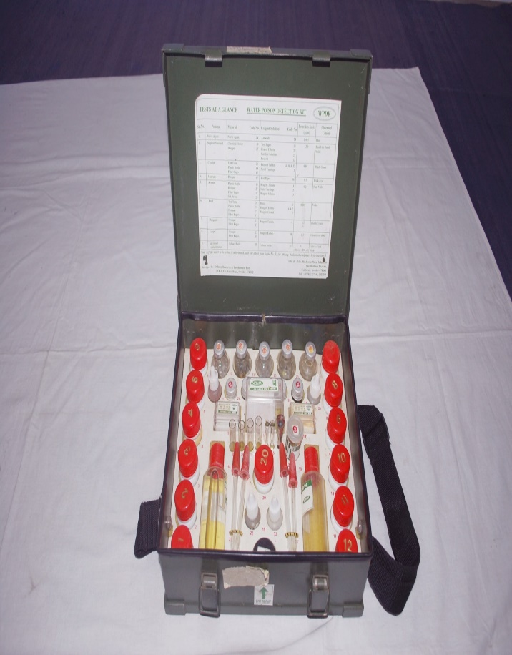
WATER POISON DETECTION KIT
Detection Process: Practical
WPDK SIZE: 325x270x110 mm
Weight: 3.4 Kg
Capacity: i) 50 test for all poison
ii) 05 test for nerve agent
iii) 05 test for Microbial contamination
Performance test :-
a) Nerve agent – 0.01mg/ltr (blue)
b) Sulphur mustard-2.0 mg/l (purple blue)
c) Cyanide – 0.05mg/ltr (bluish green)
d) Mercury – 0.5 mg/ltr (brick red)
e) Arsenic – 0.2mg/ltr (pinkish violate)
f) Lead – 0.001 mg/ltr (violate)
g) Manganese – 0.2mg/ltr (bluish green)
h) Copper – 1.5mg/ltr (olive green)
i) Microbial contaminants – 1-3 coliform/100ml –(Z black) Approx time 18 hrs

Slide 30
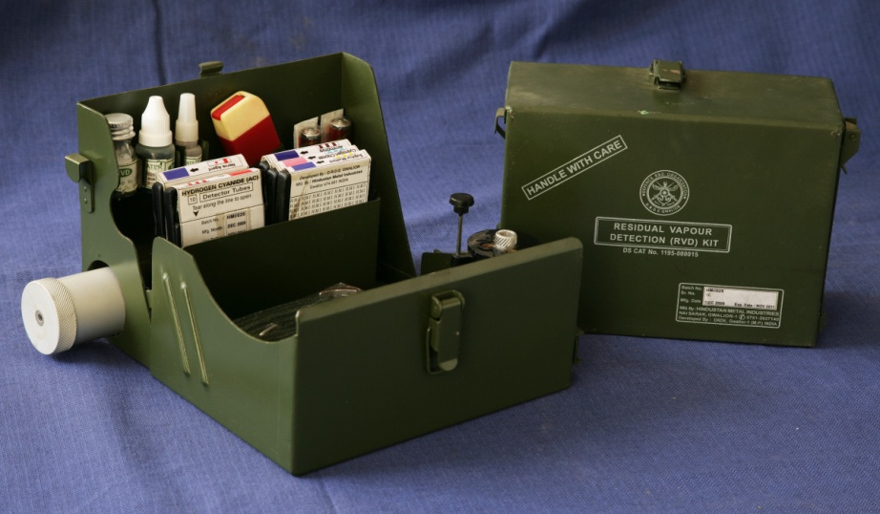
RESIDUAL VAPOUR DETECTION KIT (RVD)
Construction: Al sheet Epoxy coated
Principle: Chromogenic Reaction
Weight: 1.75 kg
Size: 210x158x110 mm
Expiry: 2 years
Detection: CW Agents
Cyanogen chloride 0.01mg/ltr
(Pinkesh Red)
2. Hydrogen cyanide 0.01mg/ltr
(Pinkesh Red)
3. Sulphur mustard 0.003mg/ltr (Blue)
4. Nerve agent 0.0004mg/ltr (Blue)
5. Phosgene (Cocl2) 0.01mg/ltr (Red)
6. Ammonia 0.01mg/ltr (Violet)

Slide 31
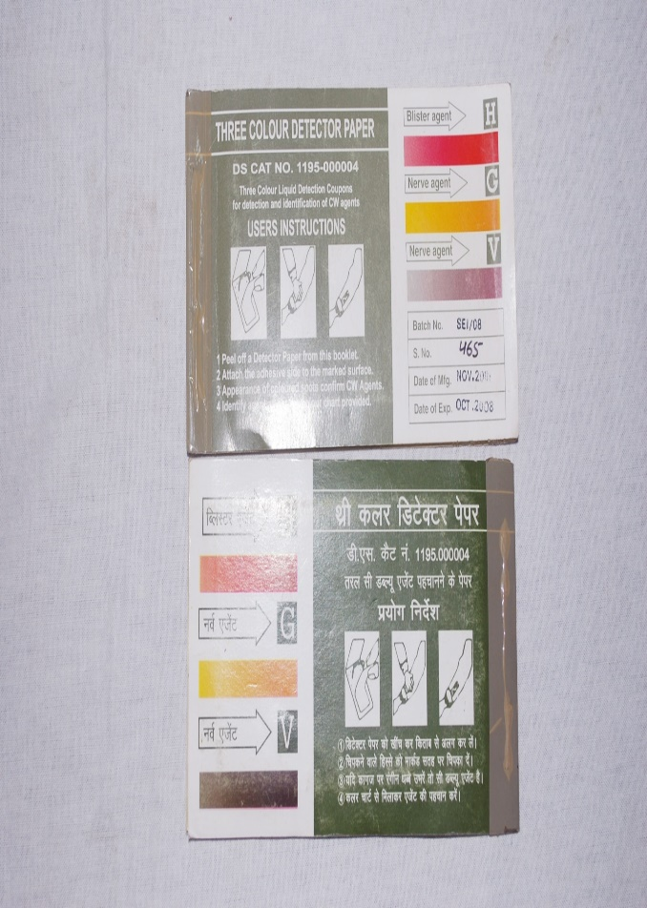
THREE COLOUR DETECTOR PAPER (TCDP)
Used to identify of CW Agents
Three type of CW Agents can detects
Blister Agent (change in pink)
G Nerve Agent (change in yellow)
V Nerve agent (change in green)
*change color immediately when agent
consumed
*One Pack having 10 detection coupons
*Self Life – 2 Year
*DS CAT NO. 1195-000004
31

Slide 32
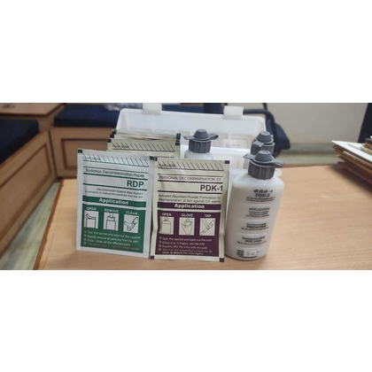
PERSONAL DECONTAMINATION KIT (PDK)
This kit consists three components:-
a) PDK-1
b) PDK-II
c) RDP (Radiation Decontamination Paper)
Used for decon of CW agents .
Dimensions : 230 + 2 X 135 + 2 x 45 + 2 mm
Weight : 0.480+15 Kg
Self Life : 5 Year (Packed Condition)
Temp : 25° C
Humidity : 50%

Slide 33
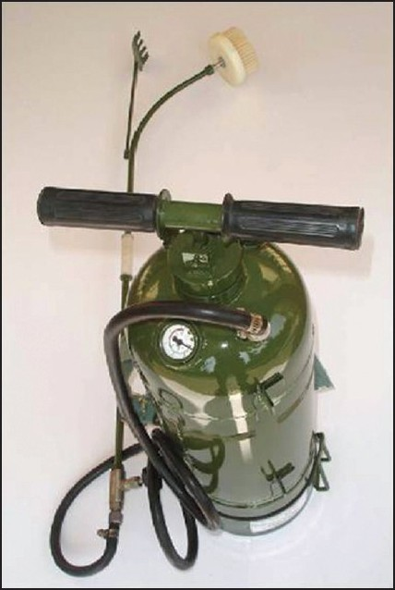
PORTABLE DECONTAMINATION APPARATUS
Very useful in small scale decon of NBC Agents
Made : Stainless steel
Capacity : 14 Litre
Fill capacity : 12 ltr.
Weight : 10.5 + 0.5 Kg
Operating Pressure : 5.5 + 0.5 Kg/cm (300 Bar Pressure)
Self Life : 5 Year (non metallic)
:10 Year (metallic)
Ratio:- 11:1 (Water & DS-2)
DS-2 :- Decontamination solution-2

Slide 34
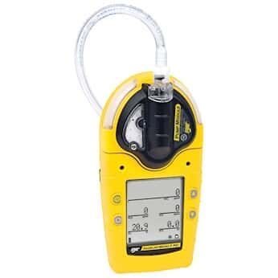
Working principal:-Catalyst (A catalyst is an agent or compound that is added to a process to make a chemical reaction happen more quickly. The catalyst can increase the reaction rate of the steam and can participate in the secondary reactions. The packing can also act as a catalyst to enhance desired chemical transformations.)
Sensor type:
O2 ------------------------%
H2S--------------PPM
CL2-----------------------PPM
CO---------------PPM
LEL (Flammable Gas - SO₂, PH₃, CI₂, NH₃, NO₂, HCN, CIO₂, O₃ )--%
GAS
ALERT
MICRO 5

Slide 35

EMERGENCY RESPONSE GUIDEBOOK (ERG)
Developed jointly by:
Transport Canada (TC)
The U.S. Department of Transportation (DOT)
The Secretariat of Transport and Communications of Mexico (SCT)
Used by fire fighters, police, and other emergency services personnel who may be the first to arrive at the scene of a transportation incident involving dangerous goods.
35

Slide 36

APPLICATION OF THE ERG
Primarily a guide to aid first responders in quickly identifying the specific or generic hazards of the material(s) involved in the incident, and protecting themselves and the general public during the initial response phase of the incident.
Assists first responders in making initial decisions upon arriving at the scene of a dangerous goods incident.
36

Slide 37

ERG FORMAT
The book is divided into sections by the page border colors
Yellow
Blue
Orange
Green
37

Slide 38
ERG Sections:
Telephone numbers
Table of placards
Railcar and Road Trailer ID Charts
YELLOW Section (ID No.)
BLUE Section (Shipping Names)
ORANGE Section(Guide Pages)
GREEN Section (Initial Isolation and Protective Action Distances for highlighted substances)
ERG FORMAT
38

Slide 39
Major Accident Hazard (MAH) units are facilities or sites where hazardous materials are produced, processed, handled, or stored in quantities that pose a significant risk of causing a major accident. These units typically include industries such as chemical manufacturing, petroleum refineries, gas processing plants, and other facilities that deal with dangerous substances.
MAH UNITS

Slide 40
Chemical Plants: Facilities that manufacture or process chemicals.-
Oil Refineries: Plants where crude oil is refined into products like gasoline and diesel.
Gas Processing Plants: Facilities that process natural gas.
Storage Depots: Sites where large quantities of hazard
EXAMPLES
OF
MAH UNITS
40

Slide 41
Prevent Accidents: Early detection of potential hazards can prevent accidents from occurring
Minimize Impact: In the event of an accident, rapid response can reduce the impact on human health, the environment, and property.
Compliance: Ensuring that MAH units comply with safety regulations and standards.
IMPORTANCE
OF
MONITORING
MAH UNITS
41

Slide 42
Now, you have able to know…………….
What is CBRN Emergency?
Info about TIC & TIM
Management of HAZMAT Transportation accident
Role and Procedure during offsite Emergency
Info about CBRN Eqpts, Wiser/ERG apps
Monitoring of threats in cities/towns with MAH Units
Conclusion
REVIEW

Slide 43


ANY QUESTION ?

Slide 44
EVALUATION
What is the full form of TIC & TIM ?
Ans. Toxic Industrial Chemicals &Toxic Industrial Material
2.Write down the 3 Radiological Eqpts Name.
Ans. Minired, alsin monitor, Teletector , Personnel Radiological detectors (PRDs)

Slide 45
THANK YOU

