Slide 1
INTRODUCTION TO NDRF
AND
ITS ROLE IN DISASTER
Presented by:- Dileep Kumar, 2IC
Notes:
1

Slide 2
OBJECTIVES
Upon completion of this lesson, you will be able to:
  Introduction to NDRF.
  Its role in Disaster.

Slide 3
Such disasters led Govt. of India to formulate a Disaster Management Plan and to have an institutionalized mechanism in the country to deal with disasters
DM Act was passed by Parliament on 26th Dec’ 2005
Chapter –VIII, Sec-44(1) of DM Act provides for creation of National Disaster Response Force for the purpose of specialist response to a threatening situation or disaster.
National Disaster Response Force (NDRF) was raised on 19th January 2006 after the enactment of Disaster Management Act, 2005. Since its raising, it has grown from initial 8 Battalions to 16 Battalions today.

Slide 4
Presently, it has presence at 68 locations including 28 Regional Response Centre (RRCs) and 24 Tactical pre-positioning locations (TPLs). Each battalion of NDRF has 18 specialized Search and Rescue (SAR) Teams which are self-contained and have specialists like engineers, technicians, electricians, dog squads and medical/para-medical personnel. The sanctioned strength of the Force is 18,556.
RAISING OF NDRF

Slide 5
Since its raising NDRF has conducted more than 12,000 operations, rescued more than 1,58,000 persons and evacuated more than 8.5 lakhs persons during various disasters.
It has also conducted more than 13,000 Community Awareness Programs (CAPs) and about 8000 School Safety Programs (SSPs) benefitting more than 93 lakhs students .
RAISING OF NDRF

Slide 6
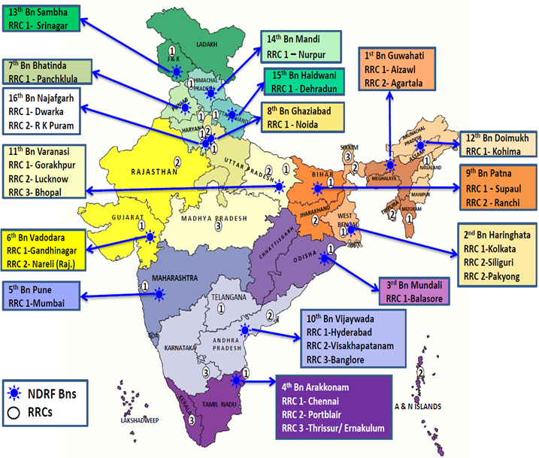

Slide 7
NDRF HEADED BY DIRECTOR GENERAL –
Shri Piyush Anand (IPS)
Sector headed by DIG-
                East & North East Sector
                North-West Sector
                South Sector
16 Bn headed by Commandant
NDRF: COMPOSITION

Slide 8
Each Battalion has authorized strength of 1149 personnel.
Each Bn has 06 coys and each coy have 03 specialist teams. Total 18 specialist teams including medical, technical, engineering & Dog Squad members to handle disasters & CBRN emergencies.
NDRF: COMPOSITION

Slide 9
Team Commander
(Inspector)
NDRF Unit : 1149
Total Teams : 18
2 IC/ Ops Officer
(Sub Inspector)
Tech
Support
(6)
Team A
(6)
Team B
(6)
Team C
(6)
Team D
(6)
Dog
Squad
(3)
Medical
Support
Team
(2)
2 Comn
(SI+HC)
2 Struc. Engr.(SI)
1 Technician
1 Electrician
1 SI
5 Const
1 HC
5 Const
1 SI
5 Const
1 HC
5 Const
3 Const
Dog Handlers
(Dogs 02 Nos)
1 Paramedic
1 Nursing Asstt
Adm.
Support
Team
(7)
1 HC
2 Support Staff (1 follower/1 Const)
4 Security (1 HC/3 Const*)
Total strength : 44 + 03 Drivers

Slide 10
Prepared for any disaster related Ops assignment.
On Wheels : Alert Team / QRT
Response Time : Within 20 Mins
OPERATIONAL PREPAREDNESS

Slide 11
Pre-disaster
Regular and intensive training.
Regular familiarization of AOR.
Carry out joint exercise with various stakeholders
To carry out Community Awareness & School Safety Program in area of responsibility.
To train SDRF and other stakeholders.
Role of NDRF

Slide 12
MOCK EXERCISE ON TRAIN ACCIDENT WITH RAILWAY

Slide 13
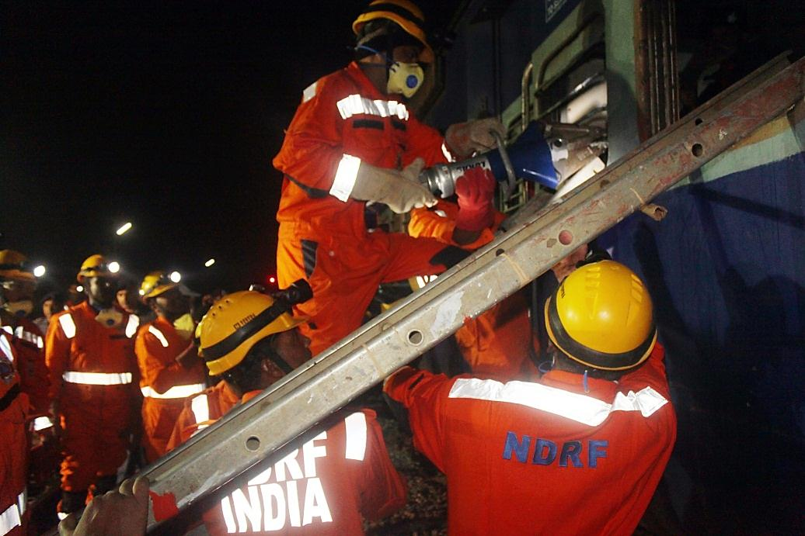
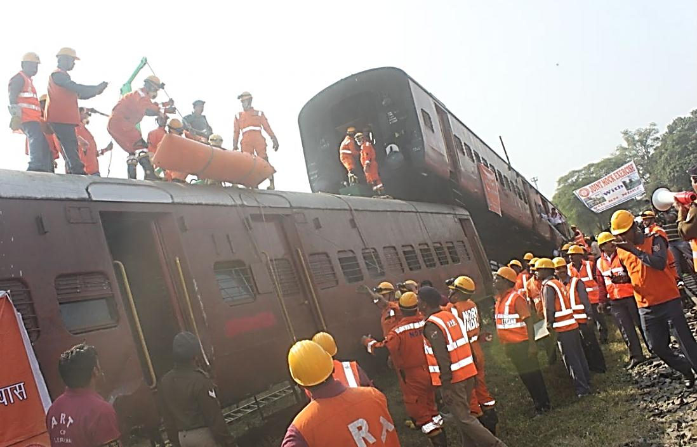
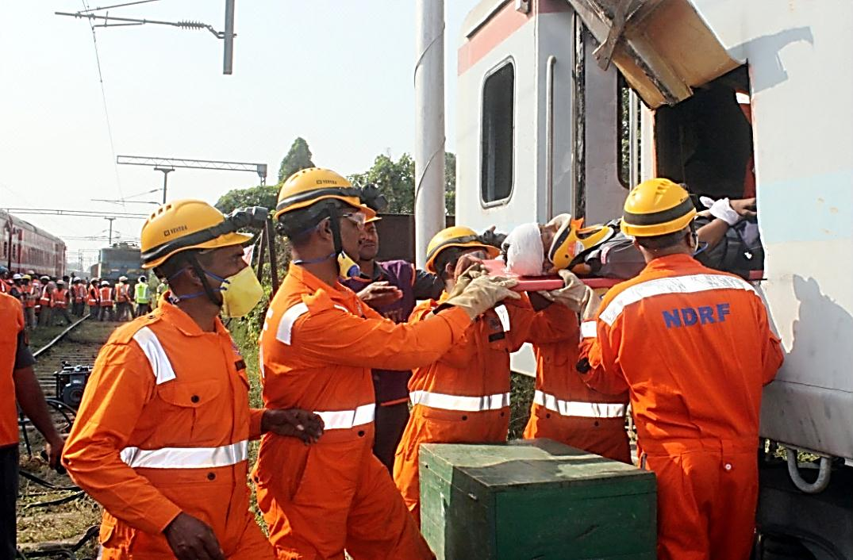
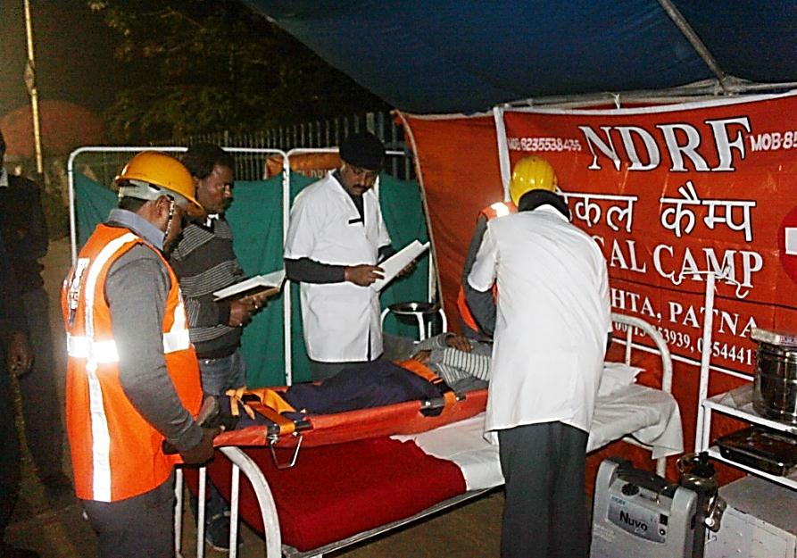

Slide 14
MOCK EXERCISE WITH MAH UNITS

Slide 15
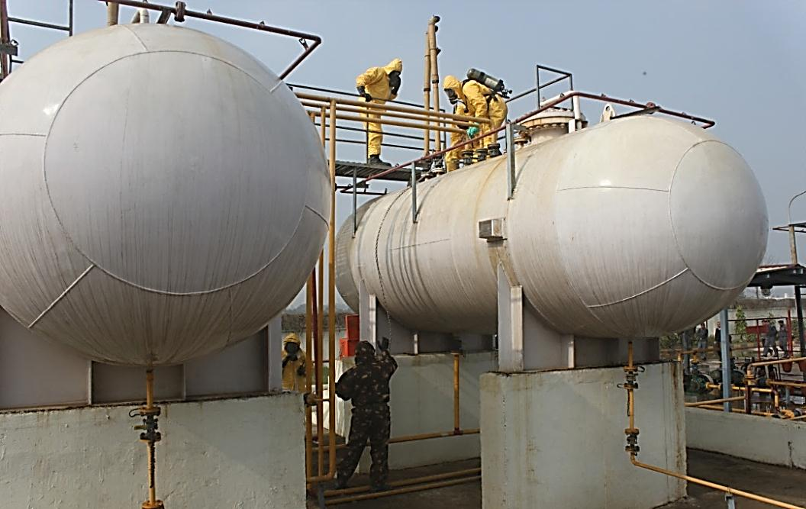
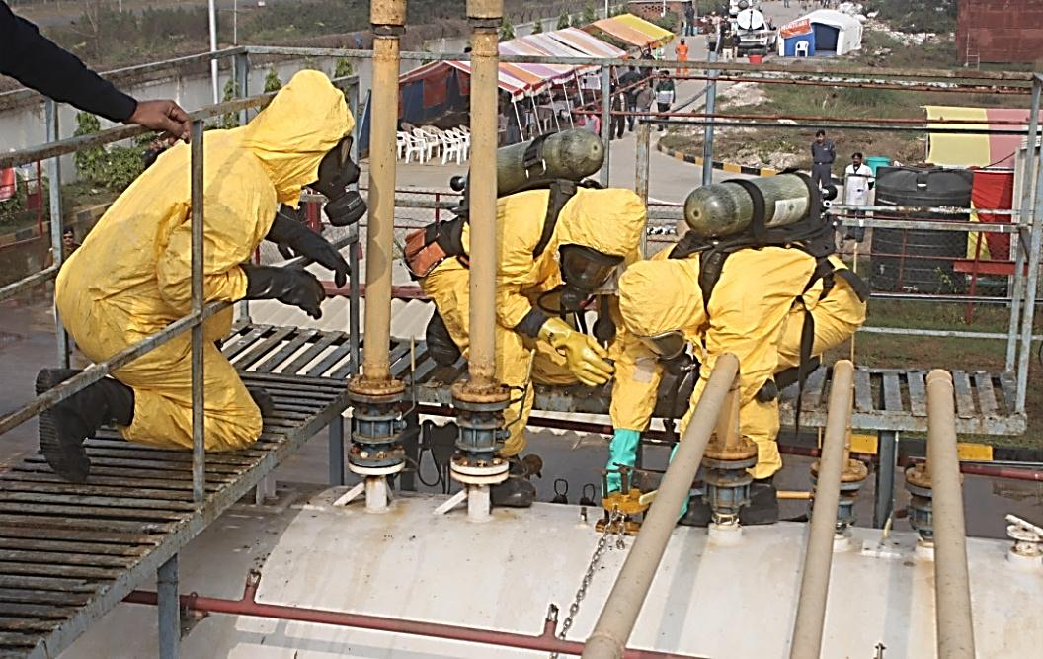
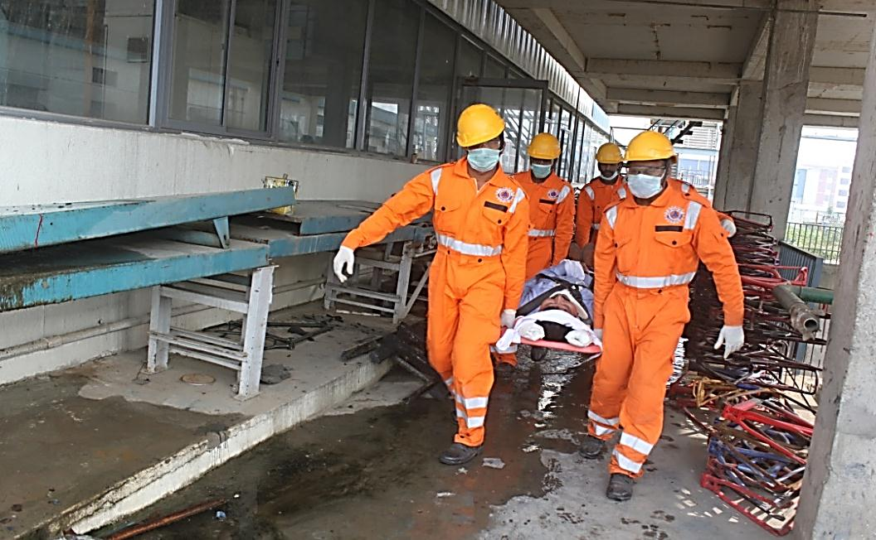
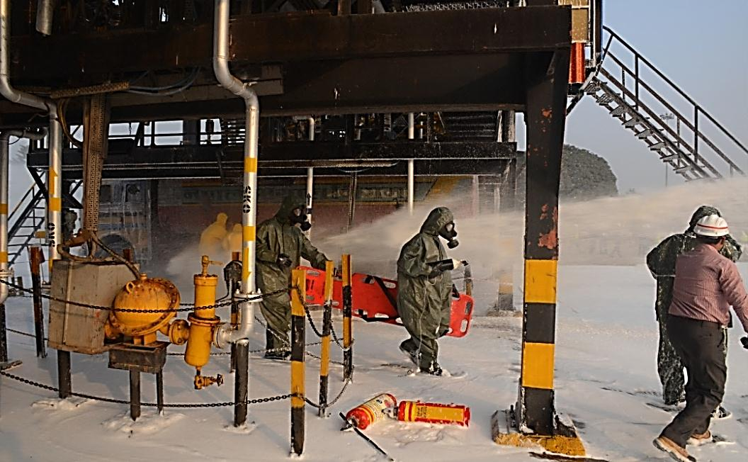

Slide 16
During disaster
Pro-active deployment at level– III Disaster.
Provide hi-tech-specialist response during search and rescue of victims.
Provide immediate relief with available men and material in the affected areas.

Slide 17
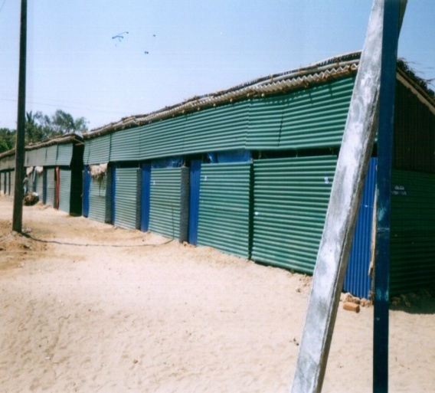
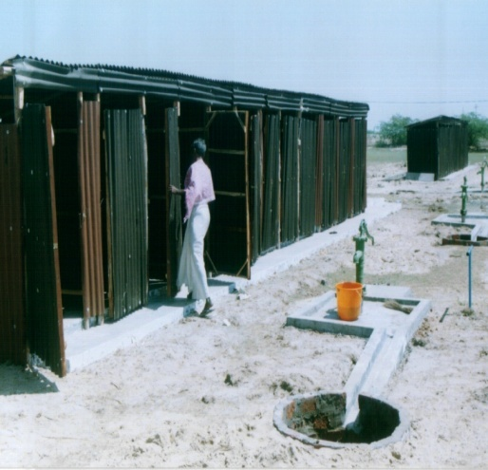
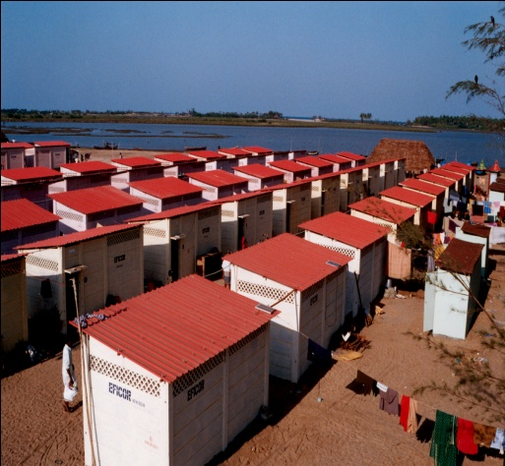
Post disaster
To assist states in recovery and maintenance of normalcy at the areas of disaster.
Rehabilitation & Re-construction

Slide 18
Capable in Flood Rescue, CSSR & CBRN operations.
Capable in animal disaster management.
Capable to undertake any disaster related Ops under any climatic condition.
Capable to carry out sustained & prolonged rescue Ops.
CAPABILITIES: NDRF

Slide 19
Maintaining high standard of skills by the troops.
Availability of highly specialized Eqpts.
High mobility.
Capable to carry out disaster response operations within the Country & also at International level.
CAPABILITIES: NDRF

Slide 20
INCIDENT RESPONSE SYSTEM
“Incident Response System is a standardized, on-scene, all-hazards incident management concept that can be used for an incident or a planned event to effectively accomplish stated objectives pertaining to an incident.”

Slide 21
IRS system promotes an orderly response by ensuring clarity of roles and responsibilities, effective use of resources and information management, as well as coordination of participating departments/organizations.
• It provides for the hierarchical and modular structure having unity of Command with optimal span of control which believes in the unified Command structure with predefined roles for each stakeholder leading to responsibility and accountability of officials.

Slide 22
Responsible Officer
Nodal Officer
(Air Operation)
Incident Commander
Deputy
IRS
Information Officer
Liaison Officer
Safety Officer
Operation Section
Planning Section
Logistic
Section

Slide 23
Operation Section
Staging Area
IRS
Response Branch (Rescue & Relief)
Transportation
Branch
Divisional (Geographical)
Road
Rail
Single Resource
Water
Task force/Strike Team
Air

Slide 24
Planning Section
Resource Unit
IRS
Situation Unit
Documentation Unit
Demobilization Unit

Slide 25
Logistic Section
Service Branch
Support Branch
Finance Branch
IRS
Time Unit
Communication Unit
Resource Provisioning Unit
Compensation /Claim Unit
Medical Unit
Facilities Unit
Procurement Unit
Food Unit
Ground Support Unit
Cost Unit

Slide 26
MFR
CSSR
CBRN Emergency
Heli-Slithering
Surface & Under Water Rescue Technique
Animal Rescue Techniques
TRAINING :
NDRF

Slide 27
Each NDRF Unit is equipped with 310 State-of-the-Art equipment as per INSARAG standard for
      CSSR (Earthquake) : 124 equipment
      Water Rescue/Diving : 12 equipment
      Mountaineering / High - Altitude Rescue : 16 equipment
      Medical First Response : 112 equipment
      CBRN Emergencies : 46 equipment
NDRF: EQUIPMENTS

Slide 28
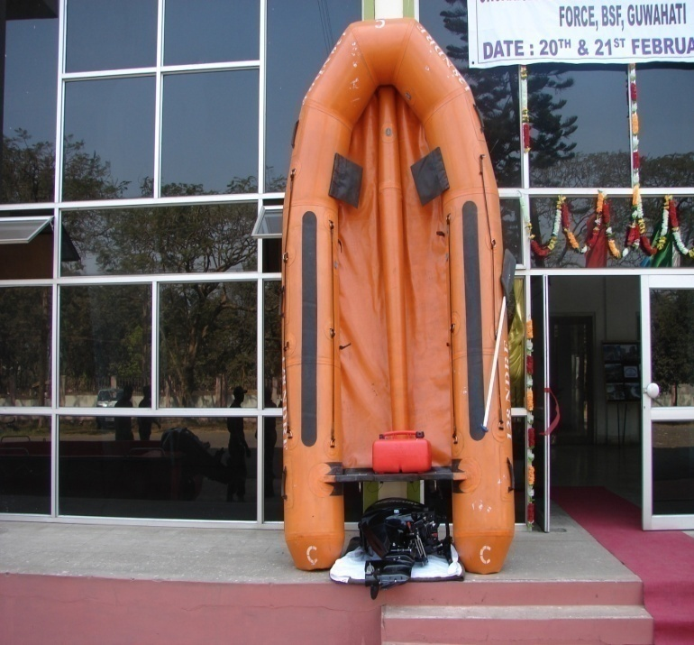
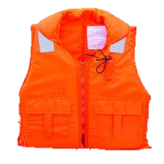
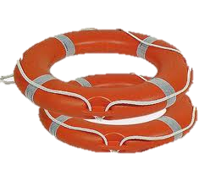
INFLATABLE
RUBBER BOATS
LIFEBUOY
LIFE JACKETS

Slide 29

At least 02 deep divers are available with each NDRF team along with deep diving sets for carrying out under water Ops.

Slide 30
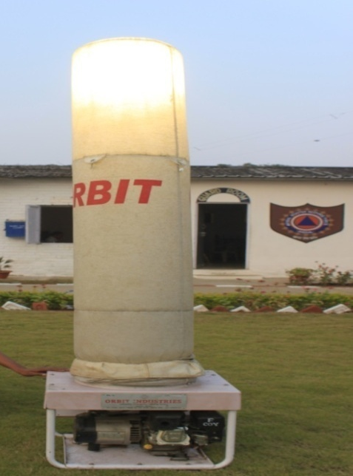
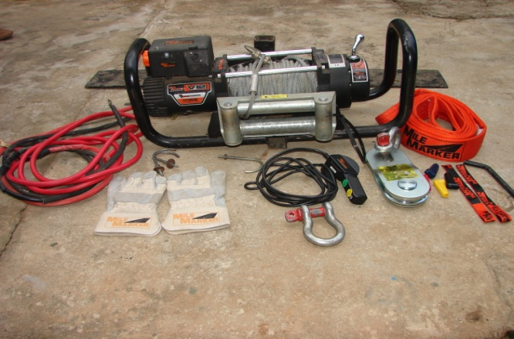
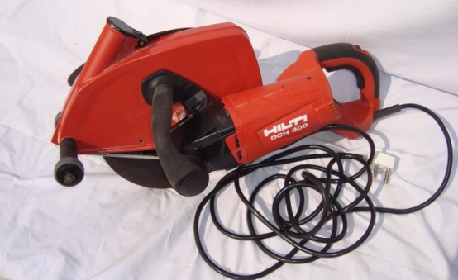
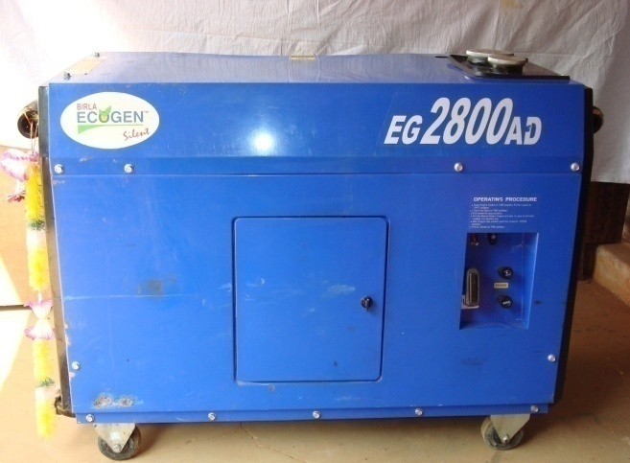
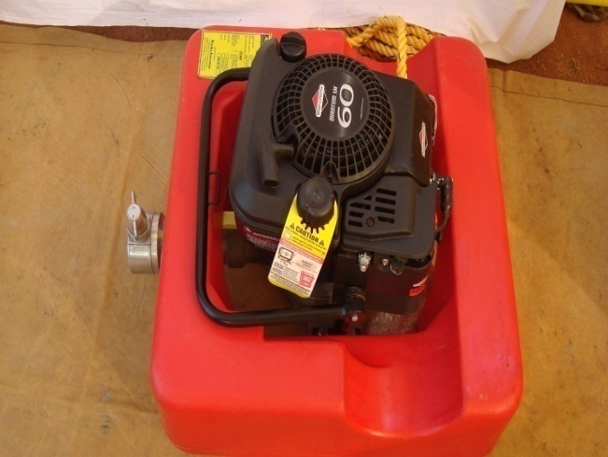
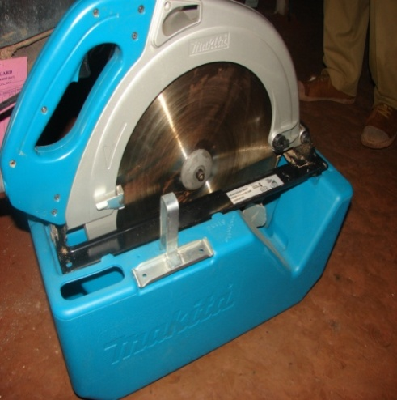
INFLATABLE LIGHTING TOWER
MULTI CABLE WINCH
ANGEL CUTTER
GENERATOR SET
FLOAT PUMP
CIRCULAR SAW

Slide 31
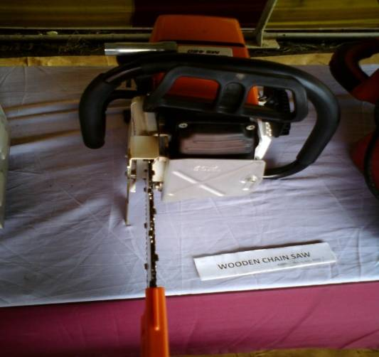
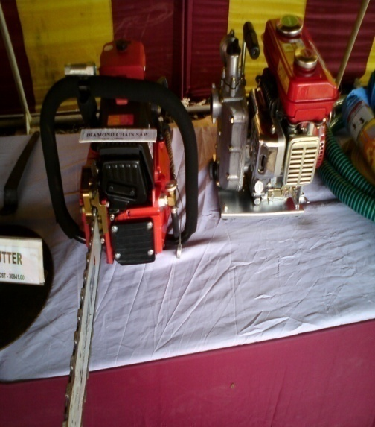
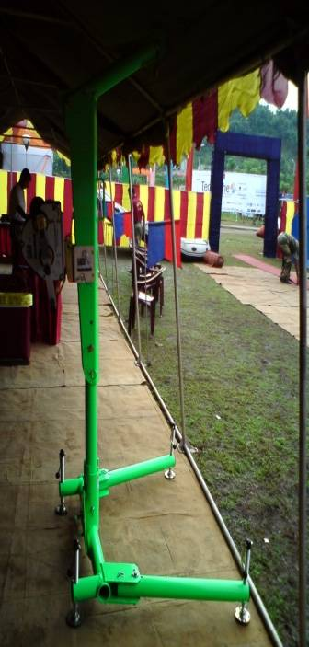
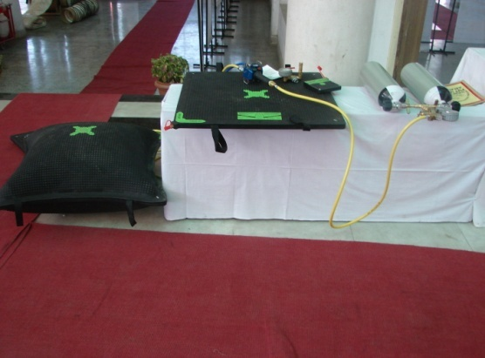
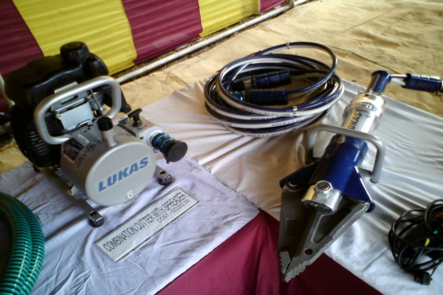
ELECTRIC DRILL MACHINE
CARBIDE TIPPED CHAIN SAW
DIAMOND CHAIN SAW
CAM- ALONG
AIR LIFTING BAG SET
COMBINATION CUTTER WITH SPREADER

Slide 32
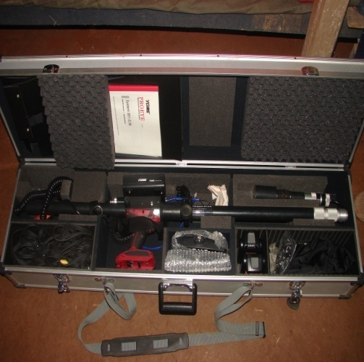
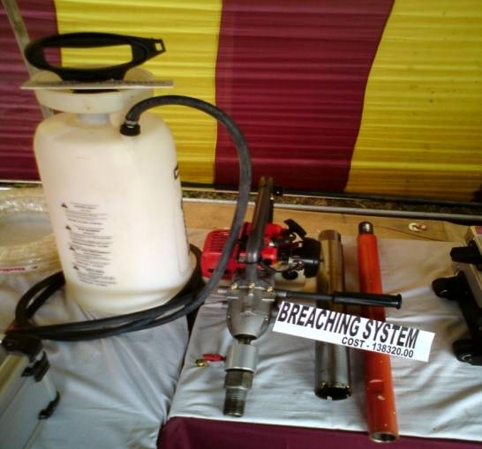
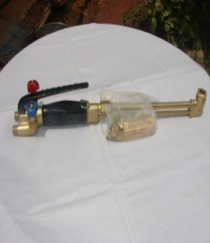
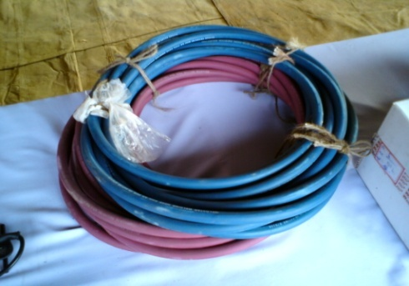
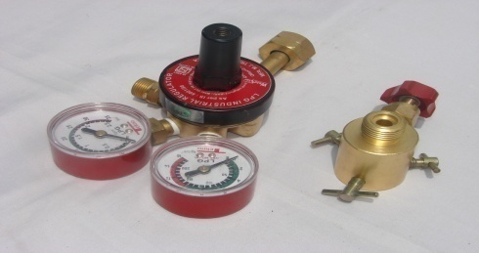
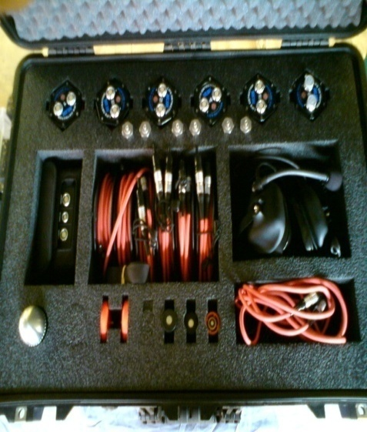
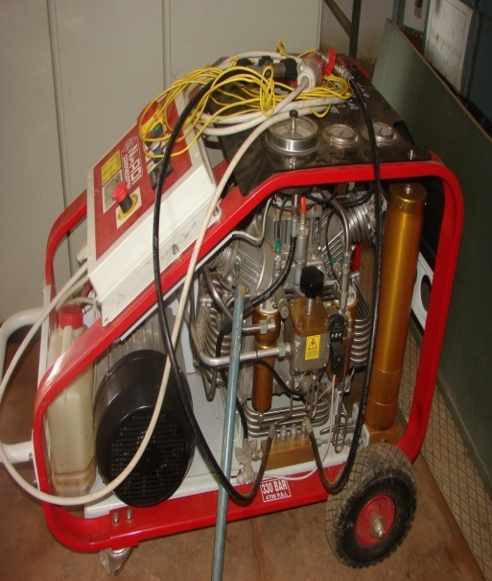
VICTIM LOCATION UNIT
BREACHING SYSTEM
GAS CUTTER 450 MM
LIFE DETECTOR TYPE -I
HIGH PRESSURE BREATHING AIR COMPRESSOR

Slide 33
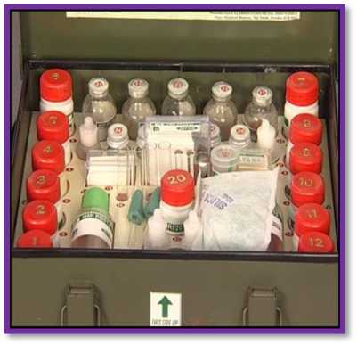
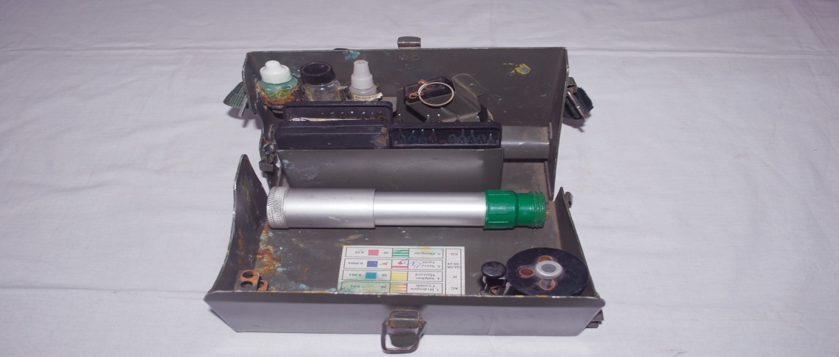
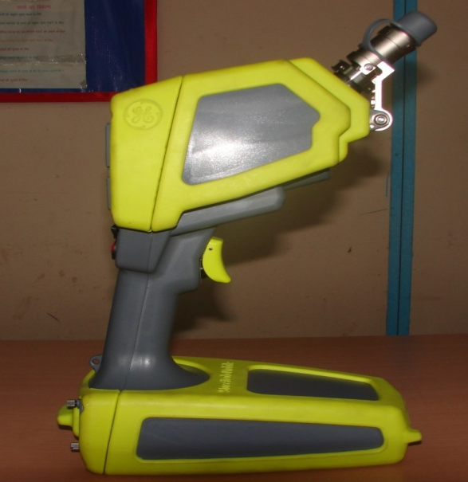
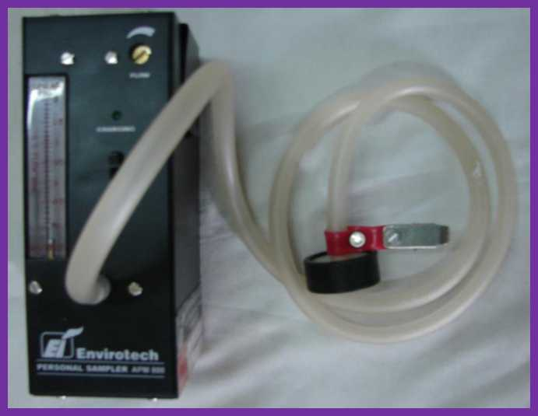
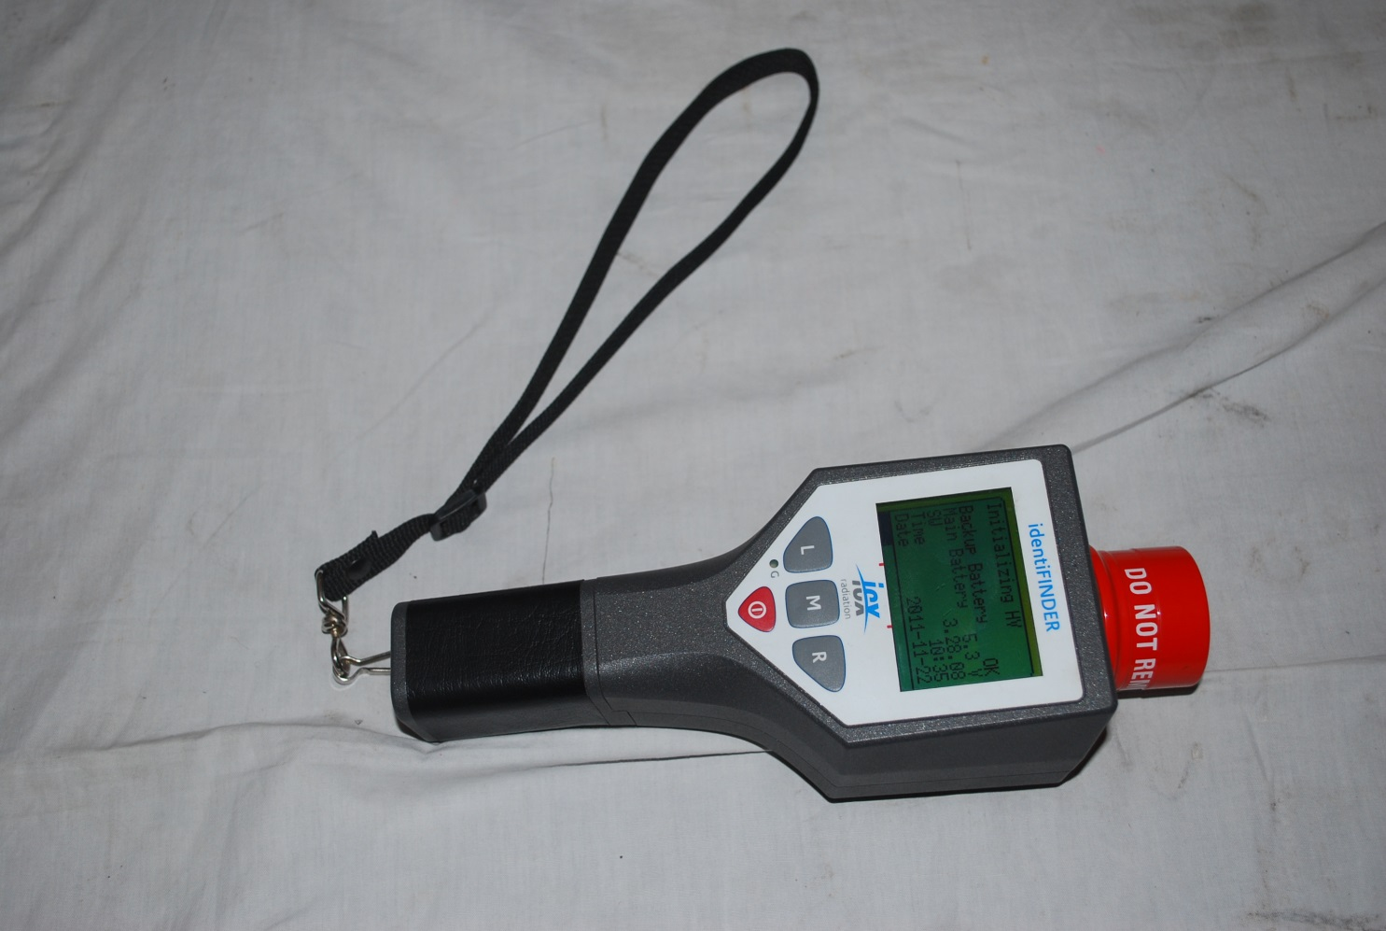
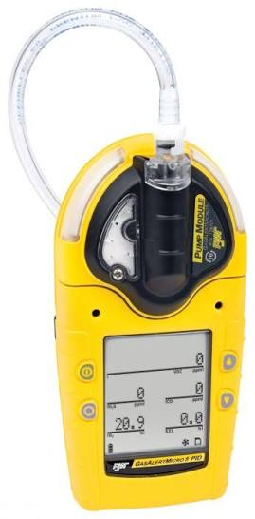
RAMAN SPECTROMETER
WPDK
RVD
AIR SAMPLER
ISOTOPE IDENTIFINDER
GAS ALERT MICRO 5

Slide 34
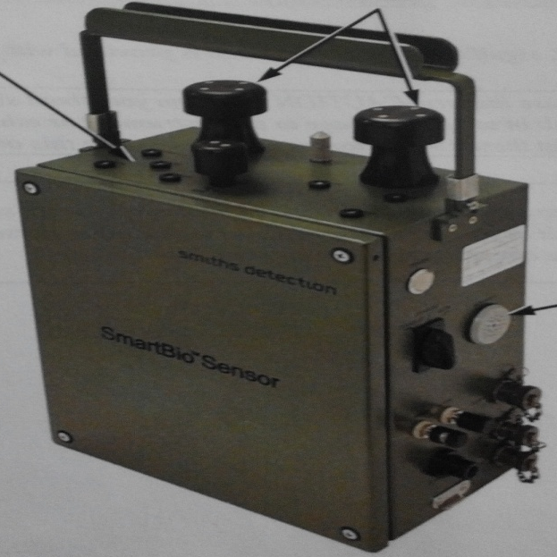
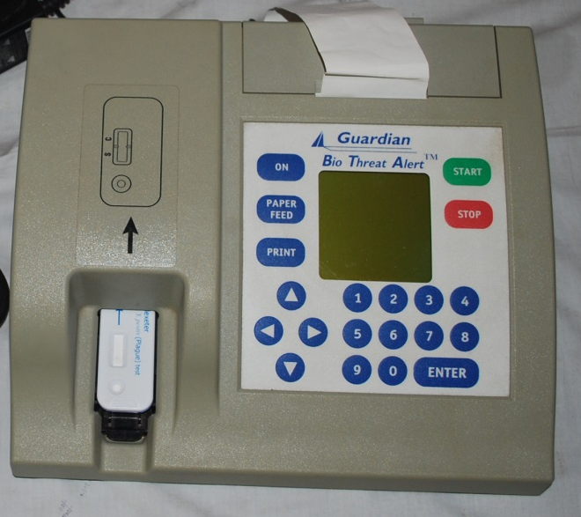
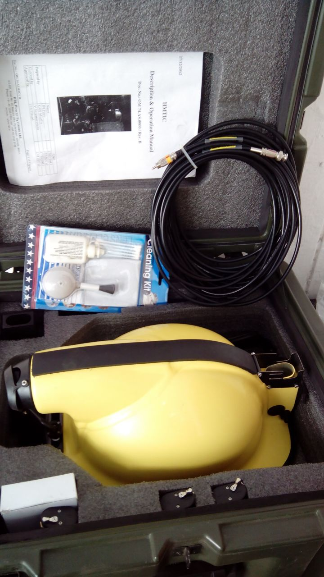
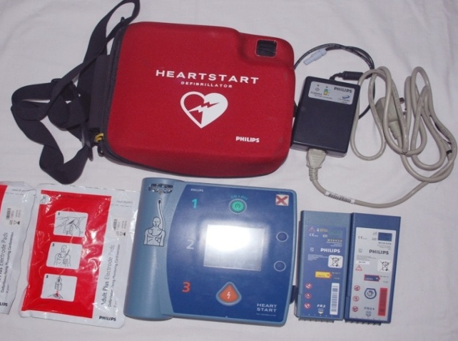
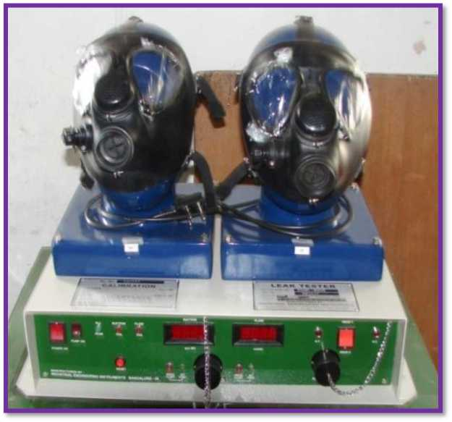
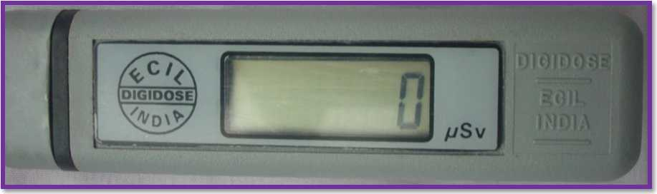
SMART BIO-SENSOR
BIO - AGENT DETECTOR
THERMAL IMAGER
RESUSCITATOR
LEAK TESTER
POCKET DOSIMETER

Slide 35
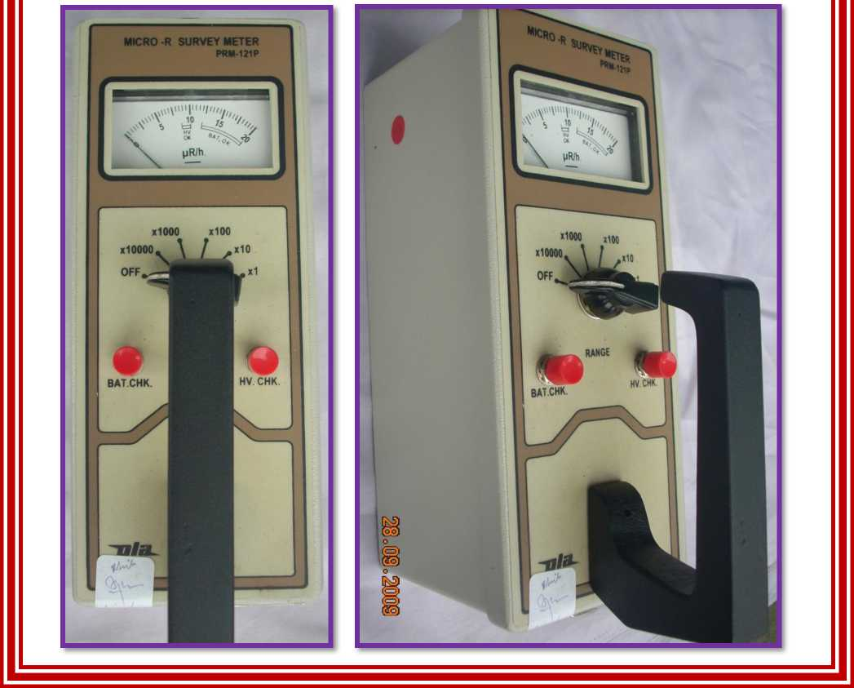
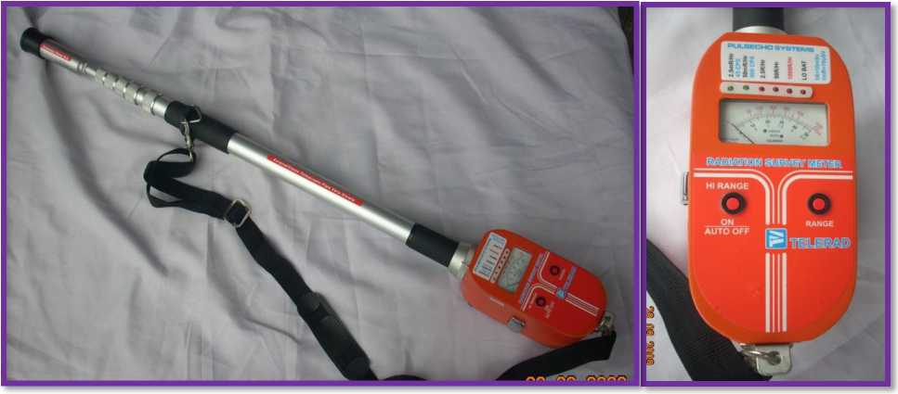
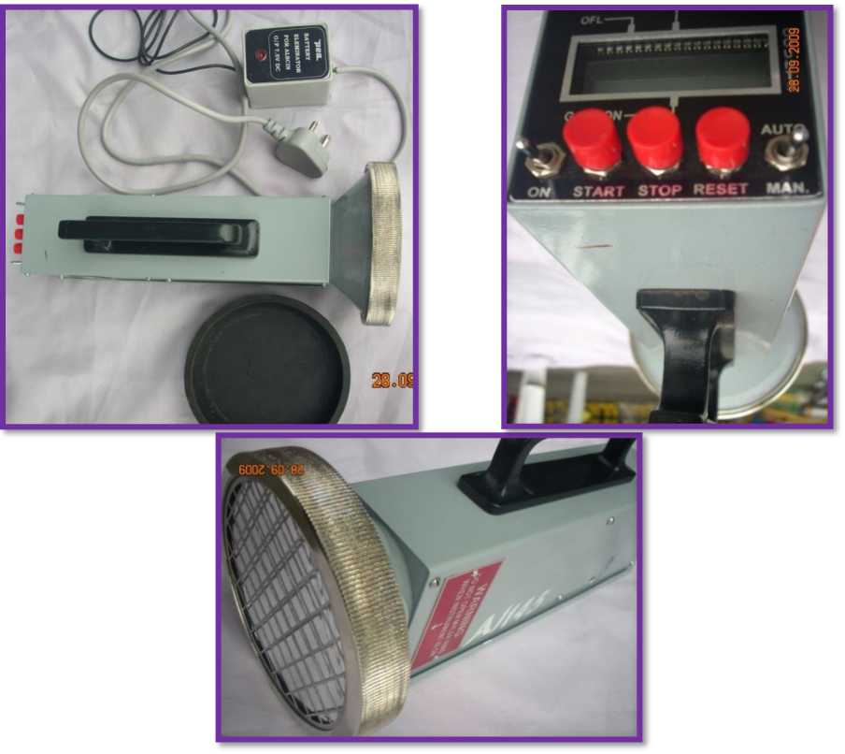
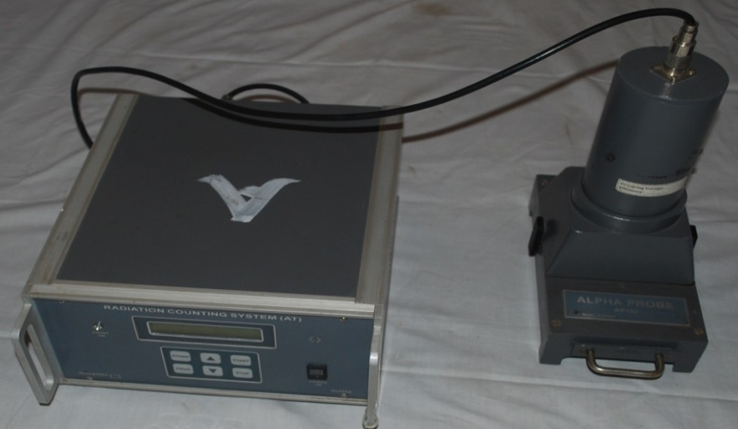
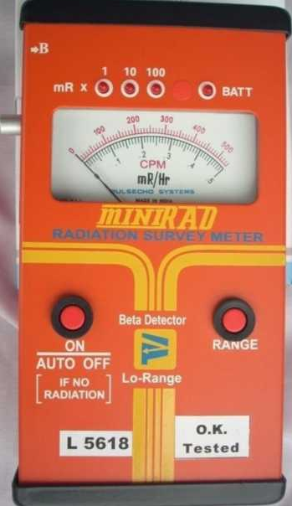

TELETECTOR
MICRO R SURVEYMETER
ALSCIN MONITOR
ALFA CONTAMINATION MONITOR
MINIRAD METER
GM SURVEY METER

Slide 36






D M KIT
24 x 7 CBRN MONITOR
PRP SUIT
PDA
PDK
TCDP
Isotope identifinder

Slide 37


SATELLITE PHONE
COMMUNICATION

Slide 38







Slide 39


QUICK DEPLOYMENT ANTENNA (QDA) /
V-SAT

Slide 40
DISASTER RESPONSE IN ABROAD BY NDRF

Slide 41
March 11, 2011 – Japan was struck by triple disaster (earthquake, tsunami and nuclear leakage).
One team of NDRF (46 personnel) deployed in Onagawa, Japan.
Working in sub zero temperature, they recovered 07 dead bodies and Japanese currency worth Fifty Million Yen.
NDRF’s exemplary dedication and compassion was widely appreciated by the Japanese Government, people, media and most importantly by Hon’ble Prime Ministers of both the Countries.
FIRST INTERNATIONAL RESPONSE OPERATION

Slide 42
Place of Deployment : Rifuchaw, Japan
Date of Deployment : March /April 2011
No of Team : 01 Team
Achievement : Team retrieved 07 dead bodies and recovered 50 million Yen in cash.
OPS IN JAPAN

Slide 43
NEPAL EARTHQUAKE
No. of teams deployed : 16 teams
Date of operation : 25th April - 04th May 2015
Achievements
Rescued : 11 Pers
Retrieved : 133 Dead Bodies
Medical Assistance Provided : 1219 Pers
Occurrence: On 25th April, 2015 at 11:56 Hrs.
Magnitude - 7.8 Richter Scale

Slide 44
TURKEY EARTHQUAKE (OPS DOST)
NDRF mobilised rescue teams to turkey
Dated : 7th feb 2023 time : 1700 hrs
A massive earthquake of 7.8 magnitude struck southern parts of turkey close to the syrian border on monday 6th feb.

Slide 45



Slide 46
Kumbh Mela – 2019 & 2025
CYCLONE MAHA - 2019
CYCLONE BULBUL - 2019
Cyclone FANI - 2019
CYCLONE VAYU - 2019
BOREWELL INCIDENT AT MATHURA - 2019
OPERATIONAL ACTIVATES IN INDIA -2019 -20

Slide 47
building collaspe at dongri, mumbai - 2019
boat capsize - 2019
landslide in kerala - 2019
collapse of under construction building in distt- dharwad (karnataka) - 2019
flood – 2019
cyclone 2019-20

Slide 48
CONCLUSION
Awareness
Training
Resources
Planning
Exercises
Preparedness is the key to effective disaster management
Notes:
a. Preparedness is the key to effective event Command
(1) Preparedness is the combination of awareness, training, equipment, resources and planning.
(2) In order to be prepared for a WMD event, or any other major disaster, agencies need to establish multi-agency coordination systems.
b. Awareness
(1) First Responders need to be aware of the dangers of terrorism events and Chemical, Biological, Radiological agents.
(2) Responders need the appropriate protective equipment against Chemical, Biological, Radiological agents.
(3) Responders need training in identifying initial actions in a WMD event, including gathering and reporting information.
(4) WMD awareness helps dispel unwarranted fears.

Slide 49
REVIEW
Upon completion of this lesson,now you are able to.
  Introduction to NDRF.
  Its role in Disaster

Slide 50
ANY QUESTION ?

Slide 51


THANK YOU

