Slide 1



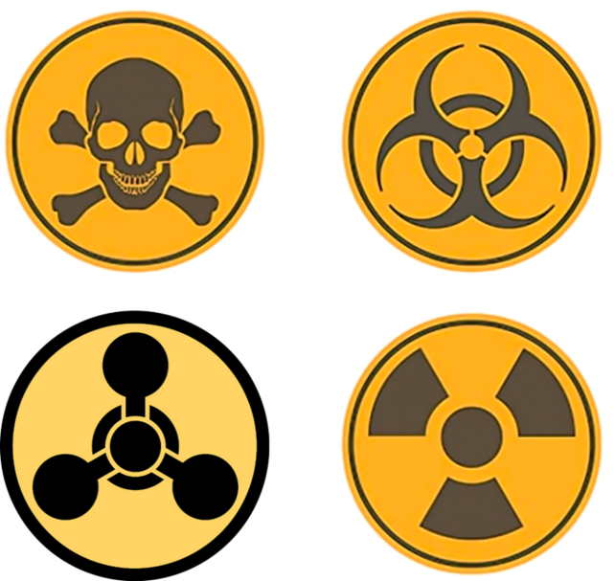
CBRN Module: CAPF
LESSON 01
Definition and terminology
Presented by:- Pavan Dev Gaur, 2IC

Slide 2
OBJECTIVES
Upon completing this lesson, you will be able to:
1
Familiar with important terminology related with Chemical Emergency
Familiar with important terminology related with Biological Emergency
Familiar with important terminology related with Radiological Emergency
2
3

Slide 3
terminology related with Chemical Emergency
Agent: Any substance, force, radiation, organism, or influence that affects the body. Effects may be beneficial or injurious.
Antidote: Remedy to relieve, prevent, or counteract the effects of a poison or hazardous chemical substance.
Asphyxiant: Vapor or gas which causes unconsciousness or death by suffocation.
PPT 2 -

Slide 4
terminology related with Chemical Emergency
Boiling Liquid Expanding Vapor Explosion (BLEVE): Condition in which liquids gets excessively heated, which may result in the violent rupture of a container, and the rapid vaporization of the material
Carcinogen: Substance or agent capable of causing or producing cancer in mammals.
Cont…
PPT 2 -

Slide 5
terminology related with Chemical Emergency
Chemical Warfare (CW): Employment of chemical products to produce death or casualties in man/animal, to create a military advantage, or defend against such action.
Concentration (C): The amount of a chemical agent present as vapor or aerosol in a given volume of air.
Cont…
PPT 2 -

Slide 6
terminology related with Chemical Emergency
Contamination: The deposition and/or absorption of radioactive material, biological warfare agent or chemical warfare agents on structures, areas, persons, or objects..
Combustible Liquids: Liquids having a flash point of 100°F or higher.
Compressed Gas: Gaseous material contained under pressure
Cont…
PPT 2 -

Slide 7
terminology related with Chemical Emergency
Confined Space: Any area that has limited openings for entry and exit has a lack of ventilation, contains known and potential hazards.
Corrosive: Liquid or solid that causes visible destruction or irreversible alterations in skin tissue at site of contact
Cont…
PPT 2 -

Slide 8
terminology related with Chemical Emergency
Dike: A barrier constructed to control or confine hazardous substances and prevent them from entering sewers, ditches, streams, or other flowing waters.
Decontaminant: Any substance used to destroy, remove, seal-in or otherwise render harmless a biological or chemical warfare agent.
Cont…
PPT 2 -

Slide 9
terminology related with Chemical Emergency
Decontamination: The process of making any person, object or area safe by absorbing, destroying, neutralizing, making harmless or removing chemical or biological agents, or by removing radioactive material clinging to or around it.
Detection: The process by which the presence of a biological or chemical warfare agent is established.
Cont…
PPT 2 -

Slide 10
terminology related with Chemical Emergency
Detector: A device for determining the presence of significant amount of biological or chemical warfare agents.
Dose: The amount of a Radiological energy, biological agent or chemical warfare agent absorbed by an individual.
Effective Dose: Dose required for producing desired effects
Cont…
PPT 2 -

Slide 11
terminology related with Chemical Emergency
Flash Back: A phenomenon, occurs when a trail of flammable material is ignited by a distant spark or ignition source.
Flash Point: Temperature at which a liquid will give off enough flammable vapor to ignite.
Foam: Firefighting material consisting of small bubbles of air, water, and concentrating agents.
Cont…
PPT 2 -

Slide 12
terminology related with Chemical Emergency
Hazardous Material: Any substance or mixture of substances having properties capable of producing adverse effects on the health or safety of a human being.
Immediately Dangerous to Life and Health (IDLH): Maximum concentration from which one could escape within 30 minutes without any escape-impairing symptoms or any irreversible health effects.
Cont…
PPT 2 -

Slide 13
terminology related with Chemical Emergency
Irritant: Substance which, by contact in sufficient concentration for a sufficient period of time, will cause an inflammatory response or reaction of the eye, skin, or respiratory system.
Irritant: Substance which, by contact in sufficient concentration for a sufficient period of time, will cause an inflammatory response or reaction of the eye, skin, or respiratory system.
Cont…
PPT 2 -

Slide 14
terminology related with Chemical Emergency
Non-Persistent: The term used for chemical agent when the hazard produced by it, though serious, last for very short duration.
Oxidizing Agent: Chemical or substance that brings about an oxidation reaction.
Personal Protective Equipment (PPE): Devices or clothing worn to help isolate a worker from direct exposure to hazardous materials.
Cont…
PPT 2 -

Slide 15
terminology related with Chemical Emergency
Persistent Agent: A term used to describe a chemical agent which does not evaporate, decomposes or absorbed by soil etc. quickly.
Polymerization: Chemical reaction in which one or more small molecules combine to form larger molecules.
Cont…
PPT 2 -

Slide 16
terminology related with Chemical Emergency
Respiratory Protection: Devices that will protect the wearer's respiratory system from overexposure by inhalation to airborne contaminants.
Toxicity: The extent of the ability of a poisonous or physiologically harmful substance to incapacitate or death.
Cont…
PPT 2 -

Slide 17
terminology related with Biological Emergency
Anaerobe: A microorganism capable of growing or metabolizing in the absence of free oxygen; may be facultative or obligate.
Antibiotic: A substance of microbial origin that kills or inhibits certain other microorganisms.
Antibody: A general term for the several types of Immuno- globulins found in immune serum and capable of reacting specifically
PPT 2 -

Slide 18
terminology related with Biological Emergency
Antigen: A substance (usually protein, polysaccharide or complex) that evokes a specific immunological response in an animal.
Biological Warfare: Means the wartime use of agents causing disease or death in man, animals or plants following multiplication within target organism, against an enemy.
Cont…
PPT 2 -

Slide 19
terminology related with Biological Emergency
BW Agents: Living organisms, including viruses or infectious material derived from them, which are used for hostile purposes to cause disease or death in humans, animals or plants, and which usually depend for their primary effects upon their ability to multiply in organism attack.
Contagious: Capable of being transmitted from one individual to another
Cont…
PPT 2 -

Slide 20
terminology related with Biological Emergency
Epidemic: A disease attacking many people in the same place at the same time.
Immunity: Resistance of the body to the effects of pathogenic microorganisms or their toxins.
Incubation Period: The time period between the penetration of the germ into the body and the appearance of the first symptom.
Cont…
PPT 2 -

Slide 21
terminology related with Biological Emergency
Pathogen: A disease producing micro-organism.
Symptoms: The consciousness of a disturbance in a bodily function; the subjective feeling that there is something wrong in the working of the body and of which the patient complains.
Vector: Living organism that carry a pathogen from one host to another e.g. Mosquito, ticks etc.
Cont…
PPT 2 -

Slide 22
terminology related with Radiological-Nuclear Emergency
Atomic Bomb: A term sometimes applied to a nuclear weapon utilizing fission energy.
Chain Reaction: Any chemical or nuclear process in which some of the products of the process are instrumental in the continuation or magnification of the process.
PPT 2 -

Slide 23
terminology related with Radiological-Nuclear Emergency
Decay: Disintegration of the nucleus of an unstable element by the spontaneous emission of charged particles.
Dose Rate: The amount of ionizing radiation which an individual or material would receive per unit time.
Radiation Dose: A general term denoting the quantity of radiation or energy absorbed in a body.
Cont…
PPT 2 -

Slide 24
terminology related with Radiological-Nuclear Emergency
Fallout: The process of the descent of particles contaminated with radioactive material from radioactive cloud to the earth surface.
Half-Life: The time required for radioactive substance to lose 50 percent of its activity by decay.
Cont…
PPT 2 -

Slide 25
terminology related with Radiological-Nuclear Emergency
Half Value Layer: The thickness of shielding materials necessary to reduce the intensity of radiation by one half is sometimes referred to half value thickness or half value layer.
Ionization: The result of any process whereby a neutral atom or molecule acquires either positive or negative charge.
Cont…
PPT 2 -

Slide 26
terminology related with Radiological-Nuclear Emergency
Nuclear Fission: The splitting of the nucleus of an atom into at least two other nuclei is called nuclear fission. It may be accompanied by the release of relatively large amount of energy.
Nuclear Fusion: The process where two light atomic nuclei combine to form a heavier nucleus, releasing vast amounts of energy.
Cont…
PPT 2 -

Slide 27
terminology related with Radiological-Nuclear Emergency
Permissible Dose: The maximum, total dose of radiation, over any given period, which is believed to cause no permanent ill effect to the human body.
Radioactivity: A spontaneous change in the nucleus of an atom accompanied by the emission of penetrative (Ionizing)radiation.
Cont…
PPT 2 -

Slide 28
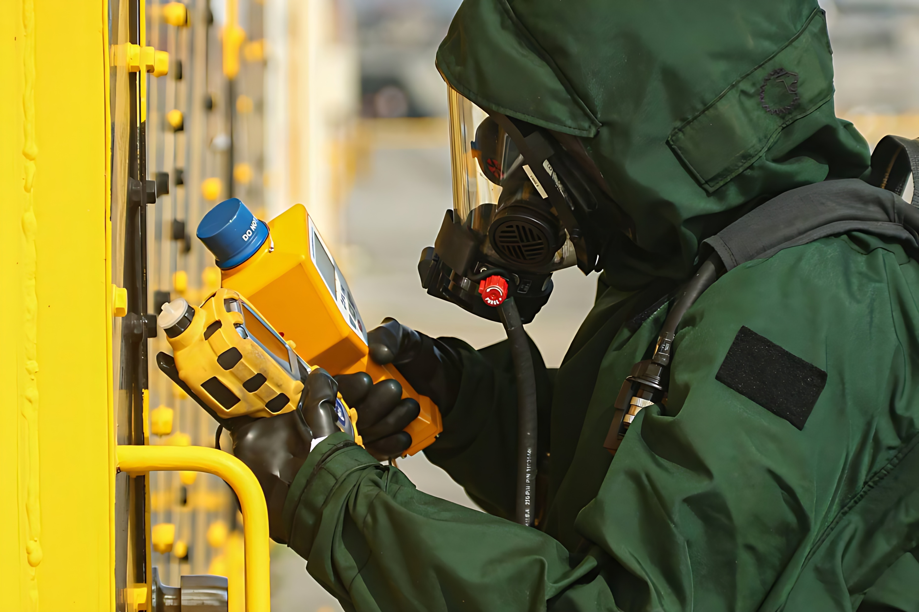

THANK YOU

