Slide 1

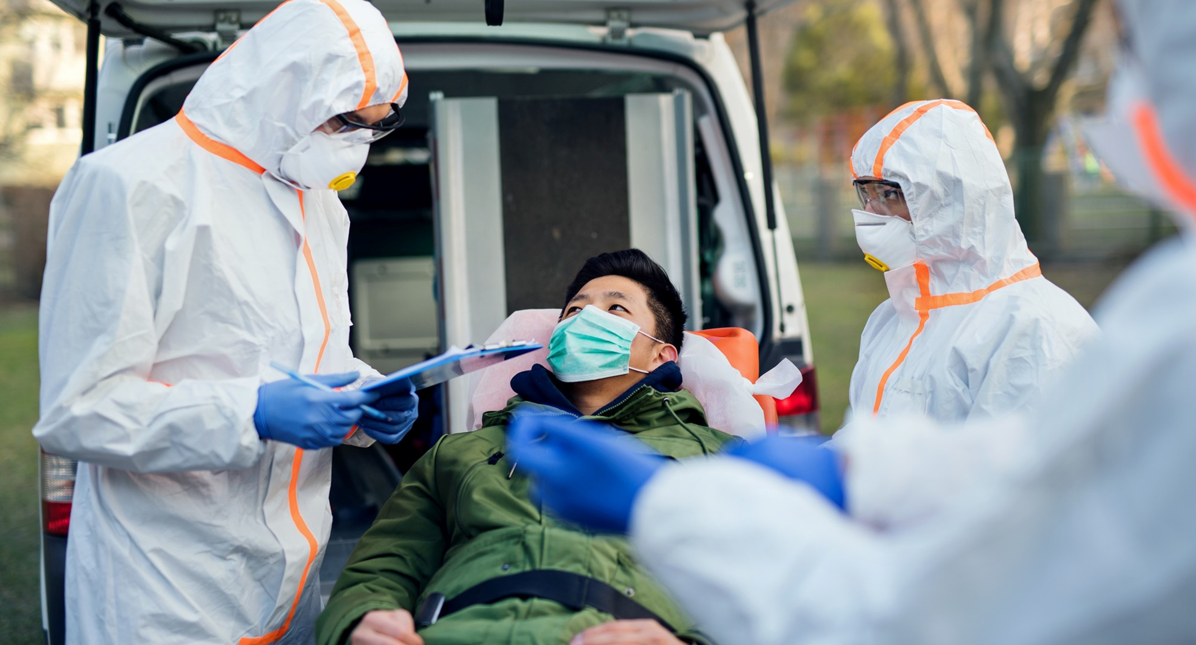


MEDICAL FIRST RESPONDER
LESSON 3
Infectious Disease and Precautions
Presented By:- Kamal Mehra,2IC
PPT 2 -
NDRF | MFR | INDIA
PPT 3 - 1

Slide 2
OBJECTIVES
Upon completing this lesson, you will be able to:
1
Define infectious disease.
Describe the two means of transmission of infectious disease.
List eight signs and symptoms
of infectious disease.
2
3

Slide 3
OBJECTIVES
Upon completing this lesson, you will be able to:
4
Define body substance isolation and list three categories of body substance isolation precautions.
List five components of the personal protective equipment (PPE) used for patient assessment and during
pre-hospital treatment.
5

Slide 4
Infectious Diseases
Illnesses caused by pathogens, microorganisms such as bacteria or viruses, that can be transmitted.

Slide 5

Methods of Transmission
Direct contact:
Which occurs through contact with bodily fluids, contact through open wounds or exposed tissues, or contact with mucous membranes of the mouth, eyes or nose.
PPT 3 -

Slide 6
Methods of Transmission
Indirect contact:
Through airborne pathogens spread by tiny droplets sprayed during breathing, coughing or sneezing, or by way of contaminated objects, such as needles.
PPT 3 -

Slide 7
Infectious Disease
Signs and Symptoms
Fever
Nausea, vomiting, dizziness
Yellowish coloration of the skin and whites of the eyes
Headache, chest or abdominal pain

Slide 8
Infectious Disease
Signs and Symptoms
Coughing, shortness of breath
Diarrhea
Fatigue
Weight loss

Slide 9
Body Substance Isolation
A strict form of infection control based on the premise that blood and bodily fluids are infectious.
PPT 3 -

Slide 10
Body Substance Isolation
Five components of the personal protective equipment (PPE) used for patient assessment and during pre-hospital treatment.
Latex gloves
Personal mask
Eye Protection
Gown
CPR mask
PPT 3 -

Slide 11

DANGER
All bodily fluids are considered infectious and you must take appropriate precautions for all patients at all times!

Slide 12
Always discard contaminated items properly so YOU don’t get infected!

Slide 13

Any question ?

Slide 14

THANK YOU

