Slide 1
ENDOCRINE SYSTEM
LESSON-9
BY
AMANDEEP KAUR
ASI/ANM

Slide 2
OBJECTIVES
Upon completion of this lesson you will be able to:
Introduction to the endocrine system
To learn about the various endocrine glands & their structure
To learn about the hormones secreted by these glands
To learn about the structure of the eye

Slide 3
OBJECTIVES
5. To learn briefly about the mechanism of
vision.
6. To learn about the structure of the ear &
physiology of hearing
7. To learn about the physiology of equilibrium
(balance)

Slide 4
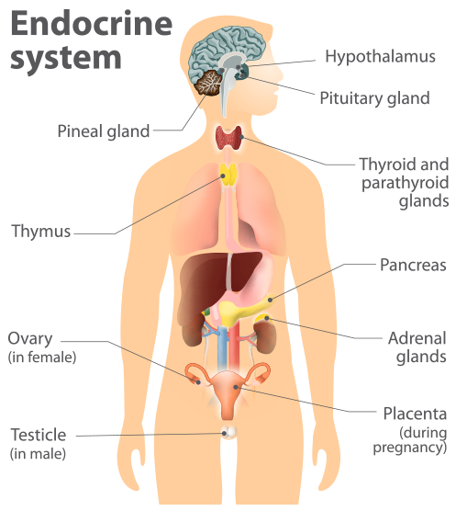
INTRODUCTION

Slide 5
INTRODUCTION
The endocrine system is made up of ductless glands
The secretions are delivered directly into the blood stream
The secretions are called hormones
The hormones circulate all over the body via the blood stream
The hormones control coordinated growth of the body & regulate various other vital activities of the body
Production & secretion of hormones are regulated by feed-back systems (for eg., increase in sugar levels of the blood leads to increased secretion of insulin which reduces the sugar levels

Slide 6
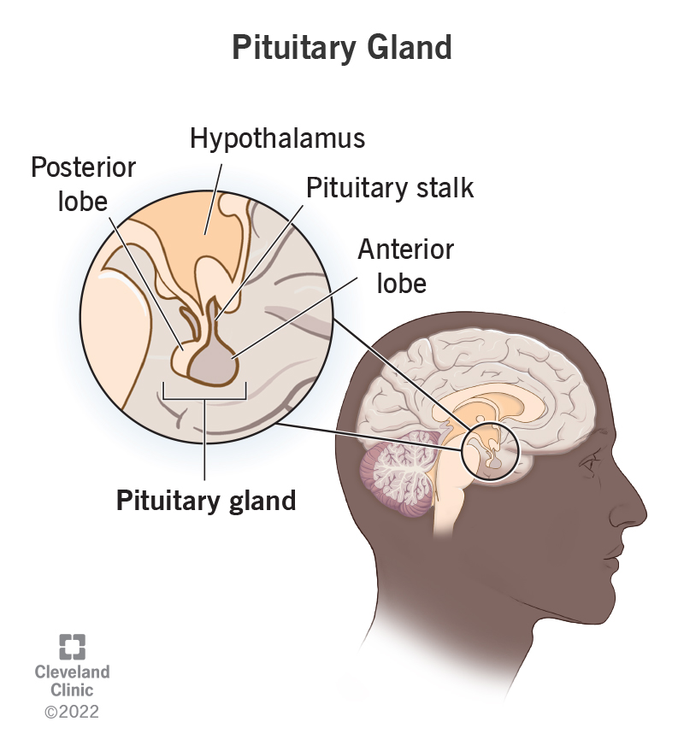
PITUTARY
This is located in the cranial cavity below the cerebral hemispheres
One of the most important
endocrine glands which controls
the other endocrine glands
Secretes –
GH (growth hormone) –
Controls growth of the body
Decrease in production & secretion of GH leads to ‘dwarfism’
Increase in production & secretion of GH leads to ‘gigantism’
ACTH (adreno-corticotrophic hormone) –
Controls activity of the adrenal glands

Slide 7
TSH (thyroid stimulating hormone) –
Controls activity of the thyroid gland
FSH (follicle stimulating hormone) –
Controls activity of ovaries
LH (leutinizing hormone) –
Controls activity of the ovaries
ADH (anti-diuretic hormone; Vasopressin) –
Controls the formation of urine & regulates blood pressure
Oxytocin –
Controls the production & ejection of milk from the breast

Slide 8
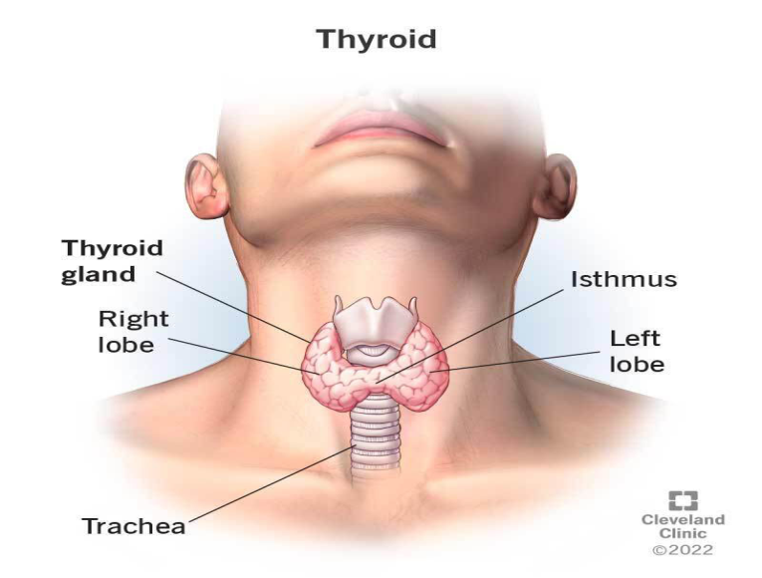
THYROID
It is located in the anterior part of the neck
Deficiency of iodine causes ‘goitre’
(swelling of the thyroid gland)
Secretes –1. THYROXINE –
Regulates carbohydrate, protein
& fat metabolism in the body
Iodine is essential for its synthesis
Increase in production & secretion of thyroxine leads to ‘thyrotoxicosis’
Decrease in production & secretion of thyroxine leads to ‘hypothyroidism’
2. CALCITONIN –
Maintains ‘calcium-balance’ in the body

Slide 9
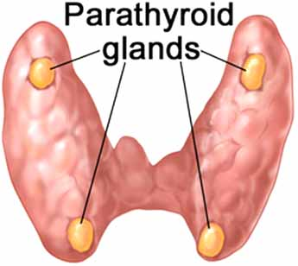
PARATHYROID
Located in the front of the neck,
near the thyroid gland
Secretes –
Parathormone –
Regulates excretion of urine
Regulates ‘calcium-balance’ in the body

Slide 10
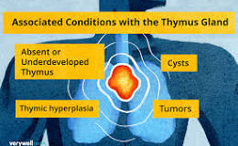
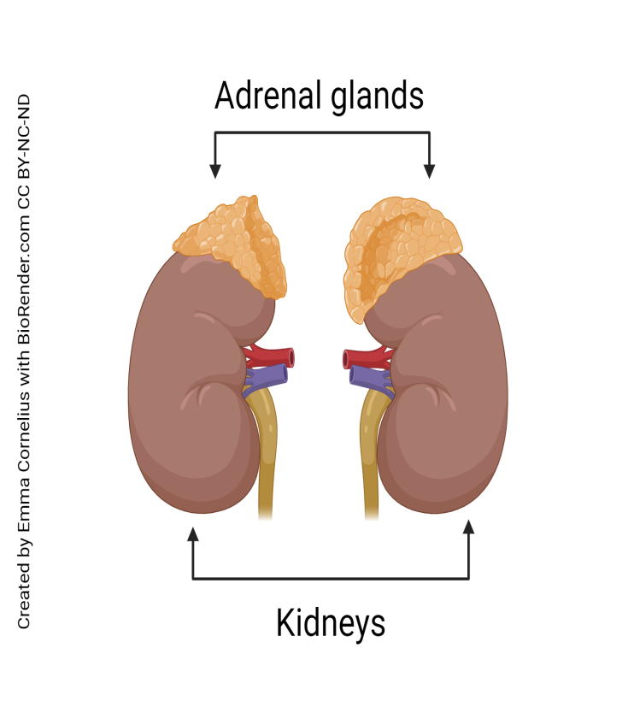
THYMUS
In children, it regulates the production of lymphocytes
ADRENAL
Located on top the kidneys
Secrete –
Adrenaline & Nor-adrenaline –
Prepare the body in ‘fight or flight’
situations
Coticosteroids –
Regulate growth, muscle mass
& various other activities
.

Slide 11
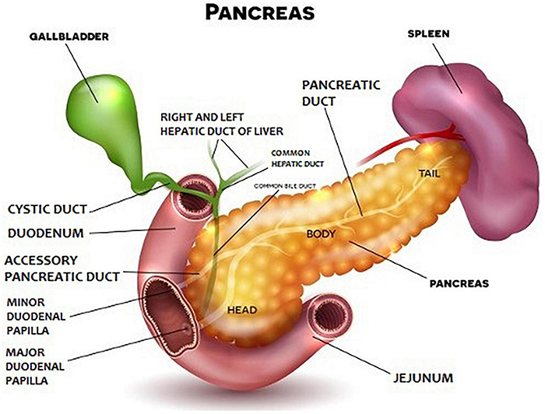
PANCREAS
It Is A Mixed Gland (Exocrine As Well As Endocrine)
Exocrine Function Is To Secrete Pancreatic Juice Through The Pancreatic Duct Into The Intestines, Which Aids In Digestion
Endocrine secretions –
Insulin –
Control sugar levels in the body
Glucagon –
Controls carbohydrate metabolism
in the body

Slide 12
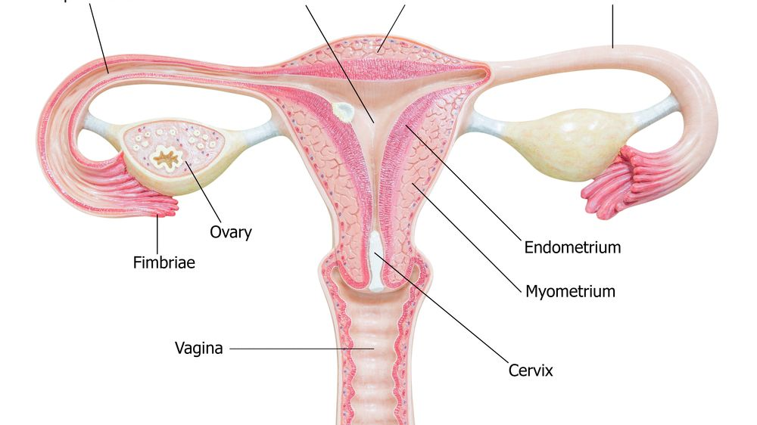
OVARIES
LOCATED IN THE ABDOMEN ON
EITHER SIDE OF THE UTERUS
SECRETE –
OESTROGEN&PROGESTRONE –
DETERMINE SECONDARY SEXUAL CHARACTERS IN FEMALES
REGULATE MENSTRUAL CYCLES
PREPARATION OF UTERUS FOR PREGNANCY

Slide 13
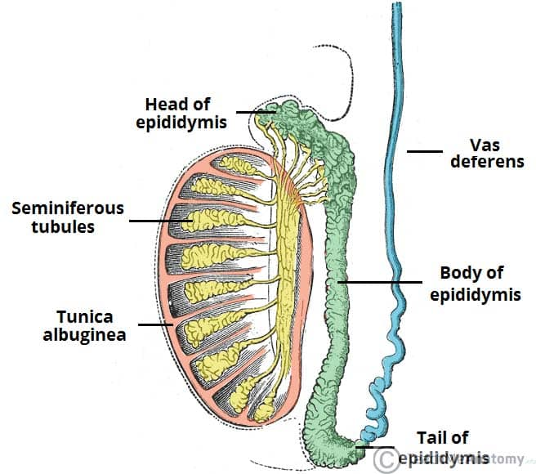
TESTES
Located in the scrotum
Secrete –
Testosterone –
Determine secondary sexual characters in males
Regulate production of spermatozoa

Slide 14
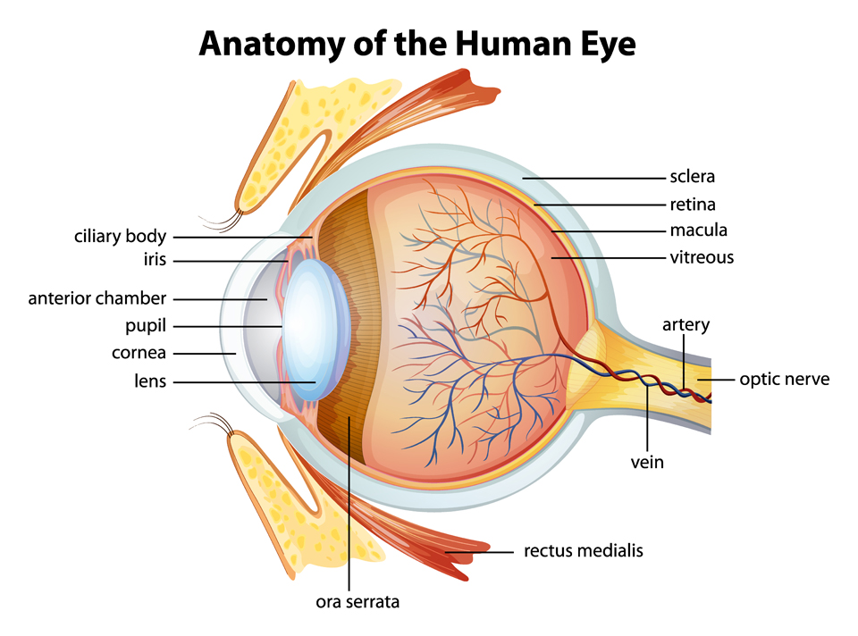
SPECIAL ORGANS
EYE
It is the organ of sight
Located in the orbital cavity
Protected by the bones of the orbital cavity on the lateral & posterior aspects and by the eye-lids in front.

Slide 15
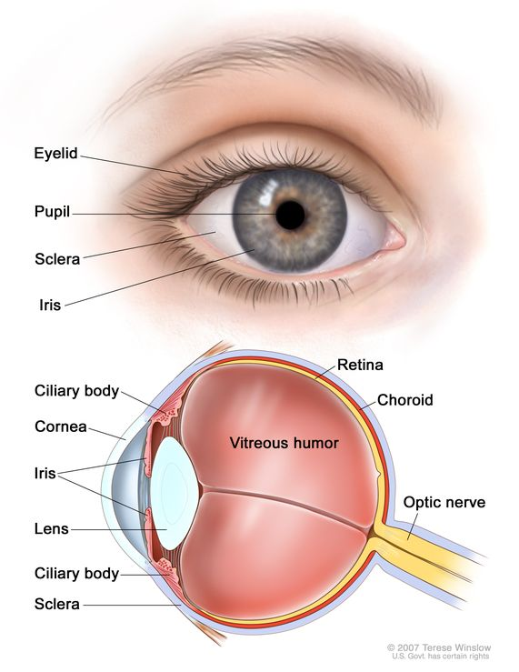
STRUCTURE OF THE EYE
3 LAYERS –
1. SCLERA –
Outer coat
Made up of fibrous tissue
Forms the ‘white part’ of the eye laterally
Anteriorly, it forms a transparent circle called ‘cornea’

Slide 16
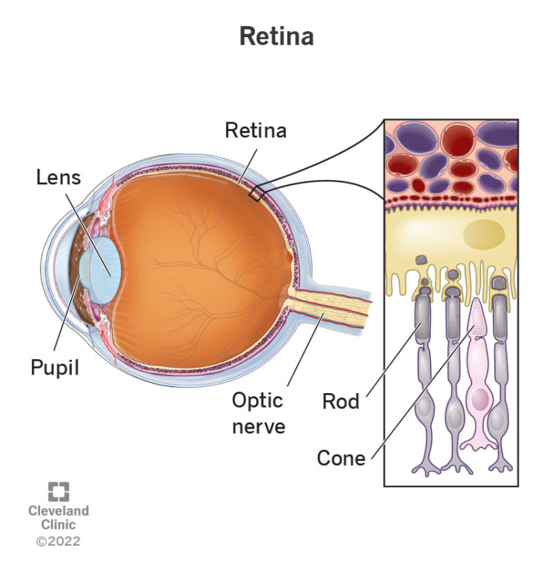
STRUCTURE OF THE EYE
2. CHOROID –
Middle layer
Contains the blood vessels
Anteriorly, forms the ‘iris’ with a central opening (pupil)
3. RETINA –
Innermost layer
Contains the special
cells of sight (‘rods’ & ‘cones’)

Slide 17
ANTERIOR CHAMBER OF THE EYE
Bounded anteriorly by the cornea & posteriorly by the iris
Filled with fluid called ‘aqueous humour’
PUPIL –
Aperture in the iris through which light enters the eye
IRIS –
Continuation of the choroid layer in the central part of the eye anteriorly
Blackish or brownish in colour
Consist of radiating & circular fibres
Controls the size of the pupil, thus maintaining the amount of light passing over the lens

Slide 18
POSTERIOR CHAMBER
BOUNDED IN FRONT BY THE IRIS & BEHIND BY THE LENS
FILLED WITH AQUEOUS HUMOUR
LENS –
IT IS A TRANSPARENT STRUCTURE LOCATED BEHIND THE PUPIL
CONVEX IN SHAPE
HELD IN PLACE BY THE SUSPENSORY LIGAMENTS
VITREOUS CHAMBER –
LARGE PORTION OF THE EYEBALL BEHIND THE LENS
FILLED WITH FLUID CALLED VITREOUS HUMOUR

Slide 19
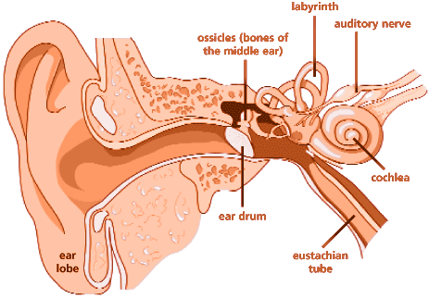
EAR
It is the organ of hearing
Located on either side of the skull, within the temporal bone
It is supplied by the 8th cranial (vestibule-cochlear) nerve

Slide 20


Slide 21
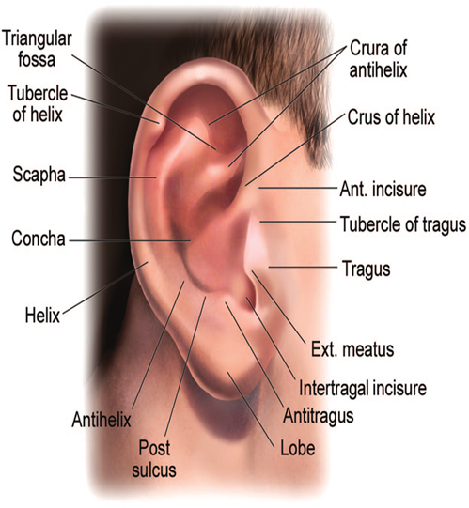
EXTERNAL EAR
I] PINNA (AURICLE) –
It is the expanded portion which
projects from the side of the head
Composed of fibro-cartilage covered
by skin
The skin is covered with fine hair
The lobe is the part which is on the lower side and is soft & pliable

Slide 22
EXTERNAL EAR
II] EXTERNAL AUDITORY MEATUS –
This extends from the auricle to the tympanic membrane
Approximately 4cms in length
Slightly ‘s’-shaped
Lined with continuation of skin from the auricle
It has a cartilegenous part containing modified sweat glands which secrete cerumen (wax)

Slide 23
EXTERNAL EAR
III] TYMPANIC MEMBRANE (EAR-DRUM) –
Separates the external from the middle ear
Oval shaped; slightly broader at the top than below
Formed by 3 types of tissues –
Outer covering – stratified epithelium
Middle layer – fibrous tissue
Inner layer – cuboid epithelium

Slide 24
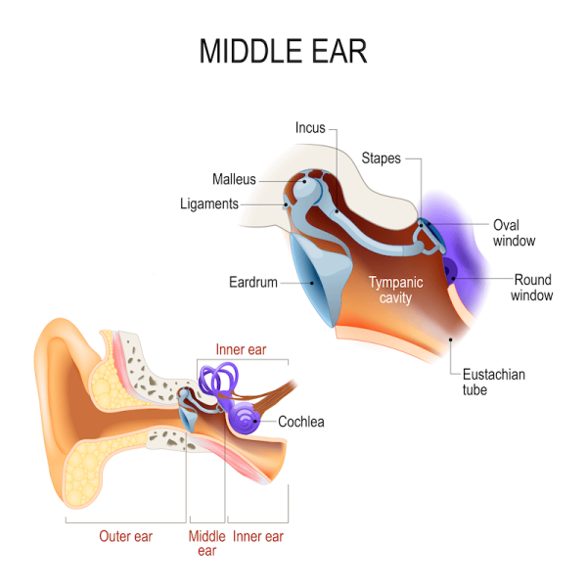
MIDDLE EAR
It is an irregular cavity within the
temporal bone
Lined with mucous membrane
Lateral wall of the middle ear
is formed by the tympanic membrane
The floor is formed by the temporal bone
There are 2 vestibular openings (oval window) and 1 cochlear (round) window

Slide 25
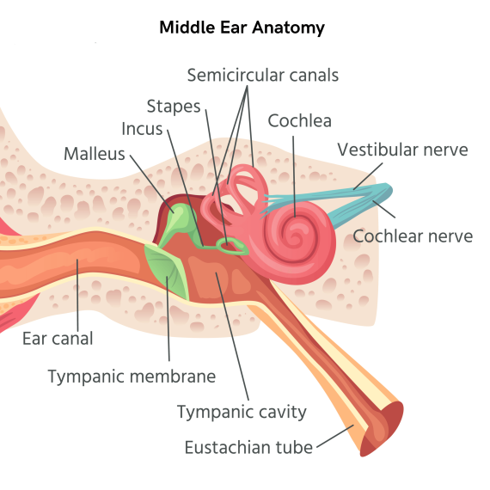
MIDDLE EAR
1. AUDITORY (EUSTACHIAN/ PHARYNGO-TYMPANIC) TUBE –
Connects the middle ear with
the naso-pharynx
Approximately 4cms in length
Lined with epithelium
It aids in maintaining equal
air-pressure on both sides
of the tympanic membrane

Slide 26
2. AUDITORY OSSICLES –
It is a chain of 03 small bones
1. Malleus –
Hammer-shaped
Handle-end joins with the tympanic membrane
Head-end joins with the incus
2. INCUS –
Anvil-shaped
Body joins with the malleus
Long-process joins with the stapes
3. STAPES –
Stirrup-shaped
The top-part joins with the incus
The base joins with the oval window

Slide 27
INNER EAR
BONY LABYRINTH –
It is a cavity within the temporal bone
Larger than the membranous labyrinth
Filled with a fluid called ‘perilymph’
MEMBRANOUS LABYRINTH –
It fits into the bony labyrinth like a tube within a tube
Filled with a fluid called ‘endolymph’
COCHLEA –
It is shaped like a snail-shell
It makes 2½ turns

Slide 28
PHYSIOLOGY OF HEARING
Every sound produces a sound-wave (a disturbance in the air) which travels at a speed of 332 mtrs/sec.
The auricle collects the sound-waves and directs it via the external auditory meatus to the tympanic membrane. This sets up vibrations in the tympanic membrane which is transmitted by the auditory ossicles to the oval window.
This sets up a fluid-wave in the perilymph & further to the endolymph. This stimulates the ‘Organ of Corti’ (the basic organ of hearing). Nerve impulses are produced which are passed through the cochlear portion of the 8th cranial (vestibule-cochlear) nerve to the hearing centre of the cerebral cortex in the temporal lobe, where the sound is perceived.

Slide 29
PHYSIOLOGY OF BALANCE
The endolymph in the semi-lunar canals changes its level with changes in the position of the head.
The nerve endings get stimulated and impulses are transmitted via the vestibular nerve, which joins the cochlear nerve to form the vestibule-cochlear nerve.
The impulses pass to the cerebellum which receives impulses with regard to position of the body from other sources like muscles & joints.
All the impulses are analyzed in the cerebellum and appropriate efferent impulses are passed to the muscles & joints to maintain posture.

Slide 30
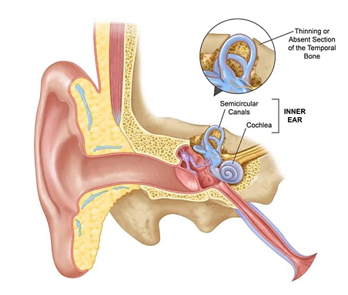
Semi-lunar canals

Slide 31
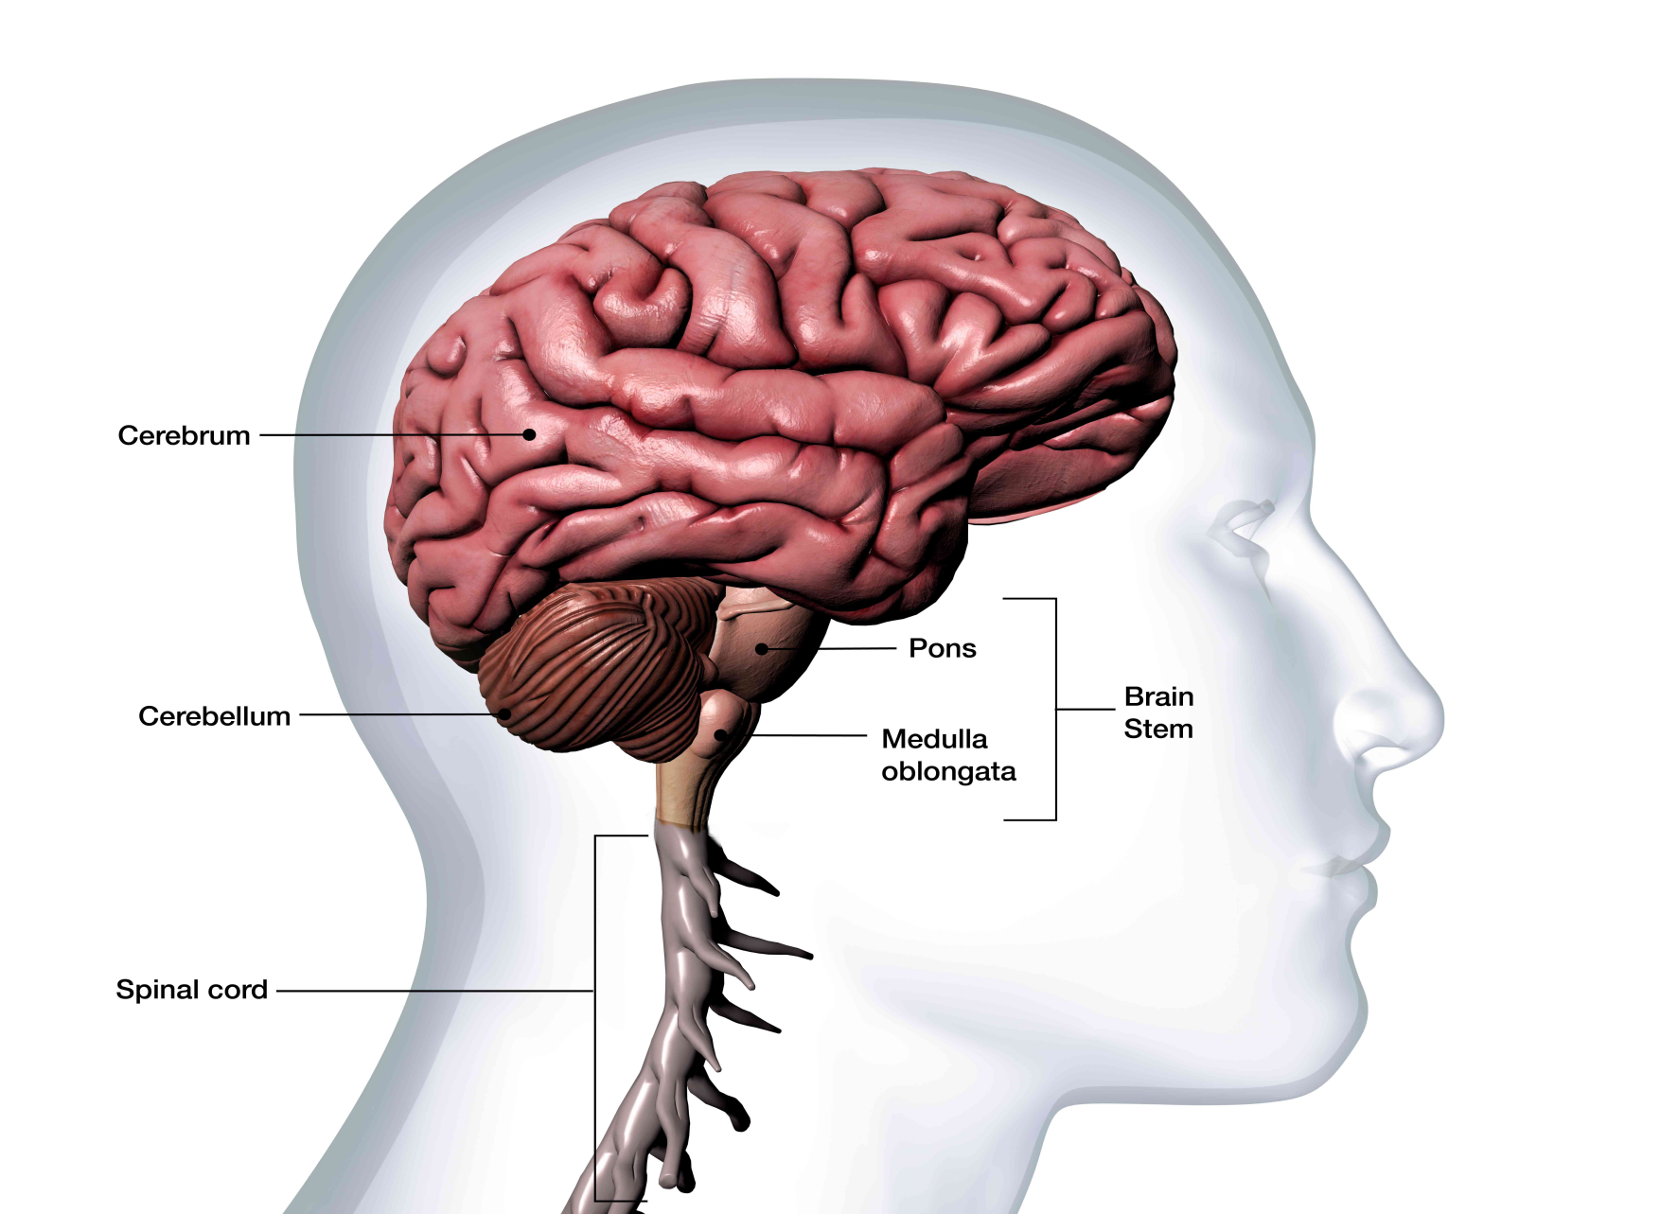
CEREBELLUM

Slide 32
ANY QUESTION
?

Slide 33
THANKS

