Slide 1
Determining Heart Rate from Rhythm Strip & Normal ECGs
LESSON -9
By
AMANDEEP KAUR
ASI/ANM

Slide 2
Learning Objectives
By the end of this module, you will be able to:
• Determine heart rate using various ECG methods
• Identify normal sinus rhythm characteristics
• Recognize normal ECG waveforms
• Understand how rate, rhythm, and morphology relate to cardiac function
Notes:
Introduce practical ECG interpretation skills.

Slide 3
Introduction
Heart rate and rhythm are key elements of ECG interpretation. Rhythm strips help assess regularity and rate.
Notes:
Explain rhythm strip concept.

Slide 4
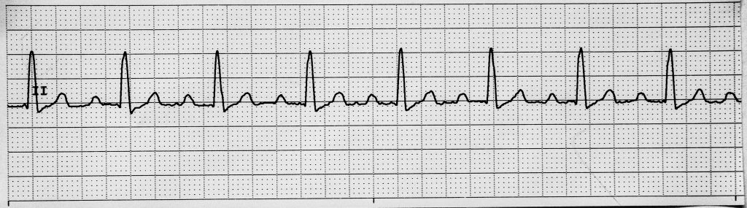
What is a Rhythm Strip?
• A long recording (usually Lead II)
• Captures continuous cardiac electrical activity
Notes:
Describe the function of rhythm strips.

Slide 5
Methods of Calculating Heart Rate
1. 300 Method (for regular rhythms)
2. 1500 Method (most precise for regular)
3. 6-Second Method (for irregular rhythms)
Notes:
Introduce the three primary methods for heart rate calculation.

Slide 6
300 Method
• Count large boxes between R waves
• Heart rate = 300 ÷ number of large boxes
Example: 4 boxes → 300 ÷ 4 = 75 bpm
Notes:
Simple method for regular rhythms.

Slide 7
1500 Method
• Count small boxes between R waves
• Heart rate = 1500 ÷ number of small boxes
Example: 20 small boxes → 1500 ÷ 20 = 75 bpm
Notes:
Use for accurate calculation on detailed strips.

Slide 8
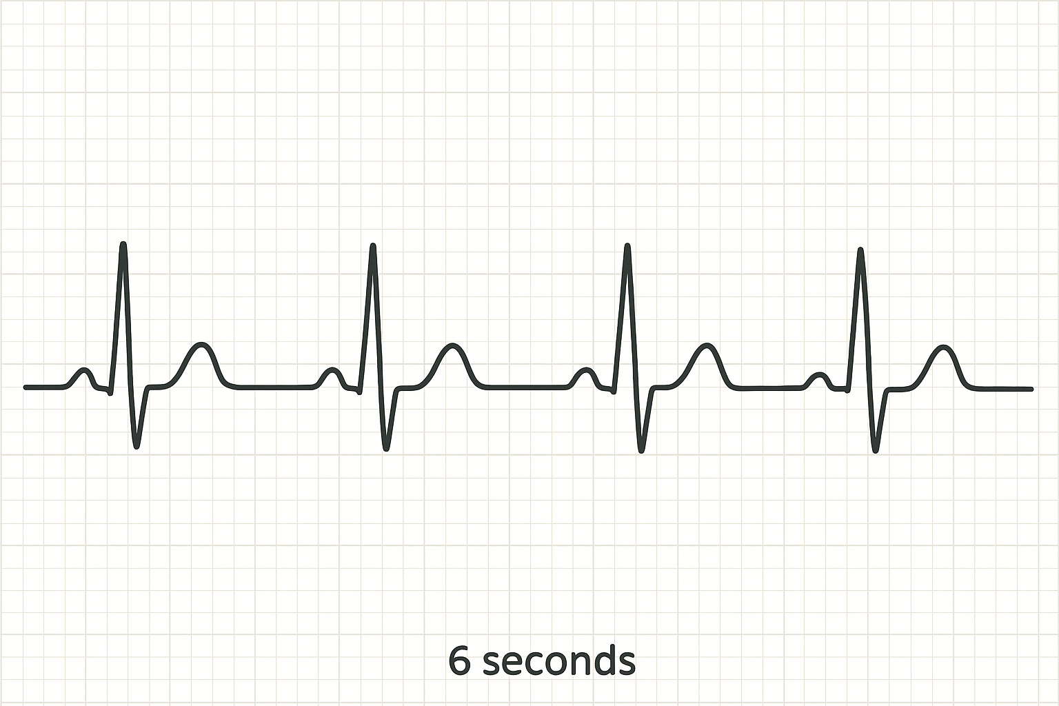
6-Second Method
• Count number of QRS complexes in 6 seconds and multiply by 10
• Works for regular or irregular rhythms
Notes:
Preferred method in emergency settings.

Slide 9
Normal Sinus Rhythm (NSR)
• Originates from SA node
• Regular rhythm
• Rate: 60–100 bpm
• P wave before every QRS
• PR interval: 0.12–0.20 sec
• QRS ≤ 0.12 sec
Notes:
Define characteristics of a normal ECG pattern.

Slide 10
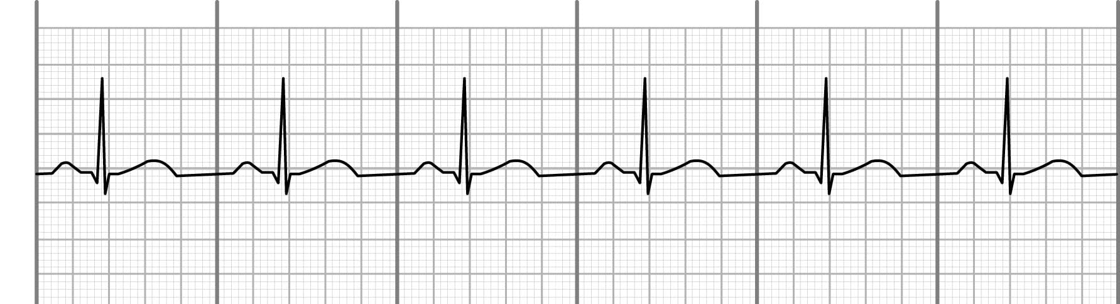
Normal Sinus Rhythm (NSR)

Slide 11
Sinus Bradycardia
• Same as NSR but rate < 60 bpm
• Often normal in athletes or during sleep
Notes:
Discuss physiologic vs pathologic causes.

Slide 12
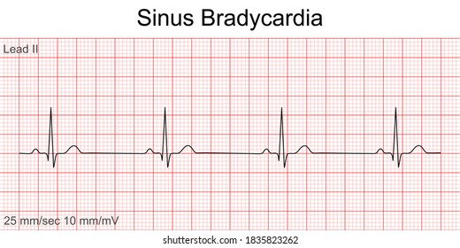
Sinus Bradycardia
Notes:
Discuss physiologic vs pathologic causes.

Slide 13
Sinus Tachycardia
• Same as NSR but rate > 100 bpm
• Can occur during stress, fever, exercise
Notes:
Link to increased sympathetic stimulation.

Slide 14
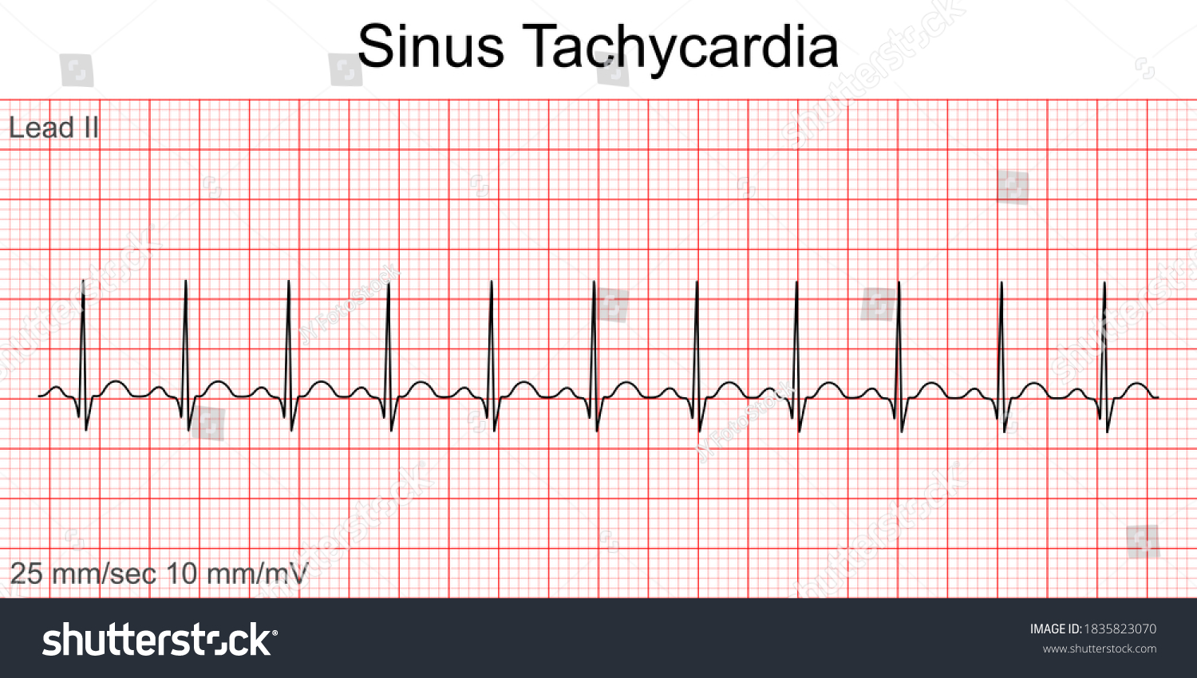
Sinus Tachycardia
Notes:
Link to increased sympathetic stimulation.

Slide 15
Normal ECG Features
• P wave upright in I, II, aVF
• QRS narrow and consistent
• T wave upright in most leads
• Regular RR intervals
Notes:
Describe features of a healthy ECG.

Slide 16
ECG Example – Normal Sinus Rhythm
Notes:
Show example with waveform annotations.

Slide 17
Assessing Rhythm Regularity
• Measure intervals between R waves
• Equal spacing = regular rhythm
• Variable spacing = irregular rhythm
Notes:
Guide on rhythm evaluation.

Slide 18
Average Heart Rate Chart
• >100 bpm: Tachycardia
• 60–100 bpm: Normal
• <60 bpm: Bradycardia
Notes:
Summarize rate categories.

Slide 19
Clinical Importance
• Abnormal rates affect cardiac output
• Bradycardia → low perfusion
• Tachycardia → increased myocardial demand
Notes:
Discuss physiological implications.

Slide 20
Summary
• Rhythm strips are essential for assessing rate and rhythm
• Multiple methods exist to calculate heart rate
• Recognizing normal ECG patterns is fundamental to interpretation
Notes:
Conclude and prepare for module on arrhythmias.

Slide 21
ANY QUESTION
?

Slide 22
THANKS

