Slide 1

OPERATION PROCEDURE OF AED
LESSON-08
By
JITENDER YADAV
INSP/PH

Slide 2
WHAT IS AN AED USED FOR?
An automated external defibrillator (AED) is a medical device designed to analyze the heart rhythm and deliver an electric shock to victims of ventricular fibrillation to restore the heart rhythm to normal. Ventricular fibrillation is the uncoordinated heart rhythm most often responsible for sudden cardiac arrest.

Slide 3
automated external defibrillator (AED)
Check unresponsiveness.
Call 1-1-2 or the local emergency number (if applicable) and retrieve the AED.
Open the airway and check for breathing. ...
Check for a pulse. ...
Attach the AED electrode pads.
Analyze the heart rhythm. ...
Press the "shock" button, if advised.

Slide 4
HOW TO USE?
Two pads will need to be placed on the chest of the person. The first is placed on the right-hand side of the chest below the collar bone. The second is placed on the left-hand side, below the armpit. The AED you use will indicate which pad is the first and second.

Slide 5
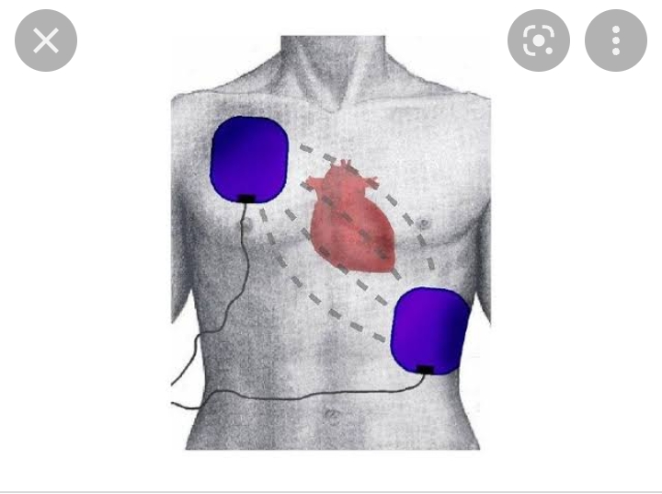

Slide 6
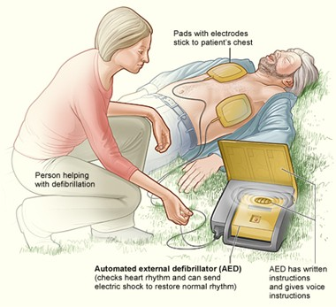

Slide 7
What precautions should you take for using an AED on someone with a pacemaker?
Pacemakers and Implanted Defibrillators – Someone with an internal device still can be shocked with an AED. In fact, if their internal device does not save them immediately, it is crucial an AED is used as quickly as possible. It is important to remember, do not place the pads directly over the meta

Slide 8
WHEN USING AN AED, FOLLOW THESE PRECAUTIONS
Do not touch the victim
Do not use alcohol to wipe the victim's chest dry.
Do not defibrillate someone around flammable materials.
Do not use an AED in a moving vehicle.
Do not use an AED on a victim in contact with water.
Do not use an AED and/or electrode pads designed for adult victims on an infant or a child under age 8 or weighing less than 55 pounds.

Slide 9
THANK YOU!

