Slide 1
LESSON-8
Basic Life Support (BLS) &
Cardiopulmonary Resuscitation (CPR)
BY
PRAVIN DUDHE
INSP/PH
P. Page No-7-1
BLS & CPR
TR- 7-1

Slide 2
Objectives
Upon completion of this lesson, you will be able to:
List two causes of partial or total upper airway
obstruction.
2 Demonstrate rescue breathing for adults,
children and infants using a mannequin, with
and without foreign body airway obstruction.
Cont…
P. Page No-7-1
BLS & CPR
TR- 7-2

Slide 3
Objectives
3 Describe and demonstrate CPR in adults,
children, and infants using a mannequin.
Describe and demonstrate two-rescuer CPR
for adults.
P. Page No-7-1
BLS & CPR
TR- 7-3

Slide 4
The Respiratory System
The respiratory system is made up of four components:
Airway (upper and lower).
Neuromuscular system (includes the
respiratory center in the brain, respiratory
muscles, and the nerves that connect the two).
Alveoli – tiny airs sacs surrounded by
capillaries.
4 Arteries, capillaries and veins.
BLS & CPR

Slide 5
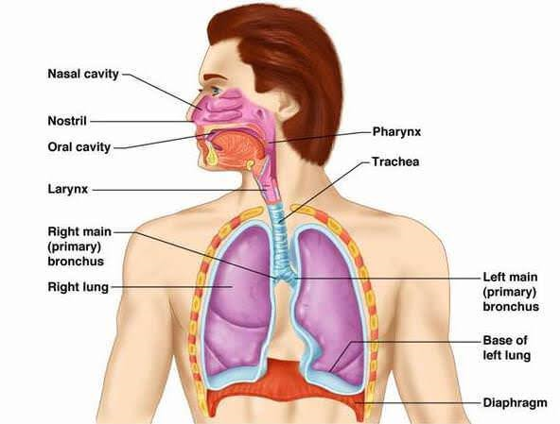

Slide 6
The Respiratory System
1 The alveoli are surrounded by the capillaries
The brain sends nerve signals to muscles in the
thorax and diaphragm, causing us to breathe.
3 With each inhalation, air is carried through the airways to the alveoli in the lungs, where oxygen and carbon dioxide are exchanged.
BLS & CPR

Slide 7
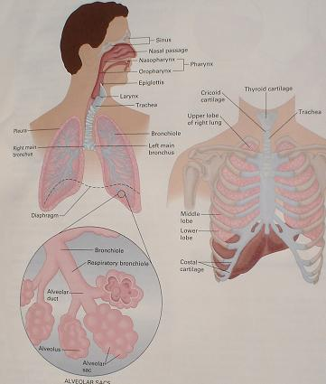
BLS & CPR

Slide 8
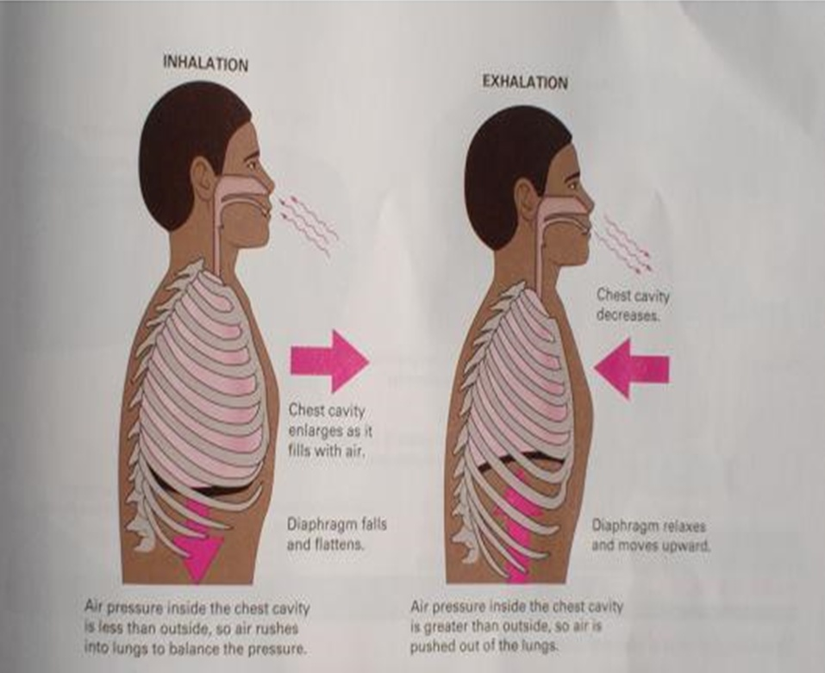
BLS & CPR

Slide 9
Respiratory System
In combination with the respiratory system, the circulatory system supplies the oxygen necessary for life, and eliminates carbon dioxide from the body.
BLS & CPR

Slide 10
Breathing
To assess the presence of breathing, we look, listen and feel.
Adequate breathing is characterized by:
1 Chest and abdomen rise and fall with each breath.
2 Air can be heard and felt exiting the mouth
or nose.
3 Ease of breathing (effortlessness).
4 Adequate rate.
BLS & CPR

Slide 11
Breathing
Inadequate breathing is characterized by:
1 Inadequate rise and fall of the chest
2 Noisy breathing: bubbles, whistling, etc.
3 Increased respiratory effort.
4 Cyanosis.
5 Inadequate rate.
6 Altered mental status.
BLS & CPR

Slide 12
Breathing
Absent breathing is characterized by:
1 No chest or abdominal movement.
Air cannot be heard and felt exiting the
mouth or nose.
BLS & CPR

Slide 13
Cyanosis
A bluish coloration of the skin and mucous membranes caused by lack of oxygen in the blood and tissues.
BLS & CPR

Slide 14
Cyanosis can be more easily noticed
1 On the lips, ears and nostrils or nail beds.
In patients with dark pigmentation, inspect
the nostrils, palms and nail beds, and the
mouth and tongue.
BLS & CPR

Slide 15
Techniques for Opening the Airway
Head-Tilt Chin-Lift
This is the method of choice for opening the airway.
Do not use this method if you suspect head,
neck or spinal injury.
BLS & CPR

Slide 16
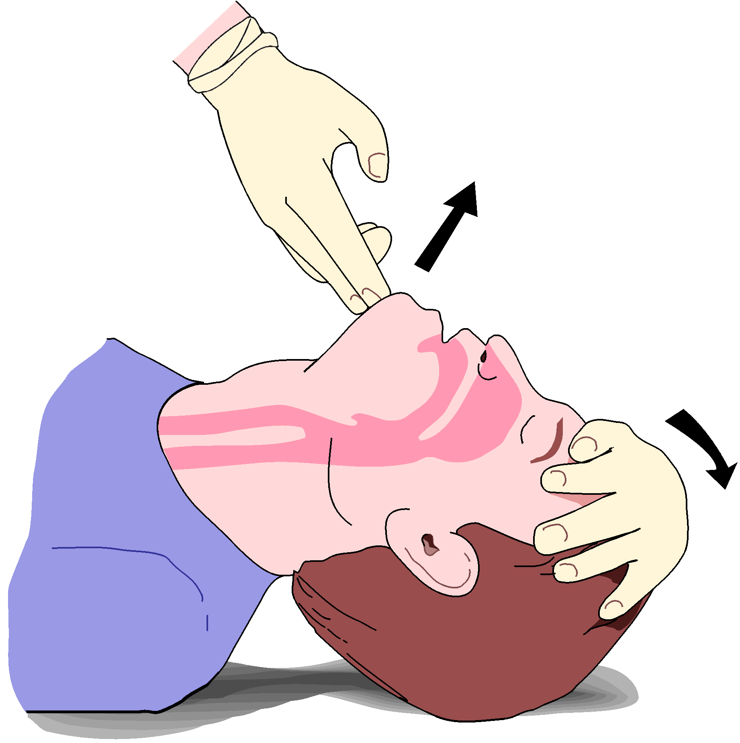
Head -Tilt Chin - Lift
BLS & CPR

Slide 17
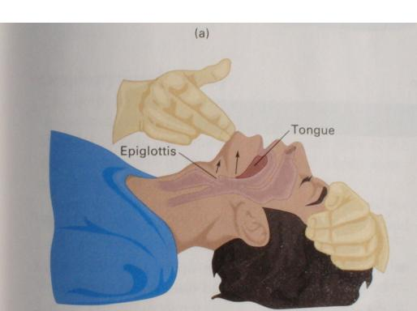
BLS & CPR

Slide 18
Important precautions:
Always keep the patient’s mouth slightly
open – use your thumb to hold down the patient’s lower lip.
Never dig into the soft tissue under the
patient’s chin.
BLS & CPR

Slide 19
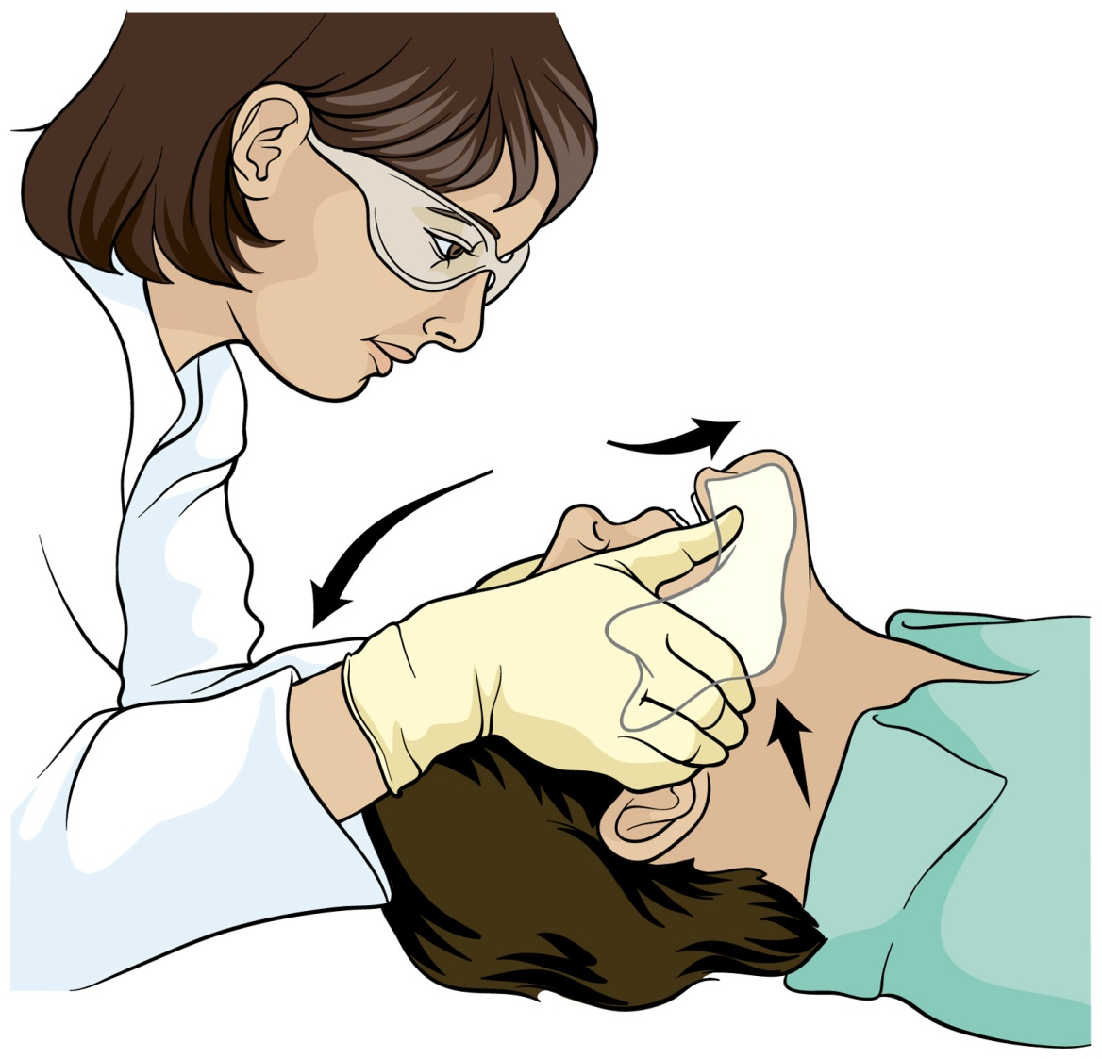
Jaw thrust
P.Page No-7-6
BLS & CPR
TR- 7-23

Slide 20
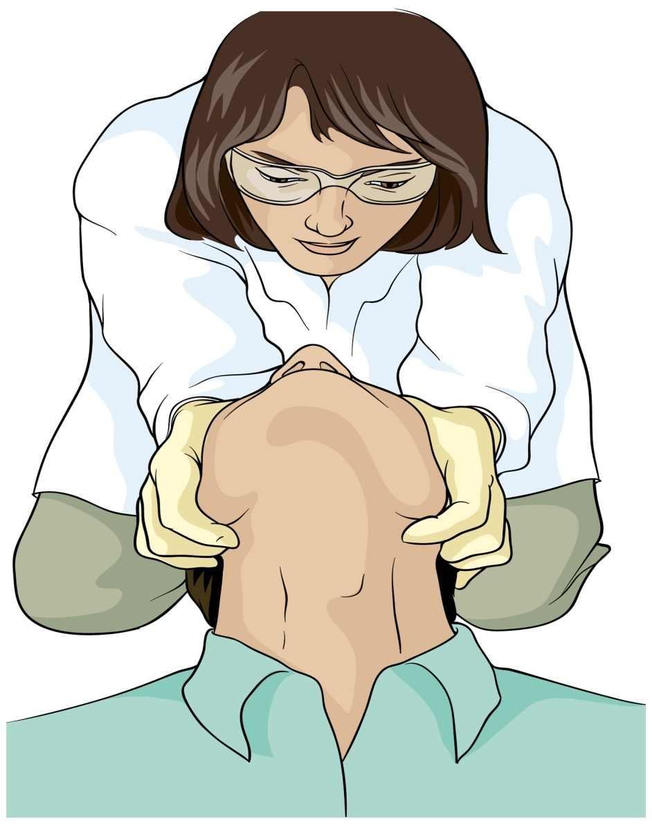
Jaw thrust
BLS & CPR

Slide 21
How is it possible to maintain a patient alive with exhaled air?
Natural air contains approximately 21% oxygen
and the body only utilizes about 5%.
2. Therefore, exhaled air contains 16% oxygen.
3. This exhaled air can resuscitate a person who
is not breathing, until a high concentration
oxygen source is available.
BLS & CPR

Slide 22
Artificial Ventilation
(Rescue Breathing)
There are many techniques for artificial ventilation. You should be competent in three, listed below in recommended order of preference:
1. Mouth-to-mask.
2. Mouth-to-barrier device.
3. Mouth-to-mouth.
BLS & CPR

Slide 23
Breathing rates and duration
Adults : 10 to 12 per min lasting 1.5 to 2 sec.
Children : 20 breaths per min. lasting 1 sec.
Newborns : 40 breaths per min lasting 1 sec.
1 Look for proper chest rise.
2 With infants and newborns, use puffs from the
mouth so as not to over-ventilate.
BLS & CPR

Slide 24
Hazards to Rescuers
1 Diseases: Blood-borne and/or airborne. Mask, gloves, and eye protection should be worn. Use BVM (Bag Valve Mask) or pocket mask.
Chemicals: Exposure from a contaminated
patient. Patient should be decontaminated first.
Vomitus: One-way valve on a pocket mask or
BVM should be used.
BLS & CPR

Slide 25
Gastric Distention
This problem can occur during rescue breathing, which can force some air into the patient’s stomach, causing the stomach to become inflated, or distended.
BLS & CPR

Slide 26
This can result in two serious problems:
  1 Reduced lung volume – the lungs become
  upwardly displaced by the diaphragm.
  2 Vomiting – Explosive expulsion of fluids or
  partially digested foods from the stomach
  into the throat, resulting in airway obstruction,
  aspiration of vomit into lungs.
BLS & CPR

Slide 27
Recovery Position:
1 For a patient with a pulse and adequate
breathing, place the patient in the recovery
position.
2 This position uses gravity to keep the airway
clear, allowing fluids to drain out of the mouth
instead of into the airway.
3 The recovery position should be used on an
unresponsive, uninjured patient who is
breathing adequately.
4 Keep the patient in that position until
transportation arrives
BLS & CPR

Slide 28
Mouth-to-Mask Ventilation
This method uses a pocket face mask with a one-way valve to form a seal around the patient’s nose and mouth. It is the preferred method because it eliminates direct contact with the patient and prevents exposure.
BLS & CPR

Slide 29
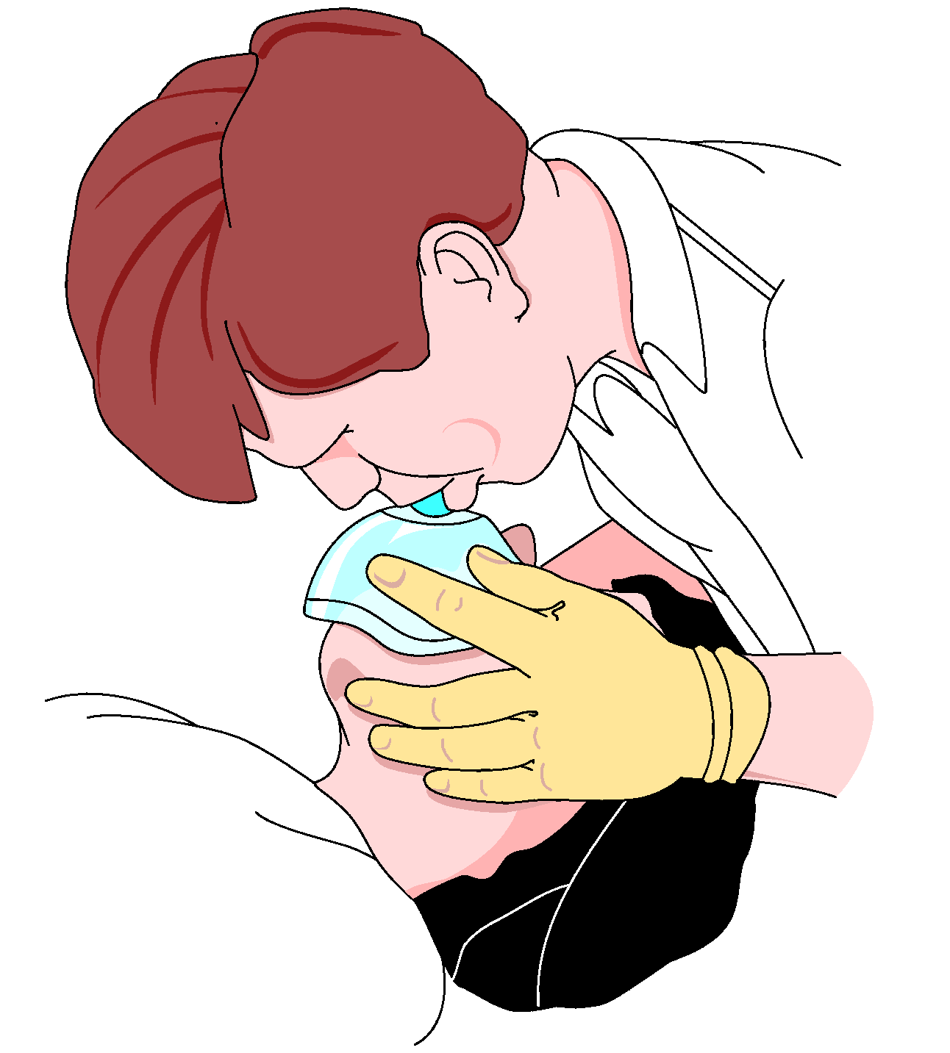
BLS & CPR

Slide 30
Mouth-to-Barrier Ventilation
There are two broad categories of barrier devices: mask and shield. Most have a one way valve but no exhalation port. The patient’s exhaled air will leak out around the barrier device.
BLS & CPR

Slide 31
Mouth-to-Mouth Ventilation
The risk of contracting infectious diseases makes mouth-to-mouth ventilation very risky for use in the field. The decision to use this method is a personal one. Use barrier devices whenever possible.
BLS & CPR

Slide 32
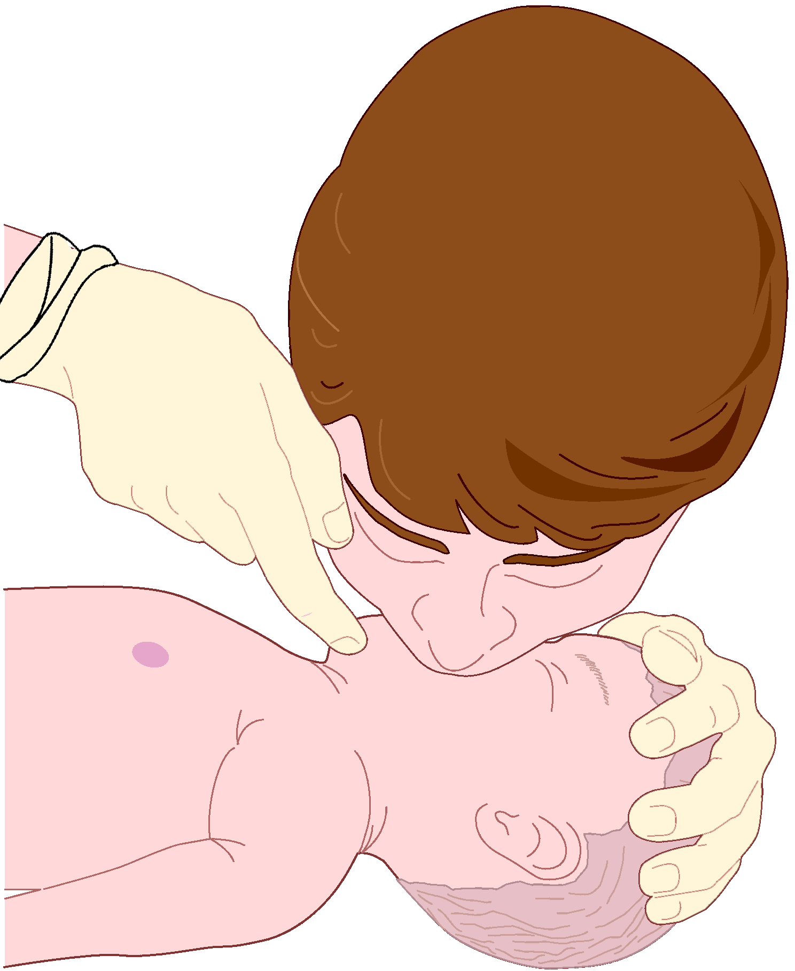
BLS & CPR

Slide 33
Stoma Patients
Occasionally, you may encounter a patient who has undergone a laryngectomy. This person will have a “stoma” a permanent opening from the trachea to the front of the neck. Perform direct mouth to-stoma ventilation.
BLS & CPR

Slide 34
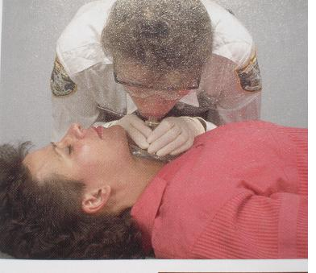
P.Page No-7-12
BLS & CPR
TR- 7-47

Slide 35
Foreign Body Airway Obstruction
(FBAO)
BLS & CPR

Slide 36
Airway Obstruction
There are upper and lower airway
obstructions.
An upper airway obstruction is anything that
blocks the back of the mouth or throat or the
nasal passages.
A lower airway obstruction is caused by
breathing in a foreign body or by severe spasm
of the bronchial passages, such as asthma.
BLS & CPR

Slide 37
Causes of Airway Obstruction
Airway obstruction can be caused by the following.
Tongue: The tongue falls back, blocking the
throat. This problem is common in unconscious
patients.
Epiglottitis: Occurs when patients try to force
breathing. Also caused by allergies and spasms
of different kinds.
BLS & CPR

Slide 38
Causes of Airway Obstruction
3 Foreign body: Objects such as food, ice, toys, dentures , vomitus and liquids that remain in the upper portion of the throat or airways.
Tissue damage: Can be caused by a penetrating
injury to the neck, crushing trauma to the face,
inhalation of hot air (as occurs in fires),
ingestion of chemicals, and severe neck trauma.
BLS & CPR

Slide 39
Causes of Airway Obstruction
5 Illness: Respiratory infections and certain chronic conditions (such as asthma) or Sudden Infant Death Syndrome may cause tissue inflammation or muscular spasms and obstruct the airways.
The most common airway obstruction in a
responsive patient is food, and in the
unresponsive patient it is the tongue. The
focus of this lesson is primarily on removing
upper FBAO.
BLS & CPR

Slide 40
Recognizing FBAO
The key to successful treatment is early recognition. Suspect FBAO in any victim who suddenly stops breathing becomes cyanotic, and loses consciousness for no apparent reason.
There are two types of FBAO –
Partial .
Complete.
BLS & CPR

Slide 41
Partial Air Obstruction
An object caught in the throat that does not totally block breathing.
A patient with partial obstruction may have
adequate or poor air exchange.
With adequate air exchange, the patient
may cough forcefully, though there may
be wheezing between coughs.
4 Do not interfere with patient’s attempt
to clear the airway.
BLS & CPR

Slide 42
With poor air exchange
The patient will exhibit a weak, ineffective
cough, high-pitched noise while inhaling, increased respiratory difficulty and possible cyanosis.
Treat this situation as a complete airway
obstruction.
BLS & CPR

Slide 43
Complete Airway Obstruction
A patient with complete foreign body airway obstruction will not be able to speak and may grasp at his / her throat (Universal sign). Movement of air will be absent.
BLS & CPR

Slide 44
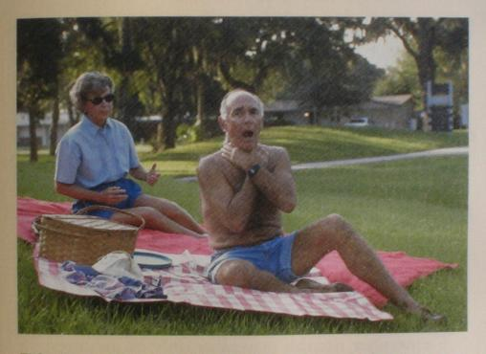
P.Page No-7-14
BLS & CPR
TR- 7-57

Slide 45
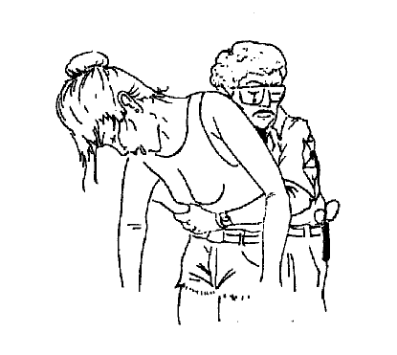
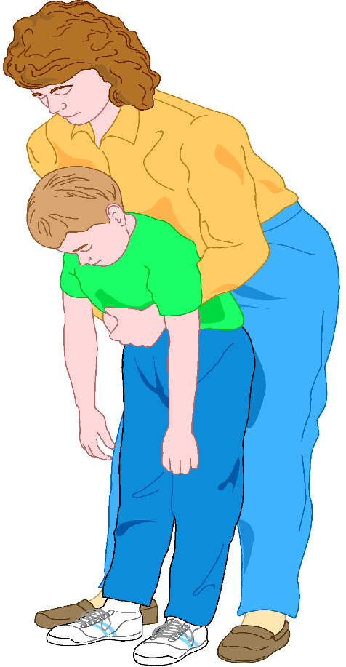
Managing FBAO in Adults and Children
Heimlich Maneuver
BLS & CPR

Slide 46
Managing FBAO in Adults and Children
The method recommended for relieving
FBAO with poor air exchange or complete obstruction is the abdominal thrust (Heimlich maneuver).
Each individual thrust should be administered
with the intent of relieving the obstruction.
BLS & CPR

Slide 47
It may be necessary to perform several
thrusts.
It is possible to damage internal organs with
this method.
To minimize the possibility of injury, never place
your hands on the xiphoid process or on the
lower edges of the rib cage – your hands should
be below this area but above the navel.
BLS & CPR

Slide 48
Managing FBAO in Children
1 Same way you would for adults, except that you never use a blind finger sweep in children ages 1 to 8 as well in infants.
Airway obstructions in children may also be
caused by infections such as epiglottitis or croup
(cPpksa esa d.B jksx) which produce airway odema.
3 Suspect this condition if an infant or child has a
fever with congestion, hoarseness transport
to an emergency facility. It is dangerous to the
patient to attempt to relieve this form of
obstruction
BLS & CPR

Slide 49
Abdominal Thrusts — Responsive Adult or Child (Patient Standing or Sitting)
1 Get in position. Stand behind the victim, wrap your arms around the victim’s waist, keeping your elbows away from the patient’s ribs.
Position your hands. Make a fist with one
hand, place the thumb-side of the fist
against the patient’s abdomen, slightly above
the navel and below the xiphoid process.
BLS & CPR

Slide 50
3 Perform an abdominal thrust. Grasp the fist
with the other and press the fist into the
patient’s abdomen with a quick upward
thrust.
Repeat thrusts until the object is expelled
from the airway or the patient becomes
unconscious. Each new thrust should be a
separate and distinct movement.
P.Page No-7-15
BLS & CPR
TR- 7-63

Slide 51
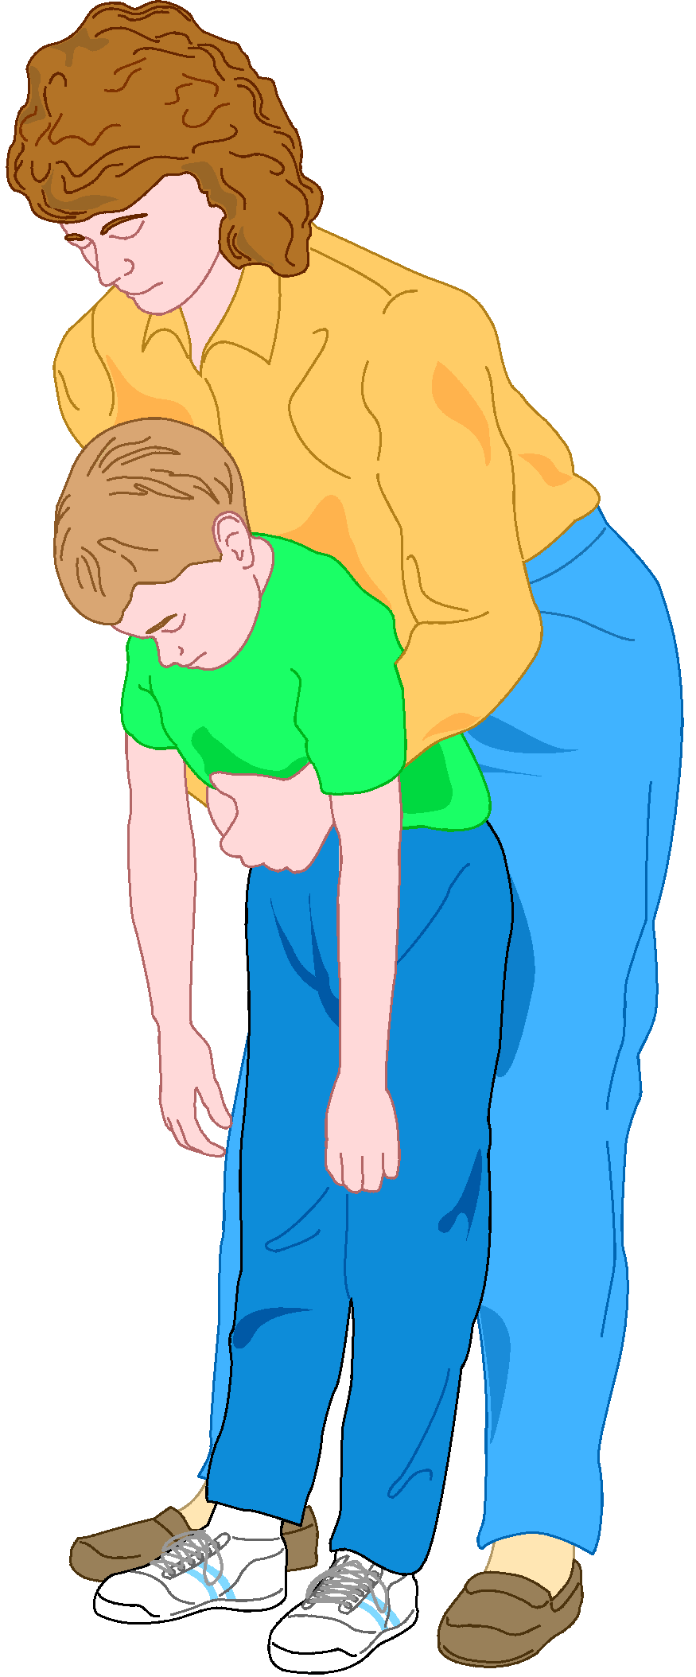
P.Page No-7-15
BLS & CPR
TR- 7-64

Slide 52
Unresponsive Adult or Child/Obese or Pregnant (Patient lying down)
1 Position the patient face up (supine).
2 Tape and shout to assess responsiveness. If unresponsive activate EMS.
3 Get in position (as in CPR). Begin CPR (without
a pulse check)
4 After 30 compression, open airway. If object is
seen remove object from victims mouth by
finger sweep. Use the tongue-jaw lift to open
the patient’s mouth. Insert the index finger of
the other hand along the inside of the cheek
into the throat, using a hooking action to
dislodge the foreign body and lift it out.
BLS & CPR
TR- 7-65

Slide 53
5 Do not use finger sweep on unresponsive patients who have a gag reflex
6 Attempt to give 2 ventilations.
7 If after 2 attempt you are not able to achieve
chest rise continue CPR until effective .
BLS & CPR

Slide 54
Chest Thrusts — Pregnant or Obese Responsive Adult (Patient Standing or Sitting)
Chest thrusts are to be used only with patients in late stages of pregnancy or with the markedly obese, when abdominal thrusts cannot be applied effectively.
  1 Get in position. Stand behind the patient,
  with your arms directly under the patient’s
  armpits, and encircle the patient’s chest.
BLS & CPR

Slide 55
  2 Position your hands. Place the thumb-side of your fist along the patient’s sternum, avoiding the xiphoid process and margins of the rib cage.
  3 Perform a chest thrust. Grab your fist with the
  other hand and perform backward thrusts
  until the object is expelled from the airway
  Repeat this step until patient airway is opened.
  or the patient becomes unconscious.
BLS & CPR

Slide 56
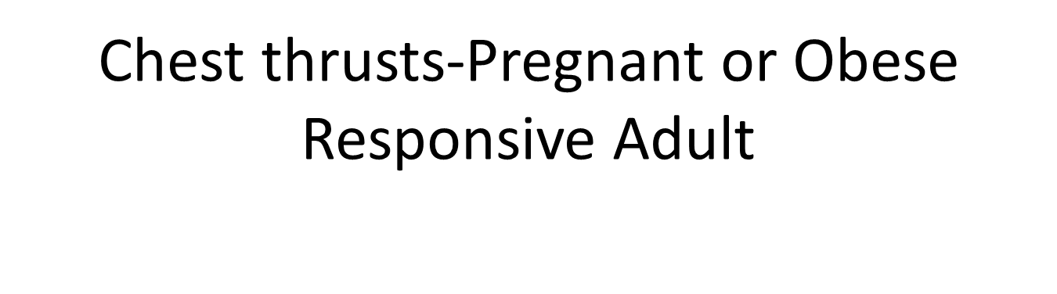
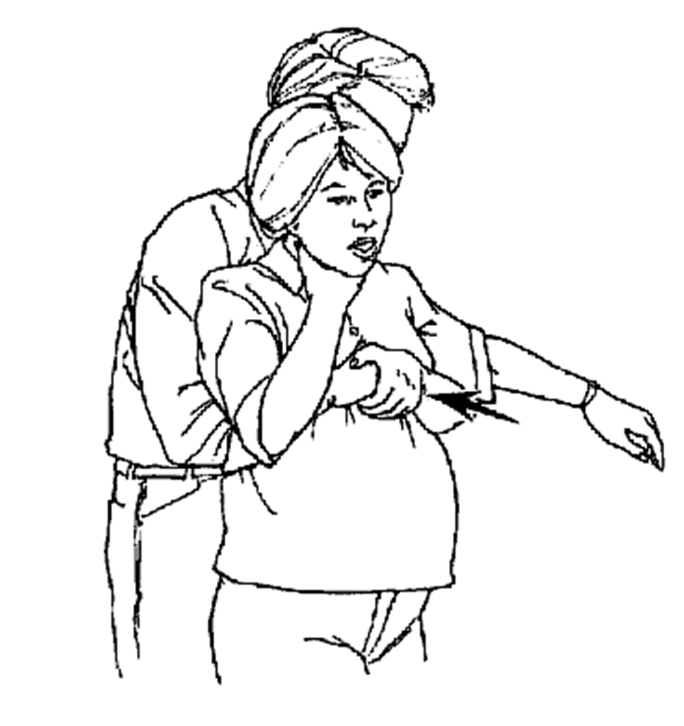
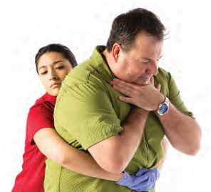
  ABDOMINAL THRUSTS

Slide 57
Managing FBAO in Infants
1 Always suspect foreign body airway obstruction in infants who demonstrate a sudden onset of respiratory distress associated with gagging, coughing or wheezing.
Most common causes are toys or other
small objects (coins).
BLS & CPR

Slide 58
3 As mentioned earlier, airway obstructions
may also be caused by infection .Suspect this
condition if the infant has a fever with
congestion, hoarseness drooling.
Do not attempt to relieve this form of obstruction
and transport the patient immediately
BLS & CPR

Slide 59
Removing FBAO in Conscious Infant
Perform the following procedure only if the infant has a complete obstruction or partial obstruction with poor air exchange and only if you suspect a foreign object.
  1 Verify complete airway obstruction. Serious
  breathing difficulty, ineffective cough, no
  strong cry.
BLS & CPR

Slide 60
  2 Position the infant. Straddle the infant face down over one of your forearms, head lower than the body. Support the infant’s head by holding the jaw with your hand
  3 Deliver 5 back blows. Use the heel of your
  hand between the shoulder blades. If foreign
  object is not expelled, position the infant
  face-up on your arm, head lower than the body.
BLS & CPR

Slide 61
  4 Deliver 5 chest thrusts. Position your middle and ring fingers in the middle of the infant’s sternum, just below the imaginary line between the infant’s nipples. Use a quick downward motion.
  Repeat steps 2 to 4 until effective, or until the
  infant becomes unconscious.
BLS & CPR

Slide 62
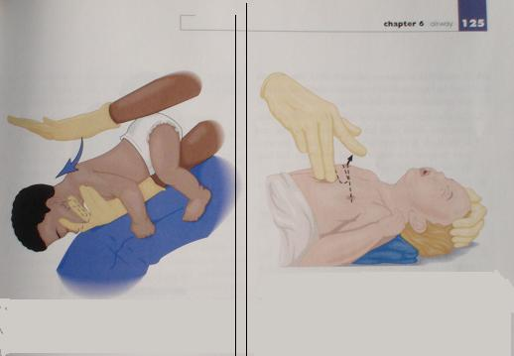
BACK BLOWS & CHEST COMPRESSIONS FOR AN INFANT WITH AN FBAO
BLS & CPR

Slide 63
FBAO in Unconscious Infant
1 Establish unresponsiveness.
Begin CPR with 30 chest compression
3 Open airway and give 2 ventilations.
If after 2 attempts you are unable to achieve
adequate chest rise , continue CPR until
effective
BLS & CPR

Slide 64
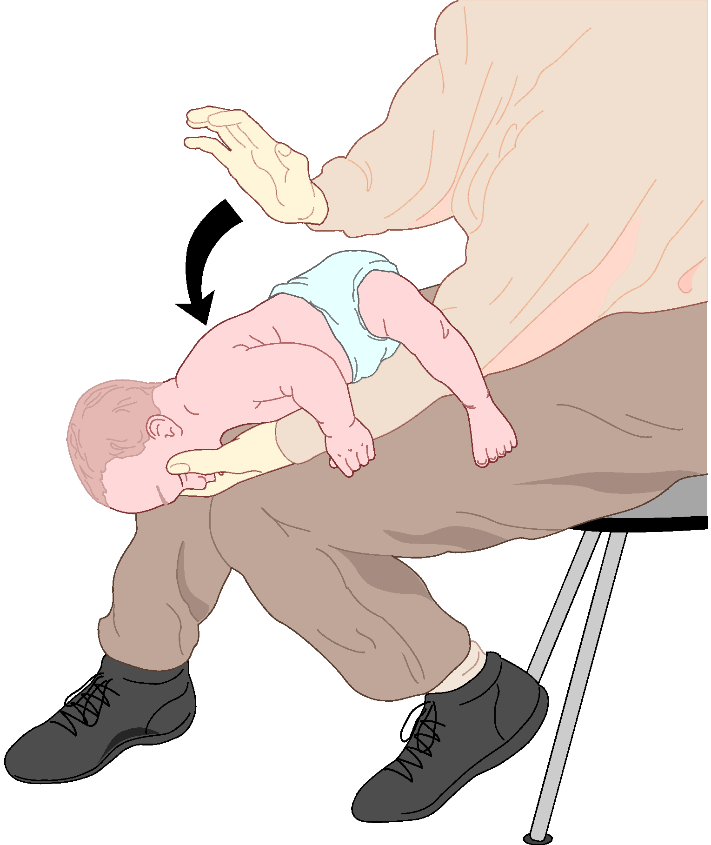
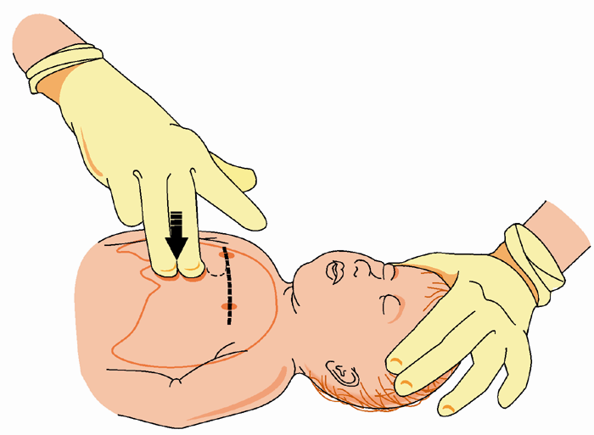
Managing FBAO in Infants
BLS & CPR

Slide 65
Chain of Survival
Cardiopulmonary resuscitation (CPR) can
save the lives of victims in cardiac arrest.
Two-thirds of heart attack victims (due to
heart disease) die outside the hospital, most
within two hours of the onset of symptoms.
Though CPR itself is not enough to save the
life of a victim of heart attack, it is a vital link
in the chain of survival.
P.Page No-7-20 BLS & CPR TR- 7-78

Slide 66
Chain of Survival
1 Early Access : Recognize the signs and
symptoms of cardiac and respiratory emergencies early and notify Emergency Medical Services.
2 Early CPR : Perform effective CPR. Starting
CPR early greatly increases the patients chances
for survival.
P.Page No-
BLS & CPR
TR- 7-79

Slide 67
3 Early defibrillation : If trained on and equipped with automated external defibrillator (AED), use it as soon as possible. This link is the most likely to improve survival rates.
Early advanced care : It is important that
advanced medical care ( ACLS) be available
rapidly for a positive outcome.
BLS & CPR

Slide 68
The need for these interventions should not be limited to victims of heart disease. Many victims of drowning, trauma, electrocution, suffocation, airway obstruction, allergic reaction, etc., may be saved by prompt intervention.
BLS & CPR

Slide 69
Heart Attack Risk Factors
1 Factors that cannot be changed -
a) Family history.
b) Sex.
c) Ethnic background.
d) Age.
BLS & CPR

Slide 70
Heart Attack Risk Factors
2 Risk Factors that can be changed
A) Smoking .
B) High blood pressure.
C) High Cholesterol.
D) Physical activity.
BLS & CPR

Slide 71
Heart Attack Risk Factors
3 Contributing factors
a) Obesity.
b) Diabetes.
c) Excessive stress.
BLS & CPR

Slide 72
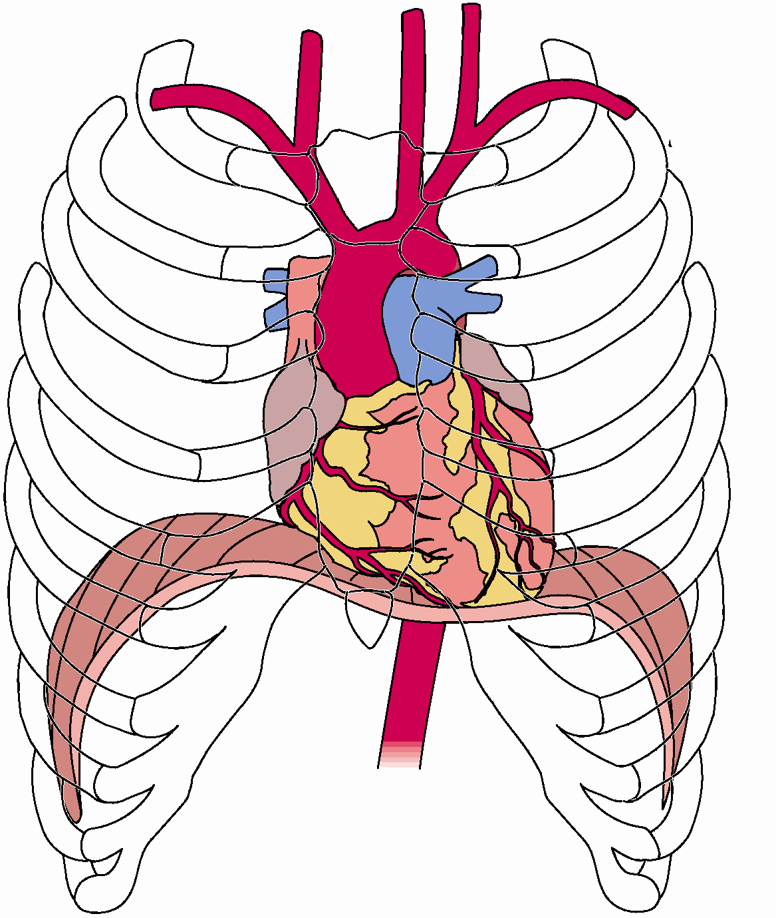
The Cardiovascular System
P.Page No-
BLS & CPR
TR- 7-1

Slide 73
1 The cardiovascular system consists of the heart, blood, arteries, capillaries and veins.
2 The heart is a muscular organ, approximately
the size of a fist, and is located in the thoracic
cavity behind the sternum and between the lungs.
The coronary arteries are special arteries that
supply blood to the heart muscles themselves.
P.Page No-
BLS & CPR
TR- 7-1

Slide 74
1 The function of the heart is to pump blood.
The left side receives oxygenated blood from
the lungs and pumps it to the body through
the arteries.
The right side receives, from the veins, the
blood that has circulated through the body
and pumps it to the lungs to be oxygenated
once again.
A system of one-way valves keeps the blood
flowing in the right direction and prevents it
from flowing backwards.
P.Page No-
BLS & CPR
TR- 7-1

Slide 75
Clinical Death
1 Occurs when a patient is in respiratory arrest (not breathing) or in cardiac arrest (heart not beating). The patient has a period of 4 to 6 minutes to be resuscitated without brain damage.
2 Clinical death can be reversed.
P.Page No-
BLS & CPR
TR- 7-1

Slide 76
Biological Death
1 The moment the brain cells begin to die.
2 Biological death cannot be reversed.
EXCEPTION: Cold-water drowning's. There have
been cases of persons resuscitated one hour or
more after cold-water drowning. In these cases,
victims should receive prolonged resuscitative
efforts. In a cold environment, a person should
not be considered dead until the victim's body
is warmed
P.Page No-
BLS & CPR
TR- 7-1

Slide 77
Signs of Certain Death
1 Lividity : The pooling of blood in the lower areas of the body.
Rigor mortis : Stiffening of the body and limbs
that occurs after death, usually within 4 – 10 hrs.
Decomposition : A decomposing body always
produces a fetid odor. The rate of decomposition
depends on a number of factors, primarily
ambient temperature.
P.Page No-
BLS & CPR
TR- 7-1

Slide 78
4 Other signs: mortal wounds such as decapitation, dismemberment, incineration, severe crushing injuries, etc.
Only a medical doctor can pronounce a person
officially dead.
P.Page No-
BLS & CPR
TR- 7-1

Slide 79
Cardiopulmonary Resuscitation
1 During respiratory arrest, the heart can continue to pump for several minutes.
2 Respiratory arrest may lead to cardiac arrest.
Once cardiac arrest occurs, circulation ceases and
vital organs are deprived of oxygen.
When respiratory and cardiac arrest occur
together, the patient is considered clinically dead.
Within 4 to 6 minutes without circulation, brain
damage will begin, and after 8 to 10 minutes,
the damage is irreversible.
P.Page No-
BLS & CPR
TR- 7-1

Slide 80
CPR Methodology
1 CPR involves a combination of chest compressions and artificial ventilations designed to revive a person and prevent biological death by mechanically keeping a person`s heart and lungs working.
2 CPR must begin as soon as possible.
P.Page No-
BLS & CPR
TR- 7-1

Slide 81
Preparing for CPR
1 No patient should undergo CPR until the need for resuscitation has been established by appropriate assessment.
Before providing CPR you must determine
unresponsiveness, breathlessness and
pulselessness.
P.Page No-
BLS & CPR
TR- 7-1

Slide 82
Preparing for CPR
1 Establish unresponsiveness.
2 Activate the EMS.
3 Check CAB`s
  A) Circulation
  B) Airway
  C) Breathing
P.Page No-
BLS & CPR
TR- 7-1

Slide 83
CPR Chest compression
Chest compressions consist of rhythmic, repeated pressure over the lower half of the sternum. When combined with artificial ventilation, it provides enough blood circulation to sustain life. Follow these steps:
1 Position the Patient
2 Expose the Patient's chest.
3 Get in position.
P.Page No-
BLS & CPR
TR- 7-1

Slide 84
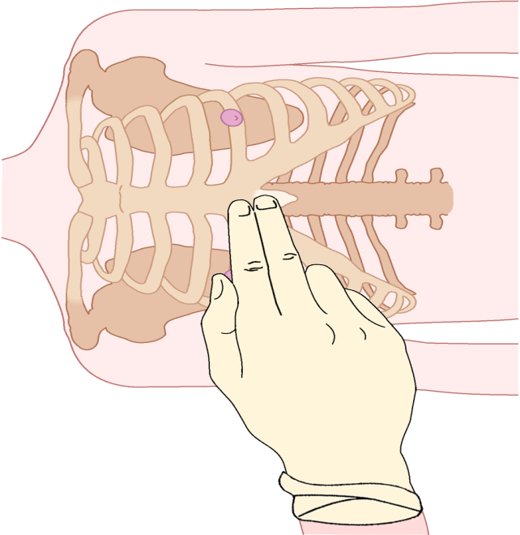
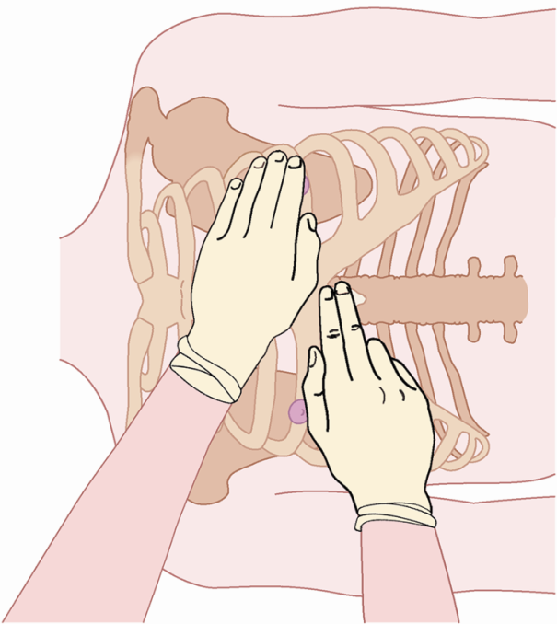
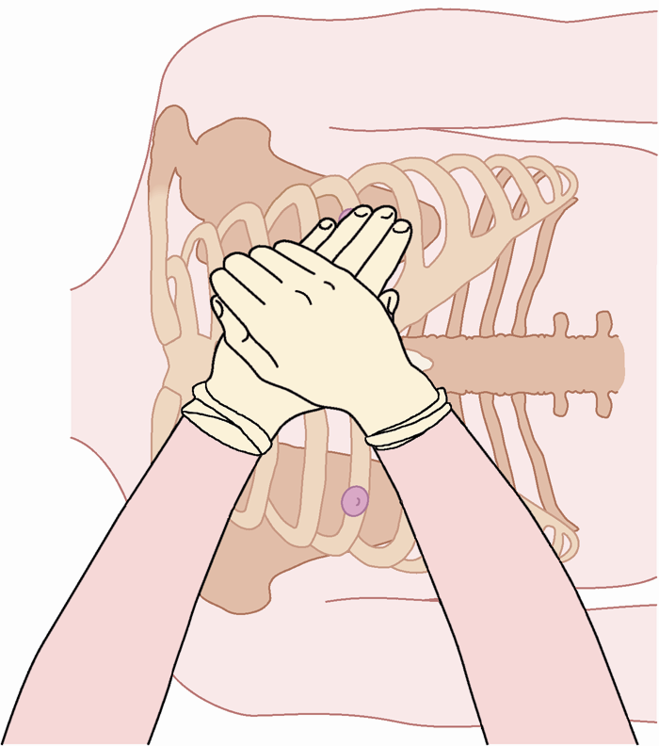
  4 Locate the xiphoid process.
  5 Locate the compression site.
  6 Position yours hands.
P.Page No-
BLS & CPR
TR- 7-1

Slide 85
7 Position your shoulders.
8 Perform Chest compressions.
Keeping your arms straight and your elbows
locked, thrust straight downward from your
shoulders. Release pressure completely
after each compression.
However, do not lift or move your hands,
or you will lose proper position.
c) Count as you perform compressions.
P.Page No-
BLS & CPR
TR- 7-1

Slide 86
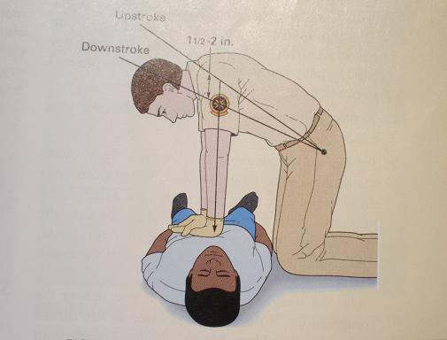
P.Page No-
BLS & CPR
TR- 7-1

Slide 87
Adult CPR Summary – 9 years and older
Compression depth : 5-6 cm.
Compression rate : 80 – 100 per min.
Each ventilation : 1.5 – 2 sec.
Pulse location :carotid artery.
One-rescuer cycle : 30 : 2
Two-rescuer cycle : 30 : 2
P.Page No-
BLS & CPR
TR- 7-1

Slide 88
CPR Chest Compressions for
Infants and Children
Cardiac arrest in infants and children is rarely caused by heart problems.
Usually the cause is too little oxygen (hypoxia) due to injuries, suffocation, smoke inhalation etc.
For this reason, you should resuscitate an infant/child for one minute before activating the EMS system (if you are alone)
P.Page No-
BLS & CPR
TR- 7-1

Slide 89
Steps for Child & infant CPR
Position the patient. Must be supine on firm, flat surface, with arms along sides. If an infant, place him or her on your forearm, using your palm to support the head.
2 Expose the patient’s chest.
3 Locate the compression site.
  a) In a child, use the same location as an adult.
  b) In infants, use one finger width below an
  imaginary line between the nipples.
P.Page No-
BLS & CPR
TR- 7-1

Slide 90

4 Perform chest compressions.
  For an infant, use the flat part of your middle
  and ring fingers to compress the sternum.
P.Page No-
BLS & CPR
TR- 7-1

Slide 91
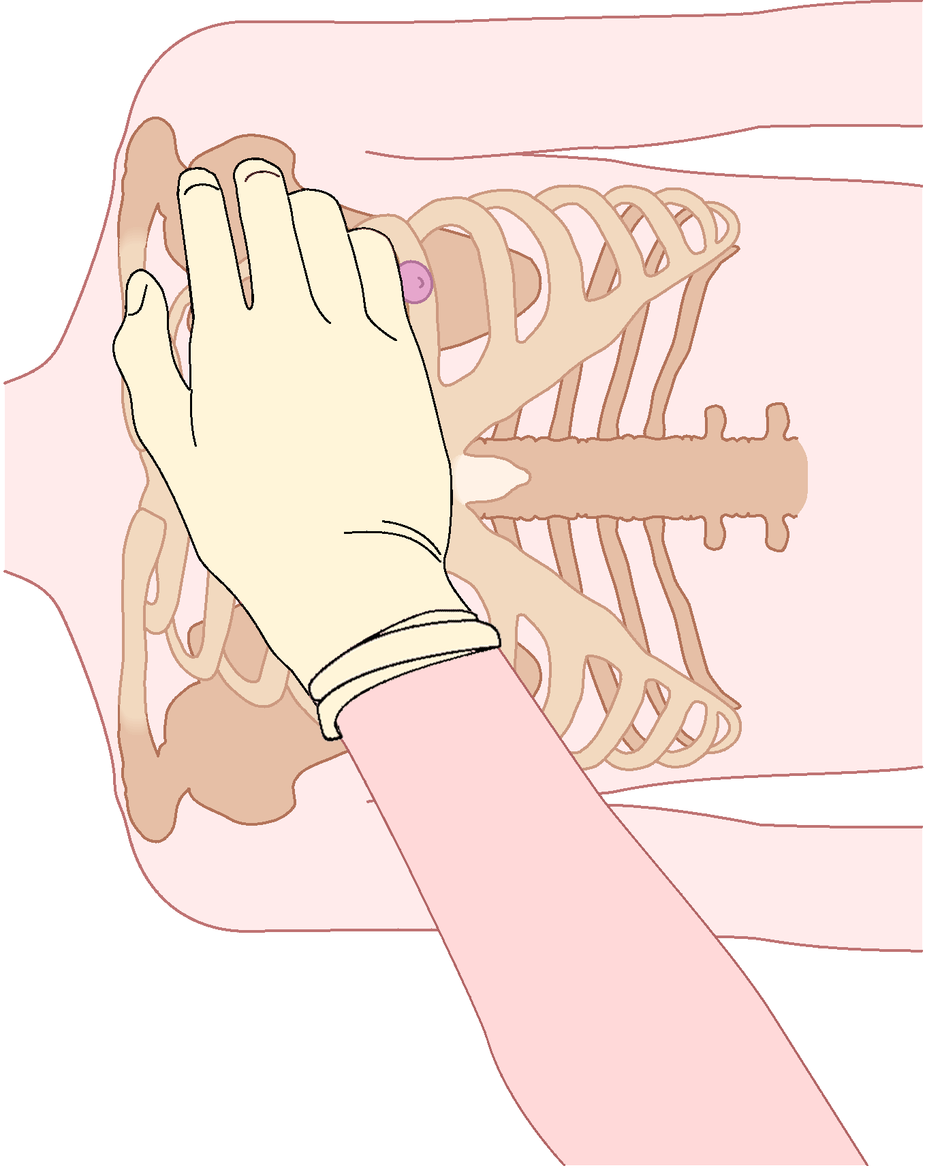
  For a child, use the heel of one hand.
  Release pressure completely after each compression. However, do not lift or move your hands, or you will lose proper position.
  c) Count as you perform compressions.

Slide 92
Child CPR – 1-8 years of age
Compression depth : 3–4 cm
Compression rate : 100 per minute
Each ventilation : 1 to 1.5 second
Pulse location : carotid artery
One-rescuer cycle : 30 compressions, 2 breaths
Two-rescuer cycle : 30 compressions, 2 breaths
P.Page No-
BLS & CPR
TR- 7-1

Slide 93
Infant CPR – 1 year old and under
Compression depth : 1.5 – 2.5 cm
Compression rate : 100 per min or more
Each ventilation : 1 sec
Pulse location : Brachial Artery
Rescuer Cycle : 30 :2 compressions, 2 breaths
New Born : 30 :2 compressions, 2 breaths
P.Page No-
BLS & CPR
TR- 7-1
TR- 7-1

Slide 94
Signs of Successful CPR
1 “Successful” CPR does not mean that the patient survives – it only means that you performed it correctly.
Very few patients will survive if they do not
receive advanced cardiac life support (ACLS).
The goal of CPR is to prevent the death of cells
and organs for a few crucial minutes.
The patient’s condition needs to be monitored
throughout CPR to determine if CPR is effective.
P.Page No-
BLS & CPR
TR- 7-1

Slide 95
Signs of Successful CPR
a) Have someone feel for a pulse during compressions. A pulse should be palpable with every compression.
b) The pupils may begin to react normally.
c) Patient’s skin color may improve.
d) Patient may attempt to move and try to swallow.
e) Heartbeat may return.
P.Page No-
BLS & CPR
TR- 7-1

Slide 96
When not to begin CPR
1 Obvious mortal wounds.
2 Rigor mortis.
3 Decomposition.
4 Lividity.
5 Still birth
6 Other ( check local protocol).
P.Page No-
BLS & CPR
TR- 7-1

Slide 97
Complication caused by CPR
Even properly performed CPR can cause injuries including:
1 Fracture of the sternum and ribs.
2 Pneumothorax.
3 Haemothorax.
4 Cuts and bruises to the lungs.
5 Laceration to the liver.
Most of these complications are rare. Take care to
use proper technique. Remember that even if CPR
results in complications, the alternative is death.
P.Page No-
BLS & CPR
TR- 7-1

Slide 98
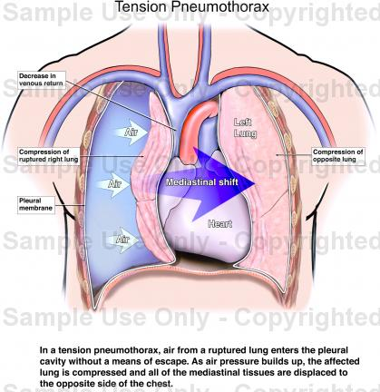
PNEUMOTHORAX

Slide 99
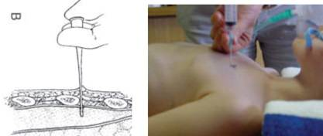
PNEUMOTHORAX

Slide 100
Mistakes in performing CPR
1 Patient is not on hard surface.
A- Compressions are not effective.
2 Patient is not on horizontal position.
A- If patient`s head is higher than the rest of
the body there is insufficient blood to reach
the brain.
Cont…
P.Page No-
BLS & CPR
TR- 7-1

Slide 101
Mistakes in performing CPR
3 Incomplete seal around the patient`s mouth and / nose.
A- Ventilations are not effective.
4 Nostrils are not completely pinched and the
patient`s mouth is not fully open during mouth
to mouth ventilation.
A- Ventilations are not effective.
Cont…
P.Page No-
BLS & CPR
TR- 7-1

Slide 102
5 Hands not in correct position or compressions incorrectly placed.
A- Fractured ribs ; fractured sternum, lacerated
liver, spleen, lungs or heart or injured pleura
as a result of fractured rib.
6 Compression too deep or too frequent.
A- Insufficient amount of blood pumped.
7 Improper compression/ ventilation ratio.
A- Inadequate oxygenation of blood.
P.Page No-
BLS & CPR
TR- 7-1

Slide 103
Interrupting CPR
Once you begin CPR, you should not interrupt for more than a few seconds to check for pulse and breathing, or to reposition yourself or the patient. In addition, you interrupt CPR to:
1 Move the patient onto a stretcher.
Move the patient down a flight of stairs or
through a hallway
P.Page No-
BLS & CPR
TR- 7-1

Slide 104
3 Loading or unloading the patient into the ambulance.
4 To allow for defibrillation or ACLS (Advanced
Cardiac Life Support) measures to be initiated.
5 Recover from physical exhaustion.
P.Page No-
BLS & CPR
TR- 7-1

Slide 105
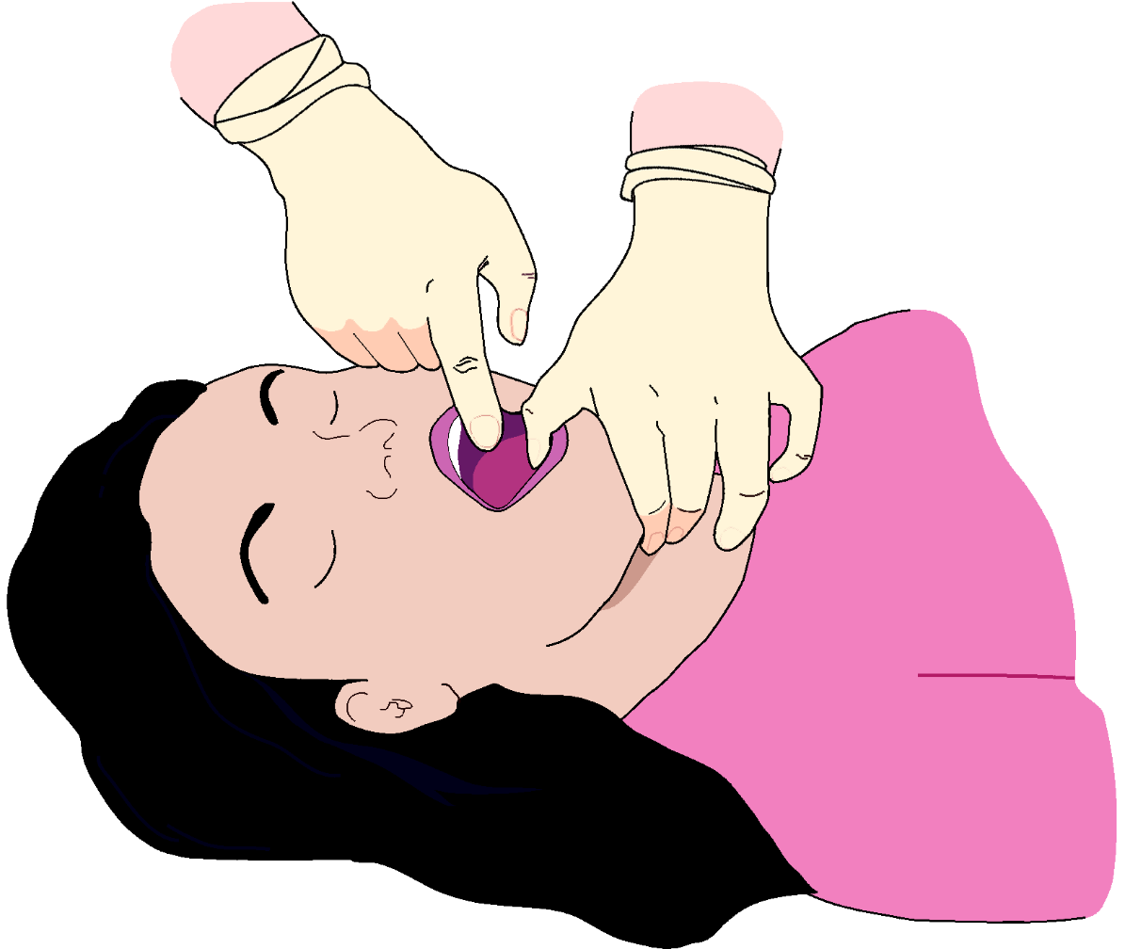
Finger Sweep

Slide 107
ANY QUESTION
BLS & CPR
TR- 7-1

Slide 108
THANKS

