Slide 1
LESSON -2
ANATOMICAL
REFERENCES
BY
JITENDER YADAV
INSP/PH

Slide 2
OBJECTIVES
Upon completion of this lesson, you will be able to:
    1. Define anatomical position.
  2. Identify and describe the three anatomical planes.
3. List five regions of the human body
  4. Enumerate the five body cavities and the
  organs they contain.
  5. List the abdominal quadrants and organs
  they contain.
Cont…

Slide 3
ANATOMICAL POSITION
Definition:
Patient standing erect with arms down at the sides, palms facing forward. “Right” and “left” refers to the patient’s right and left.
RIGHT
LEFT

Slide 4
CONVENTIONAL REFERENCES
Communication among paramedics is easier and more precise when using common terminology.

Slide 5
ANATOMICAL PLANES
The anatomical planes refer to imaginary planes that divide the body in two halves, in different orientations.
Medial plane: Imaginary plane that divides the body in two halves — Left half and right half.

Slide 6
Transverse plane: Imaginary plane that passes through the navel and divides the body in two halves — the superior half and inferior half.
Frontal plane: Imaginary plane that divides the body in two halves — anterior half and posterior half.

Slide 7
RIGHT
LEFT
MEDIAL PLANE

Slide 11
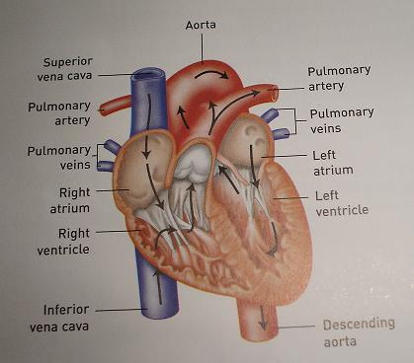
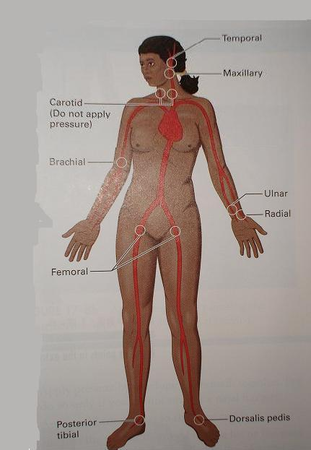
ANATOMICAL POSITIONS
Supine position
Prone position
Rt. lateral recumbent
position
(Recovery position)
Lt. lateral recumbent
position
(Recovery position)

Slide 12
BODY REGIONS
For the purposes of this course we recognize five regions:
Head: Skull, face, jaw (mandible).
Neck.
Trunk: Thorax, abdomen, pelvis.
Upper extremities: Shoulder joint (scapula, clavicle and humorous), arm, elbow, forearm, wrist, hand.
Lower extremities: Hip joint (pelvis and femur), thigh, knee, leg, ankle, foot.

Slide 13
Head
Upper extremities
Neck
Trunk
Lower extremities
BODY REGIONS

Slide 14
BODY CAVITIES
For purposes of this course we recognize five body cavities:
Cranial – houses and protects the brain. Made of immovable joints.
Abdominal – least protected cavity.
Thoracic – contains the heart, lungs and the great vessels. Separated from the abdomen by the diaphragm.

Slide 15
Pelvic – contains the bladder and reproductive organs. Consists of the ilium, pubis and ischium. Iliac crests form the wings of the pelvis.
Spinal – houses and protects the spinal cord.

Slide 16
BODY CAVITIES
Cranial Cavity
Thoracic Cavity
Diaphragm
Spinal cavity
Abdominal
pelvic cavity

Slide 17
Abdominal quadrants & Organs
RT. UPPER QUADRANT
MIDLINE AREA
LT. UPPER QUADRANT
Liver
Colon
Pancreas
Gallbladder
Aorta
Small intestines
Pancreas
bladder
Liver
Spleen
Stomach
Colon
Pancreas
Colon
Small intestines
Major artery and
Veins to the rt.leg
Urethra
appendix
Colon
Small intestines
Major artery and
Veins to the Lt.leg
Urethra
RT. LOWER QUADRANT
LT. LOWER QUADRANT

Slide 18
Hollow abdominal organs: stomach, gallbladder, the large and small intestines, and the urinary bladder and the uterus.
Solid abdominal organs: liver, spleen and pancreas.
It is important to know the anatomy of the abdomen because damaged organs, such as the liver or spleen, can threaten the patient’s life.

Slide 19
Kidneys: These solid organs are located in the retroperitoneal cavity (behind the peritoneum, or abdominal wall). They are not in the abdominal cavity.

Slide 20
ANY QUESTION

Slide 21
THANKS

Slide 22
RESPIRATORY SYSTEM
The function of the respiratory system is to deliver oxygen to the body and to remove carbon dioxide from the body.
Air passing into and out of the lungs is known as respiration.
Breathing in is called inspiration or inhaling and breathing out is called expiration or exhaling.

Slide 23
While breathing or during the process of inspiration, the muscles of the thorax contract, moving the ribs outward and up. The diaphragm contracts and lowers.
This process expands the chest cavity and causes air to flow into the lungs.
During exhalation the opposite occurs. The muscles of the chest relax and cause the ribs to move inward. At this time, the diaphragm relaxes and moves up.

Slide 24
The respiratory system is made up of the organs that allow us to breathe.
Air enters in through the nose and the mouth.
The area behind the mouth and nose is called the pharynx which is divided into the oropharynx and the nasopharynx (windpipe).
The trachea is the air passageway to the lungs.

Slide 25
The epiglottis is a leaf-shaped structure that keeps foreign objects from entering the trachea during the swallowing process.
The trachea splits into two bronchi.
These air passages become smaller and smaller until they reach the alveoli, where carbon dioxide and oxygen are exchanged with blood.

Slide 26
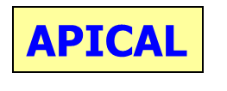
RESPIRATORY SYSTEM

Slide 27
DIGESTIVE SYSTEM
The digestive system consists of the alimentary tract (food passageway) and additional organs.
The main function of the digestive system is to ingest food and get rid of waste.
Digestion consists of two processes:
  Mechanical and chemical.

Slide 28
The mechanical process includes –
  Chewing,
  Swallowing,
  Rhythmic movement of matter through the tract,
  Defecation (the elimination of waste).
The chemical process consists of-
  Breaking down food into simple components .
  Can be absorbed and used by the body.

Slide 29
Excluding the mouth and the esophagus, the organs of the digestive system are in the abdomen.
These organs include the stomach, pancreas, liver, gallbladder, small intestine, and large intestine.

Slide 30
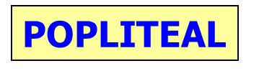
DIGESTIVE SYSTEM

Slide 31
URINARY SYSTEM
The urinary system filters and excretes waste from the body.
It consists of –
Two kidneys.
Two ureters.
One urinary bladder.
One urethra.

Slide 32
The ureters take urine from the kidneys to the next part of the system – the bladder.
The bladder stores urine until it is passed through the urethra and is excreted from the body.

Slide 34
FEMALE REPRODUCTIVE SYSTEM
The reproductive system of the female consists of-
Two ovaries,
Two Fallopian tubes,
The uterus,
The vagina and external genitals.
The female reproductive system provides the egg (ovum) which is fertilized by the male’s sperm.

Slide 35
MALE REPRODUCTIVE SYSTEM
The reproductive system of the male consists of –
Two testes,
A seminal duct,
Accessory glands,
Penis.
The male reproductive system provides the sperm which fertilizes the female’s ovum.

Slide 36
NERVOUS SYSTEM
The nervous system is composed of –
Brain,
Spinal cord
Nerves
The nervous system has two major functions:
Communication and control.

Slide 37
This system lets a person be aware of and react to the environment.
It coordinates the body’s responses to stimuli and keeps body systems working together.

Slide 38
NERVOUS SYSTEM
The nervous system has three main parts:
Central nervous system
Peripheral nervous system
Autonomic nervous system.

Slide 39
The central nervous system consists of the brain and the spinal cord.
The peripheral nervous system consists of the nerves.
The autonomic nervous system regulates functions throughout the body.

Slide 40
ENDOCRINE SYSTEM
The endocrine glands regulate the body by secreting hormones directly into the bloodstream.
These glands affect physical strength, mental ability, stature, reproduction, hair growth, voice pitch, and behavior.

Slide 41
The secretions from these tiny glands can affect how people think, act and feel.
Each gland produces one or more hormones.
Some of the glands in the endocrine system are the thyroid, parathyroid, adrenals, ovaries, testes, and the pituitary.

Slide 42


Slide 43
MUSCULOSKELETAL SYSTEM
The musculoskeletal system is made up of the skeleton and muscles.
This system helps to give the body shape and to protect internal organs.
Muscles also provide for movement.

Slide 44
The skeleton shapes the human body with its bony framework.
The bone consists of living cells and non-living matter.
The non-living matter contains calcium compounds that help make the bone hard and rigid.

Slide 45
Without bones, the body would collapse.
The skeleton is held together mainly by ligaments, tendons and layers of muscle.
The three kinds of joints are immovable like the skull, slightly movable like the spine, and freely movable like the elbow or the knee.

Slide 46
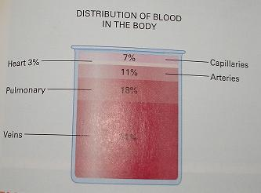
JOINTS
Immovable
Slightly Movable
Freely movable

Slide 47
MAJOR AREAS OF THE SKELETON
The skull has several broad, flat bones that form a hollow shell.
The top, including the forehead, back, and sides of this shell make up the cranium.

Slide 48
The spinal column houses and protects the spinal cord.
The spinal column is the main supportive bony structure of the body.
It consists of 33 bones called vertebrae.

Slide 49
The spine is divided into five major sections:
Cervical spine -7 vertebrae.
Thoracic spine -12 Vertebrae.
Lumbar spine-5 vertebrae.
Sacrum -5 fused vertebrae.
Coccyx-4 fused vertebrae.

Slide 50
The thorax, or rib cage, protects the heart and lungs .
They are enclosed by 12 pairs of ribs and are attached at the back to the spine.
The top 10 pairs attached in the front to the sternum, or breastbone.
The lowest portion of the sternum is called the xiphoid process.

Slide 51
The pelvis, or hip bones, consists of the ilium, pubis, and ischium.
Iliac crests from the “wings” of the pelvis.
The pubis is the anterior portion of the pelvis.
The ischium is the posterior portion.

Slide 52
The shoulder girdle consists of the clavicle (collar bone) and the scapulae (shoulder blades).

Slide 53
The upper extremities extend from the shoulders to the fingertips.
The arm (shoulder to elbow) has one bone known as the humorous.
The bones in the forearm (elbow to wrist) are the radius and the ulna.

Slide 54
The lower extremities extend from the hips to the toes.
The bone in the thigh, or upper leg, is known as the femur.
The bones in the lower leg (knee to ankle) are the tibia and fibula.
The kneecap is called the patella.

Slide 55
MAJOR TYPES OF MUSCLES
Skeletal muscle, or voluntary muscle, makes possible all deliberate acts like walking and chewing.
Smooth muscle, or involuntary muscle, is made of longer fibers and is located in the walls of tube-like organs, ducts and blood vessels and forms much of the intestinal wall.
A person has little or no control over this type of muscle.

Slide 56
Cardiac muscle makes up the walls of the heart.
This muscle can stimulate itself into contraction, even when disconnected from the brain

Slide 57
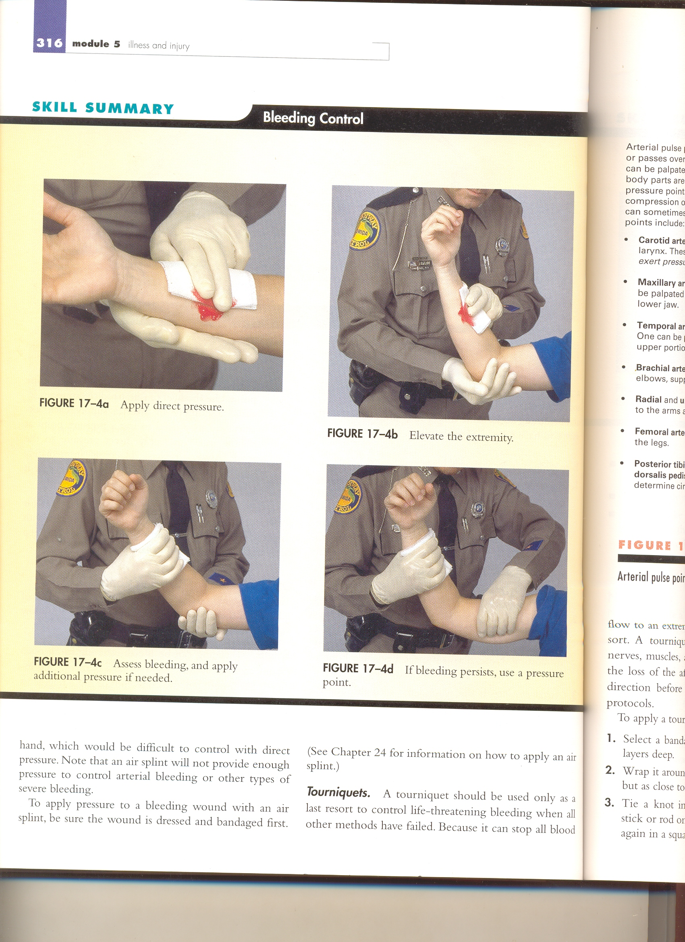
TYPES OF MUSCLES

Slide 58
THE SKIN
The skin protects the body from the outside world.
It also protects the deep tissues from injury, drying out, and invasion by bacteria and other foreign bodies.

Slide 59
The skin helps to regulate the body temperature, aids in getting rid of water and various salts, and helps to prevent dehydration.
The skin also acts as the receptor organ for touch, pain, heat, and cold.
The epidermis is the outermost layer of the skin and contains cells that give it color.

Slide 60
The dermis, or second layer, contains a vast network of blood vessels.
The deepest layers of the skin contain hair follicles, sweat and oil glands, and sensory nerves.
Just under the skin is a layer of subcutaneous fatty tissue.

Slide 61
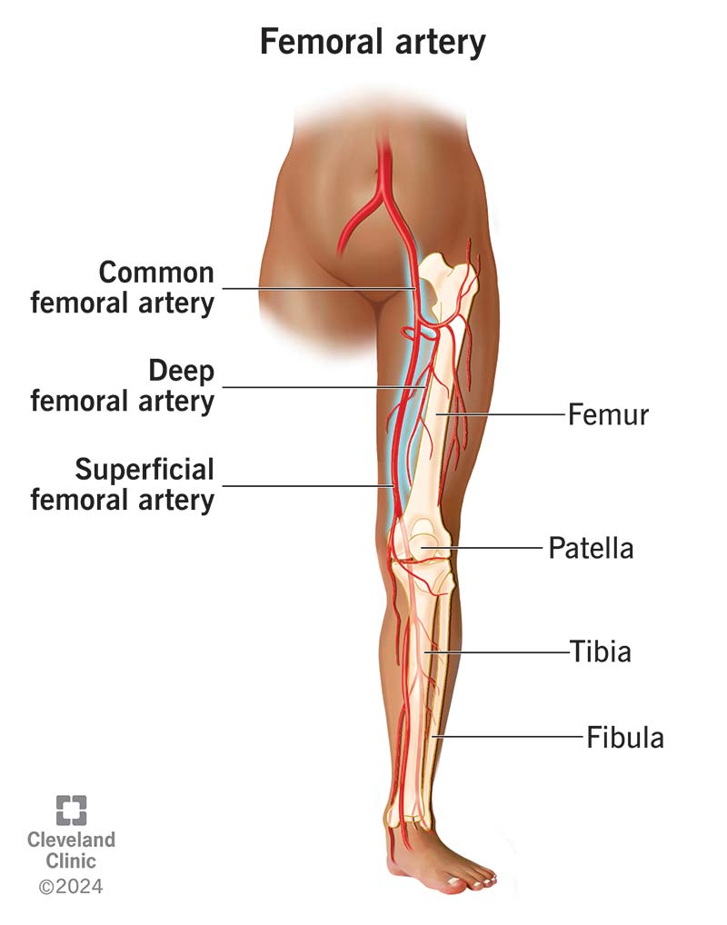
SKIN

Slide 62
ANY QUESTION
?

Slide 63
THANKS

Slide 66
Superior
TRANSVERSE PLANE
Inferior
TRANSVERSE PLANE

Slide 68
BODY CAVITIES
Cranial Cavity

Slide 69
BODY CAVITIES
Diaphragm
Abdominal

Slide 70
BODY CAVITIES
Thoracic Cavity
Diaphragm

Slide 71
BODY CAVITIES
pelvic cavity

Slide 72
BODY CAVITIES
Spinal cavity

Slide 73
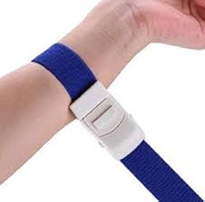
FEMALE REPRODUCTIVE SYSTEM

Slide 74
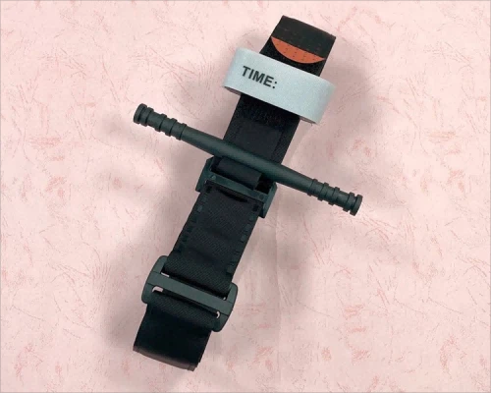
MALE REPRODUCTIVE SYSTEM

