Slide 1
Lead Placement, Finding Heartbeat & Performing ECG
LESSON -7
By
AMANDEEP KAUR
ASI/ANM

Slide 2
Learning Objectives
By the end of this module, you will be able to:
• Identify correct electrode and lead placement
• Locate landmarks for chest leads
• Understand how to obtain a clear ECG recording
• Recognize basic troubleshooting during ECG performance
Notes:
Introduce key objectives for practical ECG performance.

Slide 3
Introduction
Correct lead placement and technique are essential for accurate ECG recording and interpretation.
Notes:
Explain the importance of precision in lead placement.

Slide 4
Types of Leads
• Limb leads: I, II, III
• Augmented leads: aVR, aVL, aVF
• Chest (precordial) leads: V1–V6
Notes:
Overview of 12-lead ECG system.

Slide 5
Limb Lead Placement
• RA – Right Arm: anywhere between shoulder and wrist
• LA – Left Arm: same on left side
• RL – Right Leg: grounding electrode
• LL – Left Leg: reference electrode
Notes:
Describe proper limb electrode placement.

Slide 6
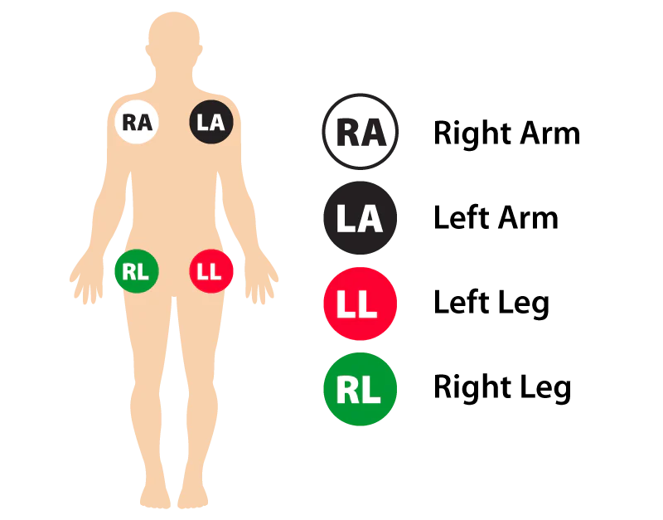

Slide 7
Precordial Lead Placement
• V1 – 4th intercostal space, right sternal border
• V2 – 4th intercostal space, left sternal border
• V3 – between V2 and V4
• V4 – 5th intercostal space, midclavicular line
• V5 – level with V4, anterior axillary line
• V6 – level with V4, midaxillary line
Notes:
Demonstrate correct precordial lead placement.

Slide 8
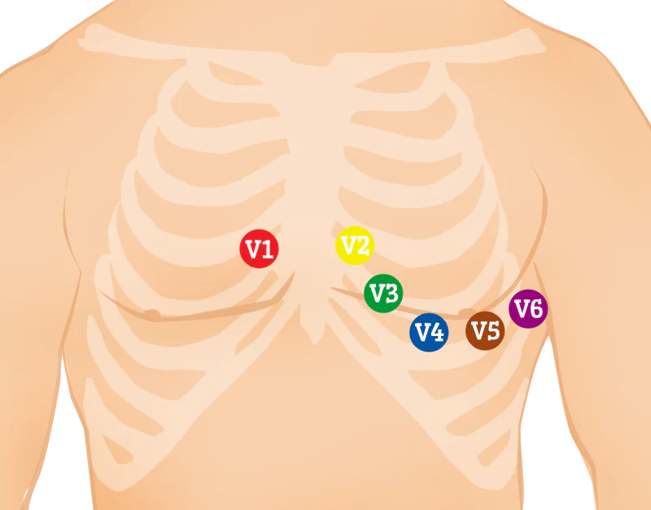
Precordial Lead Placement
Notes:
Clarify lead arrangement.

Slide 9
Landmark Identification
• Use sternum, clavicle, and ribs to find intercostal spaces
• Palpate landmarks gently for accuracy
Notes:
Emphasize anatomical accuracy.

Slide 10
Common Placement Errors
• Leads reversed (e.g., RA/LA swapped)
• Incorrect chest lead spacing
• Loose electrodes causing artifacts
Notes:
Discuss troubleshooting techniques.

Slide 11
Checking Lead Connection
• Verify all leads securely attached
• Confirm cables not twisted or stretched
Notes:
Ensure signal stability.

Slide 12
Preparing to Record
• Confirm calibration and paper speed
• Ensure patient relaxed and breathing normally
• Minimize movement
Notes:
Stress preparation before recording.

Slide 13
Finding the Heartbeat
• Observe lead II for clear rhythm
• Confirm QRS complex visibility
• Adjust gain or filter if needed
Notes:
Describe practical steps to visualize heartbeat.

Slide 14
Recording ECG
1. Press start or record button
2. Ensure 10-second tracing for all 12 leads
3. Observe real-time waveform for artifacts
4. Stop and print or save recording
Notes:
Outline the ECG recording process.

Slide 15
Verifying ECG Quality
• Baseline stable
• No muscle or electrical interference
• Consistent waveform across leads
Notes:
Teach quality assurance steps.

Slide 16
Labeling and Documentation
• Include patient name, date, time, and technician initials
• Record any observations during test
Notes:
Ensure accurate recordkeeping.

Slide 17
Troubleshooting
• Poor contact – clean skin, reapply gel
• Electrical noise – check grounding
• Motion artifact – remind patient to stay still
Notes:
Offer quick problem-solving guide.

Slide 18
Post-Procedure
• Remove electrodes gently
• Clean skin and equipment
• Thank patient and explain next steps
Notes:
Conclude ECG process professionally.

Slide 19
Summary
• Correct lead placement and patient cooperation are vital
• Systematic procedure ensures reliable ECG tracing
• Understanding practical technique improves interpretation accuracy
Notes:
Wrap up and prepare for ECG analysis modules.

Slide 20
ANY QUESTION
?

Slide 21
THANKS

