Slide 1
LESSON- 7
HEMORRHAGE
&
SHOCK
BY
PRAVIN DUDHE
INSP/PH

Slide 2
OBJECTIVES
Upon completion of this lesson, you will be able to:
  1. List four methods of controlling external
  hemorrhage.
  List the three steps for pre-hospital
  treatment for internal hemorrhage.
  3. List ten signs and symptoms of shock.
  4. List the five steps for pre-hospital treatment of shock.

Slide 3
THE HEART
  The heart is a hollow muscular organ.
The right side of the heart receives the
deoxygenated blood coming from the body
and pumps it to the lungs for oxygenation.
The left side of the heart receives the
oxygenated blood coming from the lungs
and from there is pumped through the
whole body.

Slide 4
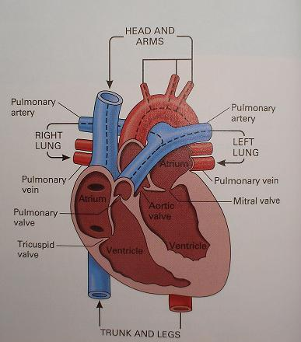
HEART CIRCULATION

Slide 5
ARTERIES
  The arteries are the blood vessels that
  transport the blood to the body.
They are of different diameters, ranging
from very thick (aorta, femoral), to medium
(radial) and small (arterioles). .
Arterial bleeding is characterized by a
bright red color.

Slide 6
CAPILLARIES
1. Each artery is divided into smaller
transport vessels until they narrow
down into capillaries, the tiny vessels
closest to the skin.
2. Through their thin walls, the exchange of
oxygen and carbon dioxide takes place.
3. Other substances are also exchanged
between the body’s cells and the blood.

Slide 7
VEINS
1. Veins are blood vessels that carry blood
back to the heart.
Veins do not have as much pressure as the
arteries.
3. Venous bleeding is characterized by a dark
red color.

Slide 8
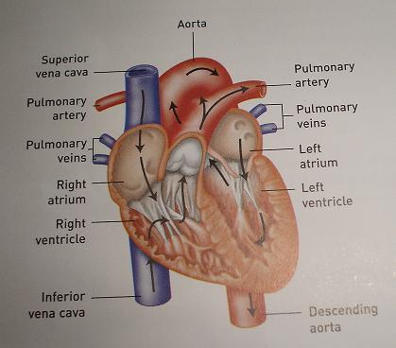
HUMAN HEART

Slide 9
COMPOSITION OF BLOOD
1. The solid portion of the blood consists of
white blood cells, red blood cells and
platelets.
The liquid portion of blood is called plasma.
3. The normal adult has approximately five
to six liters of blood.

Slide 10
FUNCTIONS OF BLOOD
Blood transports oxygen and nutrients to
tissues.
It also transports cells that combat infection
and eliminate waste products.
3. Blood also has the capacity to clot
(solidify); this process usually takes 6 to 7
minutes.

Slide 11
PULSE
The pulse can be felt more easily in areas
of the body where arteries are closer to the
skin and near a solid structure (bone).
The most accessible pulse locations:
- Radial
- Femoral
- Carotid
- Brachial
Every time the heart pumps, you can feel the
pulse of the arterial system.

Slide 12
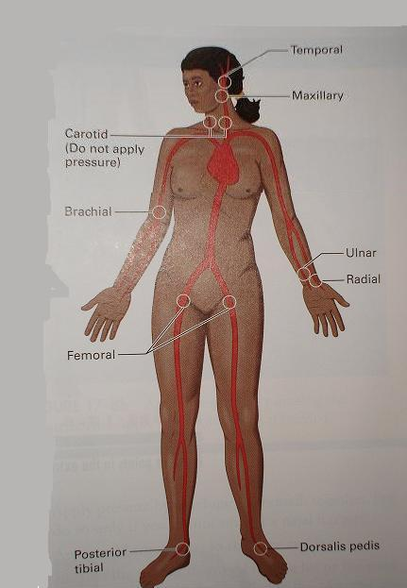
PULSE OCATION
TEMPORAL
MAXILIARY
CAROTID
BRACHIAL
ULNAR
RADIAL
FEMORAL
POSTERIOR TIBIAL
DORSALIS PEDIS

Slide 13
HEMORRHAGE
The loss of blood from the body. It can be external and or internal.

Slide 14
EXTERNAL HEMORRHAGE TYPES
With external hemorrhage, the wound and
loss of blood are visible.
Arterial: Arterial hemorrhage is bright red and
characterized by blood spurts coinciding with
the pulse.
Venous: Venous bleeding is steady and dark red.
Capillary: Blood flows smoothly out of the capillaries and is similar in appearance to venous bleeding.

Slide 15
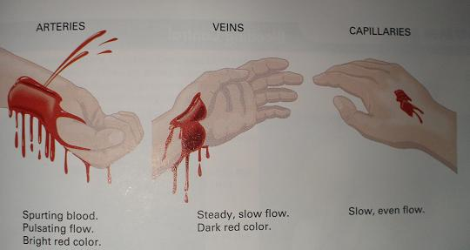
ARTERIES
VEINS
CAPILLARIES
SLOW, EVEN FLOW
SPURTING BLOOD
PULSATING FLOW
BRIGHT RED COLOUR
STEADY, SLOW FLOW
DARK RED

Slide 17
PRE-HOSPITAL TREATMENT FOR
EXTERNAL HEMORRHAGE
Apply direct pressure. With a hand on the wound using a bandage or gauze dressing, apply pressure to control bleeding. A compressive bandage should follow the dressing.
Elevate extremity. If the forearm is bleeding,
it is not necessary to elevate the whole
extremity, only the forearm. Apply direct
pressure to the bleeding are as explained before.

Slide 18
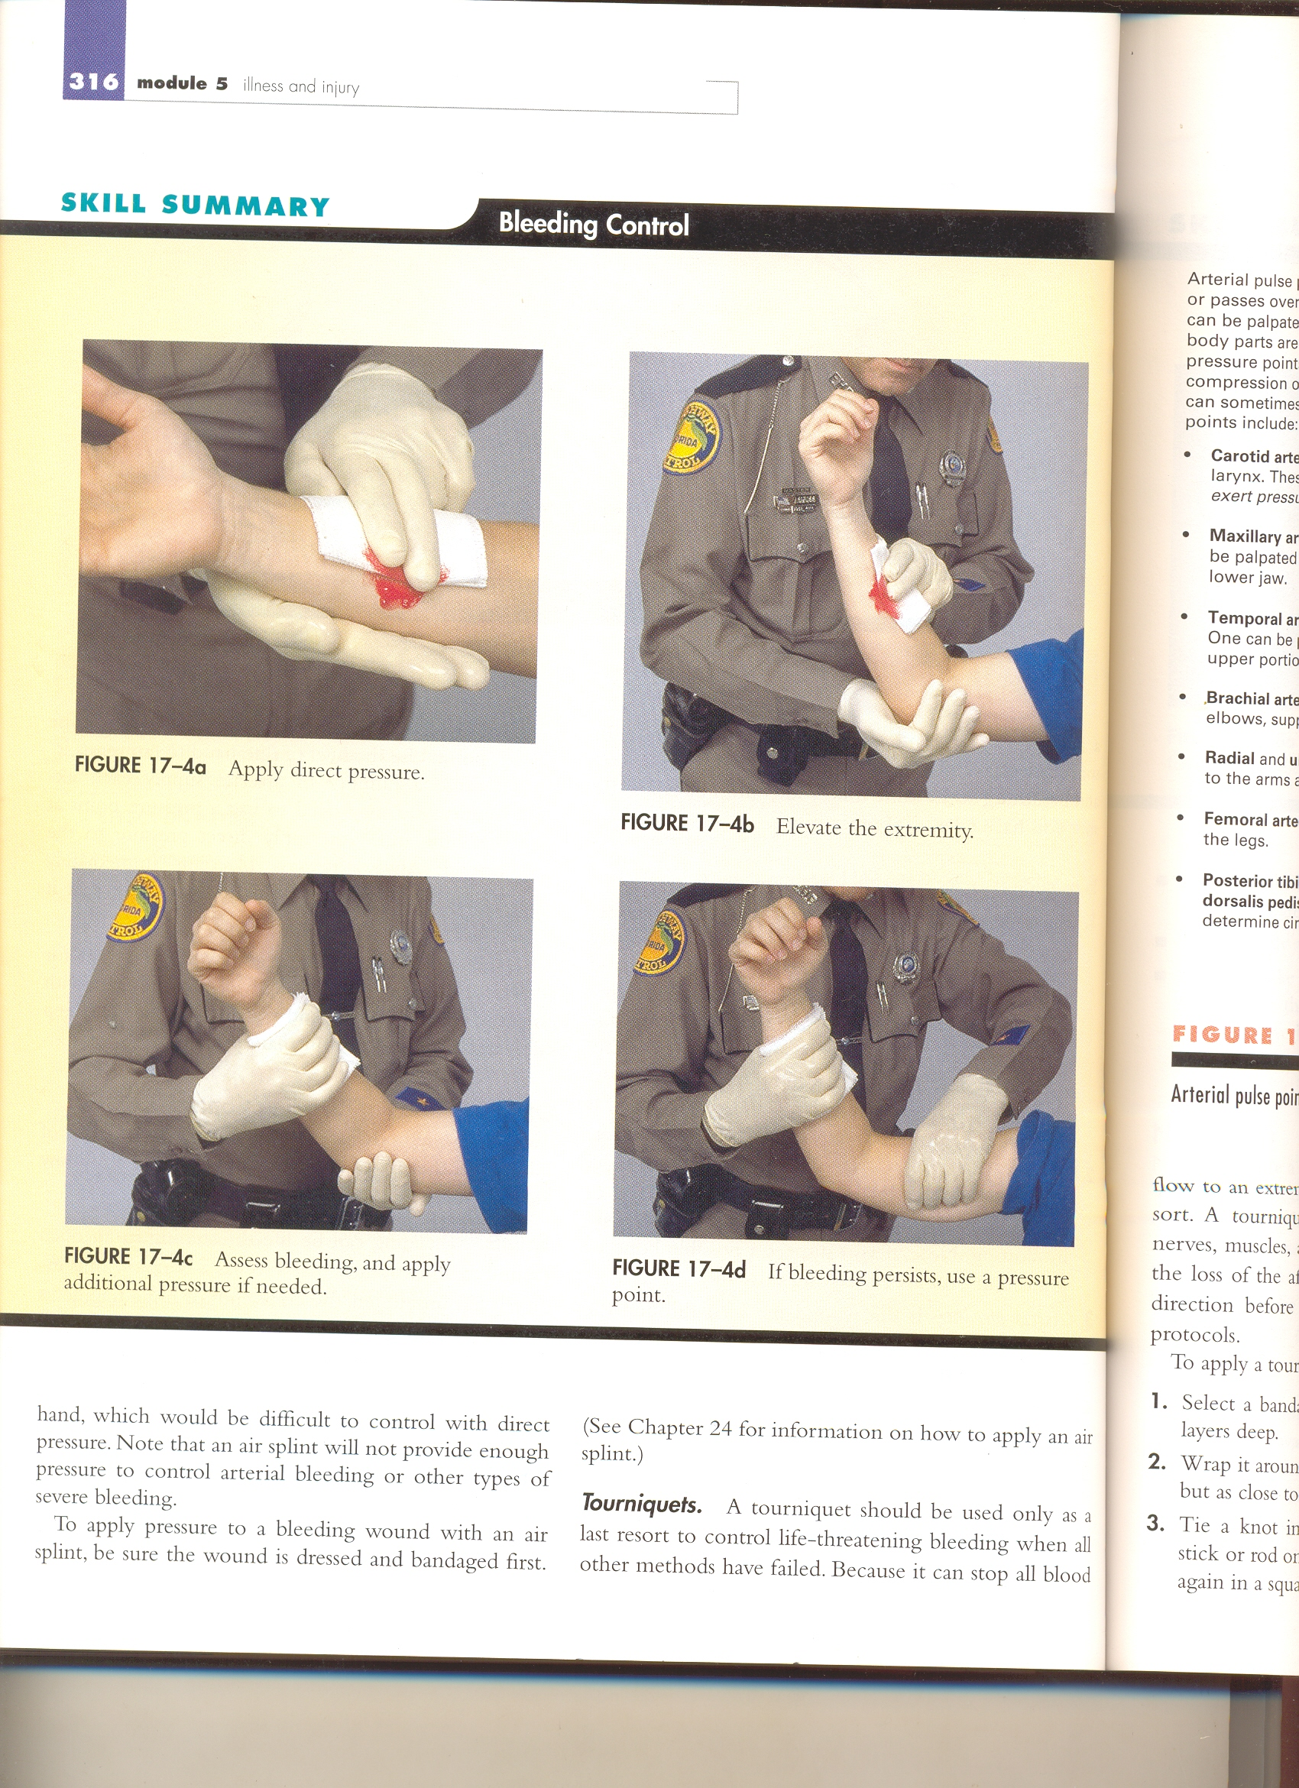
Apply direct pressure

Slide 19
Elevate extremity

Slide 20
Use pressure points. Use pressure points only when direct pressure fails.
Example: If it is not possible to make a
compression bandage, a pressure point
could be used to control severe hemorrhage
of an arm or a leg.
– Arm: Press on the brachial artery to
control the bleeding.
– Thigh: Press on the femoral artery to
control the bleeding from the leg

Slide 21
Use pressure points

Slide 22
Use a tourniquet. A tourniquet is only used in
a severe emergency when other means cannot
stop the bleeding of an extremity. The tourniquet
should be applied as distal as possible.
DANGER
Using a tourniquet can cause damage to the nerves and blood vessels. It can result in the loss of an extremity.

Slide 23
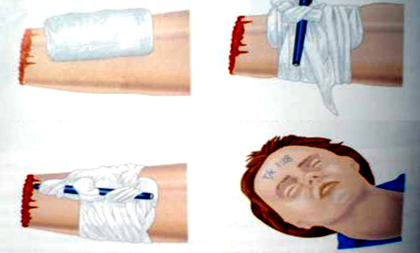
2. Tighten Tourniquet
1. Apply Pad
3. Fix in Place
4.Record Time
Apply Tourniquet as an last Resort

Slide 24
INTERNAL HEMORRHAGE
Internal hemorrhaging can range from minor to a life -threatening problem. The loss of blood cannot be seen in internal bleeding. Examples:
A closed fracture of the femur can cause a loss of 1 liter of blood.
A laceration to the liver or spleen can cause a severe loss of blood, potentially fatal.

Slide 25
SIGNS AND SYMPTOMS
Coughing up bright red blood.
Vomiting dark-colored blood (the color of coffee grounds).
Small or large areas of bruising.
Rigid abdomen.

Slide 26
Pre-hospital Treatment for Internal
Hemorrhage
Maintain an open airway and provide high-flow oxygen per local protocol.
Keep the patient warm, but be careful not to overheat him/her.
Treat for shock.
Transport the patient as soon as possible.
Report the possibility of internal bleeding as soon as more highly trained EMS personnel arrive at the scene.

Slide 27
PERFUSION
The circulation of blood throughout an organ.
An organ is perfusing when oxygenated blood is entering through the arteries and is exiting through the veins.
Perfusion maintains the cells in the organ by giving them oxygen and other nutrients and by removing waste products.
If perfusion fails, it will result in the death of an organ.

Slide 28
SHOCK
Failure of the circulatory system to provide adequate oxygenated blood supply throughout the body.
(Inadequate tissue perfusion)

Slide 29
TYPES OF SHOCK
1. Cardiogenic Shock (due to heart problems)
2. Hypovolemic Shock (caused by too little blood
volume)
Anaphylactic Shock (caused by damage to the nervous system)
4. Septic Shock (due to infection)
5. Neurogenic Shock (caused by damage to the
nervous system)

Slide 30
CAUSES OF SHOCK
Shock is caused by:
Inability of the heart to pump enough blood through the organs.
Severe loss of blood; insufficient blood in the system.
Excessive dilation of blood vessels. Blood volume will be insufficient to fill them and shock will develop.
Any of the above can cause oxygen insufficiencies in the body’s organs

Slide 31
There are different types of shock but the end result is the same – inadequate perfusion to the organs.

Slide 32
SIGNS OF SHOCK
Breathing: Shallow and rapid.
Pulse: Rapid and weak.
Skin: Pale, cool and clammy.
Face: Pale, often with blue color (cyanosis) in
the lips, tongue and ear lobes.
Eyes: Lackluster, pupils dilated.

Slide 33
SYMPTOMS OF SHOCK
Nausea and possible vomiting.
Thirst
Weakness.
Vertigo.
Uneasiness and fear – in some patients these
symptoms can be the first sign of shock.

Slide 34
There is nothing the first responder can
do to reverse the late stages of shock,
but it is possible to keep the patient from
deteriorating until a higher level of help
arrives.
It is of importance that the patient be evaluated and treated to prevent the onset of shock.

Slide 35
PRE-HOSPITAL TREATMENT FOR SHOCK
Maintain open airway. If breathing is inadequate, administer oxygen.
Prevent further blood loss.
Elevate the lower extremities 20-30 cm, only
if there are no suspected spinal, neck, chest
or abdominal injuries. If these injuries is
suspected, keep the patient supine (face up).

Slide 36
Keep the patient warm, but do not overheat.
Provide care for specific injuries.
Transport the patient immediately.

Slide 37
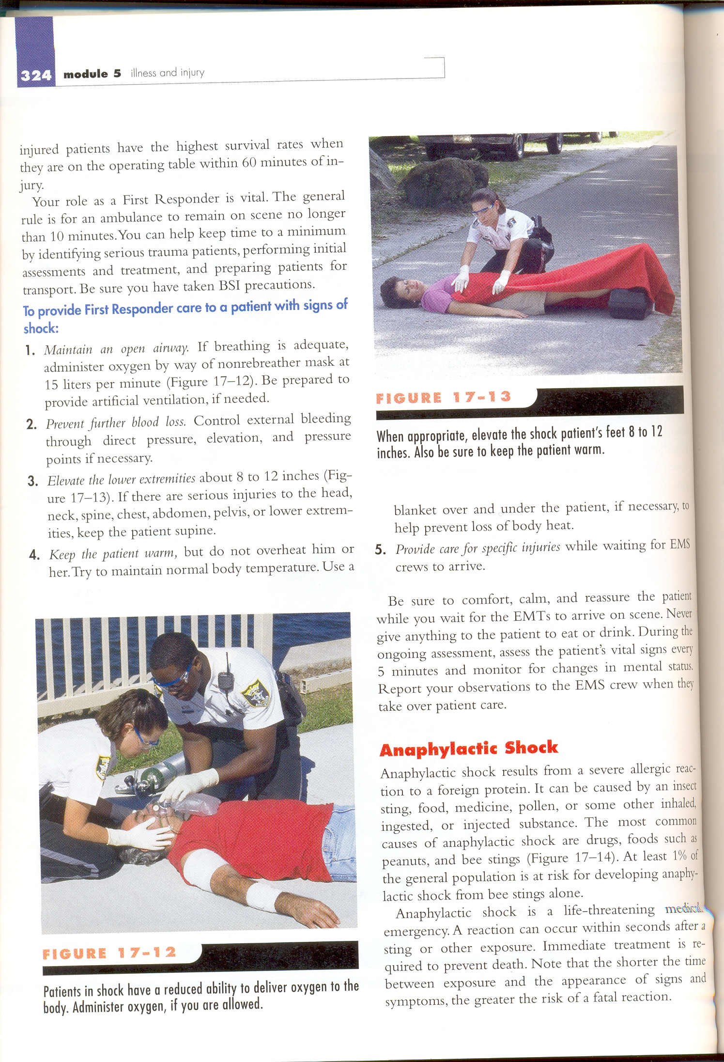

Slide 38
Apply direct pressure

Slide 39
Elevate extremity

Slide 40
Use pressure points

Slide 41
2. Tighten Tourniquet
1. Apply Pad
3. Fix in Place
4.Record Time
Apply Tourniquet as an last Resort

Slide 42
THANKS

Slide 43
ANY QUESTION
?

