Slide 1
HEMATOLOGY
LESSON -6
By
JITENDER YADAV
INSP/PH

Slide 2
Upon completion of this lesson, you will be able to:
List of HEMATOLOGY TEST:
HAEMOGLOBIN
RED CELL COUNT
PACKED CELL VOLUME
MCV, MCH & MCHC
5. ERYTHROCYTE SEDIMENTATION RATE
6. TOTAL LEUCOCYTE COUNT (TLC)
.

Slide 3
7. DIFFERENTIAL LEUCOCYTE COUNT
8. MALARIA PARASITE: (PLASMODIUM FALCIPARUM, PLASMODIUM VIVAX, PLASMODIUM MALARIAE, PLASMODIUM OVAL, PLASMODIUM KNOWLES).
9. PLATELET:
10. PROTHROMBIN TIME (PT)
11 .PARTIAL THROMBOPLASTIN TIME (APTT)
12. BLOOD GROUP

Slide 4
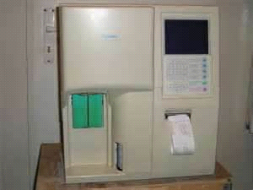
Haemoglobin:-
Haemoglobin is a chromo protein consisting of the colorless globin molecule. The globin molecule consists of two alpha polypeptide chain and two beta polypeptide chain. Hemoglobin is a metal complex containing an iron atom in the Centre of a porphyrin structure.
1) Cyanmethaemoglobin Method:-
Requirements:-
1) Photoelectric colorimeter with filter 540 nm.
2) Test tubes.
3) 5ml and 20ul micropipettes.
4) Drabkin's Solution

Slide 5
Calibration curve:-
Hb standard for the cyanmeth Hb method is used for calibrating.
Into three clean and dry test tubes add solution as described below:-
1) Pipette 5ml of Hb standard in the first tube (60mg/ml).
2) Add 2.5ml of Hb standard and add in the same tube exactly 2.5ml of Hb diluting reagent. Stopper the tube and mix well, this is 1:1 dilution of standard.
3) In third test tube add 5ml of Hb diluting reagent which serve as a blank.
Procedure:- 1) Take a test tube and add 5ml Drabkin's solution.
2) Add 20ul whole blood and mix well.
3) Incubate 5 minute at room temperature.
4) Take absorbance against 540nm filter.

Slide 6
Calculation:-
O.D. of unknown cons. of std. in mg/dl X dilution factor
Hb = -------------------- X --------------------------------------- g/dl
O.D. of Standard 1000
0.385 X60 X251
Example -------------------------- = 13.8 g/dl
0.418 X 1000

Slide 7
Normal range of Hb
Men 13 - 17 g/dl
Women 11 - 15 g/dl
Infants (full term cord blood) 14 - 19 g/dl
Children 3 months 10 - 13 g/dl
Children 3 - 6 yrs. 11 - 14 g/dl
Children 6 - 12 yrs. 12 - 15 g/dl

Slide 8
Red Cell Count: -
RBC can be done on oxalate mixed blood or on capillary blood directly collected into the pipette. In the former case the sample unless refrigerated must not be more than 6 hrs.
Requirements:- 1) Red cell pipette
2) RBC Diluting fluid
3) Neubauer's chamber with cover slip

Slide 9
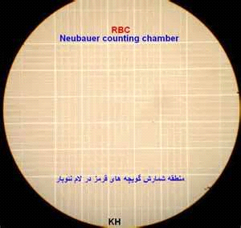

Slide 10
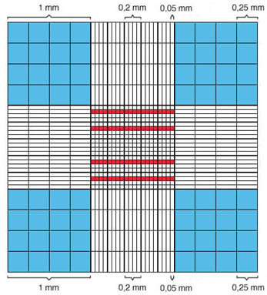
Neubauer's chamber
(Red colored squares for RBC count and Blue colored for total leucocytes count)

Slide 11
Procedure:-
If oxalate mixed blood is to be used first mix it thoroughly by gentle shaking.
Fill the red cell pipette exactly upto 0.5 mark by holding the pipette almost horizontally. The pipette must be clean and dry.
Now draw in the diluting fluid upto the mark 101(dilution 1 in 200). While filling the bulb the pipette should be gently rotated to obtain good mixing.
4) The cover slips is placed over the Neubauer's chamber so as to cover both the ruled platforms evenly.
5) Now load the chamber. This is done in three steps.

Slide 12
a) Mix the contents of pipette for 3 minutes.
b) Expel 6 drops from the pipette to remove the fluid in the stem which has not been mixed with blood.
c) By holding the pipette at an angle of 450 and touching the space between the cover slip and the chamber by the point of the pipette, an appropriate drop of the mixture is allowed to run under the cover glass by capillary action.
6) Allow two minute for setting of the cells and then count.
7) In the erythrocyte count, the central double ruled square is used. Red cells lying in 80 very small squares comprise 5 medium sized squares, each of which is bound by a triple line. It is recommended that the five medium squares chosen for counting cells should consist of four corners and one central.

Slide 13
Calculation:-
Dilution is 1:200
RBC Count = Dilution X 1/Volume X Number of cells counted(N)
= 200 X 50 X N
=10,000 X N cells/cumm.
Normal Values:-
Men 4.5 - 6.5 X 10¹²/l
Women 3.8 - 5.8 X 10¹²/l
Infants (full term cord blood) 4.0 - 6.0 X 10¹²/l
Children 3 months 3.0 - 5.0 X 10¹²/l
Children 1 - 12 yrs. 3.5 - 5.5 X 10¹²/l

Slide 14
DETERMINATION OF PACKED CELL VOLUME:-
Specimen:- The packed cell volume or haematocrit done on Oxalate mixed blood collected from the vein The blood must be oxalate mixed with the special mixture of potassium and ammonium oxalate. The sample must be processed within two hours of collection.
Requirments:- 1) The Wintrobe haematocrit tubes.
2) Pasture pipettes.
3) Centrifuse with a speed of 3000 r.p.m.

Slide 15
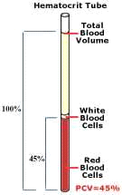

Slide 16
Procedure:- 1) The hematocrit tube must be clean and dry.
2) Mix the oxalate mixed sample of blood thoroughly by gently shaking with 3 minutes.
3) With the Pasteur pipette fill the haematocrit tube to the '10' mark and there must be no air bubbles.
4) Centrifuge the tube with proper balance at 3000 r.p.m. for 30 minutes.
Take the reading of packed red cell. Recentrifuged for 5 minutes more at the same reading and take the reading again. There should be no difference between the two readings if the packing has been complete. If there is a difference, further centrifugation indicated. Normal Values:-
Males 43 - 54 per 100ml
Female 37 - 47 per 100ml

Slide 17
MCV, MCH and MCHC:-
PCV
MCV = -------------------------- X 10
(in cubic microns) RBCs in mill/cu mm
Normal value-: 82-92/cu.mm
Clinical significance-: M.C.V increased Macrocytic anaemia.
M.C.V decreased Microcytic anaemia.
Hb in gm%
MCHC = ------------------- X 100
(in per cent) PCV

Slide 18
Hb in gm %
MCH = ------------------------- X10
(in picogms) RBCs in mill/cu mm

Slide 19
Erythrocyte Sedimentation Rate:-
There are two methods for estimation of Erythrocyte sedimentation rate.
1) Wintrobe Method:-
Requirments:- a) Wintrobe Tube with 0-100 graduation in mm
b) Wintrobe tube stand
c) Pasture Pipette
d) Double oxalate whole blood

Slide 20
Procedure:-
The tube is filled upto the 100mm mark, allowed to stand in a vertical position at room temperature, read the fall of red cell at the end of one hour.
Normal Values:-
Males 0 - 5 mm/hr
Female 0 - 10 mm/hr

Slide 21
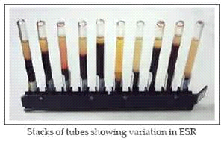

Slide 22
2) Westergren Method:-
Requirments:- a) Westergren tube with 0-200 graduation in mm
b) Westergren tube stand
c) Citrated whole blood with 1:4 ratio.
Procedure:- The mixture is drawn into a Westergren tube up to the '0' mark and tube set upright in a stand at room temperature. The level of the top of the red cell column is read at the end of 1 hour. Normal Values:-
Males 0 - 10 mm/hr
Female 0 - 20 mm/hr

Slide 23
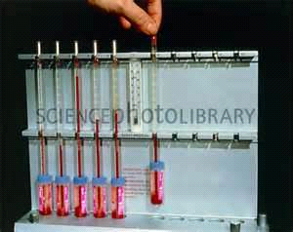

Slide 24
Total Leucocyte Count (TLC):-
The leucocytes count may be done on oxalate mixed blood or capillary blood. EDTA whole blood is also prefer for TLC.

Slide 25
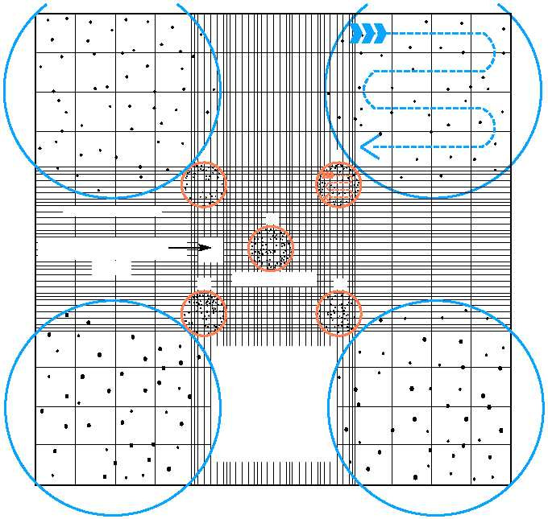

Slide 26
Requirments:-
While cell pipette
Diluting fluid (Turke's fluid)
c) Neubauer's chamber with cover slips
d) Microscope
Procedure:-
1. Draw blood in a clean dry pipette upto the mark 0.5 with all possible accuracy. The oxalate mixed sample must be thoroughly mixed before use.
2. Wipe off the outside of the pipette with gauge.
3. Now draw the diluting fluid upto mark 11(dilution 1 in 20). While drawing the fluid rotate the pipette.
4. Mix the contents of the pipette for 3 minutes.

Slide 27
5. Dispel the first 4 drops of the contents.
6. Adjust the Neubauer's chamber. It must be clean and dry. Load it with the mixture, by holding the pipette at the 45 degree and toupace between the cover glass and the chamber by the point of the pipette, an appropriate drop of the mixture is allowed to run under the cover glass by capillary action.
7. Allow 2 minutes for setting of cells, then count.
8. The improved Neubauer chamber has two central platforms each of which is ruled. When the cover glass is in place there is a space of 0.1mm depth over the ruled area.
Calculation:-
TLC = N X50 per cu mm
N = No. of cells in four corner squares

Slide 28
DIFFERENTIAL LEUCOCYTE COUNT:-
1) NEUTROPHILIA-: Increased in the percentage of neutrophils is called neutrophilia. All the physiological causes that produce leucocytosis give rise of neutrophilia
2) LYMPHOCYTOSIS-: It may be relative or absolute
LYMPHOPAENIA-: It is observed in acute stages of infections and in excess irradiation.
EOSINOPHILIA-: It is observed in asthma, hypersensitivity reactions, parasitic infestations and in chronic inflammatory diseases.
MONOCYTOSIS-: It is observed in tuberculosis, malaria, subacute bacterial endocarditis, typhoid and in kala azar.
BASOPHILIA-: It is usually observed in chronic myeloid Luekaemia.

Slide 29
Requirements:- a) Clean glass Slide
b) Spreader
c) Whole Blood with anticoagulant or capillary blood
d) Leishman Stain
e) Buffer or Distilled water
Procedure:-
1) A small drop of blood is placed in the central line of a slide about 1-2 cm from one end.
2) The spreader is placed at an angle of 45⁰ to the slide and then moved back to make contact with the drop and spread quickly without stopping to make a smooth slide
3) The slide should be 3-4cm long and thin

Slide 30
4) After staining the cells should be counted using high power
or oil immersion lens in a strip running the whole length of the film.
5) The film should be inspected from the head to the tail. At least 100 cells should be counted.
6) In patients with very high counts the cells should be counted in any well spared area where the cells types are easy to identify.
Leishman Stain:- 0.15% in Methyle alcohol.

Slide 31
Staining Method:-
a) Pour enough stain on the smear to cover it fully. b) Allow for 2 minutes.
c) Add twice the quantity of buffer to the stain. d) Mix well with buffer and allow for 8-10 minutes to act.
e) Wash the smear, clean the back of the smear and allow drying and seeing under oil immersion.
Normal Differential Leucocyte Count(Adult):-
Neutrophils 40 - 75% Lymphocytes 20 - 40%
Monocytes 2 - 10% Eosinophils 1 - 6%
Basophils 0 - 1%

Slide 32
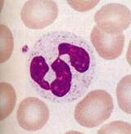
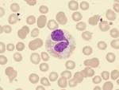
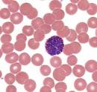
NEUTROPHIL EOSINOPHIL BASOPHIL
MONOCYTE LARGE & SMALL LYMPHOCYTES

Slide 33
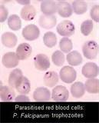
Malaria Parasite: -
Malaria parasite is seen under microscope with Leishman stain.
Procedure and requirements are same as Differential Leucocyte count

Slide 34
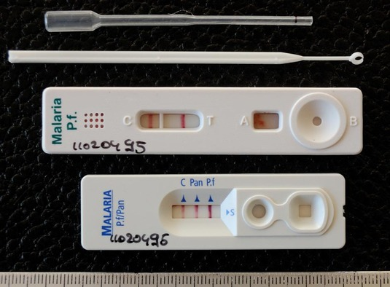

Slide 35
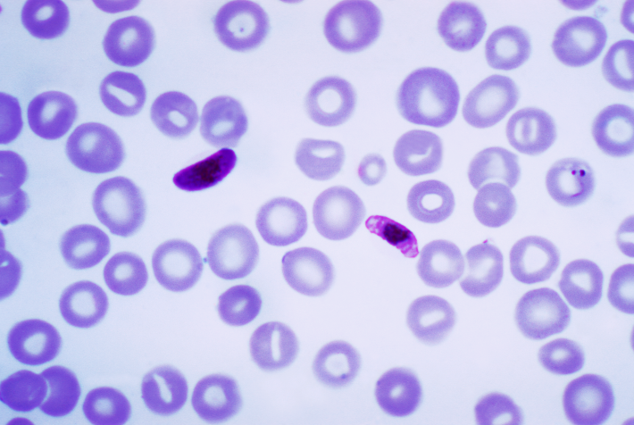
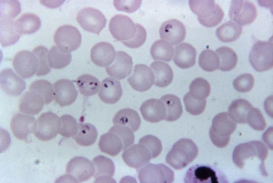
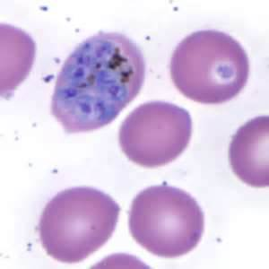
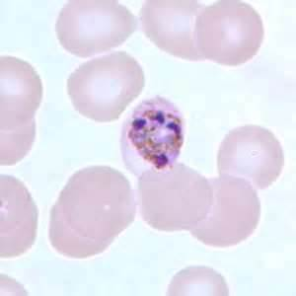
P. FALCIPARUM P. VIVAX
P. MALARIAE P. OVALE

Slide 36
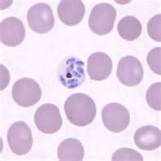
P. KNOWLESI

Slide 37
PLATELET COUNT:-
Requirements:- 1) Red cell pipette
2) Platelet Diluting fluid (Rees - Ecker)
3) Neubauer's chamber with cover slip 4) EDTA Whole Blood
Procedure:- a) Draw the blood into a clean dry RBC pipette upto the mark 0.5.
b) Wipe off the outside of the pipette.
c) Draw the blood upto the mark 101. Shake the pipette for 5 minutes.
d) Discard the first 4 - 6 drops and load the chamber.
e) Allow the preparation to stand for 15 minutes in a moist chamber. An inverted Petridis with a piece of wet filter paper in the top makes a good moist chamber.

Slide 38
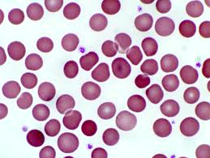
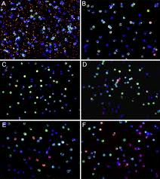
PLATELET IN DLC SLIDE
PLATELET IN NEUBAUER CHAMBER
Calculation:- No. of platelet counted X 10 X dilution
--------------------------------------------- = Platelet /cu mm
No. of 1 mm squares counted
Normal Values:- 1,50,000 - 4,00,000/cu mm

Slide 39
COAGULATION OF BLOOD
Coagulation Time or Clotting Time:
Many methods have been used by the haematologists for the determination of coagulation time and the results obtained do not match with one another due to differences in the techniques used and the conditions to which blood samples are subjected.
Drop Method: Place several drops of blood on a clean glass slide and go on passing a needle through one drop at a time at one minute interval. When the fibrin threads stick to the needle and are dragged along it, the coagulation has taken place and the time is noted from a stop watch from the time of collection of blood to the time of coagulum formation. In dry warm weather, the slide should be kept on beaker of warm water to avoid evaporation.
Precaution: The blood should be collected from a sharp deep puncture and the first few drops should be discarded.

Slide 40
. Capillary Method: The method is most commonly used and found satisfactory. In this method, the blood is drawn into the fine capillary tubes. The site is cleaned, dried and punctured with a sharp needle. First drop is wiped off. The second drop is drawn into the capillary tube filled by capillary action. Avoid touching of the tube to the skin of the animal. After one minute place the capillary tube in such a way that index finger is kept above and thumb below the capillary tube and break a bit of the capillary with slight pressure from thumb. If there is no thread formation between the two broken ends when taken apart gently, then break the other one after every 30 seconds intervals till the gap is bridged. Note the time from the time of receiving the blood till the bridge formation. This is the coagulation time of that individual.

Slide 41
Bleeding Time: It is the time taken for the formation of clot at the point of puncture, detected by watching when bleeding stops as ascertained by frequent soaking of the blood by means of a filter paper
Prothrombin Time PT or Pro Time
This test is a measure of phase III of the clotting process. The PT may give false readings due to some other clotting defects. However, it is usually indicative of a phase III problem.
Normal values: (child or adult): 11-15 seconds or 70%-100% (depends on method used)

Slide 42
Partial Thromboplastin Time PTT
A test similar to the PT, the PTT is also used to detect clotting abnormalities. APTT, Activated PTT, similar to PTT but is more sensitive than PTT test; it will help to identify the defective factor, if one is defective.
Normal Values: - PTT: 60–70seconds APTT: 30 - 40 seconds

Slide 43
BLOOD GROUPING
Landsteiner in 1901 demonstrated that human beings could be classified into 4 groups depending on whether their red cells contain A or B agglutinogen or both AB or neither i.e., O. He also showed that there are antibodies (agglutinins) to A and B agglutinogen named Anti-A and Anti-B and that a person's serum does not contain the antibody for the antigen present in his own red cells but carries antibodies against the agglutinogens he doesn’t possess. So the ABO blood group system is as follows:

Slide 44
Group Agglutinogen/Antigen Agglutinin/
Antibody in Serum
A A Anti-B
B B Anti-A
AB A and B None
O None Anti-A
So far, in human beings 14 blood group systems have been identified.
Requirement: 1. Blood samples. 2. Anti-Serum for A and B.

Slide 45
Blood group O positive: neither anti-A nor anti-B have agglutinated, but anti-Rh has
Result: Blood group B negative: anti-A and anti-Rh have not agglutinated but anti B has
In the slide testing method shown above, three drops of blood are placed on a cavity glass slide with liquid reagents. Agglutination indicates the presence of blood group antigens in the blood.
ABO blood group antigens present on red blood cells and IgM antibodies present in the serum

Slide 46
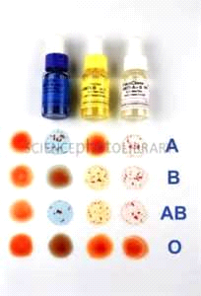

Slide 47
ANY QUESTION
?

Slide 48
THANKS

