Slide 1
ECG Exam Room, Instrumentation & Patient Preparation
LESSON -6
By
PARMOD KUMAR
HC/MED

Slide 2
Learning Objectives
By the end of this module, you will be able to:
• Describe the setup of an ECG exam room
• Identify essential ECG instruments and accessories
• Prepare a patient properly for ECG recording
• Understand safety and infection control procedures
Notes:
Introduce module goals related to environment and patient prep.

Slide 3
Introduction
The ECG exam room and patient preparation are critical for obtaining accurate, artifact-free ECG recordings.
Notes:
Overview of environmental and procedural importance.

Slide 4
ECG Exam Room Setup
• Quiet, well-lit, temperature-controlled environment
• Properly grounded electrical outlets
• Bed or examination couch with adjustable height
Notes:
Describe ideal ECG room conditions.

Slide 5
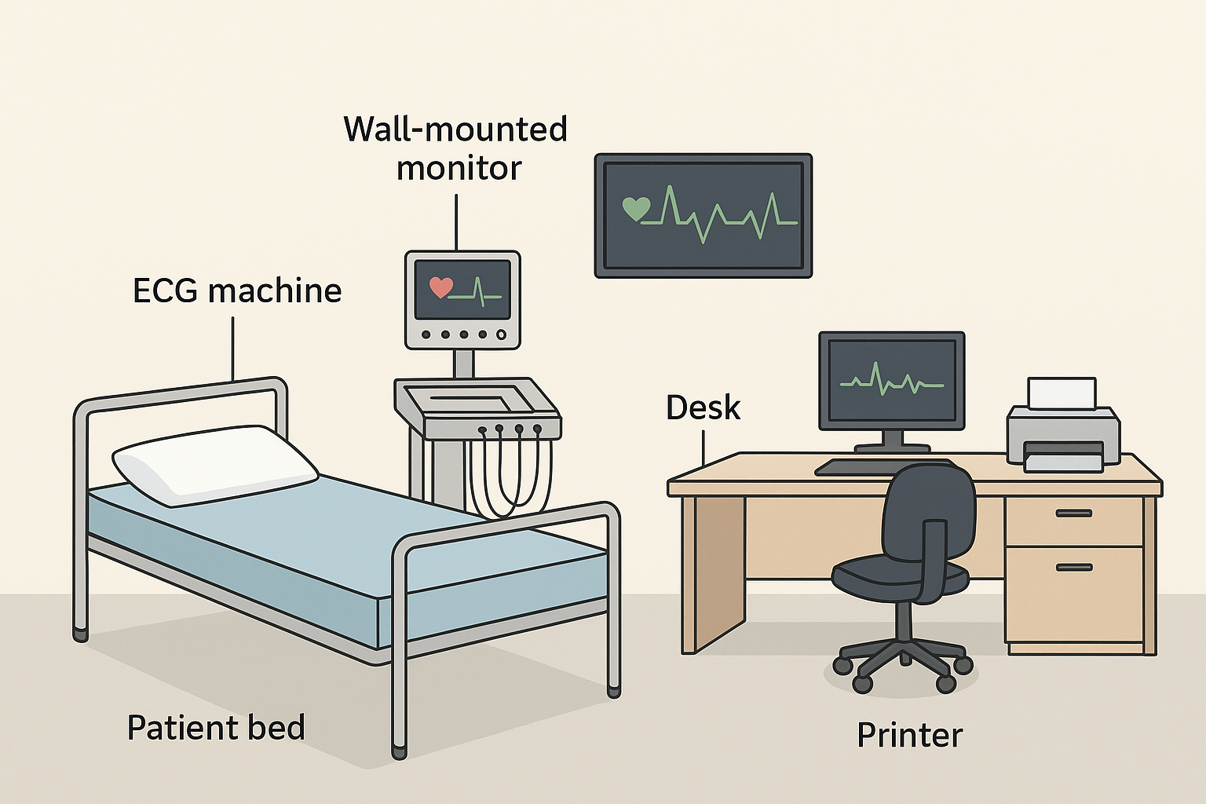
ECG Exam Room Setup

Slide 6
Equipment Checklist
• ECG machine
• Electrodes and conductive gel
• Paper or digital recording system
• Disinfectants, gloves, and wipes
Notes:
Ensure readiness before patient arrival.

Slide 7
Power and Grounding
• ECG machines require proper grounding to avoid interference
• Avoid placing near electrical equipment like X-ray or diathermy machines
Notes:
Emphasize safety precautions.

Slide 8
Infection Control
• Use disposable electrodes if possible
• Clean leads and machine after each use
• Follow hospital infection prevention guidelines
Notes:
Highlight hygienic practices.

Slide 9
Patient Identification
• Verify patient identity using two identifiers (name, ID number)
• Confirm procedure details and explain purpose
Notes:
Ensure safety and consent compliance.

Slide 10
Patient Preparation Steps
1. Explain the procedure
2. Ensure privacy and comfort
3. Ask patient to remove jewelry and upper clothing
4. Clean electrode sites (shave hair if necessary)
5. Apply electrodes correctly
Notes:
Provide structured preparation process.

Slide 11
Patient Positioning
• Supine position on flat bed
• Arms relaxed beside body
• Legs uncrossed
Notes:
Minimize muscle interference.

Slide 12
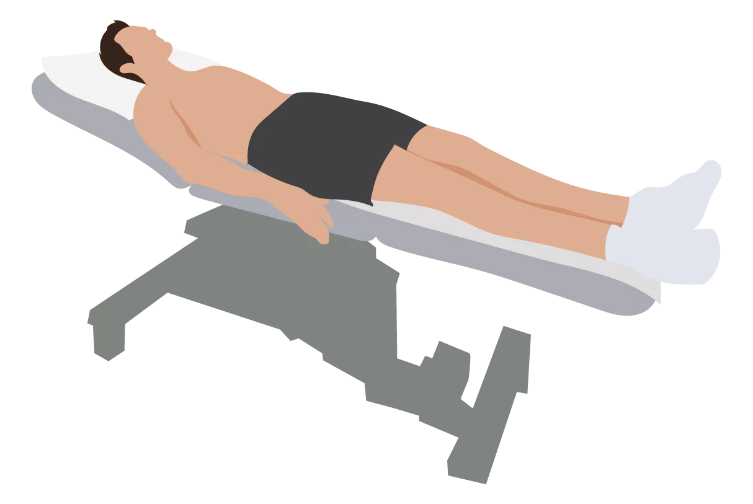
Patient Positioning for 12-Lead ECG Placement

Slide 13
Skin Preparation
• Remove oil, sweat, and dead skin with alcohol wipe
• Ensure good electrode contact
Notes:
Promote high-quality signal acquisition.

Slide 14
Lead Wires Arrangement
• Organize leads to avoid tangling
• Secure leads away from power cables
Notes:
Prevent artifacts and ensure comfort.

Slide 15
Patient Comfort and Safety
• Communicate throughout procedure
• Maintain modesty with drapes
• Avoid chilling or overheating
Notes:
Build patient trust and compliance.

Slide 16
During ECG Recording
• Instruct patient to remain still and silent
• Watch for movement or shivering
• Monitor for signs of distress
Notes:
Focus on accuracy during recording.

Slide 17
Post-Procedure Care
• Remove electrodes gently
• Clean gel residue from skin
• Disinfect equipment
• Label and store ECG appropriately
Notes:
Ensure cleanliness and documentation.

Slide 18
Special Considerations
• Pediatric patients: smaller electrodes, distraction techniques
• Critically ill patients: monitor continuously
• Obese or hairy patients: ensure strong contact
Notes:
Discuss variations in approach.

Slide 19
Summary
• Proper environment, equipment setup, and patient preparation are essential for accurate ECG results
Notes:
Conclude and transition to next module on performing ECG.

Slide 20
ANY QUESTION
?

Slide 21
THANKS

