Slide 1
PATIENT ASSESSMENT
LESSON -14
BY
JITENDER YADAV
INSP/PH

Slide 2
OBJECTIVES
List the five general procedures a medical first responder should complete when arriving at the scene.
List the six phases of the patient assessment plan.
List the six step of initial assessment.
Demonstrate a complete physical examination as defined in this lesson.

Slide 3
ASSESSMENT PLAN
Scene Size - up.
Initial Assessment.
Physical Examination.
Patient History.
On going Assessment.
Patient Hand – Off Report.

Slide 4
SCENE SIZE-UP
DEFINITION:- The evaluation of factor that are used in the decision-making process to establish the strategy and tactics to be used in a particular incident .

Slide 5
SCENE SIZE -UP
WHAT IS THE CURRENT SITUATION?
Medical or Mechanism of injury ?
WHERE IS IT GOING ?
What are the possibilities ?
HOW DO I CONTROL IT?
What resources are needed ?

Slide 6
ARRIVAL ON THE SCENE
Ensure your own personnel safety.
Ensure patient safety.
Establish a general impression of the scene and begin initial assessment of the patient (if responsive, identify yourself.
Identify and treat life threatening conditions.
Stabilize and continue to monitor the patient.
Cont…

Slide 7
IDENTIFY YOURSELF
State your name and Organization.
Identify yourself as a medical first responder.
Ask the patient if you may help him/her (obtain consent).

Slide 8
IMMEDIATE SOURCES OF
INFORMATION
The scene itself (observe, plan, react ).
Patient (if responsive).
Relatives and by standards.
The mechanism of injury, (force that cause the injury - kinematics).
Any remarkable deformity or obvious injury.
Any sign or characteristics of certain types of injury or illness.
Cont…

Slide 9
INITIAL ASSESSMENT
“A process used to identify and treat conditions posing an immediate threat to the patient life”.

Slide 10
STEPS FOR INITIAL ASSESSMENT
General impression
Responsiveness
Circulation (C)
Airway (A)
Breathing (B)
Patient status update.

Slide 11
GENERAL IMPRESSION
Obtain a chief complaint and determine if the situation is trauma or medical.
Examine front and back of neck and for trauma case with suspected cervical spine injury, apply a cervical collar to immobilize the cervical region.

Slide 12
RESPONSIVENESS
There are four level of responsiveness (AVPU).
A=ALERT: Patient who is alert responsive and oriented.
V=VERBAL: Patient who responds only when spoken to.
P=PAINFUL: Patient respond only to painful stimulus.
U=UNRESPONSIVE: Patient does not respond to any stimulus. does not open eyes.

Slide 13
ASSESS CIRCULATION (C)
RESPONSIVE PATIENT:
Radial pulse for adult patient.
Brachial pulse for an infant.
UNRESPONSIVE PATIENT:
Carotid pulse for adult patient.
Carotid/femoral pulse for children.
Brachial pulse for infants.

Slide 14
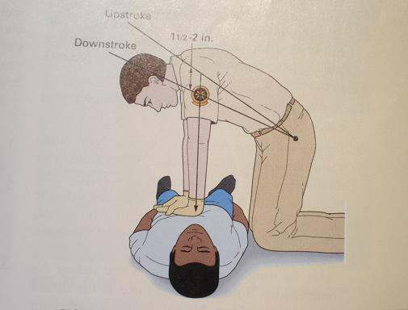
IF PULSE IS ABSENT,BEGIN CPR IMMEDIATELY

Slide 15
ENSURE ADEQUATE AIRWAY
HOW ?
IT DEPENDS ON PATIENT RESPONSIVENESS.
RESPONSIVE PATIENT : If patient can speak clearly mean airway clear. gurgling or similar sound may indicate airway obstruction.

Slide 16
UNRESPONSIVE PATIENT: If patient unresponsive you have to open airway.
Two method are used to open the airway of unresponsive patient.
  Head – tilt/Chin lift method (for medical patient).
  Jaw thrust method (for trauma patient).

Slide 17
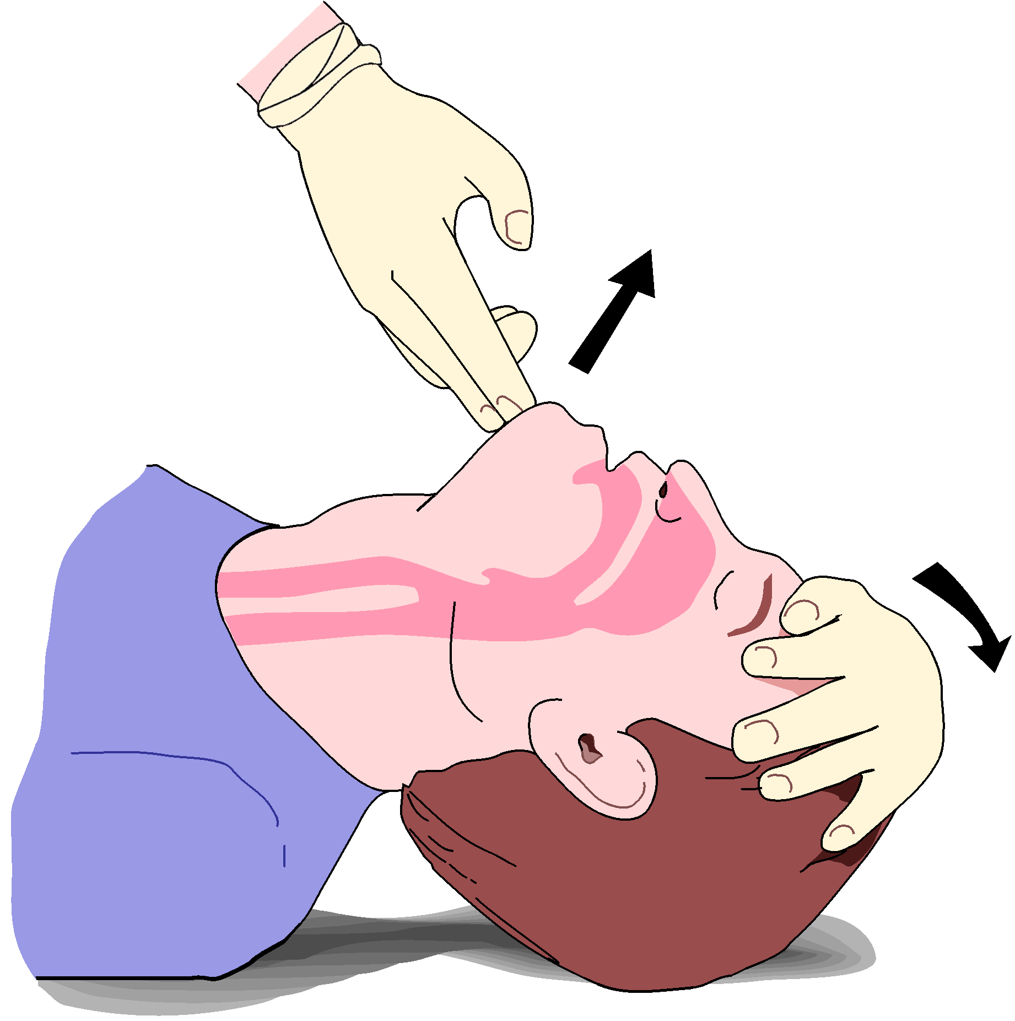
Head -Tilt Chin - Lift
P.Page No-7-4
BLS & CPR
TR- 7-16

Slide 18
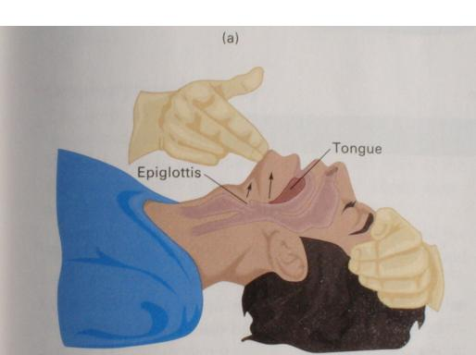
P. Page No-7-5
BLS & CPR
TR- 7-18

Slide 19
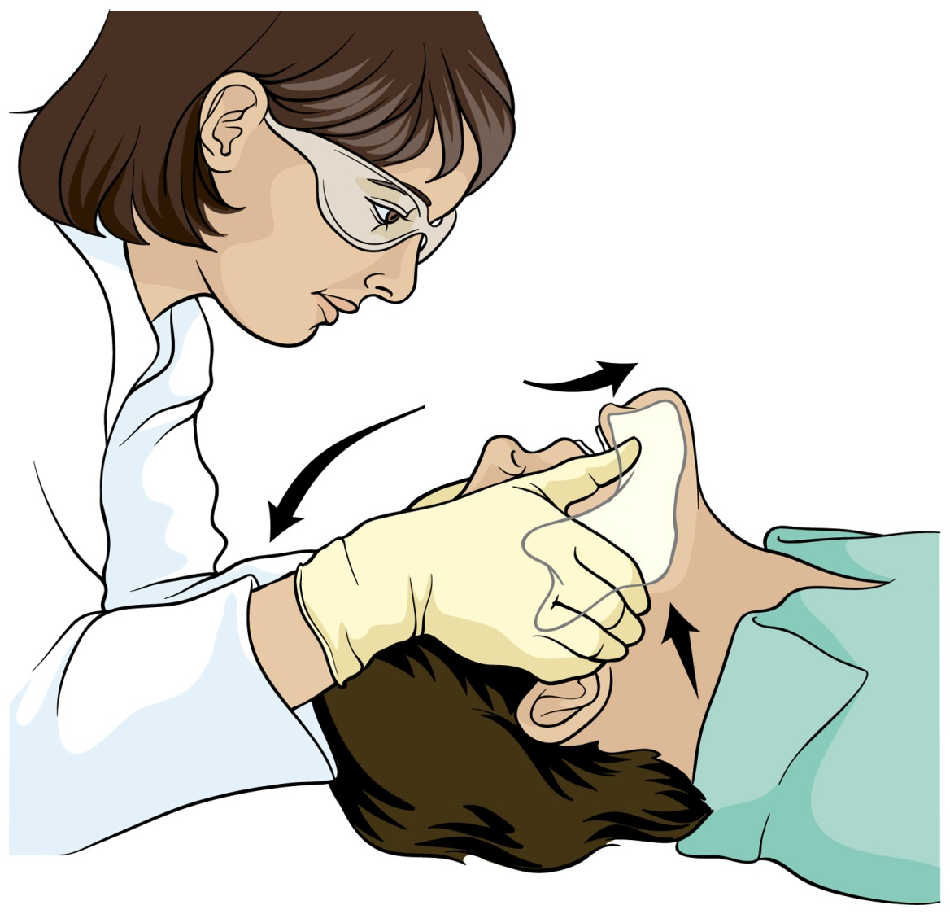
Jaw thrust
P.Page No-7-6
BLS & CPR
TR- 7-23

Slide 20
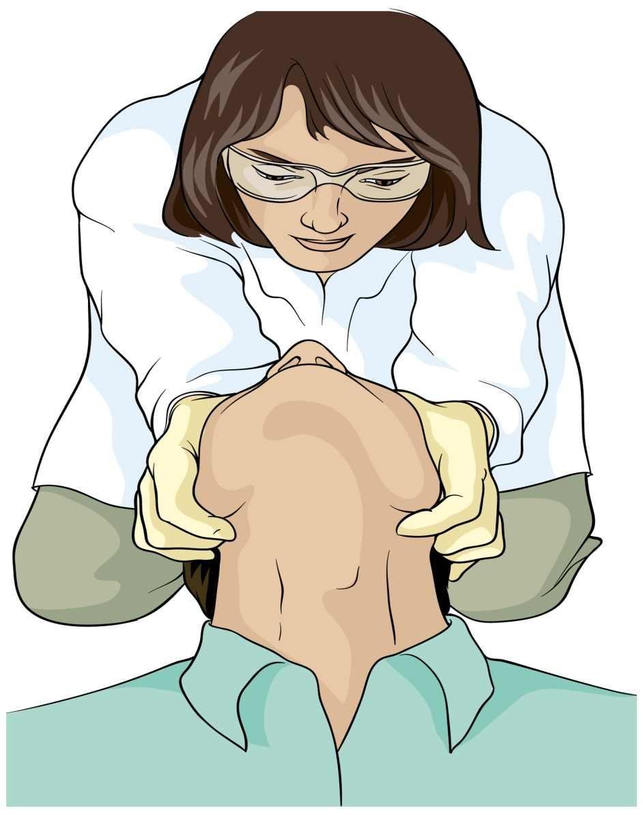
Jaw thrust
P.Page No-7-6
BLS & CPR
TR- 7-24

Slide 21
VERIFY BREATHING
L.L.F. Method is used to verify breathing.
L - Look for full rise and fall of chest.
L - Listen sound of breathing.
F - Feel exhaled air on your cheek.

Slide 22
ADEQUATE BREATHING IS CHARACTERISED BY
Full rise and fall of chest.
Easy breathing.
Normal respiratory rate.

Slide 23
INADEQUATE BREATHING IS CHARACTERISED BY
Insufficient rise and fall of chest.
Increase respiratory effort.
Cyanosis.
Mental status changed.
Inadequate respiratory rate (<8 in adult ,<10 in children,<20 in infants).

Slide 24
ADMINISTER OXYGEN TO PREVENT SHOCK AND DAMAGE TO VITAL ORGANS
OXYGEN IS USED FOR BOTH MEDICAL AND TRAUMA PATIENTS

Slide 25
PATIENT STATUS UPDATE
Inform responding EMS units of your findings.
If more resources will be needed, request them.
If patient has life threatening injuries or illness, let responding units know.
If patient is stable with minor injuries, advise responding units.

Slide 26
THE INITIAL ASSESSMENT SHOULD BE COMPLETED AND ALL LIFE THREATS TREATED BEFORE YOU CAN PROCEED TO PHYSICAL EXAM

Slide 27
PHYSICAL EXAM
The main purpose of the physical exam is to reveal any injury or medical problem that could pose a threat to patient survival if left untreated.

Slide 28
PRINCIPLES OF PATIENT ASSESSMENT
Inspection (looking)
Auscultation (listening)
Palpation (feeling)

Slide 29
Conducting an Exam
Medical vs. Trauma Patients
Physical signs of an injury can be observed and palpated for a trauma patient.
Medical problems are felt by the patient. Ask question for symptoms.

Slide 30
WHEN CONDUCTING PHYSICAL EXAM LOOK FOR THE FOLLOWING SIGNS OF INJURY.
B= BLEEDING
P=PAIN
D=DEFORMITY
O=OPEN INJURY
C=CREPITUS

Slide 31
PHYSICAL EXAM
Use B.P.D.O.C.
Head
Neck
Chest/back
Abdomen
Pelvis
Cont…

Slide 32
Extremities
Vital sign
  Respiration
  Pulse
  Skin
  Pupils
  Blood Pressure

Slide 33
EXAMINATION OF HEAD
SCALP AND SKULL : Check for B.P.D.O.C.
EAR AND NOSE : Look for blood or cerebrospinal fluid.
PUPIL : Symmetry of pupil, reactivity to light.
MOUTH : Check for B.P.D.O.C. and airway obstruction.

Slide 34
EXAMINATION OF NECK
Always go front to back (anterior to posterior).
Check for B.P.D.O.C.
If open injury apply occlusive dressing to prevent air from entering veins.
Cont…

Slide 35
Check medic alert necklace.
Check trachea for mid-line position.
Palpate vertebrae.

Slide 36
EXAMINATION OF THE CHEST
Check for B.P.D.O.C.
Feel ribs for deformities .
Palpate the sternum.

Slide 37
EXAMINATION OF ABDOMEN
Check for rigidity, open injury, distention, swelling (B.P.R.O.D.).
Check for laceration abrasion, penetrating wound ,protruding organs.
Palpate quadrant with pain last.

Slide 38
EXAMINATION OF BACK
Check chest wall for deformities that may indicate broken ribs.
Check for B.P.D.O.C. along entire length of spinal cord.
Check for penetrating and sucking wound.
Check for blood accumulation in the flanks may indicate abdominal injury.

Slide 39
EXAMINATION OF THE PELVIS
Composed of the left and right ileum, ischium and pubic bone.
Pelvic or hip fracture could result in blood loss of 2 liters or more.
Internal organs, blood vessels and nerves pass through pelvic area.
Cont…

Slide 40
Spinal injury possible.
Genital region: Priapism in males.
Deformities not always obvious. palpate iliac crest (Pelvic wings)and pubic bones.
Cont…

Slide 41
Open injuries may occur, but are uncommon.
Penetrating injuries possible.
Assess for tenderness.

Slide 42
EXAMINATION OF LOWER EXTERMITIES
Check for B.P.D.O.C.
Check Dorsalis Pedis/Posterior Tibial Pulse.
Check for motion -wiggle toes.
Check for sensation.

Slide 43
EXAMINATION OF UPPER EXTERMITIES
Check for B.P.D.O.C.
Check for radial pulse.
Check for motion - Wiggle fingers.
Check for sensation.
Check for medic -alert bracelet.

Slide 44
MEASURING VITAL SIGNS
Respiration
Pulse
Skin
Pupils
Blood Pressure.

Slide 45
Equipment Required to Measure
Vital Signs
Wristwatch
Penlight
Stethoscope
Pen and notebook
Blood pressure cuff(sphygmomanometer)

Slide 46
NORMAL RESPIRTORY RATES
AGE GROUP | RESPIRATION
INFANT (below 01 year) | 25-50 RPM
CHILD (01 to 08 year) | 15-30 RPM
ADULT (09 and older) | 12-20 RPM

Slide 47
ABNORMAL BREATHING CONDITION
Poor rise and fall of the chest.
Irregular breathing.
Unusual noise (snoring or wheezing).
Increase effort.
Cyanosis.

Slide 48
PULSE
AGE GROUP | PULSE
Infant | 120-150 PPM
Child | 80-150 PPM
Adult | 60-80 PPM

Slide 49
CHECK THE PULSE FOR
Pulse rate
Strength of pulse
Rhythm

Slide 50
LOCATION TO MEASURE A PULSE:
Brachial - Upper arm
Carotid - Neck
Femoral - Groin
Dorsalis pedis - Top of the foot
Posterior tibial artery - Medial surface of ankle

Slide 51

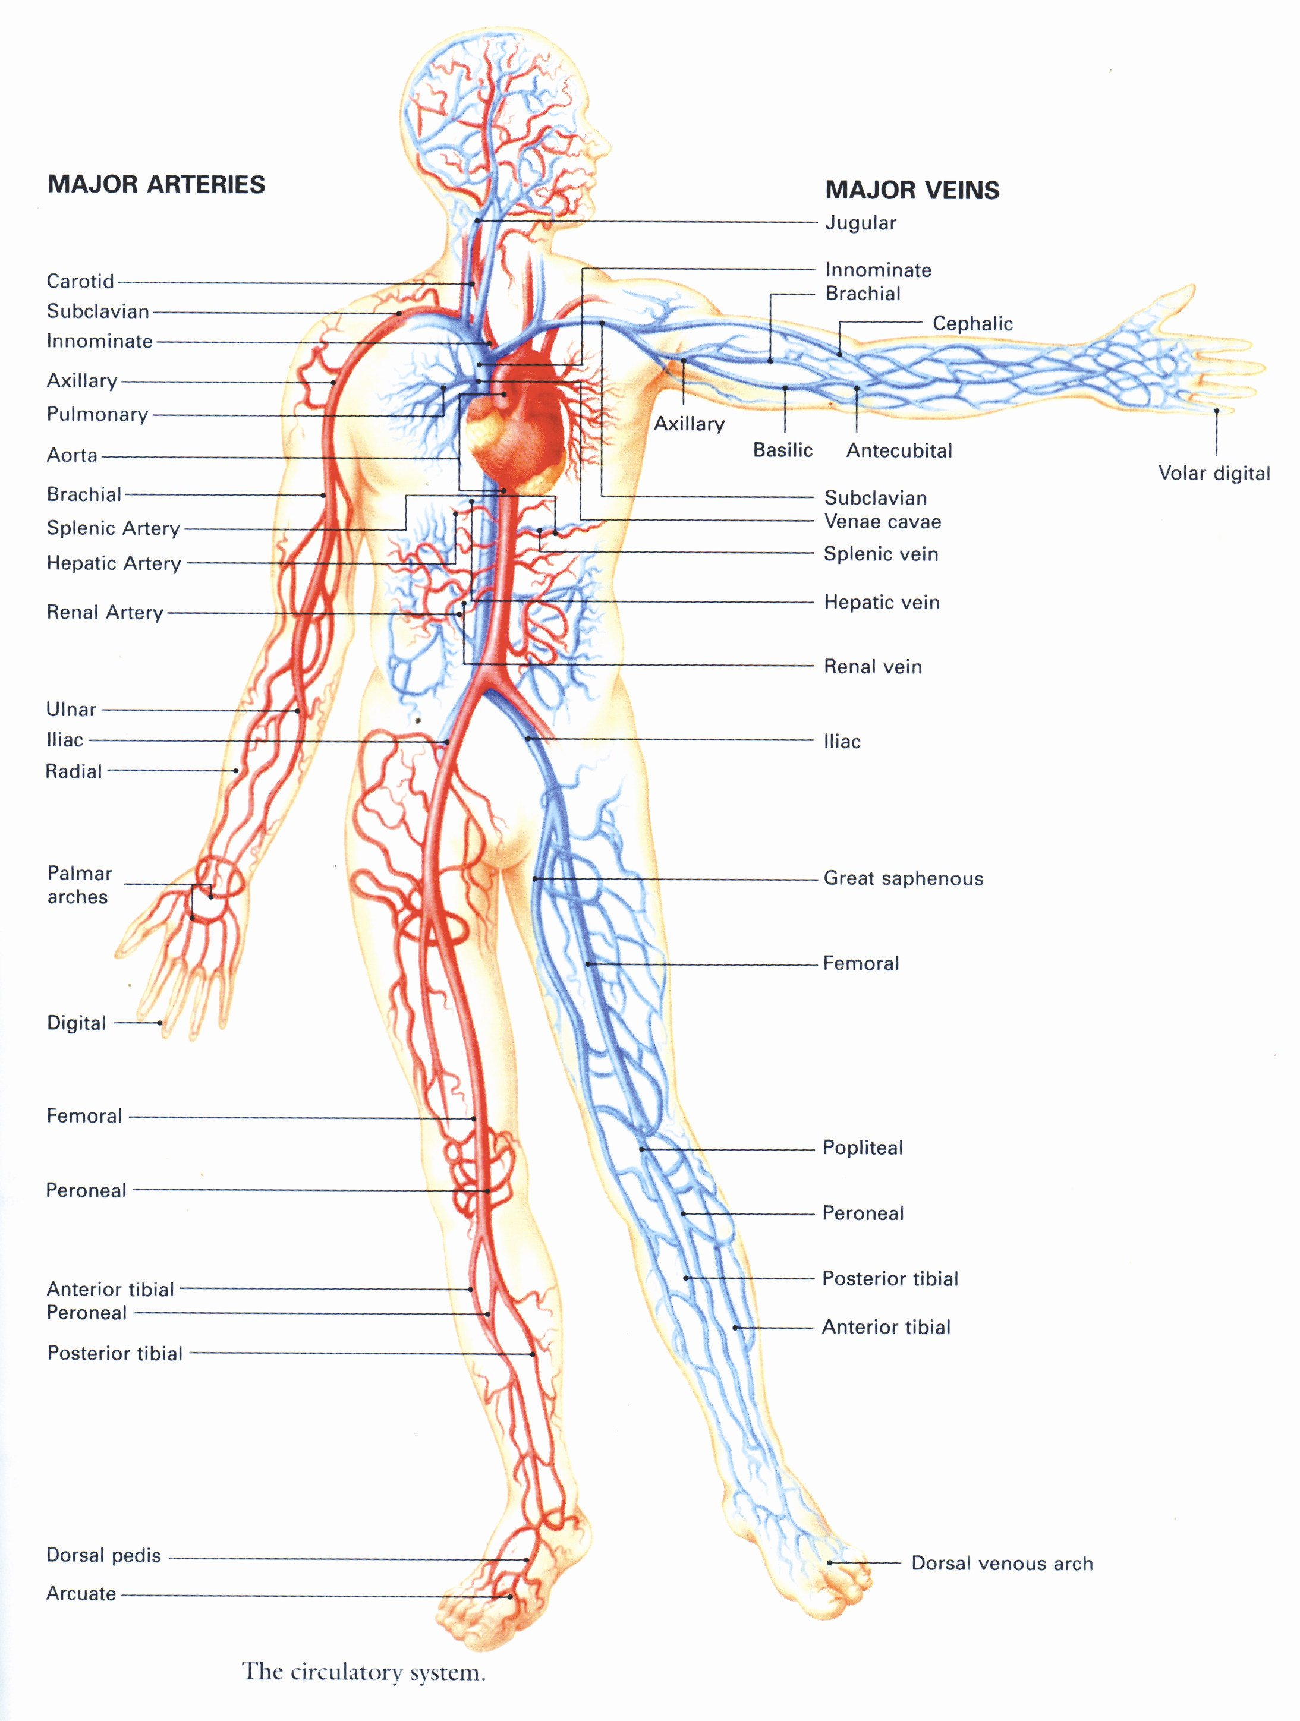
Major Arteries
Major Veins
Carotid
Brachial
Brachial
Superior
veins
Radial
Femoral
Femoral
Posterior Tibial
Posterior Tibial
Dorsal
venous
Dorsalis Pedis

Slide 52
SKIN
Check for relative skin temperature. (Normal body temperature: 98.6 °F or 37°C).
Check for skin condition (dry, moist or wet).
Check for color of skin
  Paleness (white ashen).
  Redness(Flushing).
  Blueness (Cyanosis).
  Yellowness.
  Black and Blue mottling.

Slide 53
CAPILLARY REFILL
Used for infants and children under 6 years old. Not always accurate in adults. Press on nail bed and observe how long it takes for the normal pink color to return after releasing. Always re-check at the same place.
Capillary refill may be delayed in patients with cold extremities. This method is used on adults in triage situations.

Slide 54
PUPILS
Check for
Normal response.
Abnormal finding.

Slide 55
BLOOD PRESSURE
NORMAL BLOOD PRESSURE VALUES (mmHg)
 | ADULT | CHILD
SYSTOLIC | 100+AGE (up to 150 mmHg) | 80+(2 x Age)
DIASTOLIC | 65-90 mmHg | 50-80 mmHg

Slide 56
FACTOR AFFECTING THE BLOOD PRESSURE
Factor that increase the Blood Pressure
Cold environment, stress, pain, smoking, caffeine, and decongestants that constrict blood vessels can increase blood pressure.

Slide 57
Factor that decrease the Blood Pressure
Heart failure, trauma and /or shock will decrease Blood Pressure.

Slide 58
PATIENT HISTORY
“S.A.M.P.L.E.”
Sign and Symptoms.
Allergies.
Medications.
Past History.
Last oral intake.
Events.

Slide 59
ONGOING ASSESSMENT
EVERY 05 MINUTE FOR UNSTABLE PATIENT AND EVERY 15 MINUTES FOR STABLE PATIENT

Slide 60
ONGOING ASSESSMENT
Reassess the patient for
Responsiveness(LOC)
Airway problem
Respiration
Cont…

Slide 61
Pulse rate and quality.
Skin temperature, color and condition.
Repeat any part of physical exam if needed.
Continue to calm and reassure the patient.
Cont…

Slide 62
Repeat initial assessment.
Repeat physical exam.
Reassess treatment and interventions.
Calm and reassure the patient.

Slide 63
PATIENT HAND – OFF REPORT
Patient age and sex.
Chief complaint.
Level of responsiveness.
Airway status.
Breathing status.
Patient history.
Treatment given.

Slide 64
ANY QUESTION
?

Slide 65
THANKS

Slide 66
HEAD TILT CHIN LIFT METHOD

Slide 67

JAW THURST METHOD

