Slide 1





MEDICAL FIRST RESPONDER
PATIENT ASSESSMENT
PEER | CSSR | INDIA
PPT 2 -

Slide 2

OBJECTIVE
Upon completing this lesson, you will become familiar with :-
Six Phases of patient assessment
General procedure an MFR complete after arrival at scene.
Six steps of initial assessment.
Demonstrate a complete physical examination as learnt in this lesson.
REVIEW

Slide 3
SCENE SIZE-UP
The scene size-up ensures the safety of the people at the scene, identify the mechanism of injury or the nature of illness , and determines the need for additional resources .
Most likely you will have no patient contact during scene size-up but your observation , decision and action set the foundation for the entire call

Slide 4
SCENE SIZE-UP
What is the current situation?
Medical or mechanism of injury, Observe for related hazards.
Where it is going ?
what are the possibilities?
How do I control it ?
what resources are needed?

Slide 5
AIM OF SCENE SIZE UP
Safety of the people at the scene of incident
Identify the mechanism of injury or the nature of illness
Determine the additional resources needed

Slide 6
ACION ON ARRIVAL AT THE SCENE BY A MFR
Ensure your own personal safety.
Ensure patient safety
Establish a general impression of the scene and begin initial assessment of the patient.

Slide 7
ACTION ON ARRIVAL AT THE SCENE BY A MFR
Identify and treat life threatening injury.
Stabilize and continue to monitor the patient

Slide 8
HOW TO INTRODUCE YOURSELF
State your name and organization
Identify yourself as an MFR
Ask the consent of the patient

Slide 9
IMMEDIATE SOURCE OF INFORMATION
The scene itself will describe
(Observe , Plan & React)
Patient if responsive
Relatives/ bystanders (If unresponsive

Slide 10
IMMEDIATE SOURCE OF INFORMATION
The mechanism of injury (Forces that caused the injury)
Any remarkable deformity or obvious injury
Any sign or characteristics of certain types of injury or illness

Slide 11
INITIAL ASSESSMENT
Process to identify and treat conditions that
pose an immediate threat to the patient’s life.

Slide 12
STEPS OF INITIAL ASSESSMENT
1) General impression (trauma or medical, apply cervical collar if needed )
2) Responsiveness ( A V P U )
(alert ,verbal ,painful ,unresponsive)
3) Verify Circulation, Airway and Breathing

Slide 13

CHECK CIRCULATION
Assess circulation. (Take 5-10 seconds to determine if the patient has an adequate pulse.)
CHECK IRCULATION (RADIAL & CAROTIDPULSE)

Slide 14
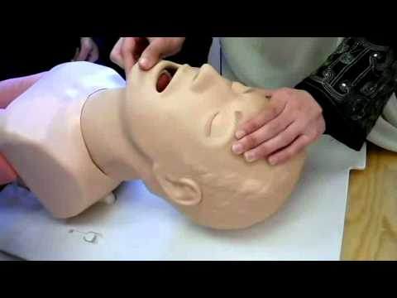
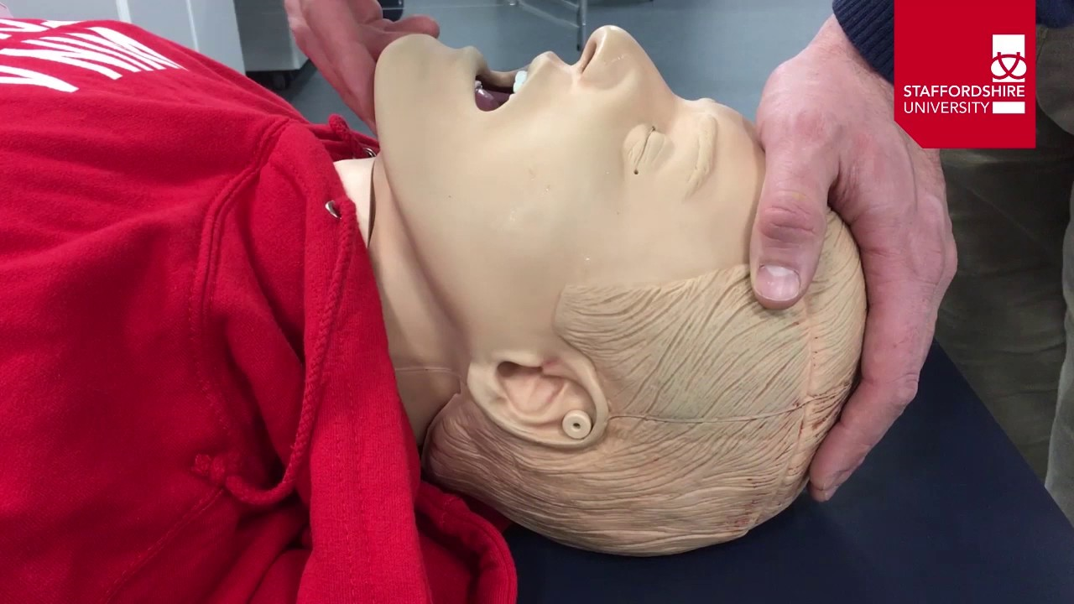
METHOD OF AIRWAY OPEN (HEAD-TILT CHIN-LIFT METHOD)

Slide 15
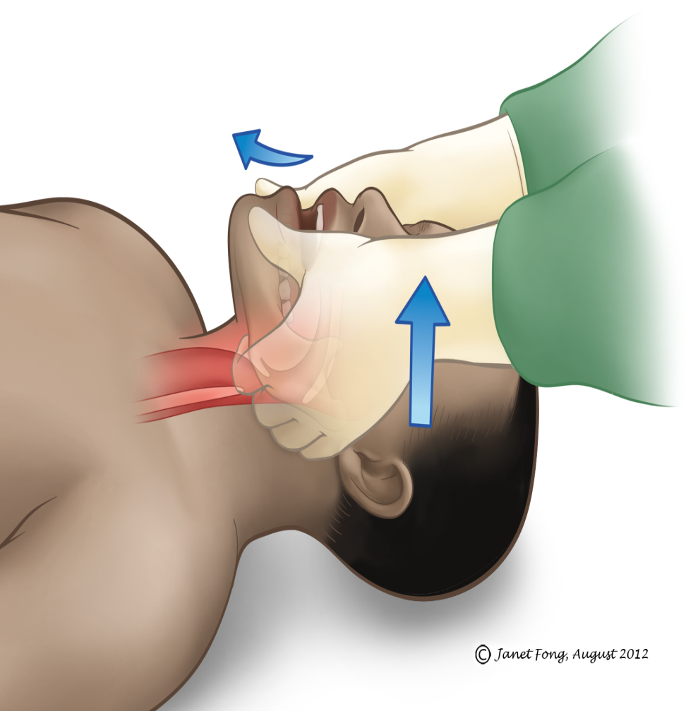
METHOD OF AIRWAY OPEN (JAW THRUST METHOD)

Slide 16
Verify breathing
1. Look, listen and feel for air exchange
Full rise and fall of chest
Easy breathing
Normal respiratory rate

Slide 17
PATIENT STATUS UPDATE
1. Inform responding EMS unit of your findings\
2. If more resources will be needed request them
3. If any life threatening injury/illness, let responding unit

Slide 18
PHYSICAL EXAMINATION
The main purpose of the physical exam is to reveal any injury or medical problem that could pose a threat to patient survival if left untreated

Slide 19
PRINCIPLES OF PHYSICAL ASSESSMENT
1. INSPECTION (looking)
2. AUSCULTATION (listening)
3. PALPATION (feeling)

Slide 20
PHYSICAL EXAM (HEAD TO TOE) (BPDOC)
1. EXAM OF HEAD-
Scalp & skull (BPDOC : Bleeding, Pain , deformity, open injury, Crepitus sound)
Ears & nose (CSF–Cerebro Spinal, Fluid)
Pupil (perl-pupil equally reacting to light)
Mouth (BPDOC)

Slide 21
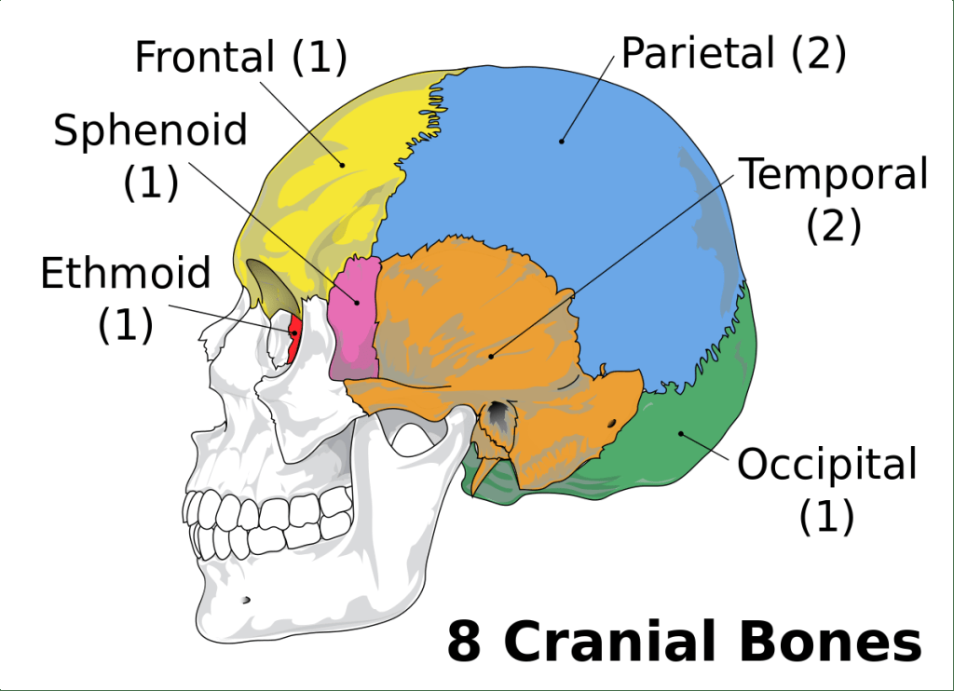
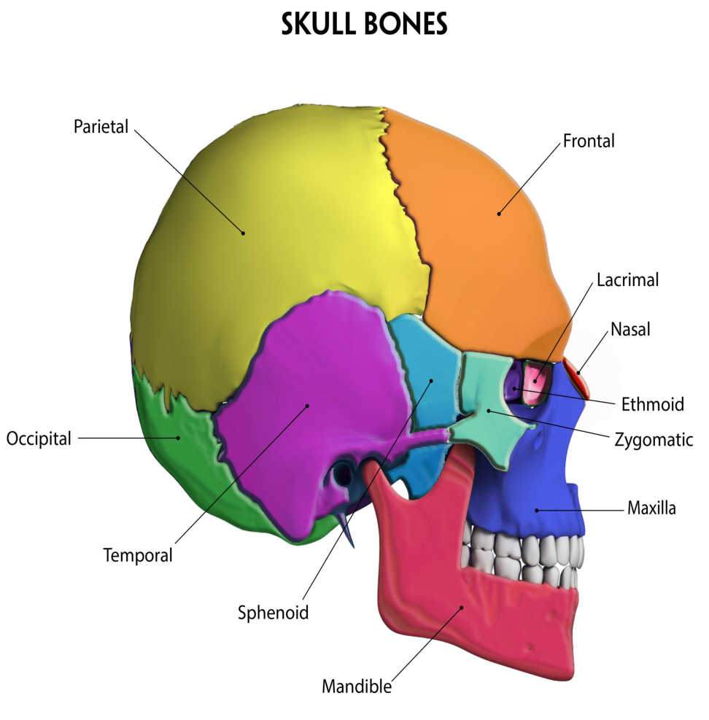
Skull bones - 22

Slide 22
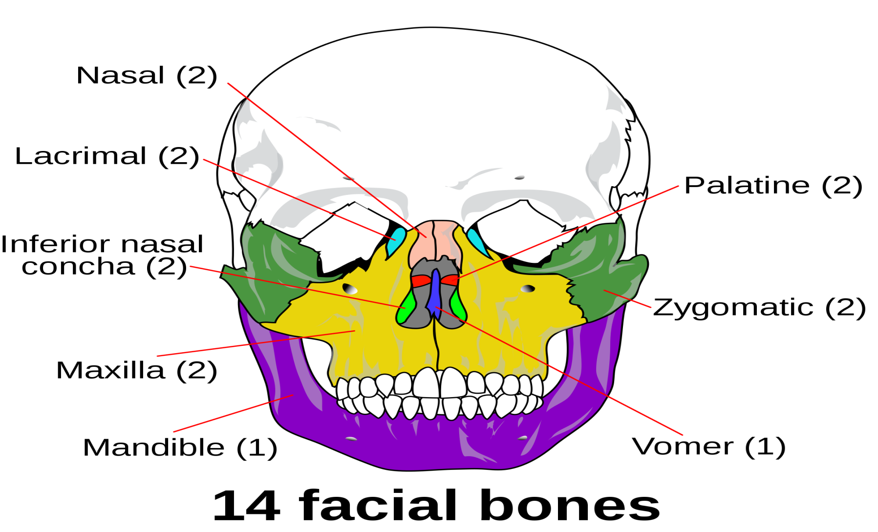
FACIAL BONES - 14

Slide 23
EXAM OF NECK
Go from front to back
Check for (BPDOC)
Palpate vertebra
Check trachea for mid-line position
Open injury
Check for medic alert

Slide 24
EXAM OF CHEST
Any injury may involve the vital organ or major blood vessels
Check for DOTS
Feel ribs for deformities all the way to spine
Palpate the sternum

Slide 25
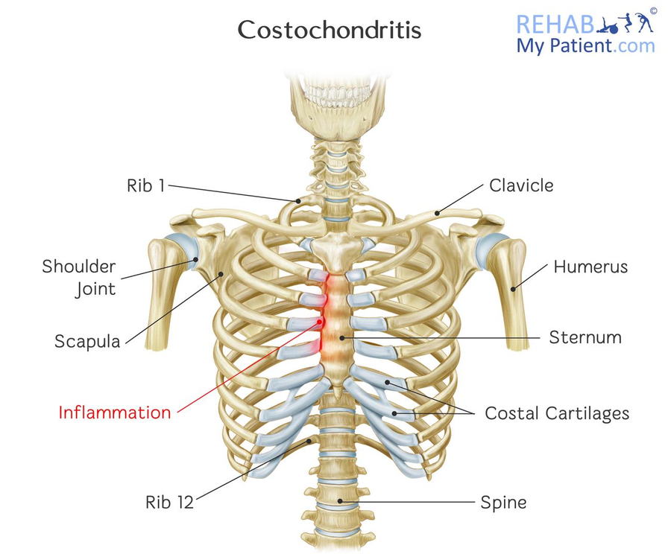
CHEST BONES

Slide 26
EXAM OF ABDOMEN
Check for rigidity or distention (tenderness)
Cuts scratches (laceration& abrasion), penetrating wound, protruding organs, potential bleeding and infection)
May indicate underlying injury (palpate quadrant with pain last
Swelling or discoloration

Slide 27
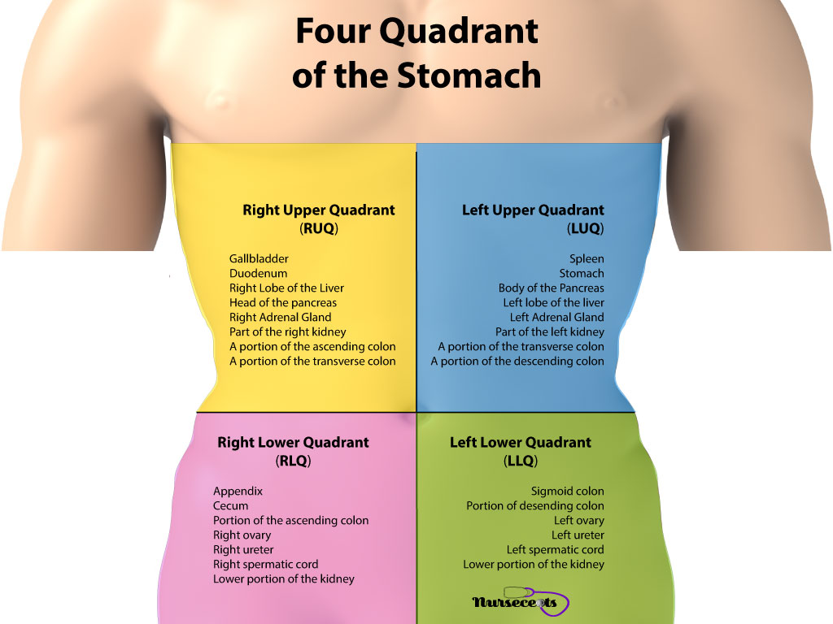
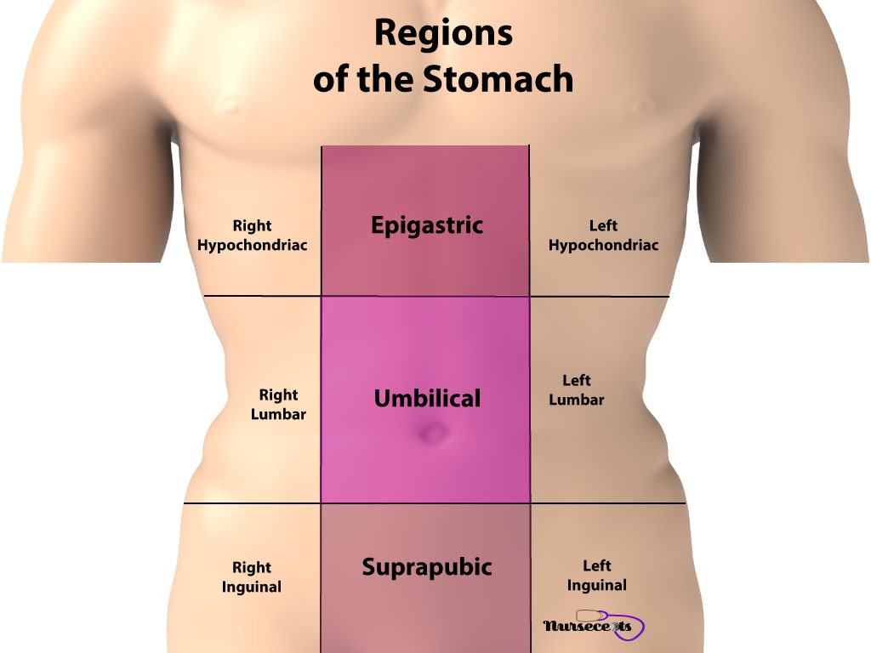
ABDOMEN QUADRANTS

Slide 28
EXAM OF THE BACK
Check chest wall for deformities (broken ribs)
Check for D & T for entire spine
Check for sucking wound
Blood accumulation in the flanks and/or tenderness may indicate abdominal injury

Slide 29
EXAM OF PELVIS (LT & RTILEUM, ISCHIUM & PUBIC)
Pelvic or hip fracture (blood loss 2 ltr.)
Internal organs of pelvic area
Possible spinal injury
Genital region : priapism in male
Possible penetrating injury
Assess for tenderness

Slide 30
EXAM OF UPPER EXTREMITIES
Check for BPDOC
Check radial pulse
Check for motion wiggle fingers
Check for sensation
Check for medic-alert bracelet

Slide 31
EXAM OF LOWER EXTREMITIES
Check for BPDOC
Check for dorsalis pedis pulse or posterior tibial pulse
Check for motion wiggle toes
Check for sensation

Slide 32
MEASURING VITAL SIGNS (R, P, S, P, Bp)
Respiration
Pulse
Skin
Pupils
Blood Pressure

Slide 33
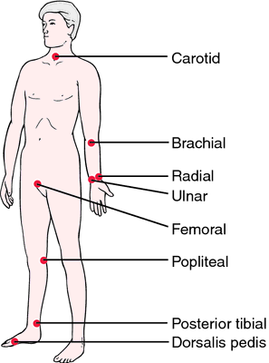
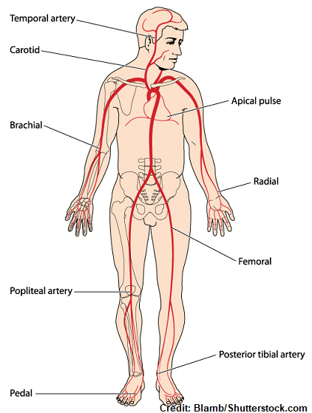
Pulse Location

Slide 34
EQUIPMENT TO MEASURE VITAL SIGNS
Wrist watch ( to count seconds)
Pen light (pupils)
Stethoscope ( BP, heart beat )
BP cuff (sphygmomanometer)
Pen & note-book

Slide 35
AGE DEFINITION
INFANT : UNDER 1 YEAR
CHILD : 1 TO 9 YEARS
ADULT : ABOVE 9 YEARS

Slide 36
NORMAL RESPIRATORY RATE
INFANT : 25 – 50 RPM
CHILD : 15 – 30 RPM
ADULT : 12 - 20 RPM
PULSE RATE
INFANT : 120-150 PPM
CHILD : 80-120 PPM
ADULT : 60-80 PPM

Slide 37
SKIN TEMPERATURE AND COLORATION
Relative skin temp by placing back of the hand against skin
COLOUR
Paleness
Redness
Blueness
Yellowness
Black & blue mottling

Slide 38
BLOOD PRESSURE
The amount of pressure blood exerts against artery walls
NORMAL BP VALUES (mmHg)
ADULT CHILD
100+Age 80+(2xAge)
Upto150mmHg
65-90 mmHg 50-80 mmHg

Slide 39
PATIENT HISTORY (SAMPLE)
Sign & Symptoms
Allergies
Medication- Identify all medical conditions the patient is currently taking or has recently taken. These may identify medical condition.

Slide 40
PATIENT HISTORY (SAMPLE)
Pertinent history- Pertinent to the emergency care you are providing.
Last Oral Intake
Events - Activities prior to the patient

Slide 41
ONGOING ASSESSMENT (Upto the better care)
Reassess loc (AVPU)
Reassess & correct any airway problem
Reassess breathing for rate and quality
Reassess pulse rate and quality

Slide 42
ONGOING ASSESSMENT (Upto the better care)
Reassess Skin temp, color & condition
Repeat any part of patient examination needed
Reassess your treatment to check effectiveness
Assurance to patient

Slide 43
HAND OFF REPORT
Patient age and sex
Chief complaints
Level of consciousness
Airway status
Breathing status
Circulation status
Patient history
Treatment given

Slide 44
REVIEW
Six Phases of patient assessment
General procedure an MFR complete after arrival at scene.
Six steps of initial assessment.
Demonstrate a complete physical examination as learnt in this lesson.

Slide 45
Any Questions?

Slide 46


THANK YOU

Slide 47
EVALUATION
Q1) What are the three methods to verify breathing?
Ans- Look, Listen, Feel
Q2) What are the Respiration Rate of Infant?
Ans- 25-50 / min

