Slide 1
ECG Machine & Terminology
LESSON -5
By
AMANDEEP KAUR
ASI/ANM

Slide 2
Learning Objectives
By the end of this module, you will be able to:
• Identify the main parts of an ECG machine
• Understand different types of ECG machines
• Define basic ECG terminology
• Recognize standard lead configurations and paper settings
Notes:
Introduce the equipment and vocabulary of ECG recording.

Slide 3
Introduction
An ECG machine records the electrical activity of the heart using electrodes placed on the body.
Notes:
Provide a basic overview of ECG purpose and equipment.

Slide 4
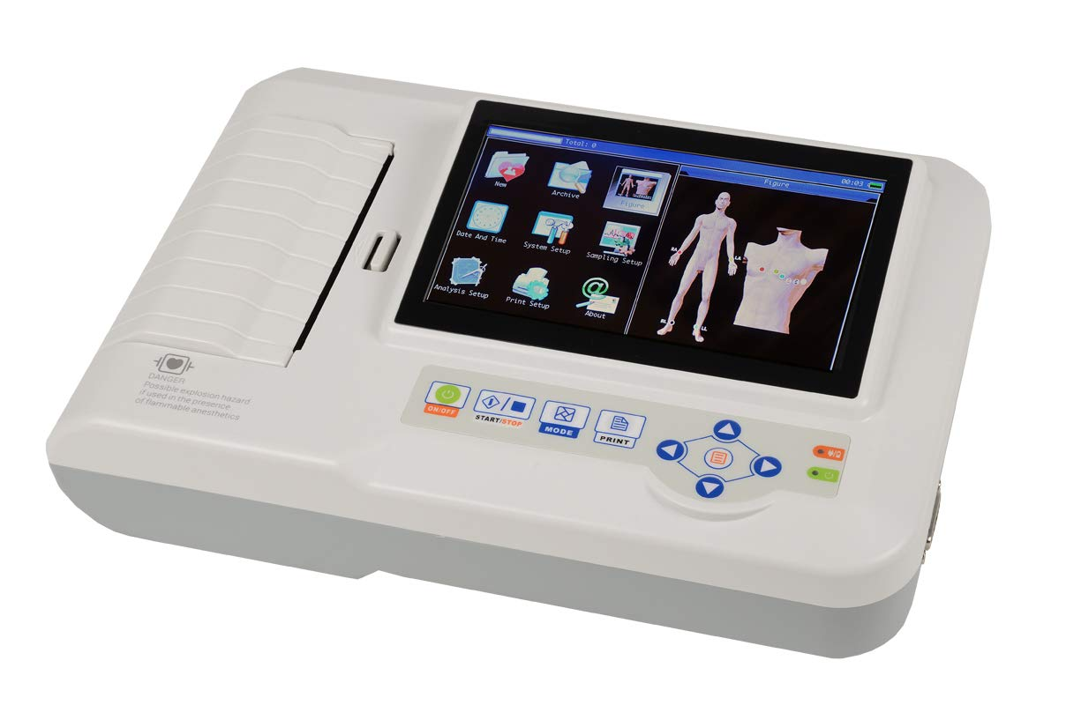
Basic Components of ECG Machine
• Power supply and control panel
• Electrodes and lead wires
• Amplifier and filter system
• Display screen or printout system
Notes:
Introduce students to parts of an ECG machine.

Slide 5
Types of ECG Machines
• Single-channel ECG
• Multi-channel ECG
• Portable or Holter monitors
• Stress test ECG systems
Notes:
Discuss their uses in clinical settings.

Slide 6
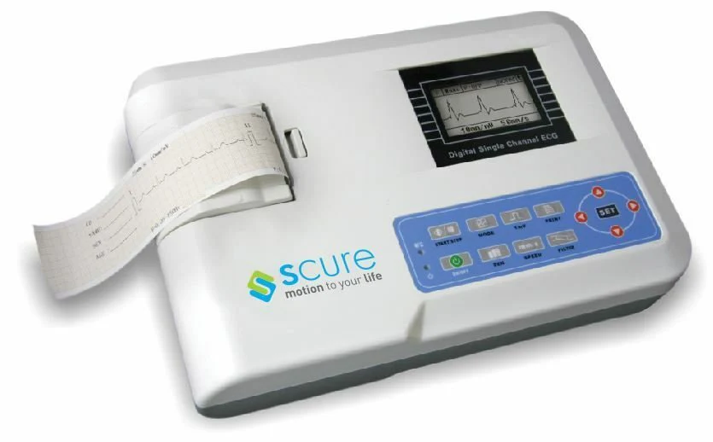
Single-channel ECG Machine

Slide 7
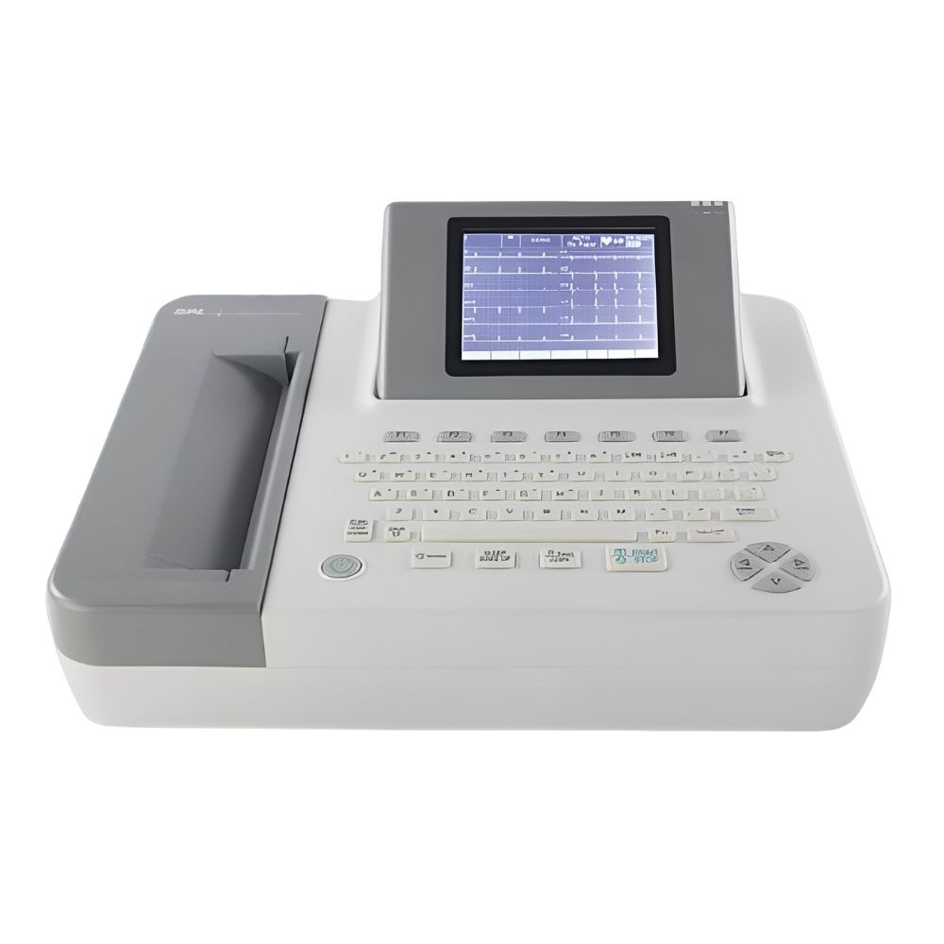
Multi-channel ECG Machine

Slide 8
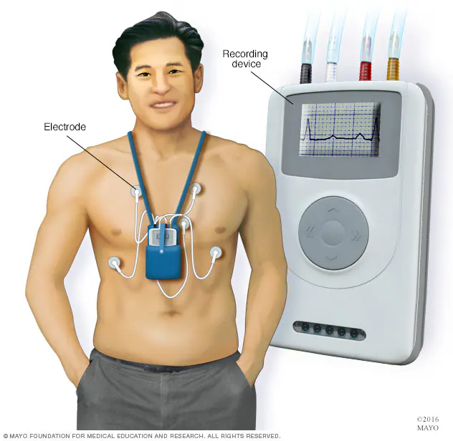
Portable or Holter monitors

Slide 9
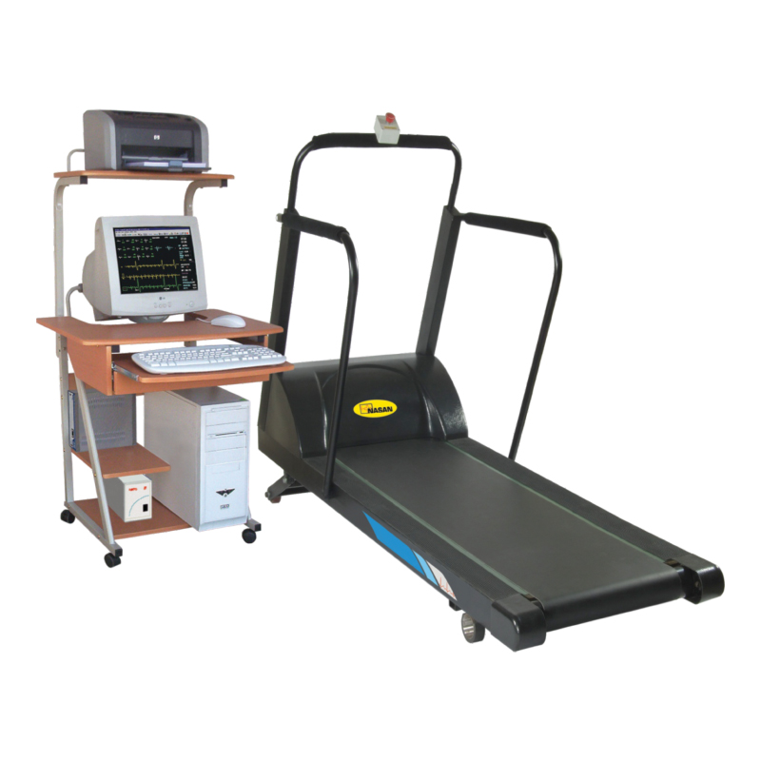
Stress test ECG systems

Slide 10
Electrodes and Lead Wires
• Electrodes detect electrical signals from the skin
• Conductive gel improves signal quality
• Leads connect electrodes to machine
Notes:
Explain placement and function of electrodes.

Slide 11
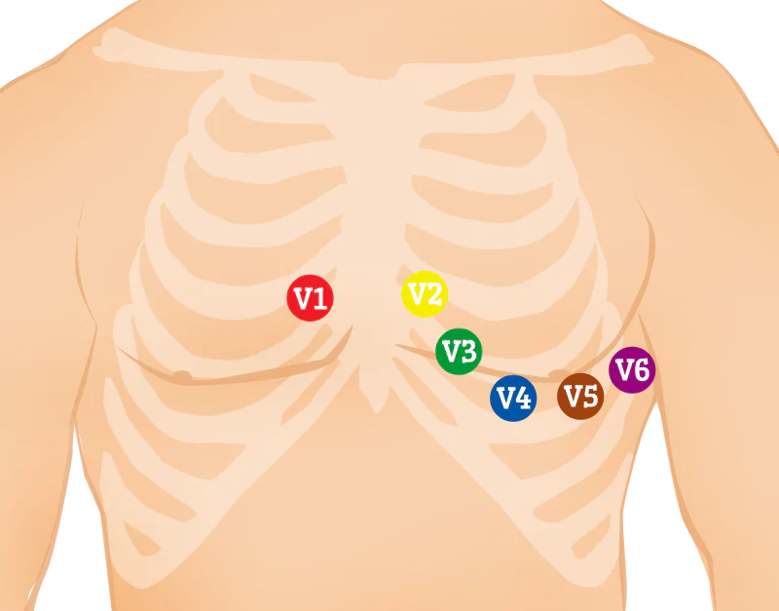
Leads and Lead Systems
• Standard 12-lead ECG: 3 limb leads, 3 augmented leads, 6 precordial leads
• Lead I, II, III form Einthoven’s triangle
Notes:
Clarify lead arrangement.

Slide 12
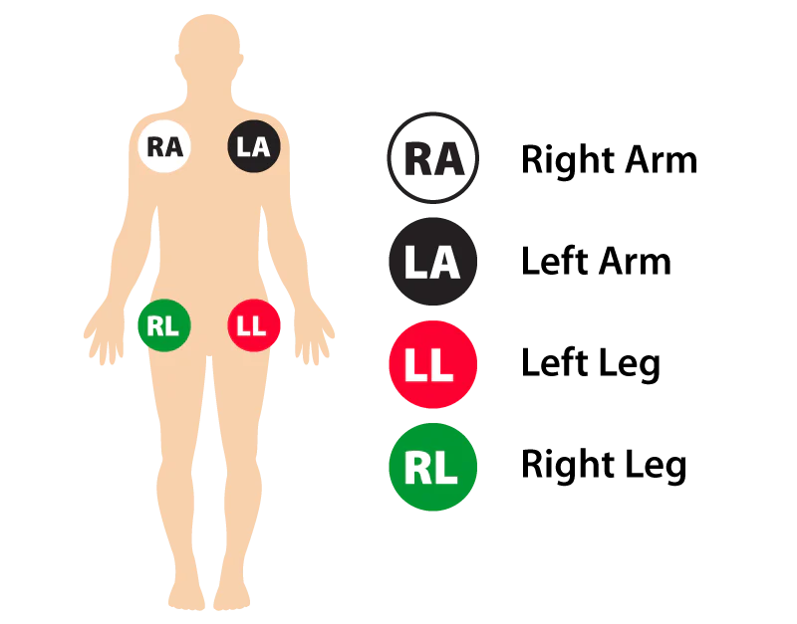

Slide 13
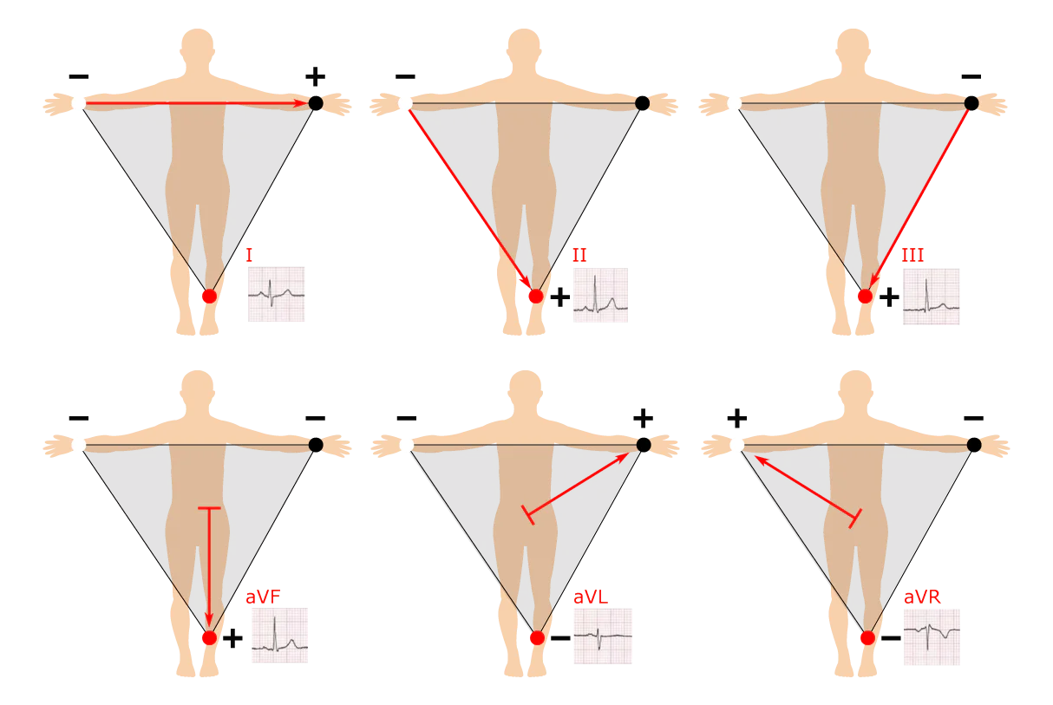
Einthoven’s Triangle
• Formed by leads I, II, III
• Demonstrates the relationship of limb leads
Notes:
Explain its role in understanding lead vectors.

Slide 14
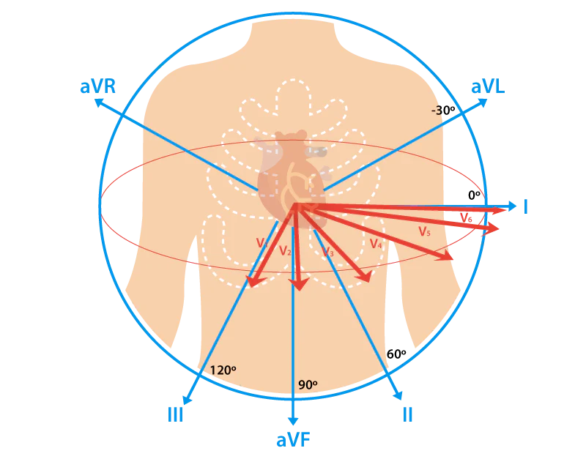

Slide 15
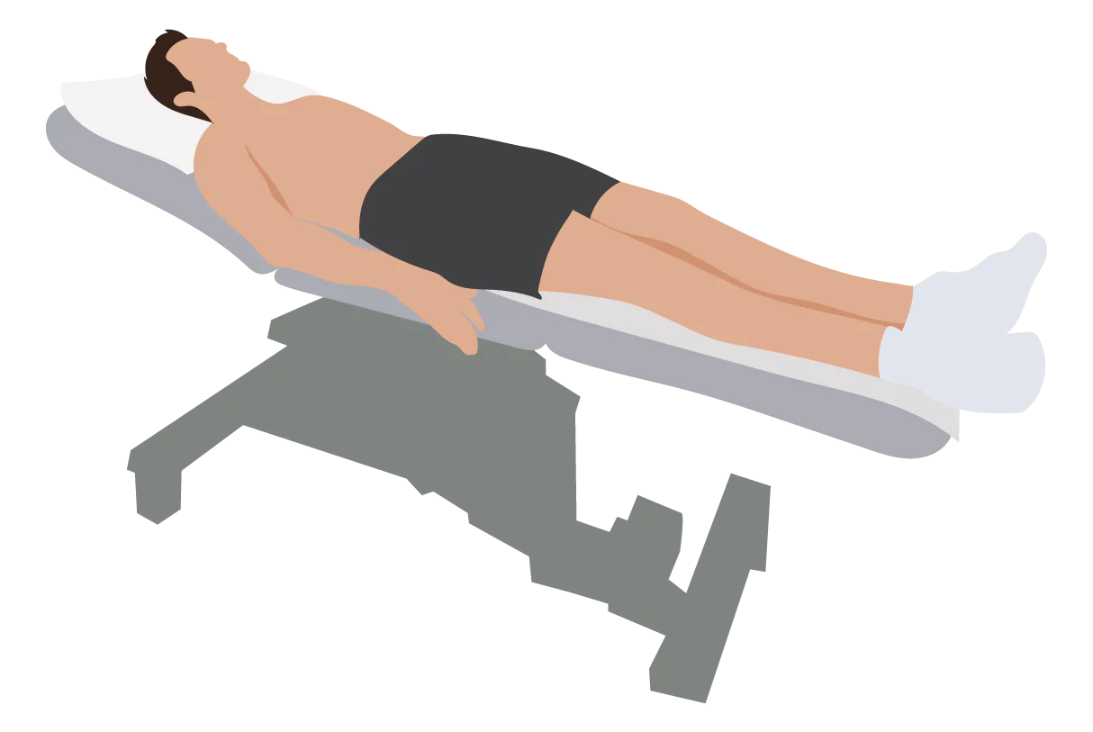
Patient Positioning for 12-Lead ECG Placement

Slide 16
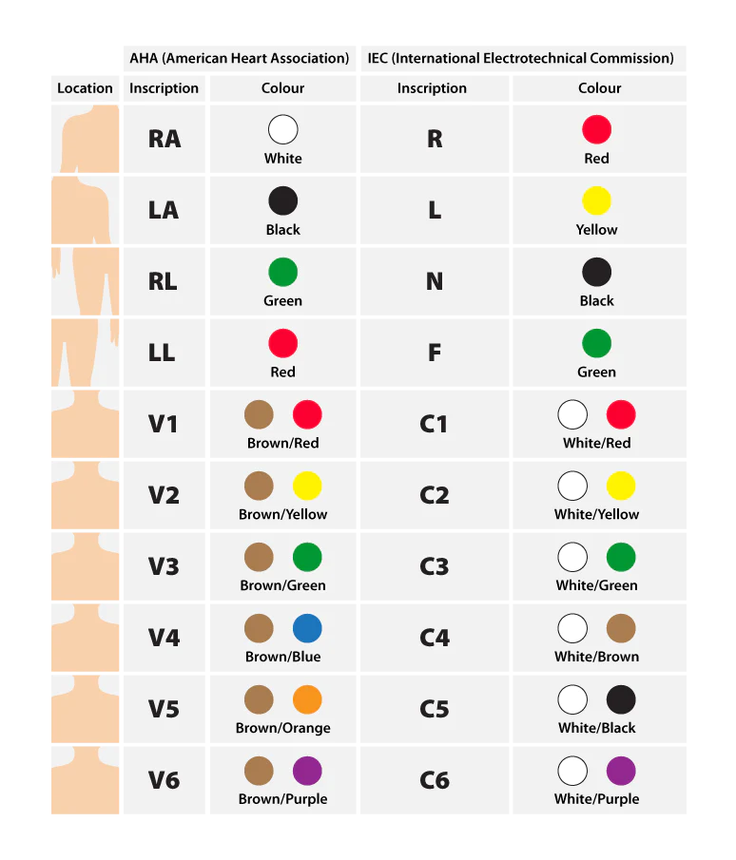
COLOR CODING STANDARDS FOR THE 12-LEAD ECG
Currently, there are two color coding standards for 12-lead ECG:
IEC (International Electrotechnical Commission) system
AHA (American Heart Association) system

Slide 17
Augmented and Precordial Leads
• Augmented: aVR, aVL, aVF
• Precordial: V1–V6
• Together provide full cardiac electrical view
Notes:
Connect to spatial orientation of leads.

Slide 18
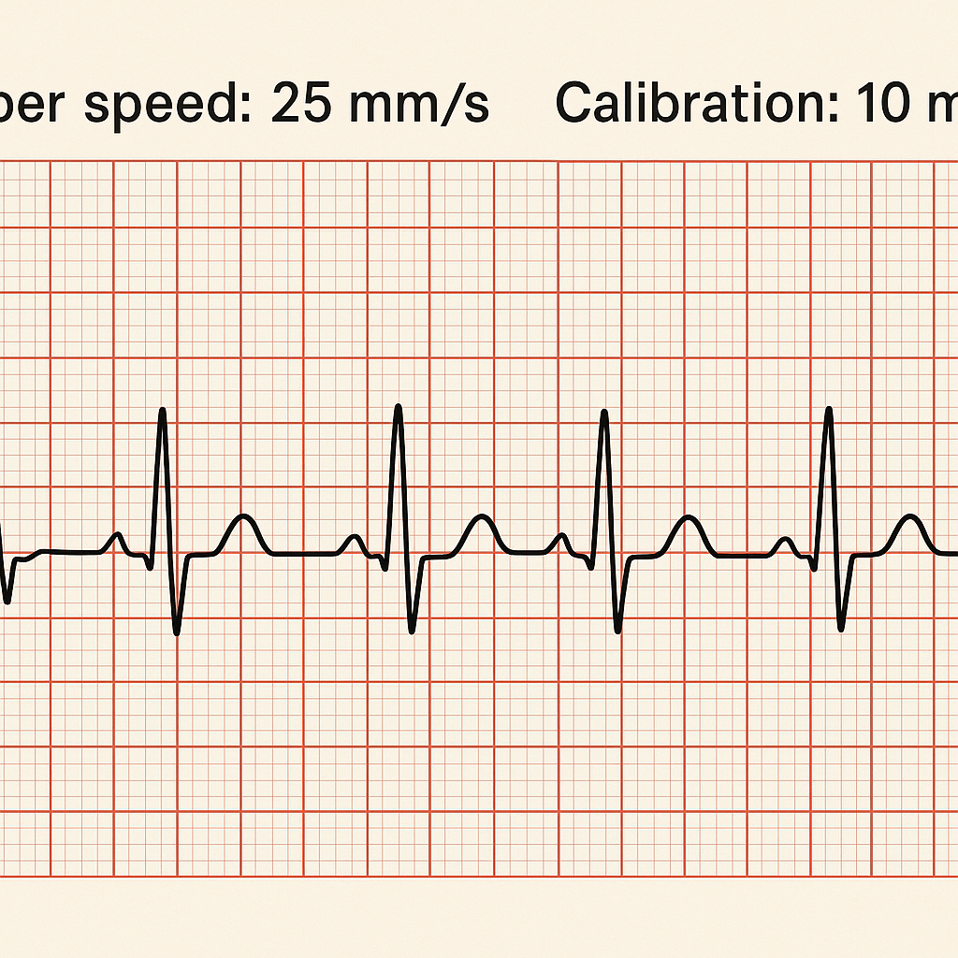
Paper Speed and Calibration
• Standard paper speed: 25 mm/sec
• Voltage calibration: 1 mV = 10 mm
Notes:
Explain importance for accurate interpretation.

Slide 19
Filters and Artifacts
• Filters remove muscle or electrical noise
• Artifacts may result from movement or poor contact
Notes:
Teach importance of clean signal acquisition.

Slide 20
Common ECG Terminology
• Depolarization: electrical activation
• Repolarization: electrical recovery
• Baseline: isoelectric line
• Complex, interval, and segment definitions
Notes:
Introduce vocabulary used in ECG interpretation.

Slide 21
COMMON ABBREVIATIONS
AA: Antiarrhythmic
AF: Atrial fibrillation
ATP: Ant tachycardia pacing
AVID: Antiarrhythmics Versus Implantable Defibrillators study
CABG: Coronary artery bypass graft
CAD: Coronary artery disease
CASH: Cardiac Arrest Study Hamburg
CHD: Coronary heart disease

Slide 22
COMMON ABBREVIATIONS
CHF: Congestive heart failure
DFT: Defibrillation threshold
EF: Ejection fraction
EPS: Electrophysiologic Study
HCM: Hypertrophic cardiomyopathy
ICD: Implantable cardioverter defibrillator
LOS: Length of stay
LQTS: Long Q-T syndrome

Slide 23
Lead Axis and Polarity
• Positive and negative electrodes create lead axis
• Wave deflection direction depends on impulse travel
Notes:
Describe how direction affects ECG tracing.

Slide 24
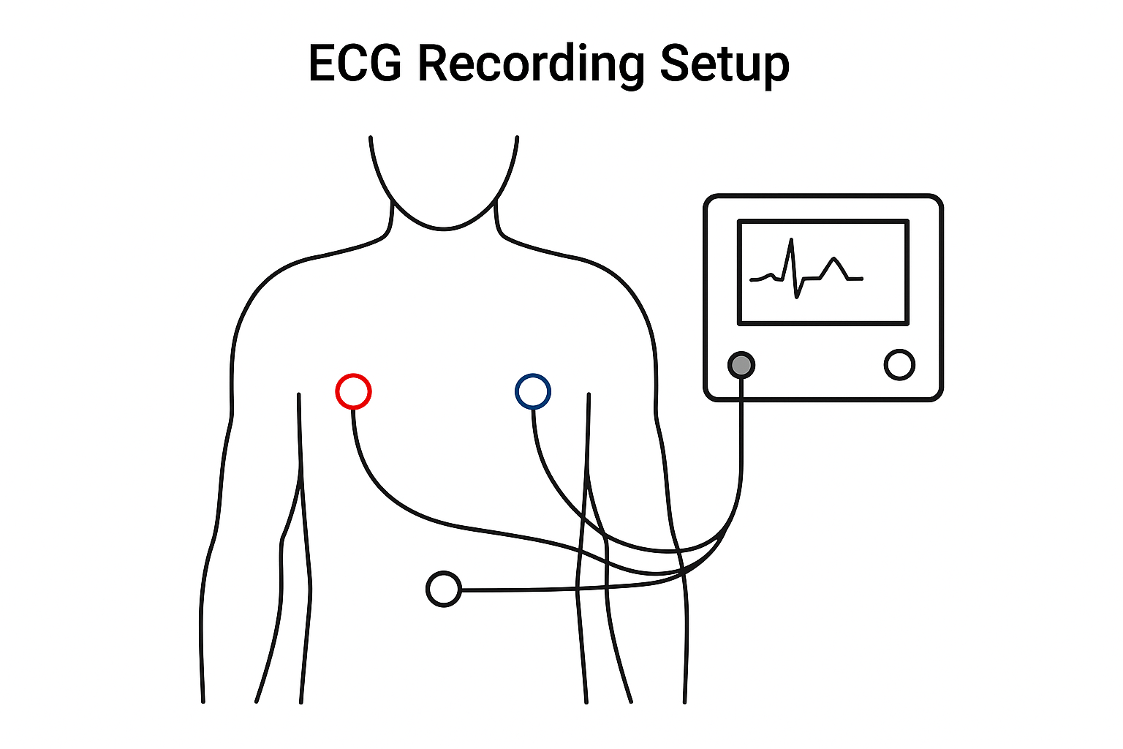
Recording a Standard ECG
Ensure calibration and paper speed are correct
Attach leads properly
Instruct patient to remain still
Notes:
Outline basic procedure for recording ECG.

Slide 25
Digital ECG Systems
• Modern ECGs store data electronically
• Software assists in rhythm analysis
• Enables easy sharing via EHR systems
Notes:
Highlight technological advancements.

Slide 26
Troubleshooting ECG Machine
• Check electrode placement and contact
• Ensure proper grounding
• Verify paper and ink supply
Notes:
Discuss maintenance and troubleshooting steps.

Slide 27
Summary
• ECG machines detect and record heart's electrical signals
• Understanding machine parts, lead systems, and terminology ensures accurate results
Notes:
Wrap up and prepare for module on patient preparation and exam setup.

Slide 28
ANY QUESTION
?

Slide 29
THANKS

