Slide 1
BLOOD/SAMPLE COLLECTION
LESSON -5
By
JITENDER YADAV
INSP/PH

Slide 2
PURPOSE
BLOOD IS USUALLY DRAWN AND COLLECTED IN ORDER TO PERFORM A VARIETY OF LABORATORY TESTS. SPECIMENS ARE OFTEN SENT TO HELP DIAGNOSE CONDITIONS SUCH AS ELECTROLYTE IMBALANCES, TO SCREEN FOR RISK FACTORS LIKE HIGH CHOLESTEROL LEVELS, AND TO MONITOR THE EFFECTS OF TREATMENTS AND MEDICATIONS.

Slide 3
BLOOD SPECIMEN COLLECTION
AND PROCESSING
THE FIRST STEP IN ACQUIRING A QUALITY LAB TEST RESULT FOR ANY PATIENT IS THE SPECIMEN COLLECTION PROCEDURE. THE VENIPUNCTURE PROCEDURE IS COMPLEX, REQUIRING BOTH KNOWLEDGE AND SKILL TO PERFORM. SEVERAL ESSENTIAL STEPS ARE REQUIRED FOR EVERY SUCCESSFUL COLLECTION PROCEDURE:

Slide 4
VENIPUNCTURE PROCEDURE:
A PHLEBOTOMIST MUST HAVE A PROFESSIONAL, COURTEOUS, AND UNDERSTANDING MANNER IN ALL CONTACT WITH ALL PATIENTS.
T HE FIRST STEP TO THE COLLECTION IS TO POSITIVELY IDENTIFY THE PATIENT BY TWO FORMS OF IDENTIFICATION; ASK THE PATIENT TO STATE AND SPELL HIS/HER NAME AND GIVE YOU HIS/HER BIRTH DATE. CHECK THESE AGAINST THE REQUISITION (PAPER OR ELECTRONIC).

Slide 5
CHECK THE REQUISITION FORM FOR REQUESTED TESTS, OTHER PATIENT INFORMATION AND ANY SPECIAL DRAW REQUIREMENTS. GATHER THE TUBES AND SUPPLIES THAT YOU WILL NEED FOR THE DRAW.
POSITION THE PATIENT IN A CHAIR, OR SITTING OR LYING ON A BED.
WASH YOUR HANDS.
SELECT A SUITABLE SITE FOR VENIPUNCTURE, BY PLACING THE TOURNIQUET 3 TO 4 INCHES ABOVE THE SELECTED PUNCTURE SITE ON THE PATIENT. SEE BELOW FOR VENIPUNCTURE SITE SELECTION “NOTES.”

Slide 6
DO NOT PUT THE TOURNIQUET ON TOO TIGHTLY OR LEAVE IT ON THE PATIENT LONGER THAN 1 MINUTE.
NEXT, PUT ON NON-LATEX GLOVES, AND PALPATE FOR A VEIN.
WHEN A VEIN IS SELECTED, CLEANSE THE AREA IN A CIRCULAR MOTION, BEGINNING AT THE SITE AND WORKING OUTWARD. ALLOW THE AREA TO AIR DRY. AFTER THE AREA IS CLEANSED, IT SHOULD NOT BE TOUCHED OR PALPATED AGAIN. IF YOU FIND IT NECESSARY TO REEVALUATE THE SITE BY PALPATION, THE AREA NEEDS TO BE RE-CLEANSED BEFORE THE VENIPUNCTURE IS PERFORMED.

Slide 7
10. ASK THE PATIENT TO MAKE A FIST; AVOID “PUMPING THE FIST”. GRASP THE PATIENT’S ARM FIRMLY USING YOUR THUMB TO DRAW THE SKIN TAUT AND ANCHOR THE VEIN. SWIFTLY INSERT THE NEEDLE THROUGH THE SKIN INTO THE LUMEN OF THE VEIN. THE NEEDLE SHOULD FORM A 15-30 DEGREE ANGLE WITH THE ARM SURFACE. AVOID EXCESS PROBING.

Slide 8
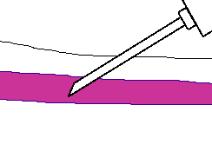

Slide 9
11. WHEN THE LAST TUBE IS FILLING, REMOVE THE TOURNIQUET.
12. REMOVE THE NEEDLE FROM THE PATIENT'S ARM USING A SWIFT BACKWARD MOTION.
13. PLACE GAUZE IMMEDIATELY ON THE PUNCTURE SITE. APPLY AND HOLD ADEQUATE PRESSURE TO AVOID FORMATION OF A HEMATOMA. AFTER HOLDING PRESSURE FOR 1-2 MINUTES, TAPE A FRESH PIECE OF GAUZE OR BAND-AID TO THE PUNCTURE SITE.
DISPOSE OF CONTAMINATED MATERIALS/SUPPLIES IN DESIGNATED CONTAINERS.

Slide 10
NOTE:
THE LARGER MEDIAN CUBITAL AND CEPHALIC VEINS ARE THE USUAL CHOICE, BUT THE BASILIC VEIN ON THE DORSUM OF THE ARM OR DORSAL HAND VEINS ARE ALSO ACCEPTABLE. FOOT VEINS ARE A LAST RESORT BECAUSE OF THE HIGHER PROBABILITY OF COMPLICATIONS

Slide 11
FINGERSTICK PROCEDURE:
FOLLOW STEPS #1 THROUGH #5 OF THE PROCEDURE FOR VENIPUNCTURE AS OUTLINED ABOVE.
THE BEST LOCATIONS FOR FINGERSTICK ARE THE 3RD (MIDDLE) AND 4TH (RING) FINGERS OF THE NON-DOMINANT HAND. DO NOT USE THE TIP OF THE FINGER OR THE CENTER OF THE FINGER. AVOID THE SIDE OF THE FINGER WHERE THERE IS LESS SOFT TISSUE, WHERE VESSELS AND NERVES ARE LOCATED, AND WHERE THE BONE IS CLOSER TO THE SURFACE. THE 2ND (INDEX) FINGER TENDS TO HAVE THICKER, CALLUSED SKIN. THE FIFTH FINGER TENDS TO HAVE LESS SOFT TISSUE OVERLYING THE BONE. AVOID PUNCTURING A FINGER THAT IS COLD OR CYANOTIC, SWOLLEN, SCARRED, OR COVERED WITH A RASH.

Slide 12
3. WHEN A SITE IS SELECTED, PUT ON GLOVES, AND CLEANSE THE SELECTED PUNCTURE AREA.
4. MASSAGE THE FINGER TOWARD THE SELECTED SITE PRIOR TO THE PUNCTURE.
5. USING A STERILE SAFETY LANCET, MAKE A SKIN PUNCTURE JUST OFF THE CENTER OF THE FINGER PAD. THE PUNCTURE SHOULD BE MADE PERPENDICULAR TO THE RIDGES OF THE FINGERPRINT SO THAT THE DROP OF BLOOD DOES NOT RUN DOWN THE RIDGES.
6. WIPE AWAY THE FIRST DROP OF BLOOD, WHICH TENDS TO CONTAIN EXCESS TISSUE FLUID.

Slide 13


Slide 14
7. COLLECT DROPS OF BLOOD INTO THE COLLECTION TUBE/DEVICE BY GENTLE PRESSURE ON THE FINGER. AVOID EXCESSIVE PRESSURE OR “MILKING” THAT MAY SQUEEZE TISSUE FLUID INTO THE DROP OF BLOOD.
8. CAP, ROTATE AND INVERT THE COLLECTION DEVICE TO MIX THE BLOOD COLLECTED.
9. HAVE THE PATIENT HOLD A SMALL GAUZE PAD OVER THE PUNCTURE SITE FOR A FEW MINUTES TO STOP THE BLEEDING.
10. DISPOSE OF CONTAMINATED MATERIALS/SUPPLIES IN DESIGNATED CONTAINERS.
11. LABEL ALL APPROPRIATE TUBES AT THE PATIENT BEDSIDE.

Slide 15
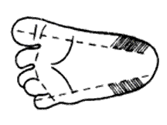
HEELSTICK PROCEDURE (INFANTS):
THE RECOMMENDED LOCATION FOR BLOOD COLLECTION ON A NEWBORN BABY OR INFANT IS THE HEEL. THE DIAGRAM BELOW INDICATES THE PROPER AREA TO USE FOR HEEL PUNCTURES FOR BLOOD COLLECTION.

Slide 16
PREWARMING THE INFANT'S HEEL (42° C FOR 3 TO 5 MINUTES) IS IMPORTANT TO INCREASE THE FLOW OF BLOOD FOR COLLECTION.
WASH YOUR HANDS, AND PUT GLOVES ON. CLEAN THE SITE TO BE PUNCTURED WITH AN ALCOHOL SPONGE. DRY THE CLEANED AREA WITH A DRY GAUZE PAD.
HOLD THE BABY'S FOOT FIRMLY TO AVOID SUDDEN MOVEMENT.
USING A STERILE BLOOD SAFETY LANCET, PUNCTURE THE SIDE OF THE HEEL IN THE APPROPRIATE REGIONS SHOWN ABOVE. MAKE THE CUT ACROSS THE HEEL PRINT LINES SO THAT A DROP OF BLOOD CAN WELL UP AND NOT RUN DOWN ALONG THE LINES.

Slide 17
5. WIPE AWAY THE FIRST DROP OF BLOOD WITH A PIECE OF CLEAN, DRY COTTON GAUZE. SINCE NEWBORNS DO NOT OFTEN BLEED IMMEDIATELY, USE GENTLE PRESSURE TO PRODUCE A ROUNDED DROP OF BLOOD. DO NOT USE EXCESSIVE PRESSURE BECAUSE THE BLOOD MAY BECOME DILUTED WITH TISSUE FLUID.
6. FILL THE REQUIRED MICROTAINER(S) AS NEEDED.
7. WHEN FINISHED, ELEVATE THE HEEL, PLACE A PIECE OF CLEAN, DRY COTTON ON THE PUNCTURE SITE, AND HOLD IT IN PLACE UNTIL THE BLEEDING HAS STOPPED. APPLY TAPE OR BAND-AID TO AREA IF NEEDED.
8. BE SURE TO DISPOSE OF THE LANCET IN THE APPROPRIATE SHARPS CONTAINER. DISPOSE OF CONTAMINATED MATERIALS IN APPROPRIATE WASTE RECEPTACLES.
9. REMOVE YOUR GLOVES AND WASH YOUR HANDS.

Slide 18
ORDER OF DRAW:
BLOOD COLLECTION TUBES MUST BE DRAWN IN A SPECIFIC ORDER TO AVOID CROSS-CONTAMINATION OF ADDITIVES BETWEEN TUBES. THE RECOMMENDED ORDER OF DRAW FOR PLASTIC VACUTAINER TUBES IS:
FIRST - BLOOD CULTURE BOTTLE OR TUBE (YELLOW OR YELLOW-BLACK TOP)
SECOND - COAGULATION TUBE (LIGHT BLUE TOP).
THIRD - NON-ADDITIVE TUBE (RED TOP)
LAST DRAW - ADDITIVE TUBES IN THIS ORDER:

Slide 19
  SST (RED-GRAY OR GOLD TOP). CONTAINS A GEL SEPARATOR AND CLOT ACTIVATOR.
  SODIUM HEPARIN (DARK GREEN TOP)
  PST (LIGHT GREEN TOP). CONTAINS LITHIUM HEPARIN ANTICOAGULANT AND A GEL SEPARATOR.
  EDTA (LAVENDER TOP)
  OXALATE/FLUORIDE (LIGHT GRAY TOP) OR OTHER ADDITIVES
NOTE: TUBES WITH ADDITIVES MUST BE THOROUGHLY MIXED. CLOTTING OR ERRONEOUS TEST RESULTS MAY BE OBTAINED WHEN THE BLOOD IS NOT THOROUGHLY MIXED WITH THE ADDITIVE.

Slide 20
LABELING THE SAMPLE
A PROPERLY LABELED SAMPLE IS ESSENTIAL SO THAT THE RESULTS OF THE TEST MATCH THE PATIENT. THE KEY ELEMENTS IN LABELING ARE:
PATIENT'S SURNAME, FIRST AND MIDDLE NAMES.
PATIENT'S ID NUMBER. NOTE: BOTH OF THE ABOVE MUST MATCH THE INFORMATION ON THE REQUISITION FORM.
DATE, TIME AND INITIALS OF THE PHLEBOTOMIST MUST BE ON THE LABEL OF EACH TUBE OR ELECTRONICALLY ENTERED. AUTOMATED SYSTEMS MAY INCLUDE LABELS WITH BAR CODES.

Slide 21
AREAS TO AVOID WHEN CHOOSING A SITE FOR BLOOD DRAW:
CERTAIN AREAS ARE TO BE AVOIDED WHEN CHOOSING A SITE FOR BLOOD DRAW:
EXTENSIVE SCARS FROM BURNS AND SURGERY - IT IS DIFFICULT TO PUNCTURE THE SCAR TISSUE AND OBTAIN A SPECIMEN.
THE UPPER EXTREMITY ON THE SIDE OF A PREVIOUS MASTECTOMY - TEST RESULTS MAY BE AFFECTED BECAUSE OF LYMPH EDEMA.
HEMATOMA - MAY CAUSE ERRONEOUS TEST RESULTS. IF ANOTHER SITE IS NOT AVAILABLE, COLLECT THE SPECIMEN DISTAL TO THE HEMATOMA.
INTRAVENOUS THERAPY (IV) / BLOOD TRANSFUSIONS - FLUID MAY DILUTE THE SPECIMEN, SO COLLECT FROM THE OPPOSITE ARM IF POSSIBLE.
CANNULA/FISTULA/HEPARIN LOCK - HOSPITALS HAVE SPECIAL POLICIES REGARDING THESE DEVICES. IN GENERAL, BLOOD SHOULD NOT BE DRAWN FROM AN ARM WITH A FISTULA OR CANNULA WITHOUT CONSULTING THE ATTENDING PHYSICIAN.
EDEMATOUS EXTREMITIES - TISSUE FLUID ACCUMULATION ALTERS TEST RESULTS.

Slide 22
BLOOD SAMPLE HANDLING AND PROCESSING:
PRE-CENTRIFUGATION HANDLING - THE FIRST CRITICAL STEP IN THE LAB TESTING PROCESS, AFTER OBTAINING THE SAMPLE, IS THE PREPARATION OF THE BLOOD SAMPLES. SPECIMEN INTEGRITY CAN BE MAINTAINED BY FOLLOWING SOME BASIC HANDLING PROCESSES:
FILL TUBES TO THE STATED DRAW VOLUME TO ENSURE THE PROPER BLOOD-TO-ADDITIVE RATIO. ALLOW THE TUBES TO FILL UNTIL THE VACUUM IS EXHAUSTED AND BLOOD FLOW CEASES.
VACUTAINER TUBES SHOULD BE STORED AT 4-25°C (39-77°F).
TUBES SHOULD NOT BE USED BEYOND THE DESIGNATED EXPIRATION DATE.

Slide 23
BLOOD SAMPLE HANDLING AND PROCESSING:
PRE-CENTRIFUGATION HANDLING - THE FIRST CRITICAL STEP IN THE LAB TESTING PROCESS, AFTER OBTAINING THE SAMPLE, IS THE PREPARATION OF THE BLOOD SAMPLES. SPECIMEN INTEGRITY CAN BE MAINTAINED BY FOLLOWING SOME BASIC HANDLING PROCESSES:
FILL TUBES TO THE STATED DRAW VOLUME TO ENSURE THE PROPER BLOOD-TO-ADDITIVE RATIO. ALLOW THE TUBES TO FILL UNTIL THE VACUUM IS EXHAUSTED AND BLOOD FLOW CEASES.
VACUTAINER TUBES SHOULD BE STORED AT 4-25°C (39-77°F).
TUBES SHOULD NOT BE USED BEYOND THE DESIGNATED EXPIRATION DATE.

Slide 24
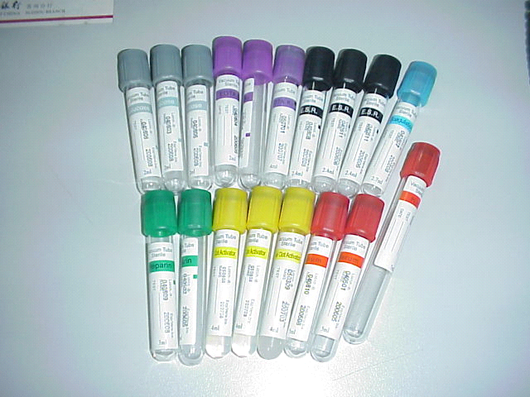
ANTICOAGULANTS-: FOR VARIOUS PURPOSES A NUMBER OF DIFFERENT ANTICOAGULANTS ARE AVAILABLE. THE ANTICOAGULANTS IN USE ARE:-

Slide 25
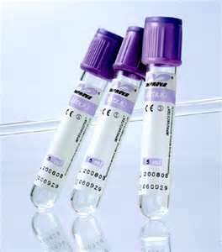
ETHYLENEDIAMINE TETRA ACIDIC ACID (EDTA):- THE SODIUM AND POTASSIUM SALTS OF EDTA ARE POWERFUL ANTICOAGULANT AND THEY ARE THE ANTICOAGULANTS OF CHOICE FOR ROUTINE HAEMATOLOGICAL WORK. EDTA ACTS BY ITS CHELATING EFFECT ON THE CALCIUM MOLECULES IN BLOOD. EDTA IS NOT SUITABLE FOR USE IN THE INVESTIGATION OF COAGULATION PROBLEMS AND SHOULD NOT BE USED IN THE ESTIMATION OF PROTHROMBIN TIME. THE RATIO OF EDTA WITH BLOOD IS 1MG /ML. CODED BY PURPLE COLOR.

Slide 26
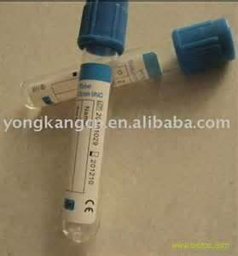
2) TRISODIUM CITRATE:- TRISODIUM CITRATE IS THE ANTICOAGULANT OF CHOICE OF COAGULATION STUDIES. 9 VOLUME OF BLOOD ARE ADDED TO 1 VOLUME OF THE SODIUM CITRATE SOLUTION AND IMMEDIATELY WELL MIXED WITH IT. CODED BY SKY BLUE COLOUR.

Slide 27
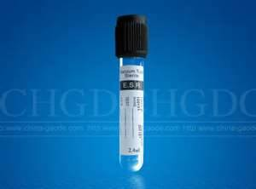
SODIUM CITRATE IS WIDELY USED IN THE ESTIMATION OF THE ERYTHROCYTE SEDIMENTATION RATE (ESR), FOR THESE 4 VOLUME BLOODS ARE DILUTED WITH 1 VOLUME OF THE SODIUM CITRATE SOLUTION. CODED BY BLACK COLOUR.

Slide 28
3) HEPARIN: THIS MAY BE USED AT A CONCENTRATION OF 13-17 IU PER ML OF BLOOD. HEPARIN IS AN EFFECTIVE ANTICOAGULANT AND DOES NOT ALTER THE SIZE OF THE RED CELLS; IT IS A GOOD DRY ANTICOAGULANT WHEN IT IS IMPORTANT TO REDUCE TO A MINIMUM THE CHANCE OF LYSIS OCCURRING AFTER BLOOD HAS BEEN WITHDRAWN. HOWEVER, HEPARINIZED BLOOD SHOULD NOT BE USED FOR MAKING BLOOD FILMS AS IT GIVES A FAINT BLUE COLORATION TO THE BACKGROUND WHEN THE FILMS ARE STAINED BY ROMANOWSKY DYES. CODED BY GREEN COLOUR.

Slide 29
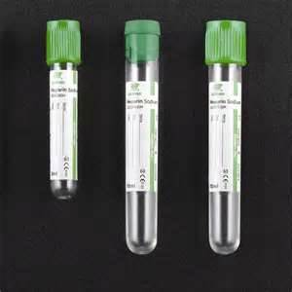
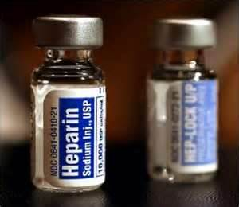

Slide 30
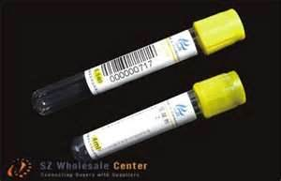
4) ACID CITRATE DEXTROSE SOLUTION:-
THIS IS PREFERRED FOR BLOOD TRANSFUSIONS, FOR PRESERVING RED CELLS, FOR ENZYME STUDIES, AND FOR THE STUDY OF HEMOLYTIC PROCESSES.

Slide 31
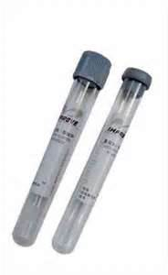
5) AMMONIUM AND POTASSIUM OXALATE MIXTURE:- THIS CONSISTS OF A MIXTURE OF 2 PARTS OF POTASSIUM OXALATE AND 3 PARTS OF AMMONIUM OXALATE. TAKE 1% SOLUTION OF POTASSIUM OXALATE 0.4ML AND 1% SOLUTION OF AMMONIUM OXALATE 0.6ML IN A TEST TUBE. EVAPORATE TO DRYNESS IN THE INCUBATOR. THIS AMOUNT OF OXALATE IS SUFFICIENT TO PREVENT COAGULATION OF 5ML OF BLOOD.

Slide 32
ANY QUESTION
?

Slide 33
THANKS

