Slide 1
MASS CASUALTY
AND
TRIAGE
LESSON -46
BY
JITENDER YADAV
INSP/PH

Slide 2
OBJECTIVES
To learn about multiple casualty incident and their management.
To learn the system of triage.

Slide 3
MASS CASUALTY
Mass casualty (Multiple casualty Incident – MCI) is any event where three or more patients are involved or when the number of injured exceeds the capabilities of the first arriving medically trained personnel

Slide 4
INCIDENT COMMAND SYSTEM (ICS)
A flexible system for managing people and resources.
One widely used plan for handling a multiple casualty incident is the Incident Command System. It provides a framework for all types of incidents. The ICS provides a command structure through which to manage multiple casualty incidents.

Slide 5
In the incident command system one component or part of the system will take care of triage, treatment, and transportation of the victims. This is common in many systems used to deal with multiple casualty incidents. The following method is a good way to divide or organize an incident to deal with triage, treatment, and transportation of the victims.

Slide 6
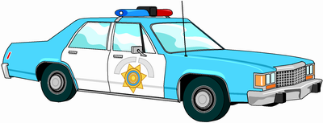
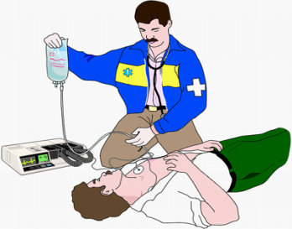
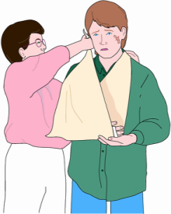
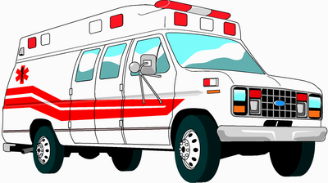
INCIDENT COMMAND SYSTEM
Communication
Outer perimeter
Command
Inner Perimeter
Incident Area
(Triage)
Security &
Access Control
Collection &
Treatment Area
Transportation
Logistics&
Staging Area
Collection area for
Walking Wounded

Slide 7
EMS SECTOR FUNCTIONS
Triage Sector
Treatment Sector
Transportation
Staging Sector
Safety Officer
Cont…

Slide 8
Triage Sector – provides patient assessment, tagging, and removal of patients to a designated treatment area.
Treatment Sector – sets up a treatment area.
Transportation Sector – arranges for ambulances and tracks patients.
Staging Sector – releases and distributes resources when they are needed.
Safety Officer – maintains scene safety.

Slide 9
ROLE OF MEDIC
Establish command.
Assess the scene.
Request additional resources.
Begin triage.

Slide 10
SCENE ASSESSMENT
Scene safety.
Number of patients.
Needs for extrication.

Slide 11
Estimated number of ambulances needed.
Other factors affecting the scene and resources.
Number of sectors needed.
Area to stage resources.

Slide 12
Make an initial scene report to EMS dispatch. Keep it brief. Give all information necessary for other rescuers to react to the MCI appropriately.

Slide 13
TRIAGE
The process of sorting patients to determine the order in which they will receive care.
Triage is a French word meaning “pick” or “sort”. It is a process of classifying sick and injured patients in a mass casualty incident. In triage, the most critical but salvageable patients are treated and transported first. It is your goal to afford the greatest number of people the greatest chance of survival.

Slide 14
“S.T.A.R.T.” METHOD OF TRIAGE
Priority 1-RED
Priority 2-YELLOW
Priority 3-GREEN
Priority 0-BLACK

Slide 15
Priority 1-RED: Highest priority, assigned
to patients with critical conditions such as airway and breathing difficulties, uncontrolled or severe bleeding, and decreased mental status.
Priority 2-YELLOW: Second priority or urgent care category. Assigned to patients with conditions such as burns without airway problems and major or multiple painful, swollen or deformed extremities; and back injuries.

Slide 16
Priority 3-GREEN: Lowest priority or delayed-care category. Assigned to patients who are not seriously injured, need minimal care, and can wait for treatment without getting worse. This includes patients with minor painful, swollen, or deformed extremities, minor soft-tissue injuries.
Priority 0-BLACK: Assigned to the dead or fatally injured. Includes injuries incompatible with life.

Slide 17
TRIAGE RIBBONS AND TAGS
After patients are assessed and sorted, they must be tagged for rapid identification.
Triage ribbons and tags come in a variety of sizes, shapes and colors.
Once a patient is given a tag, do not remove it.
If a patient changes status before being treated, draw a bold line through the original tag, note the time and put a new tag on the patient.

Slide 18
THE S.T.A.R.T. SYSTEM
Respirations
Perfusion
Mental Status
Once you have tagged to a patient, your assessment ends.
Move on to the next patient.

Slide 19
In the S.T.A.R.T. system, first tell all patients who are able to walk to move unassisted to a specified area. Assign these patients — called the “walking wounded” — a Priority 3-Green (delayed care). Then turn your attention to the patients unable to walk away. Begin triage with an initial assessment using the following benchmarks:

Slide 20
Respirations:
If breathing is faster than 30 and less than 11 respirations per minute, assign Priority 1-Red.
If the patient is not breathing, make one attempt to open the airway and clear foreign matter from the mouth. If unassisted breathing resumes, assign Priority 1-Red. If breathing does not resume, assign Priority 0-Black.
If breathing is between 11-30 per minute, perform perfusion assessment.

Slide 21
Perfusion:
Assess capillary refill. More than 2 seconds indicates inadequate perfusion – assign Priority 1-Red. Control all major hemorrhages.
If capillary refill is less than 2 seconds, perform mental status assessment.
In cases of poor lighting, check radial pulse. Absent pulse indicates blood pressure below 80 mmHg and inadequate perfusion.

Slide 22
Mental Status (ability to follow simple commands):
If patient is unable to respond to simple commands such as “close your eyes,” assign Priority 1-Red.
If the patient is able to respond, assign Priority 2-Yellow.
Once you have tagged to a patient, your assessment ends. Move on to the next patient.

Slide 23
S.T.A.R.T. FLOWCHART
Ambulatory
patient
YES
Minor Injuries
*GREEN*
NO
NO
Patient
breathing
YES
Open Airway
Adequate
respiration
NO
YES
Patient
Breathing After
opening airway
YES
URGENT
*RED*
Check Perfusion/
Radial Pulse
NO
NO
Radial Pulse
present
DEAD
*BLACK*
Control
Bleeding
NO
Can
patient follow
simple orders
YES
Check mental status
YES
DELAYED
*YELLOW*

Slide 24
ANY QUESTION
?

Slide 25
THANKS

