Slide 1

LESSON-41
TECHNIQUE OF HYPODERMIC IM,IV ADMINISTRATION OF FLUID
BY
AMANDEEP KAUR
ASI/ANM

Slide 2
GENERAL GUIDELINES
Essential anti-anaphylactic drugs should be kept readily available in an emergency tray before giving any injection
Prior to giving any injection, history of any reaction to injection or any allergy or asthmatic attack should always be enquired
Before administering the injection, one should read the label of the vial/ampule noting the name, expiry date and the routes of administration mentioned

Slide 3
GENERAL GUIDELINES
It is always preferable to give intra-dermal test dose to safeguard the patient as well physician. Negative result does not guarantee that all further injections of the same medicine may not cause allergic reaction, but ensures that one has taken reasonable precaution
Never give any patient injection while standing. Lying down position is the best for the patient, sitting with a proper support is the next best choice.
Always aspirate before injecting so that the position of the needle can be ascertained (if inadvertently in vessel in IM or if correctly in vein in IV inj)

Slide 4
Medicines should be injected slowly, especially
by IV route.
While giving infusion - observe neck veins for distension, auscultate for any rales, look at the injection site to note for any extravasation and overall general condition of the patient
Patient should be observed for ½ hour after any injection
Do not mix 2 drugs in the same syringe if one is not clear about their compatibility
Always administer injections in morning sessions and if in evening, early evening so that any acute emergency arising out of injection administration can be managed effectively

Slide 5
SYRINGES & NEEDLES:
A syringe is a simple reciprocating pump consisting of a plunger that fits tightly within a cylindrical tube called a barrel.
The plunger can be linearly pulled and pushed along the inside of the tube, allowing the syringe to take in and expel liquid or gas through a discharge orifice at the front end of the tube.

Slide 6
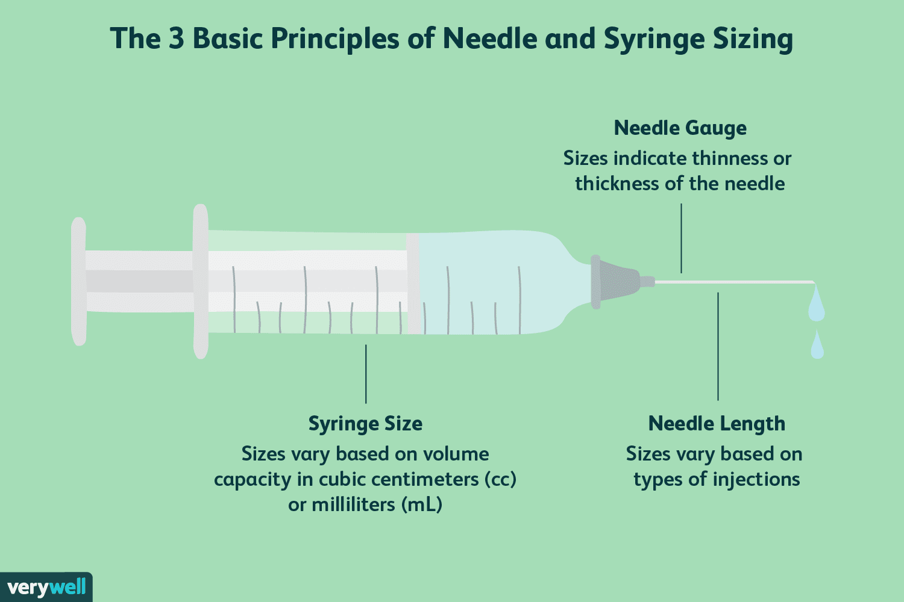

Slide 7
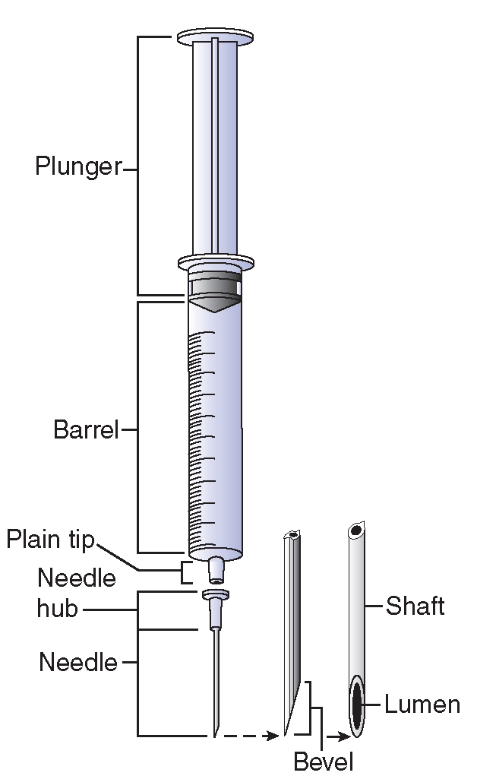

Slide 8
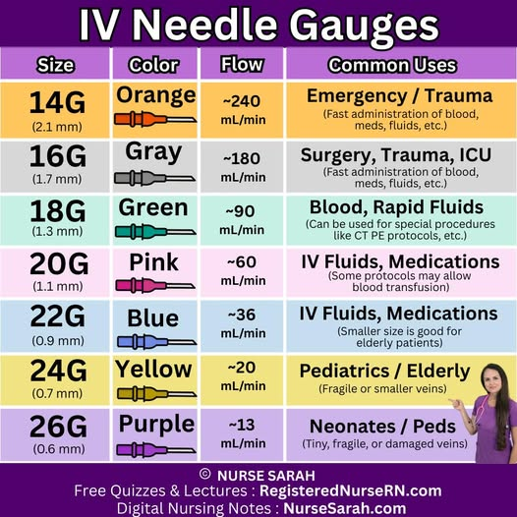

Slide 9
PREPARING INJECTIONS: AMPULES &VIAL
AMPULE:-
1. An Ampule Contains Single Doses Of
Injectable Medication In A Liquid Form And
Are Available In A Size Of 1ml To 10 Ml Or More.
2. An ampule is made of glass with constricted
Neck that is snapped off to allow access to
the medication.
3. A coloured ring around the neck indicates
where the ampule is pre-scored to be broken
easily

Slide 10
4. Medication is easily withdrawn from the amp.
By aspirating with a filter needle & syringe.
5. Filter needles must be used when preparing
Medications fm a glass amp to prevent glass
particles from being drawn into the syringe.
6. Donot use the filter needle to administer
the medication
7. Draw up medication quickly, using a filter needle
long enough to reach bottom of the ampule to
access medication.

Slide 11
8. Hold ampule upside down or set it on a flat surface.
Enter filter needle into center of ampule opening.
Donot allow needle tip or shaft to touch rim of ampule.
9. Aspirate medication into a syringe by gently pulling
back on plunger.
10. Keep needle tip under surface of liquid. Tip ampule
to bring all fluid within reach of needle.
11. If you aspirate air bubbles, do not expel air into ampule.

Slide 12
COLLECTION OF INJECTION MATERIAL
FROM AMPOULES
Ampoules have narrow upper portion (the stem), wide lower portion (body) with a neck in between, which may be constricted or smoothly curved.
Apply the spirit swab to the neck, tap gently on the upper portion and rub the file gently at the neck in circular fashion.
Break away the stem either by gentle pressure or by cutting with file.

Slide 13
COLLECTION OF INJECTION MATERIAL
FROM AMPOULES
Break away the stem either by gentle pressure or by cutting with file.
Take care that the cut is even and no broken pieces of glass enters the ampoule.
Hold the ampoule in tilted position with open end at higher level and using a longer wide bore needle aspirate the fluid in the syringe. Never push air into the ampoule

Slide 14
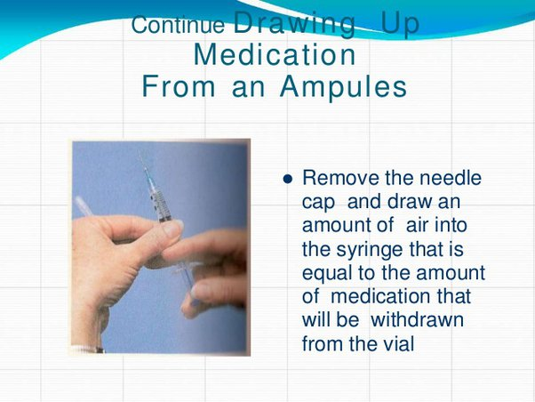

Slide 15
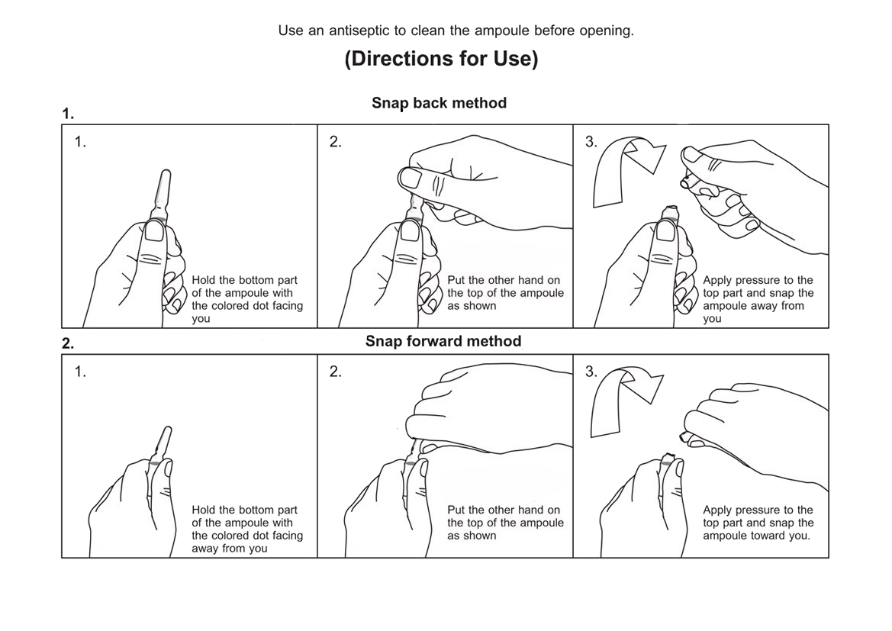

Slide 16
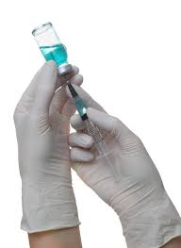
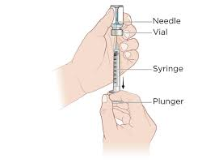

Slide 17
COMMON ROUTES OF INJECTION AND TECHNIQUES
INTRADERMAL:
Avoid visible veins
Stretch the skin
Keeping the syringe and the needle practically parallel to the skin, just pierce the skin, keeping bevel of the needle up. Push the needle just beyond the bevel and inject.

Slide 18
SUBCUTANEOUS:
Pinch the skin and lift it up in a thin person and pierce the skin at 90⁰ angle with a short fine needle
If a person is obese with thick subcutaneous fat, stretch the skin, and pierce the skin with a medium length needle
Aspirate and inject slowly

Slide 19
INTRAMUSCULAR:
The site selected should be away from important nerves
Relax the muscle by contracting the opposite group of muscles
Collect the medicine with one needle from the container and use another appropriate needle for injecting the drug
Always aspirate prior to injection and inject gradually
Injection in Deltoid muscle:

Slide 20
INJECTION IN DELTOID MUSCLE:
Allow the arm to hang by the side of the chest
Avoid directing injection close to the radial groove
The middle of the muscle (centre of the acromian process and the insertion of the deltoid muscle in the humerus) is the ideal site
The muscle mass may be picked up with the thumb and fingers of the left hand and the muscle pierced at right angle
Aspirate for confirming that the needle is not in the blood vessel and then inject.

Slide 21
INJECTION IN GLUTEAL MUSCLE:
Do not use this site in children
Flex the thigh at hip
Right gluteal area – keeping the ball of the left index finger just above the greater trochanter and pointing the index finger towards the right anterior superior iliac spine and then keeping middle finger at right angle to the index finger pointing towards the upper border of the iliac crest gives a ‘V’ shaped area enclosed between the two fingers that is ideal for injection.

Slide 22
INJECTION IN GLUTEAL MUSCLE:
In Z technique, the skin is stretched with the thumb of other hand in distal direction and after injection slowly the pressure on the skin is released so that the injected material does not come up superficially and cause irritation to the superficial tissues.

Slide 23
Intravenous:
Used for giving a) quick bolus; b) slow bolus;
c) fast iv infusion
Because fluids/medications are instilled into the blood stream, absolute sterile technique is necessary
Standard equipment include: IV solution/ medication and tubing, Needle or catheter, antiseptic, tourniquet, gloves and dressing and an arm board in children
Veins usually on the upper extremity nearer the cubital fossa, anterior aspect of forearm and the dorsum of hands as they are easily visible and superficial. If right handed, prefer left hand for infusion

Slide 24
Intravenous:
Contraindications for venipuncture site:
infection, infiltration or thrombosis.
The vein is made prominent by tourniquet, placed above or tapping over the area & asking the patient to clench the fist for few times.
After swabbing the area, the venflon guide with needle is introduced into the vein and and needle withdrawn back and simultaneously pushing the plastic tubing into the vein.
It is then fixed firmly to adjacent skin with adhesive tape without soiling the tape with blood as it promotes infection.
Always check expiry date, any suspended articles in medication/infusion before IV administration

Slide 25
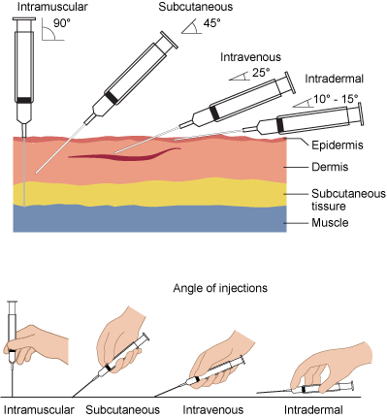

Slide 26
FACTORS TO CONSIDER
When Choosing an Injection Site:
Type of injection: Different injection types require different depth and tissue types.
Patient's age and physical condition: Infants and young children may have different injection site recommendations than adults.
Medication being administered: Some medications may be better suited for specific injection sites.
Patient comfort and convenience: Choosing a site that is easily accessible and causes minimal discomfort is important.
Avoiding nerves and blood vessels: Proper technique and site selection are crucial to avoid injury.

Slide 27
EXAMPLES OF SPECIFIC INJECTION SITES:
Upper Arm:
The outer side or back of the upper arm can be used for subcutaneous injections.
Thigh:
The front and outer side of the thigh is a common site for both subcutaneous and intramuscular injections.
Abdomen:
The area below the ribs and above the hip bones is suitable for subcutaneous injections, avoiding the navel and waistline.
Buttocks:
The ventrogluteal site (hip) is a common intramuscular injection site, especially for adults.
Deltoid:
The deltoid muscle in the upper arm is another common intramuscular injection site, particularly for vaccines.

Slide 28
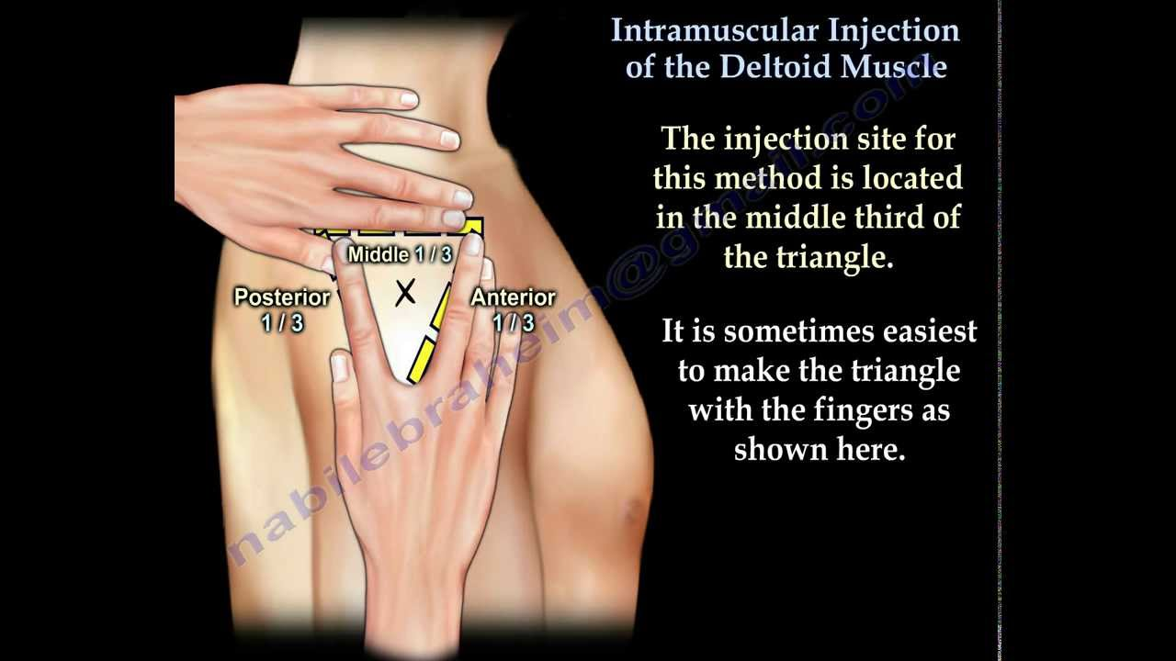

Slide 29
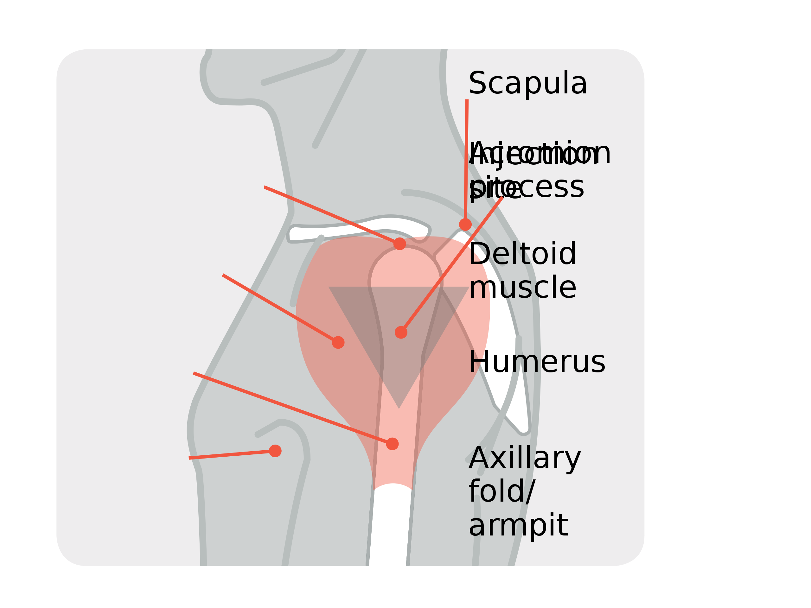

Slide 30
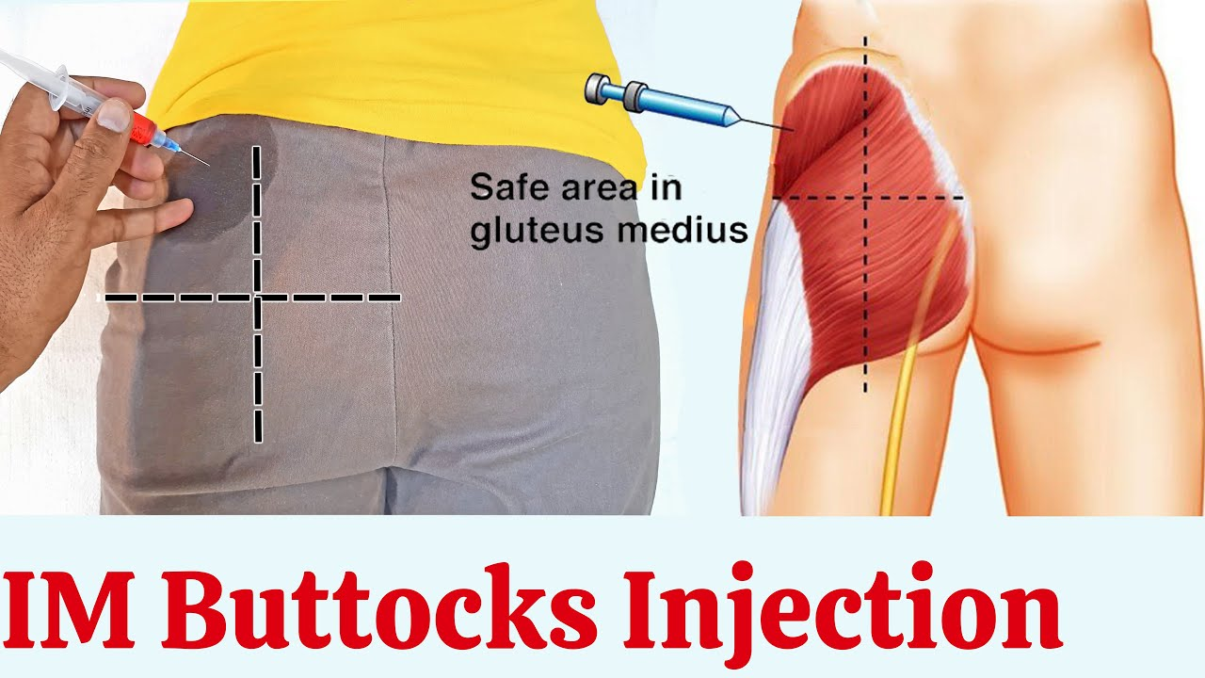

Slide 31
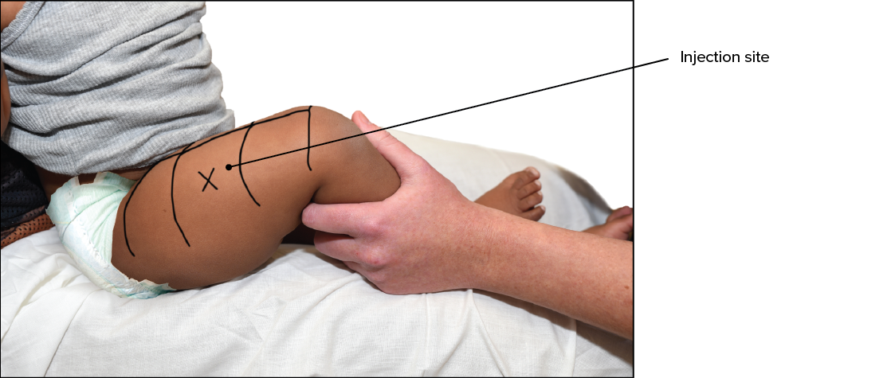

Slide 32


Slide 33
IV INFUSIONS
Articles required:
Sterile tray containing appropriate IV fluid as prescribed
IV cannula or scalp vein
disposable syringe
cotton swabs
spirit
adhesive tape
tourniquet
kidney tray
IV stand

Slide 34
GENERAL GUIDELINES:
Reassure the patient and record vitals
Set the IV stand and check the fluid to be infused and temperature
Ask the patient to void before infusion
Select a site on the non-dominant arm and ensure good light source
Call for assistance if required

Slide 35
PROCEDURE:
Wash your hands
Remove the bottle seal from the top; swab with spirit; holding the bottle upright, insert the drip set and air vent into the bottle openings
Close the screw clamp to prevent drip chamber being completely filled by fluid
Set the bottle on the IV stand about 18 – 24 inches high

Slide 36
PROCEDURE:
Connect the scalp vein set or needle to the IV tubing and open the clamp and flush the IV fluid through tubing and needle into a kidney tray until air is removed. Clamp the tube and re-apply the protective covering over needle.
Prepare few strips of adhesive tape ready for use
Prepare the veni-puncture site by applying tourniquet above, swabbing over the site and by gently tapping the vein to make it prominent

Slide 37
PROCEDURE:
Grasp the arm distally to the point of entry of the needle and make the skin taut; holding the needle or venflon at 30 degree angle with bevel up, pierce the skin lateral to the vein. Now follow the course of the vein and pierce the side of the vein
When backflow of blood occurs into the needle and tubing, gently insert the needle ¾ ich further into the vein; if IV cannula, then gradually withdraw the stillet/needle and simultaneously advance the plastic tubing into the vein

Slide 38
PROCEDURE:
Secure the needle / iv cannula with the base to limit movement of the needle in the vein
Secure the iv tubing forming a loop and splint the arm if necessary
Maintain the flow rate prescribed
Record the fluid administered, time of starting and rate of flow and if any medication added to the infusion
Monitor the patient for fluid overload, chills, restlessness, dyspnoea

Slide 39
PROCEDURE:
If flow stopped, then check the following:
    1. Stroke the vein gently above needle to relieve spasm
    2. If swelling above the site/displacement of needle, remove and restart elsewhere
    3. Kinking of the tube or minor displacement of the needle can be corrected by adjusting the tubing or needle
    4. Elevating the height of bottle if pressure within IV fluid is low
    In infusions, always ensure that the temperature of fluid administered is at room temperature and keep the patient warm and comfortable

Slide 40
PROCEDURE:
Watch for the completion of bottle and when needed to change the IV bottle, prepare the new bottle prior to finish of old one; clamp the intravenous tubing, remover the air vent and tubing and insert into the new one and re-start
When the infusion is over, clamp the tubing; loosen all the adhesive tapes securing the needle and tubing
Gently remove the needle from the vein and press a dry sterile swab over the site and apply firm pressure
Apply a firm adhesive and ask the patient to keep the limb elevated for some time

Slide 41
COMPLICATIONS:
Circulatory overload
Allergic reaction
c) Hematoma
d) Thrombophlebitis
e) Pyrogenic reactions
f) Air embolism
g) Infiltration into subcutaneous tissues

Slide 42
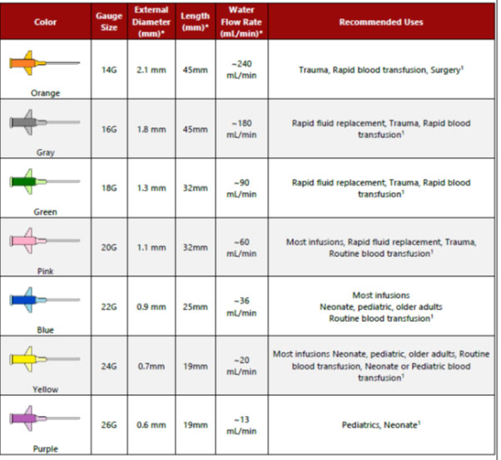

Slide 43
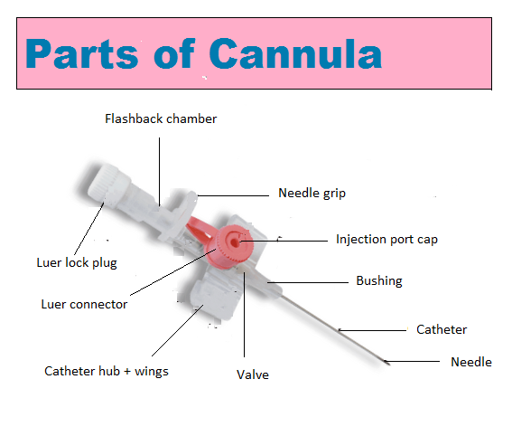

Slide 44
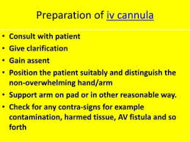

Slide 45
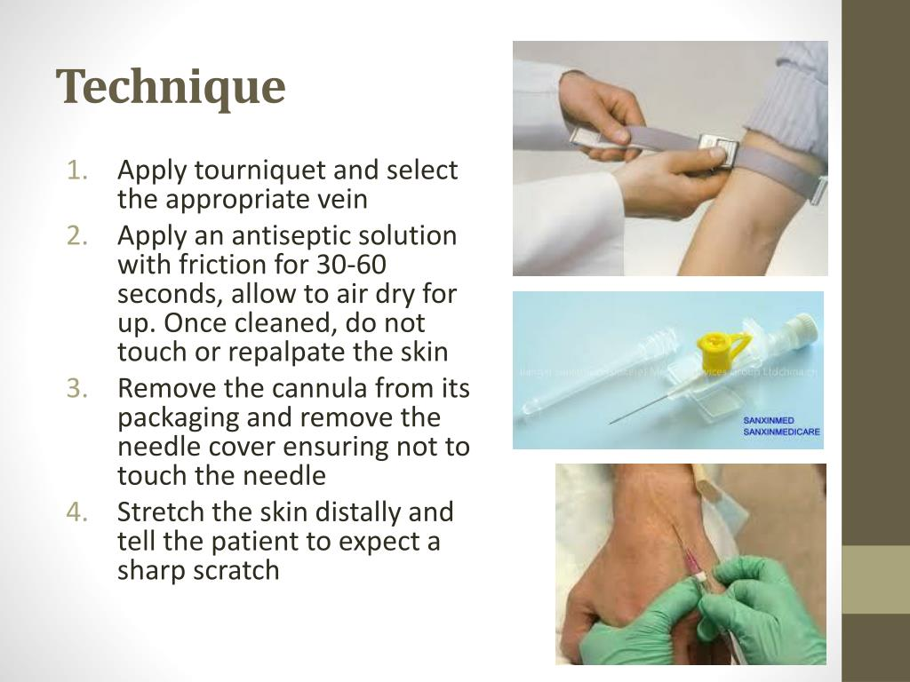


Slide 46
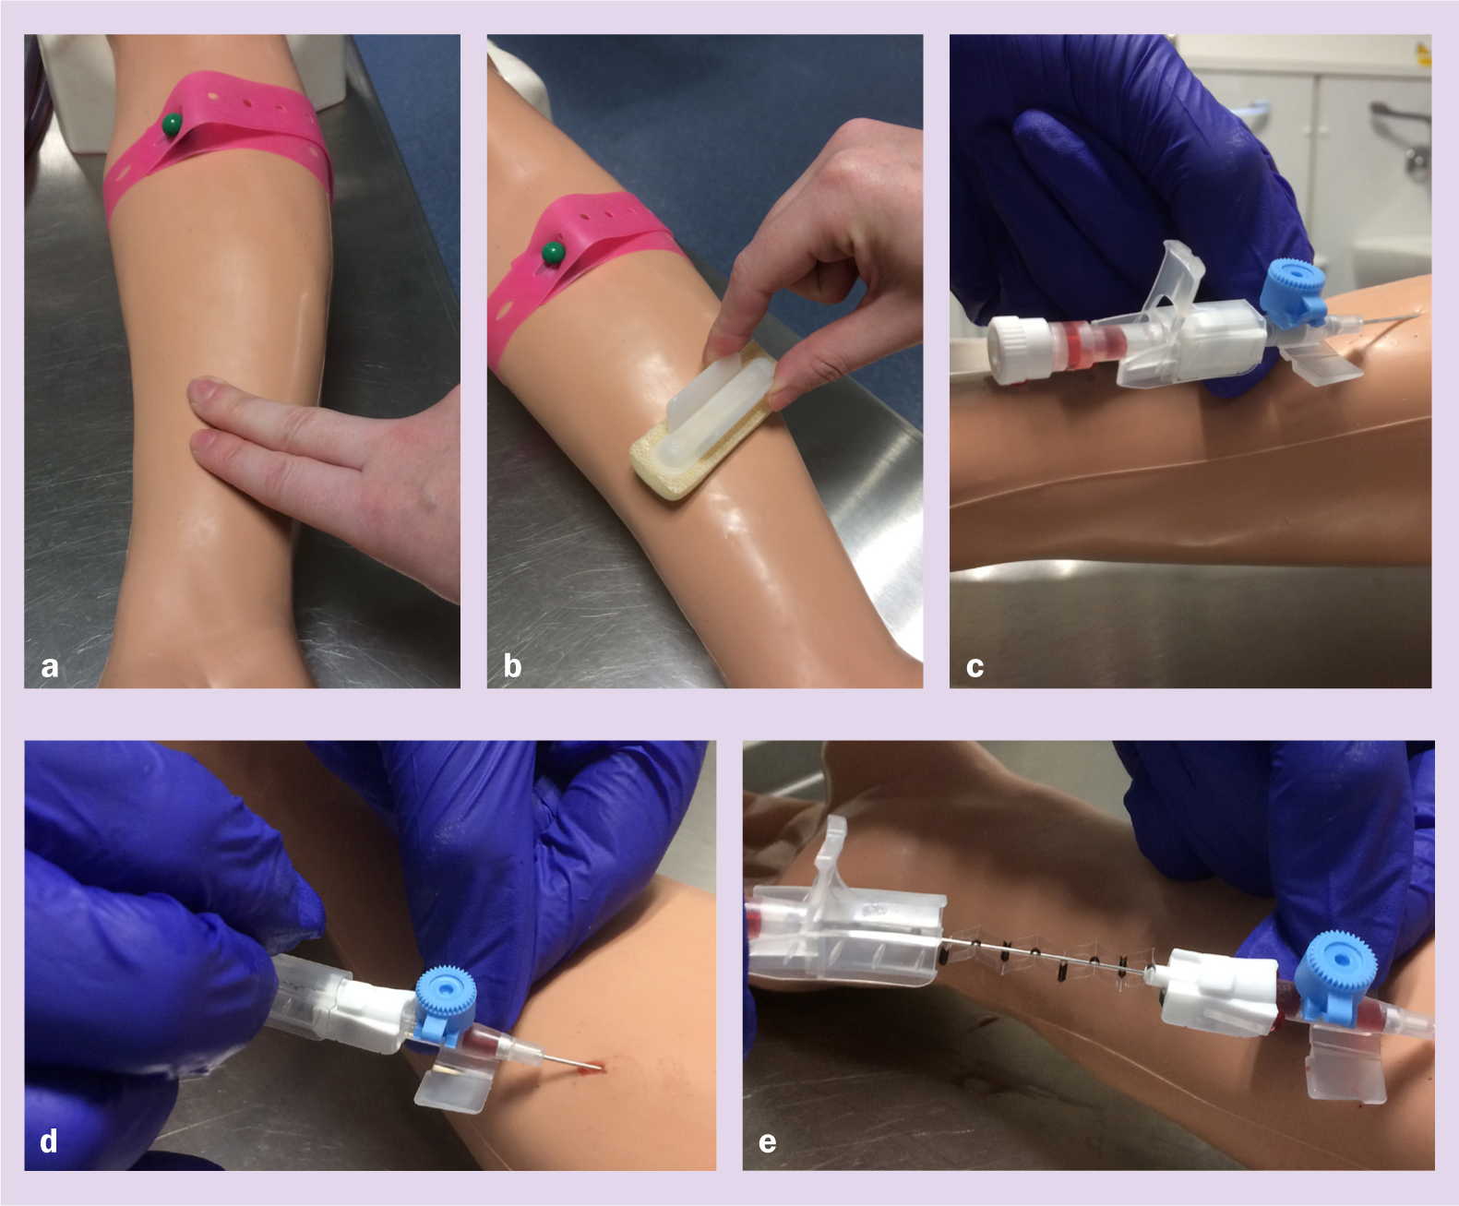

Slide 47


Slide 48
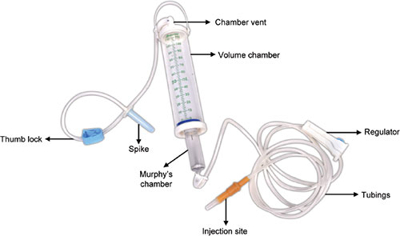

Slide 49
TYPE | SOLUTION | USES | SPECIAL CONSIDERATION
ISOTONIC | DEXTROSE 5% IN WATER (D5W) | -FLUID LOSS -DEHYDRATION -HYPERNATREMIA | -USE CAUTIOUSLY IN RENAL AND CARDIAC PATIENTS -CAN CAUSE FLUID OVERLOAD
ISOTONIC | 0.9% SODIUM CHLORIDE (NORMAL SALINE) | -SHOCK -HYPERNATREMIA -BLOOD TRANSFUSION -RESUSCITATION -FLUID CHALLENGES | -CAN LEAD TO OVERLOAD -USE IN PATIENT WITH HEART FALIURE AND EDEMA
ISOTONIC | LACTATED RINGERS (RL) | DEHYDRATION -BURNS LOWER GI FLUID LOSS ACUTE BLOOD LOSS HYPOVOLEMIA DUE TO THIRD SPACING | -CONTAIN POTASSIUM, DONOT USE IN RENAL FALIURE PATIENTS -DONOT USE WITH LIVER DISEASE, CAN NOT METABOLISE LACTATE

Slide 50
TYPE | SOLUTION | USES | SPECIAL CONSIDERATION
HYPOTONIC | 0.45% SODIUM CHLORIDE (1/2 NORMAL SALINE) | -GASTRIC FLUID LOSS FM NG OR VOMITTING WATER REPLACEMENT DKA | -USE WITH CAUTION -MAY CAUSE CARDIOVASCULAR COLLAPSE OR INCREASED INTRACRANIAL PRESSURE - DONOT USE WITH LIVER DISEASES , TRAUMA OR BURNS.
HYPERTONIC | DEXTROSE 5% IN ½ NORMAL SALINE | -LATER IN DKA TREATMENT | -USE ONLY WHEN BLOOD SUGAR FALL 250MG/dl
HYPERTONIC | DEXTROSE 5% IN NORMAL SALINE | TEMPORARY TREATMENT FOR SHOCK IF PLASMA EXPENDERS ARE NOT AVAILABLE ADDITIONS CRISIS. | -DONOT USE IN CARDIAC AND RENAL PATIENTS
HYPERTONIC | DEXTROSE 10% IN WATER | WATER REPLACEMENT CONDITIONS WHERE SOME NUTRITION WITH GLUCOSE IS REQUIRED | - MONITOR BLOOD SUGAR LEVEL.

Slide 51


Slide 52


Slide 53



Slide 54

ENEMA

Slide 55
