Slide 1
Operation procedure of ambulance stretcher
LESSON-04
By
OMKAR YADAV
INSP/PH

Slide 2
INTODUCTION
Importance of efficient ambulance stretcher operation in emergency medical services.
Key role in patient care and safety during transport.

Slide 3
Types of Ambulance Stretchers
SOME TYPES OF STRETCHERS ARE –
Manual stretchers
Hydraulic stretchers
Electric stretchers
Bariatric stretchers

Slide 4
MANUAL STRETCHERS-Manual stretchers are devices designed for the manual movement and transportation of individuals, particularly in medical or emergency situations. These stretchers are operated by human force rather than powered mechanisms, and they are commonly used to transport patients within healthcare facilities or during rescue operations. Manual stretchers typically feature adjustable components to accommodate different body sizes and may include safety features to secure the patient during transport.

Slide 5
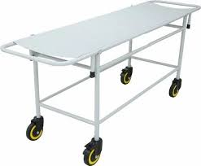
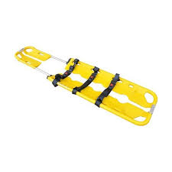
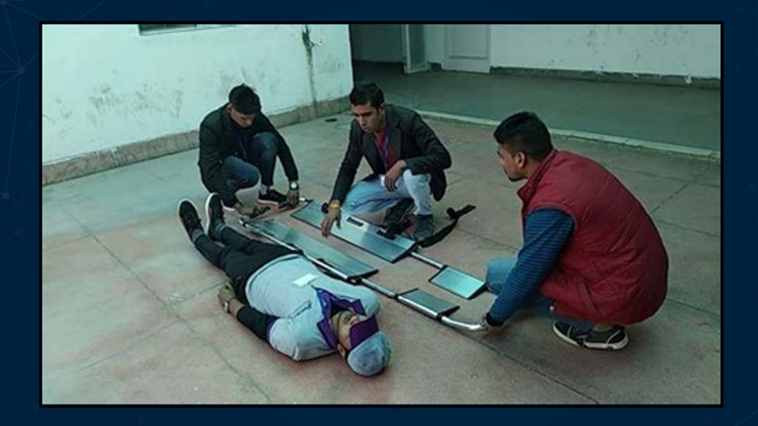
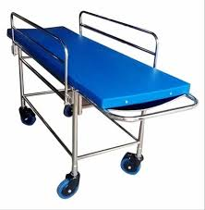

Slide 6
HYDRAULIC STRETCHER-Hydraulic stretchers are medical devices equipped with a hydraulic system to facilitate the lifting and adjustment of the stretcher's height or other functionalities. These stretchers use hydraulic fluid and a piston system to enable smooth and controlled movements, allowing healthcare professionals to easily adjust the stretcher to a comfortable working height or transfer patients with minimal manual effort. The hydraulic mechanism provides precision and stability in position changes, enhancing patient care and comfort during transportation within medical facilities

Slide 7
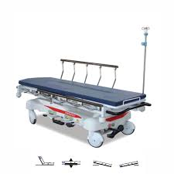
ELECTRIC STRETCHER

Slide 8
ELECTRIC STRETCHERS- Electric stretchers are medical devices powered by electricity to enable automated and motorized adjustments in height, tilt, and other functions. These stretchers utilize electric motors and control systems to facilitate easy and precise positioning of the stretcher, providing convenience for healthcare professionals during patient transfers and procedures. Electric stretchers often come equipped with features such as remote control, allowing healthcare staff to adjust the stretcher's configuration with minimal physical effort, enhancing efficiency and patient care in medical settings.

Slide 9
BARIATRIC STRETCHERS- Bariatric stretchers are specialized medical stretchers designed to accommodate the unique needs of bariatric or obese patients. These stretchers are constructed with robust materials and reinforced structures to support higher weight capacities compared to standard stretchers. Bariatric stretchers often feature wider surfaces, heavy-duty frames, and enhanced stability to ensure the safe and comfortable transport of larger individuals. These specialized stretchers play a crucial role in providing adequate care and maintaining the dignity of bariatric patients during medical procedures, transfers, or emergencies.

Slide 10
Preparing the Ambulance Stretcher
TO PREPARE A AMBULANCE STRETCHER –
Ensure cleanliness and hygiene
Check for any damage or malfunction.
Secure all loose items.

Slide 11
Positioning the Ambulance Stretcher
Ensure a clear path for movement.
Align the stretcher with the ambulance entrance.
Lock the wheels to prevent movement during loading/unloading.

Slide 12
Loading the Patient onto the Stretcher
TO LOAD A PATIENT COMFORTABLY –
Communicate with the patient and other medical personnel.
Lift the patient using proper body mechanics.
Secure the patient on the stretcher with safety straps.

Slide 13
Securing the Patient on the Stretcher
Utilize safety belts and straps to prevent movement.
Adjust the stretcher height for ease of access and visibility.
Ensure the patient is comfortable and stable.

Slide 14
Communication and Teamwork
Emphasize the importance of clear communication.
Coordinate with other medical personnel during movements.
Practice effective teamwork for efficient operations.

Slide 15
Unloading the Patient
Align the stretcher with the destination.
Lower the stretcher to a suitable height.
Safely transfer the patient to the receiving medical facility WITH PROPER HANDOFF REPORT.

Slide 16
Cleaning and Maintenance
Stress the need for regular cleaning and disinfection.
Inspect the stretcher for any wear or damage.
Report and address any issues promptly.

Slide 17
POINTS TO REMEMBER
IN CONCLUSION, ITS VERY IMPORTANT TO TAKE CARE OF SOME MEASURES LIKE CLEANLINESS,TEAMWORK,POSITIONING,ETC.OR ELSE,IT CAN HARM THE PATIENT IN MANY WAYS. FOR EXAMPLE,IF THE STRETCHER IS DIRTY IT CAN CAUSE INFECTION TO THE PATIENT AND IF THE STRETCHER IS POSITIONED WRONG IT CAN CAUSE SPRAIN TO THE PATIENT DURING TRANSPORT.

Slide 18
THANK YOU

