Slide 1
Electrical Conduction System of the Heart
LESSON -4
By
AMANDEEP KAUR
ASI/ANM

Slide 2
Learning Objectives
By the end of this module, you will be able to:
• Identify the key components of the cardiac conduction system
• Explain the role of each node and fiber
• Describe how electrical impulses coordinate heart contractions
• Understand the relationship between conduction and ECG tracing
Notes:
Introduce conduction system objectives.

Slide 3
Introduction
The electrical conduction system controls the rhythmic beating of the heart, ensuring coordinated contractions of the atria and ventricles.
Notes:
Overview of heart's intrinsic pacemaker system.

Slide 4
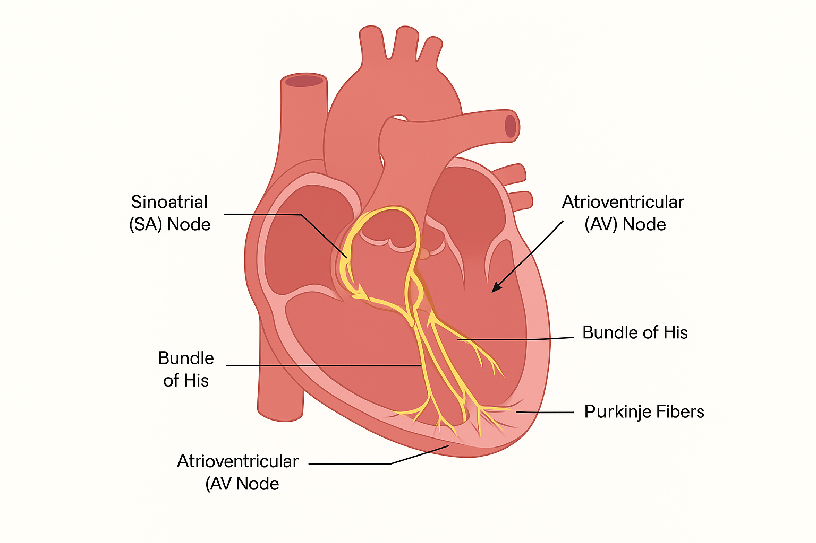
SA Node – The Pacemaker
• Sinoatrial (SA) node is located in the right atrium
• Initiates impulses at 60–100 bpm
• Sets the pace for the entire heart
Notes:
Highlight its role as the primary pacemaker.

Slide 6
AV Node
• Located at the junction of atria and ventricles
• Delays impulse ~0.1 sec to allow atrial contraction
• Secondary pacemaker (40–60 bpm)
Notes:
Explain importance of delay in cardiac efficiency.

Slide 7
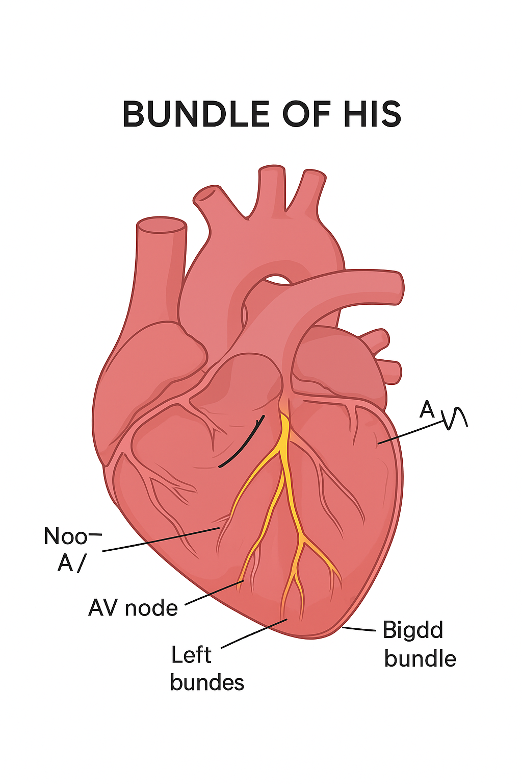
Bundle of His
• Conducts impulse from AV node to ventricles
• Divides into right and left bundle branches
Notes:
Emphasize as a bridge between atria and ventricles.

Slide 8
Right and Left Bundle Branches
• Travel along interventricular septum
• Carry impulses to respective ventricles
Notes:
Discuss synchronized conduction in ventricles.

Slide 9
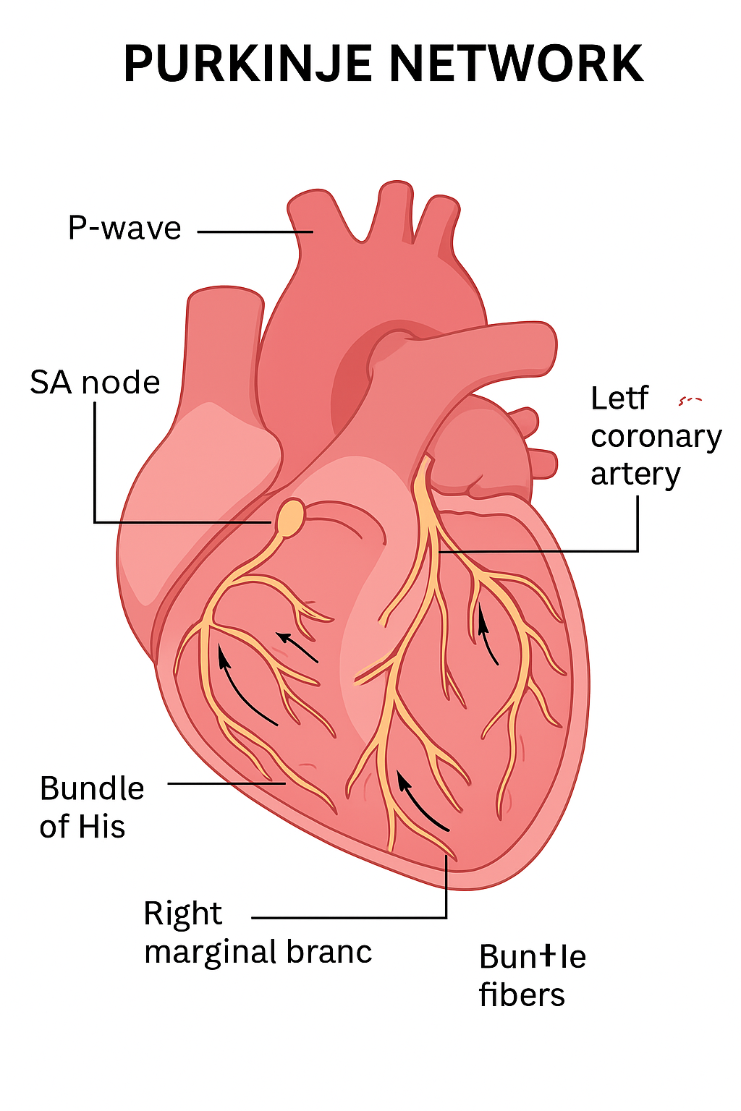
Purkinje Fibers
• Fine network of fibers spreading through ventricles
• Enable rapid depolarization and contraction
Notes:
Explain their importance in strong ventricular contractions.

Slide 10
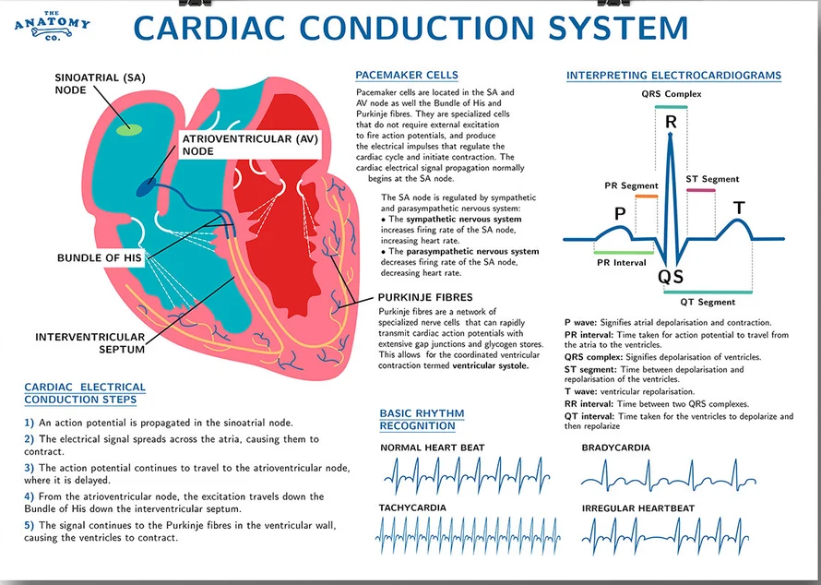

Slide 11
Sequence of Conduction
1. SA node → 2. AV node → 3. Bundle of His → 4. Right & Left Bundle Branches → 5. Purkinje Fibers
Notes:
Trace the impulse path step-by-step.

Slide 12
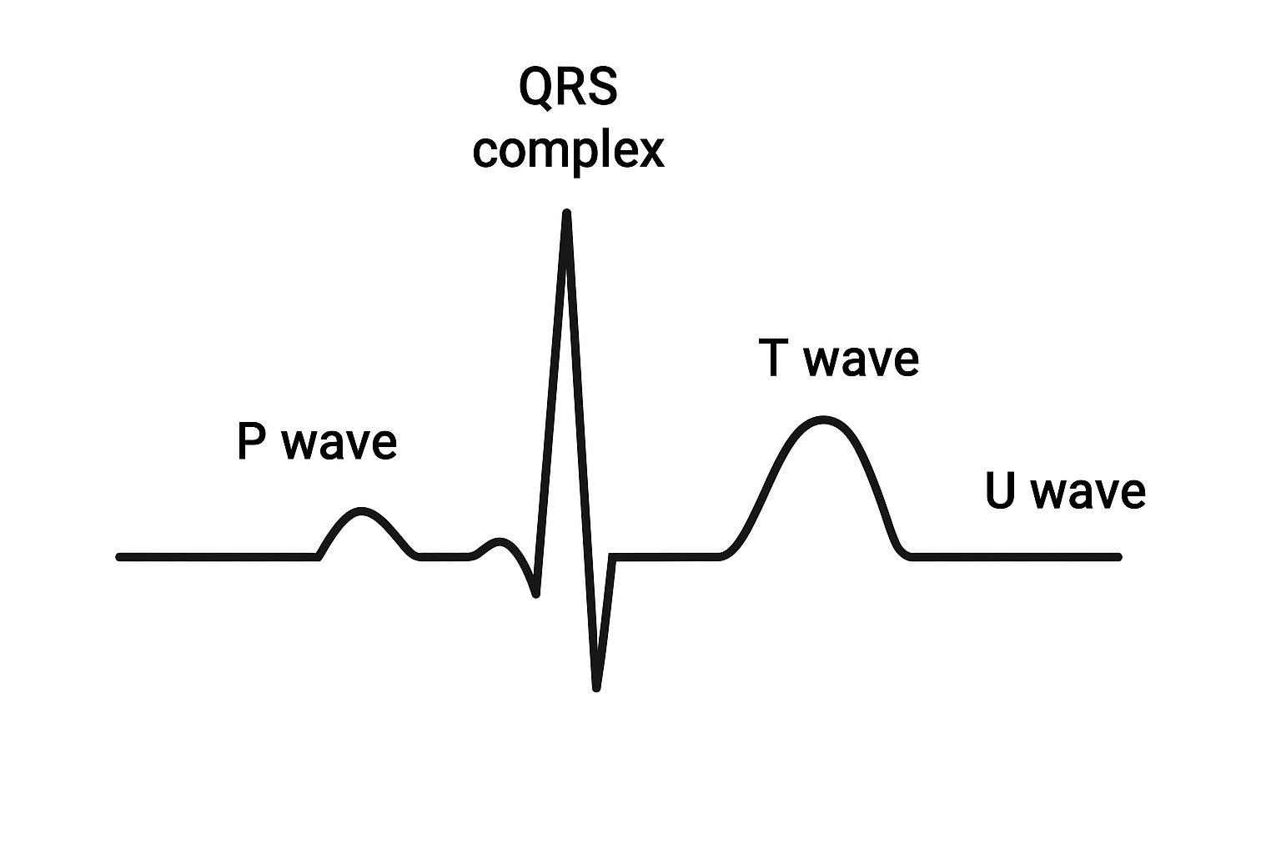
Electrical Events and ECG
• P wave: atrial depolarization
• QRS complex: ventricular depolarization
• T wave: ventricular repolarization
Notes:
Correlate ECG waveform with conduction events.

Slide 13
Automaticity and Rhythmicity
• Cardiac cells can generate impulses automatically
• SA node has highest automaticity
• AV and Purkinje fibers serve as backups
Notes:
Explain intrinsic properties of pacemaker cells.

Slide 14
Ectopic Foci
• Abnormal pacemaker sites outside SA node
• Can cause premature beats or arrhythmias
Notes:
Introduce concept of abnormal conduction.

Slide 15
Refractory Periods
• Absolute: no new impulse can trigger
• Relative: stronger impulse may trigger
• Prevents tetany in cardiac muscle
Notes:
Explain role in maintaining rhythm stability.

Slide 16
Autonomic Nervous System Effects
• Sympathetic: increases rate and conduction
• Parasympathetic: slows rate via vagus nerve
Notes:
Link to heart rate regulation.

Slide 17
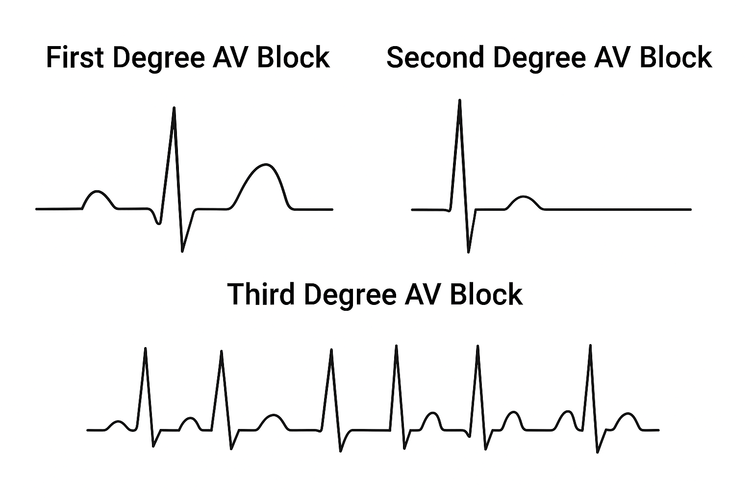
Conduction Abnormalities
• SA block, AV block (1st, 2nd, 3rd degree)
• Bundle branch blocks
Notes:
Prepare for ECG interpretation in later modules.

Slide 18
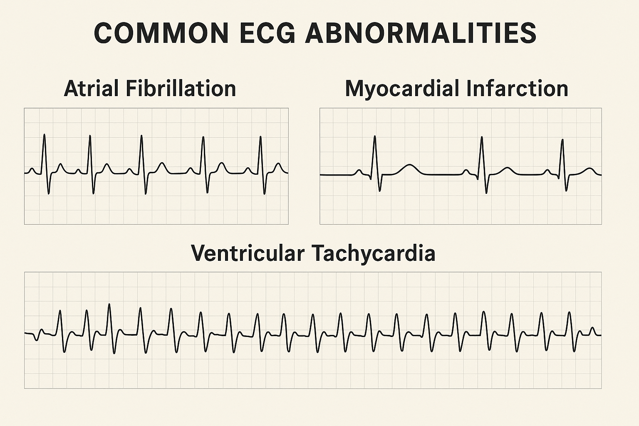
Common ECG Abnormalities
Atrial Fibrillation
Irregular R-R intervals
No distinct P waves
Chaotic baseline activity
Myocardial Infarction
ST-segment elevation
Pathological Q waves
T-wave inversions
Ventricular Tachycardia
Wide QRS complexes
Rate >100 bpm
No P wave association

Slide 19
Clinical Correlation
• Conduction issues may lead to arrhythmias
• ECG helps detect and locate defects
Notes:
Bridge theory to clinical practice.

Slide 20
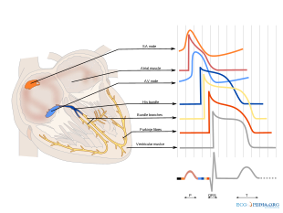
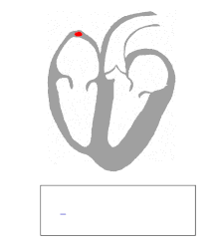
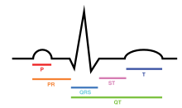
ELECTRICAL ACTIVITY:-

Slide 21
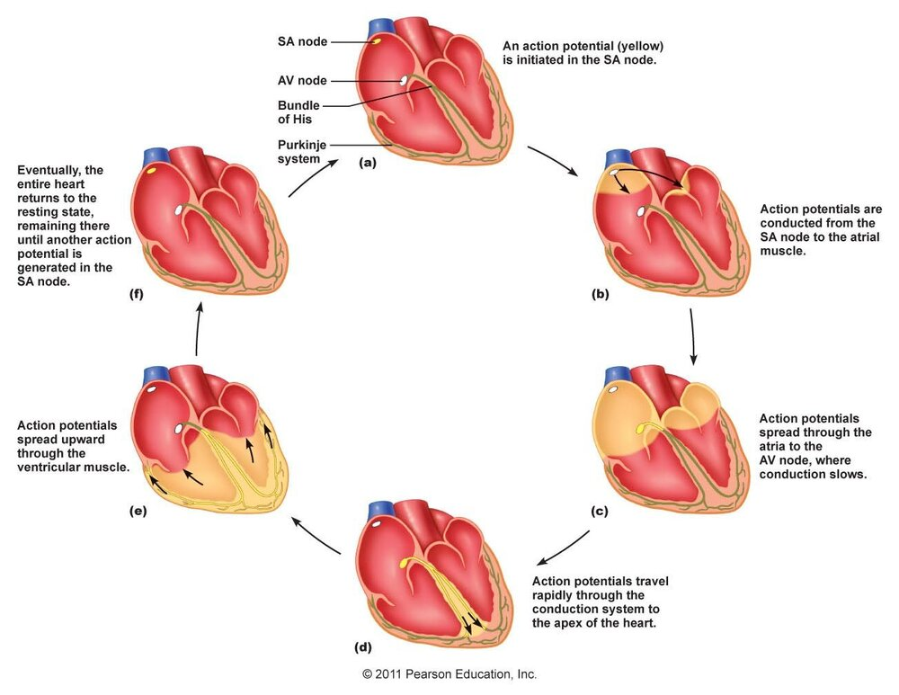

Slide 22
Summary
• SA node initiates impulse
• Conduction ensures coordinated contraction
• Disruptions can lead to arrhythmias
Notes:
Wrap up and transition to next ECG-related module.

Slide 23
ANY QUESTION
?

Slide 24
THANKS

