Slide 1
ANTICOAGULANT
LESSON -4
By
JITENDER YADAV
INSP/PH

Slide 2
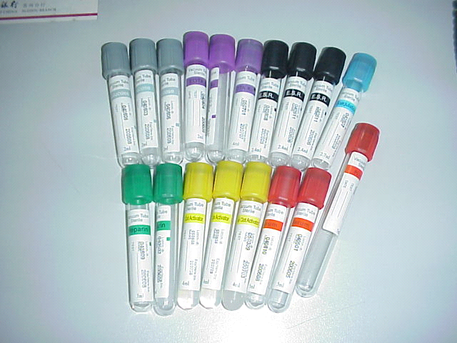
Anticoagulants-:
For various purposes a number of different anticoagulants are available. The anticoagulants in use are:-

Slide 3
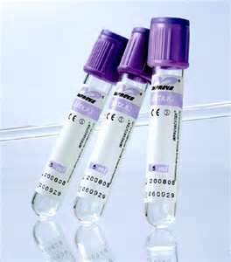
Ethylenediamine Tetra Acidic Acid (EDTA):-
The sodium and potassium salts of EDTA are powerful anticoagulant and they are the anticoagulants of choice for routine Haematological work. EDTA acts by its chelating effect on the calcium molecules in blood. EDTA is not suitable for use in the investigation of coagulation problems and should not be used in the estimation of Prothrombin time. The ratio of EDTA with Blood is 1mg /ml. Coded by purple color.

Slide 4
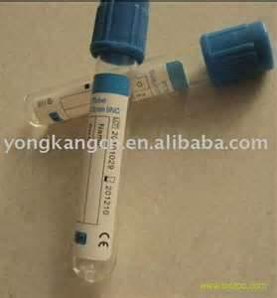
2) Trisodium Citrate:-Trisodium Citrate
is the anticoagulant of choice of coagulation
studies. 9 volume of blood are added
to 1 volume of the sodium
citrate solution and immediately
well mixed with it. Coded by sky
blue colour.
Sodium citrate is widely used in the estimation of the Erythrocyte Sedimentation Rate (ESR), for these 4 volume bloods are diluted with 1 volume of the sodium citrate solution. Coded by black colour.

Slide 5
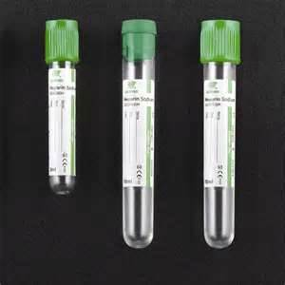
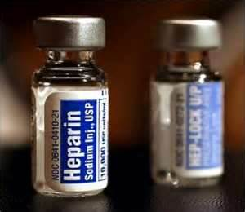
3) Heparin:-
This may be used at a concentration of 13-17 iu per ml of blood. Heparin is an effective anticoagulant and does not alter the size of the red cells; it is a good dry anticoagulant when it is important to reduce to a minimum the chance of lysis occurring after blood has been withdrawn. However, heparinized blood should not be used for making blood films as it gives a faint blue coloration to the background when the films are stained by Romanowsky dyes. Coded by green colour.

Slide 6
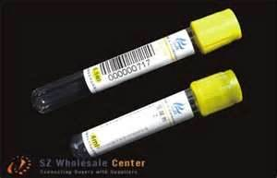
4) Acid Citrate Dextrose Solution:- This is preferred for blood transfusions, for preserving red cells, for enzyme studies, and for the study of Haemolytic processes.

Slide 7
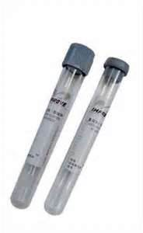
5) Ammonium and Potassium Oxalate mixture:-
This consists of a mixture of 2 parts of potassium oxalate and 3 parts of ammonium oxalate. Take 1% solution of Potassium oxalate 0.4ml and 1% solution of Ammonium oxalate 0.6ml in a test tube. Evaporate to dryness in the incubator. This amount of oxalate is sufficient to prevent coagulation of 5ml of blood.

Slide 8
ANY QUESTION
?

Slide 9
THANKS

