Slide 1
DRESSING & BANDAGE
AND
SOFT TISSUE INJURY
LESSON -4
BY
JITENDER YADAV
INSP/PH

Slide 2
OBJECTIVES
  Upon completion of this lesson, you will be able to:
  List two steps to treat a closed wound.
  List six steps to treat an open wound.
  List the steps for pre-hospital treatment for eye, ear, nose and mouth injuries. List the steps for pre-hospital treatment of abdominal and genital injuries.
Cont…

Slide 3
  Demonstrate the use of dressings and bandages to control bleeding when given a specific area of the body.
  Demonstrate the pre-hospital treatment procedures for the following:
    - Impaled object in the eye or cheek.
    - Bleeding neck injuries.

Slide 4
SOFT TISSUE INJURIES
Commonly referred to as wounds, are injuries to the skin, muscle, nerves, and blood vessels.

Slide 5
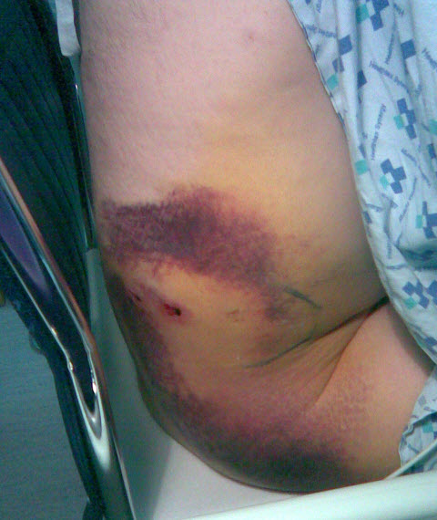
CLOSED WOUND
Injury to the soft- tissue beneath unbroken skin.
Cont…

Slide 6
  Closed wounds can involve superficial damage to the skin or can be severe with damage to internal organs. Small contusions generally do not need treatment, whereas more serious injuries can be fatal. Closed wounds are generally caused by impact with a blunt object.
Cont…

Slide 7
2. How to recognize closed wounds:
- Swelling
- Tenderness
- Discoloration
- Possible deformity

Slide 8
PHT FOR CLOSED WOUNDS
Use universal precautions and secure the scene.
1.Apply “RICE method: rest, ice, compress, elevate.
2. Monitor the patient for any rapid changes in vital signs that might indicate internal bleeding, which should be treated by a physician.
3. Treat for shock.
Transport the patient as soon as possible.

Slide 9
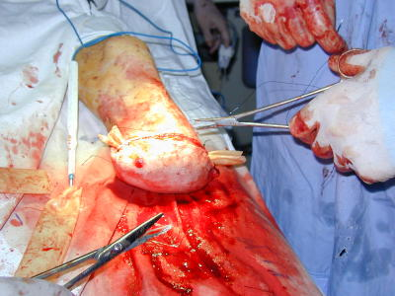
OPEN WOUND
A soft-tissue injury resulting in breaking of the skin.

Slide 10
TYPES OF OPEN WOUNDS
  Scratches and abrasions.
  Lacerations – regular and irregular.
  Penetration and puncture wounds.
  Avulsion.
  Amputations.
  Crushing injury(may open or closed).
  Gunshot wound.
  Impaled object.

Slide 11
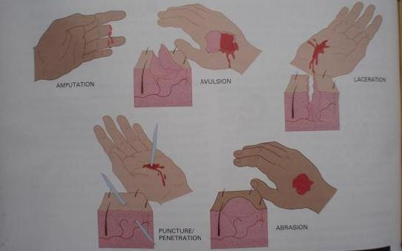
TYPES OF OPEN WOUNDS
AVULTION
LACERATION
AMPUTATION
PUNCTURE/ PENETRATION
ABRASION

Slide 12
PHT FOR OPEN WOUNDS
Use universal precautions and secure the scene.
Expose the wound. Remove all clothing and expose soft tissue. Avoid removing clothing by pulling it over the patient’s head. Best method is to remove clothing by cutting with trauma scissors.
Control bleeding. Begin with direct pressure or indirect pressure and elevation. If wound continues to bleed use a pressure point. Use a tourniquet only as last resort.
Cont…

Slide 13
4. Prevent contamination. Remove debris and contamination around the surface of the wound. Do not try to remove embedded particles.
5. Dress and bandage. Use a sterile dressing and secure with a bandage to cover the wound.
Cover the patient. Keep patient calm.
Treat for shock.
Transport the patint as soon as possible.

Slide 14
DRESSING
  Any material used to cover a wound that helps control bleeding and also aids in the prevention of additional contamination.
        Any material used to hold a dressing in place.
        BANDAGE

Slide 15
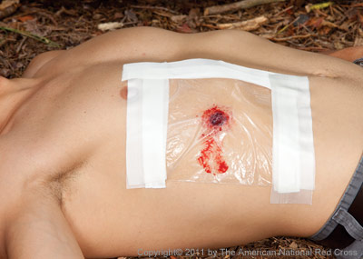
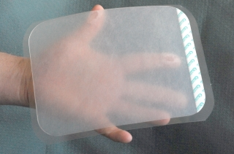
OCCLUSIVE DRESSING
  Any water-resistant material (plastic or waxed paper) that is applied to a wound to prevent the entry of air and loss of moisture from internal organs.

Slide 16
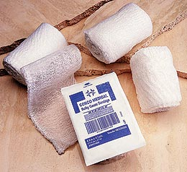
BULKY DRESSING
  Multiple stacked dressings made to form single dressing 2-3 cm thick, such as a thick sanitary napkin or any similar
  material.

Slide 17
APPLYING DRESSINGS AND BANDAGES
Control bleeding.
Apply the dressing using aseptic technique.
Cover the wounds completely.
Cont…

Slide 18
  Ensure that the dressing and the bandage are firm, fixed and comfortable, but not so tight as to affect circulation.
  Ensure there are no loose ends that can get caught.
  Avoid covering the fingertips.
The pre-hospital treatment of wounds and soft tissue injuries is directed at controlling bleeding and preventing contamination.

Slide 19
BANDAGING UNUSUAL WOUNDS
Penetrating Injury
Cover any open wound completely.
Examine the patient for possible exit wound.

Slide 20
IMPALED OBJECTS
Do not remove unless impaled in the cheek or obstructing the airway or CPR.
Control bleeding.
Stabilize the object with a bulky dressing and apply a bandage.

Slide 21
AVULSION (SKIN FLAP)
Clean the wound surface.
Return skin flap to original position.
Control bleeding.
Cover with bulky dressing and apply a bandage.

Slide 22
AMPUTATIONS OR UNATTACHED AVULSION
Clean the wound.
Control bleeding.
Apply dressing and bandages.
Keep amputated part cool and moist, but not wet.

Slide 23
SPECIAL SITUATIONS
Injuries to the Scalp:
Suspect spinal injury in any patient with a head injury. Do not apply direct pressure if you suspect a skull fracture.

Slide 24
WOUNDS TO THE EYES, PUNCTURE WOUND OR IMPALED OBJECT
Bandage the good eye to prevent movement of injured eye.
In an unconscious patient, close the eyes before blindfolding the patient to prevent the eyes from drying, which may cause blindness.
Treat an extruded eye the same way as you would treat an eye with an impaled object. Do not replace the eye if it has been expelled. Cover it with a cup or cardboard cone before applying the bandage.

Slide 25
WOUNDS TO THE EAR
Blood, clear fluid, or blood-tinged fluid draining from the ear may indicate skull fracture or severe head trauma.
  Never probe the ear.
  Never pack it to stop bleeding from the ear canal.
  Place a loose, clean dressing across the opening to absorb the fluids.
  Do not apply pressure.

Slide 26

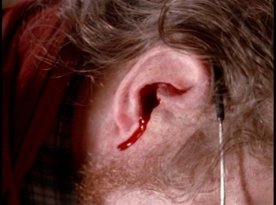

Slide 27
NOSEBLEEDS
A nosebleed in an emergency can be serious and should not be neglected. The loss of blood can be great and lead to shock. If the patient has a suspected skull fracture or spinal injury, do not try to stop the bleeding.

Slide 28
PHT for Nosebleeds
Use universal precautions and secure the scene
Maintain open airway.
Pinch nostrils together or place a dressing between the upper lip and the gum and apply pressure.
Keep patient seated and still.
Cont…

Slide 29
4. Do not pack the nose; check for clear fluid (CSF) which may indicate a skull fracture.
5. Do not remove any objects you may find inside the nose.
6. For avulsions, apply a compressive dressing.

Slide 30

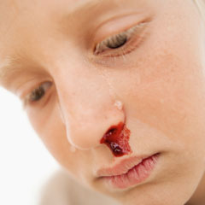
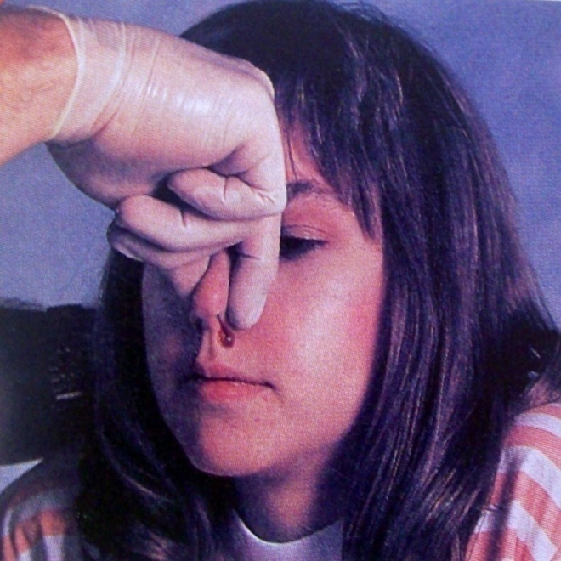
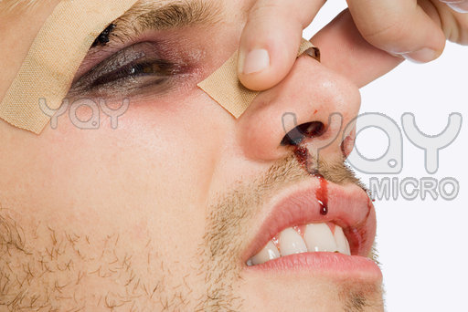

Slide 31
INJURIES TO THE NECK
Visible lacerations or other wounds can produce massive bleeding or air embolism.
Difficulty speaking; loss of voice.
Airway obstructions without foreign bodies in mouth, nose, or airway. Often caused by inflammatory process (subcutaneous emphysema).
Cont…

Slide 32

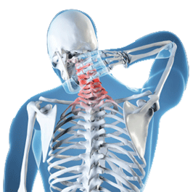

Slide 33
4. Tracheal deviation.
5. Deformities or depressions.
6. Immobilize the patient if you suspect a spinal injury.

Slide 34
PHT FOR INJURIES TO THE NECK
Use universal precautions and secure the scene.
If there is bleeding from a neck wound, apply slight to moderate pressure with an occlusive dressing.
Tape down all edges of the dressing to form an airtight seal, to avoid air embolism.
Cont…

Slide 35
3. Do not delay treatment; cover injury with a gloved hand and apply direct pressure if necessary. Add a bulky dressing over the occlusive one. Never apply pressure to both sides of the neck at the same time. Never apply a pressure dressing completely around the neck.
4. For patient without spinal injury, place patient on left side with a 15-degree incline (head lower), if possible.
Cont…

Slide 36
5. If an object is impaled in the neck, stabilize it in place with bulky dressings. Do not remove it.
6. Treat for shock.
IMPORTANT: With any head, face, scalp, eye, ear, nose or neck injury, the MFR should also suspect a possible spinal injury.

Slide 37
INJURIES TO THE ABDOMEN
The abdomen contains solid and hollow organs. The rupture of hollow organs (stomach, large and small intestine) can cause the contents (acids, digestive enzymes, bacteria) to spill into the peritoneal cavity, causing an inflammatory reaction. Rupture of the solid organs (liver, spleen, etc.) can cause severe hemorrhage. A contusion may indicate injury to the abdomen or pelvis.

Slide 38
Signs and Symptoms
    Pain or cramps in the abdominal area, local or diffuse.
    Guarding the abdomen or lying down in fetal position.
    Tenderness of the abdomen.
    Signs of shock.
    Rigid, tense or distended abdomen.
Cont…

Slide 39
6. Mild discomfort progressing to intolerable pain.
7. Deep, penetrating pain in the pelvis or lower back.
8. Pain radiating to a shoulder or both shoulders.
9. Vomiting blood, bright red or like coffee grounds.
10. Blood in the stool, bright red or tarry black.

Slide 40
PHT OF ABDOMINAL INJURIES
Use universal precautions and secure the scene. Be alert for patient vomiting.
Cover all open wounds.
Do not replace exposed internal organs – cover them with thick, moist sterile dressing. Then loosely cover moist dressing with occlusive dressing. Keep exposed area warm by placing a dressing or towel over the occlusive dressing.
Cont…

Slide 41
3. Do not remove impaled objects – stabilize them with bulky dressings.
4. Constantly monitor vital signs.
5. Put patient supine with legs in most comfortable position.
6. Treat for shock.

Slide 42
INJURIES TO THE GENITALS
PHT for wounds to genitalia:
Wounds to the genitals should be treated the same as any other wound. However, special care and attention should be given to protect the patient’s privacy.

Slide 43
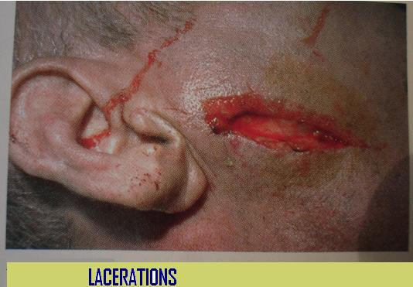
LACERATIONS

Slide 44
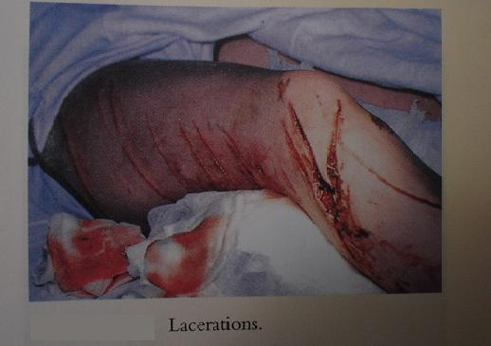
LACERATIONS
        LACERATIONS

Slide 45
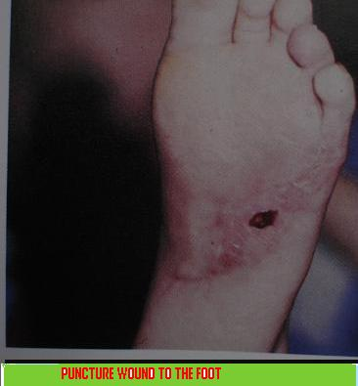
PUNCTURE WOUND TO THE FOOT

Slide 46
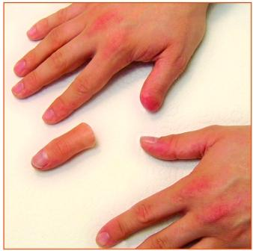
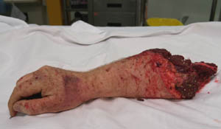
Amputation

Slide 47
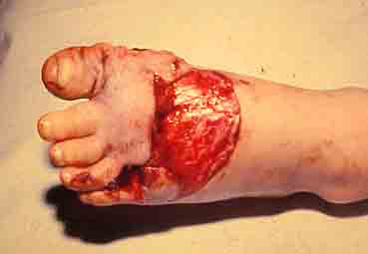
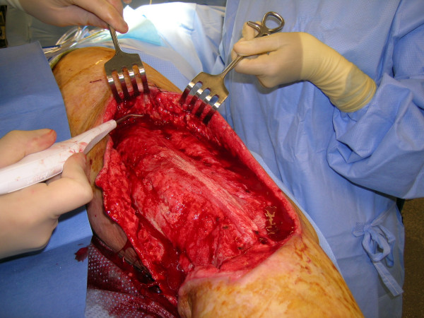
Avulsion

Slide 48
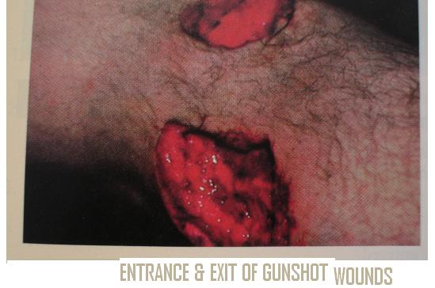
ENTRANCE & EXIT GUN SHOT WOUND
.

Slide 49
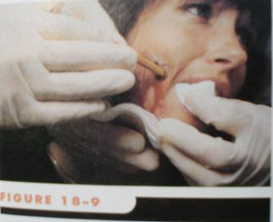
IMPALED OBJECT IN THE CHEEK

Slide 50
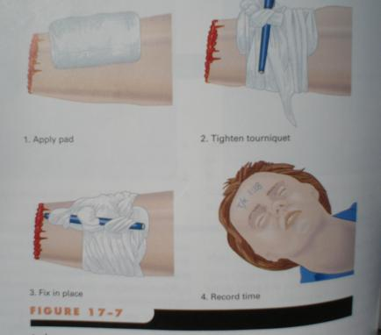
APPLY TOURNIQUET
1.Apply pad
2.Tighten tourniquet
3.Fix in place
4.Record time

Slide 51
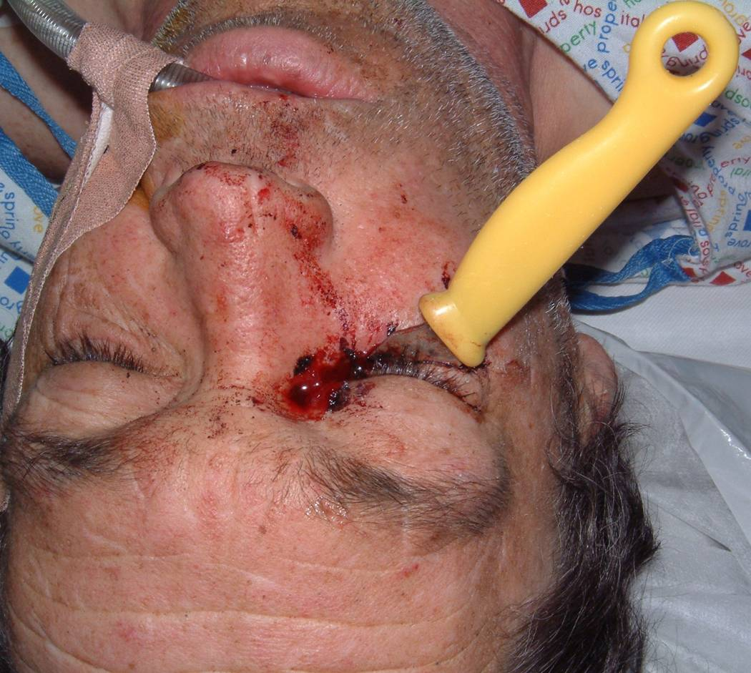

Slide 52
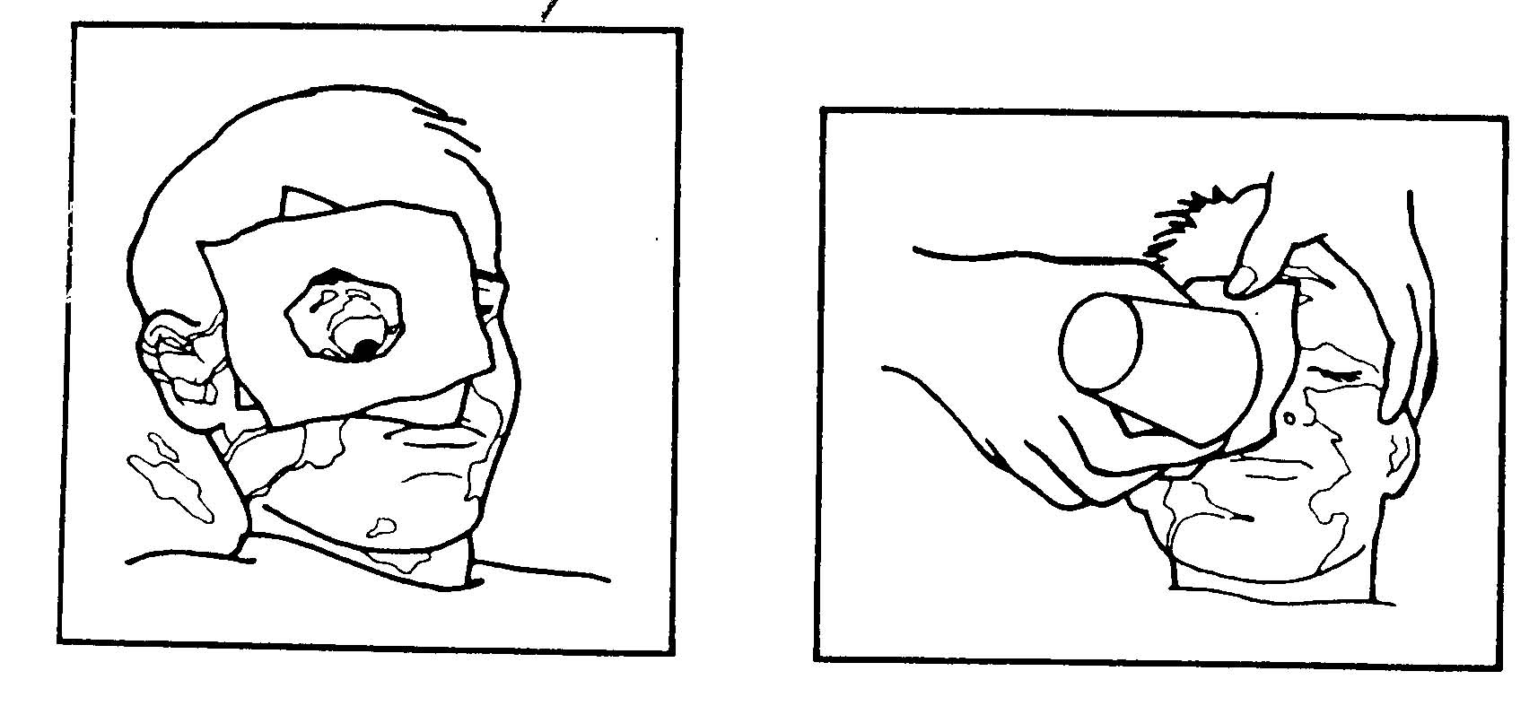

Slide 53
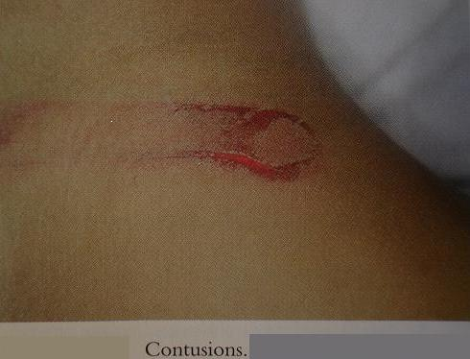
CONTUSION

Slide 54
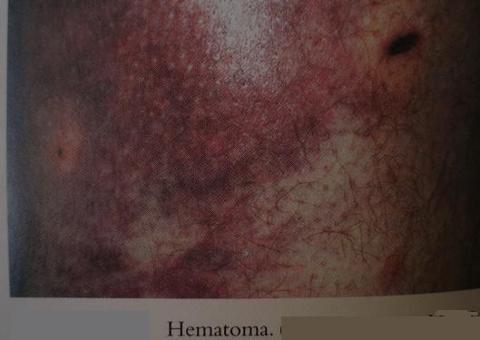
HEMATOMA

Slide 55
ANY QUESTION
?

Slide 56
THANKS

