Slide 1
LESSON-4 MUSCULO SKELETAL SYSTEM
BY
PRAVIN DUDHE
INSP/PH

Slide 2
OBJECTIVES
Upon completion of this lesson you will be able to:
Know about the names & location of Skull-bones
Describe the names & location of Skull-Sutures
Learn the names & location of bones of Trunk
Describe the Vertebral Column.
Describe the bones of the Upper Limb& Lower Limb

Slide 3
SKELETAL SYSTEM
The adult skeleton is composed of 206 bones. The human skeleton consists of two main divisions, the axial skeleton and the appendicular skeleton.
Functions of the skeletal system:-
Provides a framework for the body.
Protects vital organs.
Provides for body movement.
Produces red blood cells.

Slide 4
DIVISION OF SKULL BONES
CRANIAL BONES-08
FRONTAL-1
PARIETAL-2
OCCIPITAL-1
TEMPORAL-2
ETHMOID-1
SPHENOID-1

Slide 5
FACIAL BONES=14
ZYGOMATIC-2
MAXILAE-2
LACRYMAL-2
NASAL-2
PALATINE-2
MANDIBLE-1
VOMER-1
INF NASAL CONCHAE-2
TOTAL 22 BONES IN THE SKULL
EXCEPT MANDIBLE ALL OTHER BONES ARE IMMOBABLY ARTICULATED TO EACH OTHER IN SUCH A WAY AS TO FORM A CACITY KONOWN AS CRANIUM WHICH PROTUCT THE BRAIN.

Slide 6
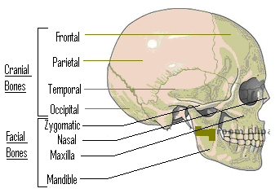
SKULL BONES

Slide 7
SUTURES
THE BONES OF THE CRANIUM ARE ARTICULATED WITH EACH OTHER IN IMMOVABLE JOINTS, WHICH ARE CALLED AS ‘SUTURES’.
CORONAL- BETWEEN FRONTAL & BOTH PARIETALS
SAGITAL- BETWEEN BOTH PARIETALS
SQUAMOUS- BETWEEN PARIETALS & TEMPORALS
LAMBDOIDAL-BETWEEN BOTH PARIETALS&OCCIPITAL

Slide 8
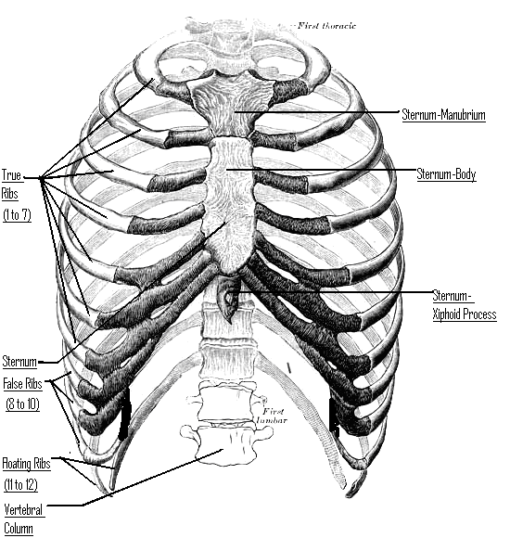
TRUNK BONES
STERNUM & RIBS:

Slide 9
STERNUM
LONG, FLAT BONE
DAGER SHAPED
SITUATED ON ANTERIOR ASPECT OF CHEST WALL
ARTICULATES WITH RIBS ON EITHER SIDE
PARTS
MANUBRIUM
BODY
XIPHOID PROCESS

Slide 10
RIBS
ARTICULATED AT THE BACK WITH VERTEBRAL COLUMN TOTAL OF 12 PAIRS.
TRUE RIBS-ARTICULATED IN FRONT WITH STERNUM 1ST TO 7TH
FALSE RIBS-ARTICULATED IN FRONT WITH UPPER RIBS 8TH TO 10TH RIBS.
FLOATING RIBS-NOT ARTICULATED IN FRONT 11TH TO 123TH RIBS.

Slide 11
VERTEBRAL COLUMN
DIVISION OF THE VERTEBRAL COLUMN:
CERVICAL=7 (1ST CERVICAL-ATLAS: 2ND CERVICAL-AXIS)
THORACIC=12(ALSO CALLED “DORSAL VERTEBRAE’
LUMBER=5
SACRAL=5 (FUSED TO FROM ONE SINGLE SACRAL BONE)
COCCYGEAL=4(FUSED TO FORM ONE SINGLE COCCYX BONE

Slide 12
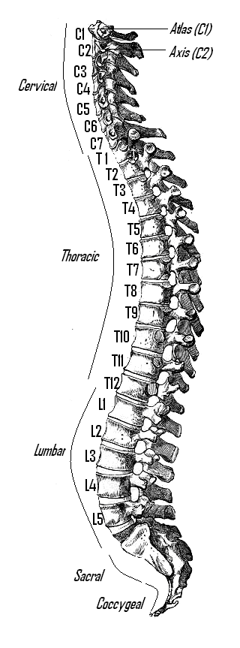
VERTEBRAL COLUMN

Slide 13
CHARACTERISTICS OF VERTEBRAE
EACH VERTEBRA HAS A CYLINDRICAL BODY
SIZE SMALLER IN CERVICAL REGION & INCREASES TOWARDS LUMBER REGION.
TOGETHER, FORM THE BEURAL-CANAL THROUGH WHICH THE SPINAL CORD PASSES.

Slide 14
FUNCTIONS OF THE VERTEBRAL COLUMN
FORMS A CENTRAL AXIS FOR SUPPORT OF OTHER BONES & MUSCLES.
ACTS AS A SHOCK- ABSORBER WITH THE HELP OF INTER-VERTEBRAL DISC.
MAINTAINS ERECT POSITION & PROVIDES THE HELP OF INTER-VERTEBRAL DISC.
PROCTETION TO THE ABDOMINAL & THORACIC ORGANS FROM BEHIND.
PROTECTION TO THE SPINAL CORD.
ALLOWS MOVEMENT OF THE HEAD.

Slide 15
