Slide 1
MEDICAL EQUIPMENTS
LESSON-3B
By
JITENDER YADAV
INSP/PH

Slide 2
EQUIPMENTS OF ALS AMBULANCE:-
Thermometer –
                Digital Thermometer
                IR Thermometer
Stethoscope
Fully Automated B.P. Instrument Aneroid
Glucometer
Suction Machine Portable
Finger Tip Pulse Oximeter

Slide 3
EQUIPMENTS OF ALS AMBULANCE:-
Oxygen Concentrator
Nebulizer
Ventilator
Video Laryngoscope
Multipara Monitor with ECG Electrode
Infusion Pump
Electric Portable Suction Aspirator with Airflow of at least 30L/min

Slide 4
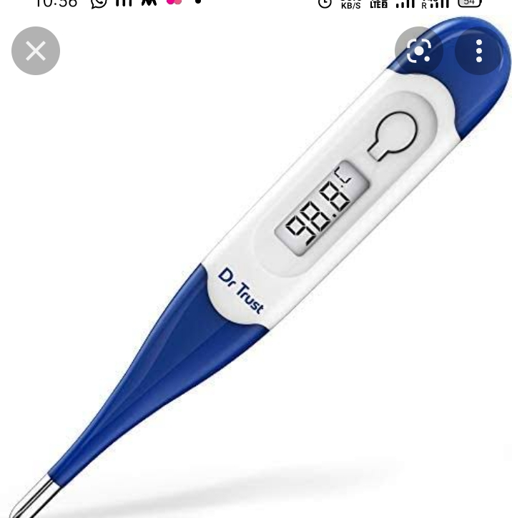
Digital thermometer
Digital Thermometer is
used to measure the
temperature of an
individual accurately

Slide 5
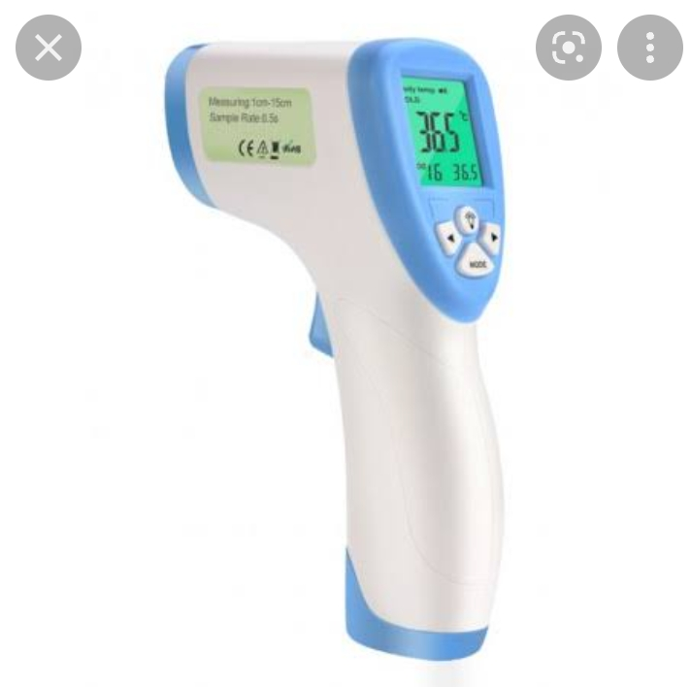
INFRARED THERMOMETER
Infra Red Thermometer is a
device which is used to
measure the temperature of
an individual without making
any direct contact with a patient

Slide 6
STETHOSCOPE
The stethoscope is a medical device for
auscultation, or listening to internal sounds
of an animal or human body.
It typically has a small disc-shaped resonator
that is placed against the skin, with either one
or two tubes connected to two earpieces.
A stethoscope can be used to listen to the
sounds made by the heart, lungs or
intestines, as well as blood flow in arteries
and veins.

Slide 7
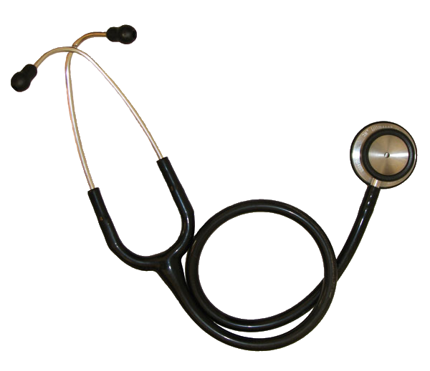
STETHOSCOPE
Parts of Stethoscope -
Ear Tips
Ear Tubes
Tubing
Bell
Diaphragm
Ear Tip
Bell
Ear Tube
Diaphragm
Tubing

Slide 8
BP APPARATUS
A sphygmomanometer, also known as a blood
pressure monitor, or blood pressure gauge, is a
device used to measure blood pressure, composed
of an inflatable cuff to collapse and then release
the artery under the cuff in a controlled manner,
and a mercury or aneroid Manometer.
There are three different types, which are-
Mercury Sphygmomanometer.
Aneroid Sphygmomanometer.
Automatic Digital Sphygmomanometer.

Slide 9
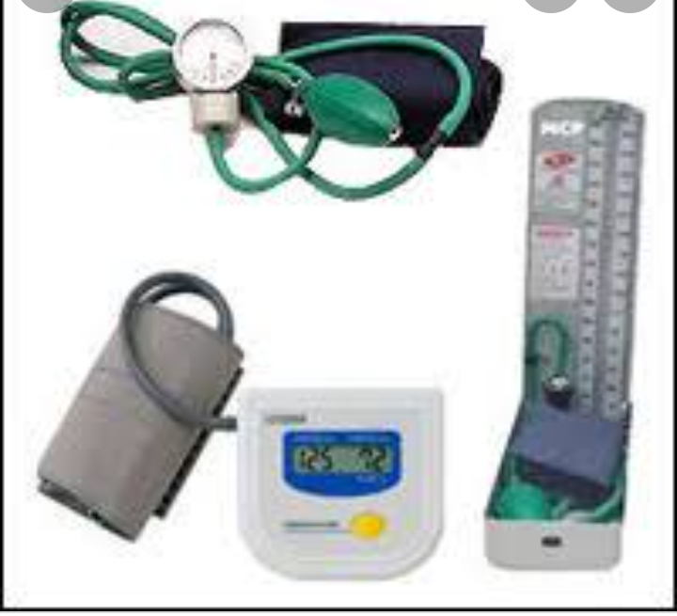
BP APPARATUS

Slide 10
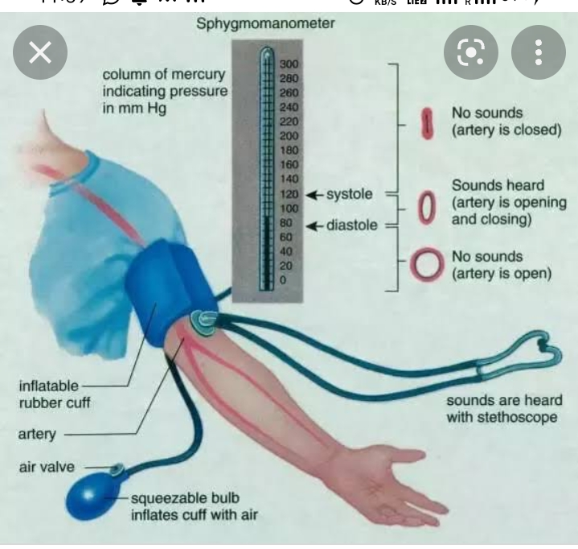

Slide 11
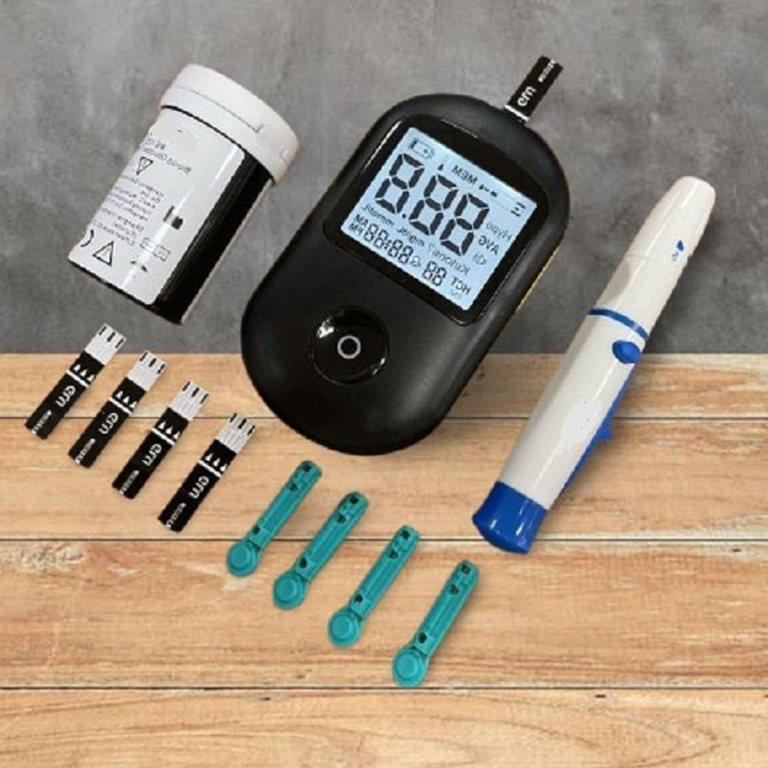
GLUCOMETER
A glucose meter, also referred to as a "glucometer", is a medical device for determining the approximate concentration of glucose in the blood.

Slide 12
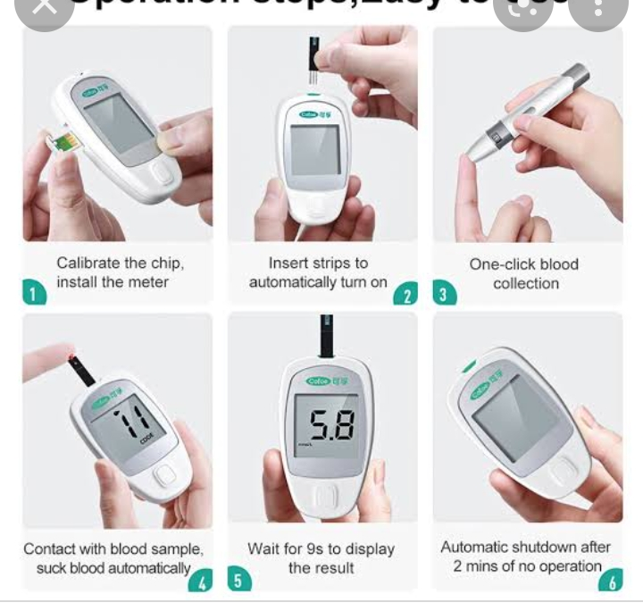
Glucometer

Slide 13
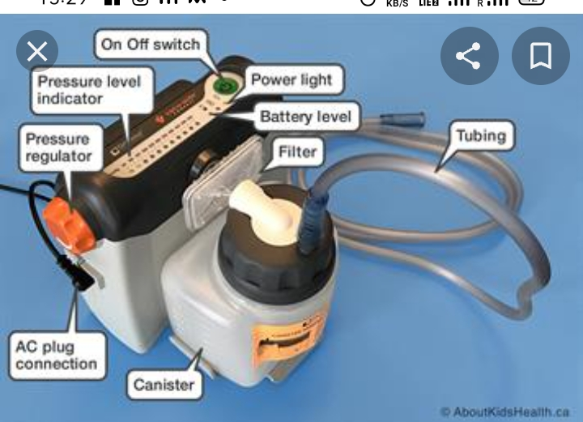
Part of suction machine

Slide 14
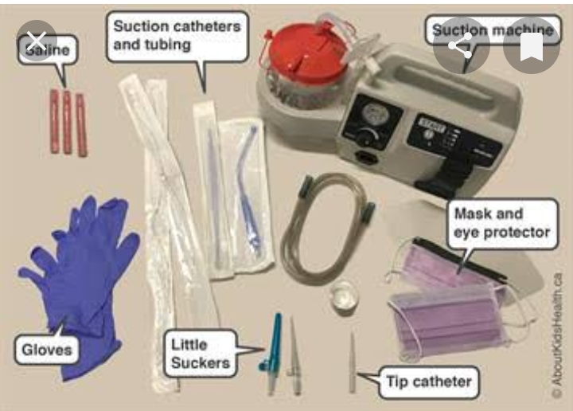
Preparation for suction

Slide 15
Suction machine
Suction machines are appliances that are used to remove substances such as blood, saliva, mucus, and vomit from a person's airway. A portable suction unit can prevent pulmonary aspiration and facilitate breathing.

Slide 16
Precautions during suctioning
Conduct a Risk Assessment.
Prepare the Patient.
Do Not Suction Too Long.
Avoid Forcing the Catheter.
Monitor for Complications.
Choose the Right Equipment.

Slide 17
Alcohol breathanalyzer
monitor
A breathalyzer or breathalyser (a portmanteau of breath and analyzer/analyser) is a device for estimating blood alcohol content (BAC), or to detect viruses or diseases from a breath sample.

Slide 18
Accuracy
There is indeed a margin of error when it comes to Breathalyzers. This margin of error can be up to 15%. Around 20% of people charged with a DUI can end up being victims and an inaccurate Breathalyzer test. The best and most accurate way to accurately test a person's BAC is by doing a blood test.

Slide 19
How does alcohol breath Analyser work?
Accuracy depends on the sample of breath being deep lung air (alveolar air). As the driver breathes out, the device continuously monitors the expired air using an infrared cell. The concentration of ethanol climbs as expiration continues, and when the level of ethanol stabilises, the sample of breath is analysed How does alcohol breath Analyser work?

Slide 20
Factor which can affect alco Test
DRINKING | The Body
Amount of Alcohol & Speed of Consumption. The more alcohol and/or the shorter the time period, the higher the Blood Alcohol Content (BAC).
Biological / Genetic Risk. ...
Ethnicity. ...
Gender. ...
Body Size and Composition. ...
Stomach Content. ...
Dehydration. ...
Carbonated Beverages.

Slide 21
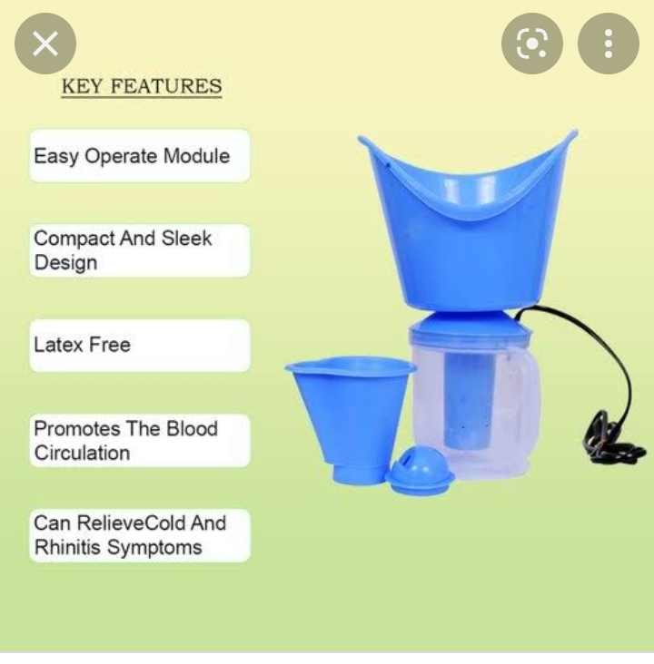
STEAMER

Slide 22
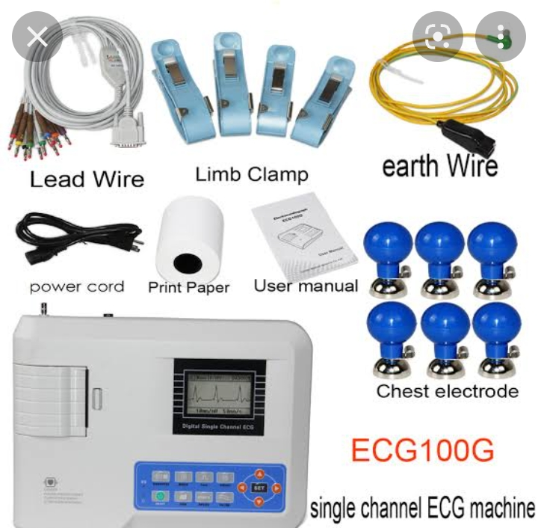
ECG MACHINE

Slide 23
electrocardiogram (ECG)
An electrocardiogram (ECG or EKG) records the electrical signal from the heart to check for different heart conditions. Electrodes are placed on the chest to record the heart's electrical signals, which cause the heart to beat. The signals are shown as waves on an attached computer monitor or printer.19-Mar-2022

Slide 24
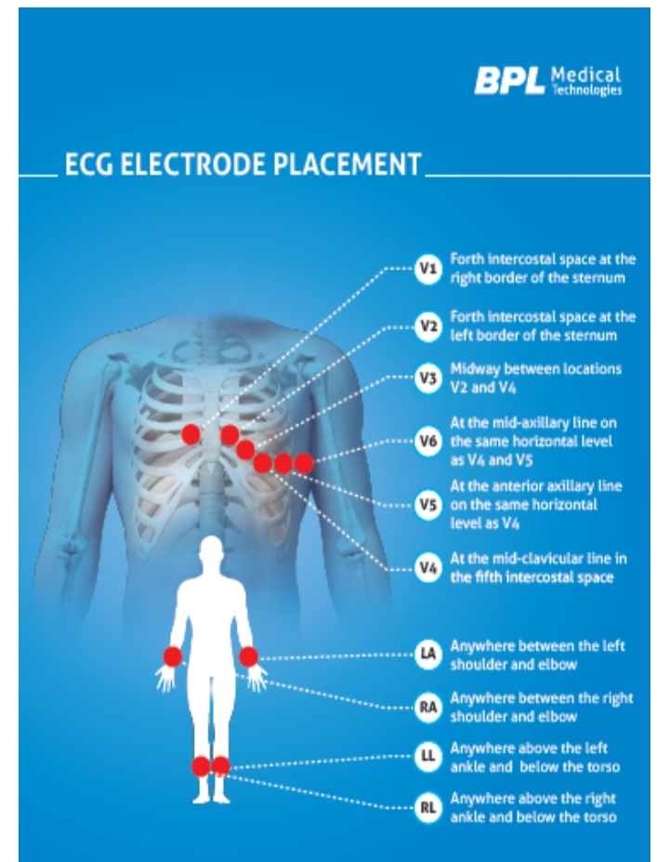
electrocardiogram (ECG)

Slide 25
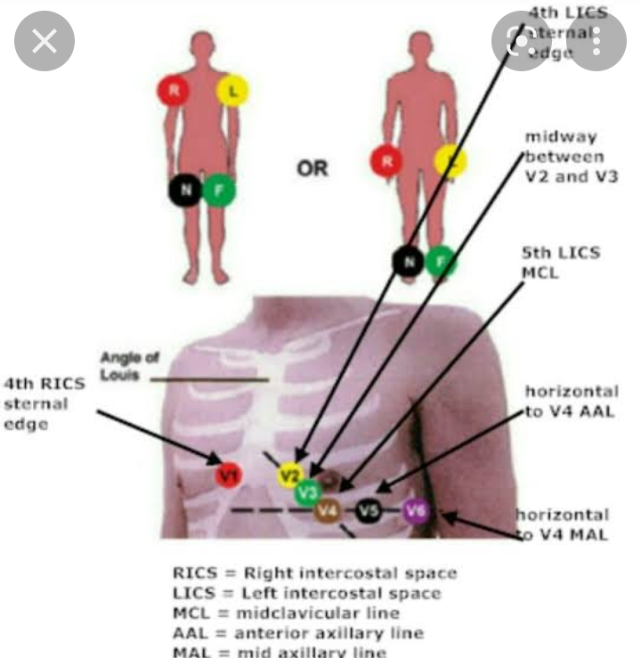

Slide 26
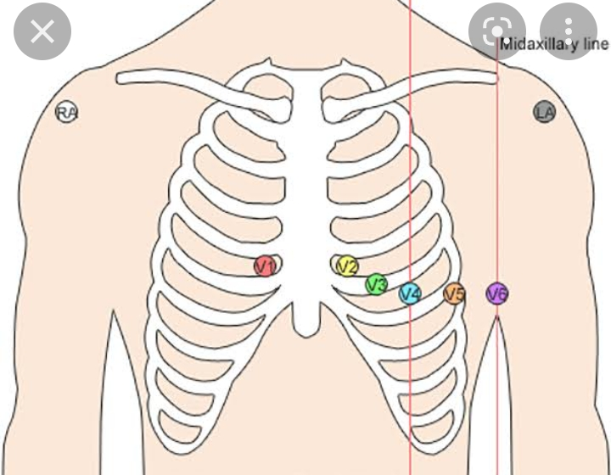
electrocardiogram (ECG)

Slide 27
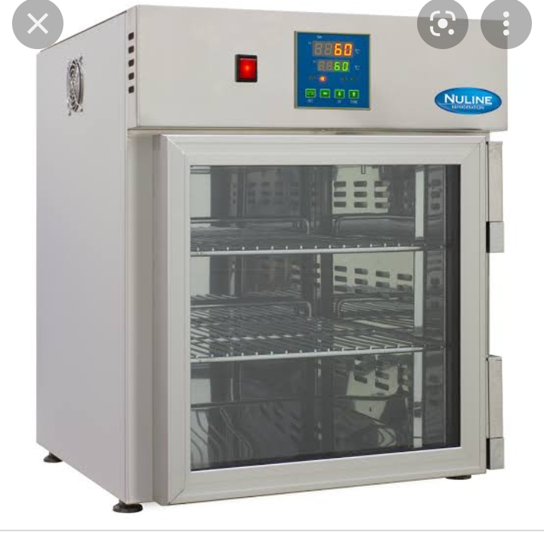
Infusion warmer

Slide 28
Infusion warmer
Most current evidence surrounds the use of warmed IV fluids in the perioperative and intraoperative periods (1). In these studies, it has been recommended that the fluid be warmed to at least 37°C. Warming to this point allows the core body temperature to be kept at the normal

Slide 29
Infusion warmer
What temperature should IV fluids be warmed to?
Most current evidence surrounds the use of warmed IV fluids in the preoperative and intra-operative periods (1). In these studies, it has been recommended that the fluid be warmed to at least 37°C. Warming to this point allows the core body temperature to be kept at the normal range of 36.5-37.5°C
What is the purpose of fluid warmer?
A fluid warmer is a medical device used in healthcare facilities for warming fluids, crystalloid, colloid, or blood product, prior to being administered (intravenously or by other parenteral routes) to body temperature levels in order to prevent hypothermia in physically traumatized or surgical patients.

Slide 30
automated external defibrillator (AED)
What is a AED used for?
An automated external defibrillator (AED) is a medical device designed to analyze the heart rhythm and deliver an electric shock to victims of ventricular fibrillation to restore the heart rhythm to normal. Ventricular fibrillation is the uncoordinated heart rhythm most often responsible for sudden cardiac arrest.

Slide 31
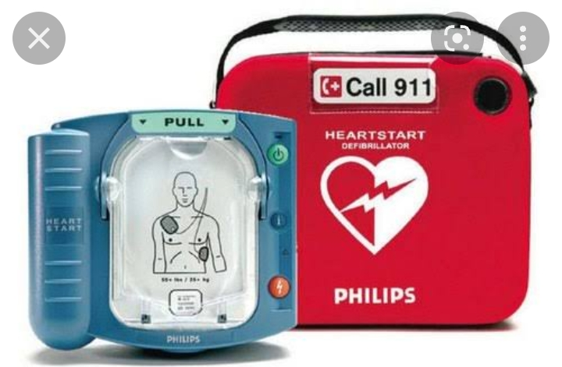
automated external defibrillator (AED)

Slide 32
automated external defibrillator
(AED)
Check unresponsiveness.
Call 9-1-1 or the local emergency number (if applicable) and retrieve the AED.
Open the airway and check for breathing. ...
Check for a pulse. ...
Attach the AED electrode pads.
Analyze the heart rhythm. ...
Press the "shock" button, if advised.

Slide 33
automated external defibrillator (AED)
Two pads will need to be placed on the chest of the person. The first is placed on the right-hand side of the chest below the collar bone. The second is placed on the left-hand side, below the armpit. The AED you use will indicate which pad is the first and second.

Slide 34
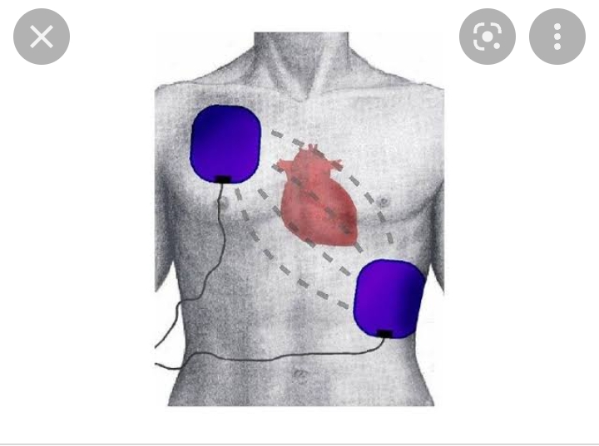
automated external defibrillator (AED)

Slide 35
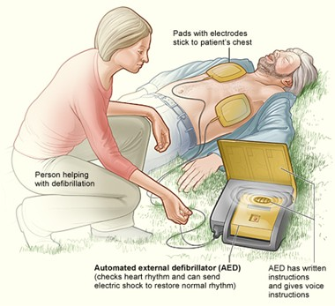
automated external defibrillator (AED)

Slide 36
automated external defibrillator (AED)
What precautions should you take for using an AED on someone with a pacemaker?
Pacemakers and Implanted Defibrillators – Someone with an internal device still can be shocked with an AED. In fact, if their internal device does not save them immediately, it is crucial an AED is used as quickly as possible. It is important to remember, do not place the pads directly over the meta

Slide 37
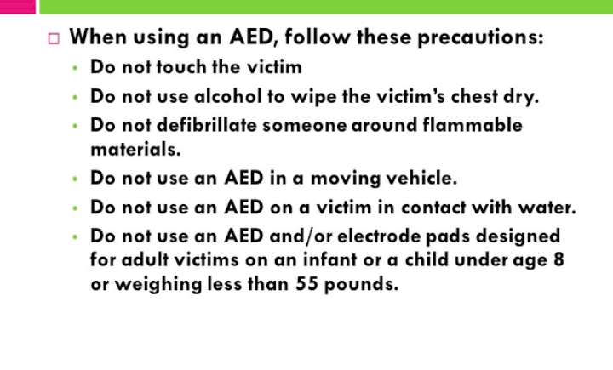

Slide 38
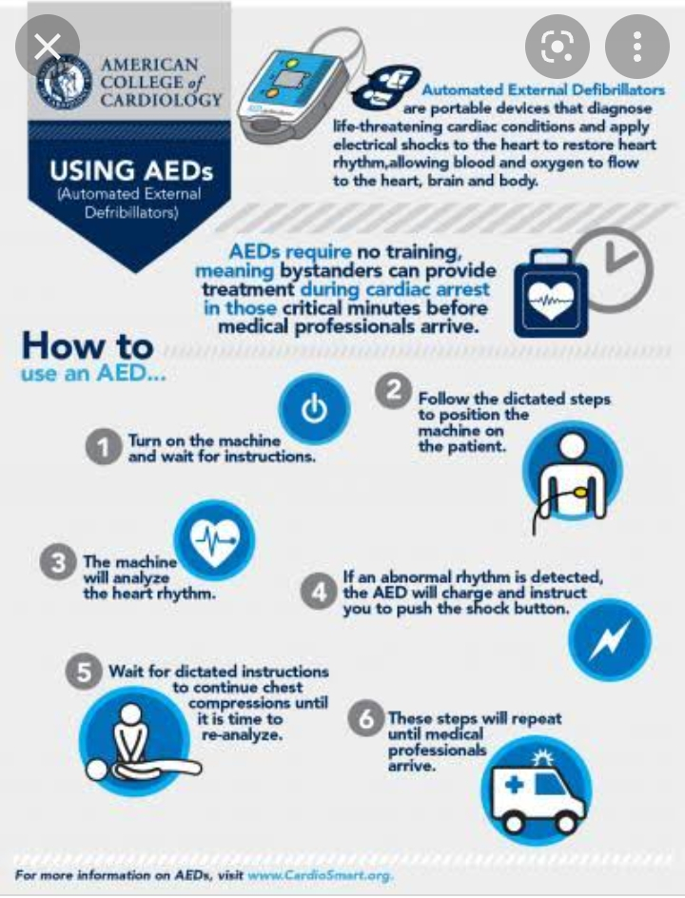

Slide 39
O2 CONCENTRATER
An oxygen concentrator is a medical device that utilises environmental air, concentrates it, and delivers oxygen from it to individuals who require supplemental oxygen due to decreased concentration of oxygen in their blood

Slide 40
O2 CONCENTRATER
Advantages of Oxygen Concentrators
Portable.
Cost-Effective.
Easy to operate.
Useful for Home & Hospitals.
Helpful in emergency.

Slide 41
Disadvantages of concentrator
Cons. Batteries required: Because they do not use pressurized oxygen within a tank, oxygen concentrators must rely on battery or electric power to perform their air filtering and oxygen flow. Noisy. Oxygen concentrators collect oxygen from the air and then filter and compress it for the user

Slide 42
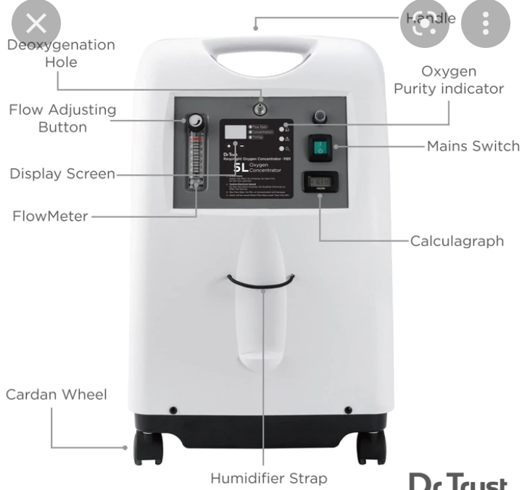
O2 CONCENTRATER

Slide 43
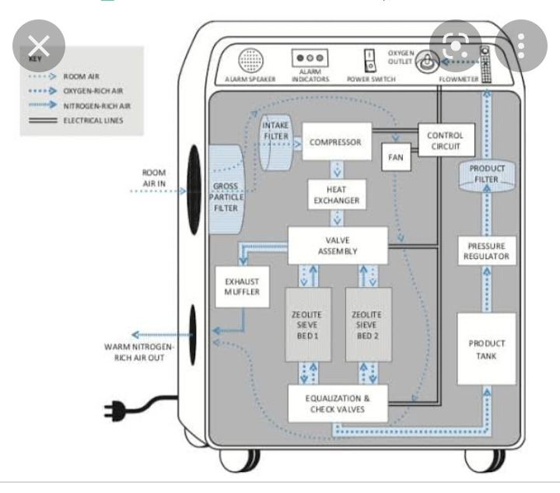
O2 CONCENTRATER

Slide 44
NEBULIZER
A nebulizer is a small machine that turns liquid medicine into a mist. You sit with the machine and breathe in through a connected mouthpiece. Medicine goes into your lungs as you take slow, deep breaths for 10 to 15 minutes. It is easy and pleasant to breathe the medicine into your lungs this way

Slide 45
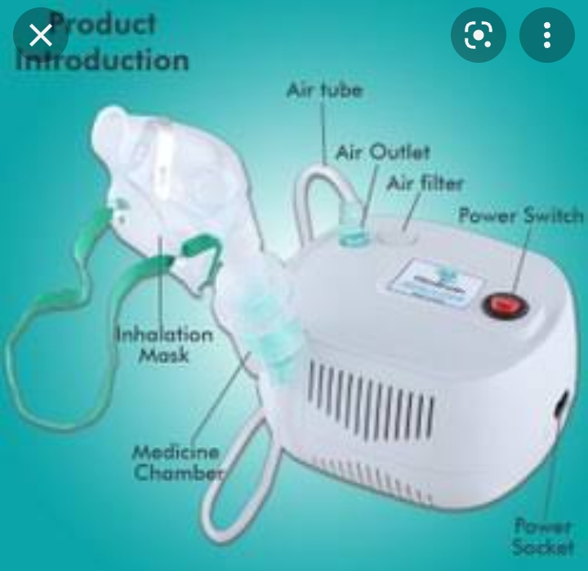
NEBULIZER

Slide 46
NEBULIZER
Nebulizers are primarily used for - asthma, COPD, and other severe breathing problems. However, it is also used for severe cases of nasal and chest congestion. It provides immediate relief by the opening of airways

Slide 47
VIDEOLARYNGOSCOPE
Video laryngoscopy is a relatively new technology developed to improve the success rate of tracheal intubation. A high-resolution micro camera mounted on the tip of a curved blade connected to small portable digital monitor improves the view of the vocal cords and subsequently the success rate of direct laryngoscopy

Slide 48
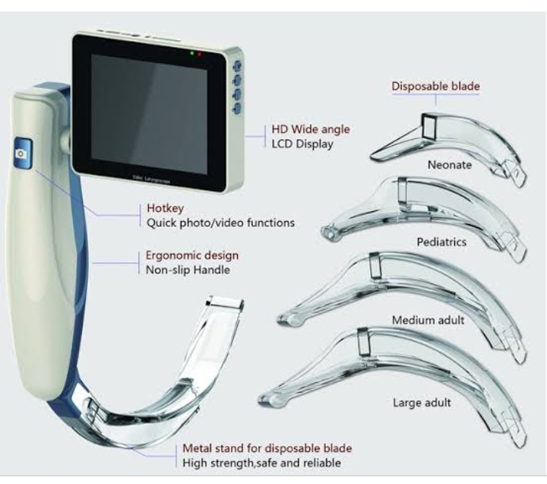
VIDEOLARYNGOSCOPE

Slide 49
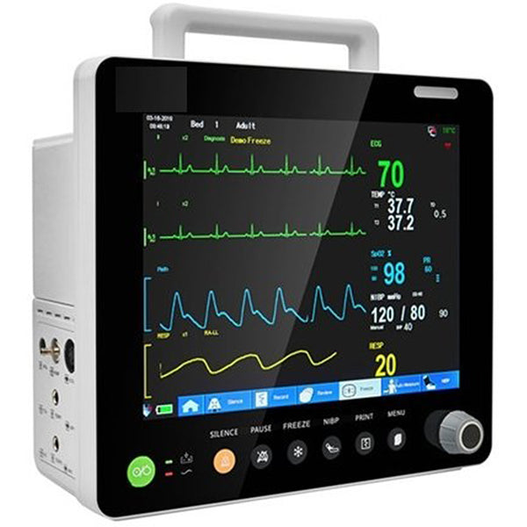
5-PARAMONITOR

Slide 50
5-PARAMONITOR
A lightweight, compact and portable 5 Para Patient Monitor(8") (5 Para) features high-resolution color TFT display and is suitable for Arrhythmia analysis and S-T segment
analysis in neonatal, pediatric and adult patients.
The multiparameter monitors are designed to give number of information on one screen and hence provides multiple information that is needed to understand the patient condition. It has emerged as a monitor to offer flexible
solution for varying critical care need.

Slide 51
5-PARAMONITOR
A cardiac event monitor is a device that you control to record
the electrical activity of your heart (ECG). This device is
about the size of a pager. It records your heart rate and
rhythm. Cardiac event monitors are used when you need
long-term monitoring of symptoms that occur less than daily

Slide 52
ANY QUESTION
?

Slide 53
THANKS

