Slide 1
LESSON-38
BEDSIDE NURSING
AND
PATIENT CARE
BY
AMANDEEP KAUR
ASI/ANM

Slide 2
OBJECTIVES
Upon completion of this lesson, you will be able to:
1. Describe Pre-Operative Care and its
components.
2. Define Post-Operative Care. Describe
immediate & subsequent care of the
patient.
3. Describe barrier nursing and its elements.

Slide 3
PRE OPERATIVE CARE:
Consists of three components –
Hospitalization
Physical and
Mental preparation
HOSPITALIZATION:
Usually, except in emergency surgeries, the patient is admitted in Hospital the day prior to planned surgery or even a day earlier if suffering from hypertension, diabetes etc.

Slide 4
PRE OPERATIVE CARE:
Most of the times the pre-op/pre-anesthetic check up is completed in out-patient department itself and specific instructions, if needed, are mentioned in admission notes.
The procedure is explained to patient and relatives and written consent is obtained after allaying the fears of the patient.
Frequent visitors are discouraged to prevent cross-contamination

Slide 5
PHYSICAL PREPARATION: includes
General preparation,
Local preparation and
Immediate /final preparation

Slide 6
General preparation -
  Rest and light nutritious diet
  Nil orally after midnight
  Good sleep; if prescribed, night time sedative
  Good bowel movement; if necessary, enema
  Vital measurements as baseline
  If instructed, skin sensitivity tests for local anesthetics
  In some cases, prophylactic antibiotic coverage is started as per surgeon’s instructions
  Discourage smoking and advise to maintain personal hygiene
  If patient is on any medications already, consult the surgeon about the administration schedule

Slide 7
Local preparation includes preparation of the operation site -
  Shaving, if hairy area
  Remove all jewellery and hand over to the patient/relatives
  General bath and clean clothes
  Surgical skin preparation, as advised the surgeon
  Always ensure the correct limb/ correct side of the organ is identified and prepared for surgery.

Slide 8
Final preparation:
(Most often the surgery is conducted in mornings) ensure -
  The patient is on over night fasting, if prescribed
  Consent forms have been signed, as appropriate
  Pre medications, as ordered by the surgeon, are given one hour before surgery
  Voiding of urine by patient before entering operating theatre

Slide 9
Final preparation:
  Recording of base-line vitals
  Sending of all patient investigations/ records along with patient to operating theatre
  Pre-op preparation is complete and correct site/side is identified
  Patient identification tag is correct (wrist tag)
  Blood, if requested, is arranged and ready
  Patient is not overly anxious and also take care of patient relatives

Slide 10
Final preparation:
  Any false teeth are removed. Similarly, the presence of prosthesis, especially with metal components, should be specified
  Any drug allergy /disinfectant allergy should be clearly indicated in the notes/wrist tag
  Ensure all valuables like gold chains, watches etc. Are removed and handed over to patient relatives
  The patient is in ot dress and gently transfer onto trolley. Care of the limbs and nerves should be ensured

Slide 11
POST OPERATIVE CARE:
Definition: The care of the patient on reception from operation theatre after surgery till he/she regains complete consciousness as well out of the immediate complication stage with skill and special attention.
It is subdivided as -
Immediate care
Subsequent care:

Slide 12
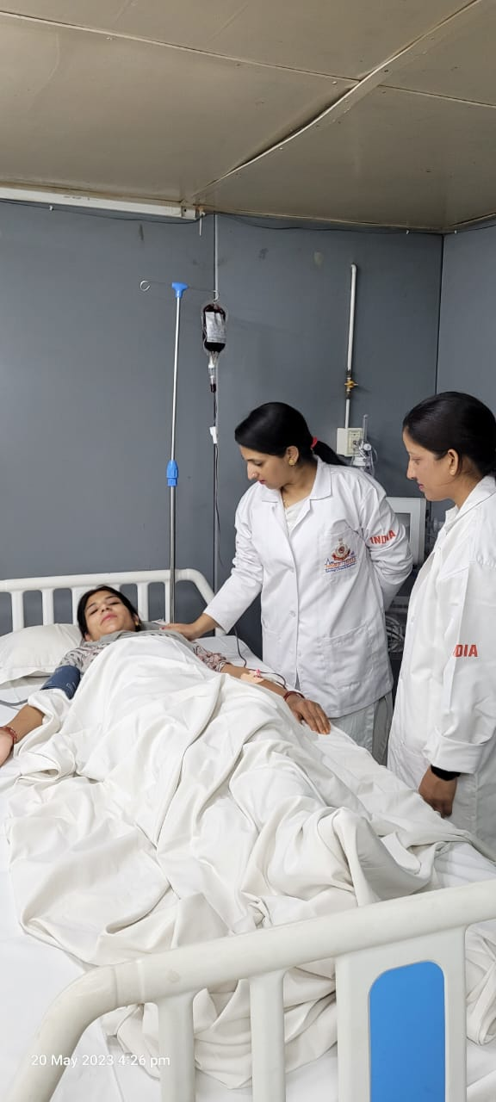
POST OPERATIVE CARE:

Slide 13
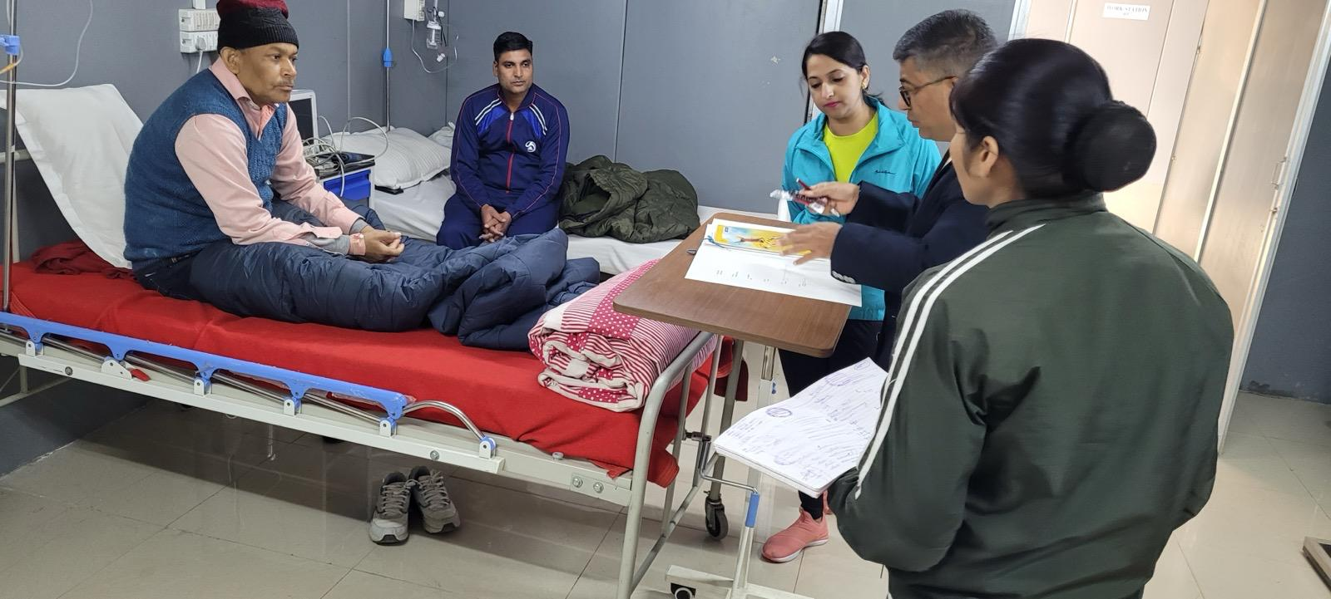
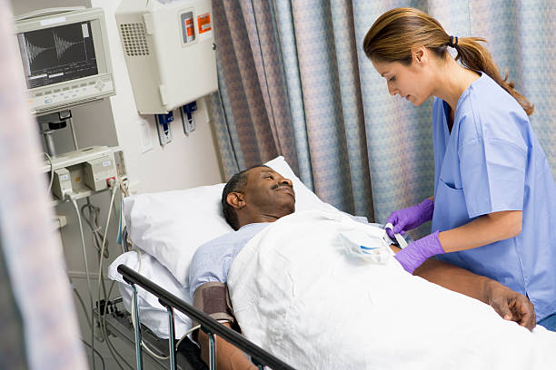
POST OPERATIVE CARE:

Slide 14
1) IMMEDIATE CARE:
    Gently Transfer From Table To Trolley; Rough Handling And Sudden Turning should Be Avoided
Cover the patient properly and ensure the dignity of the unconscious patient
Ensure the IV line, oxygen mask, catheter tubes, etc. Are free of kinking and in place during transfer from OT table to trolley and from trolley to bed
Ensure recovery from anaesthesia is smooth and constant monitoring of the patient
Take care agianst aspiration, if vomiting occurs
Body heat is maintained and bed is warm, especially in winters and the recovery room temperature should ideally be 19⁰ celsius to 22⁰ celsius

Slide 15
Monitor the vital signs as in post-op instructions and be on the look-out for haemorrage of the operation site.
    Hand hygiene of staffs between patients is important
On transfer of patient to ward, the ward nurse should come down to the recovery-room and handover by recovery-room nurse to be carried out. The following documents should accompany patient – nursing record, post-op recovery chart, anaesthetic record, operation record, prescription chart, fluid balance and temperature charts

Slide 16
2) SUBSEQUENT CARE OF PATIENT:
Attention should be directed towards
    Drugs and adequate pain relief
    Bowel sounds , abdominal distension
    Fluid and electrolyte imbalance
    Urine output, input/output chart
    Dressing
    Continuous vitals monitoring

Slide 17
COMPLICATIONS-
Immediate complications:
Hiccough, cough, vomiting
Slipping of ligature, hemorrhage from operation site.
Abdominal distension, retention of urine
Shock
Delayed complications:
Secondary hemorrhage
Fever, infection
Pulmonary complication like stasis pneumonia, venous thrombosis, etc

Slide 18
BARRIER NURSING
Transmission of infection within a healthcare setting requires three elements:
BARRIER NURSING
Source (reservoir) Susceptible host
Mode of transmission
Barrier nursing is the method by which this cycle is interrupted and infections are contained, limiting their spread

Slide 19
Source of infectious agents:
Human reservoirs: patients, healthcare
personnel, household members and
visitors
ii) Inanimate objects used in patient care

Slide 20
2. Susceptible hosts:
Extremes of age and underlying disease
(e.g., diabetes, HIV/AIDS) enhance susceptibility to infection
ii) Medications that alter the normal flora (e.g., antimicrobial agents, gastric acid suppressants, corticosteroids, anti-rejection drugs, anti-neoplastic agents, immunosuppressive drugs
iii) Surgical procedures and radiation therapy impair defenses of the skin organ systems.
iv) Indwelling devices such as urinary catheters, endotracheal tubes, central venous and arterial catheters, and synthetic implants

Slide 21
3. Modes of transmission:
i) Contact transmission, the most common mode of transmission, is divided into two subgroups:
Direct contact transmission occurs when microorganisms are transferred directly from one person to another person. Examples of direct contact transmission –Blood, Scabies etc.
Indirect contact transmission, the most frequent mode of transmission, involves the transfer of an infectious agent through a contaminated intermediate object or person. Examples of indirect contact transmission –Hands, Patient care devices, Share toys, Instruments etc.

Slide 22
ii) Droplet transmission:
Respiratory droplets are generated when an infected person coughs, sneezes or talks or during procedures such as suctioning, bronchoscopy and cough induction by chest physiotherapy. Transmission occurs when droplets, propelled short distances (traditionally, <3 feet through the air), are deposited on the conjunctivae, nasal mucosa or mouth

Slide 23
There are certain hospital settings where the infection transmission rate is quite high. Barrier nursing is essential in such settings to contain infection.
They include:-
Intensive care units
Burns units
Cancer chemotherapy patient wards
Major surgical wards
Plastic surgery units
Hemopoetic stem-cell transplant ward
Post-radiation treatment wards
Organ transplant wards

Slide 24
‘Barrier nursing’ are safe nursing practices which interrupt all of the modes of transmission and essentially consist of adopting the following basic principles:
1. Hand hygiene
2. PPE: correct usage and disposal
3. Patient care policies
4. Patient care equipment policies
5. Environment protection

Slide 25
ANY QUESTION
?

Slide 26
THANKS

Slide 28
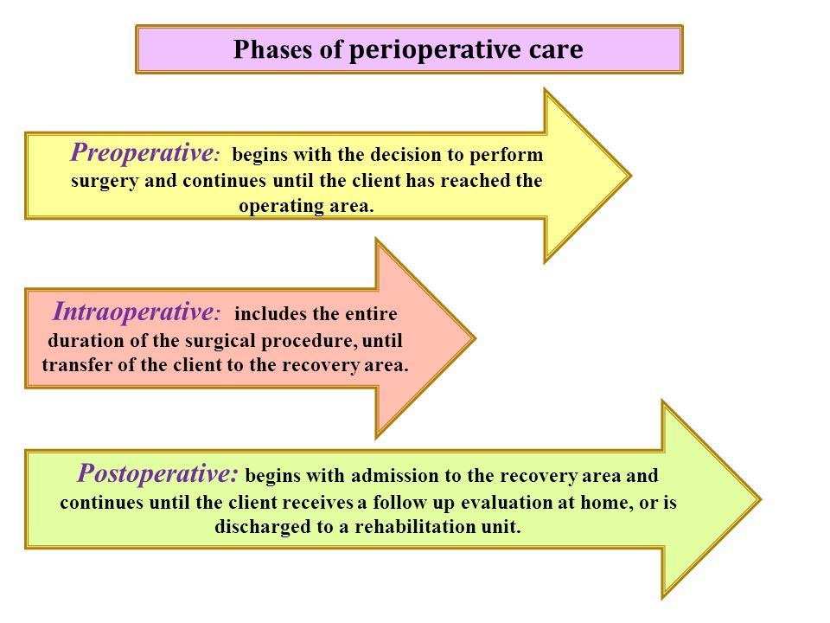

Slide 29
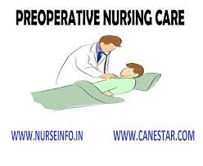

Slide 30
INTRODUCTION
The management of pre-operative patients is a core function of junior doctors. Although specific management is provided in this article, each hospital may differ slightly in its protocols, therefore it is advised that you refer to any local guidelines.
A useful tool for structuring your management plan is to utilise the acronym ‘RAPRIOP’ (this can be used for the management of any patient): Reassurance, Advice, Prescription, Referral, Investigations, Observations, Patient understanding and follow-up:

Slide 31
Reassurance
It almost goes without saying that most patients are anxious about their upcoming surgery. Recognition of this fact and a kind word will make a big difference to a wary patient.

Slide 32
ADVICE
All pre-operative patients should be given advice regarding fasting. A typical pre-operative regime is no food up to 6 hours before surgery, with clear fluids only up to 2 hours before surgery*.
Fasting ensures that the stomach is empty of contents, in turn reduces the risk of aspiration, which can cause aspiration pneumonitis and / or aspiration pneumonia.
*Some centres are moving towards allowing free access to water and encouraging drinking as it has been shown to be association with no increase in adverse events and a significant reduction in postoperative nausea and vomiting

Slide 33
PRESCRIPTIONS
The management of the pre-operative drug regime falls into three categories; prescriptions to stop, prescriptions to alter, and prescriptions to start. In certain patients, bowel preparation and blood products may also need to be considered.

Slide 34
DRUGS TO STOP
These commonly stopped medications can be remembered as ‘CHOW’.
Clopidogrel – stopped 7 days prior to surgery due to bleeding risk; aspirin and other anti-platelets can often be continued and minimal effect on surgical bleeding
Hypoglycaemics – see ‘Diabetes Mellitus’ below
Oral contraceptive pill (OCP) or Hormone Replacement Therapy (HRT) – stopped 4 weeks before surgery due to DVT risk. Advise the patient to use alternative means of contraception during this time period.

Slide 35
DRUGS TO STOP
Warfarin* – usually stopped 5 days prior to surgery due to bleeding risk and commenced on therapeutic dose low molecular weight heparin
  Surgery will often only go ahead if the INR <1.5, so you may have to reverse the warfarinisation with PO Vitamin K if the INR remains high on the evening before
*Direct Oral AntiCoagulants (DOACs), such as Rivaroxaban, Apixaban, or Edoxaban, will also need stopping pre-operatively, however the duration of this depends on the type used

Slide 36
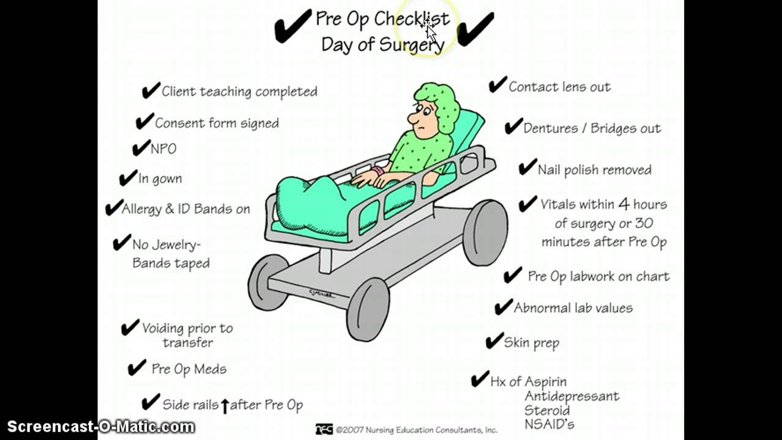

Slide 37
BOWEL PREPARATION
Patients having colorectal surgery may need bowel preparation (laxatives or enemas) to clear their colon pre-operatively (and there is some evidence to suggest it can improve peri-operative outcomes).
The exact protocol will vary between hospitals but a general guide is:
Upper GI, HPB, or small bowel surgery: none required
Right hemi-colectomy or extended right hemi-colectomy: none required
Left hemi-colectomy, sigmoid colectomy, or abdominal-perineal resection: Phosphate enema on the morning of surgery
Anterior resection: 2 sachets of picolax the day before surgery

Slide 38
BLOOD PRODUCTS
It is essential to ensure all patients undergoing major GI, HPB, vascular, gynaecological or orthopaedic surgery have a group and save requested. Others will need blood cross-matching in advance. Read more about prescribing blood products here.

Slide 39
REFERRAL
Consider where the patient may need a HDU or ITU bed to be booked. Any concern, it is best to discuss this with your senior.

Slide 40
INVESTIGATIONS
There are a range of pre-operative investigations that can be requested. The nature of the investigations required depends on a number of factors, including co-morbidities, patient age, and the procedure itself.

Slide 41
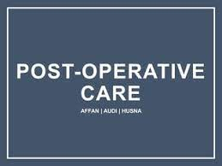

Slide 42
Postoperative Care
Planning
In the hospital
At home
Takeaway
Postoperative care is the care you receive after a surgical procedure. The type of postoperative care you need depends on the type of surgery you have, as well as your health history. It often includes pain management and wound care.
Postoperative care begins immediately after surgery. It lasts for the duration of your hospital stay and may continue after you’ve been discharged. As part of your postoperative care, your healthcare provider should teach you about the potential side effects and complications of your procedure.

Slide 43
Postoperative care in the hospital
After your surgery is complete, you will be moved to a recovery room. You’ll probably stay there for a couple of hours while you wake up from anesthesia. You’ll feel groggy when you wake up. Some people also feel nauseated.
While you’re in the recovery room, staff will monitor your blood pressure, breathing, temperature, and pulse. They may ask you to take deep breaths to assess your lung function. They may check your surgical site for signs of bleeding or infection.

Slide 44
Postoperative care in the hospital
They will also watch for signs of an allergic reaction. For many types of surgery, you will be placed under general anesthesia. Anesthesia can cause an allergic reaction in some people.
Once you’re stable, you’ll be moved to a hospital room if you’re staying overnight, or you’ll be moved elsewhere to begin your discharge process.

Slide 45
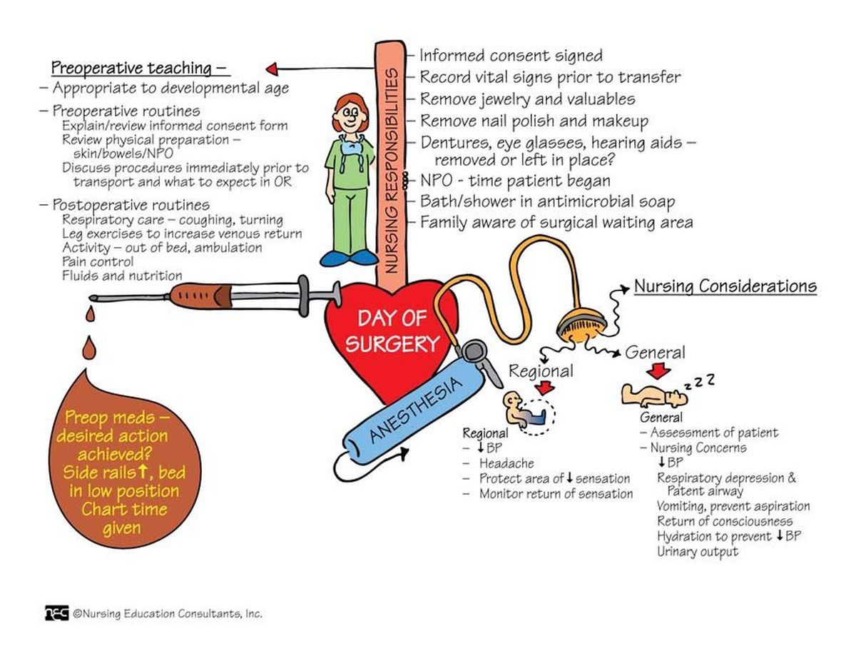

Slide 46
Outpatient surgery
Outpatient surgery is also known as same-day surgery. Unless you show signs of postoperative problems, you’ll be discharged on the same day as your procedure. You won’t need to stay overnight.
Before you’re discharged, you must demonstrate that you’re able to breathe normally, drink, and urinate. You won’t be allowed to drive immediately following a surgery with anesthesia. Make sure you arrange transportation home, preferably ahead of time. You may feel groggy into the following day.

Slide 47
Postoperative care at home
It’s very important that you follow your doctor’s instructions after you leave the hospital. Take medications as prescribed, watch out for potential complications, and keep your follow-up appointments.
Don’t overdo things if you’ve been instructed to rest. On the other hand, don’t neglect physical activity if you’ve been given the go ahead to move around. Start to resume normal activities as soon as you safely can. Most of the time, it’s best to gradually return to your normal ROUTINE

Slide 48
Postoperative care at home
In some cases, you may not be able to care for yourself for a while after your surgery. You may need a caregiver to help tend your wounds, prepare food, keep you clean, and support you while you move around. If you don’t have a family member or friend who can help, ask your doctor to recommend a professional caregiving service.
Contact your doctor if you develop a fever, increased pain, or bleeding at the surgical site. Don’t hesitate to contact your doctor if you have questions or aren’t recovering as well as expected.

Slide 49
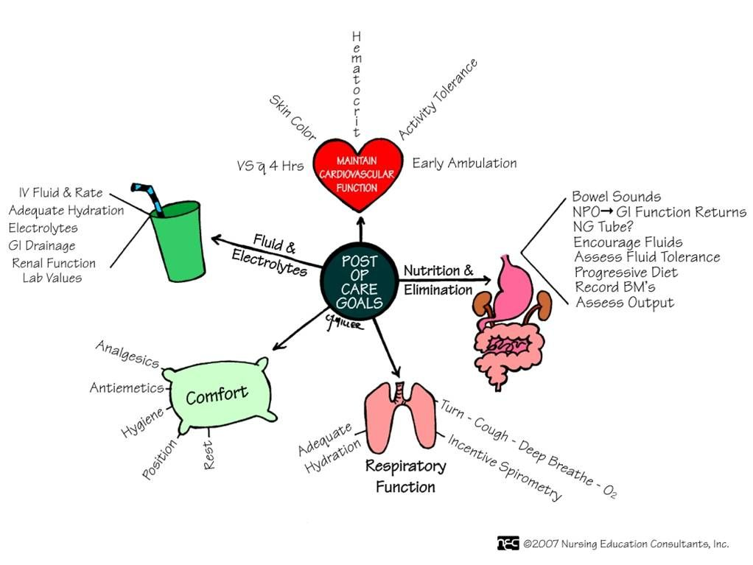

Slide 50
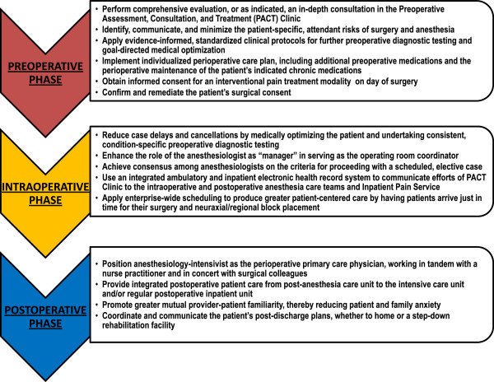

Slide 52


Slide 53


