Slide 1
MEDICAL EQUIPMENTS
LESSON -37
BY
JITENDER YADAV
INSP/PH

Slide 2
EQUIPMENTS OF ALS AMBULANCE:-
Thermometer –
                Digital Thermometer
                IR Thermometer
Stethoscope
Fully Automated B.P. Instrument Aneroid
Glucometer
Suction Machine Portable
Finger Tip Pulse Oximeter
Breath Analyzer
ECG Machine
Infusion Warmer

Slide 3
EQUIPMENTS OF ALS AMBULANCE:-
8. Oxygen Concentrator
9. Nebulizer
10. Ventilator
11. Video Laryngoscope
12. Multipara Monitor with ECG Electrode
13. Infusion Pump
14. Electric Portable Suction Aspirator with
Airflow of at least 30L/min.
15. Steam Inhaler
16.

Slide 4
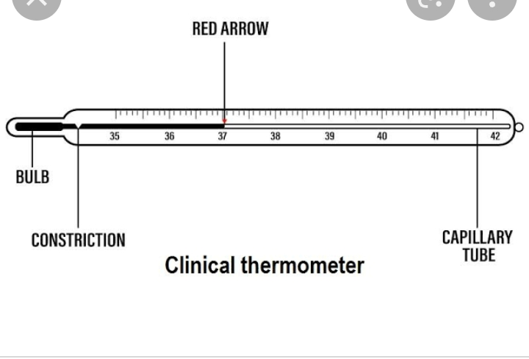
Clinical thermometer

Slide 5
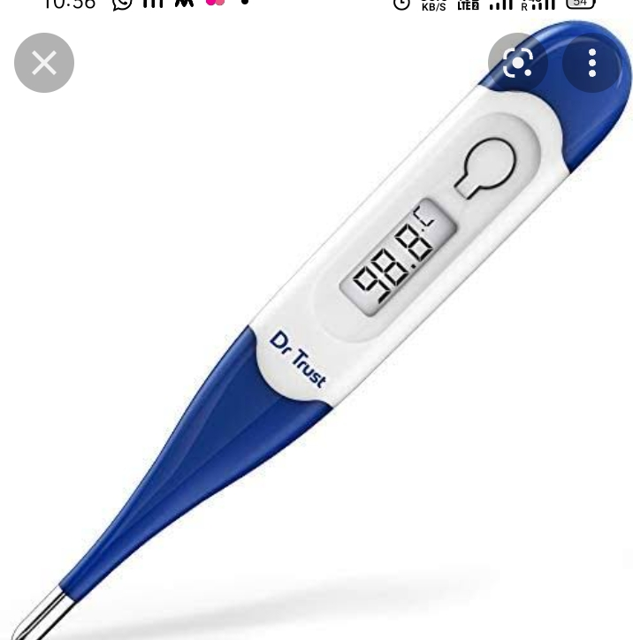
DIGITAL THERMOMETER

Slide 6
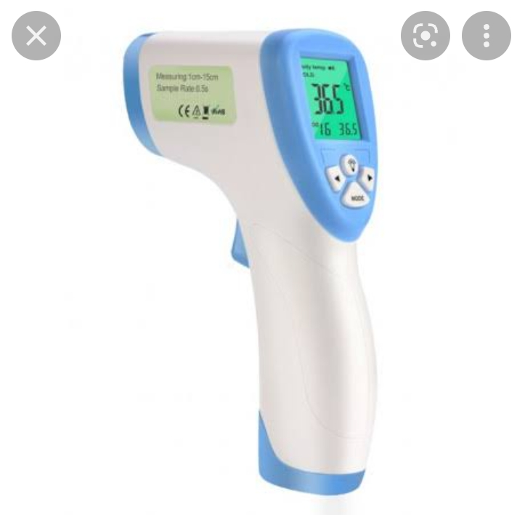
Infrared thermometer

Slide 7
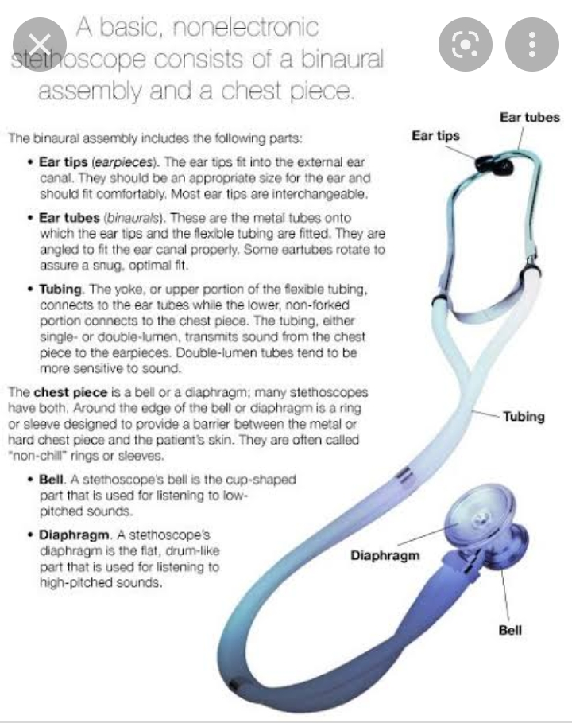
Stethoscope

Slide 8
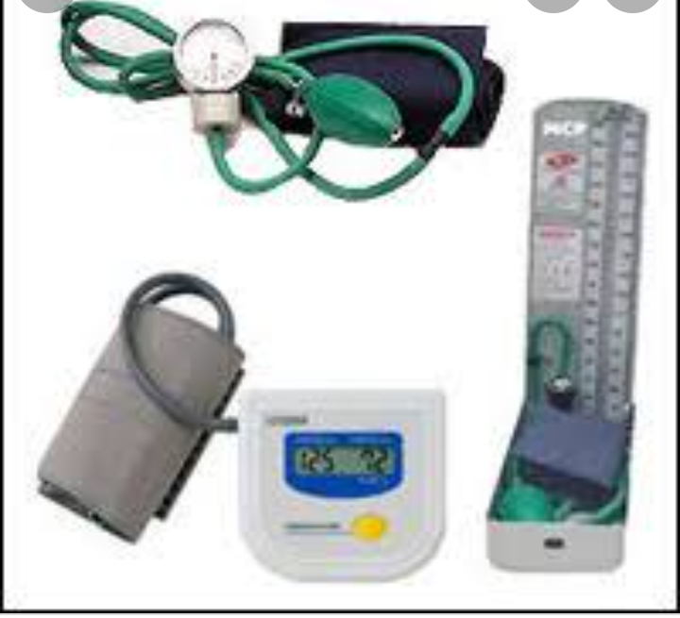
BP appratus

Slide 9
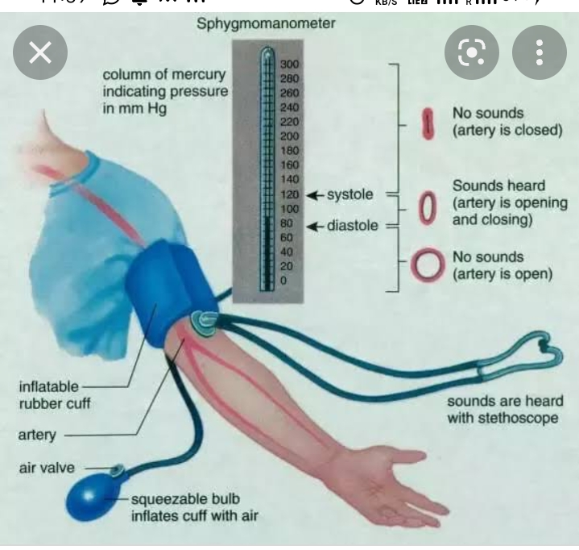

Slide 10
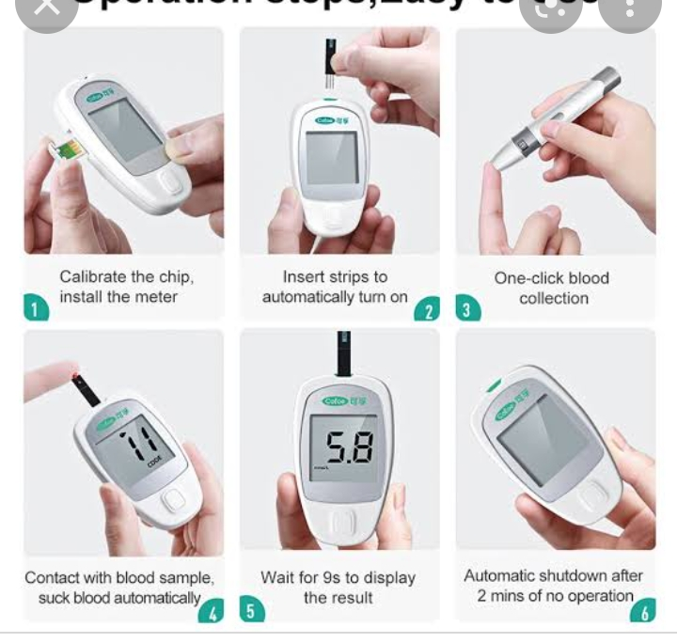
Glucometer

Slide 11
Suction machine
Suction machines are appliances that are used to remove substances such as blood, saliva, mucus, and vomit from a person's airway. A portable suction unit can prevent pulmonary aspiration and facilitate breathing.

Slide 12
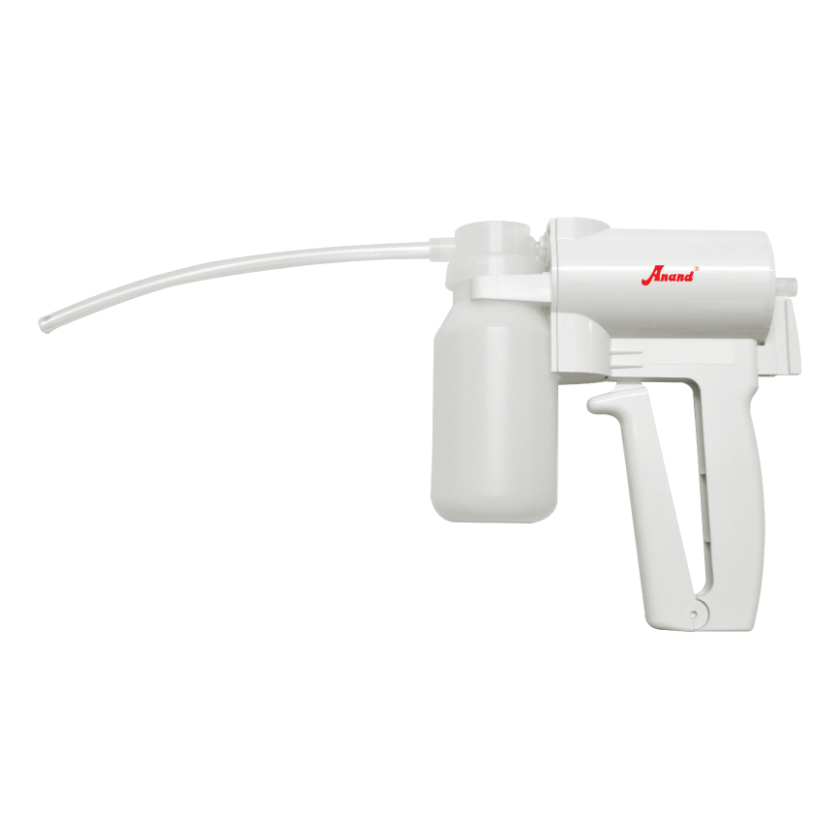
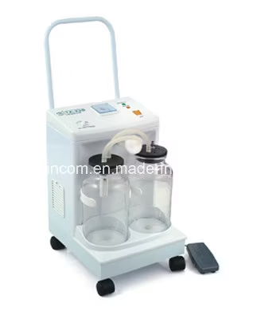
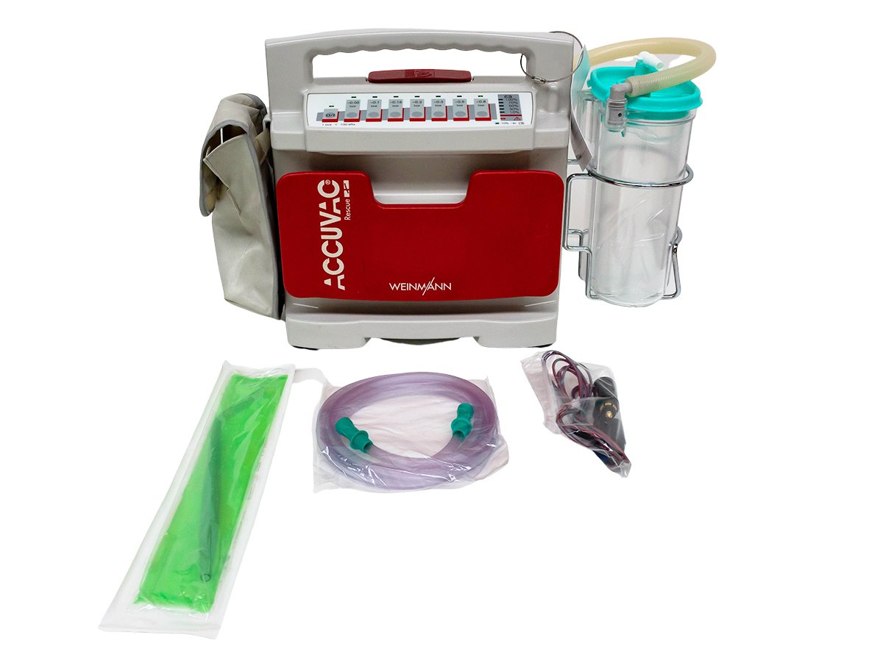

Slide 13
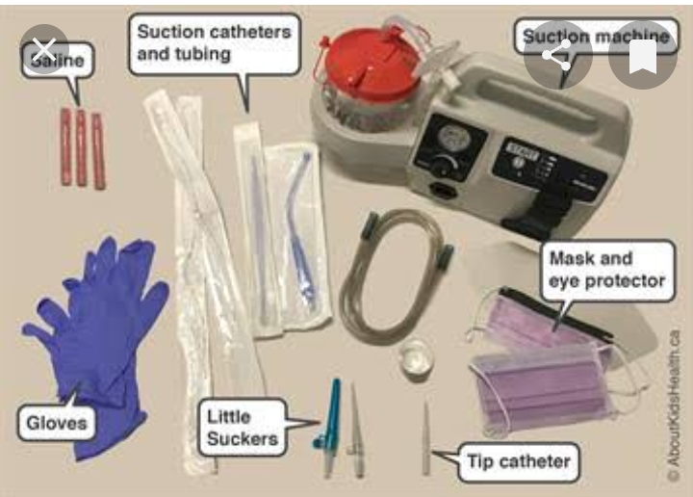
Preparation for suction

Slide 14
Precautions during suctioning
Conduct a Risk Assessment.
Prepare the Patient.
Do Not Suction Too Long.
Avoid Forcing the Catheter.
Monitor for Complications.
Choose the Right Equipment.

Slide 15
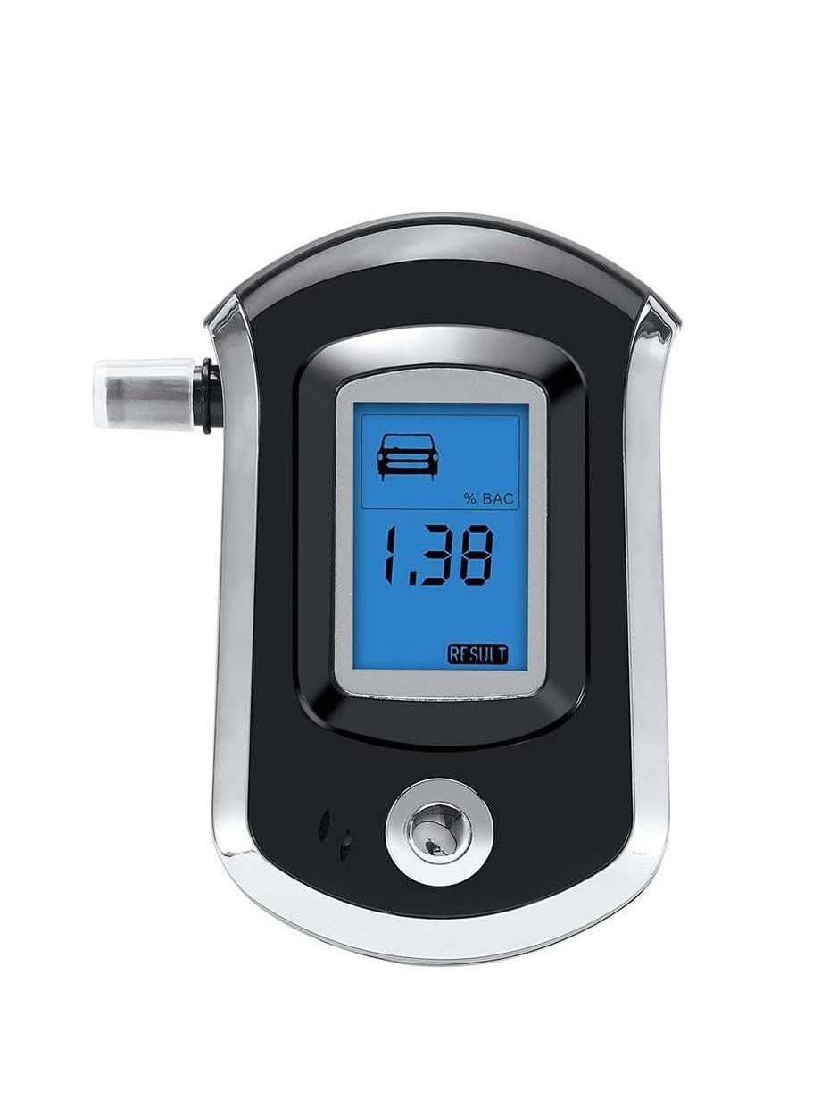
Alcohol breathanalyzer
monitor
A breathalyzer or breathalyser (a portmanteau of breath and analyzer/analyser) is a device for estimating blood alcohol content (BAC), or to detect viruses or diseases from a breath sample.

Slide 16
BREATHALYZER
A breathalyzer, or alcohol test machine, measures the concentration of alcohol in a person's breath, which is then used to estimate their blood alcohol content (BAC). The "normal" or legal range for BAC in most places is 0.00% to 0.08%, with anything above 0.08% considered legally impaired for driving

Slide 17
Accuracy
There is indeed a margin of error when it comes to Breathalyzers. This margin of error can be up to 15%. Around 20% of people charged with a DUI can end up being victims and an inaccurate Breathalyzer test. The best and most accurate way to accurately test a person's BAC is by doing a blood test.

Slide 18
How does alcohol breath Analyser work?
Accuracy depends on the sample of breath being deep lung air (alveolar air). As the driver breathes out, the device continuously monitors the expired air using an infrared cell. The concentration of ethanol climbs as expiration continues, and when the level of ethanol stabilises, the sample of breath is analysed How does alcohol breath Analyser work?

Slide 19
FACTOR WHICH CAN AFFECT ALCO TEST
DRINKING | The Body
Amount of Alcohol & Speed of Consumption. The more alcohol and/or the shorter the time period, the higher the Blood Alcohol Content (BAC).
Biological / Genetic Risk. ...
Ethnicity. ...

Slide 20
FACTOR WHICH CAN AFFECT ALCO TEST
Gender. ...
Body Size and Composition. ...
Stomach Content. ...
Dehydration. ...
Carbonated Beverages.

Slide 21
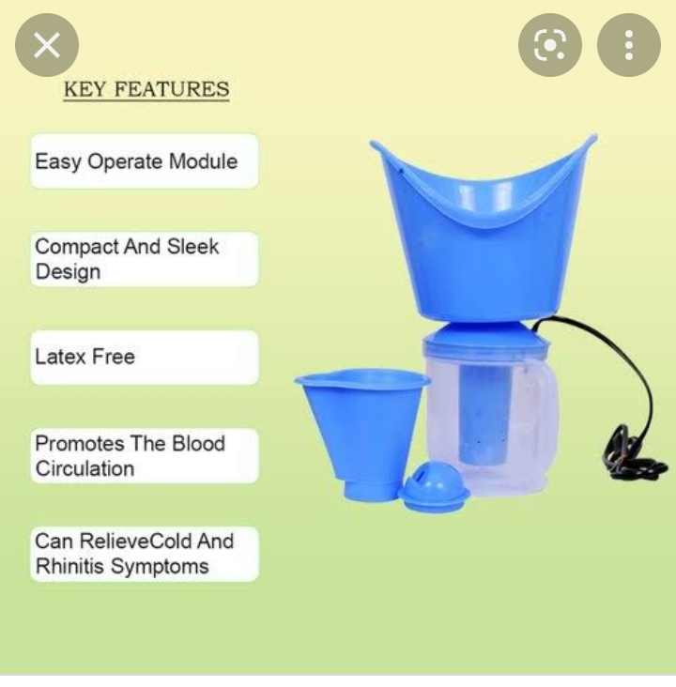
STEAMER

Slide 22
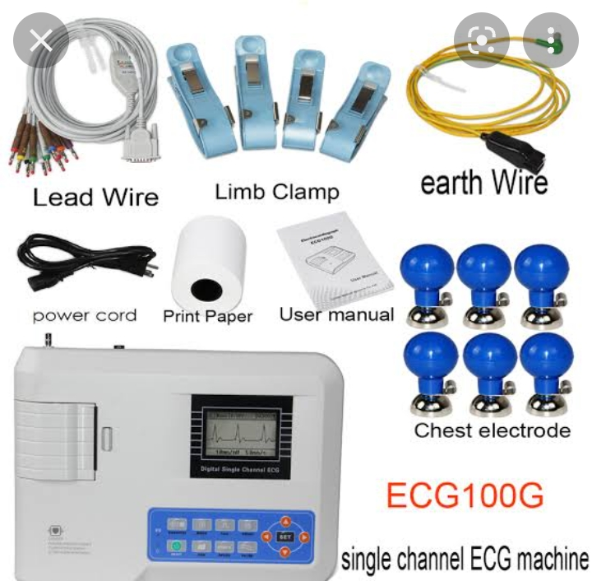
ECG MACHINE

Slide 23

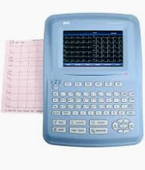

Slide 24
ELECTROCARDIOGRAM (ECG)
An electrocardiogram (ECG or EKG) records the electrical signal from the heart to check for different heart conditions. Electrodes are placed on the chest to record the heart's electrical signals, which cause the heart to beat. The signals are shown as waves on an attached computer monitor or printer.

Slide 25
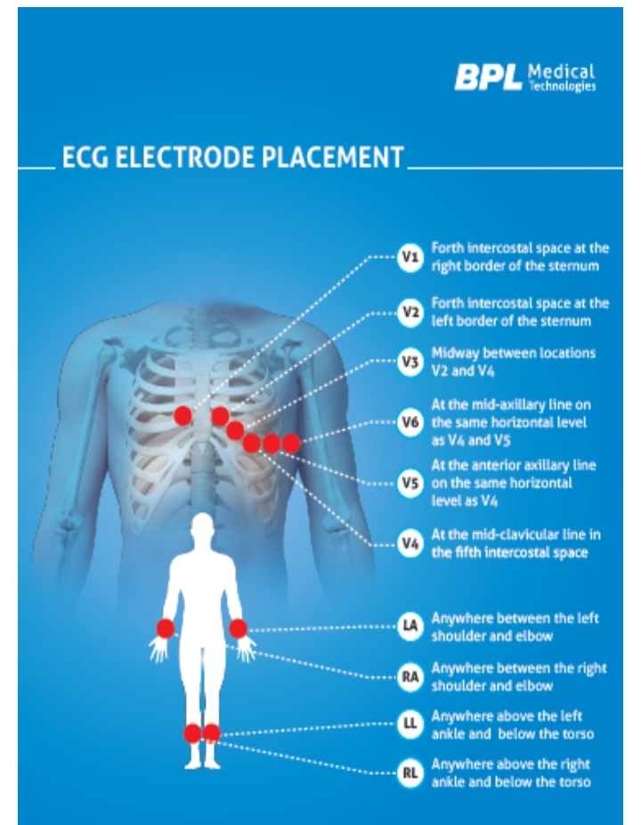
ELECTROCARDIOGRAM (ECG)

Slide 26
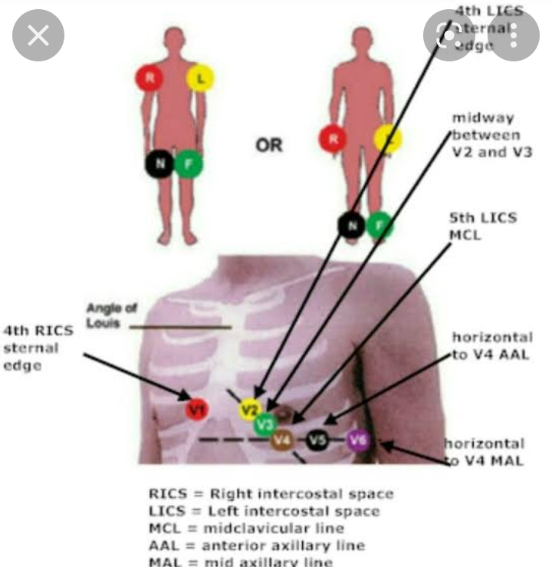

Slide 27
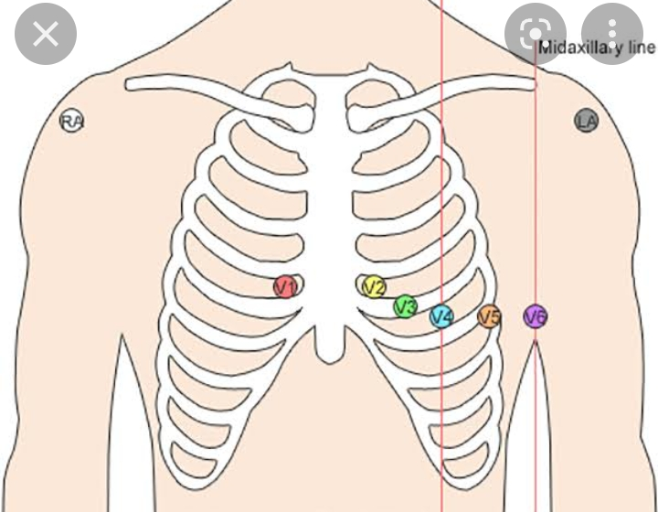
ELECTROCARDIOGRAM (ECG)

Slide 28
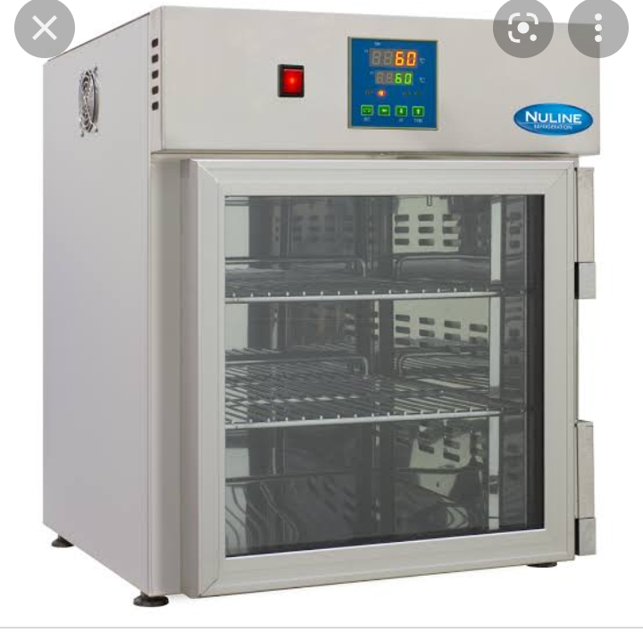
Infusion warmer

Slide 29
Infusion warmer
Most current evidence surrounds the use of warmed IV fluids in the perioperative and intraoperative periods (1). In these studies, it has been recommended that the fluid be warmed to at least 37°C. Warming to this point allows the core body temperature to be kept at the normal

Slide 30
Infusion warmer
What temperature should IV fluids be warmed to?
Most current evidence surrounds the use of warmed IV fluids in the prioperative and intra-operative periods (1). In these studies, it has been recommended that the fluid be warmed to at least 37°C. Warming to this point allows the core body temperature to be kept at the normal range of 36.5-37.5°C
What is the purpose of fluid warmer?
A fluid warmer is a medical device used in healthcare facilities for warming fluids, crystalloid, colloid, or blood product, prior to being administered (intravenously or by other parenteral routes) to body temperature levels in order to prevent hypothermia in physically traumatized or surgical patients.

Slide 31
AUTOMATED EXTERNAL DEFIBRILLATOR (AED)
What is a AED used for?
An automated external defibrillator (AED) is a medical device designed to analyze the heart rhythm and deliver an electric shock to victims of ventricular fibrillation to restore the heart rhythm to normal. Ventricular fibrillation is the uncoordinated heart rhythm most often responsible for sudden cardiac arrest.

Slide 32
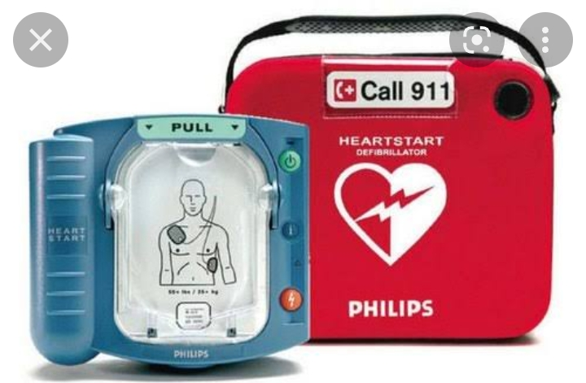
AUTOMATED EXTERNAL
DEFIBRILLATOR (AED)

Slide 33
AUTOMATED EXTERNAL
DEFIBRILLATOR (AED)
Check unresponsiveness.
Call 9-1-1 or the local emergency number (if applicable) and retrieve the AED.
Open the airway and check for breathing. ...
Check for a pulse. ...
Attach the AED electrode pads.
Analyze the heart rhythm. ...
Press the "shock" button, if advised.

Slide 34
AUTOMATED EXTERNAL
DEFIBRILLATOR (AED)
Two pads will need to be placed on the chest of the person. The first is placed on the right-hand side of the chest below the collar bone. The second is placed on the left-hand side, below the armpit. The AED you use will indicate which pad is the first and second.

Slide 35
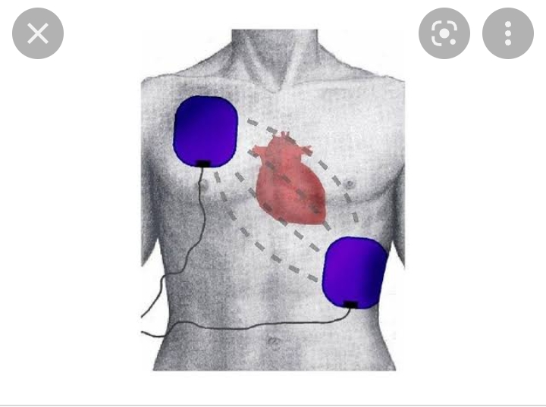
AUTOMATED EXTERNAL
DEFIBRILLATOR (AED)

Slide 36
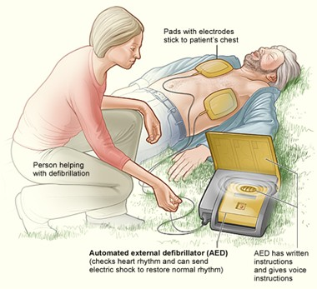
AUTOMATED EXTERNAL
DEFIBRILLATOR (AED)

Slide 37
AUTOMATED EXTERNAL
DEFIBRILLATOR (AED)
What precautions should you take for using an AED on someone with a pacemaker?
Pacemakers and Implanted Defibrillators – Someone with an internal device still can be shocked with an AED. In fact, if their internal device does not save them immediately, it is crucial an AED is used as quickly as possible. It is important to remember, do not place the pads directly over the meta

Slide 38
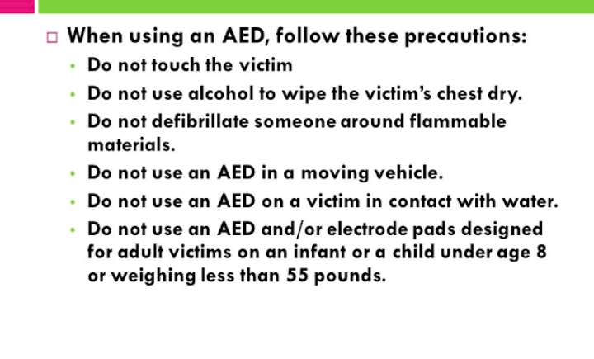

Slide 39
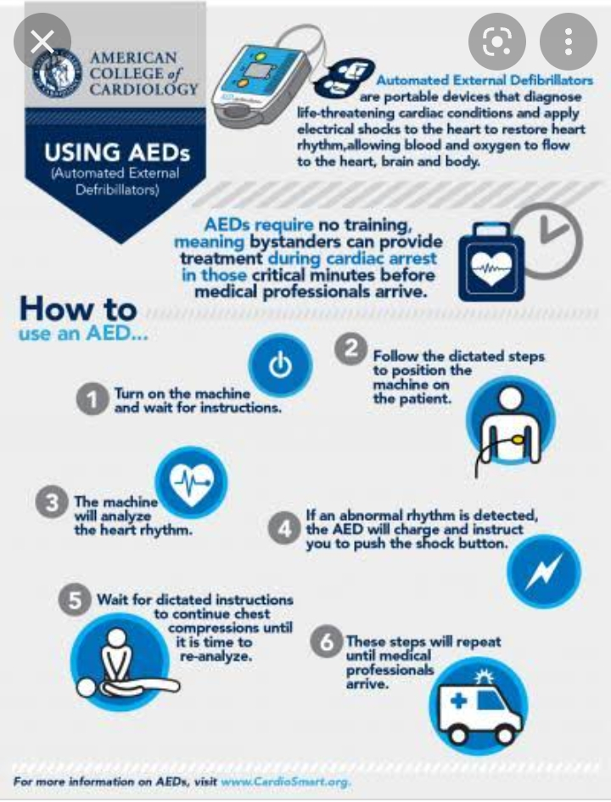

Slide 40
OXYGEN CONCENTRATER
An oxygen concentrator is a medical device that utilises environmental air, concentrates it, and delivers oxygen from it to individuals who require supplemental oxygen due to decreased concentration of oxygen in their blood

Slide 41
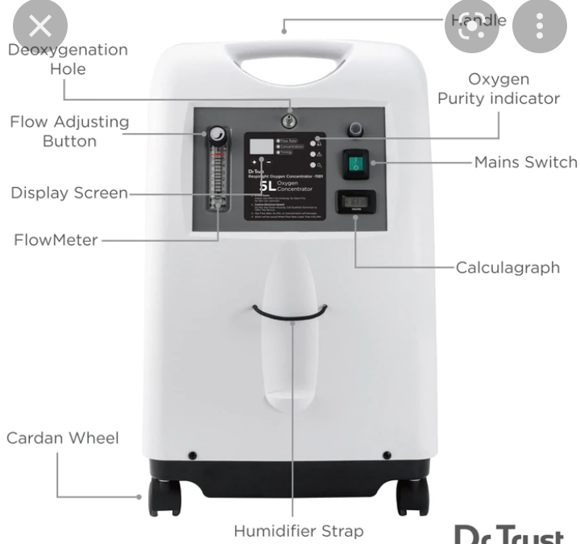
O2 CONCENTRATER

Slide 42
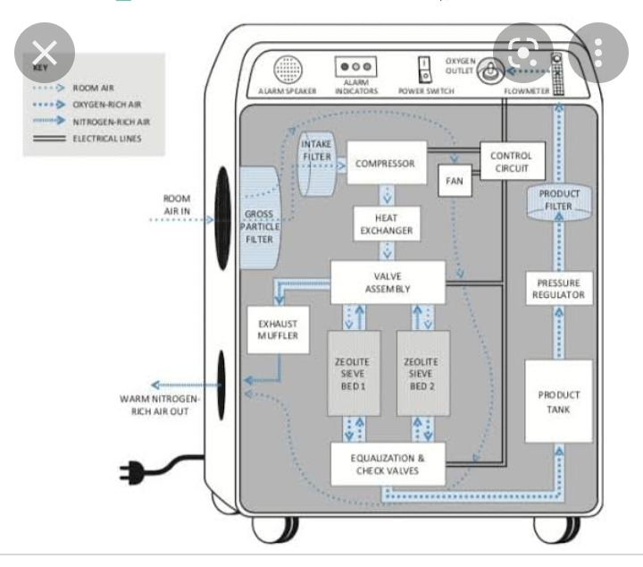
O2 CONCENTRATER

Slide 43
OXYGEN CONCENTRATER
Advantages of Oxygen Concentrators
Portable.
Cost-Effective.
Easy to operate.
Useful for Home & Hospitals.
Helpful in emergency.

Slide 44
DISADVANTAGES OF CONCENTRATER
Cons. Batteries required: Because they do not use pressurized oxygen within a tank, oxygen concentrators must rely on battery or electric power to perform their air filtering and oxygen flow. Noisy. Oxygen concentrators collect oxygen from the air and then filter and compress it for the user

Slide 45
VENTILATOR
In an ICU setting, ventilators are broadly classified into invasive and non-invasive types. Invasive ventilators, like mechanical ventilators and tracheostomy ventilators, deliver air through tubes inserted into the patient's airway (either via the mouth/nose or a surgical opening in the neck). Non-invasive ventilators, such as face mask ventilators, use masks to provide air or oxygen

Slide 46
NEBULIZER
A nebulizer is a small machine that turns liquid medicine into a mist. You sit with the machine and breathe in through a connected mouthpiece. Medicine goes into your lungs as you take slow, deep breaths for 10 to 15 minutes. It is easy and pleasant to breathe the medicine into your lungs this way

Slide 47
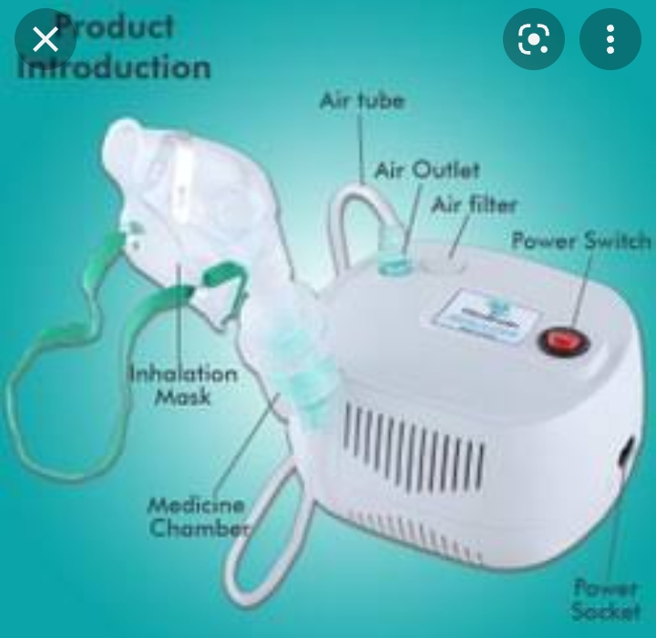
NEBULIZER

Slide 48
NEBULIZER
Nebulizers are primarily used for - asthma, COPD, and other severe breathing problems. However, it is also used for severe cases of nasal and chest congestion. It provides immediate relief by the opening of airways

Slide 49
VIDEOLARYNGOSCOPE
Video laryngoscopy is a relatively new technology developed to improve the success rate of tracheal intubation. A high-resolution micro camera mounted on the tip of a curved blade connected to small portable digital monitor improves the view of the vocal cords and subsequently the success rate of direct laryngoscopy

Slide 50
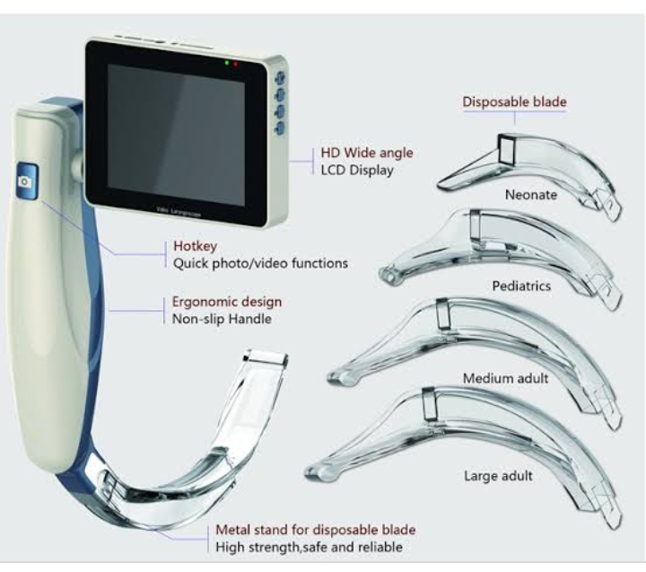
VIDEOLARYNGOSCOPE

Slide 51
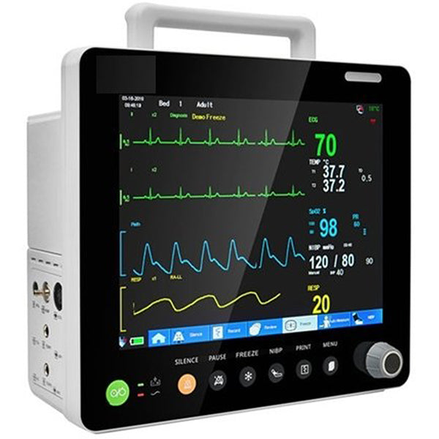
5-PARAMONITOR

Slide 52
5-PARAMONITOR
A lightweight, compact and portable 5 Para Patient Monitor (8") (5 Para) features high-resolution color TFT display and is suitable for Arrhythmia analysis and S-T segment analysis in neonatal, pediatric and adult patients.
The multiparameter monitors are designed to give number of information on one screen and hence provides multiple information that is needed to understand the patient
condition. It has emerged as a monitor to offer flexible solution for varying critical care need.

Slide 53
5-PARAMONITOR
A cardiac event monitor is a device that you control to record the electrical activity of your heart (ECG). This device is about the size of a pager. It records your heart rate and rhythm. Cardiac event monitors are used when you need
long-term monitoring of symptoms that occur less than daily

Slide 54
ANY QUESTION
?

Slide 55
THANKS

