Slide 1

COMMON DRUGS AND THEIR USES
LESSON -36
BY
OMKAR YADAV
INSP/PH

Slide 2
OBJECTIVES
What is Medicine
Important Lebel on Medicine
Form of Medicine
Reading Prescription
Common Medicine Group

Slide 3
MEDICINES
Any substance (other than food) that is used to prevent, diagnose, treat, or relieve symptoms of a disease or abnormal condition.
USE OF MEDICINES
THERAPEUTICS-
Medicines used for treatment of diseases.
PROPHYLACTIC-
Medicines used for the prevention of diseases

Slide 4
IMPORTANT LABLE ON MEDICINES
BRAND NAME
GENERIC NAME OF MEDICINES
STRENGTH OF MEDICINES
DATE OF EXPIRY
DATE OF MANUFACTURING
BATCH NUMBER
IP,BP,USP ETC
IV,IM,SC,AQU (AQUA),ETC

Slide 5
FORM OF MEDICINES
1. | LIQUID | SOLUTION, MIXTURE, SYRUP, SUSPENSION
2. | TABLET | SOLUBLE, DISPERSABLE TABLET
3. | CAPSULES | MEDICINES CONTAINS IN GELATIN/PLASTIC SHELL
4. | TOPITAL MEDICINES | CREAM, OINTMENTS, LOTIONS
5. | SUPPOSITORIES | BULLET SHAPE- SHOULD NOT BE SWALLOWED ROUTE OF ADMINISTRATION-RECTAL OR VAGINAL
6. | DROPS | EYE DROP, EAR DROP, NASAL DROP ETC
7. | INHALERS | ASTHALIN
8. | INJECTIONS | IM,IV,SUBCUTANEOUS ETC
9. | PATCHES | BELADONA PLASTER

Slide 6
TYPES OF TABLET
1. | COATED | NOT-COATED
2. | SUGAR COATED | CAN BE DIVIDED
3. | FILM COATED
4. | DISPERSIBLE TABLET
5. | SUBLINGUAL TABLET
6. | ENTERIC COATED
7. | SUSTAINED/ EXTENDED/ CONTROLLED RELEASE

Slide 7

FORM OF MEDICINES

Slide 8
READING OF PRESCRIBTION
Rx
DIAGNOSIS
NAME OF MEDICINES
DOSE
ADVICE LIKE DIAGNOSTIC TESTS
PRECAUTIONS
AST

Slide 9
LATIN WORDS USED IN PRESCRIBTION
ABBREVATION | MEANING | LATIN ORIGIN
RX | MEDICAL PRESCRIBTION | TO TAKE/RECIPE
OD/OID | ONCE A DAY | OMNE IN DIE
BD/BiD | 2 TIMES A DAY | BIS IN DIE
TID/TDS | 3 TIMES A DAY | TER DIE SUMENDUS
QID | 4 TIMES A DAY | QUARTER IN DIE
AC | BEFORE MEALS | ANTE CIBUM
PC | AFTER MEALS | POST CIBUM
HS | AT BEDTIME | HORA SOMNI
AM/PM | MORNING/EVENING | ANTE MERIDIEM/POST MERIDIEM
STAT | IMMEDIATELY/NOW | STATIM
BBF | BEFORE BREAK FAST
SOS | WHEN SYMPTOMS APPEARED | NOT MORE THAN DOSE

Slide 10
MEDICINES GROUPS
MEDICINES ARE DIVIDED INTO DIFFERENT TYPES GROUPS ON THE BASIS THEIR PHARMACOLOGICAL ACTION

Slide 11
ANALGESIC/ANTIPYRETICS/ANTI-INFLAMATORY
GENERIC NAME OF MEDICINES | POPULAR BRAND NAME
PARACETAMOL (ACETAMENOFEN) 250/500/650/1GM | CALPOL,CROCIN,
DICLOFENAC 50/75/100 | VOVERAN
ACECLOFENAC 100 | ACECLO
IBUPROFEN 400 | BRUFEN
IBUPROFEN+PARACETAMOL | COMBIFLAM
ALLUPURINOL 100 | ZYLORIC
CHLORZOXAZONE 500MG | COMBINATION
THIOCHOCHICOSITE 4/8MG | COMBINATION
TRAMADOL | ULTRACET
PENTAZOCIN | FORTWIN

Slide 12
ANTI-ALLERGIC/ ANTI-HISTAMINIC
GENERIC NAME OF MEDICINES | POPULAR BRAND NAME
CETRIZINE 5/10 | CETZIN
LEVOCETRIZINE 5MG | LEVOCET
FEXOFENADINE 120/180MG | ALLEGRA
LORATADINE
PHENERAMINE MALEATE 25MG | AVIL
PROMETHAZINE | AVOMIN/

Slide 13
ANTIBIOTICS
AMINOGLYCOSIDES | STREPTOMYCIN GENTAMYCIN | ABDOMINAL INFECTIONS
CEPHALOSPORINS | CEFTRIAXONE CEFIXIME CEFPODOXIME ETC | SKIN, URINARY, RESP INFECTIONS
TETRACYCLINES | TETRACYCLINE DOXYCYCLINE | STD PID
PENICILLINS | AMOXYCILLIN AMPICILLIN | ENT SKIN URINARY
SULFONAMIDES | SULFAMETHOXAZOLE | UTI, BURNS, EYE
FLUOROQUINOLONES | CIPROFLOXACIN LEVOFLOXACIN | RESPIRATORY & URINARY INFECTIONS
MACROLIDES | AZITHROMYCIN ERYTHROMYCIN | PNEUMONIA, SINUS, ENT STIs
CARBAPENEMS | MEROPENEM ERTAPENEM | URINARY, ABDOM INFECTION
LINCOSAMIDES | CLINDAMYCIN | SKIN BONE LUNG INF.
GLYCOPEPTIDES | VANCOMYCIN | SKIN

Slide 14
ANTIBIOTICS
GENERIC NAME OF MEDICINES | POPULAR BRAND NAME
AMOXYCILLIN 125/250/500 | AUGMENTIN, MONOCEF, CIPLOX, CEFRAN, CLAVAM, AMOXYCLAV, NOVACLOX, AZITHRAL,
AMPICILLIN 250/500
CIPROFLOXACIN 250/500
AMIKACIN
GENTAMYCIN
AZITHROMYCIN
CEFIXIME/CEFOTAXIM/CEFPODOXIM
CEFTRIAXONE/CEPHALAXIN | MONOCEF
TETRACYCLINE
ERYTHROMYCIN
NORFLOXACIN

Slide 15
CEPHALOSPOINES GENERATION
1ST Generation | 2nd Generation | 3rd Generation | 4th Generation | 5th Generation
Cephalaxin | Cefoxitin | Cefexime | Cefepime | Ceftibiprole
Cefalothin | Cefprozil | Ceftozidime | cefprrole | Ceftaroline
Cefaloridine | Cefotitan | Cefotaxime
Cefadroxil | Cefmetazole | Ceftizoxime
Cephradine | Cefaclor | Cefpodoxime
 | Cefuroxime | Ceftriaxone
 |  | Cefoperazone
 |  | Ceftibuten

Slide 16
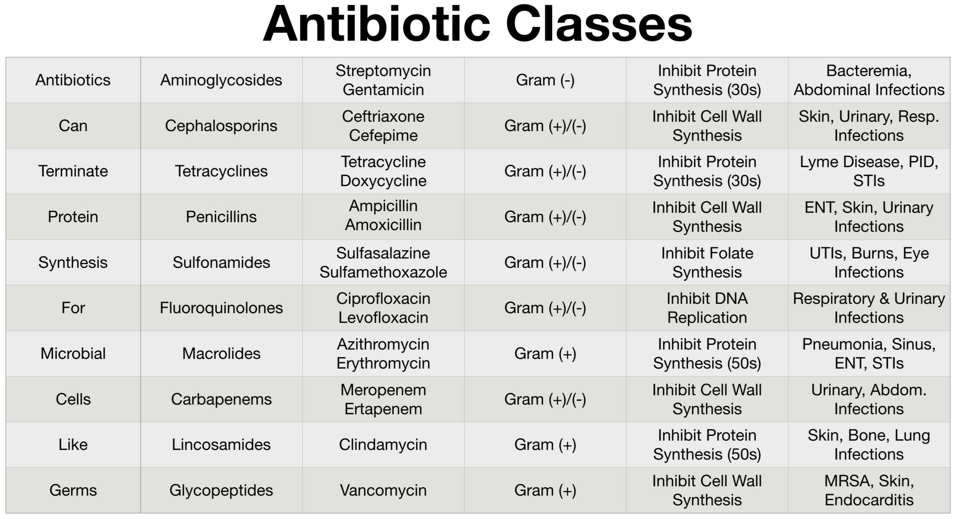

Slide 17
PROPERTIES OF GOOD ANTIBIOTICS
SHOULD HAVE A WIDE SPETRUM OF ACTIVITY
SHOULD BE HIGHLY EFFECTIVE IN LOW CONCENTRATION
SHOULD BE NOT AFFECTING NORMAL FLORA OF HOST AND NON-ALLERGIC TO HOST.
SHOULD BE COMPLETELY ELIMINATED FROM BODY AND SHOULD NOT PRODUCE ADVERSE AND SIDE EFFECT.
ABLE TO REACH AT SITE OF INFECTION IN BODY
CHEMICALLY STABLE,
HAVE LONG SELF LIFE,
INEXPENSIVE AND EASY TO PRODUCE.

Slide 18
ANTHELMENTIC | ALBENTAZOLE
ANTI-MALARIAL | Chloroquine / Primaquin
ANTI-FUNGAL | Miconazole/Fluconazole/Clotrimazole, Griseofulvin,
ANTI-EMETIC | METOCLOPRAMIDE/ONDASETRON (PERINORM/EMSET)
ANTI-VIRAL | ACYCLOVIR
ANTI-MIGRAIN | ASA (DISPRIN), PARACETAMOL
STEROIDS | DEXAMETHASONE, HYDROCORTISONE, PREDNISOLONE, METHYL PREDNISOLONE
ANTI-DIARRHOEAL | NORFLOX-TZ, OFLOX-OZ, CIPRO-TZ, METRONIDAZOLE, LOPERAMIDE
ANTI-THYROID | THYROXIN
VACCINES | TT, ANTI-RABIES,

Slide 19
ANTI-COAGOLUANT | HEPARIN, THROMBOPHOB
COAGOLUNT | ETHAMSYLATE, VIT-K, TRANEXAMIC ACID
ANTI-HYPERTENSIVE | ATENOLOL, AMLODEPIN, ENALAPRIL,NIFEDEPIN,
ANTACID | PANTOPRAZOLE,RANITIDINE,OMEPRAZOLE,RABEPRAZOLE
ANTI-DIABETIC | METFORMIN,GLIBENCLAMIDE, INSULIN
ANTI-SPASMODIC | DICYCLOMINE HYDROCHLORIDE/HYOSCINE BUTYL BROMIDE
LAXATIVE | BISACODYL/SODIUM PICOSULPHATE
ANTICONVULSANT ANTIEPILEPTIC | PHENYTOIN SODIUM INJ/TAB DIAZEPAM

Slide 20
VITAMINS & MINERALS
ASCORBIC ACID/VIT-C
CALCIUM CARBONATE
NICOTINAMIDE
PYRIDOXINE
RIBOFLAVIN
THIAMINE
VITAMIN-A
VITAMIN-D

Slide 21
IV FLUIDS
GENERIC NAME OF MEDICINES | POPULAR BRAND NAME
INJ. DEXTROSE 5%/10%/25%
INJ. DNS
INJ. NORMAL SALINE (NS) 0.9%
INJ. RINGER LACTATE
INJ. METRONIDAZOLE 100ML
INJ. CIPROFLOXACIN 100ML
INJ. HAEMACEAL 500ML
INFUSION PARACETAMOL 100ML

Slide 22
EMERGENCY/COMMON INJECTIONS GIVEN IN IV FLUID LIKE NS,D5%,DNS,RL
PAIN KILLER | DICLOFENAC INJ. | TRAMADOL INJ.
ANTI-SPASMOTIC | HYOSCINE INJ | DROTAVERINE INJ
GASTRITIS/ANTACID | PANTOPRAZOLE INJ | RANITIDINE INJ.
ANTI-EMETICS | METOCLOPRAMIDE | ONDANSETRON
BREATHING RELATED PROBLEM | ETOFYLLINE & THEOPHYLLIN INJ (DERIPHYLLIN)
DIURETICS | INJ. FRUSEMIDE (LASIX)
VITAMIN | INJ. MULTIVITAMIN (MVI) | INJ. METHYCOBALAMIN (VIT-B12)
 | INJ. IRON SUCROSE

Slide 23
LIST OF EMERGENCY MEDICINES USUALLY KEPT IN EMERGENCY TRAY
Inj. Adrenaline
Inj. Atropine
Inj. Avil
Inj. Buscopan
Inj. Dexamethasone
Inj. Dopamine
Inj. Deriphyline
Inj. Diazepam
Inj. Diclofenac Sod.
Inj. Emset
Inj. Lasix
Inj. Sod bi Carbonate
Inj. Trenexa
Inj. Phenargen
Inj. Fortwin
Inj. Tramadol
Inj. Calcium Gluconate
Inj. Hydrocortisone
Inj. Rantac
Inj. PCM
Inj. Drotin
Tab. Sorbitrate 5MG
Tab. Asprin 150 MG
Tab. Clopidogril 75 MG
Tab. Atrovas 20/10 MG
INH. Asthalin/Budecort
Resp. Asthalin/Duolin/Budecort

Slide 24
INJ. ADRENALINE BITARTRATE (EPINEPHRINE) 1MG/ML
HORMONE RELEASED BY ADRENAL GLANDS (ABOVE KIDNEY)
USES | DOSE-SC,IM, IV AFTER DILUTION,
ANAPHALACTIC REACTION (VERY SERIOUS ALLERGIC REACTIONS) INSECT STINGS/BITES,FOODS,DRUGS OR OTHER SUBTANCES. WHEN CAN NOT CONTROL BY INJ. AVIL AND DEXA | IM-0.5MG | WHEN CPR FAILED CAN BE INJECTED DIRECTLY INTO HEART MUSSCLE CONTRAINDICATION-CORONARY ARTERY DISEASE, HIGH BP,
TO INCREASE BP IN EMERGENCY CONDITIONS WHERE SUDDEN DROP OF BP | IV-1MCG
CARDIAC ARREST | IV-50MCG

Slide 25
INJ. ATROPIN SULPHATE 0.4MG/ML OR 0.6MG/ML
USES :-
BRADICARDIA (Heart rate below 60/min
Smooth muscle spasm
AV heart block

Slide 26
PRECAUTIONS
ALLERGIC
PREGNANCY
BREAST FEEDING
DRIVING
KIDNEY FUNCTION
LIVER FUNCTION
HEART DISEASES

Slide 27
THANK YOU

