Slide 1
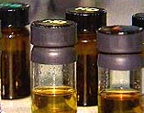

MEDICAL PROTECTION FROM CHEMICAL WARFARE
LESSON -36
BY
PRAVIN DUDHE
INSP/PH

Slide 2
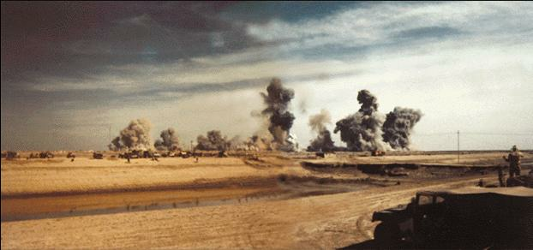
“Medical officers frankly admitted that they were
so handicapped by their lack of experience of cases of gas poisoning
that they were often in doubt, whether they were dealing with men
suffering from gas poisoning or not.”
Official History of medical Services-
Diseases of war,
Vol 31,1923,British Army.
..

Slide 3
DOSE RESPONSE RELATIONSHIP
RESPONSE:
1) Every cell of the body functions in an organized manner.
2) Chemicals alter their function by interacting with the cells. This alteration of function is called response of the cell.
3) The dose and the response can be measured and the magnitude of the response is related to the dose.
4) Response increases with the increase in the dose.
.

Slide 4
DOSE RESPONSE RELATIONSHIP
THRESHOLD DOSE OR THRESHOLD
CONCENTRATION:
The capability of the cell to accept certain dose
or concentration of chemical and safely
eliminate it is called threshold dose or
threshold concentration.
Below this dose there may not be any
effect of the chemical and it is known as
– No observed effect level (NOEL).
.

Slide 5
EFFECTIVE DOSE
Dose necessary for the chemicals to induce effect on the body is called effective dose of that chemical.
ED50. (Effective dose 50%): A dose, which induces 50% response, is known as ED50.
2)LD50 (Median lethal dose).
I A dose, which effect 50% of the population.
If the measured effect is lethality in experimental animals then the ED50 is known as LD50.
LD50 is expressed as mg/kg or gm/kg body weight of the animal. If the chemical is Airborne then it is known as LC50.

Slide 6
EFFECTIVE DOSE
LD50 is useful to compare the toxicity of various chemicals up to some extent. For example
LD50 of Nacl is 4000mg/kg
Nicotine is 1 mg/kg
CWA sarin is 0.2 mg/kg
A plant called Ricin is 0.001 mg/kg
Botulinum toxin is 0.00001 mg/kg

Slide 7
EFFECTIVE DOSE
SAFETY MARGIN
i) The ratio of LD50 to ED 50 gives a indication about the safety margin especially in the case of drug. In the case of pesticides the ED50 refers to the effect on insects and LD50 refers to the lethality of the mammalian species.
Toxic response can be reversible e.g. tear gas or it can be irreversible e.g. chemical inducing neurotoxicity, or teratogenicity

Slide 8
ABSORPTION OF CHEMICAL AGENTS
ROUTE NERVE BLISTER CHOKING BLOOD
RESP/ MAJOR YES YES YES
INHAL
EYE YES YES YES YES
SKIN YES RAPID - -
INGESTION - YES - -

Slide 9
NERVE AGENTS
MECHANISM OF ACTION.
SYMPTOMS.
TREATMENT.

Slide 10
NORMAL NERVE FUNCTION
ACh
Notes:
NORMAL NERVE FUNCTION
Nerves communicate with muscles, organs, and other nerves by releasing chemicals or neurotransmitters at their connection site (synapse). One of the most common neurotransmitters is acetylcholine (ACh), which is released and collects at the receptor site stimulating the end organ to respond and produce a variety of effects: muscle contractions, gland secretion, and nerve-to-nerve conduction.
NOTE: In this graphic, the receptor target to the right of the synapse could be the continuing nerve, a gland, or a muscle.
NOTE: At instructor’s discretion, an optional video describing nerve agent physiological effects may be used.

Slide 11
NORMAL NERVE FUNCTION
ACh
Notes:
When a nerve impulse reaches the synapse, ACh is released from the nerve ending and diffuses across the synaptic cleft to combine with receptor sites on the next nerve, and the electrical message continues.
NOTE: Emphasize that the effect of unwanted electrical message propagation depends on the receiving end organ. A gland will continue to secrete, a muscle will continue to contract, a nerve will continue to generate additional electrical impulses.

Slide 12
NORMAL NERVE FUNCTION
AChE
ACh
Notes:
To stop further stimulation of the nerve, ACh is rapidly broken down by acetylcholinesterase (AChE), producing choline, acetic acid, and the regenerated enzyme. Thus, a “check and balance” system prevents the accumulation of ACh and the resultant over-stimulation of nerves, muscles, and glands.
NOTE: This slide is an artist’s depiction of AChE metabolism of the neurotransmitter. The actual location of AChE is on the post-synaptic membrane, not in the synaptic cleft. Consider re-emphasizing that inhibition of the AChE allows accumulated ACh to continue stimulating muscle contraction, gland secretion, and nerve propagation of unwanted impulses. This mechanism relates directly to the signs and symptoms resulting from nerve agent exposure, and relating this process of effects to patients with apparently bizarre and varied symptoms could be extremely important in making a correct diagnosis in the aftermath of a terrorist attack.

Slide 13
HOW NERVE AGENTS WORK
AChE
ACh
GB
Notes:
HOW NERVE AGENTS WORK
The term “nerve agents” refers to chemicals that produce biological effects by inhibiting the enzyme AChE, thus allowing the neurotransmitter ACh to accumulate. Included among the “nerve agents” are some drugs (such as physostigmine and pyridostigmine) and some insecticides (Sevin®, malathion, and related insecticides). These compounds cause the same biological effects as the nerve agents developed for military use, but the latter are more than a hundred-fold more potent. As a result of inhibition of AChE, the neurotransmitter ACh accumulates to over-stimulate the organs it normally stimulates in the portion of the nervous system. This causes hyperactivity in these organs. These are all innervated by the cholinergic portion of the nervous system.

Slide 14
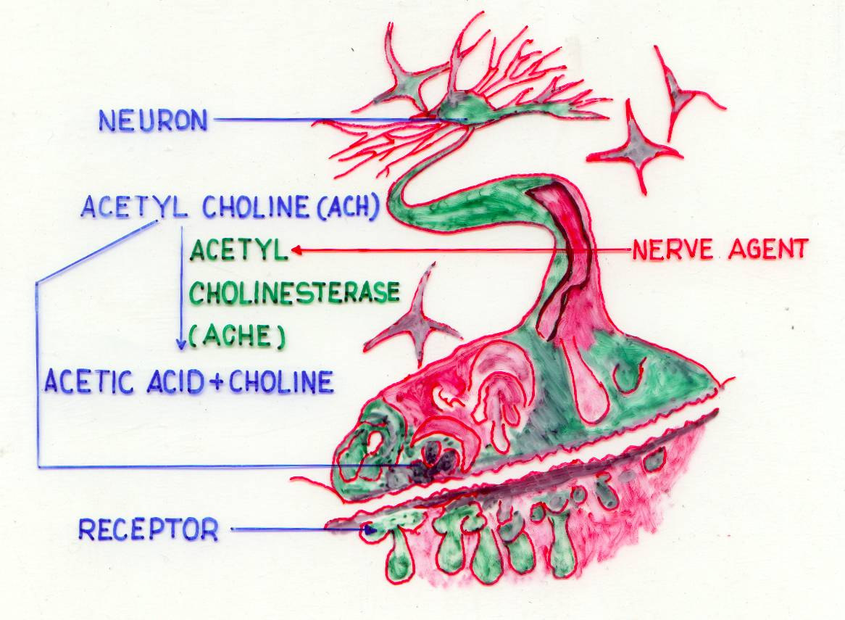
NEURON
ACETYLCHOLINE
RELEASED HERE

Slide 16
NERVE AGENT INHIBITS ACHE
(ACHE)

Slide 17
MECHANISM OF ACTION BY NERVE AGENTS
CHOLINERGIC SYNAPSES
(CNS, HEART, NEUROMUSCULAR END PLATES)
TRANSMISSION OF NERVE IMPULSE
ACETYL CHOLINE
ACTION AT NM JUNXN
IRIS, BRONCHIAL TREE, GASTROINTESTINAL TRACT, BLADDER, BLOOD VESSELS, GLANDS.
HYDROLYSIS OF ACETYL CHOLINE BY CHOLINESTERASES
CHOLINE + ACETIC ACID
NERVE AGENT
INHIBITION OF CHOLINESTERASES.
IRREVERSIBLE REACTION

Slide 18
SIGNS OF EXCESSIVE CHOLINERGIC STIMULATION
MUSCARINIC.
INCREASED BRONCHIAL, SALIVARY, OCULAR AND INTESTINAL SECRETIONS.
SWEATING.
MIOSIS.
BRONCHOSPASM.
INTESTINAL HYPER MOTILITY.
BRADYCARDIA.

Slide 19
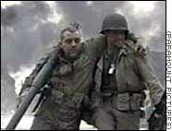
NICOTINIC.
MUSCLE TWITCHING.
WEAKNESS.
PARALYSIS.
CNS.
LOSS OF CONSCIOUSNESS.
CONVULSIONS.
RESPIRATORY DEPRESSION.
+

Slide 20
SUSPICION OF NERVE AGENT POISONING
OBSERVE CHARACTERISTIC SIGNS AND SYMPTOMS
EARLY: RUNNING NOSE, INCREASED SALIVATION, TIGHTNESS IN THE CHEST, DIMMED VISION, DIFFICULTY IN BREATHING
LATE: HEADACHE, VOMITING, EXCESSIVE SWEATING, DROOLING
DANGER: INVOLUNTARY MICTURITION AND DEFECATION, TWITCHING AND JERKING OF MUSCLES

Slide 21
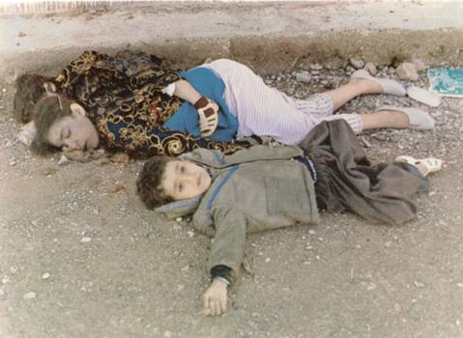
SARIN GAS VICTIMS

Slide 22

PRINCIPLES OF TREATMENT
TERMINATION OF EXPOSURE
OXYGENATION
A CHOLINOLYTIC e.g. ATROPINE TO TREAT THE EFFECTS OF EXCESS ACETYLCHOLINE
TO REACTIVATE THE INHIBITED ACETYL CHOLINESTRASE ENZYME BY AN OXIME
SYMPTOMATIC AND SUPPORTIVE TREATMENT

Slide 23
OXYGENATION
WHY?
NERVE AGENTS CAUSE DYSFUNCTION OF RESPIRATORY SYSTEM BY ADVERSELY AFFECTING RESPIRATORY MUSCULATURE AND CENTRES
INADEQUATE VENTILATION EITHER DUE TO INTOXICATION OR MECHANICAL OBSTRUCTION FROM MUCOUS, VOMITUS, RETRO VERSION OF TONGUE ETC
HOW?
MAINTAIN AIRWAY BY CLEARING OBSTRUCTION
INSTITUTE ARTIFICIAL VENTILATION

Slide 24
FIRST AID – NERVE AGENTS
PRE TREATMENT- NAPS TABLETS (PROTECTION OF AVAILABLE ACH E)
SELF AID-ATROPINE & PAM INJECTION
FIRST AID-ARTIFICIAL RESPIRATION, ATROPINE INJECTIONS (BLOCKING THE ACH RECEPTORS), USE OF PAM (REGENERATING ACH E)
USE OF ATROPINE NASAL SPRAY

Slide 25
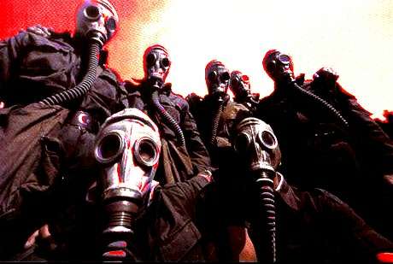
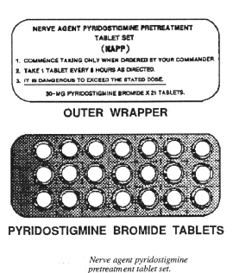
MANAGEMENT
PRE-TREATMENT
NAPS-7 days supply of
Pyridostigmine-30 mgm 8 hourly

Slide 26
NERVE AGENT TREATMENT
SER | DRUG | DOSE | SCHEDULE | ACTION
1. | PYRIDOSTIGMINE (NAPS) | 30 MG (ORALLY) | I TDS | PRESERVE ACHE
2. | ATROPINE SULPHATE (COMBOPEN) | 2 MG (I/M) | EVERY 15 MIN (UPTO 3) | TO NEUTRALIZE EFFECT OF ACH
3. | (a)PAM (b)OBIDOXIME ©HI-6 | 600MG (I/M) 220MG (I/M) | - DO - | REACTIVATION OF ACHE
4. | DIAZEPAM | 5 MG | SOS | ANTICONVULSANT

Slide 27
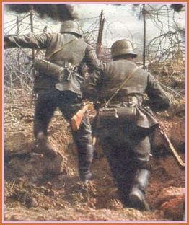
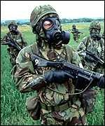
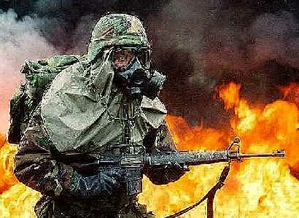
ATROPINE WITHOUT ARTIFICIAL RESPIRATION WILL SAVE FEW.
ARTIFICIAL RESPIRATION WITHOUT ATROPINE WILL SAVE MANY.
ARTIFICIAL RESPIRATION WITH ATROPINE WILL SAVE MOST.

Slide 28
ATROPINE POISONING
SIGNS
PHOTOPHOBIA AND VISUAL DISTURBANCE
DRYNESS OF MOUTH AND INTENSE THIRST
HOT DRY FLUSHED SKIN, SOMETIMES ERYTHEMATOUS RASH
TACHYCARDIA (INCREASED HEART RATE)
HEADACHE
CONFUSION
HALLUCINATION
CONSTIPATION

Slide 29
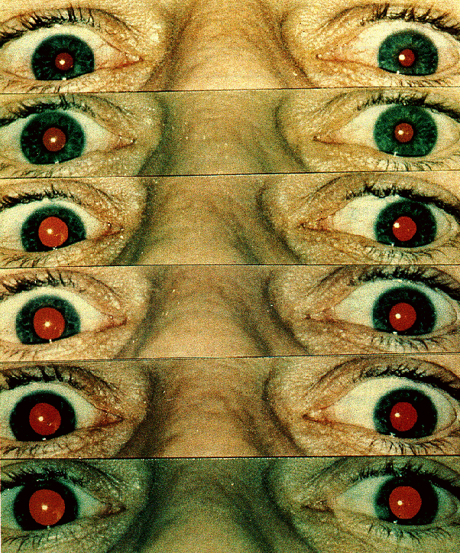
ATROPINE EFFECTS ON PUPIL

Slide 30
BLISTER AGENTS
MECHANISM OF ACTION
SYMPTOMS
TREATMENT

Slide 31
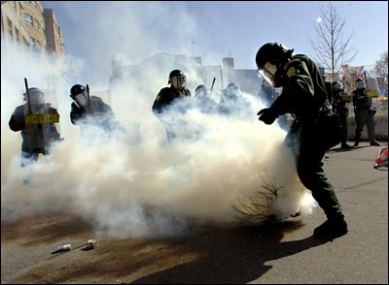
MECHANISM OF ACTION OF BLISTER AGENTS
CYTOSTATIC
MUTAGENIC
CYTO – TOXIC
ACTION RESEMBLES THAT PRODUCED BY IONIZING RADIATIONS – RADIO MIMETIC COMPOUNDS

Slide 32
SIGNS AND SYMPTOMS OF SULPHUR MUSTARD POISONING
TIME POST EXPOSURE SYMPTOMS AND SIGNS
20-60 MIN NAUSEA, VOMITING AND EYE SMARTING
2 – 6 HOURS NAUSEA, VOMITING, HEADACHE, INFLAMMATION OF THE EYES, LACRIMATION,
REDDENING OF FACE AND NECK, SORENESS OF THROAT INCREASE IN PULSE AND RESPIRATION.

Slide 33
SIGNS AND SYMPTOMS OF SULPHURMUSTARD POISONING
TIME POST EXPOSURE SYMPTOMS AND SIGNS
24 HOURS GENERAL INCREASE IN SEVERITY OF ABOVE EFFECTS INFLAMMATION OF INNER THIGHS, AXILLA, GENITALIA, BUTTOCKS,FOLLOWED BY ONSET OF BLISTER FORMATION. BLISTERS ARE LARGE, FILLED WITH YELLOW FLUID AND MAY BE PENDULOUS.
48 HOURS CONDITION GENERALLY WORSENED. BLISTERING
MORE MARKED, SWELLING OF GENITALIA. BRONCHITIS EXPECTORATION OF MUCOUS AND NECROTIC SLOUGH. INCREASED TEMPERATURE.

Slide 34
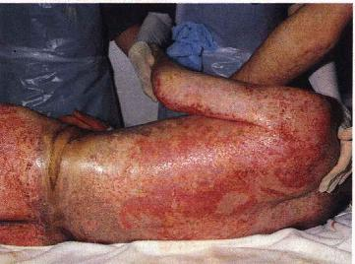

Slide 35
MUSTARD (HD) EFFECTS ON EYES
EXPOSURE LATENT PERIOD SIGNS
MILD 4 – 12 HOURS - LACRIMATION
- SENSATION OF GRIT
- CONJUNCTIVA RED
AND SWOLLEN
HEAVY 1 – 3 HOURS - BLISTERING OF EYE LID AND MUCOUS MEMBRANE
- CONJUNCTIVITIS
- CORNEAL LESION MAY
RESULT IN BLINDNESS

Slide 36
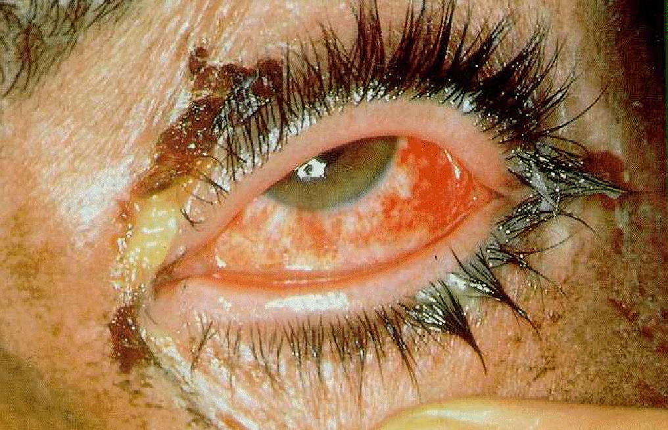
Mustard Effects Eye Injury
Notes:
There is a spectrum of eye involvement. The eye lesion, after a small exposure to mustard, may consist only of mild conjunctivitis. A larger exposure will produce a more severe conjunctivitis, lid inflammation and edema, blepharospasm, and corneal roughening. These casualties will be unable to open their eyes and will be temporarily without sight. A larger exposure, particularly if by liquid, may produce corneal opacification, corneal ulceration, or corneal perforation. Even with the potential for serious eye damage, the documentation for World War I mustard victims indicates that over 95 percent of those suffering eye injuries from the agent developed only mild to moderate conjunctivitis, and that less than one percent experienced permanent corneal injury.
Miosis is sometimes observed after mustard exposure and is thought to be due to cholinergic effects.
This Iranian casualty has severe keratoconjunctivitis with corneal edema, lid edema, and pus at the corner of the eyes.
NOTE: This is the eye of a victim from the Iran/Iraq war, 7 days after exposure to mustard. Using a pointer, emphasize the lid edema, the finger holding the eye open (suggesting blepharospasm which could render a victim functionally blind), conjunctival injection, subconjunctival hemorrhage, and corneal roughening. The yellowish exudate could be pus, but is more likely the residue of medication previously introduced into the eye.

Slide 37
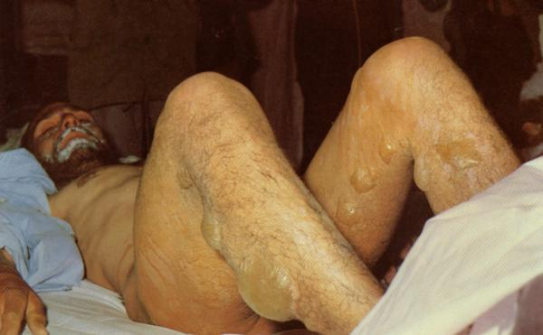
EFFECTS ON SKIN
LATENT PERIOD OF 6-12 H
ERYTHEMA, ITCHING, BURNING
VESICATION
12-48 H BLISTERS FORM
SUPPURATING WOUND & NECROSIS
HOT, HUMID WEATHER INCREASES ACTION
AXILLA, GENITALIA MORE AFFECTED

Slide 39
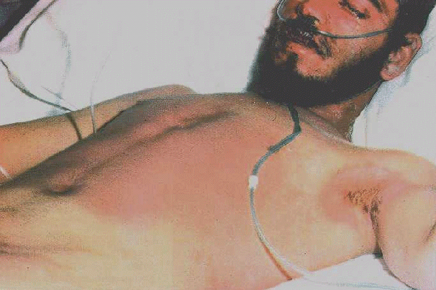
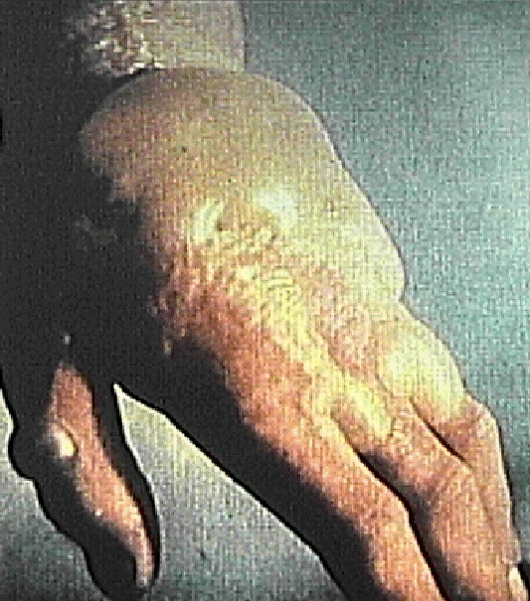
Mustard Effects Skin Injury
Erythema
Small vesicles; later coalesce
Blisters/bulla
Possible coagulation necrosis with liquid
Notes:
MUSTARD EFFECTS - SKIN INJURY
These begin hours after exposure with erythema as shown in this Iranian casualty (accompanied by burning and itching), followed later by the development of small vesicles; later, these small vesicles coalesce to form blisters. The size and depth of the lesion depends on the amount of exposure and whether exposure was by vapor or liquid. Coagulation necrosis extending into the dermis may develop under blisters caused by liquid, such as those blisters shown on this photograph of a worker’s hand several days after he was accidentally exposed to liquid mustard.
NOTE: The erythema evident on the Iranian mustard victim shown above probably developed within 24 hours of the time of his exposure; the photo was taken 5 days after exposure. In addition to skin damage, this patient also suffered pulmonary injury (note the oxygen cannula.)

Slide 40
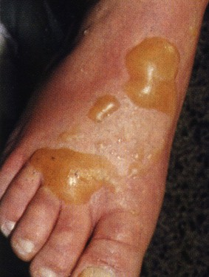

Slide 41
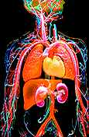
BLISTER AGENTS(VESICANTS)---EFFECTS
SYSTEMIC EFFECTS
Bone marrow
Lymphoid tissue

Slide 42
SYSTEMIC EFFECTS
BRONCHITIS
EXPECTORATION OF MUCOUS AND NECROTIC SLOUGH
INCREASED TEMPERATURE

Slide 43
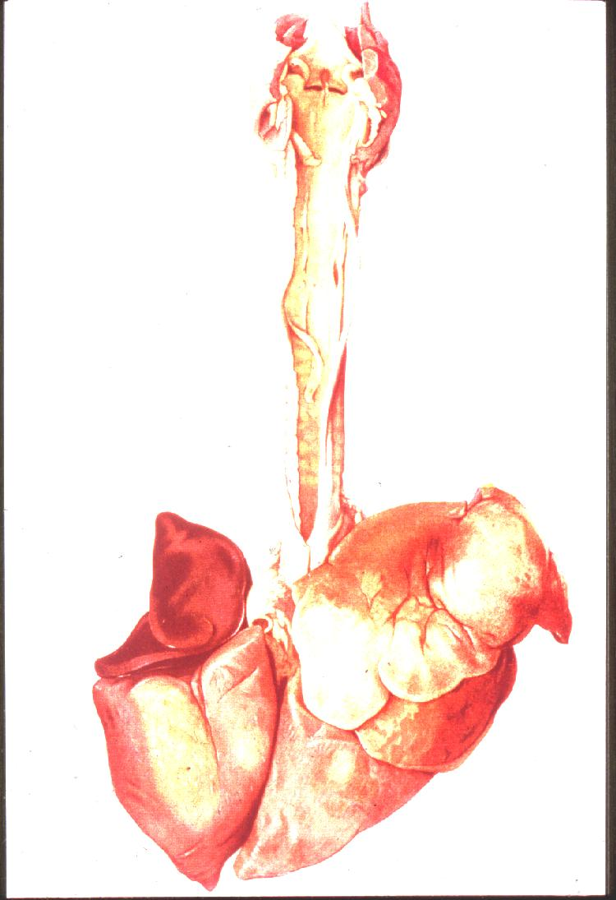
Mustard Effects:Airway Injury
Upper: nose sinuses, pharynx
(epistaxis, sore throat, hacking cough)
Mid: Larynx (hoarseness)
Lower: Bronchitis,Bronchopneumonia(dyspnea, productive cough)
Pulmonary edema is rare
Notes:
MUSTARD EFFECTS - AIRWAY INJURY
Mustard damages the mucosa or lining of the airways. This damage begins in the upper airways and descends in a dose-dependent manner to the smallest bronchiole. After a small exposure or initially after a large exposure, there may be epistaxis, sinus discomfort, and a mild to moderate pharyngitis with a hacking cough. After a moderate exposure, or later after a large exposure, there may be laryngitis with voice loss and a productive cough. If the exposure is large, the agent reaches the smallest airways to cause dyspnea and productive cough, as the mustard will damage not only the mucosa, but the underlying musculature as well. At this stage, there may be hemorrhagic pulmonary edema around the bronchioles, as depicted above, but otherwise, pulmonary edema is rare.
This slide is a World War I drawing of a mustard-exposed dog lung showing extreme inflammation and a mid-tracheal “peeling” lesion (also called a “pseudomembrane”) that may fall into a more distal airway and obstruct.
NOTE: The above photo depicts a cross-section from the lung of a mustard vapor victim. Using a pointer, emphasize the absence of mucosa, the absence of a muscular layer, the necrotic, inflammatory debris in the lumen, the slight hemorrhage around the bronchiole, and the relatively clear alveoli.

Slide 44
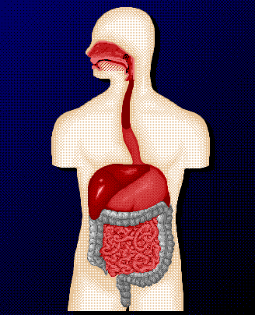
Mustard Effects Gastrointestinal Injury
Within 24 hours
Nausea and vomiting
After 3 to 5 days
Lining cell destruction
Notes:
MUSTARD EFFECTS - GASTROINTESTINAL INJURY
Gastrointestinal effects within the first 24 hours following exposure include nausea and vomiting. These effects are thought to be in part due to cholinergic stimulation. There may be some added effects of mustard on the GI tract from the swallowed tracheal secretions. The initial GI effects effects are are transient, and clear within 24 hours.
Gastrointestinal effects seen after 3 to 5 days are thought to be due to tissue destruction in the abdomen, and fluid and electrolyte loss.

Slide 45
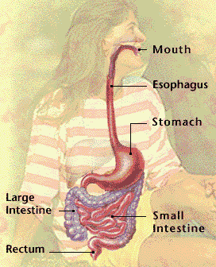
BLISTER AGENTS(VESICANTS)---EFFECTS
Oesophagitis
Erosive gastritis
Perforation
GI TRACT

Slide 46
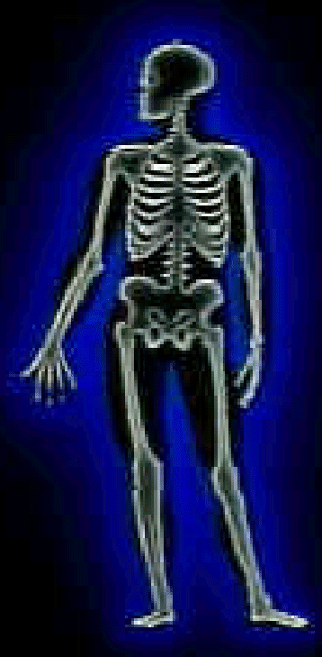
Mustard Effects Bone Marrow Damage
Damages stem cells
Decreased WBC, RBC, platelets after 3 - 5 days
Survival rare if WBC < 200
Notes:
MUSTARD EFFECTS - BONE MARROW DAMAGE
Absorption of significant amounts of mustard produces damage to and death of the stem or precursor cells of the bone marrow. If this occurs, the white blood cell count, after an initial increase because of the toxic exposure, starts decreasing on about the third or fourth day after exposure and continues downward until recovery begins. If the amount of mustard absorbed is sufficient to cause leukopenia with a white cell count below 200 cells/mm³, the prognosis is poor; the white blood count may in fact reach zero. Following the white blood cell decrease, the red blood cells and platelets also decline. The relative deficiency of these cells increases susceptibility to infection and contributes to death.

Slide 47
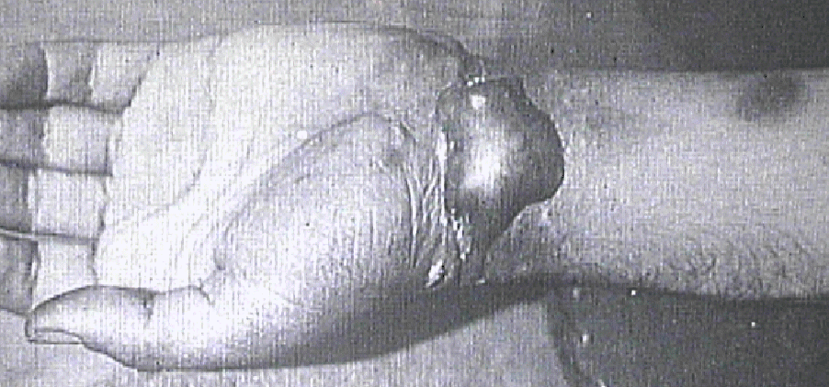
Lewisite Effects
Causes severe irritation to eyes, skin, and airways IMMEDIATELY on exposure (no delay)
Tissue necrosis
Increased capillary permeability
No bone marrow effects
Notes:
LEWISITE EFFECTS
Lewisite is a vesicant that has been stockpiled militarily, but there have been few human exposures to the chemical. Lewisite is rapidly absorbed by the eyes, skin, and lungs and produces blisters similar to sulfur mustard. In contrast to sulfur mustard, however, Lewisite is highly irritating on initial exposure. It also produces visible lesions more quickly.
Lewisite causes greater skin damage than sulfur mustard. A gray area of dead skin can progress to blisters and severe tissue necrosis and sloughing. Since it causes immediate irritation to the nose and sinuses, any effort by the victim to evacuate the area of contamination may prevent more severe lung damage. Pseudomembrane formation is common. Lewisite also causes increased capillary permeability, leading to volume depletion and hepatic and renal injury. Unlike mustard, it does not damage the bone marrow.
NOTE: Lewisite, named for its inventor, Captain W. Lee Lewis of the U.S. Army Chemical Warfare Service, was produced in 1918 for use in World War I, but didn’t make it to the front before armistice was declared. A stockpile of it destined for Europe was enroute by ship when the war ended. The Japanese mixed Lewisite with mustard for use in bombs and artillery shells which were probably used to attack China starting in about 1935, and the Soviets also stockpiled this agent.

Slide 48
TREATMENT REGIME SKIN
SKIN – DECONTAMINATION: FULLER’S EARTH, PUTTING TOWELS SOAKED IN 2% AQUEOUS SOLUTION OF CHLORAMINE – T, REPEATED EVERY 2 HOURS.
TREATMENT OF WOUNDS:1% SILVER-SULPHADIAZINE OINT /POVIDONE IODINE OINT, APPLIED TWICE A DAY COVERED WITH STERILE BANDAGE
BLAND CALAMINE LOTION, STEROID OINT FOR ERYTHEMA.
RELIEVING PAIN: ANALGESICS USED
FOR LEWISITE POISONING BAL OINT APPLIED IMMEDIATELY

Slide 49
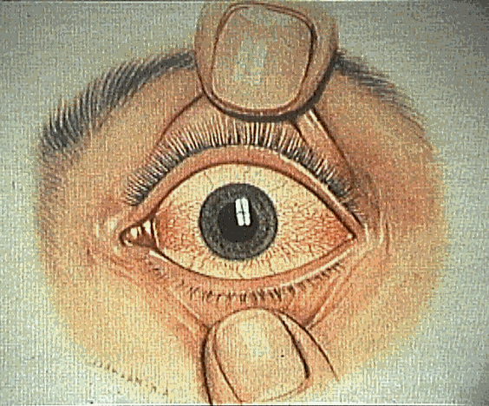
TREATMENT REGIME FOR EYES
EYES IRRIGATED WITH NORMAL SALINE
ANTIBIOTIC EYE DROPS ,PETROLEUM JELLY, EYE OINT
LOCAL ANAESTHETIC LIKE AMETHOCAINE
CORNEAL DAMAGE MANAGED BY GRAFTING
RELIEVING IRRITATION AND PAIN IN THROAT : HEXOMEDINE (0.2%) SPRAY USED

Slide 50
Eye Treatment
Topical mydriatics
Topical antibiotics
Vaseline on lid edges
Notes:
EYE TREATMENT
A discussion of the therapy for ocular exposures is best begun by repeating the observation that mustard fixes to tissues within the first several minutes after exposure. Gentle irrigation with saline or water during this time period will be helpful. Aggressive attempts to pry apart severely painful, blepharospastic eyelids to accomplish an irrigation 30 minutes or more after exposure is of dubious value, since the damage has been done and the agent has evaporated or has been absorbed. With severe eye injuries, homatropine or other mydriatics should be applied topically to prevent synechiae formation. Topical analgesics may be used for initial examination. However, oral pain medication is preferred to topical analgesics, which may allow damage to the cornea and delay healing. Topical antibiotics should be applied several times a day and petroleum jelly should be applied to lid edges to prevent them from adhering. Early involvement of an ophthalmologist is advised, and a visual acuity should be obtained before treatment measures are instituted.

Slide 51

Airway Treatment
Cool mist,Gargles, cough suppressants like Codeine for mild symptoms
Oxygen
Assisted ventilation
Early intubation
Bronchodilators (steroids) for bronchospasm
Antibiotics only for bacterial pneumonitis
Notes:
AIRWAY TREATMENT
Upper or minor airway symptoms (sore throat, non-productive cough, hoarseness) may be relieved by cool mist inhalation and cough suppressants. The initial chemical pneumonitis should be treated in the usual manner; however, antibiotics should not be used until an organism is demonstrated, which usually occurs between the third and fifth day post-exposure. A patient with severe airway effects will benefit from oxygen and assisted ventilation, particularly positive end expiratory pressure (PEEP) or continuous positive airway pressure (CPAP). Intubation should be performed if there are signs of impending laryngeal involvement, and it should be done early before laryngeal spasm or edema makes it difficult. Bronchodilators may be needed; if they fail to relieve bronchospasm, steroids may be tried. Steroids, however, are of questionable benefit otherwise.

Slide 52
MISCELLANEOUS
GASTRIC LAVAGE USING ACTIVATED CHARCOAL
REHYDRATION WITH GLUCOSE SALINE
HIGH VITAMIN AND PROTEIN DIET
ANTIBIOTIC THERAPY
ANTIHISTAMINICS GIVEN ACCORDING TO NEED
FOR SEVERE LEWISITE POISONING BAL ADMINISTERED SYSTEMICALLY (BAL IN OIL, 10% SOLN GIVEN BY DEEP I/M INJ AT 4,8 AND 12 HRS

Slide 53
DRDE, GWALIOR HAS COME OUT WITH
CC 2 SUSPENSION FOR PERS CHEM DECON OF SULPHUR MUSTARD. CONSIDERED TO BE SAFE, EFFECTIVE & STABLE
DRDE-07 FOR PROPHYLAXIS
QUERCETIN FOR TREATMENT

Slide 54
Vesicant Agent Summary
Agents damage eyes, skin, respiratory system; cause additional systemic effects
Mustard
Fast acting; symptoms delayed, no specific antidote
Lewisite
Fast acting, symptoms immediate, BAL antidote available
Decontamination is best initial treatment
Notes:
VESICANT AGENT SUMMARY
Mustard and Lewisite both cause damage within a short period of contacting a victim, though mustard’s symptoms may be delayed many hours while Lewisite causes immediate skin irritation. Both agents can cause injury in their vapor or liquid state by contacting human tissue; the eyes, skin, and respiratory systems are susceptible to damage from their effects. In addition, mustard can cause systemic damage in the form of neurological, gastrointestinal, bone marrow, and blood-forming system effects. The system effects of Lewisite exposure include injury to circulatory system capillaries, allowing fluid imbalances which can lead to liver and kidney damage.
Dimercaprol (BAL) can be used to treat Lewisite exposure; treatment for mustard is supportive and generally includes no specific antidote medication. The best initial treatment for persons exposed to either agent is prompt and thorough decontamination. This will also protect healthcare providers from secondary contamination.

Slide 55
BLOOD AGENTS
MECHANISM OF ACTION
SIGNS & SYMPTOMS
TREATMENT

Slide 56
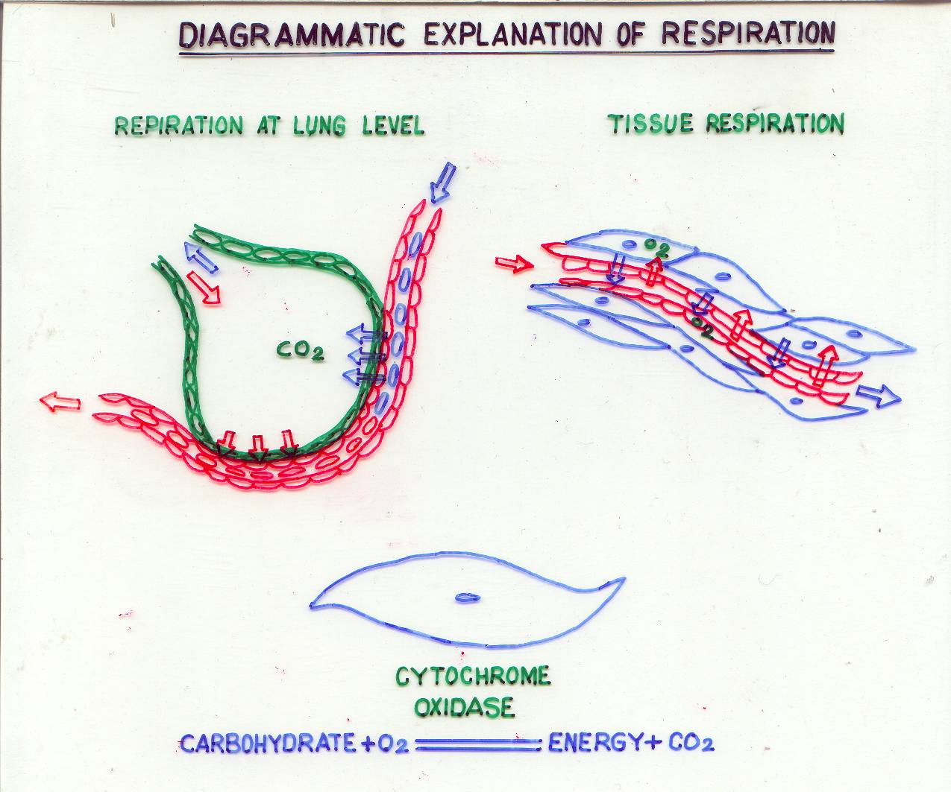
DIAGRAMMATIC EXPLANATION OF RESPIRATION

Slide 57
BLOOD AGENTS
GENERAL: HYDROCYANIC ACID (AC), CYANOGEN CHOLORIDE (CK).
MODE OF ACTION: CYANIDE HAS HIGH AFFINITY FOR IRON IN FERRIC STATE. REACTS WITH CYTOCHROME OXIDASE TO FORM COMPLEX
IMPAIRS UTILISATION OF O₂
CNS CELLS MOST SENSITIVE TO TISSUE ANOXIA, CESSATION OF RESPIRATION FOLLOWED BY CARDIOVASCULAR COLLAPSE
EFFECTS : IRRITATION OF EYES AND UPPER RESP TRACT

Slide 58
BLOOD AGENTS
SIGNS & SYMPTOMS
INHALING OF HCN MAY PRODUCE SYMPTOMS WITHIN SECONDS AND DEATH WITHIN MINUTES
ACUTE POISONING IS CHARACTERISED BY
DIZZINESS
HEADACHE, SOMETIMES NAUSEA & VOMITING
PALPITATION
ANXIETY,DYSPNOEA
ATAXIA, LACK OF COORDINATION OF MOVEMENT
PARALYSIS AND COMA

Slide 59
BLOOD AGENTS
CARDIOVASCULAR COLLAPSE, RESPIRATORY ARREST, CONVULSIONS AND METABOLIC ACIDOSIS ARE SEEN IN SEVERE CASES
DIAGNOSIS
HISTORY
ODOUR (BITTER ALMONDS)

Slide 60
BLOOD AGENTS
SELF AID/FIRST AID
SMELLING AMYL NITRITE
TREATMENT AIM OF TREATMENT TO DISSOCIATE THE CYANIDE ION FROM CYTOCHROME OXIDASE-CYANIDE COMPLEX
DICOBALT EDETATE – 300 – 600 MG I/V
SODIUM THIO-SULPHATE AND SODIUM NITRITE
THREE PERCENT OF SODIUM NITRITE 10 ML
50 PERCENT SODIUM THIO-SULPHATE 25 ML

Slide 61
BLOOD AGENTS
SPEED OF TREATMENT MOST IMP IN CYANIDE POISONING
CAS FULLY CONSCIOUS AND BREATHING NORMALLY MORE THAN 5 MINUTES AFTER EXPOSURE WILL RECOVER SPONTANEOUSLY WITHOUT TREATMENT
OXYGEN

Slide 62
CHOKING AGENTS
MECHANISM OF ACTION
SYMPTOMS
TREATMENT

Slide 63
CHOKING AGENTS
GENERAL:- PHOSGENE (CG), DIPHOSGENE (DP) CHLORINE (CL)
MODE OF ACTION:-
MASSIVE PULM OEDEMA RESULTS FROM THE PASSAGE OF FLUIDS FROM CAPILLARIES INTO LUNG ALVEOLI
GAS EXCHANGE IS INTERFERED WITH, SO HYPOXAEMIA RESULTS
DIAGNOSIS;- CLINICAL

Slide 64

SIGNS AND SYMPTOMS CHOKING AGENTS
IRRITATION OF THE EYES, THROAT AND RESPIRATORY TRACT WITH LACRIMATION, COUGHING AND CHOKING
FEELING OF TIGHTNESS IN THE CHEST, NAUSEA AND VOMITING
A LATENT PERIOD OF 30 MINUTES TO 24 HOURS FOLLOWED BY APPEARANCE OF MORE SIGNIFICANT SYMPTOMS AND SIGNS WHICH MAY BE PRECIPITATED WITH EXERCISE

Slide 65
INCREASING QUANTITIES OF FROTHY WHITE OR YELLOWISH FLUID MAY BE EXPECTORATED. LATER FLUID MAY BECOME PINK TINGED
CIRCULATORY COLLAPSE AND CARDIAC FAILURE MAY OCCUR
EIGHT PER CENT OF FATAL CASES SUCCUMB WITHIN THE FIRST 48 HOURS OF EXPOSURE
IN THE FIRST WORLD WAR, LATE DEATHS WERE ATTRIBUTABLE TO BRONCHOPNEUMONIA BRONCHIECTASIS AND LUNG ABSCESS

Slide 66
CHOKING AGENTS
WARMTH AND REST
COUGH – SUPPRESSED WITH CODEINE PHOSPHATE
OXYGEN AS REQUIRED
MORPHINE AVOIDED AS MAY RESULT IN RESP DEPRESSION

Slide 67
CHOKING AGENTS
AS THERE IS LUNG DAMAGE, ARTIFICIAL RESP GIVEN CARE FULLY
DIURETICS OF SOME ASSISTANCE
STEROIDS CAN BE LIFE SAVING IF GIVEN PROMPTLY. NOT OF MUCH USE AFTER PULMONARY OEDEMA
INHALER - BECLAMETHASONE (BECLATE).
ANTIBIOTIC ADMINISTRATION

Slide 68
INCAPACITATING AGENTS
IMP AGENTS : BZ & LSD 25.
SYMPTOMS
BZ AFTER 1-2 HRS OF EXPOSURE CAUSES
DILATATION OF PUPILS.
DRY MOUTH.
INCREASED HEART RATE.
ATAXIA.
DROWSINESS.
DELUSIONS.
HALLUCINATIONS
AIMLESS BEHAVIOR
ANTIDOTE
INJ PHYSOSTIGMINE 2-3 mg FOR BZ (REPEATED EVERY 2-3 MIN AS REQD)
SODIUM AMYTAL 200-400 mg I/V OR DIAZEPAM 10-20 mg I/V FOR LSD – 25.

Slide 69
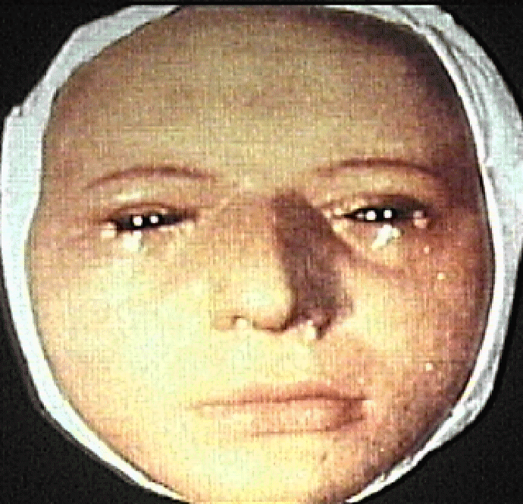
Riot Control Agents
Irritating agents, lacrimators, “tear gas”
Cause reaction in
Eyes: burning, tearing, eyelid spasm, redness
Airways: burning, coughing, dyspnea
Skin: burning, erythema
Eye irrigation and supportive care
Notes:
RIOT CONTROL AGENTS
Most people are familiar with riot control agents or “tear gas.” These agents are used by the military for training, and by law enforcement agencies to subdue crowds or individuals. Mace is sold for individual protection in small spray devices. Pepper spray, derived from the capsicum family of peppers, is relatively new, and is used by the military, law enforcement, and for personal protection.
These agents produce eye, nose, mouth, skin, and respiratory tract irritation. This class of chemical agents causes involuntary eye closing due to irritation. For police, this is an effective weapon as it can disable an assailant. The deleterious effect is usually transient (about 30 minutes after exposure). Medical treatment for those exposed to riot control agents will have to deal with their effects on the eyes, respiratory tract, and skin.
Eyes should be irrigated copiously with water or saline. Remove contact lenses. Utilize slit lamp exam to make certain that all solid particle foreign bodies are removed. Follow-up with an ophthalmologist is recommended. Treat wheezing with bronchodilators or steroids if standard bronchodilators fail. Provide oxygen therapy if indicated. Most symptoms should be maximal within 1 to 2 hours. Most skin exposures require little more than reassurance. With prolonged pain, decontaminate with soap and water or a solution containing a carbonate and/or a bicarbonate. Do NOT use bleach. Delayed onset dermatitis should be managed with frequent irrigation and soothing ointments or creams.
NOTE: Though the signs and symptoms related to riot control agents are generally temporary, exposure to high levels of the chemicals can result in more serious illness. This is especially true in the elderly, children, and individuals with underlying pulmonary disease such as asthma and COPD.

Slide 70
IMPACT OF CHEMICAL WARFARE
THREAT TO MEDICAL UNITS.
REASON OF CHEM HAZARDS.
DIRECT INTENTIONAL ATTACK.
UNINTENTIONAL ATTACK DUE TO MISTAKEN IDENTITY.
UNINTENTIONAL ATTACK DUE TO LACK OF ACCURACY.
DOWN WIND HAZARD.
OVER-ALL CASUALTY RATE HIGHER THAN WITH CONVENTIONAL WEAPONS.
AVERAGE MED OFFR EXPERIENCE.
HEAT EXHAUSTION/STROKE CASES, USE OF HIGH ATROPINE DOSES.

Slide 71
TO DETERMINE WHETHER THE CASUALTY IS A CHEMICAL CASUALTY
WAS THE CASUALTY IN FULL NBC GEAR AT THE TIME OF ATTACK
WERE THERE ANY LOW FLYING AIRCRAFTS AT THE TIME OF ATTACK
WAS THERE ANY EVIDENCE OF SPRAY
HOW MANY OTHER CASUALTIES OF THIS TYPE WERE THERE
WERE THE DETECTOR DEVICES ACTIVATED BY ATTACK

Slide 72
TO DETERMINE THE IDENTITY OF THE AGENT
WHAT SYMPTOMS CASUALTY NOTICED AND HOW SOON
HOW MUCH WAS THE DELAY BETWEEN ATTACK AND APPEARANCE OF SYMPTOMS
DID THE EFFECTS PERSIST AFTER THE ADJUSTMENT OF RESPIRATOR
DID THE CASUALTY USE AUTO INJECTOR DEVICES AND WHAT WAS THE RESULT
IS THE CASUALTY BEHAVIOUR NORMAL

Slide 73
TO DETERMINE THE IDENTITY OF THE AGENT
WHAT SYMPTOMS CASUALTY NOTICED AND HOW SOON
HOW MUCH WAS THE DELAY BETWEEN ATTACK AND APPEARANCE OF SYMPTOMS
DID THE EFFECTS PERSIST AFTER THE ADJUSTMENT OF RESPIRATOR
DID THE CASUALTY USE AUTO INJECTOR DEVICES AND WHAT WAS THE RESULT
IS THE CASUALTY BEHAVIOUR NORMAL

Slide 74
TO ASSESS THE DOSE OF AGENT RECEIVED
WAS THE CASUALTY EXERCISING OR RESTING
WAS THE CASUALTY IN OPEN OR IN BUNKER
HOW LONG THE AGENT WAS BREATHED

