Slide 1

Ward routine & bed making
LESSON -34
BY
AMANDEEP KAUR
ASI/ANM

Slide 2
OBJECTIVES
Upon completion of this lesson, you will be able to:
1. Describe the Management of the patient
ii) Describe the Management of the medical
personnel
iii) Describe the Management of the supplies
and equipment
iv) Describe the Management of ward
environment

Slide 3
WARD MAINTENANCE
includes four aspects:
i) Management of the patient
ii) Management of the medical personnel
iii) Management of the supplies and equipment
iv) Management of ward environment

Slide 4
MANAGEMENT OF PATIENT
It is the duty of the paramedic to ensure speedy and comfortable settlement of patient admitted to ward in concurrence with the treating physician and Staff Nurse
Prepare the indoor admission case sheet with correct entry of details
Inform the concerned Coy and ensure diet provisions

Slide 5
MANAGEMENT OF PATIENT
Check and record his vitals, weight and administer the prescribed medicines in consultation with the Staff Nurse
Help him daily with cleaning teeth, washing himself and changing clothes if he is too sick
Help patient in getting proper in-patient dress, utensils, slippers and make entry in appropriate registers of issue and return
Make bed available with fresh clean sheets and blankets as well as ensure their collection for washing and sterilization on discharge of patient

Slide 6
In ambulatory patients, ensure they are
ready before the ward rounds
Ensure the patient does not indulge in smoking/ drinking in wards or outside during their period of admission
Assist the staff nurse in ward rounds prior to Medical officer rounds
Ensure the visitors/ relatives of patients keep to visiting hours and do not cause discomfort for other patients
To provide comfort to the patient by eliminating pain, insomnia, boredom, inactivity etc.

Slide 7
MANAGEMENT OF PERSONNEL:
Efficient running of ward with high quality care needs a highly motivated and co operative nursing team
The staff needs to adhere to their duty schedules and be flexible in case of emergencies
Proper recording with diligence in handing over and taking over of charge to avoid negligence and missing of vital instructions in care

Slide 8
MANAGEMENT OF PERSONNEL:
The para-medic should assist the staff in getting the reports of blood/urine/ X ray before the rounds of the ward
Make available BP apparatus, flashlight, or other equipments as well dressing trolley ready for the rounds
Help in dressings, undressing patients for examination during rounds

Slide 9
MANAGEMENT OF SUPPLIES & EQUIPMENTS:
The quality of care for the patient depends on efficient, adequate supply of medicines and hospital necessities as well as proper maintenance of equipment.
The para-medic is expected to-
Assist the nurse in drug demand/ voucher entry as well as placing demand to stores with regard to special medicines needed for any patient
Ensure that the dressing materials and instruments are sterilized and ready for use in any emergency

Slide 10
MANAGEMENT OF SUPPLIES & EQUIPMENTS:
Keep ready adequate supply of disposable gloves, gowns, face masks are available
Ensure proper discarding of soiled dressing, needles etc. are carried out after sterilizing them with bleach solution as per sterilization procedures in practice
Ensure that oxygen cylinders are full and in good working condition

Slide 11
MANAGEMENT OF SUPPLIES & EQUIPMENTS:
Ensure that fresh linen is available in adequate quantities and also that dirty linen is timely given for laundry
Bring to the notice of the staff any default/ broken equipment for replacement
Maintain proper inventory for instruments and equipments and ensure that they are placed in their proper place and containers
Avoid wastage of medicines and dressing supplies as also assist the nurse in maintenance of short expiry of above items

Slide 12
MANAGEMENT OF WARD ENVIRONMENT :
Providing a safe and comfortable environment
for the patients helps in speedy recovery.
The medic should ensure the following points in ward maintenance:
Regulation of atmospheric temperature, humidity and ventilation
Adequate lighting
Prevention of noise
Elimination of unpleasant odours
Dust control

Slide 13
MANAGEMENT OF WARD ENVIRONMENT :
Safe disposal of excreta and hospital wastes
Safe water supply
Freedom from vermins, insects and animal pests
Protection from mechanical, thermal, chemical bacteriological injuries
Provision of adequate privacy
Prevention of cross infection
Cleanliness and orderliness.

Slide 14
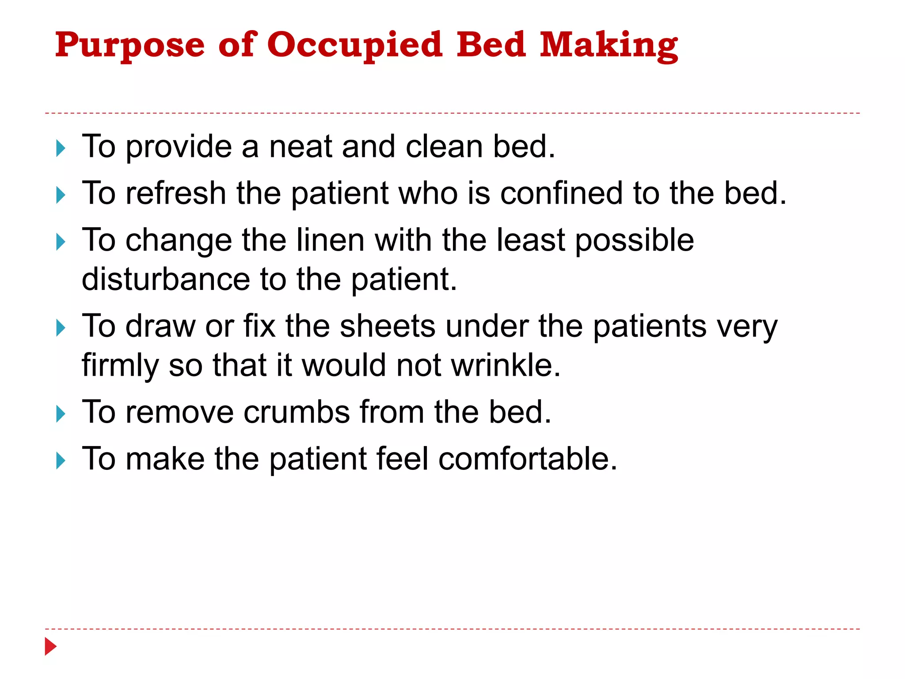
BED MAKING TECHNIQUE
1- An occupied bed is an available bed where there is a patient physically in the bed or the bed is being retained for a patient

Slide 15
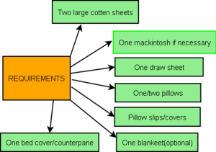

Slide 16
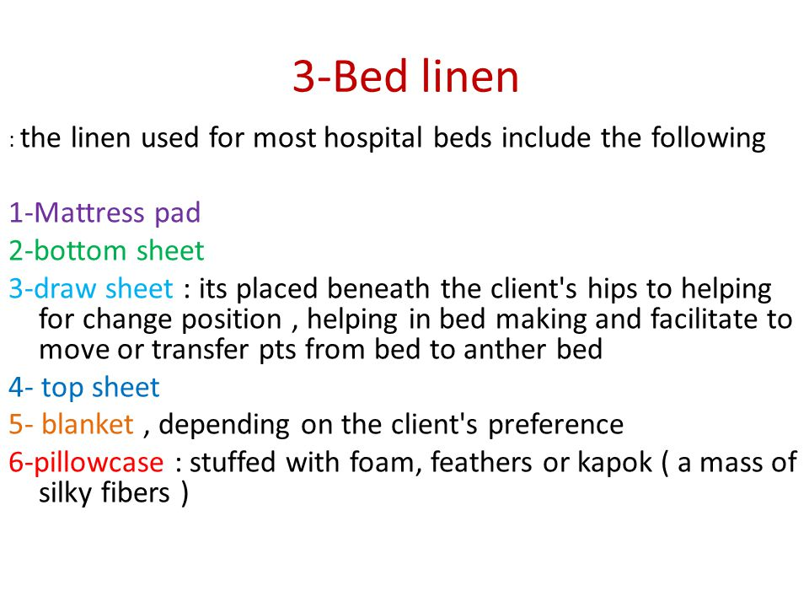

Slide 17
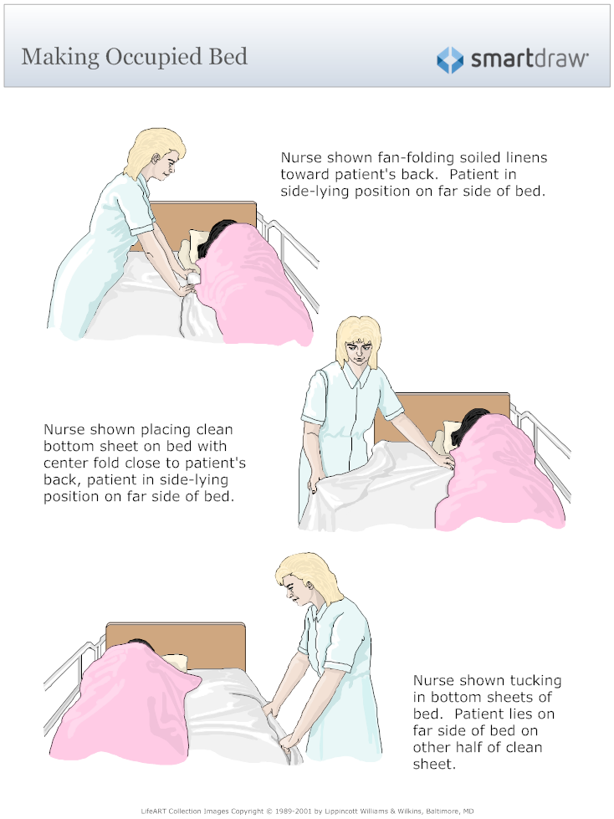

Slide 18
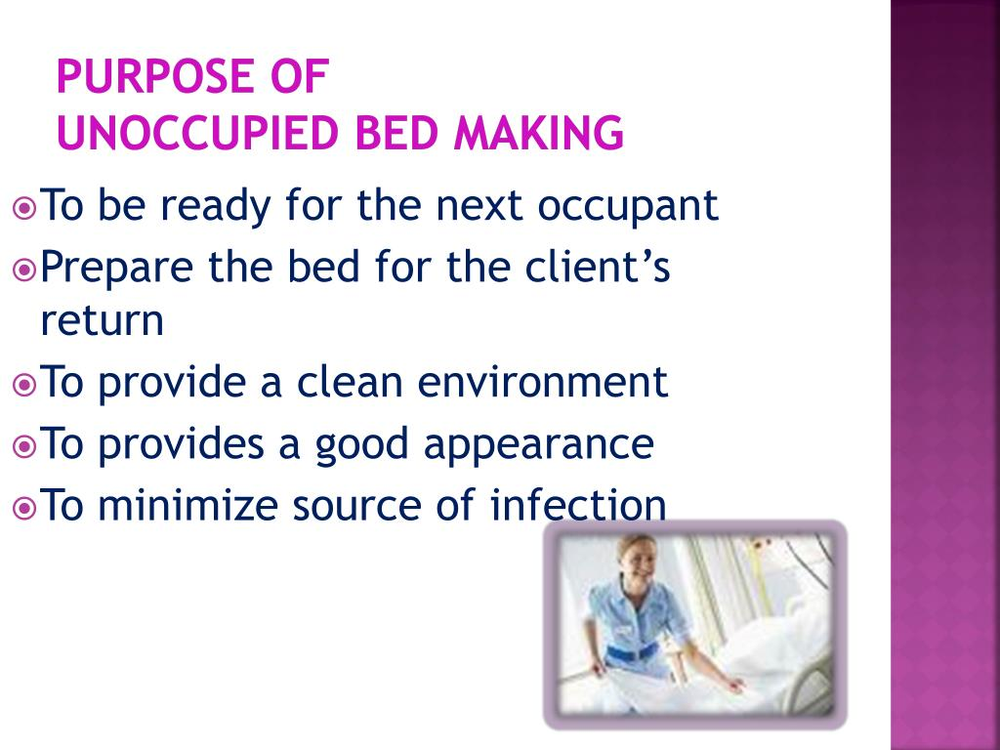
Unoccupied Bed: Is made when there is no patient confined in bed, while a patient in the shower or. sitting up in a chair.

Slide 19
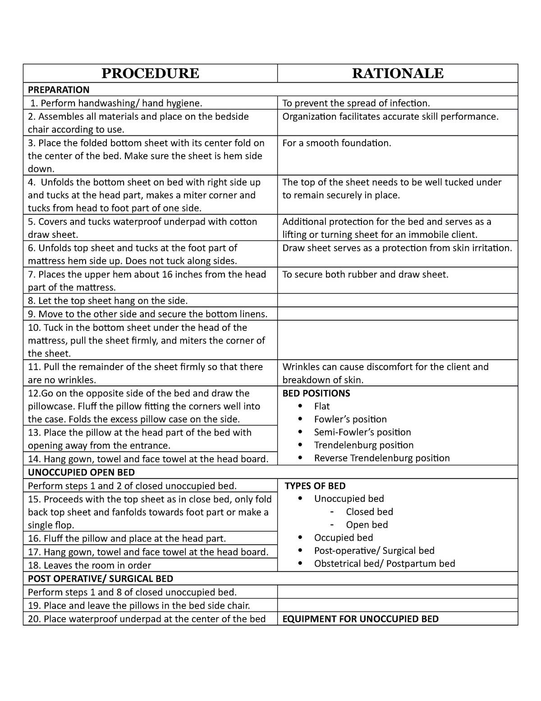

Slide 20
ANY QUESTION
?

Slide 21
THANKS

