Slide 1
LESSON -33
PATIENT INTERVENTION TECHNIQUES
BY
AMANDEEP KAUR
ASI/ANM

Slide 2
BLADDER CATHETERIZATION
OBJECTIVES
Upon completion of this lesson you will be able to:
Acute retention of urine
Chronic retention of urine
Following spinal trauma, if patient is paralyzed
Hemiplegia patients, when there is associated loss of control over urinary function

Slide 3
In post-op retention
Incontinence of urine
For accurate measurements of urine outputs in patients in intensive care units

Slide 4
Materials required:
Appropriate size catheter, usually 14FG disposable, self-retaining Foley’s catheter
Soapy antiseptic lotion, like savlon
A tube of local anesthetic like lignocaine jelly with applicator
Sterile gauze pieces for cleaning
Closed system urinary collection bag
Sterile gloves

Slide 5
Sterile towel and perineal drapes
Disposable dirt collection bag
Sterile water for injection through Foleys bulb
Disposable 10ml/5ml syringe
Sterile kidney tray

Slide 6
Catheter packaging:
Catheter should preferably have 2 wrappings. The outer wrapping should be cut before use and the catheter in its inner handling sheath should be picked up with gloved hand. The inner wrapping should open so as to expose only enough of the catheter tip for correct aseptic insertion. The inner wrapping should also allow the catheter to move forward easily and under control

Slide 7
Procedure:
Explain to the patient about the procedure, get informed consent and put him/her at ease
Give due regards to the privacy and dignity of the patient
Follow thorough antiseptic technique in preparation, insertion and maintenance of catheter
Wash your hands and arms thoroughly with soap and antibacterial scrub and don sterile gloves
In males, retract the prepuce and clean glans-penis using savlon solution

Slide 8
Lignocaine jelly is then carefully inserted down the urethera through a plastic nozzle in males and jelly massaged well posteriorly in the urethera to anaesthetize the sphincter and prostatic urethera
In female patients, the labia should be parted using the middle and index finger of the left hand and swab the inner side first one side, discard the swab; use another swab for repeating on another side and then finally a third swab for the centre of the vulva in downward direction.

Slide 9
Wash and prepare again or at the least change into new pair of gloves
Position the patient on his/her back and place sterile water-proof drapes below the patient’s perineum. In females, drape the genital area except for urethera with sterile drapes.
Keep sterile kidney tray between the patient’s legs for receiving urine.
Ease the catheter forward in its inner handling sheath to expose the tip.

Slide 10
Insert the tip of the catheter into the urethera and continue gentle insertion until urine begins to flow freely from the catheter. In the males, the penis is held taut while inserting the catheter.
The inner handling sheath is removed.
Once urine starts to drain down the catheter, it is advanced a few more centimeters into the bladder and the self-retaining balloon is inflated with 5 -10 ml of sterile water
The other end of catheter is connected to a closed drainage system and bladder allowed to drain slowly

Slide 11
Tape the catheter to the inner aspect of the thigh
Advise patient not to pull the tubing and ensure the tube is not kinked and flow is free
In unconscious patients, proper restraints so that the patient does not pull the tube is to be ensured
Whenever bladder is catheterized for retention, record the volume drained and examine the patient’s abdomen a few minutes after the procedure to exclude some other intra abdominal pathology.

Slide 12
Incidence of ascending infection following catheterization is minimized by connecting the catheter to sterile tubing and further connected to sterile collecting bag.
Employ irrigations only if clot retention occurs.
If catheter is in situ for 5 days or more, uretheritis and bacteruria is likely. In such instances, changing of catheters should be covered by appropriate prophylactic antibiotic.

Slide 13
Perineal Toilet:
It is indicated to keep the perineum clean and dry thereby reducing contamination.
Frequency: at least every 3-4 hours and after every bowel movement
Procedure: Wash the perineal region thoroughly with soap and water and dry.
Meatal care:
Proper care keeps the catheter–meatal junction clean and thus reduces the risk of ascending infection
Frequency: every 3 – 4 hours and after every bowel movement

Slide 14
Procedure:
Wash the hands thoroughly with soap and water and then with antiseptic surgical scrub
Dry the hands on a sterile towel
Use sterile gloves
Retract the glans 1-2 cm down the catheter. Using a sterile antiseptic wipe, clean away any encrustation or mucus from the catheter and meatus
Retract the prepuce and clean behind the foreskin

Slide 15
Return the prepuce and let the glans return to its original position
In females, separate the labia and swipe around the uretheral orifice.
Swipe the inner sides of labia minora taking care to move downward to prevent contamination from anus.

Slide 16
DO’S AND DON’T’S OF CATHETERIZATION:
Dos:
Do use the smallest size catheter that is adequate for the drainage
Do use catheters with balloon size 5/10ml when possible
Do use only sterile water for inflating the balloon
Do employ strict aseptic techniques throughout
Do carry out 4 hourly perienal toilet and meatal care of the patient
Do ensure adequate fluid intake in a catheterized patient.

Slide 17
Do’nts:
Don’t use large catheters or large balloons unnecessarily or arbitrarily.
Don’t practice any arbitrary routine for change of catheters
Don’t clamp the catheter shaft
Don’t employ routine bladder washout
Don’t use tap water/air/saline for distending the balloon
Don’t inflate the balloon only partially

Slide 18
GASTRIC LAVAGE
INDICATIONS:
In acute poisoning with drugs and chemicals, to remove the unabsorbed Poison
In acute intestinal obstruction, to relieve distension
In emergency gastro intestinal surgeries, to remove stomach contents pre-op
In GI surgeries Post operatively to prevent distension and promote healing
For obtaining a specimen of stomach contents

Slide 19
MATERIALS REQUIRED:
Ryle’s tube or stomach wash tube, in the size of 16 FG to 18FG
Kidney tray
Aspiration syringe 10ml/25ml
Lubricant like glycerine or liquid paraffin
Pint measure
Hand towel

Slide 20
Makintosh sheet
Clean water
PROCEDURE:
Adopt aseptic precautions and explain the patient the procedure and get informed consent, if conscious.
Wash your hands thoroughly, don gloves and gown
Assemble all the equipment needed, in a trolley, and wheel it at the head end of lying patient
Remove any artificial dentures the patient may be wearing

Slide 21
Lubricate the stomach wash tube with glycerine and place it over the center of the tongue and ask the patient to gently swallow the tube; allow him to breathe through the nose.
If patient unconscious, slowly push the tube down the esophagus until the mark on the tube touches the incisor teeth. Ensure that the tube is in the stomach and not in the lungs by pushing air through syringe and listening with the stethoscope in the stomach. It can also be checked by aspirating the gastric contents through the syringe
Ensure the makintosh sheet is over bed to prevent spills

Slide 22
Once it is confirmed that the lower end of the tube is in the stomach, pour ¼ pint measure of water into the funnel at the upper end of the tube and lower it gently over the disposable container
The contents will flow out of stomach through the tube into the container. If required obtain specimen for lab examination
Continue the wash out with clean water and until the content/fluid returning from stomach is clear

Slide 23
Once completed gradually withdraw the tube taking care that the patient does not aspirate. Give patient a mouth wash and settle him comfortably.
Dispose the contents, stomach wash tube as outlined in hospital waste management

Slide 24
ENEMA
It is an introduction of fluid into the rectum, purpose being cleansing, introduction of medicine or as a diagnostic tool.
TYPES OF ENEMAS:
Evacuant enema: administered fluid is more than 200ml and fluid is not intended to be left behind
Retention enema: administered fluid is left inside the rectum and is always less than 200 ml (capacity of rectum)

Slide 25
INDICATIONS:
For preparation of bowel before lower GI and perenial surgeries
In first stage of delivery
In bed ridden patients where constipation is due to impacted hard stools
To remove bowel contents and gas prior to X ray examination of abdomen and pelvis
For administration of certain medications as in retention enema

Slide 26
MATERIALS REQUIRED:
Rectal catheter
Makintosh sheet
Bed pan
Kidney tray with sufficient cotton wool, gauze , gloves
Hand towel
Enema can
Lubricant like xylocaine jelly or vaseline

Slide 27
Soap and warm water or glycerine
These days, enema preparations in single disposable packs (like proctoclys) are available, eliminating cumbersome preparations and are more hygienic. However in emergencies where it is not available, the age old practice of soap and water enema is ideal.

Slide 28
PROCEDURE:
Explain the procedure to the patient and get informed consent
Ensure privacy for the patient and make sure that access to toilet or bed pan is available nearby
Spread the makintosh under the patient and expose as much as necessary only
Place the patient in left lateral position
Lubricate the rectal catheter with Vaseline or xylocaine jelly and connect it to enema can tubing filled with soap water and allow it to run through

Slide 29
Clamp the rubber tubing and now introduce the lubricated rectal catheter gently through anus after separating the gluteal folds with gloved hand for about 8 – 10 cm into the anus
Ask the patient to breathe in slowly and not strain outward
Remove the clamp from the rubber tubing and allow the enema fluid to flow into rectum. The can should be at a height of 12 -16 inches only and not more than that to prevent forceful flow causing sudden distension of rectum and pain.

Slide 30
In case of disposable enema pack - remove the cap, separate the gluteal folds, introduce the nozzle and ask the patient to breathe in, gently squeeze the pack with steady sustained pressure and allow the contents to empty into rectum
When introducing rectal catheter or nozzle through the anal spinchter, pause to allow the spincter to dilate on its own and do not force through
Once the contents are emptied or if patient is feeling heavy discomfort with urgent need to evacuate the bowels, gently withdraw the nozzle or rectal catheter into the disposable cover without spilling the fluids

Slide 31
Allow the patient to use the bedpan/toilet and provide assistance if needed.
Sponge off the spills over makintosh sheet with gloved hands and carefully withdraw the makintosh sheet from the bed
Fold it for futher sterilization, collect all the used materials for safe disposal as per waste management guidelines
Settle the patient comfortably in the bed and record the time and date of enema administration in the case sheet

Slide 32
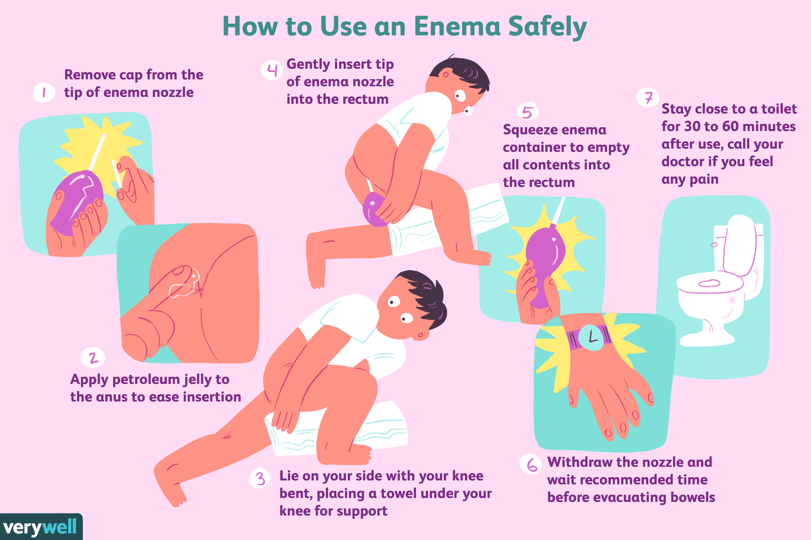


Slide 33
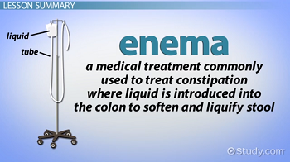
ENEMA

Slide 34
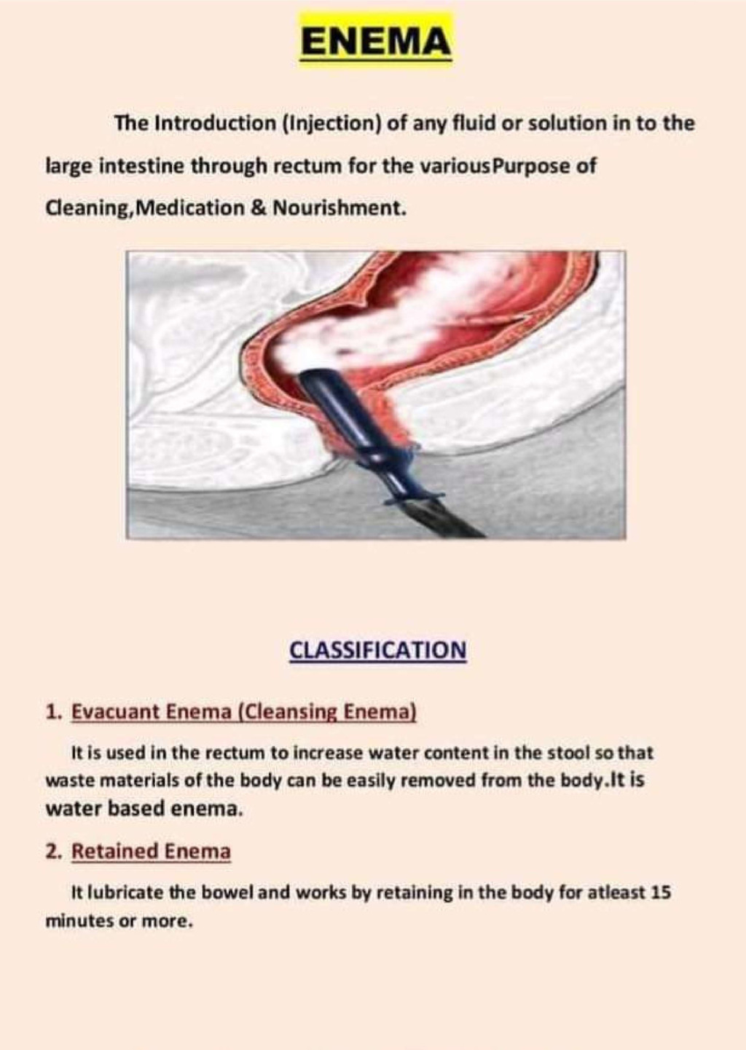

Slide 35
Any Question
Thanks

